Slide 1
FingerPuppet: Finger-Walking Performance-based Puppetry for Human Avatar 基於手指走路表演的虛擬替身操作介面
研究生: 梁中瀚
指導老師: 陳炳宇 老師
Department of Computer Science and Information Engineering
National Taiwan University

Slide 2
Outline
Introduction
Related work
Preliminary study
Method and materials
Application – a digital storytelling prototype
Conclusion

Slide 3
Introduction

Slide 4
Introduction
3D VR gaming is a well know application, which needs immersive experience.
強大的immersive experience可以藉由embodiment達到, 或是藉由好的interface達到, performance interface的好處?
尋找證據, 以及說法的來源
User喜歡的操控方式為何? 為什麼? 喜歡的原因?
我提出: 相關性與代表性
Embodiment可以透過兩種方式達到
被動 → haptic ; 主動 → 操控方式input interface
從傳統的KB, mouse, joy stick. 演進到現在的kinect, wii, switch. 新興的互動設備(interaction interface)不斷被提出 從低維度的input不斷往高維度的input邁進, 在這中間做取捨
高維度有操作不易, 操作疲勞的缺點
低微度有動作不相關導致的embodiment降低, 以及趣味程度降低的缺點
如何在這之間取捨是重要的議題
High DoF能不能夠推論有高的embodiment
我們將最novel的interaction interface研究分成三個種類
Body performance
Hand-held device
Hand performance
Notes:
目前沒有研究探索finger-walking在操作互human avatar的interface上的潛力
How to improve the immersive experience in gaming? → embody, but why? And how?
What’s Embodied interaction? what’s embody?
Why using finger-walking?
Why only using hand, but not using body?
Why controlling human avatar?

Slide 5
Introduction
這邊或許可以補一個圖示, 表示從low dimension (keyboard and mouse, joystick)到 high DoF的演進 (high DoF可以放Wii, Kinect) 補充圖示, 表示passive與active兩種不同的方式可以增進embodiment (這邊就可以參考到miniature haptics)
An interface that people use for interacting with virtual world
Keyboard and mouse, joysticks → conventional interface (2D positioning devices)
Character movement involved many degrees of freedom to control
Abstract High DoF movement to Low DoF input
Increasing the interface’s input DoF
User gets more degrees of control over the virtual avatar
This increases the sense of embodiment (←還沒有證據; 只是有可能而已)
Increase the enjoyment, … (還有哪一些好處?)
Two ways to improve embodiment, passive and active.
Passive: [Miniature haptics]; rubber hand illusion experiment
Active: novel (performance-based) interaction/control interfaces
Notes:
Ref: I'm in the Game: Embodied Puppet Interface Improves Avatar Control
需要一個說法, 能夠說明high dimension的好處, 例如, 富有趣味性, 富有embodiment, …
需不需要真的把embodiment加進來? 還是把她當成配角, 我提出自己的看法感覺上會比較好? 相關性與代表性
Embodiment部分就可以將[miniature haptics]拿出來說明
我們想要探索finger-walking是不是一個好的抽象化的input interface

Slide 6
Introduction
Controlling human avatar
Using human body and one-to-one mapping is naïve and intuitive
Implies a high dimension input
Motion capture is a solution, but requires high-end equipment and massive spaces. Kinect is another solution, but requires a large space, huge physical effort
How about using partial body motion? A lower input dimension, reduce fatigue and space requirement
CoolMoves → very important related work Only controls parts of body and use algorithm to generate the rest of them
How about other interfaces?
Notes:
對於控制human avatar而言,使用motion capture達到one-to-one mapping似乎是最佳的作法? 其實他也有很多缺點
Kinect似乎解決了設備上的困難, 但是body performance還是需要大空間與大動作, 容易造成fatigue以及動作施展受限的問題
我想要進行一個近距離的storytelling與gaming, 有沒有其他更適合的interface?
如果參考現實當中的puppetry method來設計interface, 有沒有提供甚麼好處?
這邊其實銜接到了related work的部分, 介紹各種的interfaces之間的優缺比較

Slide 7
Related work – Body performance

Slide 8
Related work – Hand-held devices
Notes:
Layering approach就是為了解決lower degree of freedom input要控制high DoF output
有趣的點: Hinton 也有發這個領域的論文

Slide 9
Related work – Hand performance

Slide 10
Preliminary study
Exploring finger-walking performances

Slide 11

Preliminary study
Goal:
Explore wider range of body movements that novice users prefer to represent by finger-walking
Explore categories/types of finger-walking performance
Interviewing several casual participants
Showing replays of 28 sports from Tokyo 2020 Olympics
Asking them to perform their finger-walking movement
Choose the best way to perform the body moment, and explain the reason
Considering goodness, ease of performance, and fatigue
Notes:
主要目標: 探索哪一些種類的human動作會是novice users想要使用finger-walking來表演/代表的
還有探索到底finger-walking會有哪一些動作, 我們就可以將這些動作種類實做到我們的prototype系統當中
緣由: 先前的研究[finger walking]只有探索少量的human avatar’s locomotion作為操作的目標

Slide 12
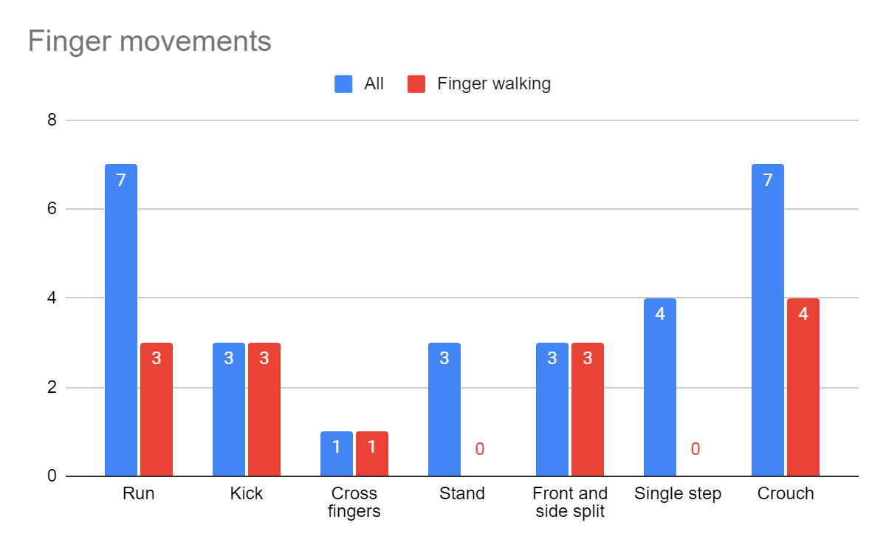
Preliminary study – result and findings
X of 28 movements are suitable to be represent by finger-walking
Run | cycling/sport climbing/athletics/boxing/table tennis/tennis/wrestling
Kick | foot ball/taekwondo/karate
Cross fingers | skateboarding
Stand | shooting/archery/golf
Front and side split | artistic gymnastic/judo/Rhythmic gymnastic
Single step | badminton/fencing/softball/handball
Crouch | equestrian/hockey/beach volleyball/trampoline gymnastic/weightlifting/rugby sevens
Notes:
有近半數的動作是適合使用finger-walking表達的, 代表它的應用範圍是廣泛的
最特別的地方是”stand”以及”single step”類別的動作不適合使用finger-walking表達
分類的結果表格, 以及對應的統計bar chart

Slide 13
Preliminary study – result and findings
Two important factor that influence user’s choice
Relevance (相關性)
Iconic (代表性)
補圖片說明:
部分dimension之間的動作具有關聯性
並且具有關聯性的那些 dimension對於users而言是能夠代表所有dimension
Notes:
兩個重要的因素, 讓novice user認為是適合使用finger-walking表達該動作

Slide 14
Preliminary study – result and findings
Other types of performances that participants prefer to use for manipulating these actions
Using the entire hand to mimic the avatar’s hand
One-to-one mapping
Dynamically switching the mimicking target to the major movement in the action
Simultaneously representing all the limbs by different fingers
Difficult to perform and can easily cause hand cramps.
Notes:
我們額外發現使用者喜好的其他種類的hand performance

Slide 15
Preliminary study – result and findings
5 actions of the avatar are implemented in our application
Action of the avatar | Finger-walking category
Run | Run
Joyful jump | Crouch
Double leg jump | Crouch
Front kick | Kick
Side kick | Front and side split
Notes:
最終我們選定了哪一些動作, 作為代表動作實作在application prototype 當中
因為找不到適合”cross finger”的human avatar action in the database [Mixamo]
“stand”以及”single step”都不適合使用finger-walking表達

Slide 16
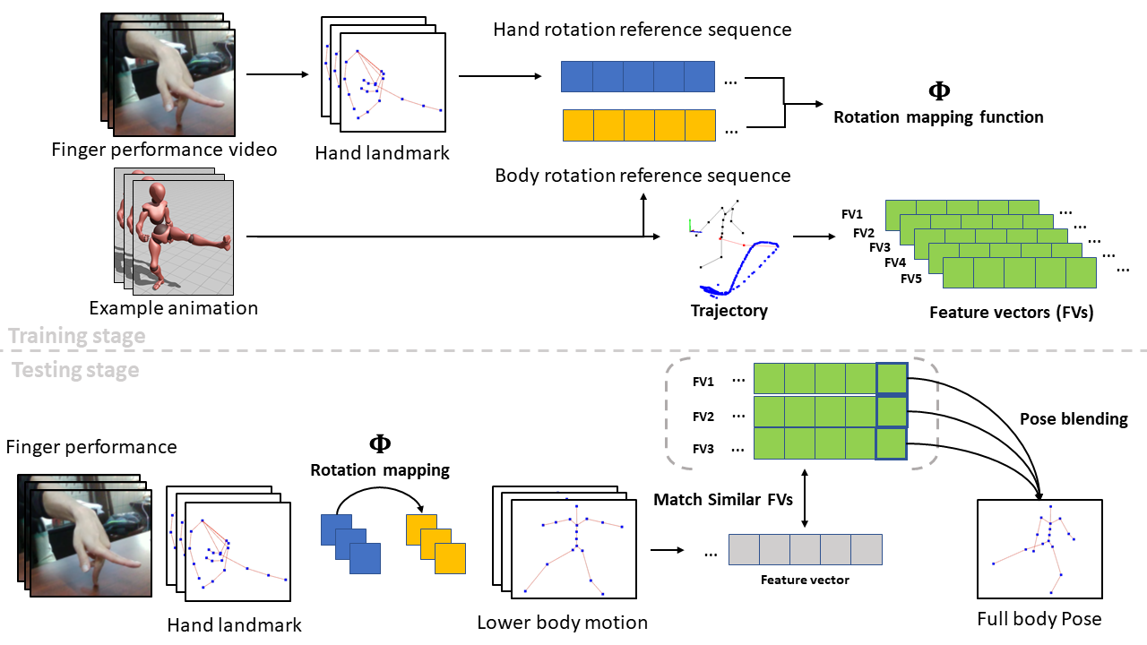
Method overview
Notes:
這是我們提出的方法的整體流程. 太多細節, 所以在下一張投影片抽象化

Slide 17
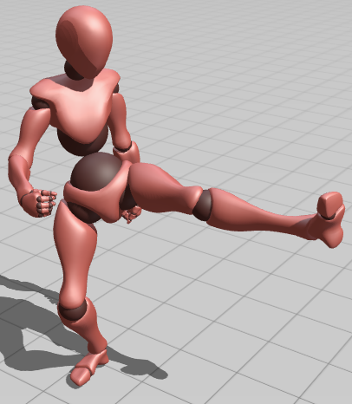
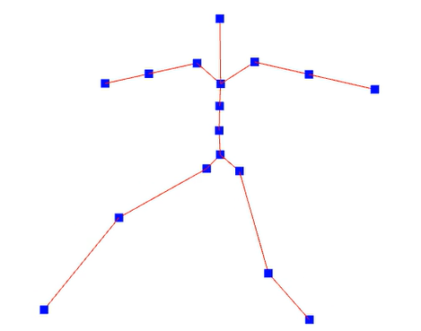
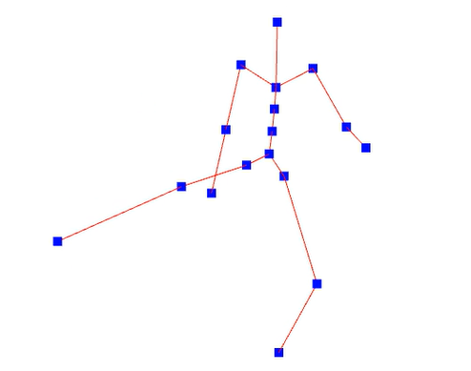

Method overview – abstraction
Finger performance video
Example animation
FV1
…
…
FV2
…
FV3
…
$$Φ$$
FV4
…
(preprocessing stage)
FV5
Training stage
Rotation mapping function
Feature vectors (FVs)
Testing stage
(performance stage)
Finger performance video
Lower body motion
Full body Pose
Notes:
上半段是preprocessing stage
下半段是testing stage, 也就是實際使用的情況
如果關注在下半段的testing stage, 可以發現是一個兩步驟的做法

Slide 18
Method overview – abstraction
Lower body motion retargeting
Finger performance video
Example animation
FV1
…
…
FV2
…
FV3
…
$$Φ$$
FV4
…
FV5
Rotation mapping function
Feature vectors (FVs)
Finger performance video
Lower body motion
Full body Pose
Notes:
前半段是lower body motion retargeting
後半段是full-body motion reconstruction

Slide 19
Method overview – abstraction
Full-body pose reconstruction
Finger performance video
Example animation
$$Φ$$
FV1
…
…
Rotation mapping function
FV2
…
FV3
…
FV4
…
FV5
Feature vectors (FVs)
Finger performance video
Lower body motion
Full body Pose
Notes:
前半段是lower body motion retargeting
後半段是full-body motion reconstruction

Slide 20
Preprocessing
Aka training stage
Notes:
這邊或許可以結合到後面的部分作說明, 因為後面的部分會結合到這些資料預處理

Slide 21
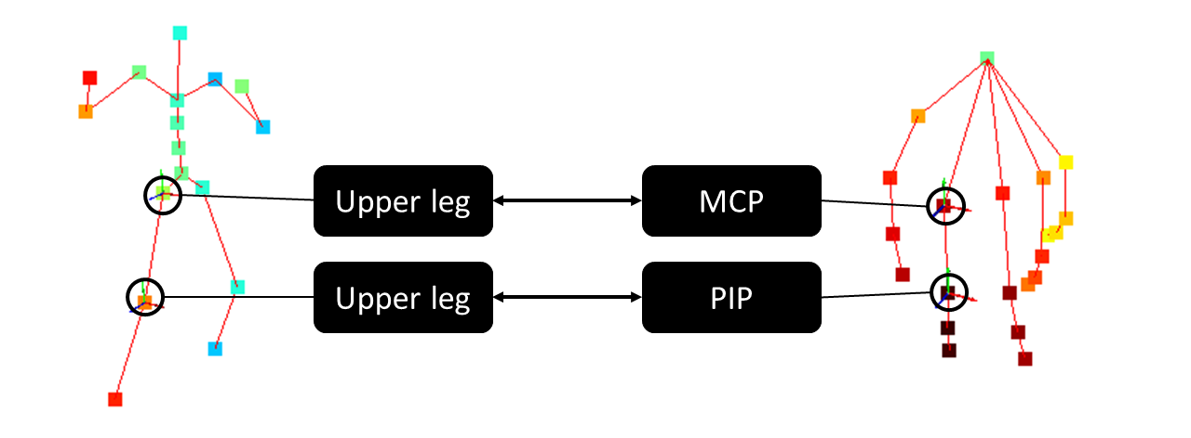
Lower body motion retargeting
補圖片: 手指的abduction與adduction示意圖, 從mani-pull-action當中尋找
The mapping criteria between finger and body
Hand landmarks by Mediapipe ; 21 joints
Body articulated structure by Mixamo ; 17 joints
Notes:
兩個不同骨架系統的對應關係
對應的理由, 因為對應點的dof相近, 且骨架系統相近
上方的MCP節點代表大腿, 下方的PIP節點代表小腿或是膝蓋
手指骨架的PIP與DIP會有強烈的相互影響關係 (請參考mani-pull-action的論述, 務必找出來)

Slide 22
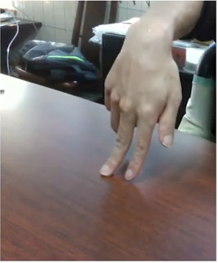
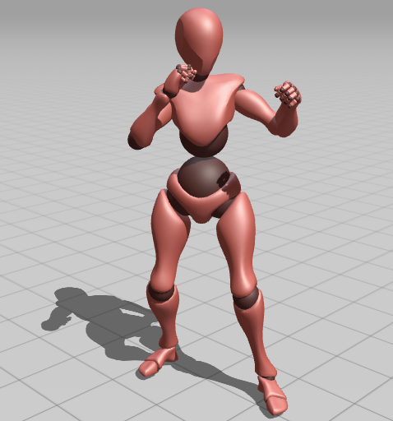
Lower body motion retargeting - preprocessing
Inspired by [motion editing with data glove]
But they used Euler angle, which caused a undesired motion
Hand rotation reference sequence
Start frame
End frame
$$Φ$$
Rotation mapping function
Body rotation reference sequence
Notes:
第一步需要準備成對的finger-walking performance以及對應的example animation
並且需要標記兩者的起始與結束的動作標籤
這些rotations會根據來源給予不同的稱呼, 從finger-walking performance產生的rotations稱為Hand rotation reference sequence (HRRS),
從example animation產生的rotations稱為Animation rotation reference sequence (ARRS)
這個動作會在preprocessing stage完成

Slide 23
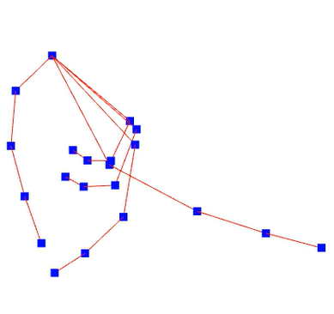

Lower body motion retargeting - performance
Rotation mapping and forward kinematic in performance stage
Hip
Upper leg
1. Find the most similar rotation
Lower leg
Feet
Wrist
MCP
PIP
DIP
TIP
2. Apply to lower body joints
$$θ$$
Notes:
在performance階段我們首先會利用preprocessing階段得到的rotation mapping, 將finger joints’ rotation轉換成lower body rotation

Slide 24
Lower body motion retargeting – performance
We adopt quaternion for rotation mapping!!
補動態圖片: 比較使用Euler angle與quaternion的結果的差異
Notes:
Euler angle造成這樣的不合適結果, 會導致後續的全身動作重建產生問題

Slide 25
Full-body pose reconstruction – preprocessing
Inspired by [CoolMoves]
They use upper body motion to generate lower body motion
X
Y
Z
補動態圖片: 人物與feet軌跡的動態圖片, feet軌跡是藍色的點組成的
FV
FV
Notes:
我們參考[coolmoves]的作法, 利用encoding short-term trajectory as feature vector, 再利用feature vector做為比對兩個motion相似與否的參考資訊
為什麼使用最後一個位置作為代表的pose? 因為我們不知道未來的數值, 所以在testing的時候只能夠拿前面的frames的position組合成feature vector

Slide 26
Full-body pose reconstruction – preprocessing
Augmentation
Since speed between finger and avatar’s leg may differ
5 speed ratios are used for augmentation
2. Generate new feature vectors
Speed
1. Times 5 different speed ratios
Notes:
因為手指的活動速度可能會與avatar原始的animation的腿的移動速度不同
所以, 我們使用augmentation的方法, 增加多種feature vectors
首先, Feature vector的每一個positions會與前一個position做相減得到速度
速度會再與5種不一樣的speed ratio相乘, 得到5個不同的speed vector
最後, 再利用這5個speed vector與原始的feature vector的末尾position相加, 就可以得到新的5個不同速度的feature vectors

Slide 27
Full-body pose reconstruction – performance
2. Search the top k most similar feature vector
1. Encode feature vector
Real time input
3. Blend corresponding poses
Notes:
在preprocessing階段準備好example animation的feature vectors, 在performance階段就可以使用它們找出最接近user performance的example animation的pose

Slide 28

Result – delay
Time cost of each processing step in testing stage (performance stage)
$≈0.03$ sec
補表格: 各個計算階段的耗時

Slide 29
Result – digital storytelling prototype
Notes:
目前只想要放使用結果的影片而已, 還沒有想到其他的表達方式

Slide 30
Conclusion
Notes:
把貢獻分成好幾點列出來

Slide 31
Thank you for listening QA

