Slide 1
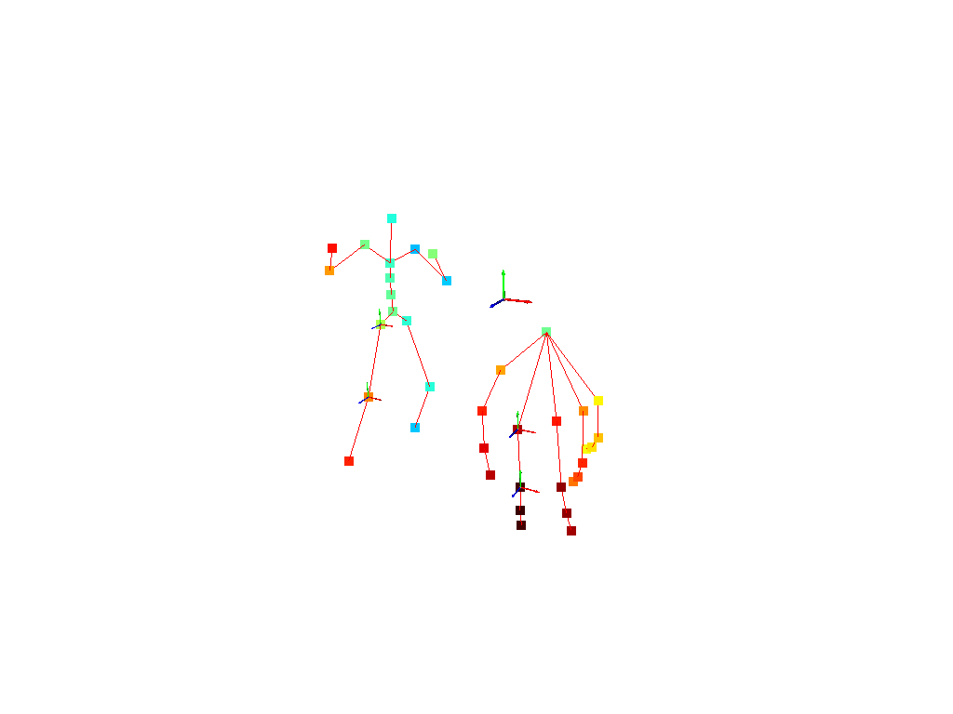
Upper leg
MCP
Lower leg
PIP

