Slide 1
Computer Graphics HW 2: Ellipse Animation
Deadline: 2023.04.11

Slide 2
Requirement
approximate an ellipse object by polygons
design the menu to manipulate the ellipse.
translation: x and y direction
rotation: clockwise/counterclockwise
press the right button to activate the menu

Slide 3
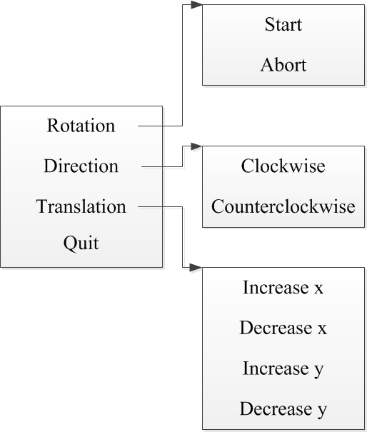
Requirement
Mouse Control
left button: identify center point
right button: activate the menu
Menu Items
rotation: start/abort the rotation
direction: clockwise / counterclockwise
translation: vertical / horizontal
quit: exit the program

