Slide 1
MATLAB
Notes:
*

Slide 2
What is MATLAB?
MATLAB is a simple programming language with its own extensive library of mathematical and graphical subroutines
It integrates computation and graphics in one easy to use interface
MATLAB stands for MATrix LABoratory.
Notes:
*

Slide 3
What is MATLAB?
MATLAB is an interpreted language
It is not a compiled language
Matlab is basically a high level language
MATLAB is very extendable. There are many add-ons (toolboxes) for specific requirements
Notes:
*

Slide 4
What is MATLAB?
Main Features
Simple programming rules
Extended accuracy
Comprehensive mathematical library
Excellent matrix computing
Extensive graphics tools
Linkages with other languages
Transportability across environment
MATLAB scripts will work on PC, UNIX, Mac
Notes:
*

Slide 5
Starting MATLAB
Using Citrix
Notes:
*

Slide 6
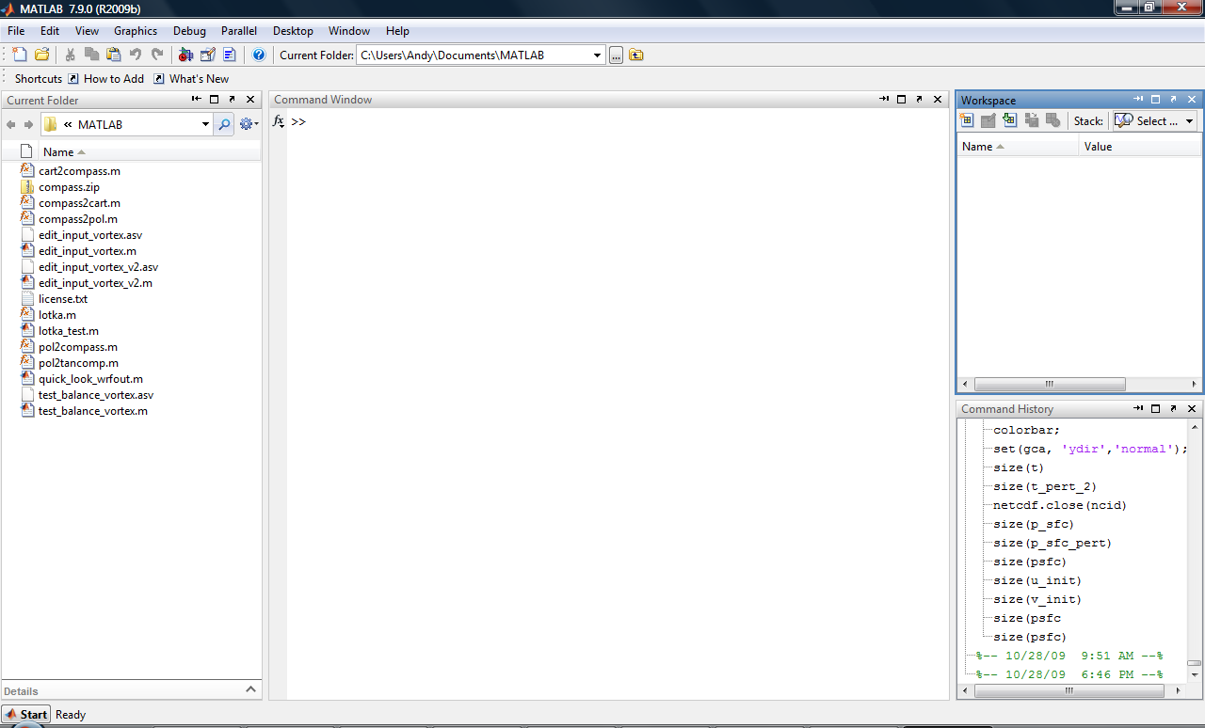
Starting MATLAB
Once MATLAB is running the GUI (Graphical User Interface) will appear
Default Window apperance
Notes:
*

Slide 7
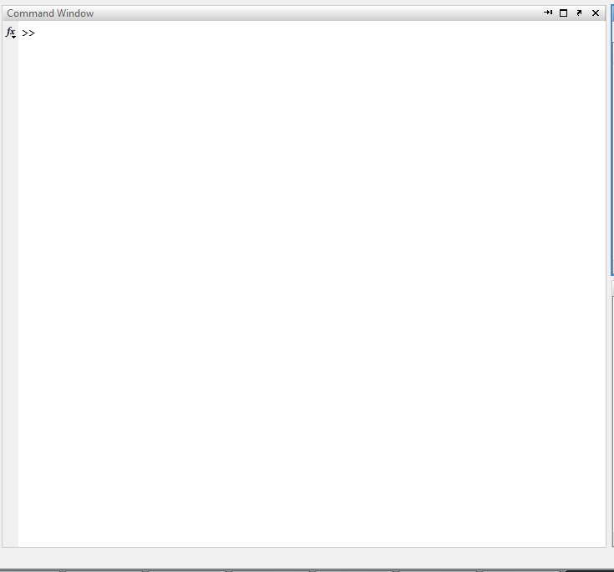
Starting MATLAB
Command Window
Main window in MATLAB
MATLAB displays >> prompt when ready for a command
Notes:
*

Slide 8
Variables
No need for types. i.e.,
All variables are created with double precision unless specified and they are matrices.
After these statements, the variables are 1x1 matrices with double precision
int a;
double b;
float c;
Example:
>>x=5;
>>x1=2;

Slide 9
Variables
Variable names must start with a letter
You’ll get an error if this doesn’t happen
After that, can be any combination of letters, numbers and underscores

Slide 10
Variables
Don’t name your variables the same as functions
min, max, sqrt, cos, sin, tan, mean, median, etc
Funny things happen when you do this
MATLAB reserved words don’t work either
i, j, eps, nargin, end, pi, date, etc
i, j are reserved as complex numbers initially
Will work as counters in my experience so they can be redefined as real numbers
Notes:
*

Slide 11
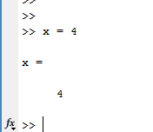
Interactive Commands
Enter commands at >> prompt
Variable ‘x’ automatically allocated
MATLAB does not require declaration of variables
Nice, but can get you in trouble so be careful
Notes:
*

Slide 12
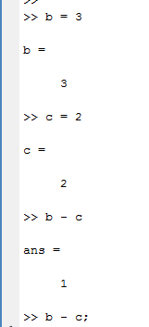
Interactive Commands
MATLAB is case sensitive
Variable ‘ans’ will take value of result of command if no equal sign specified
Holds most recent result only
Semicolon at end of line will suppress output, it is not required like in C
Useful in script files and debugging
Notes:
*

Slide 13
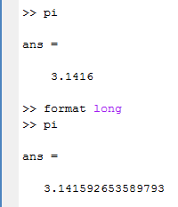
Interactive Commands
Format of output
Defaults to 4 decimal places
Can change using format statement
format long changes output to 15 decimal places
Notes:
*

Slide 14
Operators
Scalar arithmetic operations
Operation MATLAB form
Exponentiation: ^ a^{b} a^b
Multiplication: * ab a*b
Right Division: / a / b = a/b a/b
Left Division: \ a \ b = b/a a\b
Addition: + a + b a+b
Subtraction: - a – b a-b
MATLAB will ignore white space between variables and operators
Notes:
*

Slide 15
Order of Operations
Parentheses
Exponentiation
Multiplication and division have equal precedence
Addition and subtraction have equal precedence
Evaluation occurs from left to right
When in doubt, use parentheses
MATLAB will help match parentheses for you
Notes:
*

Slide 16
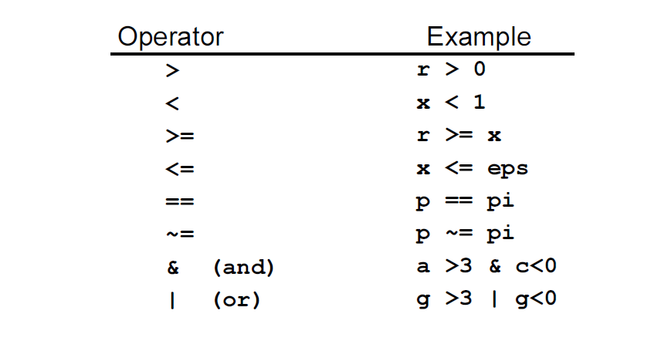
Logical Operators
Notes:
*

Slide 17
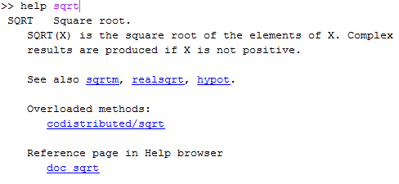
MATLAB Help
Ways to get help in MATLAB
help function name
Provides basic text output
Type helpwin on command line
Notes:
*

Slide 18
Arrays
MATLAB is adept at handling arrays
Optimized for vector/matrix operations
This allows for a reduction of code in some cases
Array types: Numeric, character, logical, cell, structure, function handle
Numeric types: single, double, int8, int16, int32, uint8, uint16, uint32
Notes:
*

Slide 19
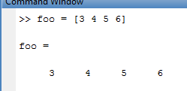
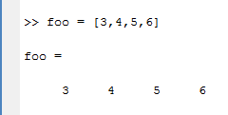
Numeric Arrays
One dimensional arrays, called vectors
Can create row or column vectors
Row vector
A few ways to create a row vector
Or use “:”
Notes:
*

Slide 20
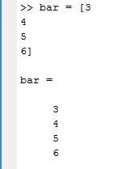
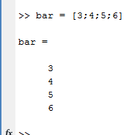
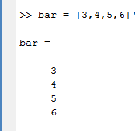
Numeric Arrays
Column vectors
A few ways to generate column vectors too
Semicolon between elements starts new row
Transpose a row vector, or use return between elements
Notes:
*

Slide 21
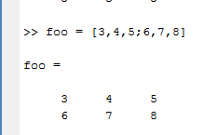
Numeric Arrays
Two-dimensional arrays, called a matrix in MATLAB often
Size = rows by columns
[r c] = size(array_name) if array_name is a matrix
size will work for n-dimension arrays and output size of each dimension into a row vector
Basic matrix creation:
Notes:
*

Slide 22
Numeric Arrays
Array addressing
Vector: foo
foo(:) gives all row or column elements
foo(1:5) gives the first five row or column elements
foo(2) gives the second element
Matrix: bar
bar(1,3) gives the first row, third column element
Bar(:,2) gives all elements in the second column
Bar(1,:) gives all elements in the first row
Bar(3:4,1:3) gives all elements in the third and fourth rows that are in the first through third columns
Notes:
*

Slide 23
矩陣的各種處理
MATLAB 亦可取出向量中的一個元素或一部份來做運算，例如：
>> t(3) = 2 % 將向量 t 的第三個元素更改為 2
t =
3 7 2 5
>> t(6) = 10 % 在向量 t 加入第六個元素，其值為 10
t =
3 7 2 5 0 10
>> t(4) = [] % 將向量 t 的第四個元素刪除，[] 代表空集合
t =
3 7 2 0 10

Slide 24
建立大小為 m×n的矩陣
在每一橫列結尾加上分號（;），例如：
>> A = [1 2 3 4; 5 6 7 8; 9 10 11 12]; % 建立 3×4 的矩陣 A
>> A % 顯示矩陣 A 的內容
A =
1 2 3 4
5 6 7 8
9 10 11 12

Slide 25
mxn矩陣的各種處理 (I)
>> A(2,3) = 5 % 將矩陣 A 第二列、第三行的元素值，改變為 5
A =
1 2 3 4
5 6 5 8
9 10 11 12
>> B = A(2,1:3) % 取出矩陣 A 的第二橫列、第一至第三直行，並儲存成矩陣 B
B =
5 6 5

Slide 26
mxn矩陣的各種處理 (II)
>> A = [A B'] % 將矩陣 B 轉置後、再以行向量併入矩陣 A
A =
1 2 3 4 5
5 6 5 8 6
9 10 11 12 5
>> A(:, 2) = [] % 刪除矩陣 A 第二行（：代表所有橫列，[]代表空矩陣）
A =
1 3 4 5
5 5 8 6
9 11 12 5

Slide 27
mxn矩陣的各種處理 (III)
>> A = [A; 4 3 2 1] % 在原矩陣 A 中，加入第四列
A =
1 3 4 5
5 5 8 6
9 11 12 5
4 3 2 1
>> A([1 4], :) = [] % 刪除第一、四列（：代表所有直行，[]是空矩陣）
A =
5 5 8 6

Slide 28
2-3 常用數學函數
MATLAB 是一個科學計算軟體，因此可以支援很多常用到的數學函數
>> y = abs(x) % 取 x 的絕對值
>> y = sin(x) % 取 x 的正弦值
>> y = exp(x) % 自然指數 exp(x)
>> y = log(x) % 自然對數 ln(x)
MATLAB 也支援複數運算，通常以 i 或 j 代表單位虛數

Slide 29
向量矩陣的運算
有一些函數是特別針對向量而設計
>> y = min(x) % 向量 x 的極小值
>> y = max(x) % 向量 x 的極大值
>> y = mean(x) % 向量 x 的平均值
>> y = sum(x) % 向量 x 的總和
>> y = sort(x) % 向量 x 的排序

Slide 30
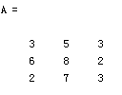


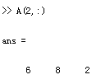

Matrix Index
The matrix indices begin from 1 (not 0 (as in C))
The matrix indices must be positive integer
Given:
A(-2), A(0)
Error: ??? Subscript indices must either be real positive integers or logicals.
A(4,2)
Error: ??? Index exceeds matrix dimensions.

Slide 31
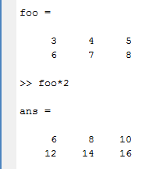
Numeric Arrays
Array operations
MATLAB has array or element by element and matrix operations when dealing with arrays
Element-by-element operations
Multiplying a vector or array by a scalar is an easy example
Notes:
*

