Slide 1
MATLAB
Notes:
*

Slide 2
Generating Vectors from functions
zeros(M,N) MxN matrix of zeros
ones(M,N) MxN matrix of ones
rand(M,N) MxN matrix of uniformly distributed random
numbers on (0,1)
x = zeros(1,3)
x =
0 0 0
x = ones(1,3)
x =
1 1 1
x = rand(1,3)
x =
0.9501 0.2311 0.6068

Slide 3
Concatenation of Matrices
x = [1 2], y = [4 5], z=[ 0 0]
A = [ x y]
1 2 4 5
B = [x ; y]
1 2
4 5
C = [x y ;z]
Error:
??? Error using ==> vertcat CAT arguments dimensions are not consistent.

Slide 4
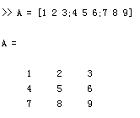
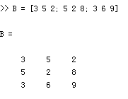
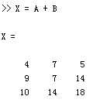
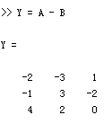
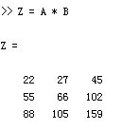
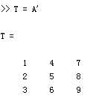
Matrices Operations
Given A and B:
Addition
Subtraction
Product
Transpose

Slide 5
Operators (Element by Element)
.* element-by-element multiplication
./ element-by-element division
.^ element-by-element power

Slide 6
The use of “.” – “Element” Operation
A = [1 2 3; 5 1 4; 3 2 1]
A =
1 2 3
5 1 4
3 2 -1
b = x .* y
b=
3 8 -3
c = x . / y
c=
0.33 0.5 -3
d = x .^2
d=
1 4 9
x = A(1,:)
x=
1 2 3
y = A(3 ,:)
y=
3 4 -1
K= x^2
Erorr:
??? Error using ==> mpower Matrix must be square.
B=x*y
Erorr:
??? Error using ==> mtimes Inner matrix dimensions must agree.

Slide 7
Basic Plotting
plot(x,y)
Basic MATLAB plotting command
Creates figure window if not already created
Autoscales each axis to fit data range
Can add axes object properties after x,y
figure(n)
Will create a new figure window
MATLAB will use current figure window by default
Plot command will overwrite figure if called repeatedly given same current figure window
Notes:
*

Slide 8
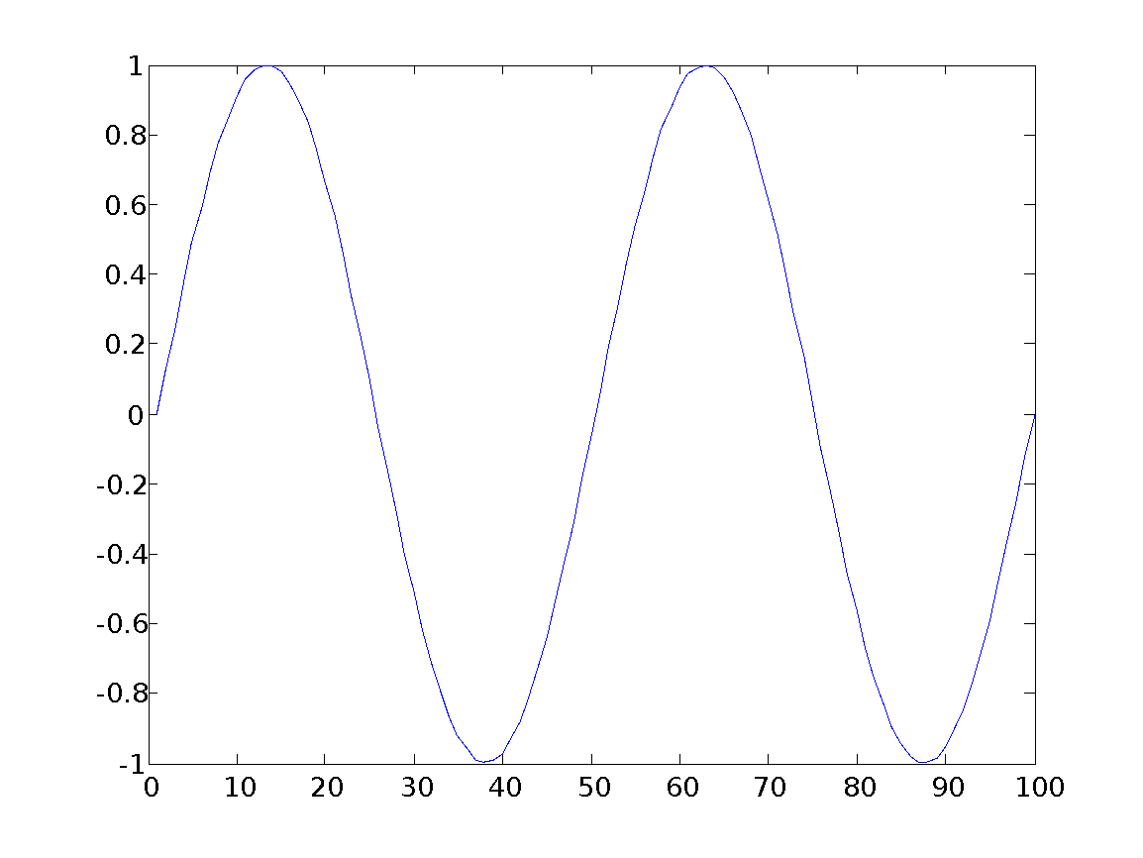
Basic Task: Plot the function sin(x) between 0≤x≤4π
Create an x-array of 100 samples between 0 and 4π.
Calculate sin(.) of the x-array
Plot the y-array
>>x=linspace(0,4*pi,100);
>>y=sin(x);
>>plot(y)

Slide 9
Plot the function e^{-x/3}sin(x) between 0≤x≤4π
Create an x-array of 100 samples between 0 and 4π.
Calculate sin(.) of the x-array
Calculate e^{-x/3} of the x-array
>>x=linspace(0,4*pi,100);
>>y=sin(x);
>>y1=exp(-x/3);

Slide 10
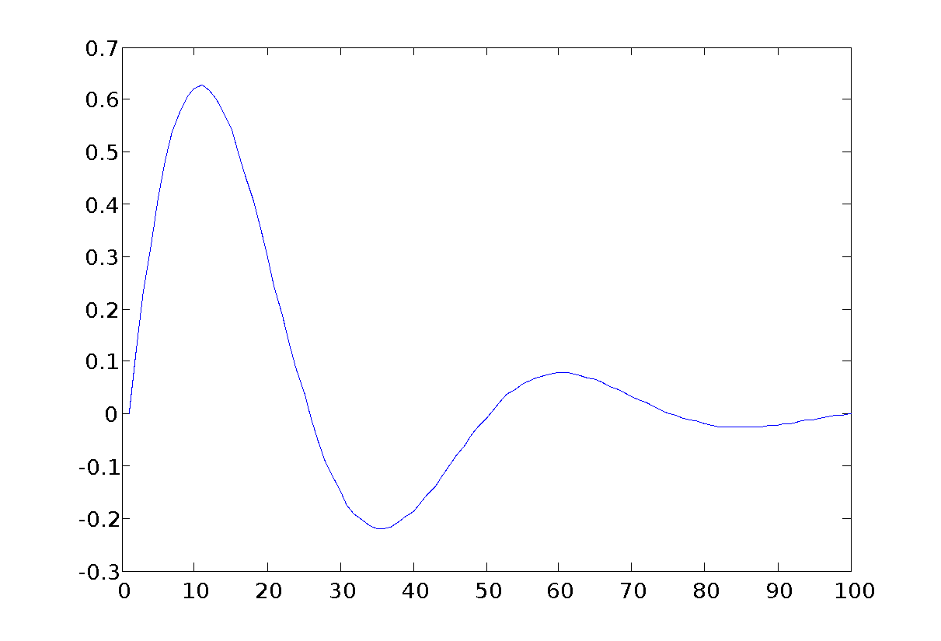
Plot the function e^{-x/3}sin(x) between 0≤x≤4π
Multiply the arrays y and y1 correctly
Plot the y2-array
>>y2=y.*y1;
>>plot(y2)

Slide 11
Practice
plot(x,sin(x), x, cos(x), x, sin(x)+cos(x));
Figure(2);
plot(x, sin(x), 'o', x, cos(x), 'x', x, sin(x)+cos(x), '*');
plot(x, y,'k:diamond')
grid on

Slide 12
plot color
Plot-color | color | RGB
b | (Blue) | (0,0,1)
c | (Cyan) | (0,1,1)
g | (Green) | (0,1,0)
k | (Black) | (0,0,0)
m | (Magenta) | (1,0,1)
r | (Red) | (1,0,0)
w | (White) | (1,1,1)
y | (Yellow) | (1,1,0)

Slide 13
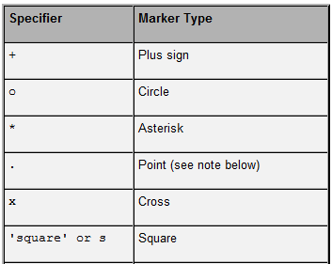
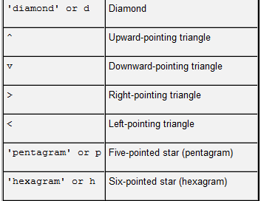
Modifying Plots
Line markers
Can choose to add markers at each data point
Can have only markers, no line
Notes:
*

Slide 14
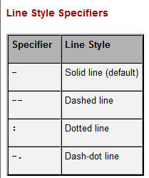
Modifying Plots
Line width
Specified by an integer, default is 0.5 points
Each point is 1/72 of an inch
Line style
Notes:
*

Slide 15
x = peaks %generate a 49*49 matrix
y = x';
plot(x, y);

Slide 16
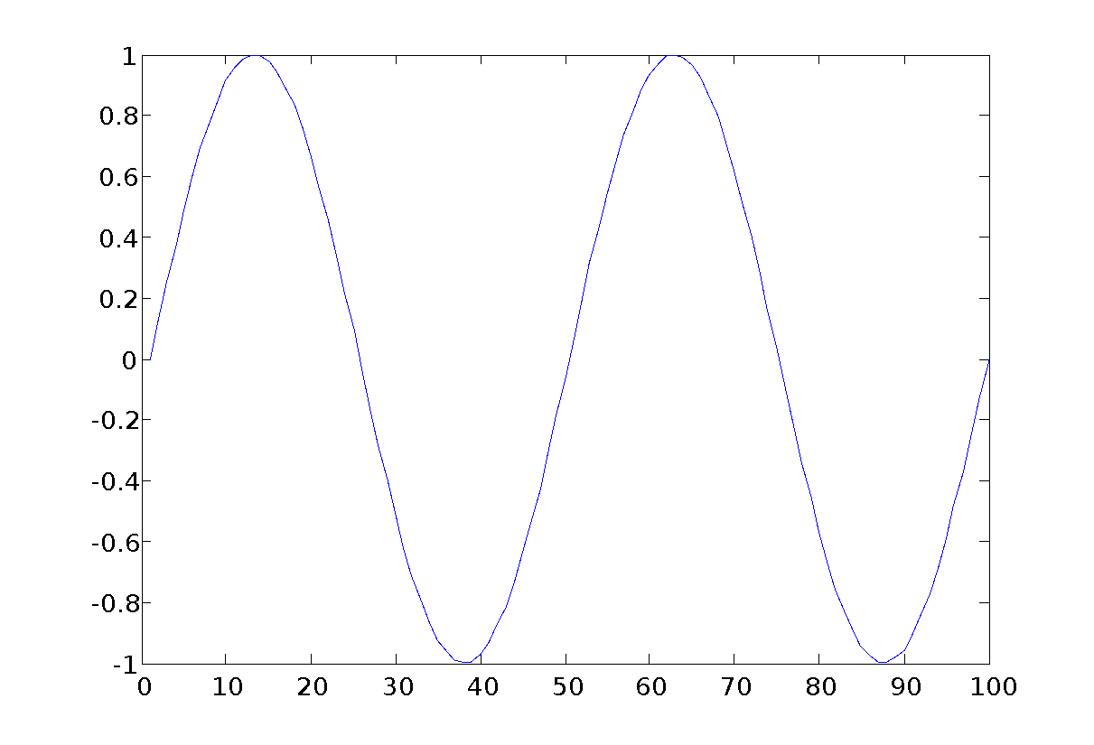
Display Facilities
title(.)
xlabel(.)
ylabel(.)
>>title(‘This is the sinus function’)
>>xlabel(‘x (secs)’)
>>ylabel(‘sin(x)’)

Slide 17
Subplots
h = subplot(m,n,p) or subplot(mnp) h = subplot(m,n,p,'replace')
Three typical syntax uses for subplot command
Subplot will generate m by n subplots on a figure object
p specifies which subplot to create out of the m*n total
‘replace’ will overwrite any subplot in that current position
Notes:
*

Slide 18
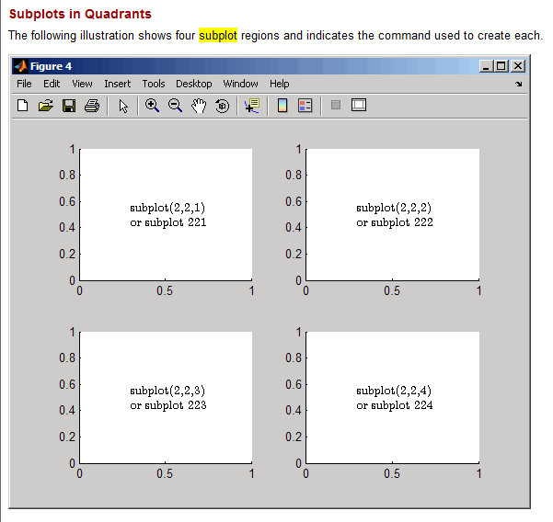
Subplots
Notes:
*

Slide 19
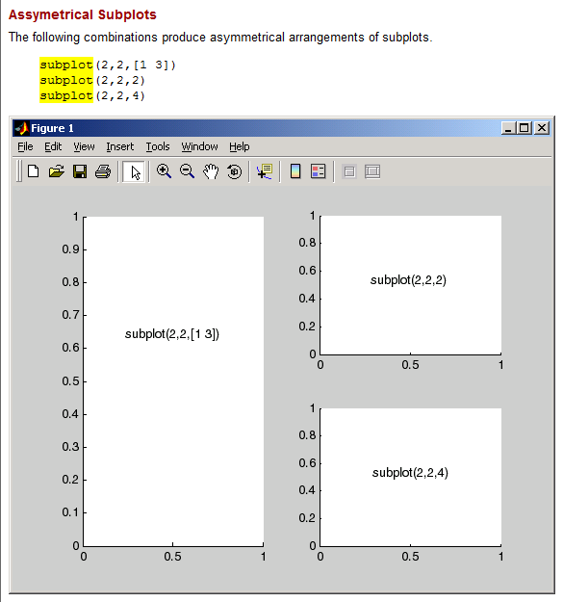
Subplots
Notes:
*

Slide 20
x = 0:0.1:4*pi;
subplot(2, 2, 1); plot(x, sin(x));
subplot(2, 2, 2); plot(x, cos(x));
subplot(2, 2, 3); plot(x, sin(x).*exp(-x/5));
subplot(2, 2, 4); plot(x, x.^2);

Slide 21
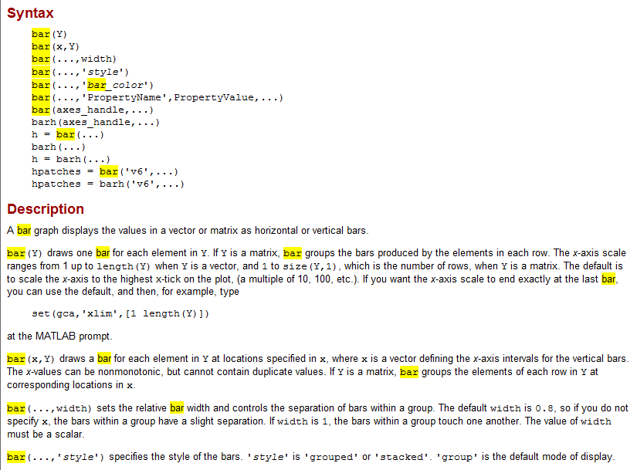
Bar Graphs
MATLAB will plot horizontal and vertical bar graphs
Notes:
*

Slide 22
Modifying Plots
set(h,'PropertyName',PropertyValue,...)
The set command takes object handle h and sets property values for give property names for that object handle
If h is an array, the property values will be set for all object handles in h
a = get(h,'PropertyName')
get returns the value of a given property
Notes:
*

Slide 23
Modifying Plots
gcf stands for get current figure handle
Will return handle of current figure
gca stands for get current axis handle
Will return handle of current axis
These two commands are very useful when used in conjunction with the set and get commands
Allows you to edit the properties of the current figure or axis without having the handle specified in a variable
Notes:
*

Slide 24
x = 0:0.1:4*pi;
plot(x, sin(x)+sin(3*x))
set(gca, 'ytick', [-1 -0.3 0.1 1]);
set(gca, 'yticklabel', {'min.', 'point 1', 'point 2', 'max. '});
grid on

Slide 25
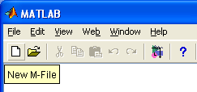
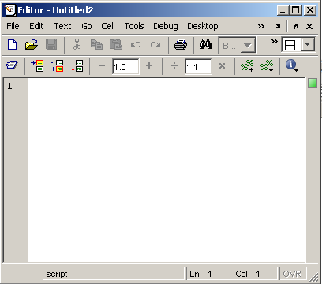
Use of M-File
Click to create a new M-File
Extension “.m”
A text file containing script or function or program to run

Slide 26
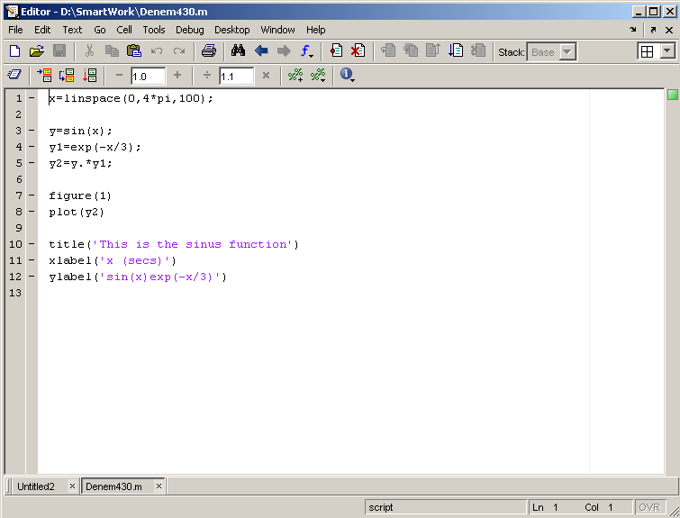
Use of M-File
Save file as Denem430.m
If you include “;” at the
end of each statement,
result will not be shown
immediately

Slide 27
Command line
Make sure current path (pwd)
cd to your m-file directory
edit m1.m
type m1.m
To run the m1 (>>m1)

Slide 28
Flow Control
if
for
while
break
….

Slide 29
Programming with Matlab
Relational operators
< less than
<= less than or equal to
> greater than
>= greater than or equal to
= = equal to
~= not equal to
Logical operations
~ not
& and
| or
xor(a,b) exclusive or

Slide 30
Control Structures
Some Dummy Examples
if ((a>3) & (b==5))
Some Matlab Commands;
end
if (a<3)
Some Matlab Commands;
elseif (b~=5)
Some Matlab Commands;
end
if (a<3)
Some Matlab Commands;
else
Some Matlab Commands;
end
If Statement Syntax
if (Condition_1)
Matlab Commands
elseif (Condition_2)
Matlab Commands
elseif (Condition_3)
Matlab Commands
else
Matlab Commands
end

Slide 31
Control Structures
Some Dummy Examples
for i=1:100
Some Matlab Commands;
end
for j=1:3:200
Some Matlab Commands;
end
for m=13:-0.2:-21
Some Matlab Commands;
end
for k=[0.1 0.3 -13 12 7 -9.3]
Some Matlab Commands;
end
For loop syntax
for i=Index_Array
Matlab Commands
end

Slide 32
Control Structures
While Loop Syntax
while (condition)
Matlab Commands
end
Dummy Example
while ((a>3) & (b==5))
Some Matlab Commands;
end

Slide 33
switch expression
case value(1)
statement(1)
case value(2)
statement(2)
…
case value(n-1)
statement(n-1)
otherwise
statement(n)
end

Slide 34
m2.m
y = [3 4 5 9 2];
for i = 1:length(y)
if rem(y(i),3)==0
fprintf('y(%g)=%g is 3n.\n', i, y(i));
elseif rem(y(i), 3)==1
fprintf('y(%g)=%g is 3n+1.\n', i , y(i));
else
fprintf('y(%g)=%g is 3n+2.\n', i , y(i));
end
end

Slide 35
m3.m
for i = 1:1000
if prod(1:i) > 1e100
fprintf('%g! = %e > 1e100\n', i, prod(1:i));
break;
end
end

Slide 36
m4.m
for month = 1:12
switch month
case {3,4,5}
season = 'Spring';
case {6,7,8}
season = 'Summer';
case {9,10,11}
season = 'Autumn';
case {12,1,2}
season = 'Winter';
end
fprintf('Month %d ===> %s.\n', month, season);
end

Slide 37
3-d Surface Plots
surf(Z) will create a 3-D surface plot of Z using the current colormap to color the surface
surfc(Z) is the same as surf except that it also draws a contour map under the surface
mesh function will create a surface without filled faces
Notes:
*

Slide 38
M7.m
x = linspace(-2, 2, 25); % 在 x 軸 [-2,2] 之間取 25 點
y = linspace(-2, 2, 25); % 在 y 軸 [-2,2] 之間取 25 點
[xx, yy] = meshgrid(x, y); % xx 和 yy 都是 25×25 的矩陣
zz = xx.*exp(-xx.^2-yy.^2); % 計算函數值，zz 也是 25×25 的矩陣
mesh(xx, yy, zz);
surf(xx, yy, zz), meshz(xx, yy, zz); waterfall(xx,yy,zz); meshc(xx, yy, zz);
The meshgrid function generates the grid point in the xy plane, and then evaluate the function f(x,y) at these points.

Slide 39
3-d of plot
[x, y] = meshgrid(-2:0.1:2);
z = y.*exp(-x.^2-y.^2);
plot3(x, y, z);

Slide 40
Function
A function file is useful when you need to repeat a set of commands several times.
function [output variables] = function_name(input variables);
All the variables in a function file are local,
(i) output variables are enclosed in square brackets, the square brackets are optional when there is only one output.
(ii) input variables are enclosed with parentheses
(iii) function_name must be the same as the filename in which it is saved (with the .m extension)
(iv) function is called by its name

Slide 41
Myfun.m
function [a b c] = myfun(x, y)
b = x * y; a = 100; c = x.^2;
myfun(2,3) % called with zero outputs
u = myfun(2,3) % called with one output
[u v w] = myfun(2,3) % called with all outputs

Slide 42
func3.m
function [ave1, ave2] = func3(vector1, vector2);
ave1 = sum(vector1)/length(vector1);
ave2 = sum(vector2)/length(vector2);
[a, b] = func3([1 2 3], [4 5 6 7 8])

Slide 43
func4.m
function [ave1, ave2] = func4(vector1, vector2)
if nargin == 1 % only one variable
ave1 = sum(vector1)/length(vector1);
end
if nargout == 2 % two variables
ave1 = sum(vector1)/length(vector1);
ave2 = sum(vector2)/length(vector2);
end
[a, b] = func4([1 2 3], [4 5 6 7 8])
c = func4([1 3 5 7 9])
bar(sin(func4([1 3 5 7 9])))

Slide 44
Elementary Math Function
Abs(), sign()
Sign(A) = A./abs(A)
Sin(), cos(), asin(), acos()
Exp(), log(), log10()
Ceil(), floor()
Sqrt()
Real(), imag()
*

Slide 45
I/O
fid = fopen(‘1.txt','r');
i = 1;
while ~feof(fid)
name(i,:) = fscanf(fid,'%5c',1);
year(i) = fscanf(fid,'%d',1);
no1(i) = fscanf(fid,'%d',1);
no2(i)=fscanf(fid,'%d',1);
no3(i)=fscanf(fid,'%g',1);
no4(i)=fscanf(fid,'%g\n');
i=i+1;
year
end
fclose(fid);

Slide 46
Alt.
name{i} = fscanf(fid, ‘%s’, 1);

Slide 47
1.txt
John 1995 12 5 2.3 4.5
Mary 1975 2 12 4.5 5.3

Slide 48
time
tic % start
inv(rand(500)); % Matrix inverse.
toc

Slide 49
t0 = cputime; % time now
a = inv(rand(500)); %
cpuTime = cputime-t0 % cpu time
I/O time are ingored

Slide 50
Time for every command
profile on -detail mmex
for i = 1:1000
a = inv(rand(100));
b = mean(rand(100));
end
profile off
profile report

Slide 51
MATLAB的影像格式
MATLAB 最常處理的影像格式為索引影像（Indexed Images）
顯示此類型影像的語法如下：
image(X)
colormap(map)
其中X為影像的資料矩陣，map為色盤矩陣。
色盤矩陣的大小為K×3，每個橫列由三個元素所組成，分別是R（紅） 、G（綠）、B（藍） ，每個元素的範圍為0~1
X的值為1~K，也就是當X(i, j)的值為p，則像素點(i, j) 的顏色為map(p, :)這一列的值所決定。

Slide 52
顯示索引影像範例一
在下例中，我們使用MATLAB顯示內建的小丑圖。
範例19-1：image01.m
load clown.mat % 載入小丑影像資料，含變數 X 和 map
image(X); % 顯示影像
colormap(map) % 取用色盤矩陣

Slide 53
顯示索引影像範例二
由於由X 是索引影像，因此其最小值是 1, 最大值會等於 map 的列數（即「可顯示之顏色數目」），可驗証如下：
範例19-2 ：image02.m
load clown.mat % 載入小丑影像資料，含變數 X 和 map
fprintf('min(min(X)) = %d\n', min(min(X)));
fprintf('max(max(X)) = %d\n', max(max(X)));
fprintf('size(map, 1) = %d\n', size(map, 1));

Slide 54
顯示索引影像範例二
min(min(X)) = 1
max(max(X)) = 81
size(map, 1) = 81
由範例可知，此小丑影像共含有 81 種不同的顏色。

Slide 55
音訊的基本介紹
聲音訊號（Audio Signal）簡稱音訊，泛指由人耳聽到的各種聲音的訊號。音訊有些基本的特質，可說明如下：
音量（Volume）：聲音的大小稱為音量，又稱為力度、強度（Intensity）或是能量（Energy）。音量越大，代表音訊波形的震幅越大。
音高（Pitch）：聲音的基本頻率（Fundamental Frequency）越高，代表音高越高（例如女高音的歌聲）；反之，聲音的基本頻率越低，代表音高越低（例如男低音的歌聲）。（有關基本頻率的說明，將在本章其後各小節說明。）
音色（Timber）：音訊波形在每個週期內的變化，就形成了此音訊的音色。不同的音色即代表不同的音訊內容，例如不同的字有不同的發音，或是不同的歌手有不同的特色，這些都是由於音色不同而產生。

Slide 56
20-2 WAV檔案的讀取範例之一
例如，若要讀取光碟中的檔案 welcome.wav，畫出音訊的波形並播放出此音訊，可使用下列程式：
範例20-1： readWave01.m
[y, fs]=wavread('welcome.wav');
sound(y, fs); % 播放此音訊
time=(1:length(y))/fs; % 時間軸的向量
plot(time, y); % 畫出時間軸上的波形

Slide 57
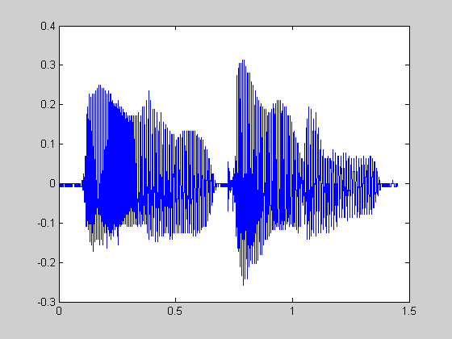
20-2 WAV檔案的讀取範例之一
執行結果:歡迎光臨波形圖

Slide 58
20-2 WAV檔案的讀取範例之二
若要知道 welcome.wav 的取樣點是由多少個位元來表示，可使用 [y, fs, nbits] = wavread(‘welcome.wav’)。若要知道音訊長度，則可使用 length(y)/fs。以下範例可以印出音訊檔 welcome.wav 的各種相關資訊：
範例20-2： readWave02.m
fileName='welcome.wav';
[y, fs, nbits]=wavread(fileName);
fprintf('音訊檔案 "%s" 的資訊：\n', fileName);
fprintf('音訊長度 = %g 秒\n', length(y)/fs);
fprintf('取樣頻率 = %g 取樣點/秒\n', fs);
fprintf('解析度 = %g 位元/取樣點\n', nbits);

Slide 59
20-2 WAV檔案的讀取範例之二
範例20-2執行結果:
音訊檔案 "welcome.wav" 的資訊：
音訊長度 = 1.45134 秒
取樣頻率 = 11025 取樣點/秒
解析度 = 8 位元/取樣點

