Slide 1
Exercise Ch.3
Suppose that each of the following update operations is applied directly to the database of figures in P.61 and P.62 in the handout. Discuss all integrity constraints violated by each operation (key, entity, or referential), if any, and all the different ways of enforcing these constraints (reject, cascade, or set null): *Foreign keys in different tables should be discussed separately in the cases of cascade or set null.*
Insert <‘135792468’, null, 4.0 > into WORKS_ON.
Insert <‘123456789’, 2, 4.0 > into WORKS_ON.
Insert < ‘Sale', 2, null, null > into DEPARTMENT.
Delete the EMPLOYEE tuple with SSN= ‘333445555'.
Delete the DEPENDENT tuples with ESSN= ‘333445555'.
Modify the DNUMBER attribute of the DEPARTMENT tuple with DNUMBER=5 to DNUMBER=6.
Modify the PNUMBER attribute of the PROJECT tuple with PNUMBER=1 to PNUMBER=2.
Modify the SSN attribute of the EMPLOYEE tuple with SSN= ‘333445555' to SSN= ‘135792468'.

Slide 2
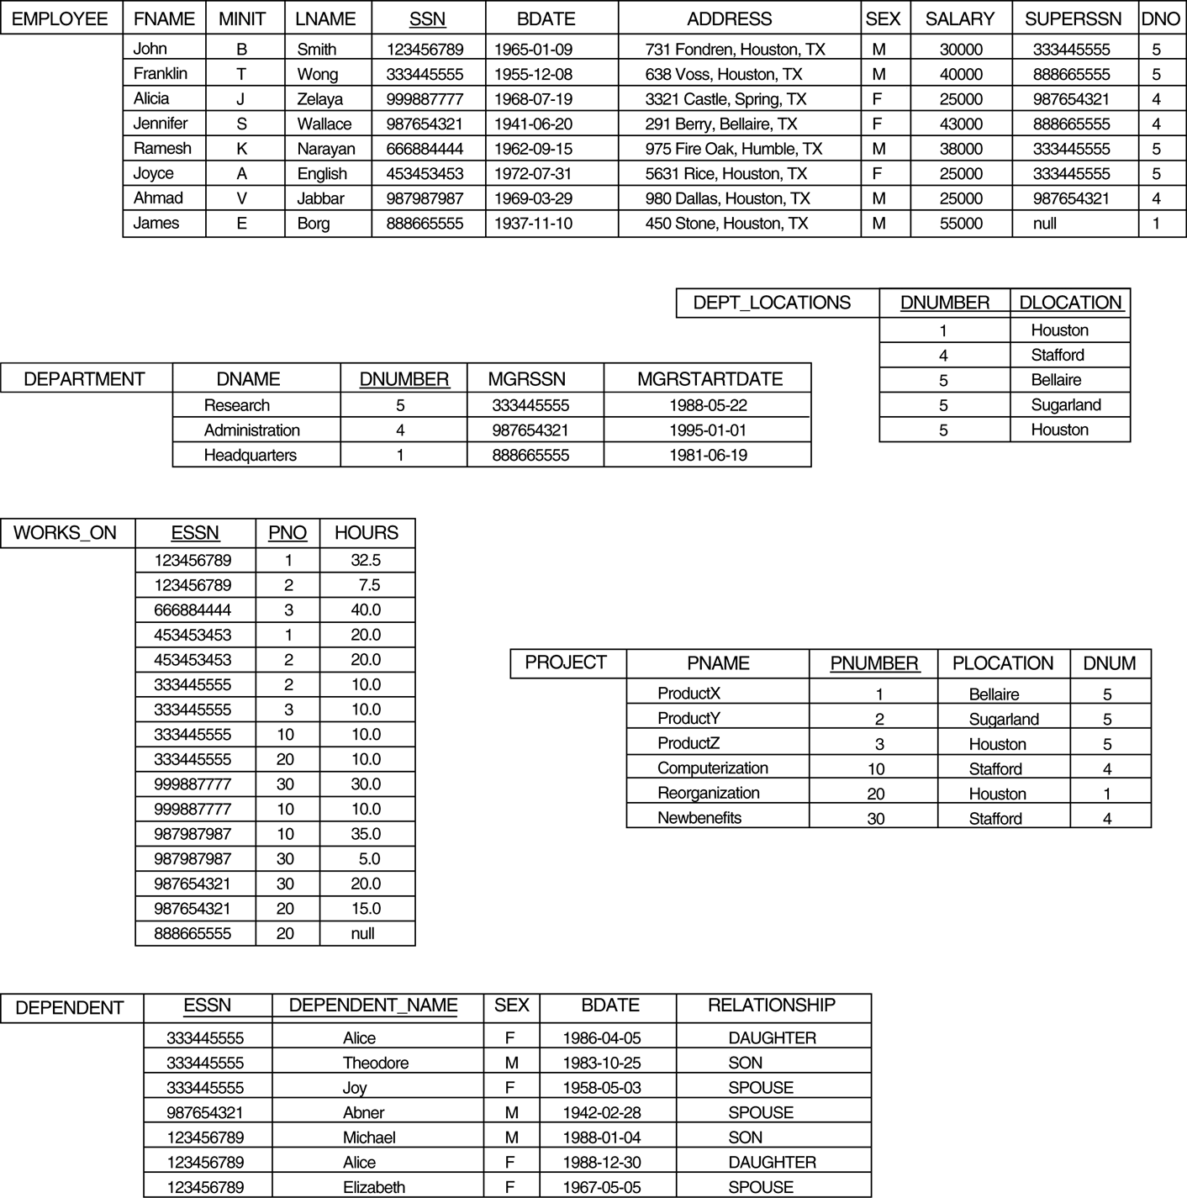
the COMPANY database
*

Slide 3
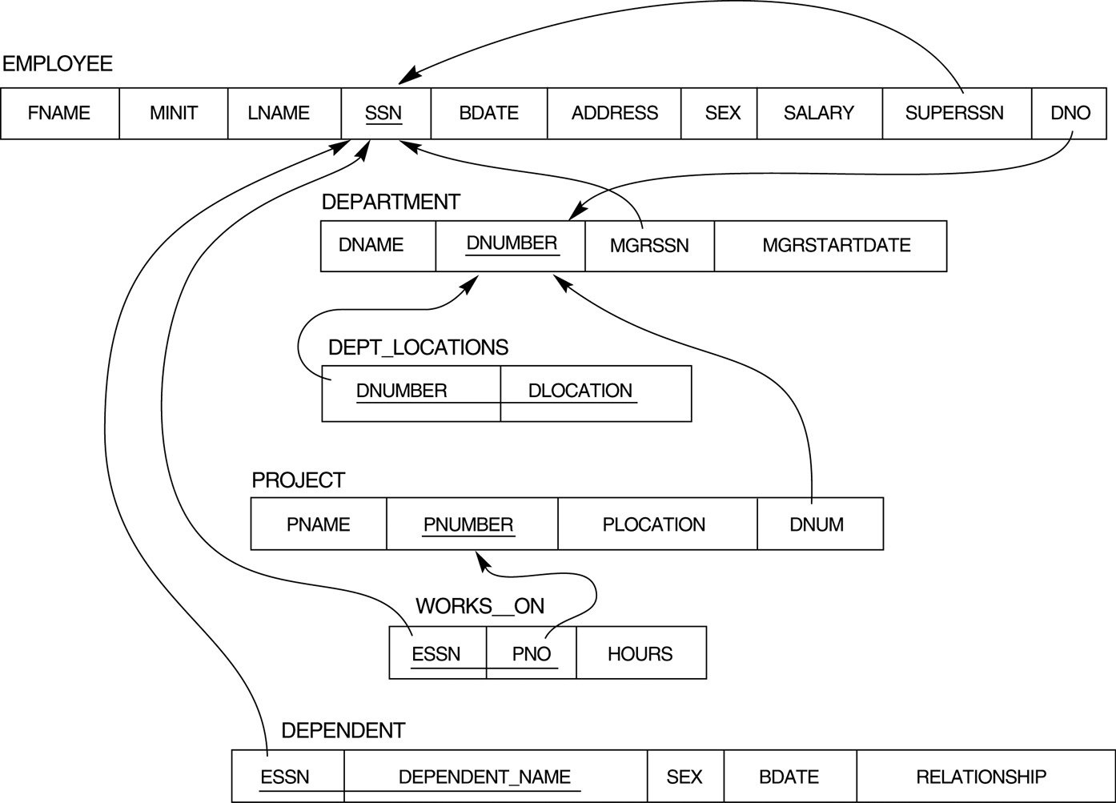
Referential integrity constraints displayed on the COMPANY relational database schema.
*

Slide 4
題號 | 是否違反 | 違反限制 | 解決方法
a |  | referential constraint entity constraint | reject
b |  | key constraint | reject
c | No
d |  | referential constraint | 1. reject
 |  |  | 2 | Employee SuperSSN | Department MGRSSN | Works_On ESSN |  | Dependent ESSN
 |  |  |  | set null | set null | cascade |  | cascade
e | No
f |  | referential constraint | 1. reject
 |  |  | 2 | Employee DNO | Dept_Locations DNUMBER |  | Project DNUM
 |  |  |  | cascade set null | cascade |  | Cascade set null
g |  | key constraint referential constraint | reject
h |  | referential constraint | 1. reject
 |  |  | 2 | Employee SuperSSN | Department MGRSSN | Works_On ESSN |  | Dependent ESSN
 |  |  |  | cascade set null | cascade set null | cascade |  | cascade

