Slide 1
針對課本中的COMPANY database schema，請寫出下列四個問題查詢的 SQL statement
查詢找出Research部門的經理姓名FNAME和LNAME，以及此部門所有員工的姓名FNAME和LNAME
查詢找出Research部門中所有員工的SSN，以及這些員工每人所參與的計畫數目No_Of_Projects
查詢找出沒有眷屬，但有參與專案計畫的經理，請顯示這些經理的SSN和FNAME
查詢找出所有員工人數超過(含)三人以上而且負責專案計畫數目超過(含)兩個以上的部門代號DNUMBER和此部門所負責專案計畫的數目

Slide 2
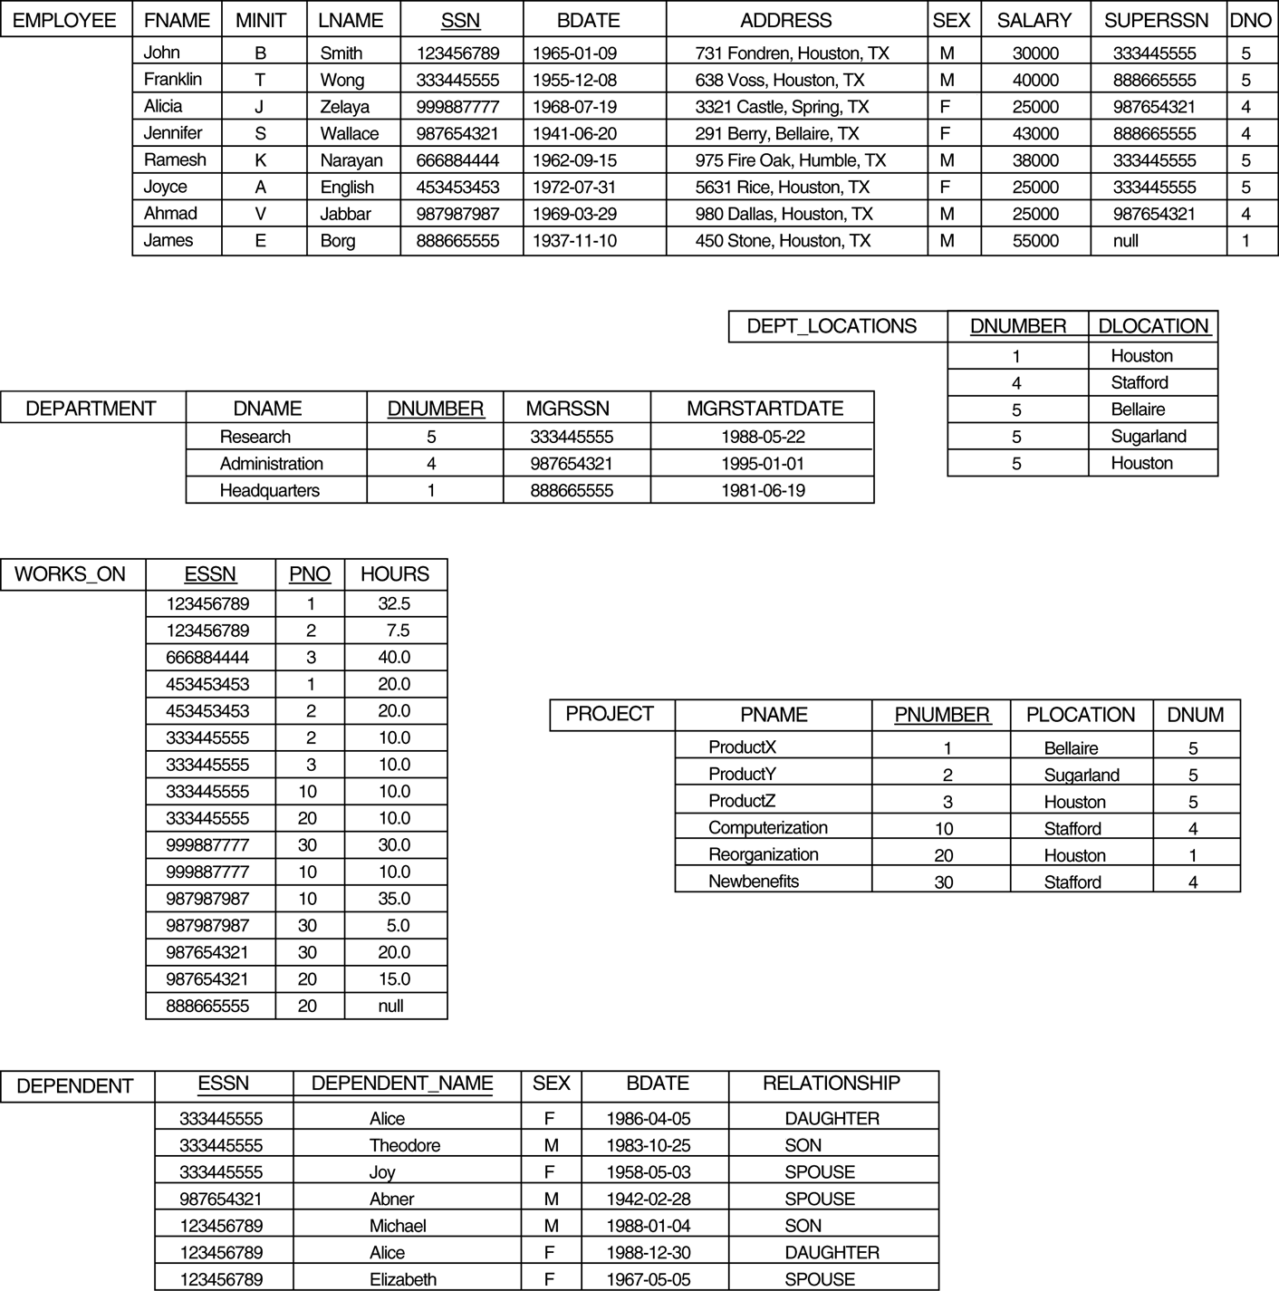

Slide 3
(1)
Select M.FNAME, M.LNAME, E.FNAME, E.LNAME
From DEPARTMENT, EMPLOYEE M E
Where DNAME=‘Research’ and MGRSSN=M.SSN and DNUMBER=E.DNO
(2)
Select SSN, COUNT(*)
From DEPARTMENT, EMPLOYEE, WORKS_ON
Where DNAME=‘Research’ and DNUMBER=DNO and SSN=ESSN
Group By SSN

Slide 4
(3)
Select SSN, FNAME
From EMPLOYEE, DEPARTMENT
Where SSN=MGRSSN and EXISTS (Select *
From WORKS_ON
Where SSN=ESSN)
and NOT EXISTS (Select * From DEPENDENT Where SSN=ESSN)
(4)
Select DNUM, COUNT(*)
From PROJECT
Where DNUM IN ( Select DNO
From EMPLOYEE
Group by DNO
Having COUNT(*) >= 3 )
Group By DNUM
Having COUNT(*)>=2

