Slide 1
Database Systems
上課用書
Title: Database Systems, 6th Edition
Authors: R. Elmasri and S.B. Navathe
Publisher: Pearson (歐亞書局代理)
ISBN: 978-0-13-214498-8
評分方式
期中考 30%
期末考 30%
小考、作業 30%
出勤與上課狀況 10%
講義下載
http://www.csie.ncue.edu.tw/~lflai
*

Slide 2
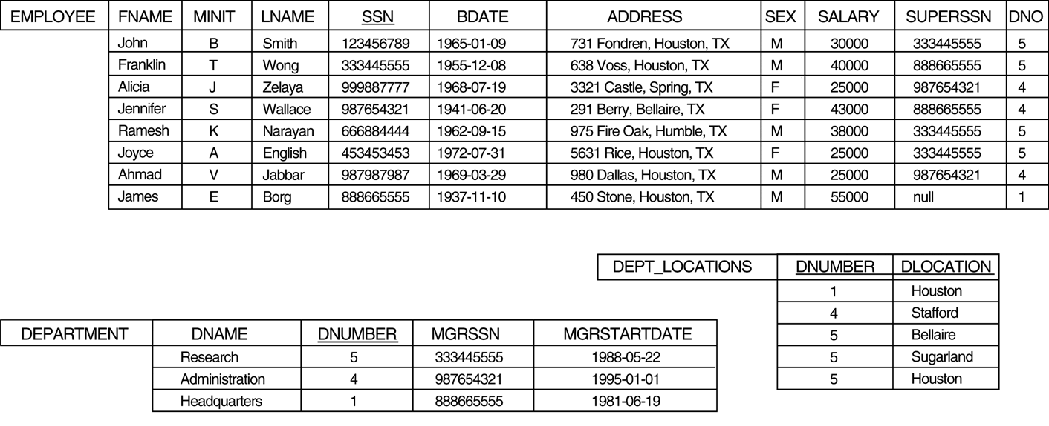
Relational Database
SQL (Structured Query Language)
Oracle, DB2, Informix, Sybase, mysql, SQL server, Access etc.
*

Slide 3
XML (eXtensible Markup Language)
Data exchange cross platform (text type)
DTD (Document Type Definition), XSD (XML Schema Definition)
<country xmlns:xsi="http://www.w3.org/2001/XMLSchema-instance"
xsi:noNamespaceSchemaLocation="country.xsd">
<name> France </name>
<capital> Paris </capital>
<language> French </language>
<money> Euro </money>
<area> 550000 </area>
<population> 63000000 </population>
</country>
*

Slide 4
Hbase (for Cloud Computing)
Big Table
Hadoop (Apache open source project), HDFS, MapReduce
Non-relational, Non-sql, Time Stamp
Row Key | Time Stamp | ColumnFamily contents | ColumnFamily anchor
CNN Headline | T1205 |  | cnn.com
CNN Headline | T0512 |  | edition.cnn.com
CNN Headline | T2568 | Pope thanks followers for support
CNN Headline | T2563 | Poll: Only 1-in-3 wants UK to stay in EU
CBS Headline | T2565 | Pope offers prayer for his upcoming replacement | www.cbsnews.com
CBS Headline | T2562 | Will Israel's "Iron Dome" help bring peace? | www.cbsnews.com
*

Slide 5
Contents
1. Introduction to databases
2. Overview of database languages and architectures
3. The basic relational model
7. Conceptual data modeling using entities and relationships
8. Mapping a conceptual design into a logical design
6. Formal relational languages: the algebra and calculus
4. SQL: data definition, constraints, and basic queries and updates
5. SQL: advanced queries, triggers, and views
14. Database design theory: Introduction to normalization using functional and multivalued dependencies
*

Slide 6
Chapter 1
Introduction to databases

Slide 7
Introduction
Database:
A collection of related data.
Data:
Known facts that can be recorded and have an implicit meaning.
Database Management System (DBMS):
A software system to facilitate the creation and maintenance of a computerized database.
Database System:
Include the DBMS software, the databases, and the applications.
Users
Application
DBMS
Database
*

Slide 8
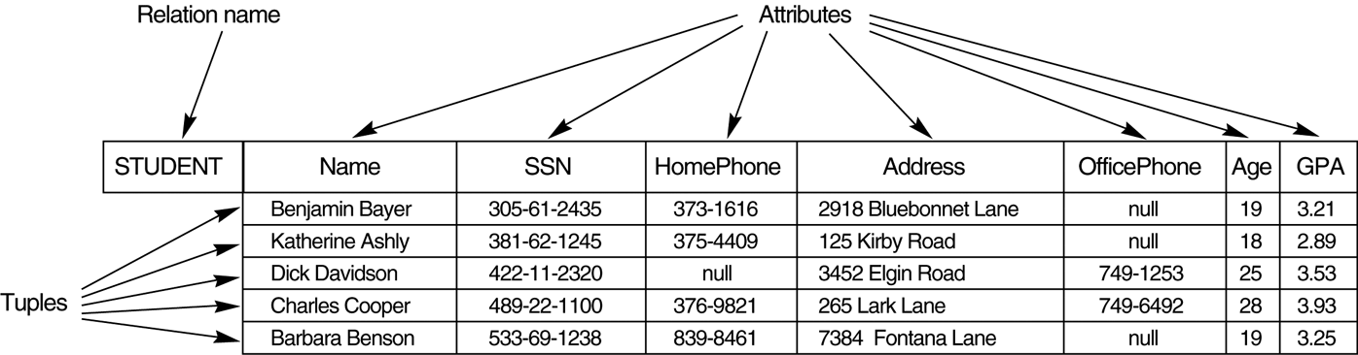
Example of a Database
database
relations (or tables)
attributes
tuples (or records)
*

Slide 9
Typical DBMS Functionality
Define a database
in terms of structures, data types and constraints
Construct the database
on a secondary storage medium
Manipulating the database
querying, generating reports, insertions, deletions and modifications to its content
Concurrent processing and sharing by a set of users and programs
keeping all data valid and consistent
*

Slide 10
Characteristics of the Database Approach
Self-describing nature of a database system:
The database contains not only the database itself but also a complete definition or description of the database (called meta-data).
Insulation between programs and data:
Program-Data independence. Allows changing data storage structures and operations without having to change the DBMS access programs.
*

Slide 11
Characteristics of the Database Approach
Data abstraction:
A data model is used to hide storage details and present the users with a conceptual view of the database.
Support of multiple views of the data:
Each user may see a different view of the database, which describes only the data of interest to that user.
Sharing of data and multiuser transaction processing :
allowing a set of concurrent users to retrieve and to update the database. Concurrency control within the DBMS guarantees that each transaction is correctly executed or completely aborted.
*

Slide 12
Database Users
Actors on the Scene: actually use and control the content
Database Designers: responsible to define the content, the structure, the constraints, and functions or transactions against the database. They must communicate with the end-users and understand their needs.
End-users: they use the data for queries, reports and some of them actually update the database content.
Database administrators (DBA): responsible for authorizing access to the database, for coordinating and monitoring its use, acquiring software and hardware resources, controlling its use and monitoring efficiency of operations.
Workers Behind the Scene: design and implement the DBMS software and system environment
DBMS designers and implementers, Tool developers
*

Slide 13
Advantages of Using the Database Approach
Controlling redundancy in data storage and in development and maintenance efforts.
Sharing of data among multiple users.
Restricting unauthorized access to data.
Providing storage structures for efficient query processing
Providing backup and recovery services.
Representing complex relationships among data.
Enforcing integrity constraints on the database.
Permitting inferences and actions using rules
*

Slide 14
Additional Advantages of Using the Database Approach
Potential for enforcing standards
permit the DBA to define and enforce standards among database users in a large organization. This facilitates communication and cooperation among various departments, projects, and users within the organization.
Reduced application development time
designing and implementing a new database from scratch may take a long time. The easy-to-use interfaces of DBMS reduces the time to develop a new application.
Flexibility to change data structures
database structure may evolve as new requirements are defined.
Availability of up-to-date information
as soon as one user’s update is applied to the database, all other users can immediately see this update
Economies of scale
consolidate data and applications to reduce the amount of wasteful overlap of resources and personnel in different projects or departments
*

Slide 15
Historical Development of Database Technology
Early Database Applications:
The Hierarchical and Network Models were introduced in mid 1960’s and dominated during the seventies.
Relational Model based Systems:
The model that was originally introduced in 1970 was heavily researched and experimented with in IBM and the universities. Relational DBMS Products emerged in the 1980’s.
Object-oriented applications:
OODBMSs were introduced in late 1980’s and early 1990’s to cater to the need of complex data processing in CAD and other applications.
Data on the Web and E-commerce Applications:
Web contains data in HTML (Hypertext markup language) with links among pages. This has given rise to a new set of applications and E-commerce is using new standards like XML (eXtended Markup Language).
*

Slide 16
Extending Database Capabilities
Emerging areas of database applications
Scientific Applications
Image Storage and Management
Audio and Video data management
Data Mining
Spatial data management
Time Series and Historical Data Management
New functionality is needed for DBMS
more complex data structures
new data types
new operations and query language
new storage and indexing structure
*

Slide 17
Chapter 2
Overview of database languages and architectures

Slide 18
Data Models
Data Model
A set of concepts to describe the structure of a database, which means the data types, relationships, and constraints that should hold on the data
Categories of data models
Conceptual (high-level, semantic) data models:
Provide concepts that are close to the way many users perceive data. (Also called entity-based or object-based data models.)
Physical (low-level, internal) data models:
Provide concepts that describe details of how data is stored in the computer.
Implementation (representational) data models:
Provide concepts that fall between the above two, balancing user views with some computer storage details. (used most frequently)
*

Slide 19
History of Data Models
Network Model:
the first one to be implemented by Honeywell in 1964 (IDS System).
Hierarchical Data Model:
implemented in a joint effort by IBM and North American Rockwell around 1965 (IMS system).
Relational Model:
proposed in 1970 by E.F. Codd (IBM), first commercial system in 1981-82. Now in several commercial products (DB2, ORACLE, SQL Server, SYBASE, INFORMIX).
Object-Relational Model:
Most Recent Trend. Started with Informix Universal Server. Exemplified in the latest versions of Oracle-10i, DB2, and SQL Server etc. systems.
Object-Oriented Data Model:
several models have been proposed for implementing in a database system.
*

Slide 20
Hierarchical Model
organize and represent data in hierarchical way
Hierarchical Model is simple to construct and operate on
has problems when representing nonhierarchical relationships
Department
DNumber DName Location
Employee
SSN Name Birth Address
Project
PNumber PName
Dependent
SSN Name Birth
Supervisee
SSN Name
Worker
SSN Name Hours
*

Slide 21
Network Model
use links to represent relationships between data, which forms a data network
Network Model is able to model complex relationships
Database contains a complex array of pointers that thread through a set of records. (implemented by linked lists)
System
Employee
works_for
all_Depts
supervisor
supervisee
manage
Supervisor
Department
dependents_of
Emp_Work
Works_On
controls
Proj_Work
Dependent
Project
*

Slide 22
Relational Model
represent data as a collection of relations
a relation is thought of as a table of value
represent relationships among data through attributes
Department
DNumber Dname Extention Manager
d02 MIS 308 e012
d04 Accounting 513 e009
Employee
ENumber EName Position Salary Department
e007 M. Hirota accountant 32000 d04
e012 J.H. Jackson manager 76000 d02
e015 K. Smith designer 53000 d02
e018 L. Peterson programmer 35000 d02
e009 K. Johnson manager 84000 d04
*

Slide 23
Schemas Vs. Instances
Database Schema:
The description of a database. Includes descriptions of the database structure and the constraints that should hold on the database.
Database Instance:
The actual data stored in a database at a particular moment in time. Also called database state (or occurrence).
Schema Diagram:
A diagrammatic display of a database schema.
Employee
ENumber EName Position Salary Department
e007 M. Hirota accountant 32000 d04
e012 J.H. Jackson manager 76000 d02
e015 K. Smith designer 53000 d02
*

Slide 24
Database Schema Vs. Database State
Database State:
Refers to the content of a database at a moment in time.
Initial Database State:
Refers to the database when it is loaded
Valid State:
A state that satisfies the structure and constraints of the database.
Distinction
The database schema changes very infrequently. The database state changes every time the database is updated.
Schema is also called intension, whereas state is called extension.
*

Slide 25
Three-Schema Architecture
To separate the user applications and the physical database
Support of multiple views of the data
End Users
…..
External Level
External View 1
External View n
external/conceptual
mapping
Conceptual Level
Conceptual Schema
conceptual/internal
mapping
Internal Level
Internal Schema
Stored Database
*

Slide 26
Three-Schema Architecture
Defines DBMS schemas at three levels:
Internal schema at the internal level to describe physical storage structures and access paths. Uses a physical data model.
Conceptual schema at the conceptual level to describe the structure and constraints for the whole database for a community of users. Uses a conceptual or an implementation data model.
External schemas at the external level to describe the various user views. Each view describes the part of the database that a particular user group is interested in. Uses a conceptual or an implementation data model.
Mappings among schema levels are needed to transform requests and data.
Programs referring to an external schema are mapped by the DBMS to requests in the conceptual schema, and requests are then mapped to the internal schema for execution.
*

Slide 27
Data Independence
Logical Data Independence:
The capacity to change the conceptual schema without having to change the external schemas and their application programs.
Physical Data Independence:
The capacity to change the internal schema without having to change the conceptual schema.
When a schema at a lower level is changed, only the mappings between this schema and higher-level schemas need to be changed in a DBMS.
When the database is changed (e.g. mysql to oracle), only the DBMS and the ODBC data sources are changed. The application programs are unchanged.
*

Slide 28
DBMS Languages
Data Definition Language (DDL):
Used by the DBA and database designers to specify the conceptual schema of a database.
Data Manipulation Language (DML):
Used to specify database retrievals and updates.
DML commands (data sublanguage) can be embedded in a general-purpose programming language (host language), such as COBOL, C, ASP, PHP, Java, or an Assembly Language.
Alternatively, stand-alone DML commands can be applied directly to the database (query language).
*

Slide 29
DBMS Languages
High Level or Non-procedural Languages:
e.g., SQL, are set-oriented and specify what data to retrieve than how to retrieve. Also called declarative languages.
Low Level or Procedural Languages:
e.g. DBASE III and FoxPro are record-at-a-time; they specify how to retrieve data and include constructs such as looping.
*

Slide 30
DBMS Interfaces
Stand-alone query language interfaces.
Programmer interfaces for embedding DML in programming languages:
User-friendly interfaces:
Menu-based (lists of options), do not need to memorize the specific commands and syntax of a query language
Forms-based, designed for naïve users to fill out all entries in a form to update data
Graphics-based, specify a query by manipulating a diagram which displays a database schema
Natural language, requests in written English
Combinations of the above
*

Slide 31
Database System Utilities
To perform certain functions such as:
Loading data stored in files into a database. Includes data conversion tools.
Backing up the database periodically on tape.
Reorganizing database file structures.
Report generation utilities.
Performance monitoring utilities.
Other functions, such as sorting, user monitoring, data compression, etc.
*

Slide 32
Architectures for DBMS
Centralized DBMS
Client-Server Architectures for DBMS
Two-Tier Client-Server Architectures
Three-Tier Client-Server Architectures
N-Tier Client-Server Architectures
*

Slide 33
Centralized Architectures
combines everything into single system including- DBMS software, hardware, application programs and user interface processing software
….
Terminal
Terminal
Terminal
Terminal
Network
Application Programs
DBMS
Compliers, Editors, Other Software …….
OS
Hardware
Centralized Computer
*

Slide 34
Client-Server Architectures
Specialized Servers with Specialized functions
File Servers, Printer Servers, Web Servers, E-mail Servers
DBMS Server
Provides database query and transaction services to the clients
Clients
Provide appropriate interfaces and a client-version of the system to access and utilize the server resources.
Connected to the servers via some form of a network. (Internet, LAN, wireless network, etc.)
*

Slide 35
Two-Tier Client-Server Architecture
User Interface Programs and Application Programs run on the client side
Interface called ODBC (Open Database Connectivity – see Ch 5) provides an Application program interface (API) allow client side programs to call the DBMS. Most DBMS vendors provide ODBC drivers.
….
Client
Client
Client
Client
Network
DBMS Server
File Server
Print Server
Mail Server
*
Notes:
*
*
ODBC是一種資料庫與應用程式之間的介面，透過 ODBC 介面，應用程式可以很容易地和各種關連式資料庫連結並取得資料。換句話說，ODBC是一種讓各種資料庫都具有相同的存取資料介面的應用程式介面。 因為 ODBC 是一個應用程式介面，所以我們要使用 ODBC 的功能時，在用戶端的應用程式端必須安裝ODBC 驅動程式 (ODBC driver)，我們一般熟知的資料庫，如dBase、Access、Oracle、MS SQL S、FoxPro，以及Excel 試算表等，都有本身對應的ODBC驅動程式。有了ODBC後，程式設計師在設計不同資料庫的程式時，就不必將重新撰寫程式，只要變動與 ODBC 所連結的介面即可，如此可以節省不少麻煩。

Slide 36
Three-Tier Client-Server Architecture
Common for Web applications
Middle tier (Application Server or Web Server)
stores the web connectivity software and flow control and business logic (constraints) part of the application used to access the right amount of data from the database server
Additional Features- Security:
encrypt the data at the server before transmission
decrypt data at the client
Presentation Tier
Middle Tier
Data Tier
GUI,
Web Interface
Application Programs,
Web Pages
Database,
DBMS
Thin Client
(Browser)
Application Server or Web Server
Database Server
*

Slide 37
N-Tier Client-Server Architecture
Presentation Tier
Middle Tier
Data Tier
Flow Control Tier
Business Logic Tier
Thin Client
(Browser)
Web
Server
Application
Server
Database Server
J2EE Sun ONE Architecture:
Thin Client
(Browser)
Web
Server
Application
Server
Database Server
Portal
Server
LDAP
Server
Identity
Server
*

Slide 38
Classification of DBMSs
Based on the data model used:
Traditional: Relational, Network, Hierarchical.
Emerging: Object-oriented, Object-relational.
Other classifications:
Single-user (typically used with one PC) vs. multi-user (most DBMSs).
Centralized (uses a single computer site with one database) vs. distributed (uses multiple computer sites, multiple databases)
*

Slide 39
Variations of Distributed DBMS(DDBMS)
Homogeneous DDBMS
use the same DBMS software at multiple sites
Heterogeneous DDBMS
use different DBMS software at multiple sites
preexisting databases
special-purpose
Federated DBMS (or Multidatabase Systems)
the participating DBMSs are loosely coupled and have a degree of local autonomy
*

Slide 40
Chapter 3 The basic relational model
Notes:
*
*

Slide 41
Relational Model Concepts
The relational Model of Data is based on the concept of a Relation.
A Relation is a mathematical concept based on the ideas of sets.
The strength of the relational approach to data management comes from the formal foundation provided by the theory of relations.
The model was first proposed by Dr. E.F. Codd of IBM in 1970 in the following paper:
"A Relational Model for Large Shared Data Banks," Communications of the ACM, June 1970.
The above paper caused a major revolution in the field of Database management and earned Ted Codd the coveted ACM Turing Award.
*

Slide 42
INFORMAL DEFINITIONS
RELATION: A table of values
A relation may be thought of as a set of rows.
A relation may alternately be though of as a set of columns.
Each row represents a fact that corresponds to a real-world entity or relationship.
Each row has a value of an item or set of items that uniquely identifies that row in the table.
Each column has a column name (column header or attribute name).
*

Slide 43
FORMAL DEFINITIONS
The Schema of a Relation: R (A1, A2, .....An)
Relation schema R is defined over attributes A1, A2, .....,An
For Example:
Customer (Cust-id, Cust-name, Address, Phone#)
Here, CUSTOMER is a relation defined over the four attributes Cust-id, Cust-name, Address, Phone#, each of which has a domain or a set of valid values. For example, the domain of Cust-id is 6 digit numbers.
*

Slide 44
FORMAL DEFINITIONS
A tuple is an ordered set of values
Each value is derived from an appropriate domain.
Each row in the Customer table may be referred to as a tuple in the table and would consist of four values.
<632895, "John Smith", "101 Main St. Atlanta, GA 30332", "(404) 894-2000"> is a tuple belonging to the Customer relation.
A relation may be regarded as a set of tuples (rows).
Columns in a table are also called attributes of the relation.
*

Slide 45
FORMAL DEFINITIONS
A domain has a logical definition: e.g., “USA_phone_numbers” are the set of 10 digit phone numbers valid in the U.S.
A domain may have a data-type or a format defined for it. The USA_phone_numbers may have a format: (ddd)-ddd-dddd where each d is a decimal digit. E.g., Dates have various formats such as monthname, date, year or yyyy-mm-dd, or dd mm,yyyy etc.
*

Slide 46
FORMAL DEFINITIONS
The relation is formed over the cartesian product of the sets; each set has values from a domain; that domain is used in a specific role which is conveyed by the attribute name.
For example, attribute Cust-name is defined over the domain of strings of 25 characters. The role these strings play in the CUSTOMER relation is that of the name of customers.
Formally,
Given R(A₁, A₂, .........., A_{n})
r(R) ⊂ dom (A₁) X dom (A₂) X ....X dom(A_{n})
R: schema of the relation
r of R: population of R (all tuples of R)
R is also called the intension of a relation
r is also called the extension of a relation
*

Slide 47
FORMAL DEFINITIONS
Let S1 = {0,1}
Let S2 = {a,b,c}
Let R ⊂ S1 X S2
Then for example: r(R) = {<0,a> , <0,b> , <1,c> }
is one possible “state” or “population” or “extension” r of the relation R, defined over domains S1 and S2. It has three tuples.
*

Slide 48
DEFINITION SUMMARY
Informal Terms |  | Formal Terms
Table |  | Relation
Column |  | Attribute/Domain
Row |  | Tuple
Values in a column |  | Domain
Table Definition |  | Schema of a Relation
Populated Table |  | Extension
*

Slide 49
Example - Figure 5.1
*

Slide 50
CHARACTERISTICS OF RELATIONS
Ordering of tuples in a relation r(R):
The tuples are not considered to be ordered, even though they appear to be in the tabular form.
Ordering of attributes in a relation schema R (and of values within each tuple):
We will consider the attributes in R(A₁, A₂, ..., A_{n}) and the values in t=<v₁, v₂, ..., v_{n}> to be ordered .
(However, a more general alternative definition of relation does not require this ordering – viewed as a set of attributes).
Values in a tuple:
All values are considered atomic (indivisible).
A special null value is used to represent values that are unknown or inapplicable to certain tuples.
*

Slide 51
CHARACTERISTICS OF RELATIONS
Notation:
We refer to component values of a tuple t by t[A_{i}] = v_{i} (the value of attribute A_{i} for tuple t).
Similarly, t[A_{u}, A_{v}, ..., A_{w}] refers to the subtuple of t containing the values of attributes A_{u}, A_{v}, ..., A_{w}, respectively.
*

Slide 52
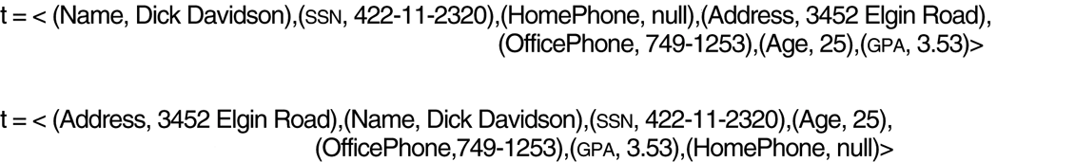
Two identical tuples when the order of attributes and values is not part of relation definition.
*

Slide 53
Relational Integrity Constraints
Constraints are conditions that must hold on all valid relation instances. There are three main types of constraints:
Key constraints
Entity integrity constraints
Referential integrity constraints
*

Slide 54
Key Constraints
Superkey of R: A set of attributes SK of R such that no two tuples in any valid relation instance r(R) will have the same value for SK. That is, for any distinct tuples t1 and t2 in r(R), t1[SK] ≠ t2[SK].
Key of R: A "minimal" superkey; that is, a superkey K such that removal of any attribute from K results in a set of attributes that is not a superkey.
Example: The CAR relation schema:
CAR(State, Reg#, SerialNo, Make, Model, Year)
has two keys Key1 = {State, Reg#}, Key2 = {SerialNo}, which are also superkeys. {SerialNo, Make} is a superkey but not a key.
If a relation has several candidate keys, one is chosen arbitrarily to be the primary key. The primary key attributes are underlined.
Hence, any two tuples in one relation is distinct (a set can’t have same members)
*

Slide 55
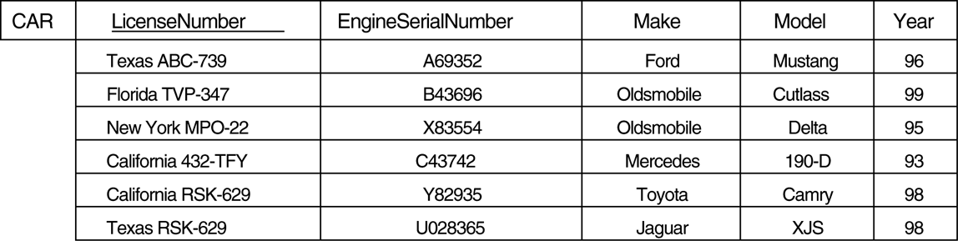
The CAR relation, with two candidate keys: LicenseNumber and EngineSerialNumber.
*

Slide 56
Entity Integrity
Relational Database Schema: A set S of relation schemas that belong to the same database. S is the name of the database.
S = {R₁, R₂, ..., R_{n}}
Entity Integrity: The primary key attributes PK of each relation schema R in S cannot have null values in any tuple of r(R). This is because primary key values are used to identify the individual tuples.
t[PK] ≠ null for any tuple t in r(R)
Note: Other attributes of R may be similarly constrained to disallow null values, even though they are not members of the primary key.
*

Slide 57
Referential Integrity
A constraint involving two relations (the previous constraints involve a single relation).
Used to specify a relationship among tuples in two relations: the referencing relation and the referenced relation.
Tuples in the referencing relation R₁ have attributes FK (called foreign key attributes) that reference the primary key attributes PK of the referenced relation R₂. A tuple t₁ in R₁ is said to reference a tuple t₂ in R₂ if t₁[FK] = t₂[PK].
A referential integrity constraint can be displayed in a relational database schema as a directed arc from R₁.FK to R₂.PK
*

Slide 58
Referential Integrity Constraint
Statement of the constraint
The value in the foreign key column (or columns) FK of the the referencing relation R₁ can be either:
(1) a value of an existing primary key value of the corresponding primary key PK in the referenced relation R_{2,}, or..
(2) a null.
In case (2), the FK in R₁ should not be a part of its own primary key.
*

Slide 59
Other Types of Constraints
Semantic Integrity Constraints:
based on application semantics and cannot be expressed by the model itself
E.g., “the max. no. of hours per employee for all projects he or she works on is 56 hrs per week”
A constraint specification language may have to be used to express these
*

Slide 60
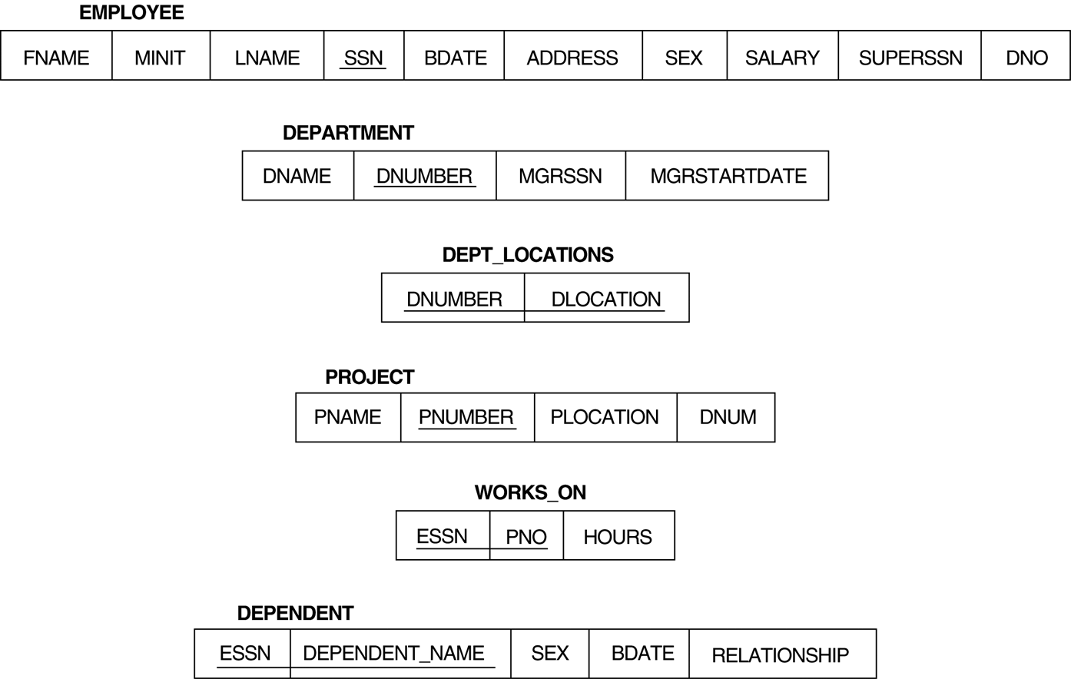
Schema diagram for the COMPANY relational database schema.
*

Slide 61
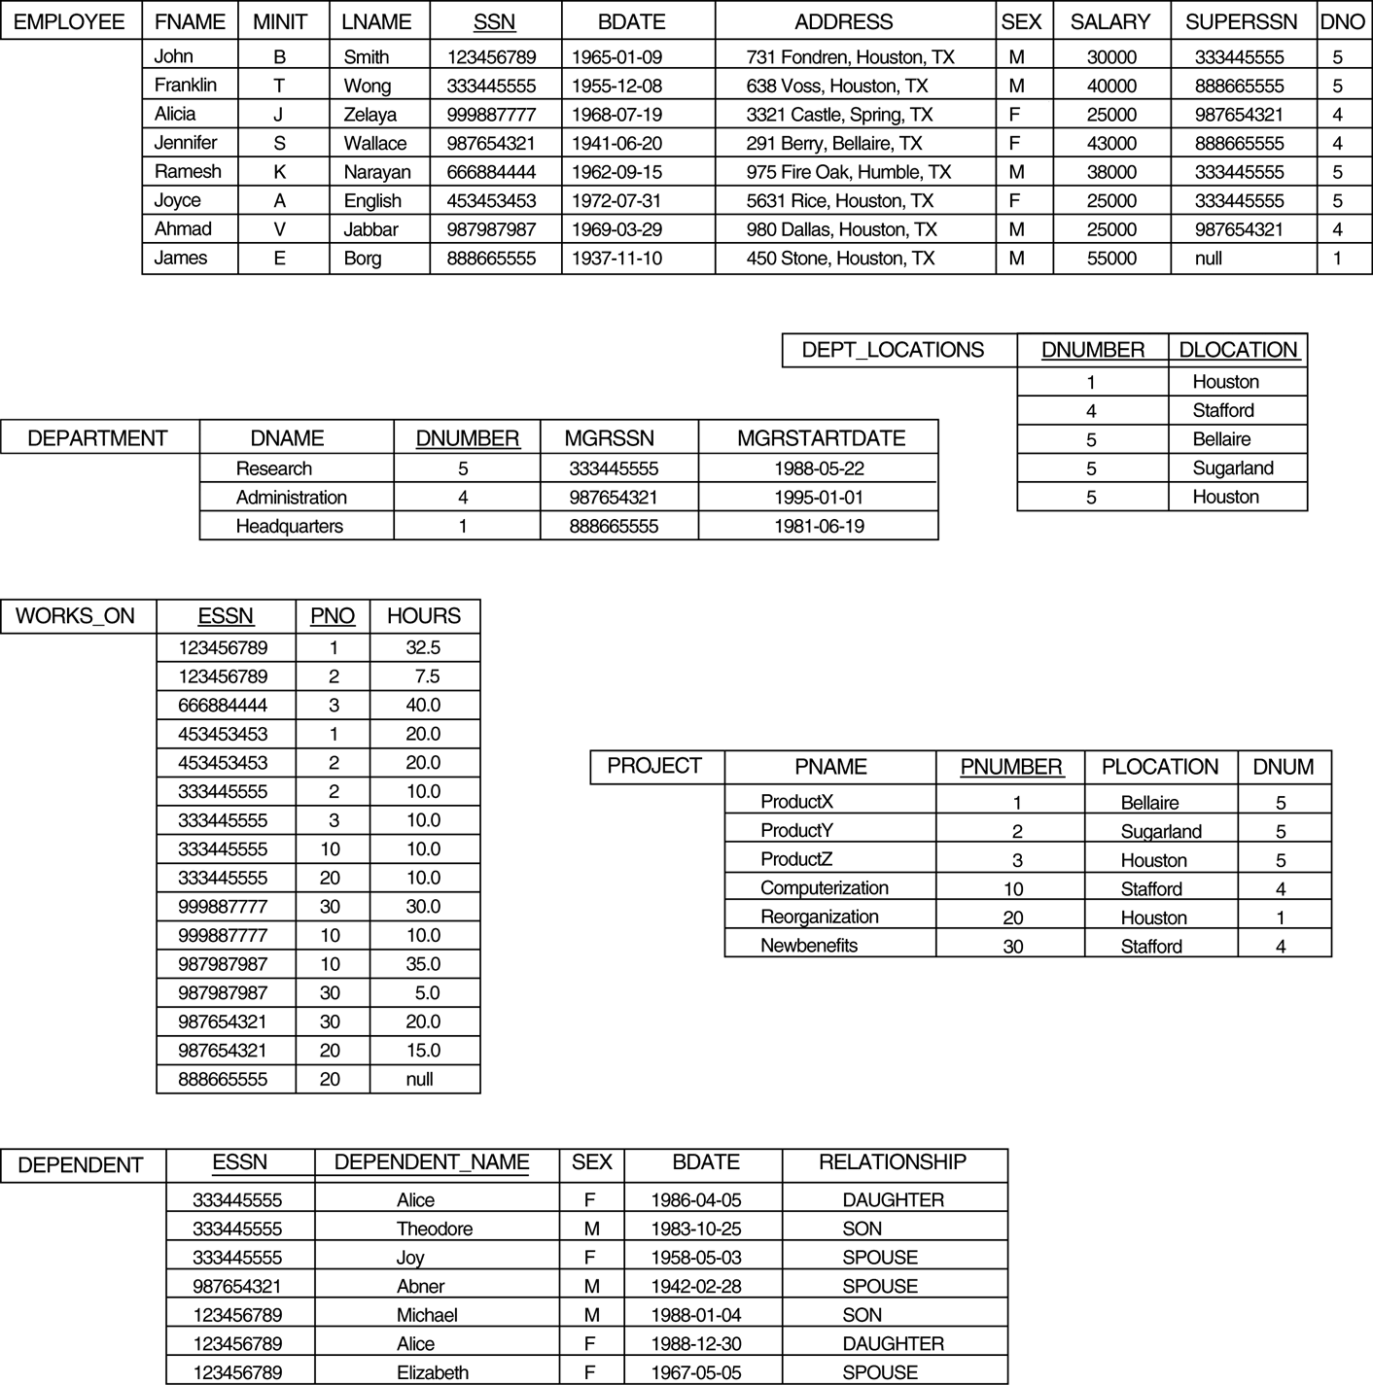
One possible database state for the COMPANY database schema.
*

Slide 62
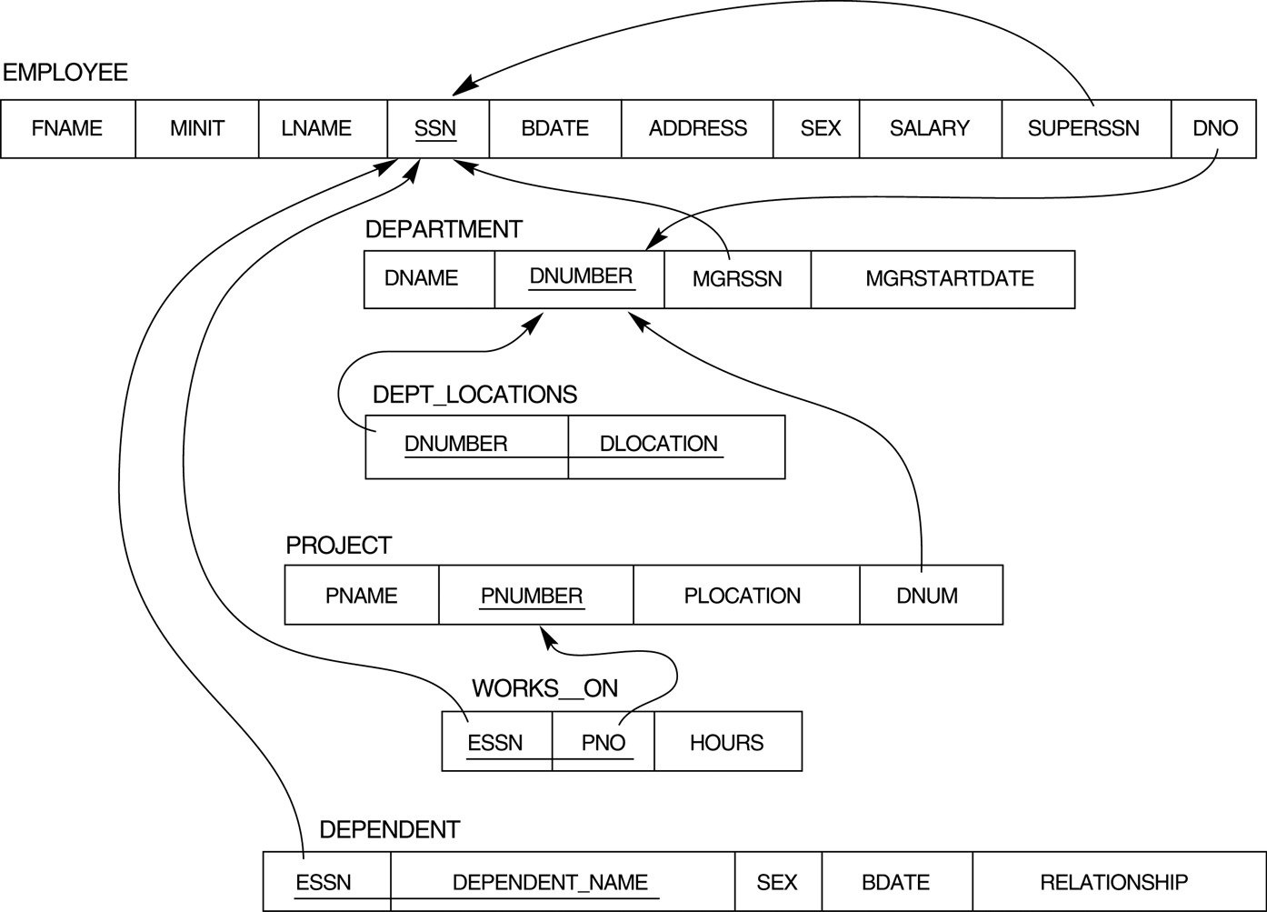
Referential integrity constraints displayed on the COMPANY relational database schema.
*

Slide 63
Update Operations on Relations
INSERT a tuple.
DELETE a tuple.
MODIFY a tuple.
Integrity constraints should not be violated by the update operations.
Updates may propagate to cause other updates automatically. This may be necessary to maintain integrity constraints.
*

Slide 64
Update Operations on Relations
In case of integrity violation, several actions can be taken:
Cancel the operation that causes the violation (REJECT option)
Perform the operation but inform the user of the violation (INFORM option)
Trigger additional updates so the violation is corrected
CASCADE option
SET NULL option
Execute a user-specified error-correction routine
*

Slide 65
Chapter 7 Conceptual data modeling using entities and relationships (Entity-Relationship Model)
Notes:
*
*

Slide 66
Example COMPANY Database
Requirements of the Company
The company is organized into DEPARTMENTs. Each department has a name, number and an employee who manages the department. We keep track of the start date of the department manager.
Each department controls a number of PROJECTs. Each project has a name, number and is located at a single location.
We store each EMPLOYEE’s social security number, address, salary, sex, and birthdate. Each employee works for one department but may work on several projects. We keep track of the number of hours per week that an employee currently works on each project. We also keep track of the direct supervisor of each employee.
Each employee may have a number of DEPENDENTs. For each dependent, we keep track of their name, sex, birthdate, and relationship to employee.
*

Slide 67
ER Model Concepts
Entities and Attributes
Entities are specific objects or things in the mini-world (some aspect of the real world) that are represented in the database.
For example the EMPLOYEE John Smith, the Research DEPARTMENT, the ProductX PROJECT
Attributes are properties used to describe an entity.
For example an EMPLOYEE entity may have a Name, SSN, Address, Sex, BirthDate
A specific entity will have a value for each of its attributes.
For example a specific employee entity may have Name='John Smith', SSN='123456789', Address ='731, Fondren, Houston, TX', Sex='M', BirthDate='09-JAN-55‘
Each attribute has a value set (or data type) associated with it
e.g. integer, string, subrange, enumerated type, …
*

Slide 68
Types of Attributes
Simple attributes
Each entity has a single atomic value for the attribute.
For example, SSN or Sex.
Composite attributes
The attribute may be composed of several components.
For example, Address (Apt#, House#, Street, City, State, ZipCode, Country) or Name (FirstName, MiddleName, LastName).
Multi-valued attributes
An entity may have multiple values for that attribute.
For example, Color of a CAR or PreviousDegrees of a STUDENT. Denoted as {Color} or {PreviousDegrees}.
*

Slide 69
Types of Attributes (cont.)
Complex attributes
composite and multi-valued attributes may be nested in an arbitrary way.
For example, PreviousDegrees of a STUDENT is a composite multi-valued attribute denoted by {PreviousDegrees (College, Year, Degree, Field)}.
Derived attributes
the value of an attribute may be determined from another attribute.
For example, the Age attribute is derivable from the BirthDate attribute and the current date.
*

Slide 70
Key Attributes
An attribute of an entity type for which each entity must have a unique value is called a key attribute of the entity type.
For example, SSN of EMPLOYEE.
A key attribute may be composite.
For example, VehicleRegistrationNumber is a key of the CAR entity type with components (Number, State).
An entity type may have more than one key. For example, the CAR entity type may have two keys:
VehicleIdentificationNumber (popularly called VIN) and
VehicleRegistratuionNumber (Number, State), also known as license_plate number.
*

Slide 71
ENTITY SET corresponding to the ENTITY TYPE CAR
CAR
Registration(RegistrationNumber, State), VehicleID, Make, Model, Year, {Color}
car₁
((ABC 123, TEXAS), TK629, Ford Mustang, convertible, 1999, (red, black))
car₂
((ABC 123, NEW YORK), WP9872, Nissan 300ZX, 2-door, 2002, (blue))
car₃
((VSY 720, TEXAS), TD729, Buick LeSabre, 4-door, 2003, (white, blue))
.
.
.
*

Slide 72
SUMMARY OF ER-DIAGRAM NOTATION
Symbol
Meaning
ENTITY TYPE
WEAK ENTITY TYPE
RELATIONSHIP TYPE
IDENTIFYING RELATIONSHIP TYPE
ATTRIBUTE
KEY ATTRIBUTE
MULTIVALUED ATTRIBUTE
COMPOSITE ATTRIBUTE
DERIVED ATTRIBUTE
TOTAL PARTICIPATION OF E₂ IN R
CARDINALITY RATIO 1:N FOR E₁:E₂ IN R
STRUCTURAL CONSTRAINT (min, max) ON PARTICIPATION OF E IN R
E₁
R
E₂
E₁
R
N
E₂
R
(min,max)
E
*

Slide 73
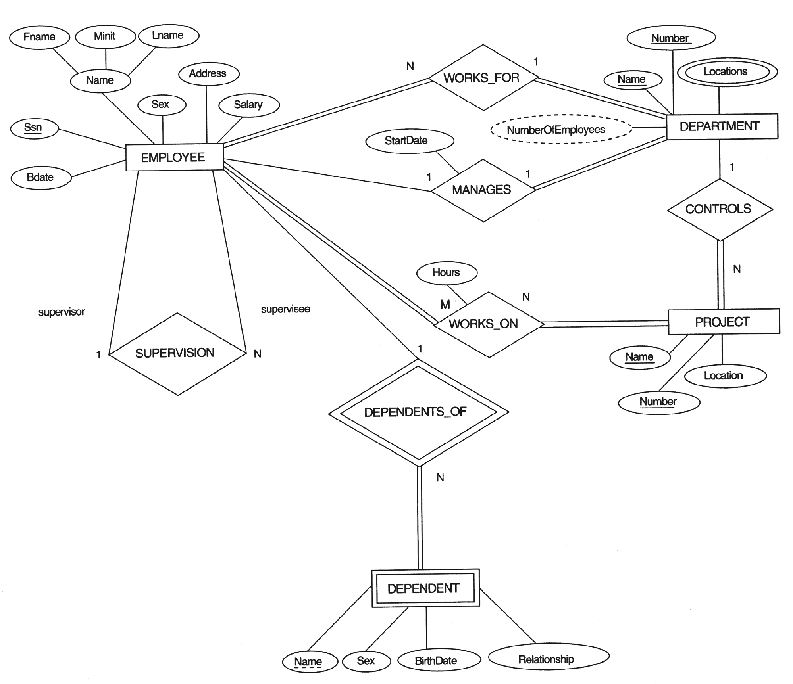
ER DIAGRAM – Entity Types are: EMPLOYEE, DEPARTMENT, PROJECT, DEPENDENT
*

Slide 74
Relationships and Relationship Types
A relationship relates two or more distinct entities with a specific meaning.
For example, EMPLOYEE John Smith works on the ProductX PROJECT or EMPLOYEE Franklin Wong manages the Research DEPARTMENT.
More than one relationship type can exist with the same participating entity types.
For example, MANAGES and WORKS_FOR are distinct relationships between EMPLOYEE and DEPARTMENT, but with different meanings and different relationship instances.
The degree of a relationship type is the number of participating entity types. Both MANAGES and WORKS_ON are binary relationships.
*

Slide 75
ER DIAGRAM – Relationship Types are: WORKS_FOR, MANAGES, WORKS_ON, CONTROLS, SUPERVISION, DEPENDENTS_OF
*

Slide 76
Weak Entity Types
An entity that does not have a key attribute
A weak entity must participate in an identifying relationship type with an owner or identifying entity type
Entities are identified by the combination of:
The particular entity they are related to in the identifying entity type
A partial key of the weak entity type
Example:
DEPENDENT is a weak entity type with EMPLOYEE as its identifying entity type via the identifying relationship type DEPENDENT_OF
a DEPENDENT entity is identified by the dependent’s name and the specific EMPLOYEE SSN that the dependent is related to
*

Slide 77
Weak Entity Type is: DEPENDENT Identifying Relationship is: DEPENDENTS_OF
*

Slide 78
Constraints on Relationships
Constraints on Relationship Types
Maximum Cardinality (also called cardinality ratio)
One-to-one (1:1)
One-to-many (1:N) or Many-to-one (N:1)
Many-to-many (M:N)
Minimum Cardinality (also called participation constraint)
zero (optional participation)
one or more (mandatory participation)
*

Slide 79
Many-to-one (N:1) RELATIONSHIP
EMPLOYEE
WORKS_FOR
DEPARTMENT
e_{1 }
e_{2 }
e_{3 }
e_{4 }
e_{5 }
e_{6 }
e_{7 }
r₁
r₂
r₃
r₄
r₅
r₆
r₇
● d₁
● d₂
● d₃
*

Slide 80
Many-to-many (M:N) RELATIONSHIP
EMPLOYEE
WORKS_ON
PROJECT
e_{1 }
e_{2 }
e_{3 }
e_{4 }
e_{5 }
e_{6 }
e_{7 }
r₉
r₁
r₂
r₃
r₄
r₅
r₆
r₇
● p₁
● p₂
● p₃
r₈
*

Slide 81
Recursive Relationship Types
We can also have a recursive relationship type.
Both participations are same entity type in different roles.
For example, SUPERVISION relationships between EMPLOYEE (in role of supervisor or boss) and (another) EMPLOYEE (in role of subordinate or worker).
In following figure, first role participation labeled with 1 and second role participation labeled with 2.
In ER diagram, need to display role names to distinguish participations.
*

Slide 82
A RECURSIVE RELATIONSHIP SUPERVISION
EMPLOYEE
SUPERVISION
e_{1 }
e_{2 }
e_{3 }
e_{4 }
e_{5 }
e_{6 }
e_{7 }
r₁
r₂
r₃
r₄
r₅
r₆
2
1
1
2
2
1
2
1
1
2
1
2
*

Slide 83
Recursive Relationship Type is: SUPERVISION (participation role names are shown)
*

Slide 84
Attributes of Relationship types
A relationship type can have attributes
for example, HoursPerWeek of WORKS_ON;
its value for each relationship instance describes the number of hours per week that an EMPLOYEE works on a PROJECT.
*

Slide 85
Attribute of a Relationship Type is: Hours of WORKS_ON
*

Slide 86
Structural Constraints on Relationships
Cardinality ratio (of a binary relationship): 1:1, 1:N, N:1, or M:N
shown by placing appropriate number on the link
Participation constraint (on each participating entity type): total or partial.
shown by double lining the link
*

Slide 87
Alternative (min, max) notation for relationship structural constraints:
Specified on each participation of an entity type E in a relationship type R
Specifies that each entity e in E participates in at least min and at most max relationship instances in R
Default(no constraint): min=0, max=n
Must have min≤max, min≥0, max ≥1
Examples:
A department has exactly one manager and an employee can manage at most one department.
Specify (0,1) for participation of EMPLOYEE in MANAGES
Specify (1,1) for participation of DEPARTMENT in MANAGES
An employee can work for exactly one department but a department can have any number of employees.
Specify (1,1) for participation of EMPLOYEE in WORKS_FOR
Specify (0,N) for participation of DEPARTMENT in WORKS_FOR
*

Slide 88
The (min,max) notation relationship constraints
(0,1)
(1,1)
(1,1)
(0,N)
*

Slide 89
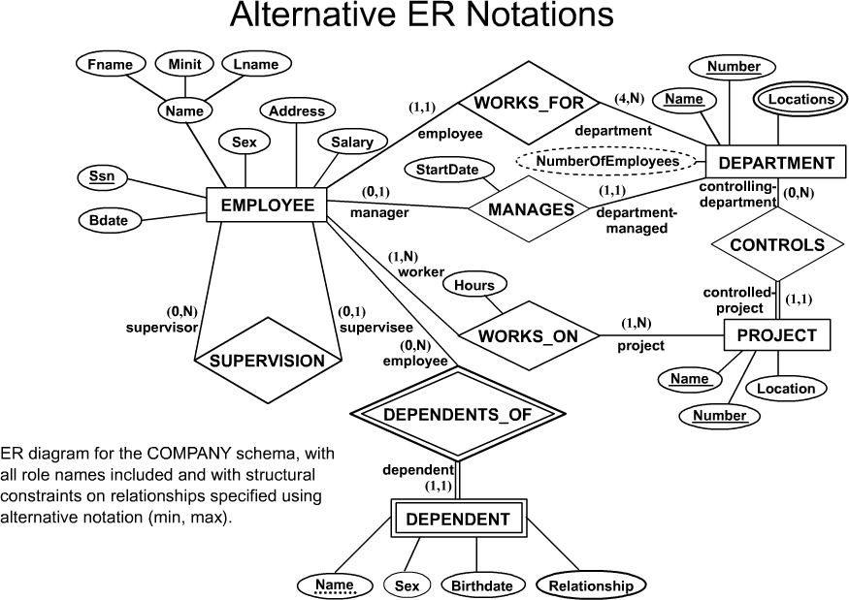
COMPANY ER Diagram using (min, max) notation
*

Slide 90
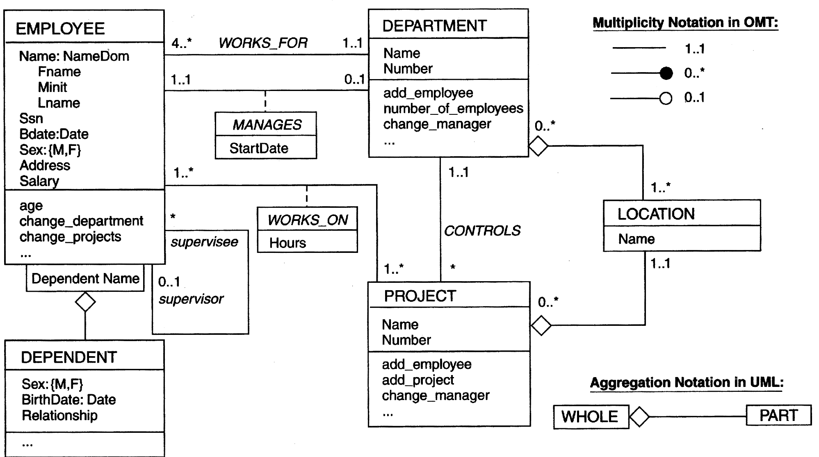
The COMPANY conceptual scheme in UML
Association Class
Reflexive Association
Qualified Association
*
Notes:
*
*
Association class (關聯類別) 將某一關聯上的相關屬性封裝起來而成的類別
Reflexive association (反身關聯) 相同類別中物件間的關係
Qualified association (限定關聯) 限定使用某一個屬性去存取或查詢另一個實體

Slide 91
Relationships of Higher Degree
Relationship types of degree 2 are called binary
Relationship types of degree 3 are called ternary and of degree n are called n-ary
Quantity
Supplier
Supply
Project
SName
PName
Part
PartNo
*

Slide 92
In general, an n-ary relationship is not equivalent to n binary relationships
Quantity
Supplier
Supply
Project
SName
PName
Part
PartNo
≠
Supplier
Supply
Project
Offer
Use
Part
*

Slide 93
PROBLEM with ER notation
the entity relationship model in its original form did not support the specialization/ generalization abstractions
Extended Entity-Relationship (EER) Model
Incorporates Set-subset relationships
Incorporates Specialization/Generalization Hierarchies
*
Notes:
*
*

Slide 94
Chapter 7 Conceptual data modeling using entities and relationships (Enhanced ER Model)
Notes:
*
*

Slide 95
Enhanced-ER (EER) Model
Includes all modeling concepts of basic ER
Additional concepts:
subclasses/superclasses, specialization/ generalization, categories, attribute inheritance
It is used to model applications more completely and accurately if needed
It includes some object-oriented concepts, such as inheritance
*

Slide 96
Subclasses and Superclasses
An entity type may have additional meaningful subgroupings of its entities
Example: EMPLOYEE may be further grouped into SECRETARY, ENGINEER, MANAGER, TECHNICIAN, SALARIED_EMPLOYEE, HOURLY_EMPLOYEE,…
Each of these groupings is a subset of EMPLOYEE entities
Each is called a subclass of EMPLOYEE
EMPLOYEE is the superclass for each of these subclasses
These are called superclass/subclass relationships.
Example: EMPLOYEE/SECRETARY, EMPLOYEE/TECHNICIAN
*

Slide 97
Subclasses and Superclasses (cont.)
These are also called IS-A relationships (SECRETARY IS-A EMPLOYEE, TECHNICIAN IS-A EMPLOYEE, …).
Note: An entity that is member of a subclass represents the same real-world entity as some member of the superclass
The Subclass member is the same entity in a distinct specific role
An entity cannot exist in the database merely by being a member of a subclass; it must also be a member of the superclass
A member of the superclass can be optionally included as a member of any number of its subclasses
Example: A salaried employee who is also an engineer belongs to the two subclasses ENGINEER and SALARIED_EMPLOYEE
It is not necessary that every entity in a superclass be a member of some subclass
*

Slide 98
Attribute Inheritance in Superclass /Subclass Relationships
An entity that is member of a subclass inherits all attributes of the entity as a member of the superclass
It also inherits all relationships
*

Slide 99
Specialization
is the process of defining a set of subclasses of a superclass
The set of subclasses is based upon some distinguishing characteristics of the entities in the superclass
Example: {SECRETARY, ENGINEER, TECHNICIAN} is a specialization of EMPLOYEE based upon job type.
May have several specializations of the same superclass
Example: Another specialization of EMPLOYEE based in method of pay is {SALARIED_EMPLOYEE, HOURLY_EMPLOYEE}.
Superclass/subclass relationships and specialization can be diagrammatically represented in EER diagrams
Attributes of a subclass are called specific attributes. For example, TypingSpeed of SECRETARY
The subclass can participate in specific relationship types. For example, BELONGS_TO of HOURLY_EMPLOYEE
*

Slide 100
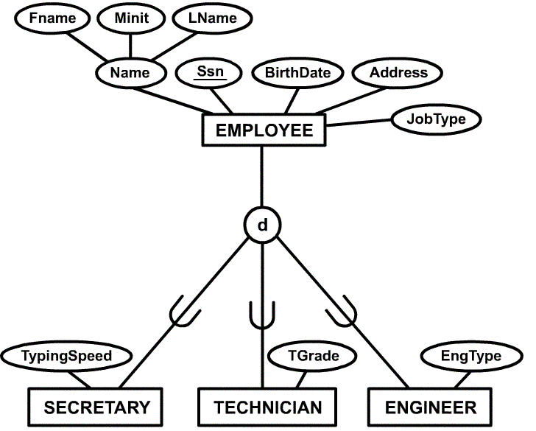
Example of a Specialization
d : disjoint
o : overlap
u : union
: total
: partial
*

Slide 101
Generalization
The reverse of the specialization process
Several classes with common features are generalized into a superclass; original classes become its subclasses
Example: CAR, TRUCK generalized into VEHICLE; both CAR, TRUCK become subclasses of the superclass VEHICLE.
We can view {CAR, TRUCK} as a specialization of VEHICLE
Alternatively, we can view VEHICLE as a generalization of CAR and TRUCK
*

Slide 102
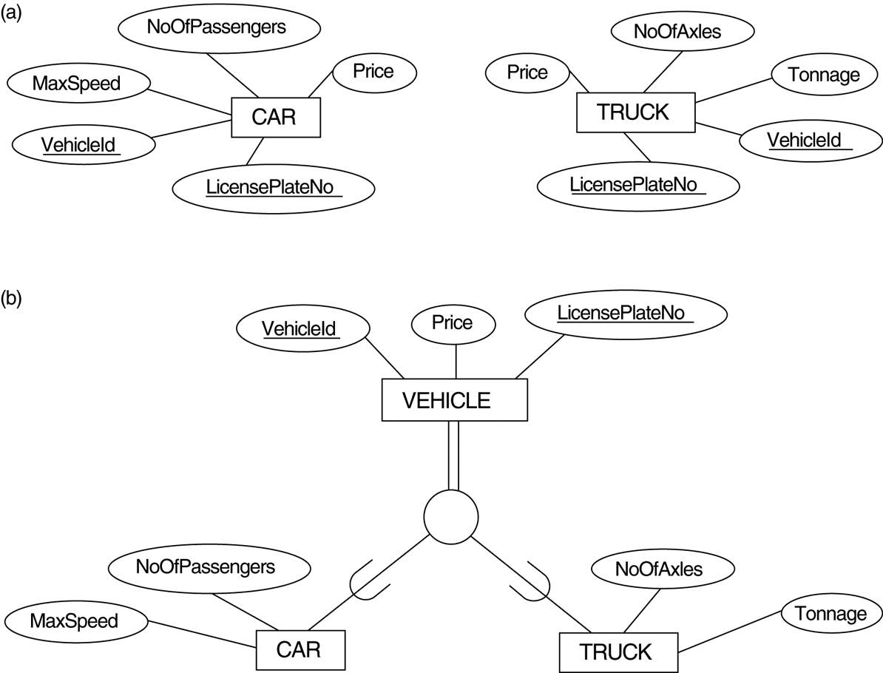
Example of a Generalization
d
*

Slide 103
Specialization and Generalization
If we can determine exactly those entities that will become members of each subclass by a condition, the subclasses are called predicate-defined (or condition-defined) subclasses
Condition is a constraint that determines subclass members
Display a predicate-defined subclass by writing the predicate condition next to the line attaching the subclass to its superclass
If all subclasses in a specialization have membership condition on same attribute of the superclass, specialization is called an attribute defined-specialization
Attribute is called the defining attribute of the specialization
Example: JobType is the defining attribute of the specialization {SECRETARY, TECHNICIAN, ENGINEER} of EMPLOYEE
If no condition determines membership, the subclass is called user-defined
Membership in a subclass is determined by the database users by applying an operation to add an entity to the subclass
Membership in the subclass is specified individually for each entity in the superclass by the user
*

Slide 104
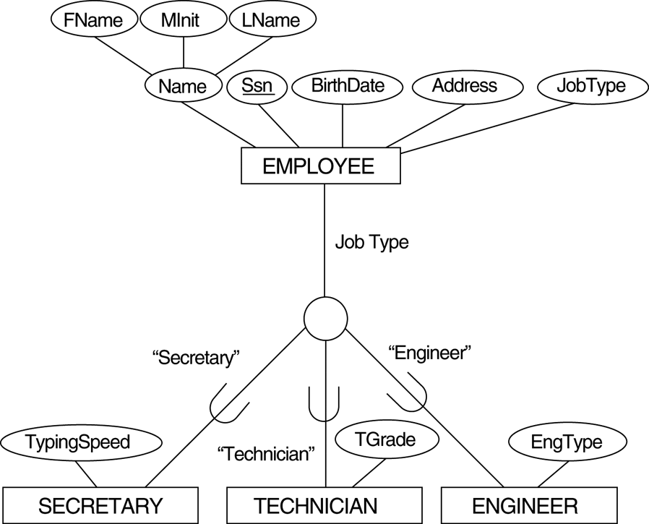
An Attribute-Defined Specialization
d
defining predicate:
JobType = “Engineer”
*

Slide 105
Constraints on Specialization and Generalization
Two other conditions apply to a specialization/generalization:
Disjointness Constraint:
Specifies that the subclasses of the specialization must be disjointed (an entity can be a member of at most one of the subclasses of the specialization)
Specified by d in EER diagram
If not disjointed, overlap; that is the same entity may be a member of more than one subclass of the specialization
Specified by o in EER diagram
Completeness Constraint:
Total specifies that every entity in the superclass must be a member of some subclass in the specialization/ generalization
Shown in EER diagrams by a double line
Partial allows an entity not to belong to any of the subclasses
Shown in EER diagrams by a single line
*

Slide 106
Constraints on Specialization and Generalization
Hence, we have four types of specialization/generalization:
Disjoint, total
Disjoint, partial
Overlapping, total
Overlapping, partial
Note: Generalization usually is total because the superclass is derived from the subclasses.
*

Slide 107
Example of Disjoint Partial Specialization
d : disjoint
o : overlap
u : union
: total
: partial
*

Slide 108
Example of Overlapping Total Specialization
I/O Device
d : disjoint
o : overlap
u : union
: total
: partial
O
Input Device
Output Device
*

Slide 109
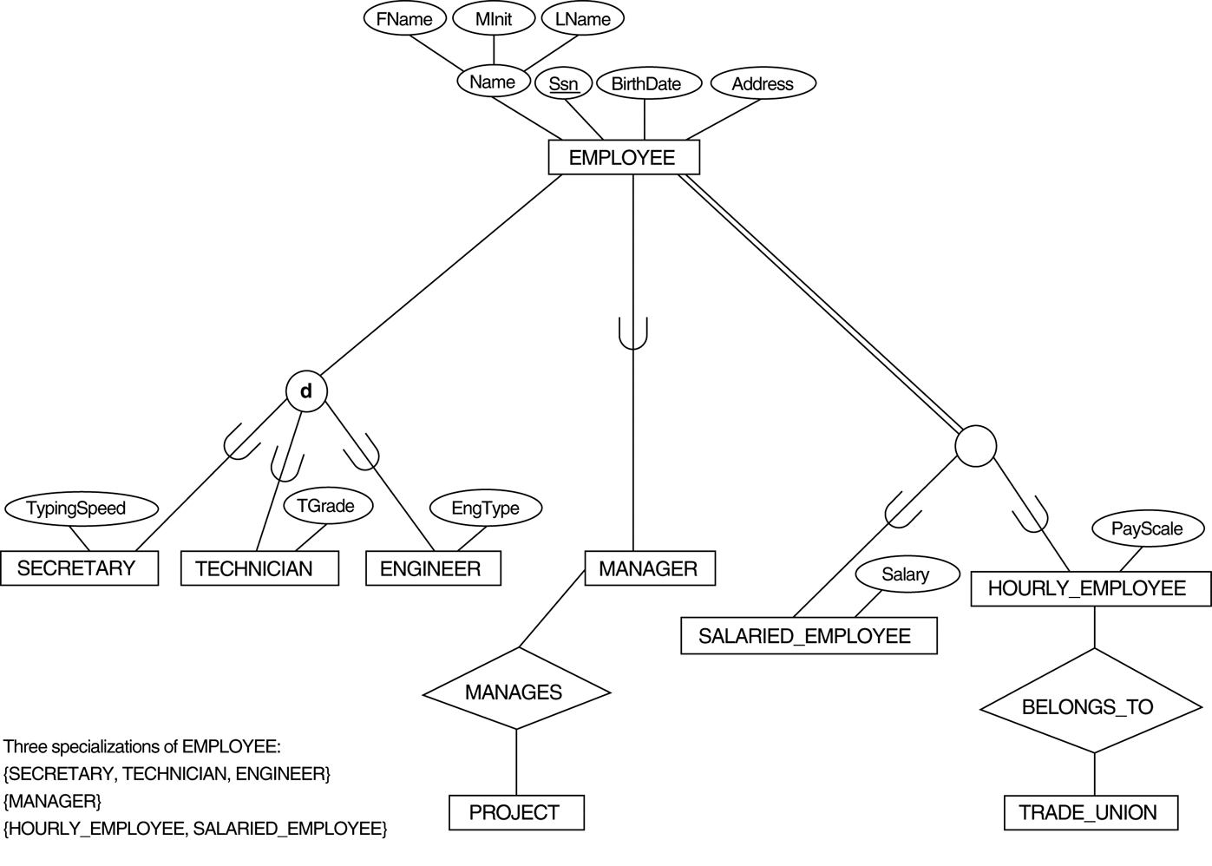
Example of Several Specializations
d
*

Slide 110
Specialization / Generalization Hierarchies, Lattices and Shared Subclasses
A subclass may itself have further subclasses specified on it
Forms a hierarchy or a lattice
Hierarchy has a constraint that every subclass has only one superclass (called single inheritance)
In a lattice, a subclass can be subclass of more than one superclass (called multiple inheritance)
In a lattice or hierarchy, a subclass inherits attributes not only of its direct superclass, but also of all its predecessor superclasses
A subclass with more than one superclass is called a shared subclass
Can have specialization hierarchies or lattices, or generalization hierarchies or lattices
In specialization, start with an entity type and then define subclasses of the entity type by successive specialization (top down conceptual refinement process)
In generalization, start with many entity types and generalize those that have common properties (bottom up conceptual synthesis process)
In practice, the combination of two processes is employed
*

Slide 111
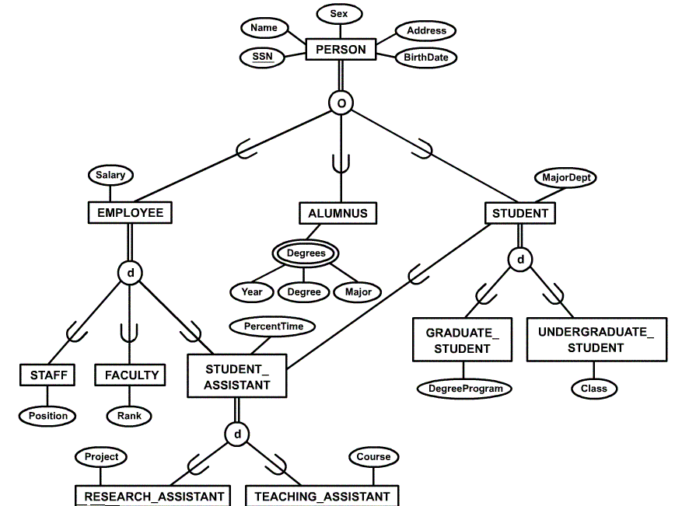
Specialization / Generalization Lattice Example (UNIVERSITY)
*

Slide 112
Categories (UNION Types)
A shared subclass is subclass in more than one distinct superclass/subclass relationships, where each relationships has a single superclass (multiple inheritance)
In some cases, need to model a single superclass/subclass relationship with more than one superclass
Such a subclass is called a category or UNION type
Example: Database for vehicle registration, vehicle owner can be a person, a bank (holding a lien on a vehicle) or a company.
Category (subclass) OWNER is a subset of the union of the three superclasses COMPANY, BANK, and PERSON
A category member must exist in at least one of its superclasses
Note: The difference from shared subclass, which is subset of the intersection of its superclasses (shared subclass member must exist in all of its superclasses).
*

Slide 113
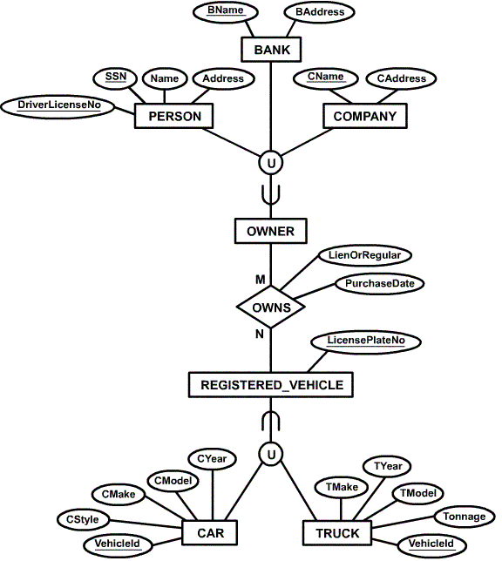
Example of categories (UNION TYPES)
*

Slide 114
Specialization / Generalization Lattice for University
*

Slide 115
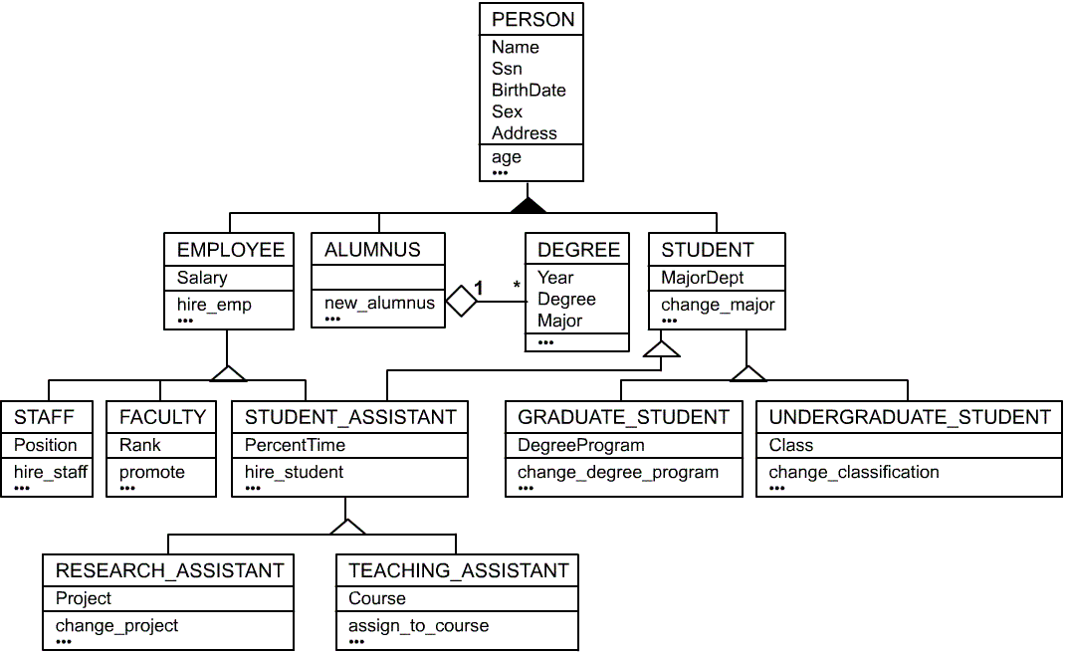
UML for the University Example
*

Slide 116
Chapter 8 Mapping a conceptual design into a logical design
Notes:
*
*

Slide 117
Chapter Outline
ER-to-Relational Mapping Algorithm
Step 1: Mapping of Regular Entity Types
Step 2: Mapping of Weak Entity Types
Step 3: Mapping of Binary 1:1 Relation Types
Step 4: Mapping of Binary 1:N Relationship Types.
Step 5: Mapping of Binary M:N Relationship Types.
Step 6: Mapping of Multivalued attributes.
Step 7: Mapping of N-ary Relationship Types.
Mapping EER Model Constructs to Relations
Step 8: Options for Mapping Specialization or Generalization.
Mapping of Shared Subclass (Multiple Inheritance)
Step 9: Mapping of Union Types (Categories).
*

Slide 118
Step 1: Mapping of Regular Entity Types.
For each regular (strong) entity type E in the ER schema, create a relation R that includes all the simple attributes of E.
Choose one of the key attributes of E as the primary key for R. If the chosen key of E is composite, the set of simple attributes that form it will together form the primary key of R.
Example: We create the relations EMPLOYEE, DEPARTMENT, and PROJECT in the relational schema corresponding to the regular entities in the ER diagram. SSN, DNUMBER, and PNUMBER are the primary keys for the relations EMPLOYEE, DEPARTMENT, and PROJECT as shown.
*

Slide 119
The ER diagram for the COMPANY database.
*

Slide 120
Result of Mapping of Regular Entity Types.
*

Slide 121
Step 2: Mapping of Weak Entity Types
For each weak entity type W in the ER schema with owner entity type E, create a relation R and include all simple attributes (or simple components of composite attributes) of W as attributes of R.
In addition, include as foreign key attributes of R the primary key attribute(s) of the relation(s) that correspond to the owner entity type(s).
The primary key of R is the combination of the primary key(s) of the owner(s) and the partial key of the weak entity type W, if any.
Example: Create the relation DEPENDENT in this step to correspond to the weak entity type DEPENDENT. Include the primary key SSN of the EMPLOYEE relation as a foreign key attribute of DEPENDENT (renamed to ESSN).
The primary key of the DEPENDENT relation is the combination {ESSN, DEPENDENT_NAME} because DEPENDENT_NAME is the partial key of DEPENDENT.
*

Slide 122
Result of Mapping of Weak Entity Types.
V
*

Slide 123
Step 3: Mapping of Binary 1:1 Relation Types
For each binary 1:1 relationship type R in the ER schema, identify the relations S and T that correspond to the entity types participating in R. There are three possible approaches:
(1) Foreign Key approach: Choose one of the relations-S, and include a foreign key in S the primary key of T. It is better to choose an entity type with total participation in R in the role of S.
Example: 1:1 relation MANAGES is mapped by choosing the participating entity type DEPARTMENT to serve in the role of S, because its participation in the MANAGES relationship type is total.
(2) Merged relation option: An alternate mapping of a 1:1 relationship type is possible by merging the two entity types and the relationship into a single relation. This may be appropriate when both participations are total. (two relations → single relation)
(3) Cross-reference or relationship relation option: The third alternative is to set up a third relation R for the purpose of cross-referencing the primary keys of the two relations S and T representing the entity types. (both participations are partial)
*

Slide 124
Result of Mapping of 1:1 Relationship MANAGES
*

Slide 125
Step 4: Mapping of Binary 1:N Relationship Types
For each regular binary 1:N relationship type R, identify the relation S that represent the participating entity type at the N-side of the relationship type.
Include as foreign key in S the primary key of the relation T that represents the other entity type participating in R.
Include any simple attributes of the 1:N relation type as attributes of S.
Example: 1:N relationship types WORKS_FOR, CONTROLS, and SUPERVISION in the figure. For WORKS_FOR we include the primary key DNUMBER of the DEPARTMENT relation as foreign key in the EMPLOYEE relation and call it DNO.
*

Slide 126
Result of Mapping of Binary 1:N Relationship Types
*

Slide 127
Step 5: Mapping of Binary M:N Relationship Types
For each regular binary M:N relationship type R, create a new relation S to represent R.
Include as foreign key attributes in S the primary keys of the relations that represent the participating entity types; their combination will form the primary key of S.
Also include any simple attributes of the M:N relationship type (or simple components of composite attributes) as attributes of S.
Example: The M:N relationship type WORKS_ON from the ER diagram is mapped by creating a relation WORKS_ON in the relational database schema. The primary keys of the PROJECT and EMPLOYEE relations are included as foreign keys in WORKS_ON and renamed PNO and ESSN, respectively.
Attribute HOURS in WORKS_ON represents the HOURS attribute of the relation type. The primary key of the WORKS_ON relation is the combination of the foreign key attributes {ESSN, PNO}.
*

Slide 128
Result of Mapping of Binary M:N Relationship Types
V
*

Slide 129
Step 6: Mapping of Multivalued attributes
For each multivalued attribute A, create a new relation R. This relation R will include an attribute corresponding to A, plus the primary key attribute K-as a foreign key in R -of the relation that represents the entity type of relationship type that has A as an attribute.
The primary key of R is the combination of A and K. If the multivalued attribute is composite, we include its simple components.
Example: The relation DEPT_LOCATIONS is created. The attribute DLOCATION represents the multivalued attribute LOCATIONS of DEPARTMENT, while DNUMBER-as foreign key-represents the primary key of the DEPARTMENT relation. The primary key of R is the combination of {DNUMBER, DLOCATION}.
*

Slide 130
Result of Mapping of Multivalued attributes
V
*

Slide 131
Step 7: Mapping of N-ary Relationship Types
For each n-ary relationship type R, where n>2, create a new relation S to represent R.
Include as foreign key attributes in S the primary keys of the relations that represent the participating entity types.
Also include any simple attributes of the n-ary relationship type (or simple components of composite attributes) as attributes of S.
Example: The relationship type SUPPY in the ER below. This can be mapped to the relation SUPPLY shown in the relational schema, whose primary key is the combination of the three foreign keys {SNAME, PARTNO, PROJNAME}
*

Slide 132
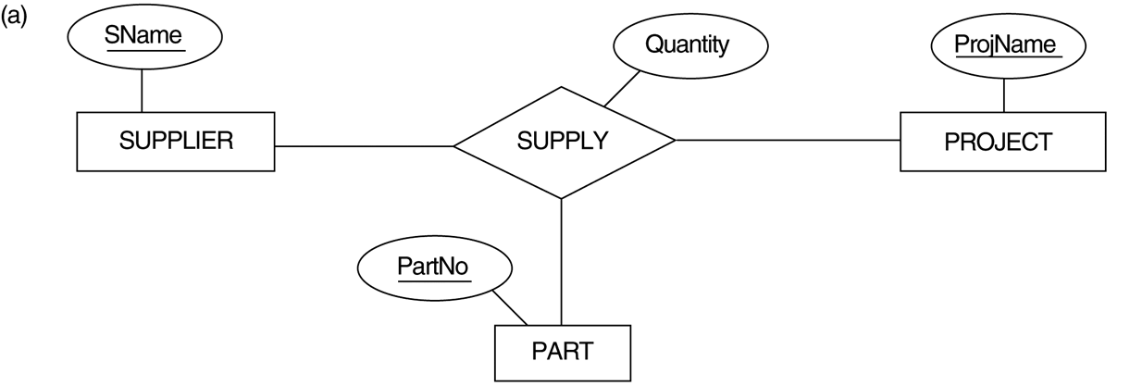
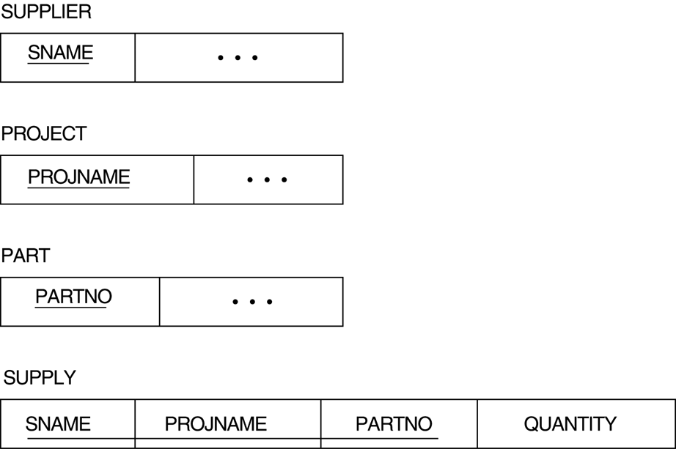
*

Slide 133
Summary of Mapping ER constructs and constraints
Table 7.1 Correspondence between ER and Relational Models
ER Model Relational Model
Entity type Relation
Weak Entity Relation and foreign key
1:1 relationship type Foreign key (or relation or merge)
1:N relationship type Foreign key
M:N relationship type Relation and two foreign keys
n-ary relationship type Relation and n foreign keys
Simple attribute Attribute
Composite attribute Set of simple attributes
Multivalued attribute Relation and foreign key
Key attribute Primary key
*

Slide 134
Step8: Options for Mapping Specialization or Generalization
Convert each specialization with m subclasses {S₁, S₂,….,S_{m}} and generalized superclass C, where the attributes of C are {k,a₁,…a_{n}} and k is the (primary) key, into relational schemas using one of the four following options:
Option 8A: Multiple relations -Superclass and subclasses.
Option 8B: Multiple relations - Subclass relations only
Option 8C: Single relation with one type attribute.
Option 8D: Single relation with multiple type attributes.
*

Slide 135
Option 8A: Multiple relations -Superclass and subclasses
Create a relation L for C with attributes Attrs(L) = {k,a1,…an} and PK(L) = k. Create a relation Li for each subclass Si, 1 < i < m, with the attributesAttrs(Li) = {k} U {attributes of Si} and PK(Li)=k.
This option works for any specialization (total or partial, disjoint or over-lapping)
d
*

Slide 136
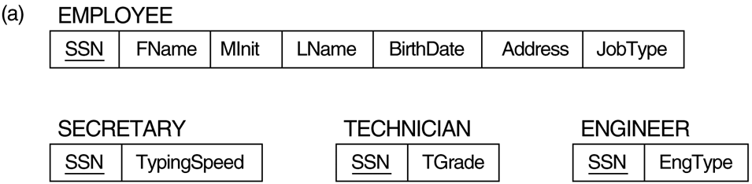
Option 8A: Multiple relations -Superclass and subclasses
*

Slide 137
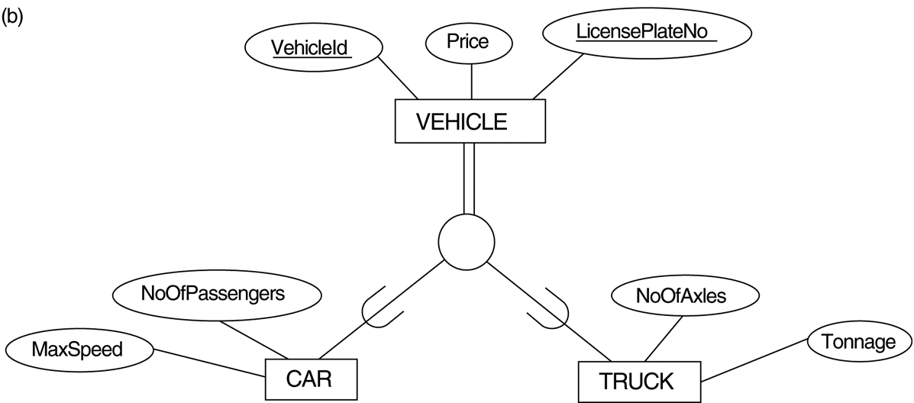
Option 8B: Multiple relations- Subclass relations only
Create a relation L_{i} for each subclass S_{i}, 1 < i < m, with the attributes Attr(L_{i}) = {attributes of S_{i}} U {k,a₁…,a_{n}} and PK(L_{i}) = k.
This option only works for a specialization whose subclasses are total (every entity in the superclass must belong to (at least) one of the subclasses).
d
*

Slide 138
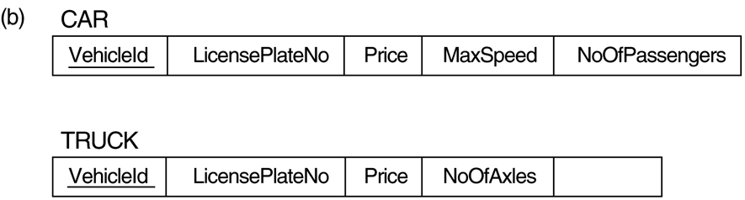
Option 8B: Multiple relations- Subclass relations only
Tonnage
*

Slide 139
Option 8C: Single relation with one type attribute
Create a single relation L with attributes Attrs(L) = {k,a₁,…a_{n}} U {attributes of S₁} U…U {attributes of S_{m}} U {t} and PK(L) = k.
This option only works for a specialization whose subclasses are disjoint
d
*

Slide 140
Option 8C: Single relation with one type attribute
EngType
The attribute JobType is called a type (or discriminating) attribute
that indicates the subclass to which each tuple belongs
*

Slide 141
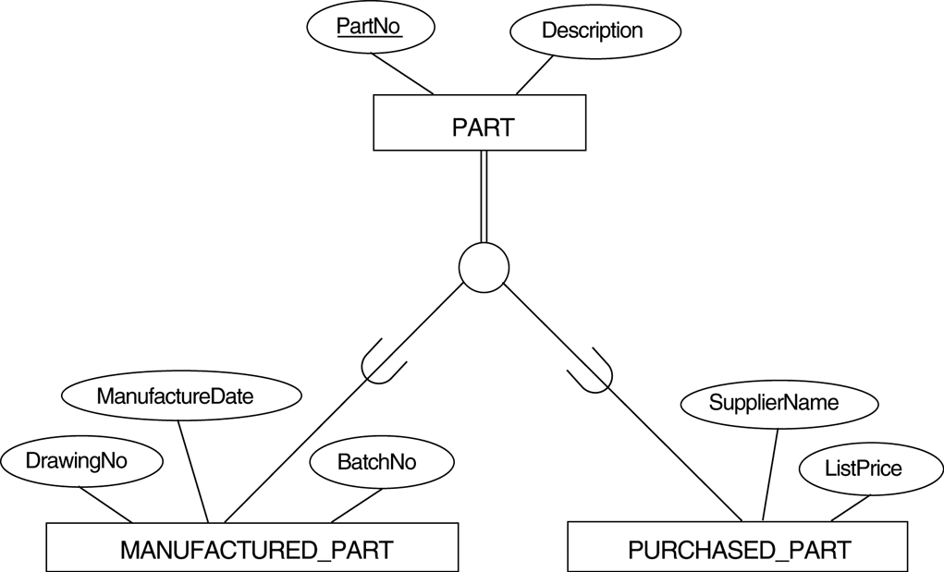
Option 8D: Single relation with multiple type attributes.
Create a single relation schema L with attributes Attrs(L) = {k,a₁,…a_{n}} U {attributes of S₁} U…U {attributes of S_{m}} U {t₁, t₂,…,t_{m}} and PK(L) = k.
This option only works for a specialization whose subclasses are overlapping (but will also work for a disjoint specialization)
O
*

Slide 142
Option 8D: Single relation with multiple type attributes.
MFlag and PFlag are Boolean type attributes indicating
whether a tuple belongs to the subclass
*

Slide 143
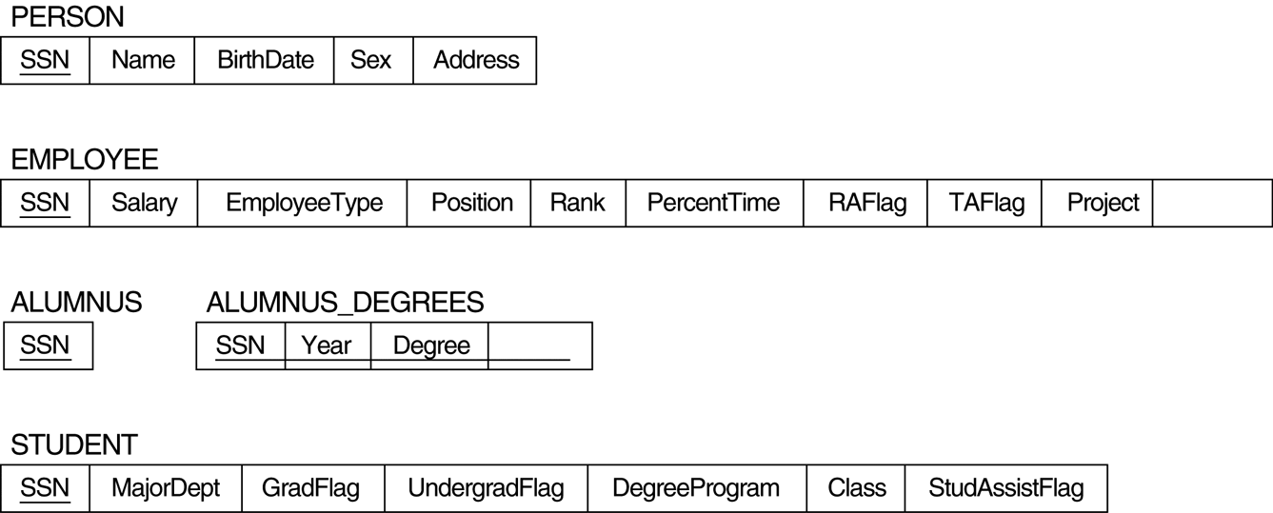
Mapping of Shared Subclasses (Multiple Inheritance)
A shared subclass, such as STUDENT_ASSISTANT, is a subclass of several classes, indicating multiple inheritance.
These classes must all have the same key attribute; otherwise, the shared subclass would be modeled as a category.
We can apply any of the options discussed in Step 8 to a shared subclass, subject to the restriction discussed in Step 8 of the mapping algorithm.
Course
Major
*

Slide 144
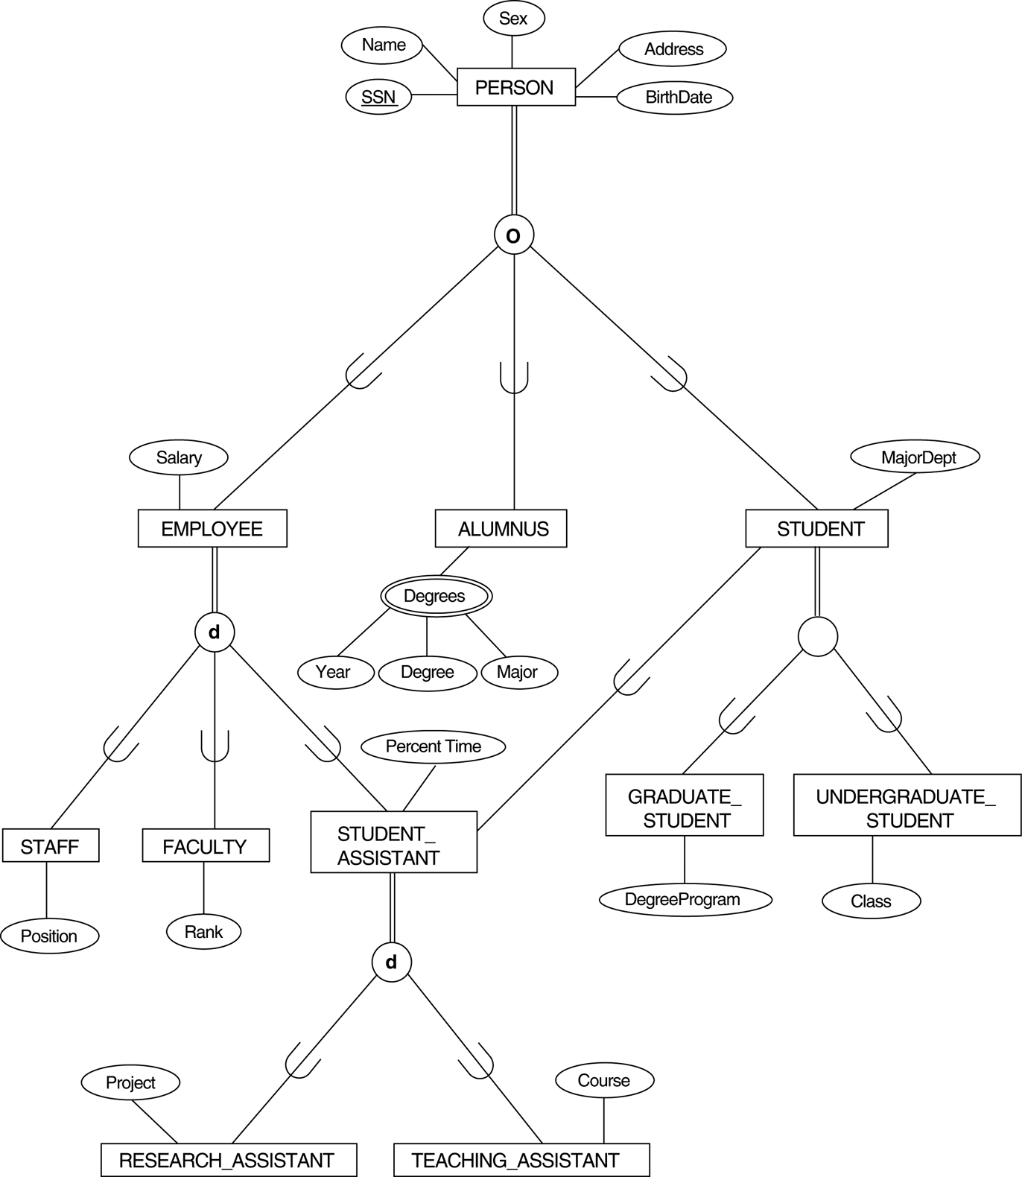
FIGURE 4.7 A specialization lattice with multiple inheritance for a UNIVERSITY database.
8A
8C
8D
d
8D
8D
*

Slide 145
Step 9: Mapping of Union Types (Categories)
For each entity type, create a relation.
For mapping a category whose defining superclasses have different keys, it is customary to specify a new key attribute, called a surrogate key, when creating a relation to correspond to the category.
For a category whose superclasses have the same key, there is no need for a surrogate key.
In the example below we can create a relation OWNER to correspond to the OWNER category and include any attributes of the category in this relation. The primary key of the OWNER relation is the surrogate key, which we called OwnerId.
*

Slide 146
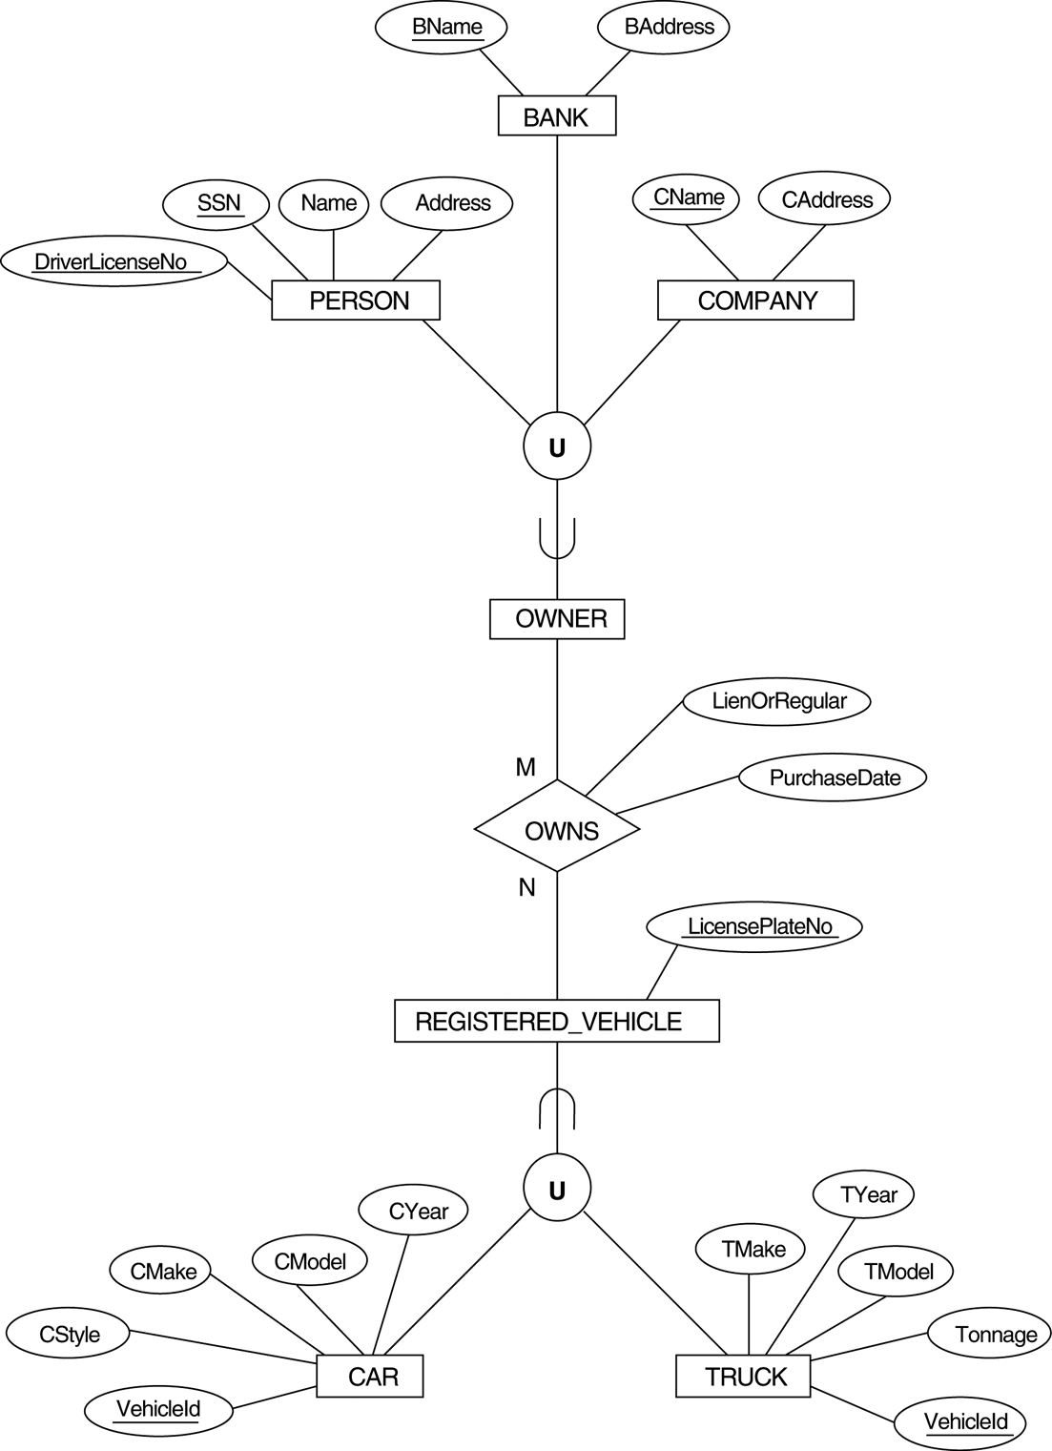
FIGURE 4.8 Two categories (union types): OWNER and REGISTERED_VEHICLE.
*

Slide 147
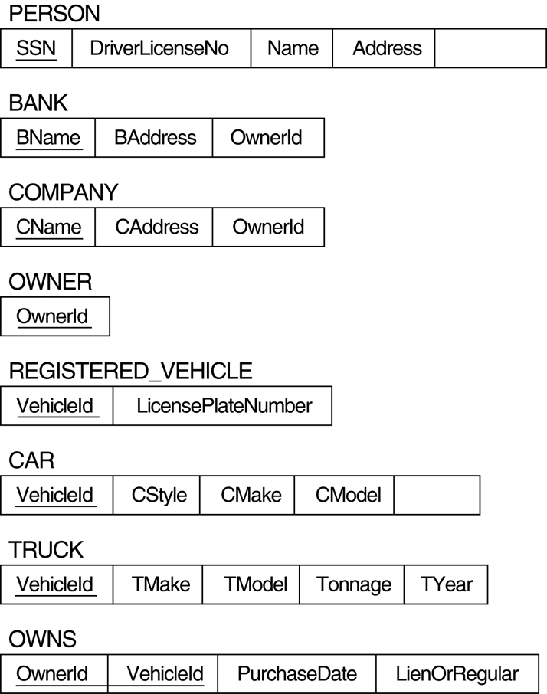
FIGURE 7.6 Mapping the EER categories (union types) in Figure 4.7 to relations.
OwnerId
CYear
*

Slide 148
Chapter 6
Formal relational languages: the algebra and calculus

Slide 149
Relational Algebra
a set of operations to manipulate and query relations for the relational model
Unary relational operations
SELECT：σ
PROJECT：π
Binary relational operations
UNION：∪
INTERSECTION：∩
MINUS：—
CARTESIAN PRODUCT：╳
JOIN：∞
DIVISION：÷
*

Slide 150
the COMPANY database
*

Slide 151
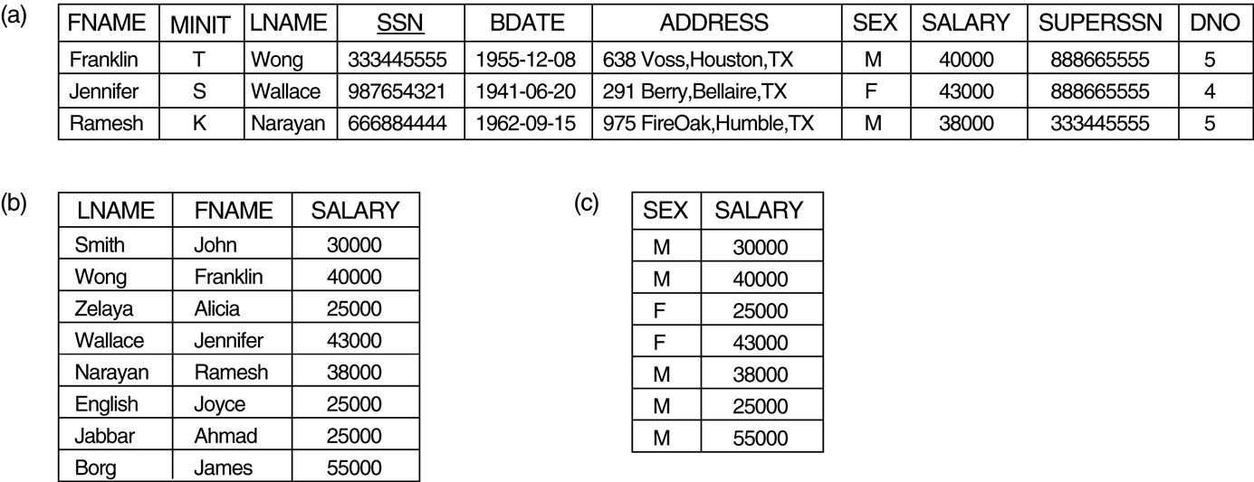
The SELECT Operation
to select a subset of the tuples (rows) in a relation
these tuples must satisfy a selection condition
σ_{(selection condition)}(R)
R: relation name
selection condition consists of attributes and =,>,<,≠,≧,≦,AND,OR,NOT
σ(DNO=4 AND SALARY>25000) OR (DNO=5 AND SALARY>30000)(EMPLOYEE)
the SELECT operation is commutative
σ_{(cond1)}( σ_{(cond2)}(R) ) = σ_{(cond2)}( σ_{(cond1)}(R) )
*

Slide 152
The PROJECT Operation
to select certain columns from the table and discards the other columns
any duplicate tuples will be removed
π_{(attribute list)}(R)
(b) π_{LNAME, FNAME, SALARY}(EMPLOYEE).
(c) π_{SEX, SALARY}(EMPLOYEE)
the PROJECT operation is not commutative
π _{(list1)}(π_{(list2)}(R) )
π _{(list2)}(π_{(list1)}(R) )
≠
*

Slide 153
Sequences of Operations
either write the operations as a single expression by nesting the operations
π_{FNAME, LNAME, SALARY} (σ_{DNO=5}(EMPLOYEE))
or apply one operation at a time and create intermediate result relations
DEP5_EMPS ← σ_{DNO=5}(EMPLOYEE)
RESULT ← π_{FNAME, LNAME, SALARY} (DEP5_EMPS)
*

Slide 154
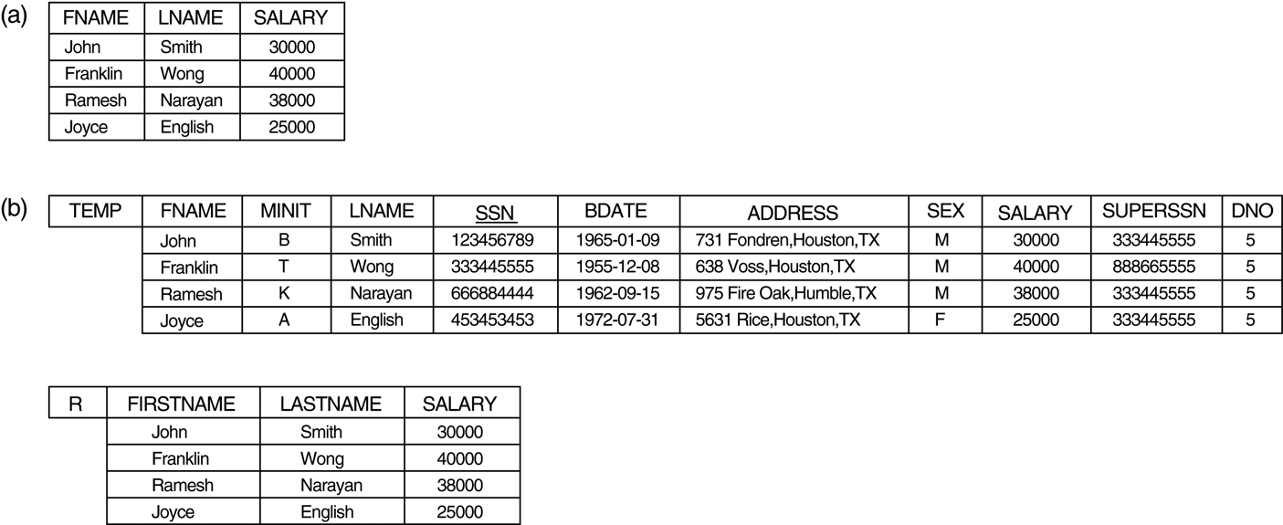
Renaming
rename the relation and attributes directly in the intermediate and result relations
TEMP ← σ_{DNO=5}(EMPLOYEE)
R(FIRSTNAME,LASTNAME,SALARY) ← π_{FNAME, LNAME, SALARY} (TEMP)
the RENAME operation (rename the relation, attributes, or both)
ρ _{S} (R) or ρ _{(B1,B2,…,Bn)} (R) or ρ _{S(B1,B2,…,Bn)} (R)
*

Slide 155
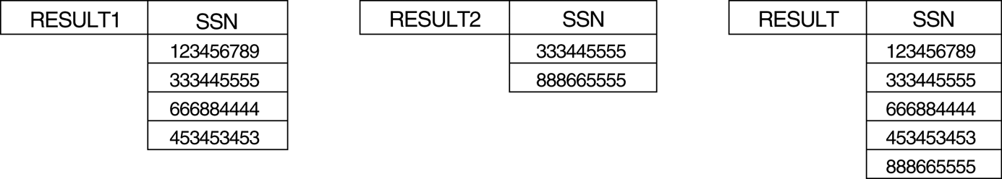
The UNION Operation
Example: to retrieve the SSN of all employees who either work in department 5 or directly supervise an employee who works in department 5
DEP5_EMPS ← σ_{DNO=5}(EMPLOYEE)
RESULT1 ← π_{SSN} (DEP5_EMPS)
RESULT2(SSN) ← π_{SUPERSSN} (DEP5_EMPS)
RESULT ← RESULT1 ∪ RESULT2
union compatibility
two relations must have the same number of attributes, and each corresponding pair of attributes has the same domain
attribute names can be different
*

Slide 156
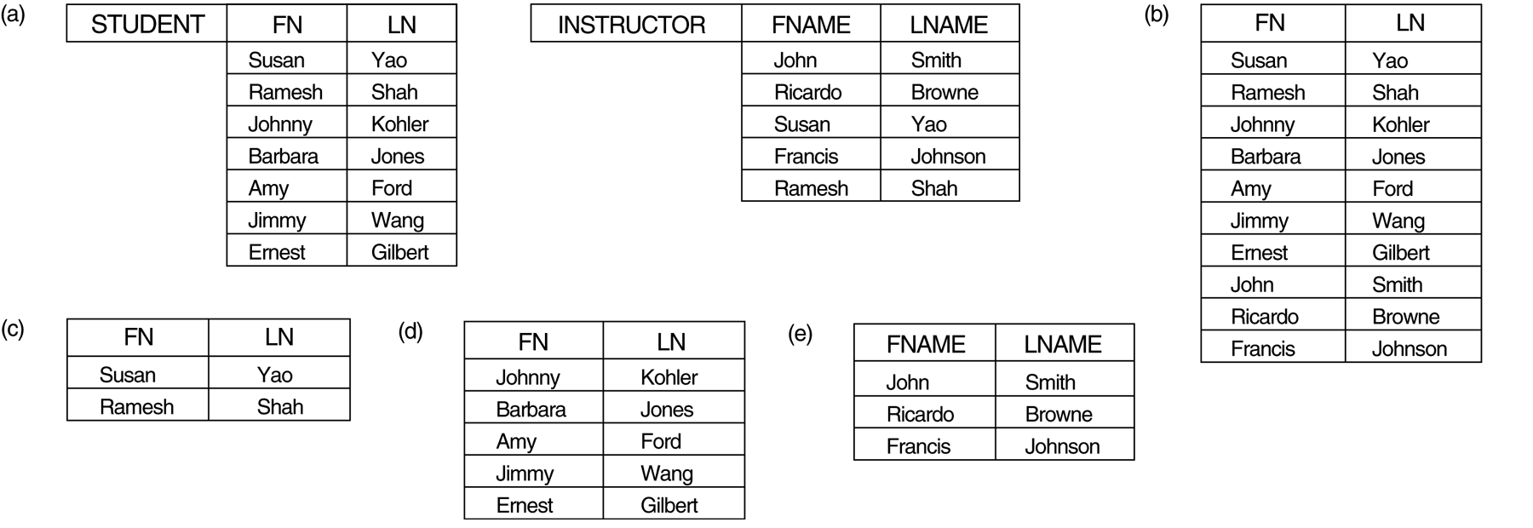
The INTERSACTION and MINUS Operations
(a) Two union-compatible relations.
(b) STUDENT ∪ INSTRUCTOR.
(c) STUDENT ∩ INSTRUCTOR.
(d) STUDENT – INSTRUCTOR.
(e) INSTRUCTOR – STUDENT
*

Slide 157
Set Properties
UNION, INTERSECTION, and MINUS should be union compatible
both UNION and INTERSECTION are commutative
R ∪ S = S ∪ R
R ∩ S = S ∩ R
both UNION and INTERSECTION are associative
R ∪ (S ∪ T) = (R ∪ S) ∪ T
R ∩ (S ∩ T) = (R ∩ S) ∩ T
the MINUS operation is neither commutative nor associative
R – S ≠ S – R
R – (S – T) ≠ (R – S) – T
*

Slide 158
CARTESIAN PRODUCT (or Cross Product)
to combine tuples from two relations R1 and R2
if R1 have n attribute and R2 have m attributes, then R1×R2 have n+m attributes
if R1 have a tuples and R2 have b tuples, then R1×R2 have a×b tuples
CARTESIAN PRODUCT do not have to be union compatible
R1
AA BB
R2
CC DD EE
R1×R2
AA BB CC DD EE
×
=
A1 B1 C1 D1 E1
A2 B2 C1 D1 E1
A3 B3 C1 D1 E1
A1 B1 C2 D2 E2
A2 B2 C2 D2 E2
A3 B3 C2 D2 E2
A1 B1
A2 B2
A3 B3
C1 D1 E1
C2 D2 E2
*

Slide 159
Example: to retrieve a list of names of each female employee’s dependents
intermediate result relations
FEMALE_EMPS ← σ _{SEX=‘F’}(EMPLOYEE)
EMP_NAMES ← π _{FNAME, LNAME, SSN} (FEMALE_EMPS)
EMP_DEPENDENTS ← EMP_NAMES × DEPENDENT
ACTUAL_DEPENDENTS ← σ _{SSN=ESSN} (EMP_DEPENDENTS)
RESULT ← π _{FNAME, LNAME, DEPENDENT_NAME} (ACTUAL_DEPENDENTS)
a single expression
π _{FNAME, LNAME, DEPENDENT_NAME} (σ _{SSN=ESSN} (
π _{FNAME, LNAME, SSN} (σ _{SEX=‘F’}(EMPLOYEE)) × DEPENDENT))
*

Slide 160
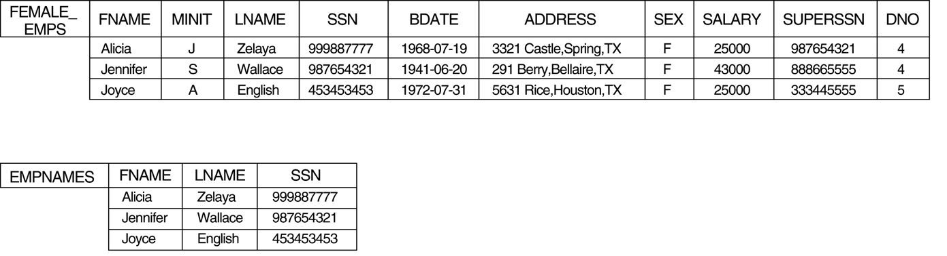
FEMALE_EMPS ← σ _{SEX=‘F’}(EMPLOYEE)
EMP_NAMES ← π _{FNAME, LNAME, SSN} (FEMALE_EMPS)
EMP_DEPENDENTS ← EMP_NAMES × DEPENDENT
*

Slide 161
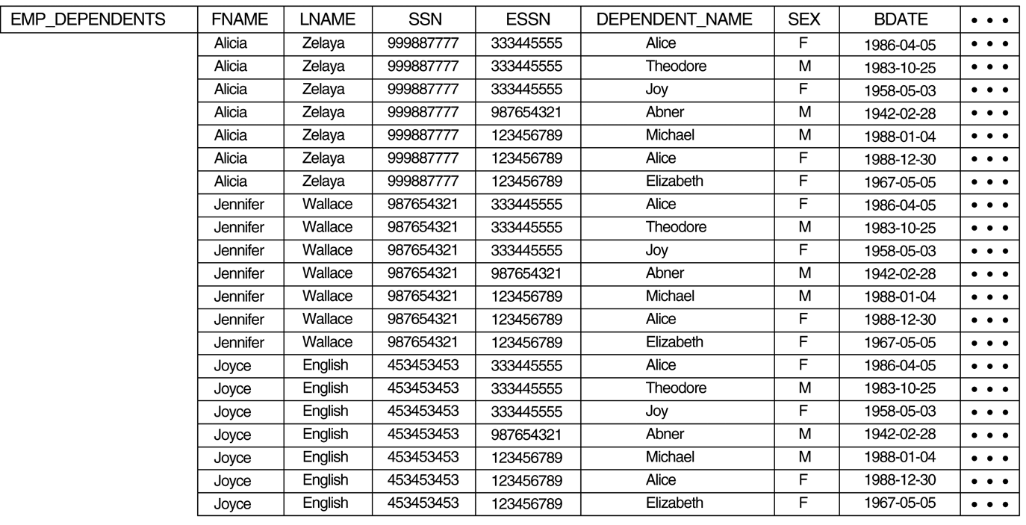
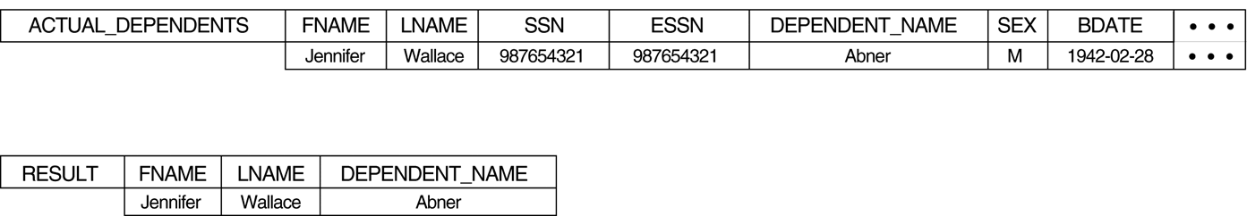
ACTUAL_DEPENDENTS ← σ _{SSN=ESSN} (EMP_DEPENDENTS)
RESULT ← π _{FNAME, LNAME, DEPENDENT_NAME} (ACTUAL_DEPENDENTS)
*

Slide 162
The JOIN Operation
to combine related tuples from two relations into single tuples
R ∞_{<join condition>} S
in terms of a CARTESIAN PRODUCT followed by a SELECT operation (i.e. join condition)
for example: two operations
EMP_DEPENDENTS ← EMP_NAMES × DEPENDENT
ACTUAL_DEPENDENTS ← σ _{SSN=ESSN} (EMP_DEPENDENTS)
can be replaced with a single JOIN operation
ACTUAL_DEPEDENTS ← EMP_NAMES ∞ _{SSN=ESSN} DEPENDENT
*

Slide 163
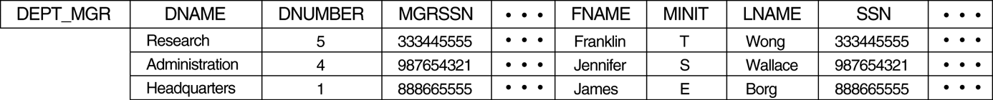
Example: to retrieve the name of the manager of each department
DEPT_MGR ← DEPARTMENT ∞_{MGRSSN=SSN} EMPLOYEE
RESULT ← π _{DNAME, LNAME, FNAME} (DEPT_MGR)
*

Slide 164
THETA JOIN, EQUIJOIN, and NATURAL JOIN
THETA JOIN (θ)
the comparison operator used in the join condition can be =,>,<,≠,≧,≦
EQUIJOIN
the only comparison operator used in the join condition is =
NATURAL JOIN
In EQUIJOIN, one pair of attributes have identical values. (one can be discarded)
R * S
get rid of the second superfluous attribute in EQUIJOIN
a pair of join attributes must have the same name (if not, apply RENAME operator first)
if two or more pairs of join attributes have the same name, the join conditions are AND together
specify the join condition explicitly can have different name
*

Slide 165
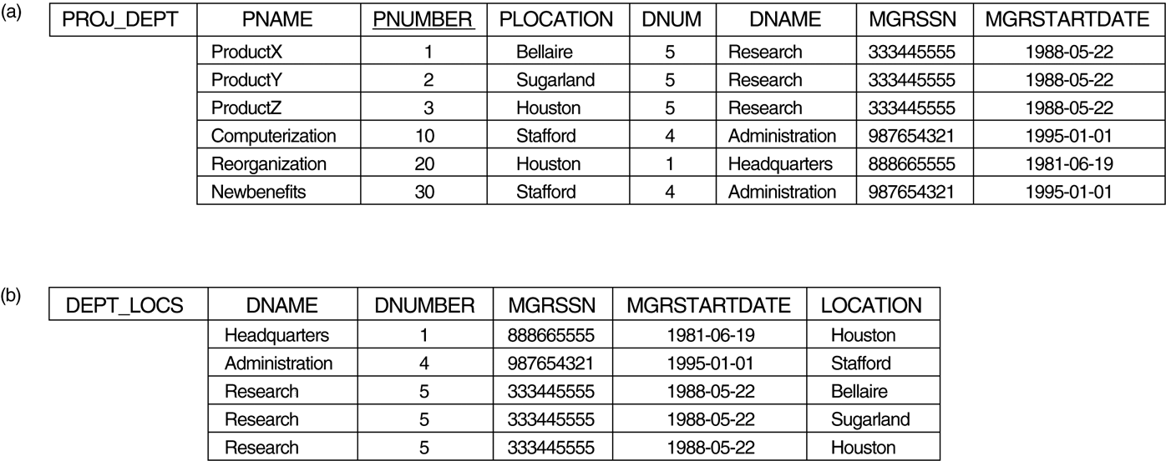
(a) PROJ_DEPT ← PROJECT * ρ (DNAME,DNUM,MGRSSN,MGRSTARTDATE) DEPARTMENT
or PROJ_DEPT ← PROJECT *_{(DNUM=DNUMBER)} DEPARTMENT
(b) DEPT_LOCS ← DEPARTMENT * DEPT_LOCATIONS
*

Slide 166
A Complete Set of Relational Algebra Operations
a complete set
{σ, π, ∪, －, ×}
any of other relational algebra operations can be expressed from this set
INTERSECTION by UNION and MINUS
R ∩ S = (R ∪ S) － ( (R － S) ∪ (S－R) )
JOIN by CARTESIAN PRODUCT and SELECT
R ∞_{<condition>} S = σ_{<condition>}( R × S )
DIVISION by PROJECT, CARTESIAN PRODUCT, and MINUS
*

Slide 167
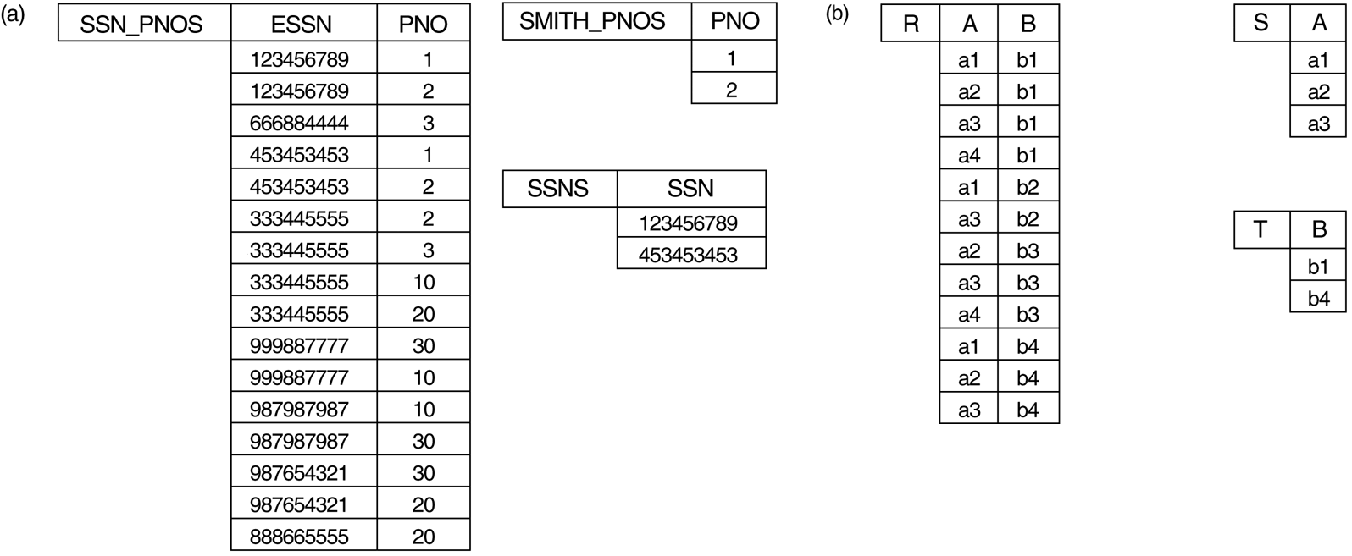
The DIVISION Operation
T ← R ÷ S
the attributes of R contains all the attributes of S
the attributes of T are (the attributes of R)－(the attributes of S)
(a) SSNS(SSN) ← SSN_PNOS ÷ SMITH_PNOS (b) T ← R ÷ S
*

Slide 168
Example: to retrieve the names of employees who work on all the projects that ‘John Smith’ works on
SMITH ← σ FNAME=‘John’ and LNAME=‘Smith’’(EMPLOYEE)
SMITH_PNOS ← π _{PNO} (WORKS_ON ∞ _{ESSN=SSN} SMITH)
SSN_PNOS ← π _{ESSN, PNO} (WORKS_ON)
SSNS(SSN) ← SSN_PNOS ÷ SMITH_PNOS
RESULT ← π _{FNAME, LNAME} (SSNS * EMPLOYEE)
DIVISION by π, × , and －
R(z) ÷ S(x) , where z are attributes of R and x are attributes of S
, let y be the attributes of R that are not attributes of S (i.e. y = z－x)
T1 ← π _{y} (R)
T2 ← π _{y} ( (S×T1)－R )
T ← T1－T2
*

Slide 169
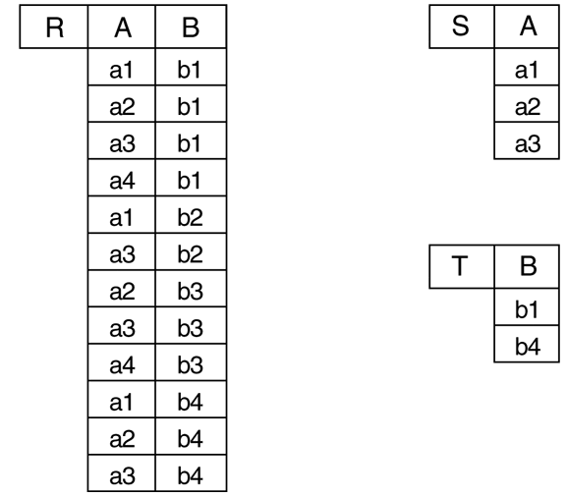
R(z) ÷ S(x)
T1 ← π _{y} (R)
T2 ← π _{y} ( (S×T1)－R )
T ← T1－T2
T1 B
b1
b2
b3
b4
SxT1 A B
a1 b1
a2 b1
a3 b1
a1 b2
a2 b2
a3 b2
a1 b3
a2 b3
a3 b3
a1 b4
a2 b4
a3 b4
SxT1-R A B
a1 b1
a2 b1
a3 b1
a1 b2
a2 b2
a3 b2
a1 b3
a2 b3
a3 b3
a1 b4
a2 b4
a3 b4
T2 B
b2
b3
T B
b1
b4
*

Slide 170
Additional Relational Operations
Aggregate Functions and Grouping
Recursive Closure Operations
OUTER JOIN Operations
The OUTER UNION Operation
*

Slide 171
Aggregate Functions and Grouping
to specify mathematical aggregation functions on collections of values from the database
SUM, AVERAGE, MAXIMUM, MINIMUM, COUNT
to group the tuples in a relation by the value of some of their attributes
_{<grouping attributes>} ℑ _{<function list>} (R)
Example: to retrieve each department number, the number of employees in a department, and their average salary
_{DNO} ℑ _{COUNT SSN, AVERAGE SALARY} (EMPLOYEE)
*

Slide 172
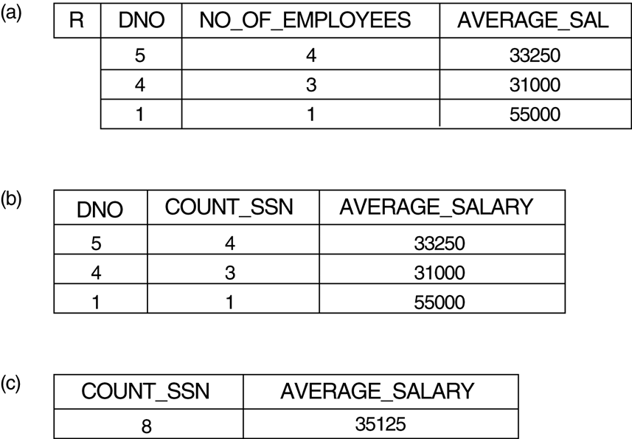
(a) ρR(DNO,NO_OF_EMPLOYEES, AVERAGE_SAL) (_{DNO} ℑ _{COUNT SSN, AVERAGE SALARY} (EMPLOYEE))
(b) _{DNO} ℑ _{COUNT SSN, AVERAGE SALARY} (EMPLOYEE)
(c) ℑ _{COUNT SSN, AVERAGE SALARY} (EMPLOYEE)
*

Slide 173
Recursive Closure Operations
apply to a recursive relationship between tuples of the same relation
e.g. the relationship between an employee and a supervisor
Example, to retrieve all supervisees of an employee ‘James Borg’ at all levels (that is, descendant)
BORG_SSN ← π _{SSN} (σ _{FNAME=‘JAMES’ AND LNAME=‘BORG’} (EMPLOYEE)
SUPERVISION(SSN1,SSN2) ← π _{SSN,SUPERSSN} (EMPLOYEE)
RESULT1(SSN) ← π _{SSN1} ( SUPERVISION ∞ _{SSN2=SSN} BORG_SSN)
RESULT2(SSN) ← π _{SSN1} ( SUPERVISION ∞ _{SSN2=SSN} RESULT1)
RESULT ← RESULT1 ∪ RESULT2
*

Slide 174
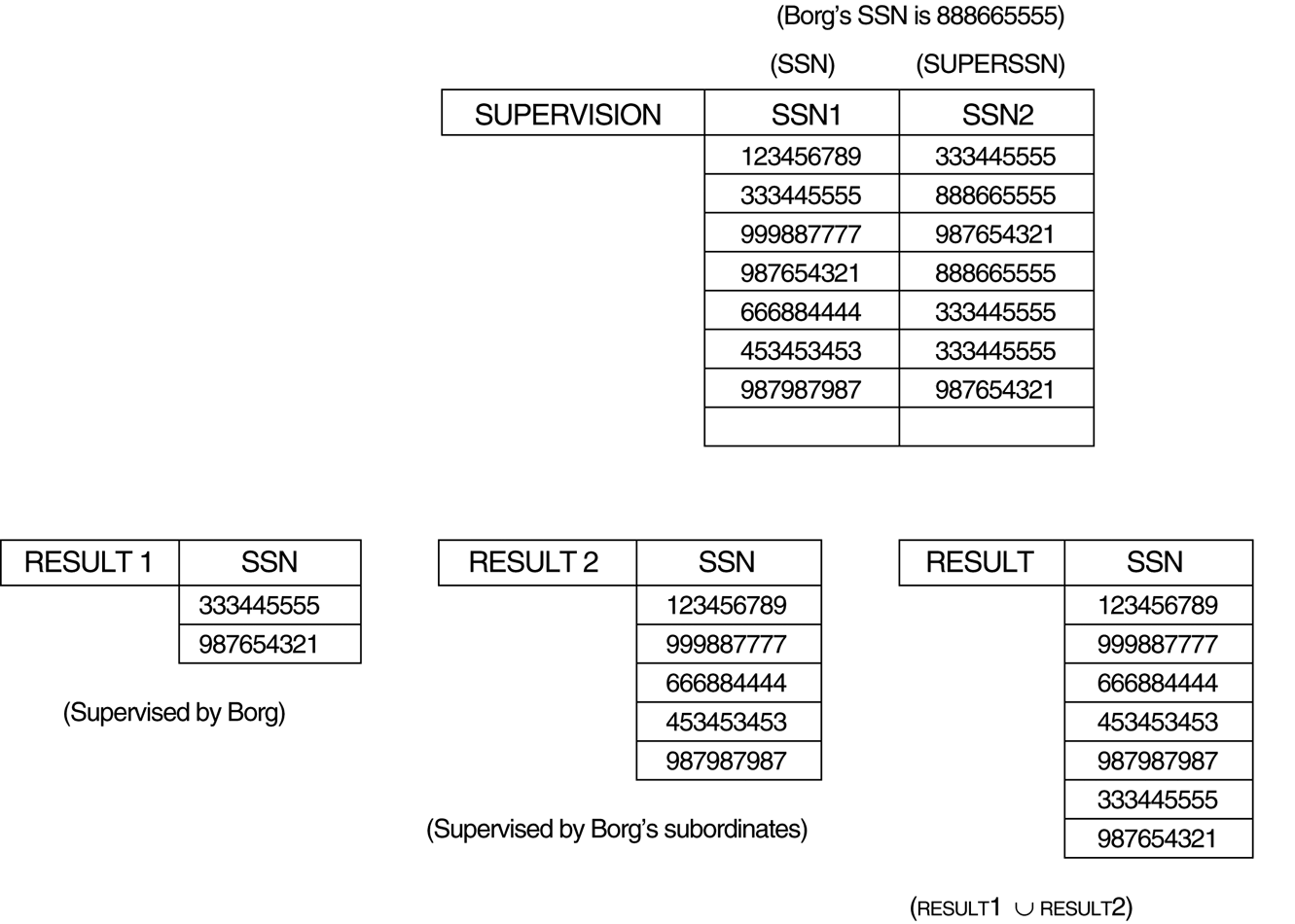
*

Slide 175
Examples of Queries in Relational Algebra
Q1: Retrieve the name and address of all employees who work for the ‘Research’ department
RESEARCH_DEPT ← σ _{DNAME=‘RESEARCH’’}(DEPARTMENT)
RESEARCH_EMPS ← (RESEARCH_DEPT ∞ _{DNUMBER=DNO} EMPLOYEE)
RESULT ← π _{FNAME, LNAME, ADDRESS} (RESEARCH_EMPS)
OR π _{FNAME, LNAME, ADDRESS} ( (σ _{DNAME=‘RESEARCH’’}(DEPARTMENT)) ∞ _{DNUMBER=DNO} EMPLOYEE)
Q2: For every project located in ‘Stafford’, list the project number, the controlling department number, and the department manager’s last name, address, and birth date.
STAFFORD_PROJS ← σ _{PLOCATION=‘STAFFORD’’}(PROJECT)
CONTR_DEPT ← (STAFFORD_PROJS ∞ _{DNUM=DNUMBER} DEPARTMENT)
PROJ_DEPT_MGR ← (CONTR_DEPT ∞ _{MGRSSN=SSN} EMPLOYEE)
RESULT ← π PNUMBER, DNUM, LNAME, ADDRESS, BDATE (PROJ_DEPT_MGR)
OR π PNUMBER, DNUM, LNAME, ADDRESS, BDATE ( ( (σ _{PLOCATION=‘STAFFORD’’}(PROJECT)) ∞ _{DNUM=DNUMBER} DEPARTMENT) ∞ _{MGRSSN=SSN} EMPLOYEE)
*

Slide 176
Q3: Find the names of employees who work on all the projects controlled by department number 5.
DEPT5_PROJS(PNO) ← π _{PNUMBER} (σ _{DNUM=5} (PROJECT))
EMP_PROJ(SSN,PNO) ← π _{ESSN, PNO} (WORKS_ON)
RESULT_EMP_SSN ← EMP_PROJ ÷ DEPT5_PROJS
RESULT ← π _{LNAME, FNAME} (RESULT_EMP_SSN * EMPLOYEE)
Q4: Make a list of project numbers for projects that involve an employee whose last name is ‘Smith’, either as a worker or as a manager of the department that controls the project
SMITHS(ESSN) ← π _{SSN} (σ _{LNAME=‘SMITH’} (EMPLOYEE))
SMITH_WORKER_PROJS ← π _{PNO} (WORKS_ON * SMITHS)
MGRS ← π _{LNAME, DNUMBER} (EMPLOYEE ∞ _{SSN=MGRSSN} DEPARTMENT)
SMITH_MANAGED_DEPTS(DNUM) ← π _{DNUMBER} (σ _{LNAME=‘SMITH’} (MGRS))
SMITH_MGR_PROJS ← π _{PNUMBER} (SMITH_MANAGED_DEPTS * PROJECT)
RESULT ← SMITH_WORKER_PROJS ∪ SMITH_MGR_PROJS
*

Slide 177
Q5: List the names of all employees with two or more dependents.
T1(SSN, NO_OF_DEPTS) ← _{ESSN} ℑ _{COUNT DEPENDENT_NAME} (DEPENDENT)
T2 ← σ _{NO_OF_DEPTS≧2} (T1)
RESULT ← π _{LNAME, FNAME} (T2 * EMPLOYEE)
Q6: Retrieve the names of employees who have no dependents
ALL_EMPS ← π _{SSN} (EMPLOYEE)
EMPS_WITH_DEPS(SSN) ← π _{ESSN} (DEPENDENT)
EMPS_WITHOUT_DEPS ← ALL_EMPS － EMPS_WITH_DEPS
RESULT ← π _{LNAME, FNAME} (EMPS_WITHOUT_DEPS * EMPLOYEE)
Q7: List the names of managers who have at least one dependent.
MGRS(SSN) ← π _{MGRSSN} (DEPARTMENT)
EMPS_WITH_DEPS(SSN) ← π _{ESSN} (DEPENDENT)
MGRS_WITH_DEPS ← MGRS ∩EMPS_WITH_DEPS
RESULT ← π _{LNAME, FNAME} (MGRS_WITH_DEPS * EMPLOYEE)
*

Slide 178
the COMPANY database
*

Slide 179
Relational Calculus
Both relational algebra and relational calculus are formal query languages for the relational model
relational algebra uses a procedural way of stating a query
a sequence of operations to specify a retrieval request
relational calculus uses a declarative (nonprocedural) way of stating a query
a calculus expression specifies what is to be retrieved rather than how to retrieve it
The expressive power of the two languages is identical
any retrieval that can be specified in the relational algebra can also be specified in the relational calculus and vice versa
relational complete
a query language can express any query that can be expressed in the relational algebra or the relational calculus
*

Slide 180
Relational Calculus
Tuple Relational Calculus
{ t | COND(t) }
to retrieve all tuples t that satisfy COND(t)
t is a tuple variable
COND(t) is a conditional expression
Example: to find all employees whose salary is above 50000
{t.FNAME, t.LNAME | EMPLOYEE(t) and t.SALARY>50000}
Domain Relational Calculus
use domain variables (one for each attribute of the relation)
{x₁,x₂,…,x_{n} | COND(x₁,x₂,…,x_{n},x_{n+1},x_{n+2},…,x_{n+m} )}
Example: to retrieve the birthdate and address of the employee whose name is ‘John B. Smith’
{uv | EMPLOYEE(qrstuvwxyz) and q=‘John’ and r=‘B.” and s=‘Smith’ }
*

Slide 181
Chapter 4
SQL: data definition, constraints, and basic queries and updates

Slide 182
SQL-99
SQL (Structured Query Language)
a standard query language for relational databases
SQL-86 (ANSI & ISO 1986) <SQL1>
SQL-92 <SQL2>
SQL-99 <SQL3>
both a DDL and a DML
statements for data definition, update, and query
a data sublanguage and a stand-alone query language
SQL statements can be embedded into a general-purpose programming language (host language)
*

Slide 183
Data Definition in SQL
The SQL commands for data definition
CREATE SCHEMA
create a database schema
CREATE TABLE
create a relation and specify the attributes
DROP SCHEMA
delete a database schema
DROP TABLE
delete a relation
ALTER TABLE
modify the attributes of a relation
*

Slide 184
CREATE SCHEMA
In SQL1, all relations are considered part of the same schema
After SQL2, the concept of SQL database schema is incorporated to group together tables and other constructs (constraints, views, domains, …)
SQL schema
schema name
authorization identifier (the user who owns the database)
CREATE SCHEMA COMPANY AUTHORIZATION JSMITH;
*

Slide 185
CREATE TABLE
Specifies a new relation by giving it a name, and specifying each of its attributes and their data types
INTEGER, FLOAT, CHAR(n) <fixed length>, VARCHAR(n) <varying length>
A constraint NOT NULL may be specified on an attribute
the primary key attributes should be NOT NULL
CREATE TABLE COMPANY.DEPARTMENT ( DNAME VARCHAR(10) NOT NULL, DNUMBER INTEGER NOT NULL, MGRSSN CHAR(9), MGRSTARTDATE CHAR(9) );
*

Slide 186
Keys in CREATE TABLE
After SQL2, we can use the CREATE TABLE command for specifying the primary key attributes, secondary keys, and referential integrity constraints (foreign keys).
Key attributes can be specified via the PRIMARY KEY and UNIQUE phrases
CREATE TABLE DEPARTMENT
( DNAME VARCHAR(10) NOT NULL, DNUMBER INTEGER NOT NULL, MGRSSN CHAR(9), MGRSTARTDATE CHAR(9), PRIMARY KEY (DNUMBER), UNIQUE (DNAME), FOREIGN KEY (MGRSSN) REFERENCES EMPOYEE(SSN) );
*

Slide 187
REFERENTIAL INTEGRITY OPTIONS
We can specify RESTRICT, CASCADE, SET NULL or SET DEFAULT on referential integrity constraints (foreign keys) CREATE TABLE DEPARTMENT ( DNAME VARCHAR(10) NOT NULL, DNUMBER INTEGER NOT NULL, MGRSSN CHAR(9) NOT NULL DEFAULT ‘888665555’, MGRSTARTDATE CHAR(9), PRIMARY KEY (DNUMBER), UNIQUE (DNAME), FOREIGN KEY (MGRSSN) REFERENCES EMPLOYEE(SSN)
ON DELETE SET DEFAULT ON UPDATE CASCADE
);
*

Slide 188
DROP SCHEMA and DROP TABLE
DROP SCHEMA
to remove a database schema
DROP SCHEMA COMPANY RESTRICT
if the schema has elements in it, the DROP command will not be executed
DROP SCHEMA COMPANY CASCADE
if the schema has elements in it, all elements are deleted
DROP TABLE
to remove a relation
DROP TABLE EMPLOYEE RESTRICT
if the table is referenced in any constraints, the DROP command will not be executed
DROP TABLE EMPLOYEE CASCADE
if the table is referenced, all constraints that reference the table are dropped automatically
*

Slide 189
ALTER TABLE
to change the definition of a base table
adding or dropping an attribute
changing an attribute definition
Example:
ALTER TABLE EMPLOYEE ADD JOB VARCHAR(12);
The new attribute will have NULLs in all the tuples of the relation; hence, the NOT NULL constraint is not allowed for such an attribute
ALTER TABLE EMPLOYEE ADD JOB VARCHAR(12) SET DEFAULT “Engineer”;
specifying a default clause
ALTER TABLE EMPLOYEE ALTER JOB VARCHAR(20) SET DEFAULT “Sales”;
changing an attribute definition
ALTER TABLE EMPLOYEE DROP ADDRESS CASCADE;
CASCADE or RESTRICT
*

Slide 190
SQL Statements
Distinction between SQL and the formal relational model
SQL allows a table (relation) to have two or more tuples that are identical in all their attribute values
Hence, an SQL relation (table) is a multi-set (sometimes called a bag) of tuples; it is not a set of tuples
SQL relations can be constrained to be sets by specifying PRIMARY KEY or UNIQUE attributes, or by using the DISTINCT option in a query
The SQL statements
USE <database schema>
SELECT <attribute list>
FROM <table list>
WHERE <condition>
GROUP BY <grouping attributes>
HAVING <condition after grouping>
ORDER BY <attributes>
*

Slide 191
Basic Queries in SQL
Basic form of the SQL SELECT statement is called a mapping or a SELECT-FROM-WHERE block
SELECT <attribute list>
FROM <table list>
WHERE <condition>
SELECT: using π (project) operation of the relational algebra
FROM: using × (cross product) operation of the relational algebra
WHERE: using σ (select) operation of the relational algebra
*

Slide 192
Relational Database Schema--Figure 5.5
*

Slide 193
Populated Database--Fig.5.6
*

Slide 194
Simple SQL Queries
Query 0: Retrieve the birthdate and address of the employee whose name is 'John B. Smith'.
SELECT BDATE, ADDRESS FROM EMPLOYEE WHERE FNAME='John' AND MINIT='B.’ AND
LNAME='Smith’
π _{BDATEADDRESS} (σ FNAME=‘John’’ and MINIT=“B.” and LNAME=“Smith” (EMPLOYEE))
However, the result of the query may contain duplicate tuples
*

Slide 195
Query 1: Retrieve the name and address of all employees who work for the 'Research' department.
SELECT FNAME, LNAME, ADDRESS FROM DEPARTMENT, EMPLOYEE WHERE DNAME='Research' AND DNUMBER=DNO
π _{FNAME, LNAME, ADDRESS} ( (σ _{DAME=‘RESEARCH’’} (DEPARTMENT)) ∞ _{DNUMBER=DNO} EMPLOYEE)
(DNAME='Research') is a selection condition (corresponds to a SELECT operation in relational algebra)
(DNUMBER=DNO) is a join condition (corresponds to a JOIN operation in relational algebra)
*

Slide 196
Query 2: For every project located in 'Stafford', list the project number, the controlling department number, and the department manager's last name, address, and birthdate.
SELECT PNUMBER, DNUM, LNAME, BDATE, ADDRESS FROM PROJECT, DEPARTMENT, EMPLOYEE WHERE DNUM=DNUMBER AND MGRSSN=SSN
AND PLOCATION='Stafford'
In Q2, there are two join conditions
The join condition DNUM=DNUMBER relates a project to its controlling department
The join condition MGRSSN=SSN relates the controlling department to the employee who manages that department
*

Slide 197
(table_name).(attribute_name)
In SQL, we can use the same name for two (or more) attributes as long as the attributes are in different relations
A query that refers to two or more attributes with the same name must qualify the attribute name with the relation name by prefixing the relation name to the attribute name
EMPLOYEE.LNAME, DEPARTMENT.DNAME
Q1:
SELECT EMPLOYEE. FNAME, EMPLOYEE.LNAME,
EMPLOYEE.ADDRESS FROM DEPARTMENT, EMPLOYEE WHERE DEPARTMENT.DNAME='Research' AND
DEPARTMENT.DNUMBER= EMPLOYEE. DNO
*

Slide 198
Aliases
Some queries need to refer to the same relation twice
In this case, aliases are given to the relation name
Query 8: For each employee, retrieve the employee's name, and the name of his or her immediate supervisor.
SELECT E.FNAME, E.LNAME, S.FNAME, S.LNAME FROM EMPLOYEE E S WHERE E.SUPERSSN=S.SSN
In Q8, the alternate relation names E and S are called aliases
We can think of E and S as two different copies of EMPLOYEE; E represents employees in role of supervisees and S represents employees in role of supervisors
We can also use the AS keyword to specify aliases
SELECT E.FNAME, E.LNAME, S.FNAME, S.LNAME FROM EMPLOYEE AS E, EMPLOYEE AS S WHERE E.SUPERSSN=S.SSN
*

Slide 199
Unspecified WHERE-clause
A missing WHERE-clause indicates no condition; hence, all tuples of the relations in the FROM-clause are selected
This is equivalent to the condition WHERE TRUE
Query 9: Retrieve the SSN values for all employees.
SELECT SSN FROM EMPLOYEE
If more than one relation is specified in the FROM-clause and there is no join condition, then the CARTESIAN PRODUCT of tuples is selected
Query10: SELECT SSN, DNAME FROM EMPLOYEE, DEPARTMENT
It is extremely important not to overlook specifying any selection and join conditions in the WHERE-clause; otherwise, incorrect and very large relations may result
*

Slide 200
USE OF *
To retrieve all the attribute values of the selected tuples, a * is used, which stands for all the attributes Examples:
Q1C: SELECT * FROM EMPLOYEE WHERE DNO=5 Q1D: SELECT * FROM EMPLOYEE, DEPARTMENT WHERE DNAME='Research' AND DNO=DNUMBER
*

Slide 201
USE OF DISTINCT
SQL does not treat a relation as a set; duplicate tuples can appear
To eliminate duplicate tuples in a query result, the keyword DISTINCT is used
For example, the result of Q11 may have duplicate SALARY values whereas Q11A does not have any duplicate values
Q11: SELECT SALARY FROM EMPLOYEE Q11A: SELECT DISTINCT SALARY FROM EMPLOYEE
*

Slide 202
SET OPERATIONS
SQL has directly incorporated some set operations
There is a union operation (UNION), and in some versions of SQL there are set difference (MINUS) and intersection (INTERSECT) operations
The resulting relations of these set operations are sets of tuples; duplicate tuples are eliminated from the result
The set operations apply only to union compatible relations ; the two relations must have the same attributes and the attributes must appear in the same order
*

Slide 203
UNION OPERATION
Query 4: Make a list of all project numbers for projects that involve an employee whose last name is 'Smith' as a worker or as a manager of the department that controls the project. Q4: (SELECT DISTINCT PNUMBER FROM PROJECT, DEPARTMENT, EMPLOYEE WHERE DNUM=DNUMBER AND MGRSSN=SSN AND LNAME='Smith') UNION
(SELECT DISTINCT PNUMBER FROM PROJECT, WORKS_ON, EMPLOYEE WHERE PNUMBER=PNO AND ESSN=SSN AND LNAME='Smith')
*

Slide 204
Substring Pattern Matching
using the LIKE comparison operator
% replaces an arbitrary number of zero or more characters
_ replaces a single character
Query 12: Retrieve all employees whose address is in Houston, Texas.
SELECT FNAME, LNAME FROM EMPLOYEE WHERE ADDRESS LIKE ‘%Houston, TX%’
Query 12A: Find all employees who were born during the 1950s.
SELECT FNAME, LNAME FROM EMPLOYEE WHERE BDATE LIKE ‘_ _5_ _ _ _ _ _ _’
*

Slide 205
ARITHMETIC OPERATIONS
The standard arithmetic operators '+', '-'. '*', and '/' can be applied to numeric values in an SQL query result
Query 13: Show the resulting salaries if every employee working on the 'ProductX' project is given a 10% raise. SELECT FNAME, LNAME, 1.1*SALARY AS INC_SAL FROM EMPLOYEE, WORKS_ON, PROJECT WHERE SSN=ESSN AND PNO=PNUMBER AND PNAME='ProductX’
*

Slide 206
Ordering of Query Results
The ORDER BY clause is used to sort the tuples in a query result based on the values of some attribute(s)
Query 15: Retrieve a list of employees and the projects they are working on, ordered by the employee's department, and within each department ordered alphabetically by last name and first name. SELECT DNAME, LNAME, FNAME, PNAME FROM DEPARTMENT, EMPLOYEE, WORKS_ON, PROJECT WHERE DNUMBER=DNO AND SSN=ESSN AND PNO=PNUMBER ORDER BY DNAME, LNAME, FNAME
*

Slide 207
ORDER BY
The default order is in ascending order of values
We can specify the keyword DESC if we want a descending order; the keyword ASC can be used to explicitly specify ascending order, even though it is the default
ORDER BY DNAME DESC, LNAME ASC, FNAME ASC
*

Slide 208
NESTING OF QUERIES
A complete SELECT query, called a nested query , can be specified within the WHERE-clause of another query, called the outer query
Query 1A: Retrieve the name and address of all employees who work for the 'Research' department.
SELECT FNAME, LNAME, ADDRESS FROM EMPLOYEE WHERE DNO IN (SELECT DNUMBER FROM DEPARTMENT WHERE DNAME='Research' )
The nested query selects the number of the 'Research' department
The outer query select an EMPLOYEE tuple if its DNO value is in the result of the nested query
The comparison operator IN compares a value v with a set (or multi-set) of values V, and evaluates to TRUE if v is one of the elements in V
In general, we can have several levels of nested queries
*

Slide 209
Query 4A: Make a list of all project numbers for projects that involve an employee whose last name is 'Smith' as a worker or as a manager of the department that controls the project. SELECT DISTINCT PNUMBER FROM PROJECT
WHERE PNUMBER IN (SELECT PNUMBER
FROM PROJECT, DEPARTMENT,
EMPLOYEE WHERE DNUM=DNUMBER AND
MGRSSN=SSN AND
LNAME='Smith') OR
PNUMBER IN (SELECT PNO
FROM WORKS_ON, EMPLOYEE WHERE ESSN=SSN AND
LNAME='Smith')
*

Slide 210
CORRELATED NESTED QUERIES
If a condition in the WHERE-clause of a nested query references an attribute of a relation declared in the outer query , the two queries are said to be correlated
Query 16: Retrieve the name of each employee who has a dependent with the same first name and same sex as the employee. SELECT E.FNAME, E.LNAME FROM EMPLOYEE AS E WHERE E.SSN IN (SELECT ESSN FROM DEPENDENT WHERE SEX=E.SEX AND E.FNAME=DEPENDENT_NAME)
the correlated nested query can be expressed as a single block query
Q16A: SELECT E.FNAME, E.LNAME FROM EMPLOYEE AS E, DEPENDENT AS D WHERE E.SSN=D.ESSN AND E.SEX=D.SEX AND E.FNAME=D.DEPENDENT_NAME
*

Slide 211
THE EXISTS FUNCTION
EXISTS is used to check whether the result of a correlated nested query is empty (contains no tuples) or not
Query 16: Retrieve the name of each employee who has a dependent with the same first name and same sex as the employee. Q16B: SELECT FNAME, LNAME FROM EMPLOYEE AS E WHERE EXISTS (SELECT * FROM DEPENDENT WHERE E.SSN=ESSN AND
E.SEX=SEX AND
E.FNAME=DEPENDENT_NAME)
*

Slide 212
THE NOT EXISTS FUNCTION
Query 6: Retrieve the names of employees who have no dependents. Q6: SELECT FNAME, LNAME FROM EMPLOYEE WHERE NOT EXISTS (SELECT * FROM DEPENDENT WHERE SSN=ESSN)
In Q6, the correlated nested query retrieves all DEPENDENT tuples related to an EMPLOYEE tuple. If none exist , the EMPLOYEE tuple is selected
*

Slide 213
Query 7: List the name of managers who have at least one dependent. SELECT FNAME, LNAME FROM EMPLOYEE WHERE EXISTS (SELECT * FROM DEPENDENT WHERE SSN=ESSN)
AND EXISTS (SELECT * FROM DEPARTMENT WHERE SSN=MGRSSN)
*

Slide 214
EXPLICIT SETS
It is also possible to use an explicit (enumerated) set of values in the WHERE-clause rather than a nested query
Query 17: Retrieve the social security numbers of all employees who work on project number 1, 2, or 3.
Q17: SELECT DISTINCT ESSN FROM WORKS_ON WHERE PNO IN (1, 2, 3)
*

Slide 215
NULLS IN SQL QUERIES
SQL allows queries that check if a value is NULL (missing or undefined or not applicable)
SQL uses IS or IS NOT to compare NULLs because it considers each NULL value distinct from other NULL values, so equality comparison is not appropriate .
Query 18: Retrieve the names of all employees who do not have supervisors. Q18: SELECT FNAME, LNAME FROM EMPLOYEE WHERE SUPERSSN IS NULL Note: If a join condition is specified, tuples with NULL values for the join attributes are not included in the result
*

Slide 216
Joined Relations
We can explicitly specify a "joined relation" in the FROM-clause
different types of joins (regular "theta" JOIN, NATURAL JOIN, etc)
Q1: SELECT FNAME, LNAME, ADDRESS FROM EMPLOYEE, DEPARTMENT WHERE DNAME='Research' AND DNUMBER=DNO
can be written as:
Q1A: SELECT FNAME, LNAME, ADDRESS FROM (EMPLOYEE JOIN DEPARTMENT ON DNUMBER=DNO) WHERE DNAME='Research’ or as: Q1B: SELECT FNAME, LNAME, ADDRESS FROM (EMPLOYEE NATURAL JOIN DEPARTMENT AS DEPT(DNAME, DNO, MSSN, MSDATE)) WHERE DNAME='Research’
use AS to rename DNUMBER as DNO for natural join
*

Slide 217
Multiple Joins
Q2: SELECT PNUMBER, DNUM, LNAME, BDATE, ADDRESS FROM PROJECT, DEPARTMENT, EMPLOYEE WHERE DNUM=DNUMBER AND MGRSSN=SSN
AND PLOCATION='Stafford'
can be written as:
Q2A: SELECT PNUMBER, DNUM, LNAME, BDATE, ADDRESS FROM (PROJECT JOIN DEPARTMENT ON DNUM=DNUMBER)
JOIN EMPLOYEE ON MGRSSN=SSN) ) WHERE PLOCATION='Stafford’
*

Slide 218
AGGREGATE FUNCTIONS
Include COUNT, SUM, MAX, MIN, and AVG
Query 19: Find the maximum salary, the minimum salary, and the average salary among all employees. Q19: SELECT MAX(SALARY), MIN(SALARY),
AVG(SALARY) FROM EMPLOYEE
Query 20: Find the maximum salary, the minimum salary, and the average salary among employees who work for the 'Research' department. Q20: SELECT MAX(SALARY), MIN(SALARY), AVG(SALARY) FROM EMPLOYEE, DEPARTMENT WHERE DNO=DNUMBER AND DNAME='Research'
*

Slide 219
COUNT
Queries 21 and 22: Retrieve the total number of employees in the company (Q21), and the number of employees in the 'Research' department (Q22). Q21: SELECT COUNT (*) FROM EMPLOYEE Q22: SELECT COUNT (*) FROM EMPLOYEE, DEPARTMENT WHERE DNO=DNUMBER AND DNAME='Research’
Query 23: Count the number of employees who have dependents.
Q23: SELECT COUNT (DISTINCT ESSN) FROM DEPENDENT
*

Slide 220
AGGREGATE FUNCTIONS WITH NESTED QUERIES
Query 5: Retrieve the names of all employees who have two or more dependents.
Q5A: SELECT LNAME, FNAME FROM EMPLOYEE WHERE ( SELECT COUNT(*)
FROM DEPENDENT
WHERE SSN=ESSN ) >= 2
Query: Retrieve the names of employees whose salaries are more than the average of all employees’ salaries.
SELECT LNAME, FNAME FROM EMPLOYEE WHERE SALARY > (SELECT AVG(SALARY)
FROM EMPLOYEE)
*

Slide 221
GROUPING
In many cases, we want to apply the aggregate functions to subgroups of tuples in a relation
Each subgroup of tuples consists of the set of tuples that have the same value for the grouping attribute(s)
The function is applied to each subgroup independently
SQL has a GROUP BY-clause for specifying the grouping attributes, which must also appear in the SELECT-clause
*

Slide 222
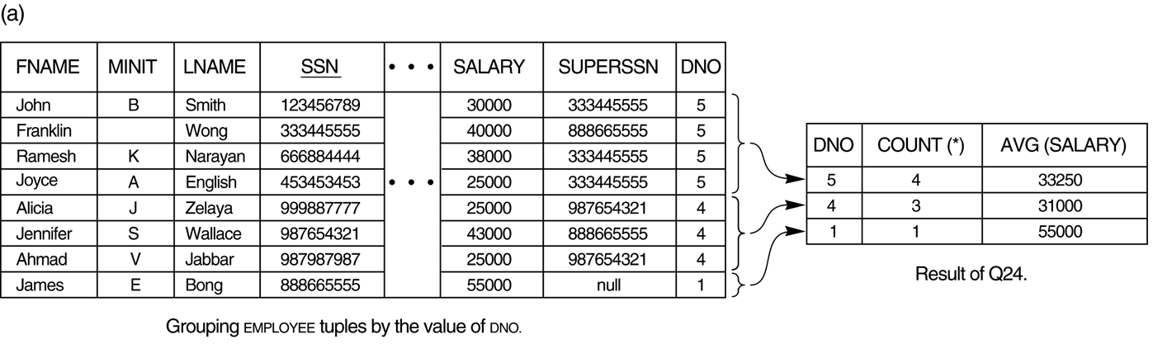
GROUP BY
Query 24: For each department, retrieve the department number, the number of employees in the department, and their average salary. Q24: SELECT DNO, COUNT (*), AVG (SALARY) FROM EMPLOYEE GROUP BY DNO
In Q24, the EMPLOYEE tuples are divided into groups--each group having the same value for the grouping attribute DNO
The COUNT and AVG functions are applied to each such group of tuples separately
The SELECT-clause includes only the grouping attribute and the functions to be applied on each group of tuples
*

Slide 223
GROUPING AFTER JOINING
Query 25: For each project, retrieve the project number, project name, and the number of employees who work on that project. Q25: SELECT PNUMBER, PNAME, COUNT (*) FROM PROJECT, WORKS_ON WHERE PNUMBER=PNO GROUP BY PNUMBER, PNAME
In this case, the grouping and functions are applied after the joining of the two relations
*

Slide 224
THE HAVING-CLAUSE
Sometimes we want to retrieve the values of these functions for only those groups that satisfy certain conditions
The HAVING-clause is used for specifying a selection condition on groups (rather than on individual tuples)
*

Slide 225
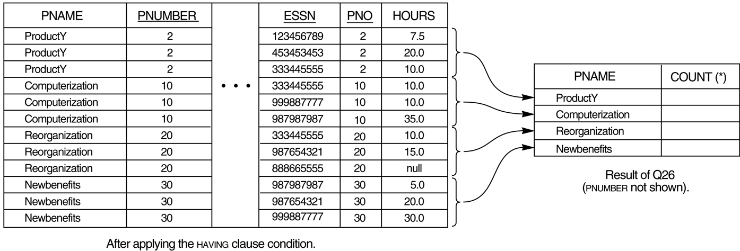
HAVING
Query 26: For each project on which more than two employees work , retrieve the project number, project name, and the number of employees who work on that project. Q26: SELECT PNUMBER, PNAME, COUNT(*) FROM PROJECT, WORKS_ON WHERE PNUMBER=PNO GROUP BY PNUMBER, PNAME HAVING COUNT (*) > 2
3
3
3
3
*

Slide 226
Query 28: For each department that has more than five employees, retrieve the department number and the number of its employees who are making more than $40,000.
incorrect: SELECT DNO, COUNT(*)
FROM EMPLOYEE
WHERE SALARY>40000
GROUP BY DNO
HAVING COUNT(*) > 5
Q28: SELECT DNO, COUNT(*)
FROM EMPLOYEE
WHERE SALARY>40000 AND
DNO IN ( SELECT DNO
FROM EMPLOYEE
GROUP BY DNO
HAVING COUNT(*) > 5 )
GROUP BY DNO
*

Slide 227
Summary of SQL Queries
A query in SQL can consist of up to six clauses, but only the first two, SELECT and FROM, are mandatory. The clauses are specified in the following order: SELECT <attribute list> FROM <table list> [WHERE <condition>] [GROUP BY <grouping attribute(s)>] [HAVING <group condition>] [ORDER BY <attribute list>]
*

Slide 228
Discussion of SQL Queries
A query is evaluated by first applying the WHERE-clause, then GROUP BY and HAVING, and finally the SELECT-clause
The SELECT-clause lists the attributes or functions to be retrieved
The FROM-clause specifies all relations (or aliases) needed in the query but not those needed in nested queries
The WHERE-clause specifies the conditions for selection and join of tuples from the relations specified in the FROM-clause
GROUP BY specifies grouping attributes
HAVING specifies a condition for selection of groups
ORDER BY specifies an order for displaying the result of a query
*

Slide 229
Database Updates in SQL
There are three SQL commands to modify the database
INSERT, DELETE, and UPDATE
the INSERT command
In its simplest form, it is used to add one or more tuples to a relation
Attribute values should be listed in the same order as the attributes were specified in the CREATE TABLE command
*

Slide 230
INSERT INTO
Example: Insert a tuple for a new EMPLOYEE.
U1: INSERT INTO EMPLOYEE VALUES ('Richard','K','Marini', '653298653', '30-DEC-52', '98 Oak Forest,Katy,TX', 'M', 37000,'987654321', 4 )
An alternate form of INSERT specifies explicitly the attribute names that correspond to the values in the new tuple
Attributes with NULL values can be left out
Example: Insert a tuple for a new EMPLOYEE for whom we only know the FNAME, LNAME, and SSN attributes. U1A: INSERT INTO EMPLOYEE (FNAME, LNAME, SSN) VALUES ('Richard', 'Marini', '653298653')
The constraints specified in the DDL commands are automatically enforced by the DBMS when updates are applied to the database
RESTRICT, NOT NULL etc.
*

Slide 231
INSERT (cont.)
Important Note: Only the constraints specified in the DDL commands are automatically enforced by the DBMS when updates are applied to the database
Another variation of INSERT allows insertion of multiple tuples resulting from a query into a relation
*

Slide 232
Insertion of Multiple Tuples Resulting from a Query into a Relation
Example: Suppose we want to create a temporary table that has the name, number of employees, and total salaries for each department.
A table DEPTS_INFO is created by U3A, and is loaded with the summary information retrieved from the database by the query in U3B.
U3A: CREATE TABLE DEPTS_INFO ( DEPT_NAME VARCHAR(10), NO_OF_EMPS INTEGER, TOTAL_SAL INTEGER); U3B: INSERT INTO DEPTS_INFO (DEPT_NAME, NO_OF_EMPS, TOTAL_SAL) SELECT DNAME, COUNT (*), SUM (SALARY) FROM DEPARTMENT, EMPLOYEE WHERE DNUMBER=DNO GROUP BY DNAME ;
The DEPTS_INFO table may not be up-to-date if we change the tuples in either the DEPARTMENT or the EMPLOYEE relations after issuing U3B. We have to create a view (see later) to keep such a table up to date.
*

Slide 233
The DELETE Command
Remove tuples from a relation
Includes a WHERE-clause to select the tuples to be deleted
Tuples are deleted from only one table at a time (unless CASCADE is specified on a referential integrity constraint)
A missing WHERE-clause specifies that all tuples in the relation are to be deleted; the table then becomes an empty table
The number of tuples deleted depends on the number of tuples in the relation that satisfy the WHERE-clause
Referential integrity should be enforced
*

Slide 234
DELETE FROM
Examples:
U4A: DELETE FROM EMPLOYEE WHERE LNAME='Brown’ U4B: DELETE FROM EMPLOYEE WHERE SSN='123456789’ U4C: DELETE FROM EMPLOYEE WHERE DNO IN ( SELECT DNUMBER FROM DEPARTMENT WHERE DNAME='Research') U4D: DELETE FROM EMPLOYEE
*

Slide 235
The UPDATE Command
Used to modify attribute values of one or more selected tuples
A WHERE-clause selects the tuples to be modified
An additional SET-clause specifies the attributes to be modified and their new values
Each command modifies tuples in the same relation
Referential integrity should be enforced
*

Slide 236
UPDATE
Example: Change the location and controlling department number of project number 10 to 'Bellaire' and 5, respectively.
U5: UPDATE PROJECT SET PLOCATION = 'Bellaire', DNUM = 5 WHERE PNUMBER=10
Example: Give all employees in the 'Research' department a 10% raise in salary.
U6: UPDATE EMPLOYEE SET SALARY = SALARY *1.1 WHERE DNO IN (SELECT DNUMBER FROM DEPARTMENT WHERE DNAME='Research')
The modified SALARY value depends on original SALARY value in each tuple
The reference to the SALARY attribute on the right of = refers to the old SALARY value before modification
The reference to the SALARY attribute on the left of = refers to the new SALARY value after modification
*

Slide 237
Chapter 5 SQL: advanced queries, triggers, and views
Notes:
*
*

Slide 238
Views in SQL
A view is a “virtual table” that is derived from other tables
some intermediate tables that are used frequently can be created as views
the result of a query may not be up-to-date if we change the tuples in base tables. We can create a view to keep the result up to date
the table may not physically be stored
Allows for limited update operations
Allows full query operations
*

Slide 239
Specification of Views
SQL command: CREATE VIEW
a view (virtual table) name
(a possible list of attribute names)
renaming, when arithmetic operations are specified or when we want the names to be different from the attributes in the base relations
a query to specify the table contents
*

Slide 240
SQL Views
1.CREATE VIEW WORKS_ON_1
AS SELECT FNAME, LNAME, PNAME, HOURS
FROM EMPLOYEE, PROJECT, WORKS_ON
WHERE SSN=ESSN AND PNO=PNUMBER
2.CREATE VIEW WORKS_ON_2(Proj_Name,Tot_Hours)
AS SELECT PNAME, SUM(HOURS)
FROM EMPLOYEE, PROJECT, WORKS_ON
WHERE SSN=ESSN AND PNO=PNUMBER
GROUP BY PNAME;
*

Slide 241
Using a Virtual Table
We can specify SQL queries from a newly create view
SELECT FNAME, LNAME
FROM WORKS_ON_1
WHERE PNAME=‘ProjectX’;
data in views are up-to-date
even the tuples in the base tables EMPLOYEE, PROJECT, WORKS_ON are changed
When no longer needed, a view can be dropped
DROP WORKS_ON_1;
*

Slide 242
Database Programming
Objective: to access a database from an application program
Embedding database commands
database commands are embedded in a general-purpose programming language
Using a library of database functions:
available to the host language for database calls e.g. connect to a database, execute a query, execute an update etc.
known as an API for accessing a database from application programs
Designing a brand-new language
a database programming language is designed from scratch to minimize impedance mismatch
*

Slide 243
Impedance Mismatch
Incompatibilities between a host programming language and the database model, e.g.,
data type mismatch
requires a new binding for each language
sets vs. record-at-a-time processing
need to loop over the tuples in a query result in order to access a single tuple at a time and to manipulate individual values
*

Slide 244
Typical Steps in Database Programming
Client program opens (establishes) a connection to the database server
Client program submits queries or updates to the database server
When database access is no longer needed, client program closes (terminates) the connection
*

Slide 245
Embedded SQL
Most SQL statements can be embedded in a general-purpose host programming language such as COBOL, C, Java
An embedded SQL statement is distinguished from the host language statements by EXEC SQL and a matching END-EXEC (or a semicolon;)
shared variables (used in both languages) usually prefixed with a colon (:) in SQL
*

Slide 246
Embedded SQL in C Programming Examples
loop = 1;
while (loop) {
prompt (“Enter SSN: “, ssn);
EXEC SQL
select FNAME, LNAME, ADDRESS, SALARY
into :fname, :lname, :address, :salary
from EMPLOYEE
where SSN == :ssn
END-EXEC
if (SQLCODE == 0) printf(fname, …);
else printf(“SSN does not exist: “, ssn);
prompt(“More SSN? (1=yes, 0=no): “, loop);
}
*

Slide 247
Embedded SQL in Java
SQLJ: a standard for embedding SQL in Java
An SQLJ translator converts SQL statements into Java, which can then be executed through the JDBC interface
several classes libraries have to be imported
java.sql.*
java.io.*
sqlj.runtime.*
sqlj.runtime.ref.*
……….
*

Slide 248
Java Database Connectivity
JDBC: SQL connection function calls for Java programming
A Java program with JDBC functions can access any relational DBMS that has a JDBC driver
JDBC allows a program to connect to several databases (known as data sources)
*

Slide 249
Embedded SQL in Java: An Example
ssn = readEntry(“Enter a SSN: “);
try {
#sql{select FNAME, LNAME, ADDRESS, SALARY
into :fname, :lname, :address, :salary
from EMPLOYEE
where SSN = :ssn};
}
catch (SQLException se) {
System.out.println(“SSN does not exist: “,+ssn);
return;
}
System.out.println(fname+“ “+lname+… );
*

Slide 250
Chapter 14 Database design theory: Introduction to normalization using functional and multivalued dependencies
Notes:
*
*

Slide 251
Relational Database Design
The grouping of attributes to form "good" relation schemas
Two levels we can discuss “goodness” of relation schemas
The logical (conceptual "user view“) level
how the users interpret the relation schemas and the meaning of their attributes
good relation schemas enables users to understand clearly the meaning of the data in the relations, and hence to formulate their queries correctly
The implementation (storage "base relation“) level
how the tuples in a base relation are stored and updated
design is concerned mainly with base relations
Database design approach
bottom-up (design by synthesis)
consider the basic relationships among individual attributes and use those to construct relation schemas
top-down (design by analysis)
relations are analyzed, leading to further decomposition until all attributes are met
*

Slide 252
Informal Design Guidelines for Relational Databases
four informal measure of quality for relational schema design
semantics of the attributes
the easier it is to explain the semantics (meaning) of the relation, the better the relation schema design
reducing the redundant values in tuples
minimize the storage space that the base relations occupy
reducing the null values in tuples
wasteful of space
problems when join
disallowing the possibility of generating spurious tuples
spurious tuples represent wrong information that is not valid
*

Slide 253
Semantics of the Relation Attributes
Semantics
the meaning specifies how we can interpret the attribute values stored in a tuple of the relation
should be unambiguous and easy to explain
Guideline 1: A relation schema corresponds to one entity type or one relationship type.
each tuple in a relation represents one entity instance or relationship instance, and hence semantically clear
attributes of different entities (EMPLOYEEs, DEPARTMENTs, PROJECTs) should not be mixed in the same relation
only foreign keys should be used to refer to other entities
entity and relationship attributes should be kept apart as much as possible.
*

Slide 254
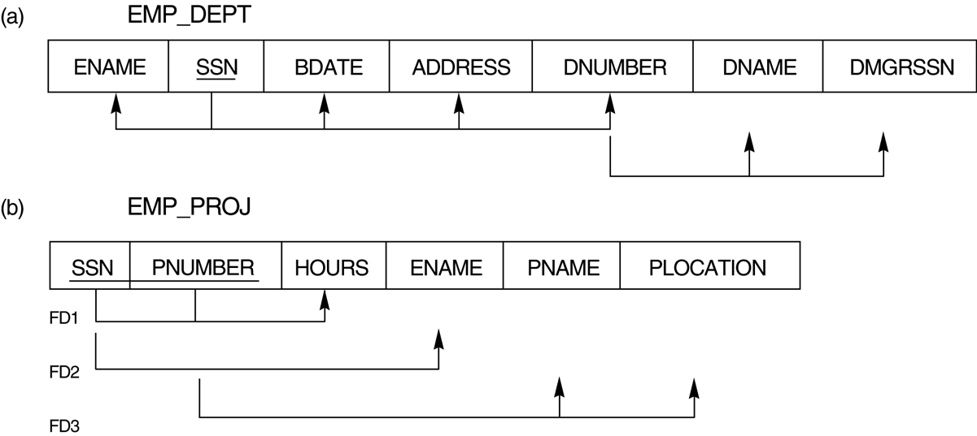
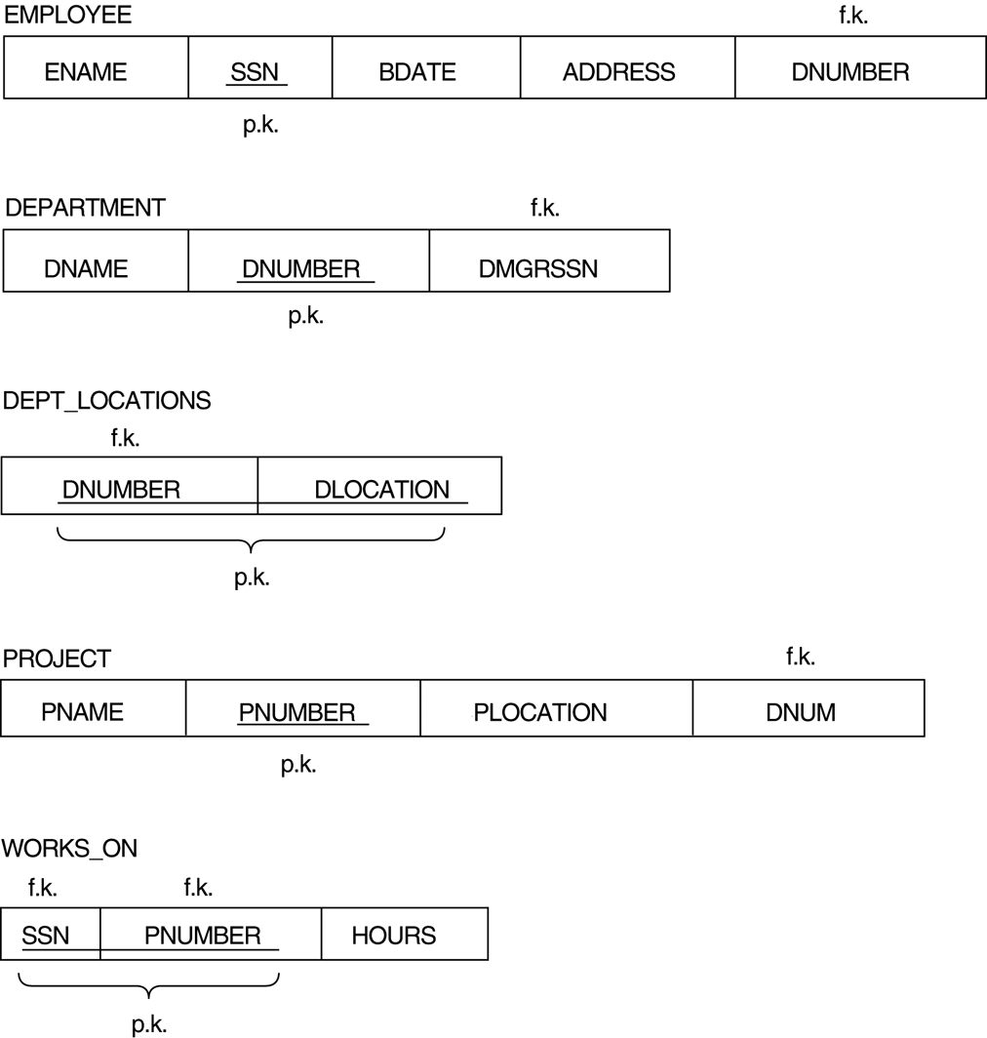
violate Guideline 1
satisfy Guideline 1
*

Slide 255
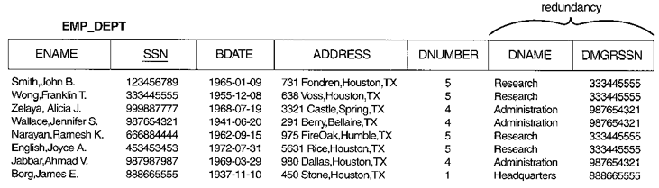
Redundant Information in Tuples
Mixing attributes of multiple entities may cause problems
e.g. (DNUMBER, DNAME, DMGRSSN) are repeated
information is stored redundantly wasting storage
problems with update anomalies
Insertion anomalies
Deletion anomalies
Modification anomalies
*

Slide 256
Insertion Anomalies
The new input tuple may be inconsistent with existing information
DNUMBER, DNAME, and DMGRSSN may be inconsistent
It is difficult to insert a new department that has no employees as yet
the information of Accounting Department can not be inserted, since no employee in that department
*

Slide 257
Deletion Anomalies
lost information
the last employee working for the Headquarters Department is deleted, the information concerning that department is lost
*

Slide 258
Modification Anomalies
change the values of tuples may cause the inconsistency problem
DNUMBER, DNAME, and DMGRSSN may be inconsistent
*

Slide 259
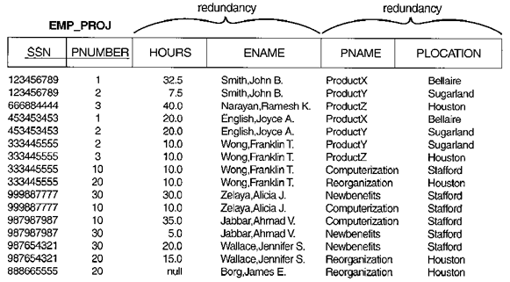
Another relation schemas suffering from update anomalies
*

Slide 260
Guideline to Redundant Information in Tuples and Update Anomalies
Guideline 2: Design the relation schemas so that no insertion, deletion, or modification anomalies are present. If any anomalies are present, note them clearly and make sure that the application programs will operate correctly
These guidelines may sometimes have to be violated in order to improve the performance of certain queries
*

Slide 261
Null Values in Tuples
Reasons for nulls
attribute not applicable to this tuple or invalid
attribute value unknown (may exist)
value known but absent (has not been recorded yet)
problems
wasteful of space at the storage level
misunderstanding the meaning of the attributes
can not apply JOIN operation
Guideline 3: As far as possible, avoid placing attributes in a base relation whose values may frequently be null. If nulls are unavoidable, make sure that they apply in exceptional cases only, and do not apply to a majority of tuples in the relation.
Attributes that are NULL frequently could be placed in another separate relations (plus the primary key)
e.g. only 10% of employees have individual offices, a relation EMP_OFFICE(SSN,OFFICE_NUMBER) can be created
*

Slide 262
Spurious Tuples
Bad designs for a relational database may result in erroneous results for certain JOIN operations
cannot recover the information that was in original relations
additional tuples that were not in original relations are called spurious tuples (wrong information)
Guideline 4: Design relation schemas so that they can be joined with equality conditions on attributes that are primary keys and foreign keys in a way that guarantees that no spurious tuples are generated
avoid joining attributes that are not (foreign key,primary key) combinations
*

Slide 263
An Example of Generating Spurious Tuples
Fig. 10.4
*

Slide 264
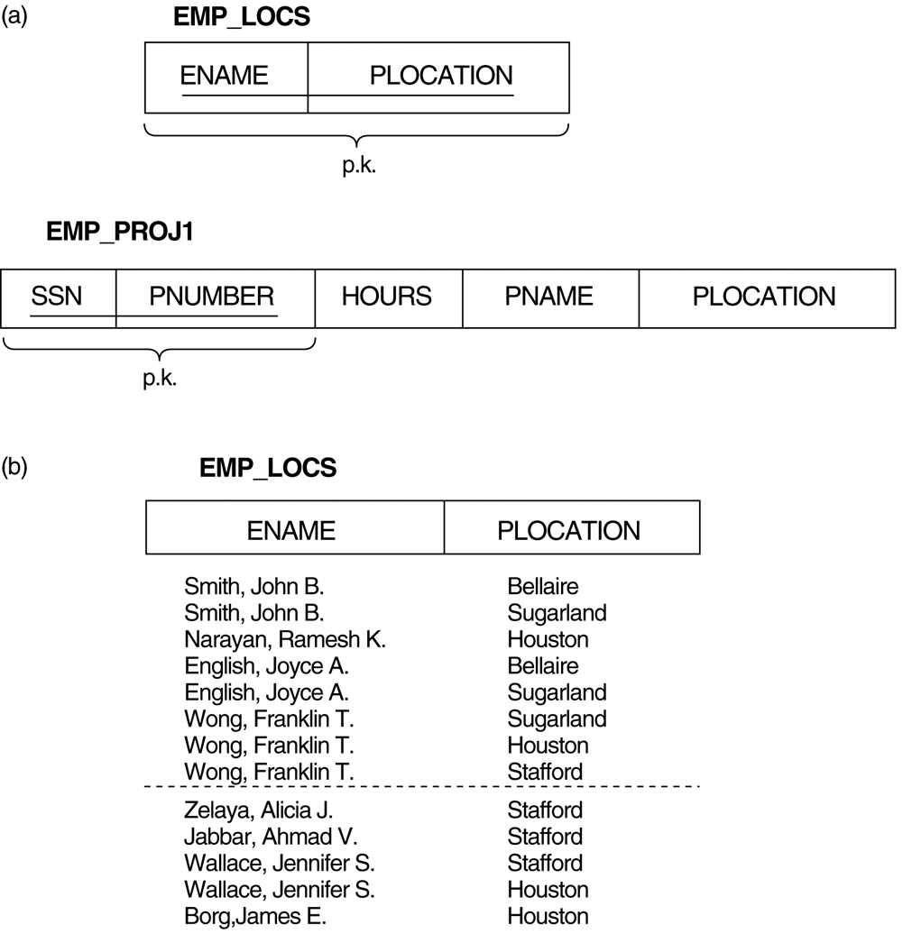
Breaking up EMP_PROJ relation (Fig10.4) into EMP_LOCS and EMP_PROJ1 relations (a) The two relation schemas EMP_LOCS and EMP_PROJ1 (b) The result of projecting EMP_PROJ onto EMP_LOCS
*

Slide 265
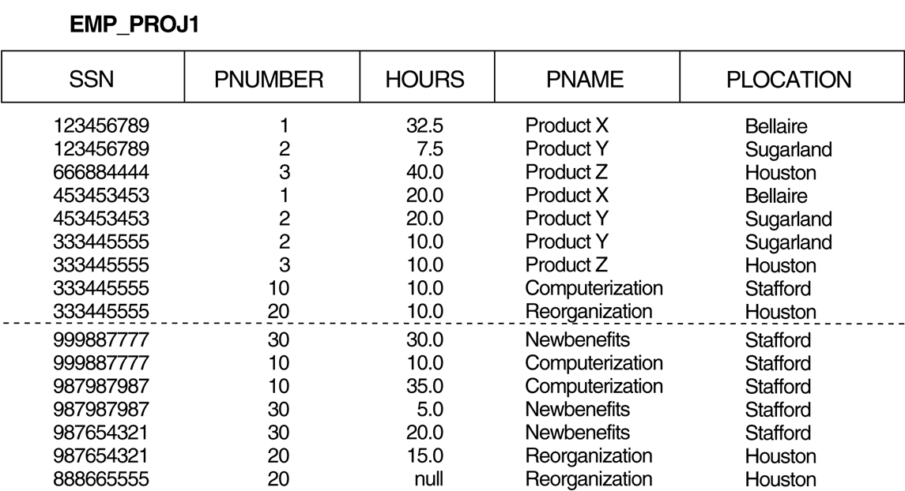
The result of projecting EMP_PROJ onto EMP_PROJ1
*

Slide 266
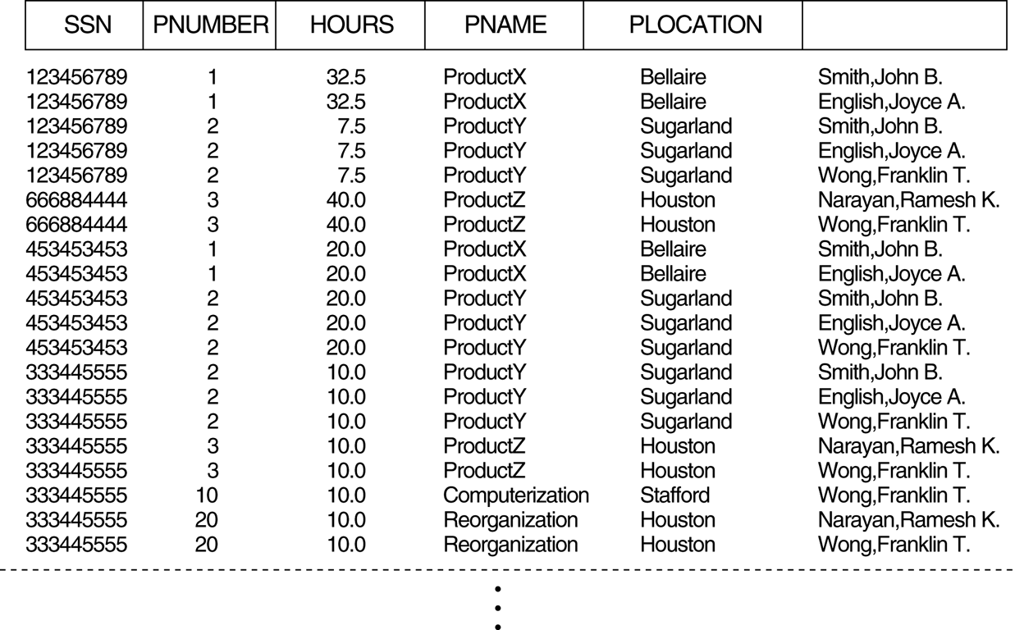
Result of applying NATURAL JOIN (on PLOCATION) to the tuples in EMP_PROJ1 and EMP_LOCS
ENAME
*
*
*
*
*
*
*
*
*
*
*
Generated spurious tuples are marked by (*).
*

Slide 267
Functional Dependencies
A functional dependency (FD) is a constraint between two sets of attributes from the database
denoted by X → Y , where X and Y are two sets of attributes
for any two tuples t1 and t2, If t1[X]=t2[X], then t1[Y]=t2[Y]
whenever two tuples have the same value for X, they must have the same value for Y
a set of attributes X functionally determines a set of attributes Y, if the value of X determines a unique value for Y
Functional dependencies are used to specify formal measures of the "goodness" of relational designs
FDs and keys are used to define normal forms for relations
*

Slide 268
Examples of Functional Dependencies
If K is a key of R, then K functionally determines all attributes in R (since we never have two distinct tuples with t1[K]=t2[K])
social security number determines employee name
SSN → ENAME
project number determines project name and location
PNUMBER → {PNAME, PLOCATION}
employee ssn and project number determines the hours per week that the employee works on the project
{SSN, PNUMBER} → HOURS
*

Slide 269
Inference for Functional Dependencies
A FD can be inferred from a set of FDs
SSN → {ENAME, BDATE, ADDRESS, DNUMBER}
DNUMBER → {DNAME, DMGRSSN}
We can infer SSN → {DNAME, DMGRSSN}
The set of all dependencies that include F (a set of FDs) and dependencies inferred from F is called the closure of F, denoted by F⁺
F |= X→Y denotes that X→Y is inferred from F
*

Slide 270
Inference Rules for Functional Dependencies
IR1. (Reflexive) If X ⊇ Y, then X → Y
IR2. (Augmentation) If X → Y, then XZ → YZ
IR3. (Transitive) If X → Y and Y → Z, then X → Z
IR4. (Decomposition) If X → YZ, then X → Y and X → Z
IR5. (Union) If X → Y and X → Z, then X → YZ
IR6. (PsuedoTransitivity) If X → Y and WY → Z, then WX → Z
IR1, IR2, IR3 form a sound and complete set of inference rules (called Armstrong’s inference rules)
The last three inference rules, as well as any other inference rules, can be deduced from IR1, IR2, and IR3 (completeness property)
*

Slide 271
Closure of X under F (Denoted by X⁺)
Closure of F (a set of FDs) is the set F⁺ of all FDs that can be inferred from F
Closure of X (a set of attributes) under F is the set X ⁺ of all attributes that are functionally determined by X
X ⁺ can be calculated by repeatedly applying IR1, IR2, IR3 using the FDs in F
ex. F={ SSN→ENAME,
PNUMBER→{PNAME, PLOCATION},
{SSN, PNUMBER}→HOURS }
{SSN}⁺ = {SSN, ENAME}
{PNUMBER}⁺ = {PNUMBER, PNAME, PLOCATION}
{SSN, PNUMBER}⁺ = {SSN, ENAME, PNUMBER, PNAME,
PLOCATION, HOURS}
*

Slide 272
Equivalence of Two Sets of FDs
F covers E (or E is covered by F), E and F are two sets of FDs,
every dependency in E can be inferred from F (every dependency in E is also in F⁺, E⁺ ⊆ F⁺)
E and F are equivalent if E covers F and F covers E
E⁺ ⊆ F⁺ and E⁺ ⊇ F⁺
E⁺ = F⁺
every FD in E can be inferred from F, and every FD in F can be inferred from E
*

Slide 273
Normalization of Relation Schemas
Normalization
breaking up the attributes of unsatisfactory relation schemas into smaller relation schemas that satisfy normal forms
to ensure relation schemas have a “good” design by disallowing the update anomalies
The process of normalization through decomposition must ensure
lossless join property, which guarantees that the spurious tuple problem does not occur
dependency preservation property, which ensures that all functional dependencies are represented in resulting relations
Normal form
using keys and FDs of a relation to certify whether a relation schema is in a particular normal form
*

Slide 274
Normal Forms
First Normal Form, 1NF
Second Normal Form, 2NF
Third Normal Form, 3NF
Boyce/Codd Normal Form, BCNF
Fourth Normal Form, 4NF
Fifth Normal Form, 5NF
1NF
2NF
3NF
BCNF
4NF
5NF
*

Slide 275
Definitions of Keys
A superkey of a relation schema R = {A₁, A₂, ...., A_{n}} is a set of attributes S⊆R with the property that no two tuples t₁ and t₂ in any relation instance r of R will have t₁[S] = t₂[S]
A key K is a superkey with the additional property that removal of any attribute from K will cause K not to be a superkey any more.
a key must be minimal
*

Slide 276
Primary Key
If a relation schema has more than one key, each is called a candidate key.
One of the candidate keys is designated to be the primary key, and the others are called secondary keys.
Prime attribute
a member of any candidate key
A Nonprime attribute is not a prime attribute
that is, it is not a member of any candidate key
*

Slide 277
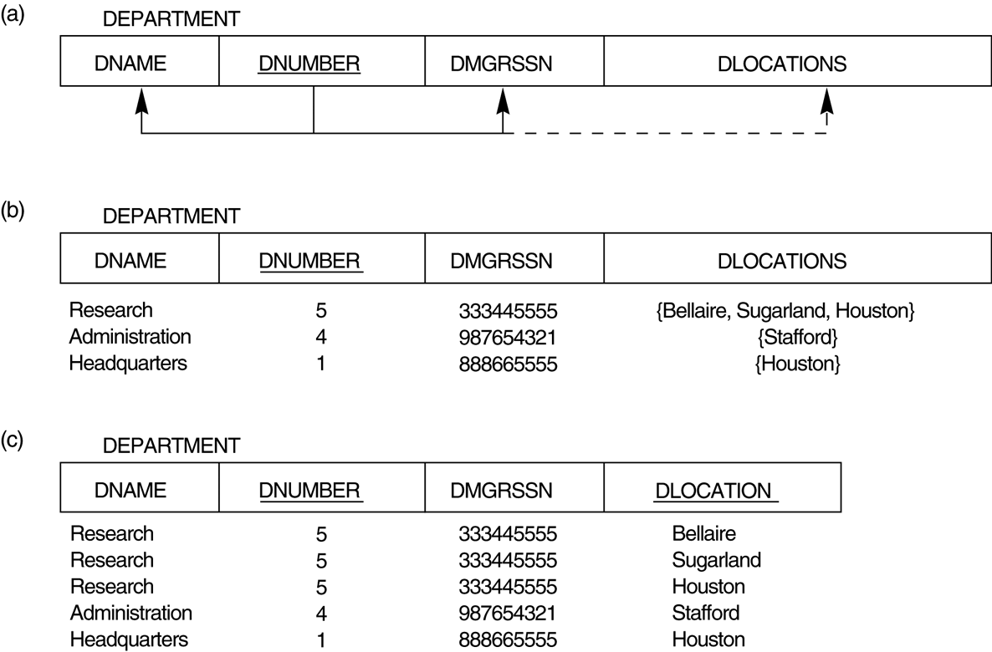
First Normal Form (1NF)
1NF: all attribute values must be single and atomic
disallows multivalued or composite attributes
not in 1NF
1NF with
redundancy
*

Slide 278

Nested relation
composite attributes that are multivalued
normalizing nested relations into 1NF.
(a) Schema of the EMP_PROJ relation with a “nested relation” attribute PROJS.
(b) Example extension of the EMP_PROJ relation showing nested relations within each tuple.
(c) Decomposition of EMP_PROJ into relations EMP_PROJ1 and EMP_PROJ2 by propagating the primary key.
*

Slide 279
Second Normal Form (2NF)
Partial dependency
X→Y is a partial dependency, if ∃A∈X , (X-A)→Y holds
Full functional dependency
X→Y is a full dependency, if ∀A∈X , (X-A)→Y does not hold
Examples:
{SSN, PNUMBER}→ HOURS is a full FD, since neither SSN → HOURS nor PNUMBER → HOURS holds
{SSN, PNUMBER}→ ENAME is not a full FD, since SSN→ ENAME holds
C
A
D
B
E
primary key
*

Slide 280

not 2NF
2NF
Second normal form (2NF)
in 1NF and every non-prime attribute A in R is fully functionally dependent on the primary key
2NF normalization
decompose a relation into several relations that satisfy 2NF
*

Slide 281
Third Normal Form (3NF)
Transitive dependency
X→Y is a transitive dependency, if both X→Z and Z→Y hold, where Z is a non-prime attribute
Examples:
SSN→DMGRSSN is a transitive FD, since SSN→DNUMBER and DNUMBER→DMGRSSN hold
SSN→ENAME is non-transitive, since there is no set of attributes Z where SSN→Z and Z→ENAME
Consider EMP (SSN, Emp#, Salary), SSN→Emp# and Emp#→Salary hold, but SSN→Salary is non-transitive, since Emp# is a candidate key.
C
A
D
B
primary key
*

Slide 282
Third normal form (3NF)
in 2NF and no non-prime attribute A in R is transitively dependent on the primary key
3NF normalization
decompose a relation into several relations that satisfy 3NF
not 3NF
3NF
*

Slide 283
General Normal Form Definitions (For Multiple Keys)
The above definitions consider the primary key only
The following more general definitions take into account relations with multiple candidate keys
Second normal form (2NF)
every non-prime attribute A in R is fully functionally dependent on any key of R
Third normal form (3NF)
whenever X→A holds in R, then either (a) X is a superkey of R, or (b) A is a prime attribute of R
NOTE: Boyce-Codd normal form disallows condition (b) above
*

Slide 284

candidate key
not 2NF
2NF but
not 3NF
3NF
*

Slide 285
BCNF (Boyce-Codd Normal Form)
Boyce-Codd Normal Form (BCNF)
whenever X→A holds in R, then X is a superkey of R
NOTE: BCNF disallows condition (b) in 3NF
BCNF is strictly stronger than 3NF
Every BCNF relation is in 3NF
BCNF excludes update anomalies, while 3NF may occur some update anomalies
3NF ensures dependency preservation property, while BCNF does not (some dependency information may be lost)
A “good” database schemas design should have each relation in BCNF or 3NF
*

Slide 286
Update Anomalies in 3NF
Supplier-Product is in 3NF but not in BCNF
insert (s01,AMD,p05,500) may cause anomaly
3NF but
not BCNF
Supplier-Product SNO SNAME PNO QTY
s01 Intel p01 300
s01 Intel p02 200
s01 Intel p03 400
decompose
BCNF
Supplier-Product SNO PNO QTY
s01 p01 300
s01 p02 200
s01 p03 400
Supplier SNO SNAME
s01 Intel
*

Slide 287

Lost Information in BCNF
candidate key
3NF but
not BCNF
BCNF normalization of LOTS1A with the functional
dependency FD2 being lost in the decomposition.
*

Slide 288

a relation TEACH that is in 3NF but not in BCNF
fd2
fd1
cannot be decomposed
All the three possible decompositions will lose fd1
{student, course} and {course, instructor }
{student, course} and {student, instructor}
{student, instructor} and {course, instructor }
*

