Slide 1
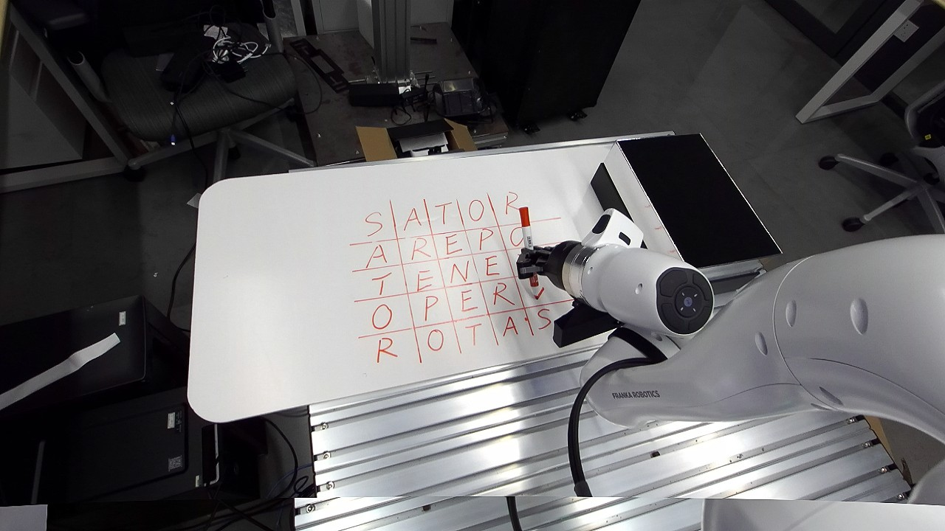
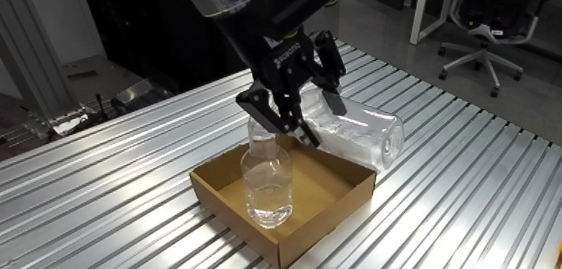
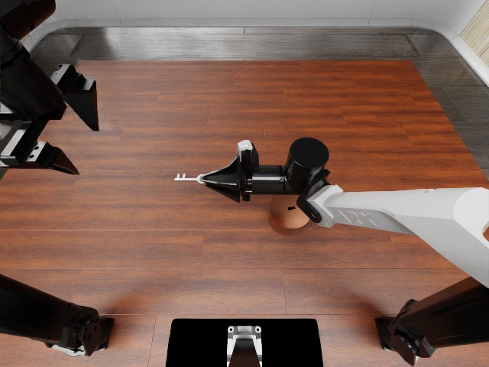
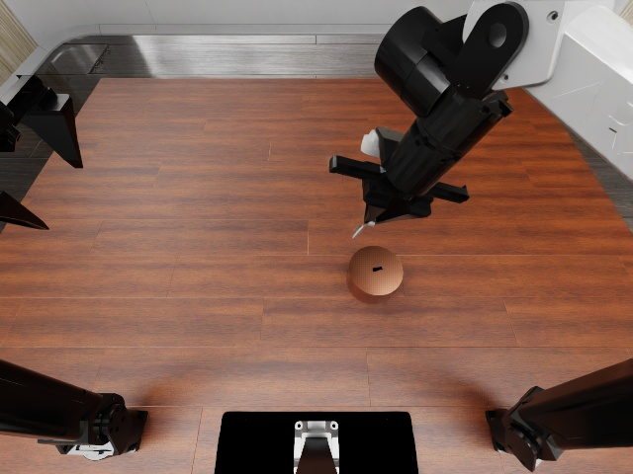
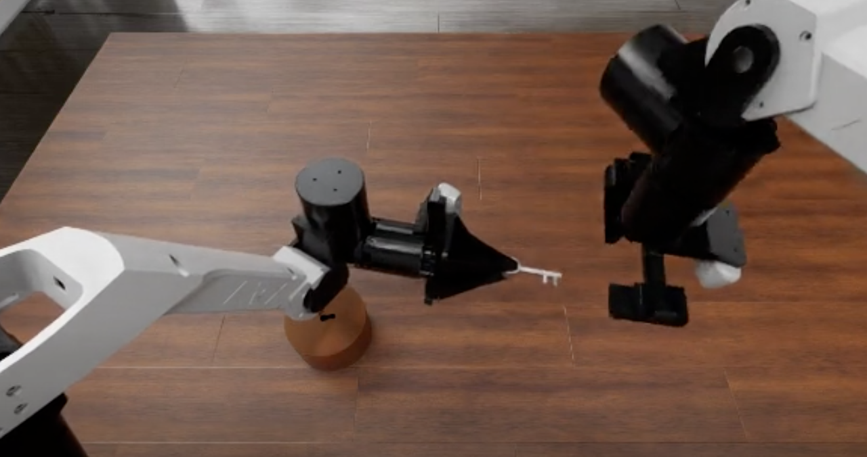
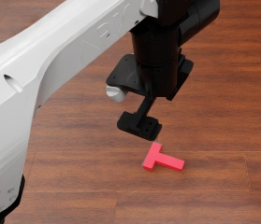
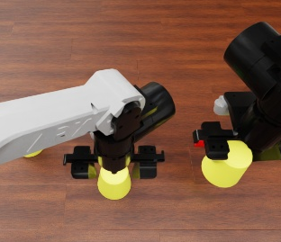
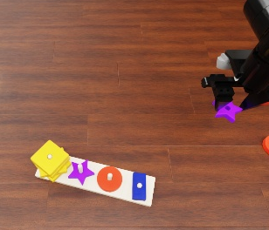
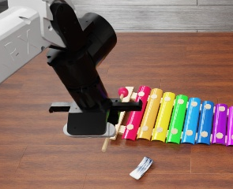
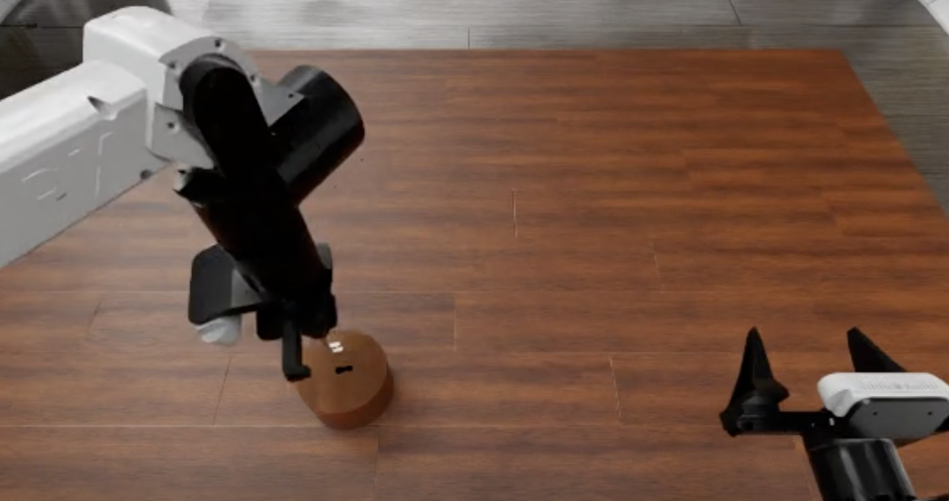
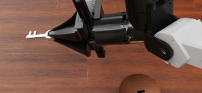
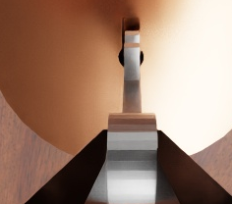
(a) Interaction across real & simulated worlds
(b) Experience-guided execution
Real
Execution agent
Retrieve
EEF poses + gripper
One session per episode
Same-task process
Task
Brief
Live state
Query /
return
…
KnowBody
Insert key
Expose tip
Body / interaction knowledge
Pen operation
Pouring
EEF targets · action chunk
Body: marker
Rel.: EEF → tip
Cond.: pose
Simulation
Free space: larger
Contact: finer
Images + state
Check current conditions
On demand
Brief / evidence
Memory manager
Push
Cover
Stack
Tool use
Source / scope
checks
Read
Images · measured state · execution feedback
Episode
start
Prepare context
Review / learn
Append / revise
Record
Read
(c) Structured experience library
Organized by body, interaction relation and conditions
Raw evidence
Conditional cases
Reusable knowledge
Body
Tool-dependent offset
Act at the functional point
EEF ref.
EEF command
EEF
• Match the tool mounting
• Recheck after regrasp
Geometry ·
tool mounting ·
visual action
Tool-dependent
offset
Tip
Tip (functional)
Schematic geometry
Tip
External
Demonstration candidate
Preserve downstream access
• Keep the working end clear
• Grasp · object ·
target geometry
Grasp ·
transform ·
interact
Grasp layout
Insertion access
Candidate; check current grasp
Episode history
…
Stored with source links
Knowledge first · details on demand
Notes:
KnowBody organizes interaction evidence for experience-guided end-effector control. (a) Original real-robot photos show marker use and pouring; original RoboDojo frames show pushing, covering, stacking and mallet use. (b) The execution agent combines the task, a prepared brief and current images/state in one native episode session. It queries same-task process candidates or body/interaction knowledge directly. Action chunks depict larger free-space steps and finer contact steps schematically. The memory manager prepares context at episode start, reviews or learns on demand, and reads the library; all writes pass source/scope checks before append or revision. (c) Body and External organize raw evidence, conditional cases and reusable knowledge. The marker example schematically relates the commanded hand/EEF reference to the visible functional tip, whose offset depends on tool mounting. Photo callouts are qualitative part annotations, not a calibrated projection or metric offset measurement. The external example uses original user-provided key-grasp and alignment demonstrations to propose preserving working-end access; the item remains a candidate to check against the current grasp, object and target geometry. The same-task retrieval and episode-history thumbnails instead follow one archived robot episode: head frames 140, 160, 200 and wrist frame 240 from run 20261020T173608_649538175, in order. They illustrate source-linked process access without certifying full insertion or a 90-degree key turn. Knowledge is read first and source details remain available on demand.
Native editable text, arrows, boxes, action-chunk schematics and landmark overlays; separate original photographs with editable viewport crop. Provenance and source/event IDs are in ASSET_PROVENANCE.json and EVIDENCE_RECORDS.json.

