Slide 1
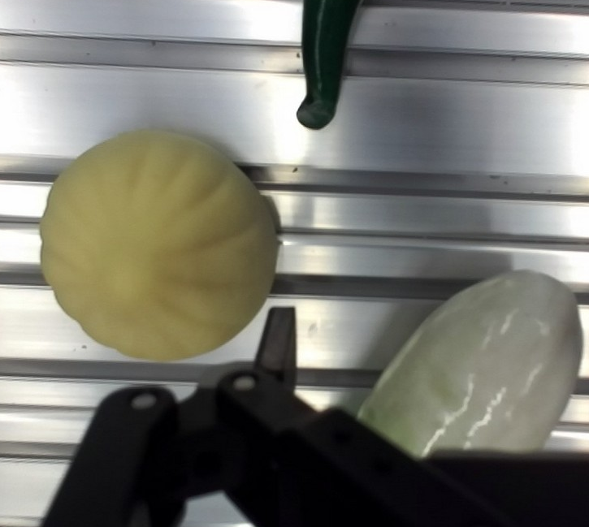
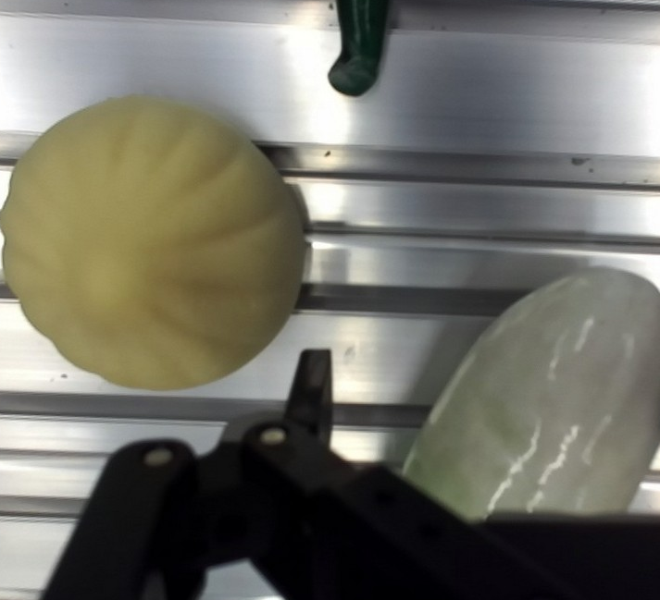
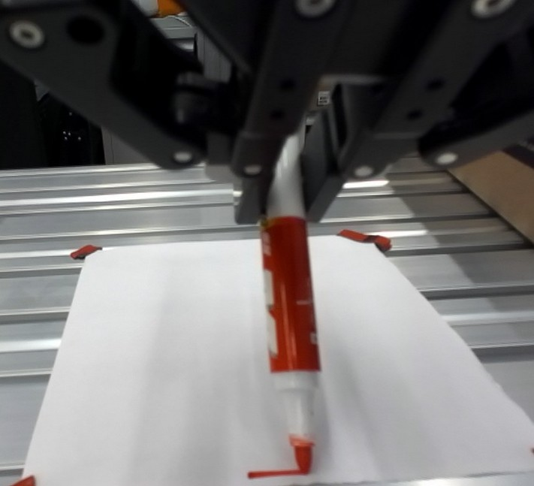
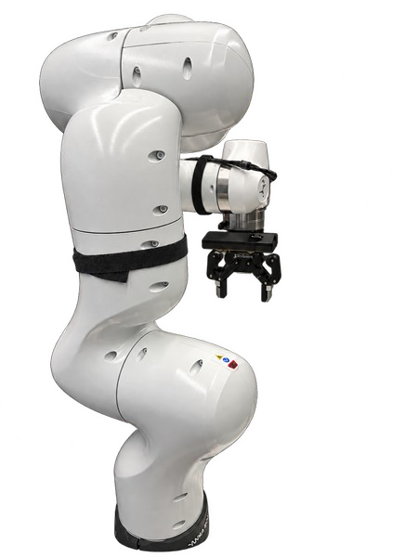
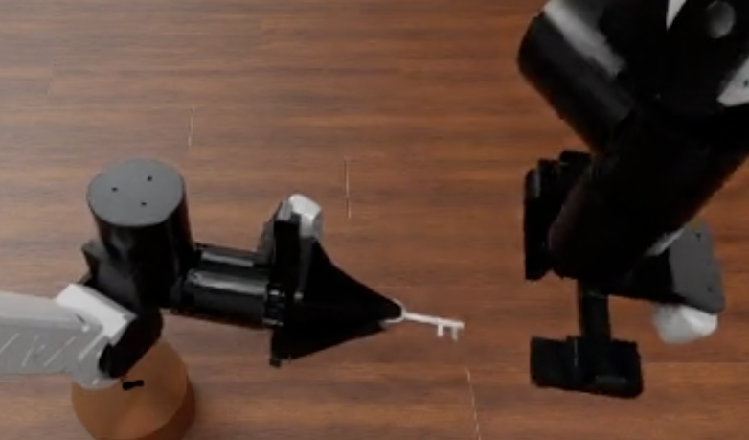
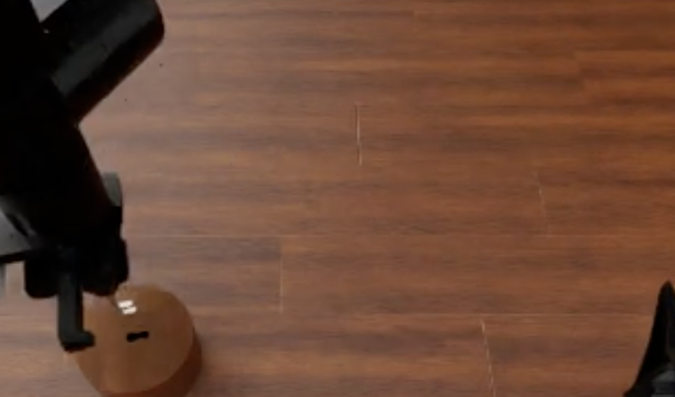
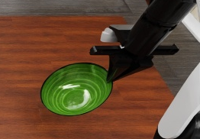
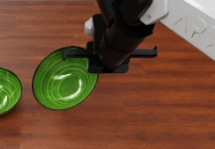
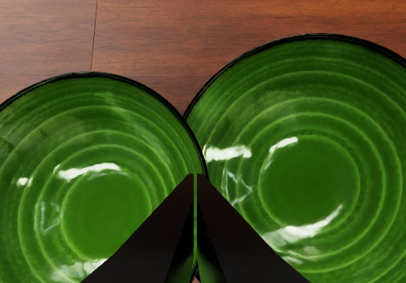
Body relations
motion response · acting part · configuration
(a) Motion–image response
(b) EEF reference and acting tip
(c) Computed path check
Before
After
EEF ref.
Schematic
Visible tip
Recorded EEF move + image response
Condition: tool mounting / grasp
Declared geometry + current joints
Use: choose direction (same camera)
Use: locate the functional part
Use: check the selected path
External interactions
grasp layout · downstream access · retention
(d) Grasp layout preserves downstream access
(e) Retention across lift and transfer
Exposed tip
Empty pads
Opening
Lift retained
Transfer retained
Later loss
Grasp layout
Insertion access
Context: recorded bowl-rim grasp attempts
Keep the working end accessible
Observed: lift retention did not always persist
Use: recheck the bowl–pad relation at arrival
Match grasp and target geometry
Recorded sim knowledge · cause unresolved
Demonstration candidate

