Slide 1
$$$
Virtual Currencies

Slide 2
Problematics
How Virtual currencies have been involved in order
to build new economic systems ?
Under which forms do they exist ? And how can
we implement it ?

Slide 3
Plan
1. Defining a virtual currency
Characteristics
Different kinds of currencies
2. Using it as a customer
Perks/Drawbacks
Utility
3. Making it as a developer
Implementation
Probability models

Slide 4
Defining a virtual currency
A virtual currency is a type of unregulated, digital money, which is issued
and usually controlled by its developers,
and used among the members of a specific virtual community
European Central Bank, 2012
Describing a virtual currency
IRL ?
Virtual Currency
Anonymous ?
Centralized ?

Slide 5
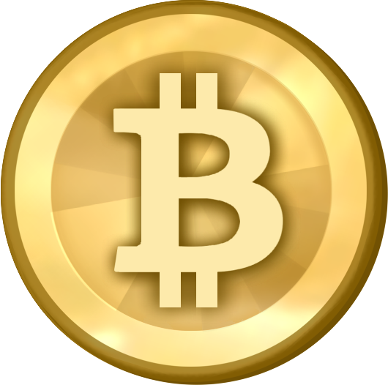

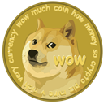
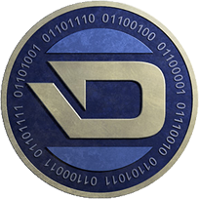

Defining a virtual currency
Kinds of virtual currencies
In-app
Currency
Electronic
Wallet
Crypto-currency
Local
Global
Most known crypto-currencies
Bitcoin
Litecoin
Dogecoin
Darkcoin
Primecoin
> 4.7B$
> 120M$
> 20M$
> 11M$
+- 1M$

Slide 6
Using it as a customer
How and where to use it ?
Customer
Your Currency
(Usable)
Real Currency
(Usable)
Your Currency
(Unusable)
Transaction
1
Transaction
2
Transaction
3
. . .
Domain of use

Slide 7
Using it as a customer
Perks
Drawbacks
Simplifying
transactions
Restrictions
of use
More secure
payments
Can emphasize
frauds
Restricted Access
Cannot be
converted back
Being a part
of the
community
Requires to
be implied

Slide 8
The making process as a developer
Why such a process ?
Development
of an
virtual
currency
Funding
Create an
alternative
Security
Exclusivity
Problematics :
Implementation depends on use
Maintenance/Control of the economic system

Slide 9
The making process as a developer
How to implement a local currency
Establish a conversion with a purchase application
Local Currency
Amount of available money into a specific variable
Favour or restrict your currency as way of payment for a given product/service.
How to implement a global currency
Design a (massive) network infrastructure
Global Currency
Establish a money accounting system
Develop an API to spread your currency

Slide 10
Conclusion
€€€
Virtual Currencies

