Slide 1
Pairs trading with partial cointegration
Replicate :
Clegg, Matthew; Krauss, Christopher (2016) : Pairs trading with partial cointegration, FAU Discussion Papers in Economics, No. 05/2016, Friedrich-Alexander- Universität Erlangen-Nürnberg, Institute for Economics, Nürnberg
https://www.econstor.eu/bitstream/10419/140632/1/858609614.pdf
&
Clegg, Matthew, Modeling Time Series with Both Permanent and Transient Components Using the Partially Autoregressive Model (January 28, 2015). Available at SSRN: https://ssrn.com/abstract=2556957 or http://dx.doi.org/10.2139/ssrn.2556957

Slide 2
Summary
Investment universe
Eligibility of a pair
Trading rules
Backtesting
Functional form

Slide 3
Investment universe
Nasdaq 100 : Tech stocks
Hypothesis: Within a homogeneous group, the pricing (random walk) components behave in a similar manner.
We analyze four years of trading data and apply the insights to trade over the subsequent six months
The model demonstrates improved properties with approximately 1000 observations (Clegg & Krauss, 2016).

Slide 4
Intuitively
Weaking of cointegration where the “cointegrating” process (our price spread) can be modeled using the Partially Autoregressive Model.
PCI :A time series, say X_t the spread of two prices, can be modeled as the sum of a random walk (R_t) and a meaning reverting component (M_t).
The random walk models shocks that have a permanent effect on the spread. (Pricing)
The mean reverting component models shocks that are transient. (Noise)
Example: New technology that benefits tech companies.
CI : The price difference between 2 tech stocks is stationnary (Noise)
PCI : Allow the price difference between 2 tech stocks to still have a random walk effect (Noise + Pricing). Pricing effect is not the same for every tech stocks

Slide 5
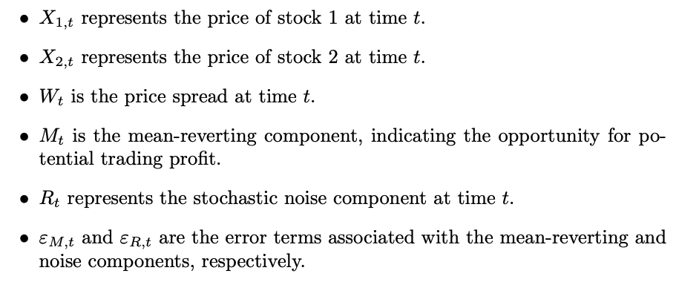
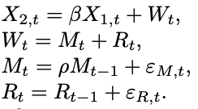
Functional form : Definition
Partial cointegrating relationship:
Def.: We say that two price time-series X_1,t and X_2,t are partially cointegrated if β, ρ, σ_M, σ_R can be found such that the following model is satisfied:
Such that,
To simplify, m_0 = 0 and r_0 = w_0

Slide 6


Functional form : State-Space representation
Goal: Differentiate M_t and R_t . Since these are not directly observable, we need to estimate them using the Kalman Filter equations. We start by restating the model in state space, which involves two equations:
State equation:
Observation equation:
Where W_t has the covariance matrix:

Slide 7
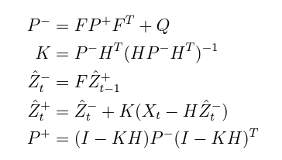
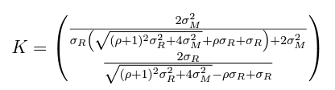
Functional form : Kalman Filter equations
We then design a Kalman filter for our state space model. The author shows that since the Partially Autoregressive model assumes a steady state system, the Kalman filter equations reduce to:
K_M
From which the Kalman gain matrix (K) can be computed as:
K_R

Slide 8
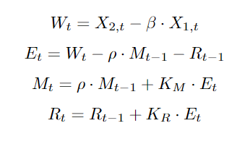


Functional form : Kalman Filter & Maximum Likelihood
Then, we can estimate values for M_t and R_t recursively along with the one-step estimation error through the following equations:
From the errors and initial parameter estimations we can calculate the likelihood score with:

Slide 9
Functional form : summary of maximum likelihood estimation
Initial estimates for rho, sigma_M and sigma_R are obtained through lagged variance approach.
Starting from these estimates, a quasi-Newton method is used to search for values that maximize the likelihood function.
Repeat the process with different starting parameters and keep parameters linked with the highest likelihood score.

Slide 10
Results of estimations
Average estimators from 1,000 simulations of two PCI time-series, with increasing values of sigma_M
Like the author, we conclude that our estimations become more precise as $R_{MR}^{2}$ increases, up to $R_{MR}^{2}$ =0.51.

Slide 11
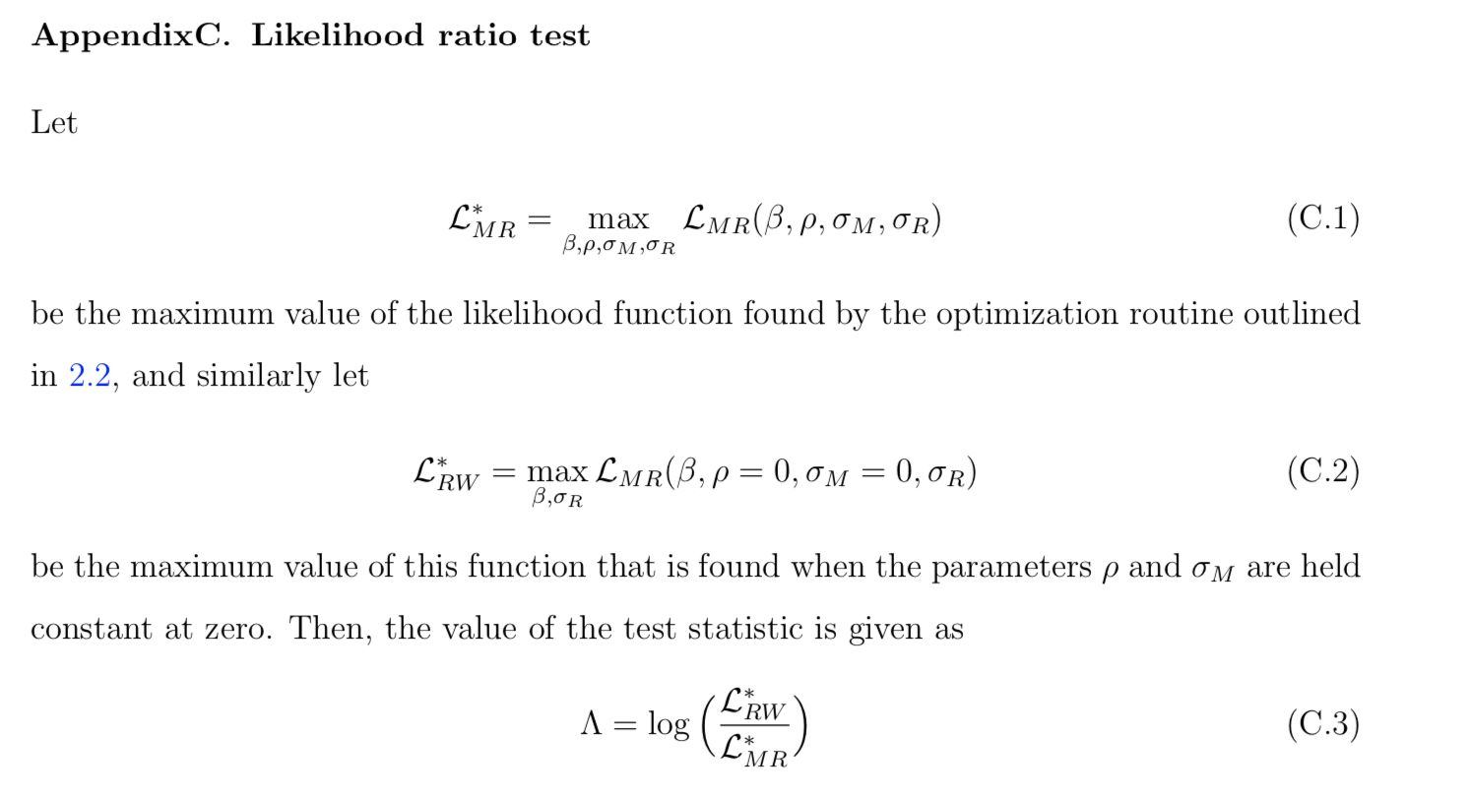
Eligibility of a pair
1. Likelihood ratio score lowest 5% among all pairs :
Where H0 is that the Cointegrating process is a pure random walk. This ensures that the pairs have a higher probability of being partially cointegrated.
Pairs have a higher probability of being (partially) cointegrated
(Clegg & Krauss, 2016)

Slide 12

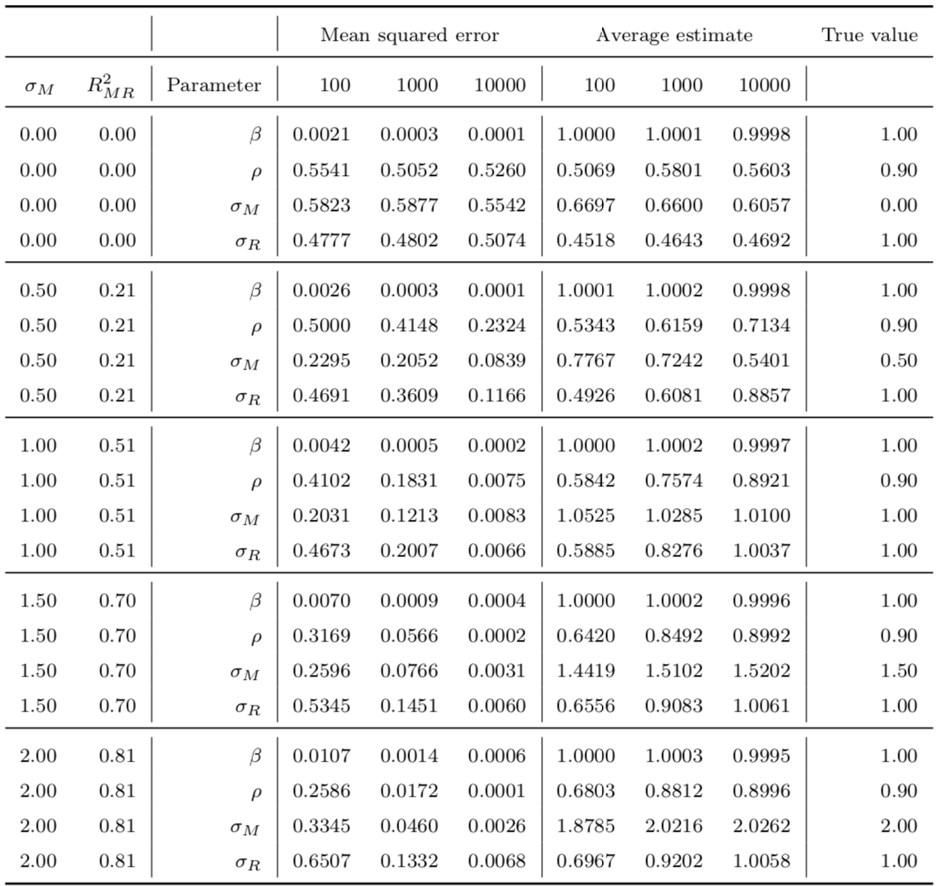

Eligibility of a pair
2. We want : $R_{MR}^{2}>0.5$
Where $R_{MR}^{2}$ represents the proportion of variance attributable to the mean-reversion component.
If $R_{MR}^{2}$ = 1: Then the series is purely mean-reverting.
If $R_{MR}^{2}$ = 0.: Then the series is purely a random-walk.
Higher $R_{MR}^{2}$ values yields better parameter estimates.
(Clegg & Krauss, 2016)

Slide 13
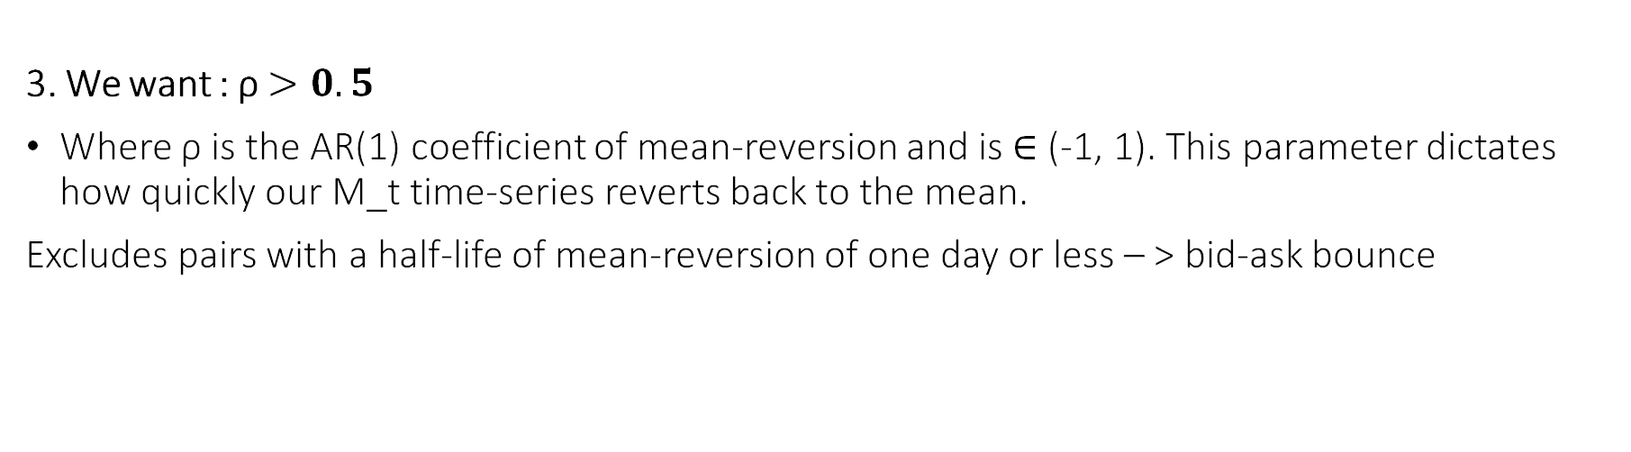
Eligibility of a pair
3. We want : ρ $>0.5$
Where ρ is the AR(1) coefficient of mean-reversion and is ∈ (-1, 1). This parameter dictates how quickly our M_t time-series reverts back to the mean.
Excludes pairs with a half-life of mean-reversion of one day or less – > bid-ask bounce

Slide 14

Trading Rules
Eligibility: Rank each pair highest to lowest $R_{MR}^{2}$ , highest to lowest ρ, and lowest to highest LRT. We then take the cumulative position (best score possible = 3), and keep the top 20 pairs.
Trading signals: At the end of each trading period, we estimate M_t and we compute a Z-score as Z_t = M_t / sigma_M. If Z_t > 1, a position is opened as going short X_2,t & long X_1,t. The position is closed when Z_t < -0.5. If Z_t > 1 and a position is already opened, the signal is ignored.
A 10 % stop loss is used.
Position sizing is based on the hedge ratio, computed as β * X_1,t / X_2,t = 1, if X_2,t = β * X_1,t. Thus a 1$ investment in stock 2, representing 1 / X_2,t shares of stock 2 is offset by an opposite position of β / X_2,t. shares in stock 1

Slide 15
Backtesting
Portfolio of shares at every period
Vector BT pro (Performance metrics)
Notes:
Partie Sebastien

Slide 16
Discussions
Short term:
Test the profitability of different opening/closing thresholds and stop-loss levels.
Develop a proper method to determine position sizing for each pair in the portfolio.
Develop a clustering algorithm based on fundamentals (Market Cap., P/E, ROE, etc.) and add correlation matrix to determine appropriate trading pairs, instead of grouping by industry/sector.
Long term:
Implement Machine Learning methods to predict how likely a given signal is to be profitable.
Notes:
Partie Antoine

