Slide 1
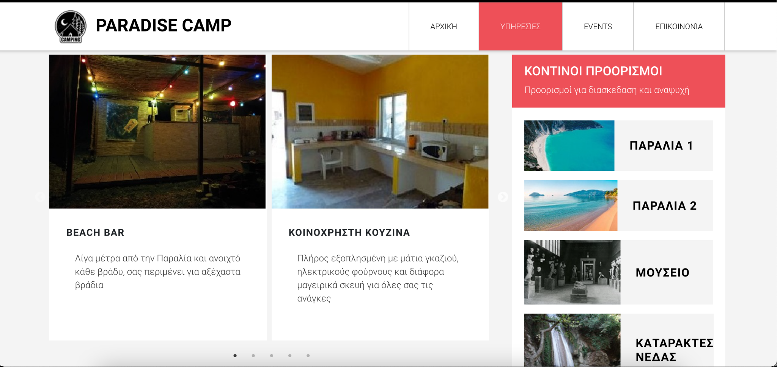
Paradise Camp

Slide 2
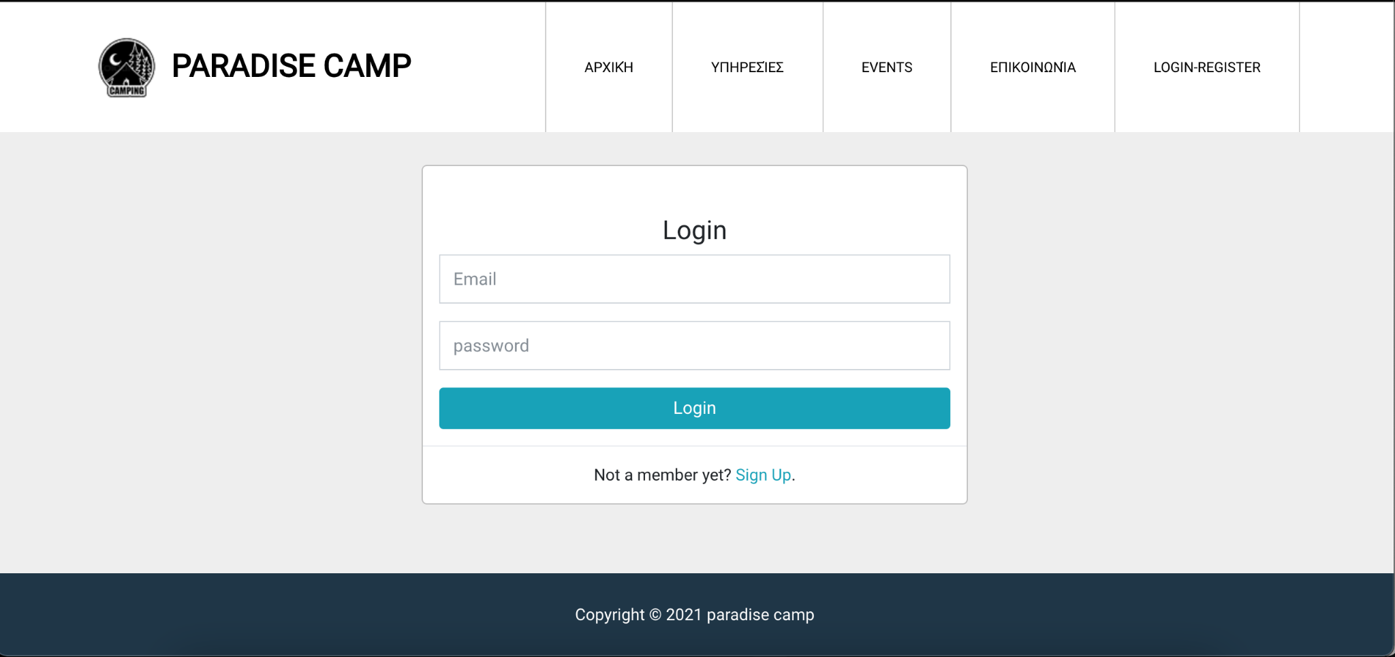
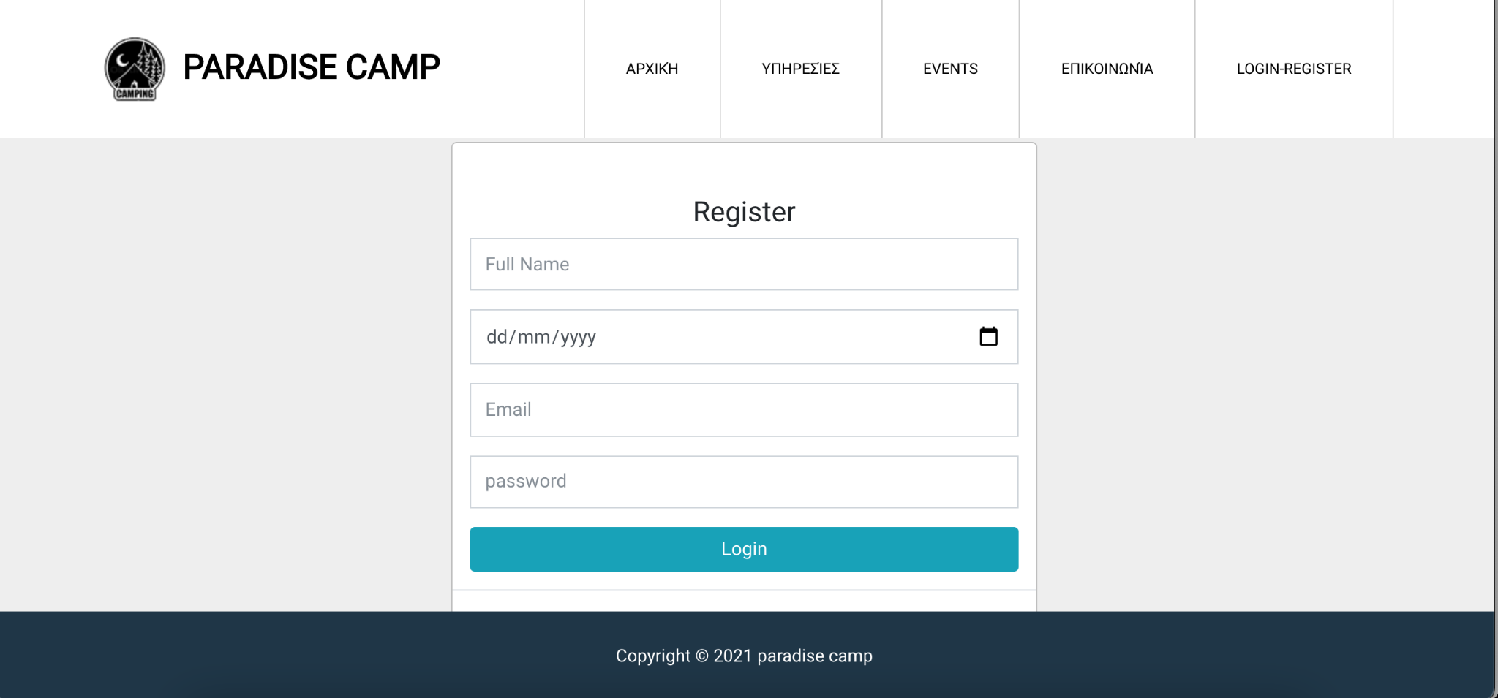
Website interface
Logging-Registers

Slide 3
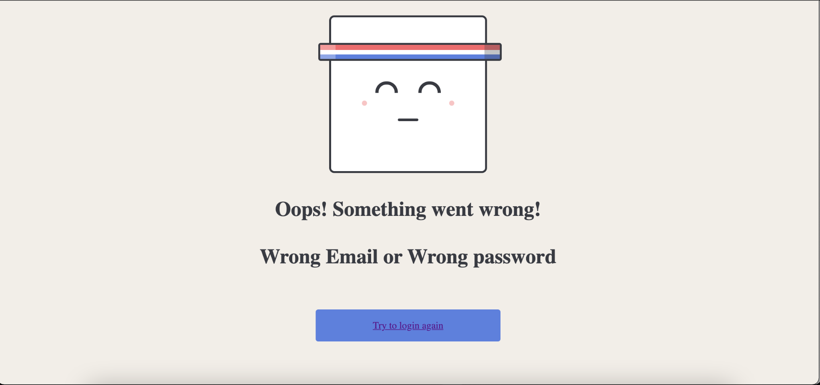
Website interface
Login with wrong mail or password

Slide 4
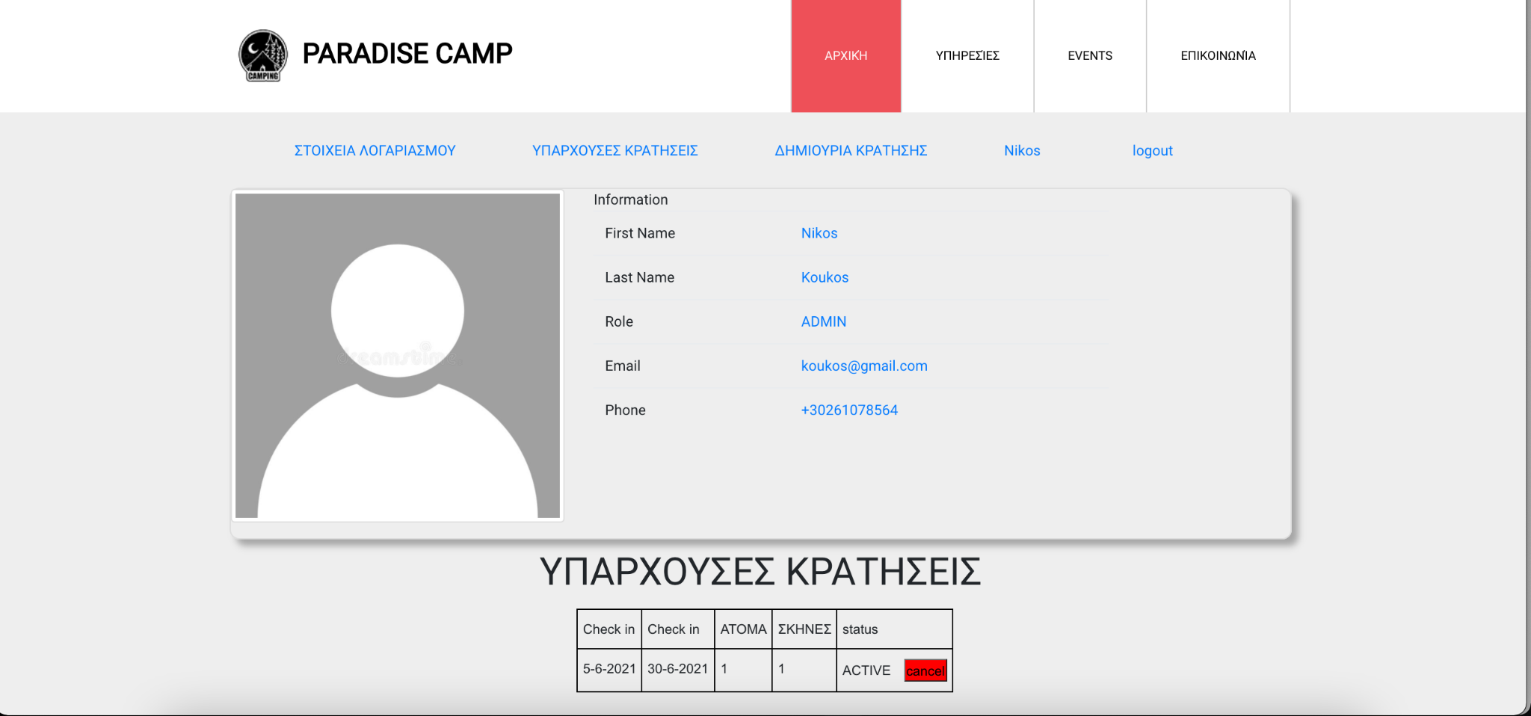
Website interface
USER INFORMATIONS

Slide 5
User΄s extra options Wrapper
NavUser
With extra options if you are
Logged in

Slide 6
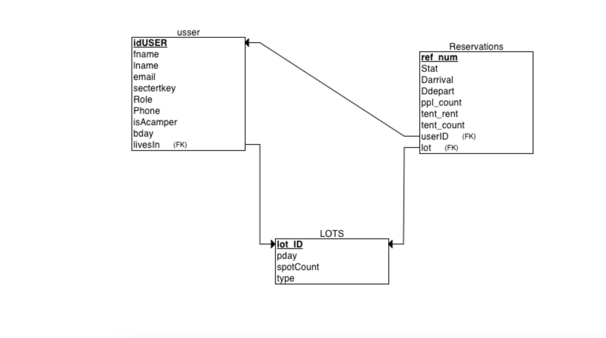
Σχεσιακο Διαγραμμα Β.Δ.

Slide 7
Paradise camp
ΙΩΑΝΝΗΣ ΛΟΥΠΗΣ
Student, ΗΜΤΥ, up1019785
ΝΙΚΟΣ ΠΑΠΑΣ
Student, ΗΜΤΥ, up1045934

