Slide 1
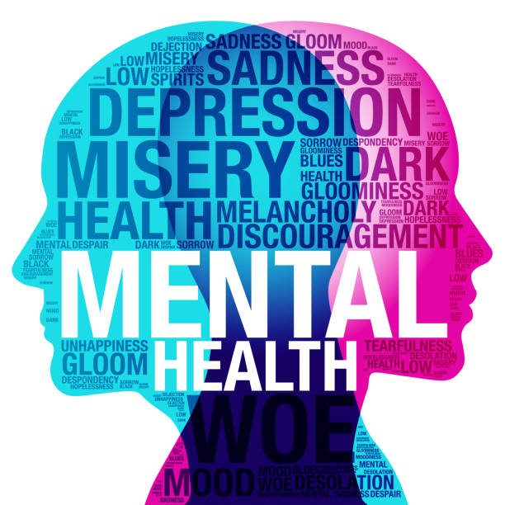
Adolescent Well-Being in the US: How Life Domains and Economics Interact
Project Proposal
Data Science Lab
University of Haifa
Lour Hakim
Shahar Rashdi

Slide 2
Background:
This project is situated in the domain of adolescent public health, focusing on risk factors that impact teen well-being in the U.S.
The CDC’s Youth Risk Behavior Survey (YRBS) collects data from high school students across multiple domains:
Bullying, violence, and safety
Mental health and emotional well-being
Sleep, screen time, physical activity, and diet
Sexual behaviors and substance use
Academic performance and living situations
These diverse factors are often interconnected and influence both short- and long-term outcomes for youth.

Slide 3
Background:
However, personal and behavioral factors don’t tell the whole story. This project expands the analysis by combining student-level data with state-level economic indicators — including GDP, unemployment rate, and mean household income — to add a broader socioeconomic perspective. By integrating these variables, we aim to better understand how both individual experiences and structural conditions influence youth mental health.
Understanding patterns and associations across these domains is key to identifying at-risk groups and informing effective prevention and intervention strategies.

Slide 4
Problem:
Most existing research focuses on single factors like bullying or sleep. But real-life teen experiences involve overlapping risks that are rarely analyzed together.
Socioeconomic indicators like GDP, unemployment and income are commonly used in adult health research but rarely explored in teen mental health studies.
Teens are affected differently depending on who they are and where they live. But studies often ignore how risk patterns vary by living situation, race, or identity.
Large-scale surveys like YRBS are full of untapped potential. But most projects fail to explore complex, multi-factor relationships in the data

Slide 5
Aim:
Research Questions:
Use student-level YRBS data and state-level economic indicators to analyze and model risk factors for adolescent mental health.
1. How accurately can we predict mental health risk among U.S. high school students using a combination of behavioral, demographic, and state-level economic variables?
2. How and which behavioral and socioeconomic factors such as bullying, sleep, household income, and unemployment are associated with reported sadness or suicidal thoughts among U.S. high school students??
The dependent variable is students’ self-reported mental health, based on responses to questions like: feeling sad or hopeless, suicidal thoughts, or poor mental health days. (Q:26, Q:27, Q:84)
3. How do mental health outcomes vary between students in economically disadvantaged states and those in more affluent states?

Slide 6
Feasibility:
Data Source: - 2023 Youth Risk Behavior Survey (YRBS) — official CDC dataset with over 100 variables on health, behavior, and demographics of U.S. high school students - State-Level GDP Data, 2023 – Published by the U.S. Bureau of Economic Analysis (merged via state names using the district column) - Unemployment Rate and Mean Household Income (2023) – Retrieved from the U.S. Census Bureau’s American Community Survey for 8 U.S. states; merged by state name
Accessibility: Freely available online in multiple formats (Access, ASCII, SPSS), with full documentation
Data Size & Quality: Large sample size (thousands of students) and rich feature set allow for multivariate analysis and machine learning applications
Planned Methods: Initial focus on data cleaning and exploratory data analysis (EDA), including visualizations and descriptive statistics, followed by classification models (e.g., logistic regression, decision trees, SVM).
Challenges & Risks: - YRBS includes some missing or inconsistent entries → handled via imputation - GDP, unemployment, and income is a macro-level variable → interpreted cautiously to avoid overgeneralizing

Slide 7
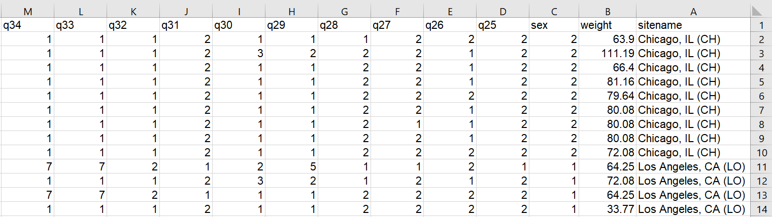
A Glimpse into YRBS Dataset
Example Questions from the YRBS Survey :
During the past 12 months, have you ever been electronically bullied? (Count being bullied through texting, Instagram, Facebook, or other social media.)
During the past 12 months, how many times were you in a physical fight?
During the past 30 days, on how many days did you smoke cigarettes?
During the past 7 days, how many times did you eat green salad?

Slide 8
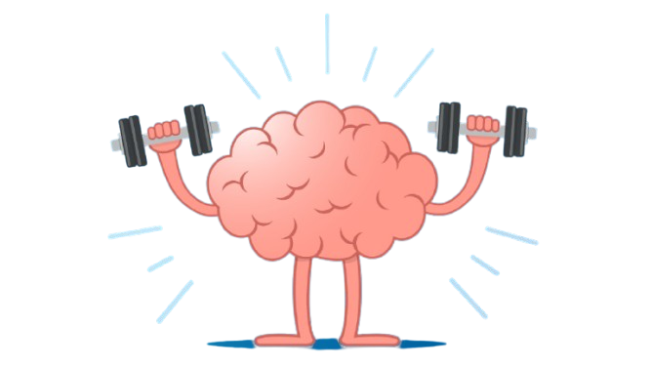
Thank You
We appreciate your time and feedback. We’re happy to answer any questions.

