Slide 1

Shahar Rashdi
Lour Hakim
Mental Health Risk Prediction Among U.S. High School Students
Final Project
Data Science Lab
University of Haifa

Slide 2
Introduction & Recap
Our project focuses on analyzing mental health risks among U.S. high school students. | Project Focus
To build predictive models that can highlight risk factors and help inform intervention strategies. | Project Goal
Q26 — Feeling sad or hopeless for two weeks or more in the past year Binary (0/1) Q27 – Seriously considered attempting suicide in the past year Binary (0/1) Q84 - Frequency of poor mental health days in the past 30 days Originally a 5-level categorical variable: (Never, Rarely, Sometimes, Most of the time, Always) Converted to binary: “Most of the time” or “Always” = 1 otherwise = 0 | Target Variables

Slide 3
Youth Risk Behavior Survey (YRBS) 2023 – CDC Student-level survey data on bullying, violence, sexual behavior, sleep, nutrition, and mental health. Covers thousands of high school students across U.S. districts. State-Level Socioeconomic Data (2023): GDP per state (2023) – U.S. Bureau of Economic Analysis Unemployment Rate & Mean Household Income (2023) – U.S. Census Bureau | Data Sources

Slide 4
ER Diagram
Student
State
Belongs to
Sitename → State
Sitename (District)
Age
Sex
Race
Bullying at school
Sleep
Grades in school
BMI
Sad or hopeless
GDP
Unemployment rate
Mean household income

Slide 5
Research Questions
1. How accurately can we predict mental health risk among U.S. high school students using a combination of behavioral, demographic, and state-level economic variables?
2. How and which behavioral and socioeconomic factors such as bullying, sleep, household income, and unemployment are associated with reported sadness or suicidal thoughts among U.S. high school students?

Slide 6
EDA
Column Filtering
Dropped: ID/location columns, constant columns, columns with >70% missing values, and redundant variables with Cramér’s V > 0.85.
Row Filtering
Removed rows with missing target values or >60 missing fields.
Missing Values
- numeric → filled with mean
- categorical → filled with -1.
Encoding
- Binary: recoded as 1/0.
- Multi-category: one-hot encoding applied.

Slide 7
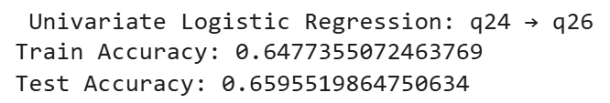

Simple Predictive Baselines
Before building complex models, we implemented simple baselines to evaluate predictive power
Constant Baseline
Univariate Logistic Regression
Q24 : Bullying at school Q26 : Felt sad or hopeless

Slide 8
Methods Overview
Models Used
Sparse Logistic Regression
Random Forest Classifier
20-fold Cross-Validation Metrics
Accuracy
Error Rate = 1 - Accuracy
Log Loss
Confidence intervals: ±1.96 × std
Holdout Test Performance
Test Accuracy
Metrics

Slide 9
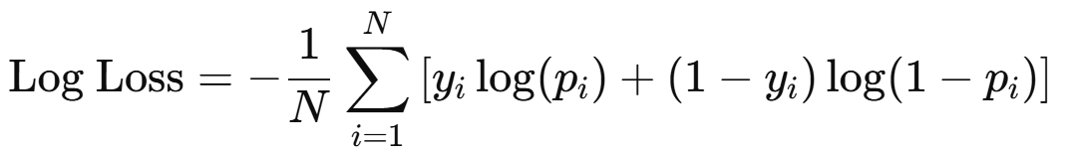
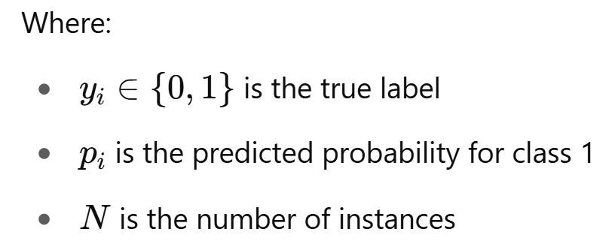
Metrics Definition
$Accuracy=\frac{Number of correct predictions}{Total number of predictions}=\frac{TP+TN}{TP+TN+FP+FN}$
$$ERROR RATE=1−ACCURACY$$

Slide 10
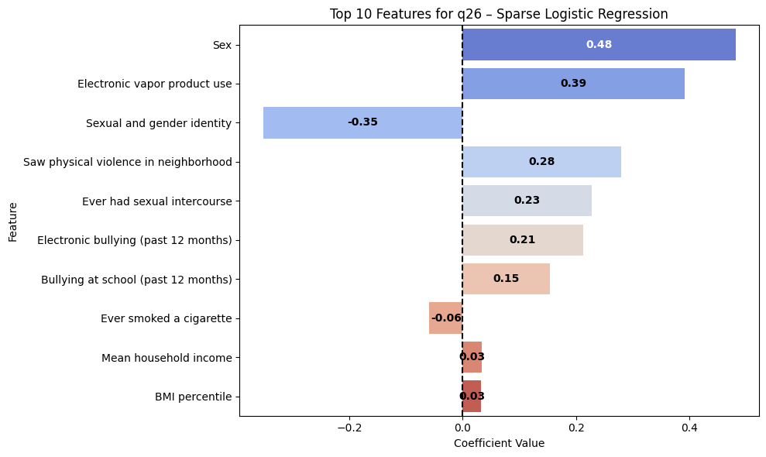
Q26: Felt Sad or Hopeless
Sparse Logistic
Regression

Slide 11

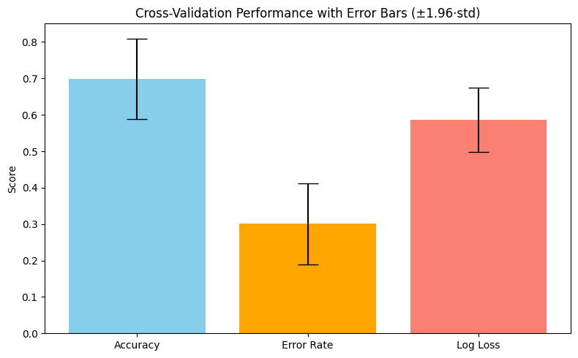
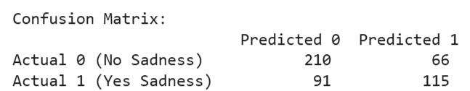

Q26: Felt Sad or Hopeless
Sparse Logistic
Regression

Slide 12
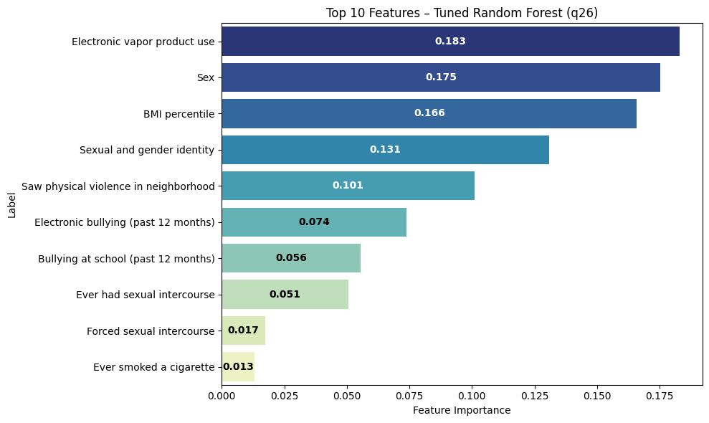
Q26: Felt Sad or Hopeless
Random
Forest

Slide 13
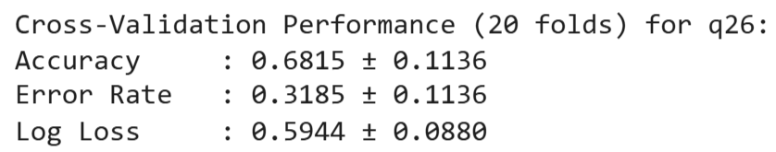
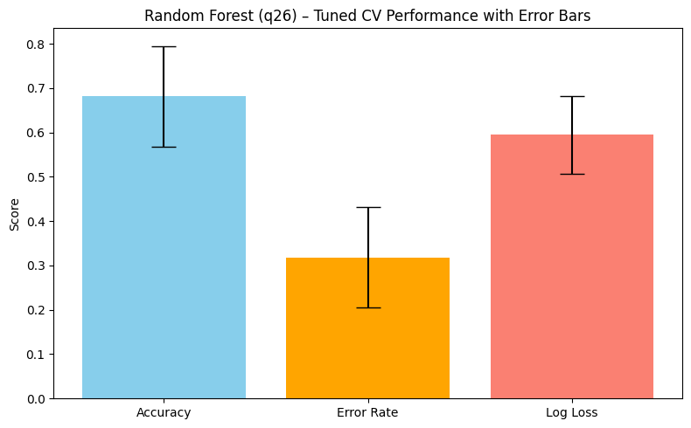
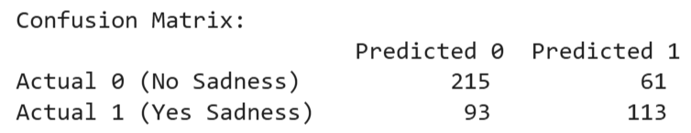

Q26: Felt Sad or Hopeless
Random
Forest

Slide 14
Model Comparison – Q26: Felt Sad or Hopeless
Random Forest | Sparse Logistic Regression
Electronic vapor product use Sex BMI percentile Sexual and gender identity Saw physical violence in neighborhood Electronic bullying Bullying at school Ever had sexual intercourse Forced sexual intercourse Ever smoked a cigarette | Negative | Positive
 | 3. Sexual and gender identity Ever smoked a cigarette | Sex Electronic vapor product use Saw physical violence in neighborhood Ever had sexual intercourse Electronic bullying Bullying at school Mean household income BMI percentile
0.6815 ± 0.1136 | 0.6990 ± 0.1110
0.3185 ± 0.1136 | 0.3010 ± 0.1110
0.5944 ± 0.088 | 0.5862 ± 0.0881
0.6805 | 0.6743
Accuracy | CV
Error Rate
Log Loss
Test Accuracy

Slide 15
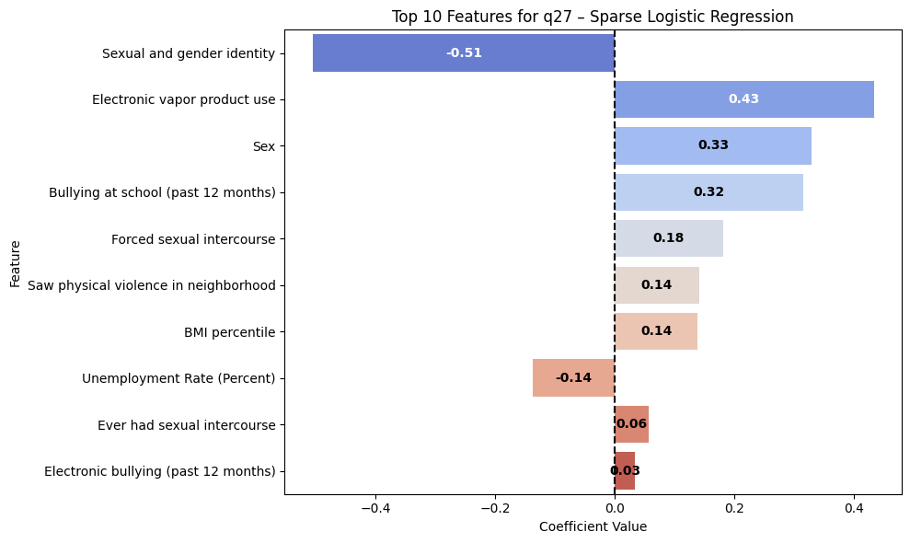
Q27: Considered Attempting Suicide
Sparse Logistic
Regression

Slide 16

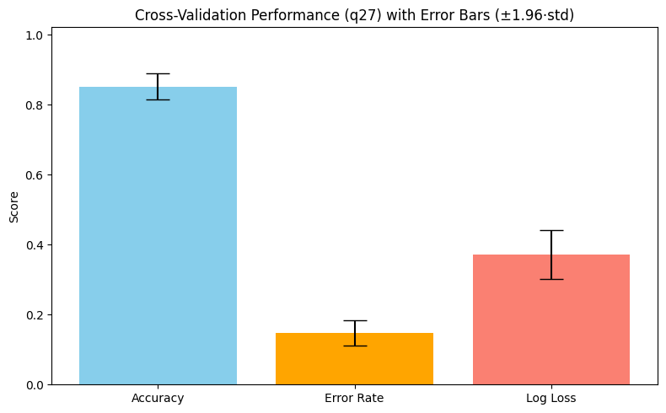
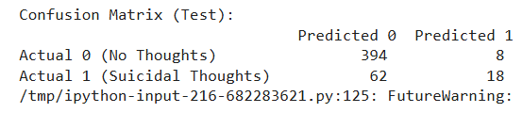

Q27: Considered Attempting Suicide
Sparse Logistic
Regression

Slide 17
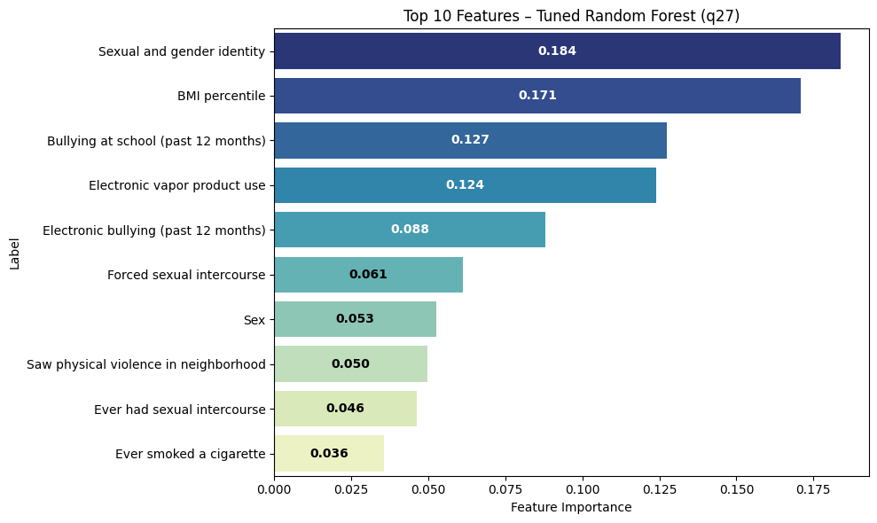
Q27: Considered Attempting Suicide
Random
Forest

Slide 18
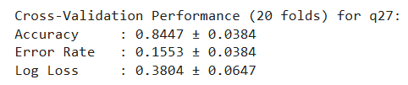
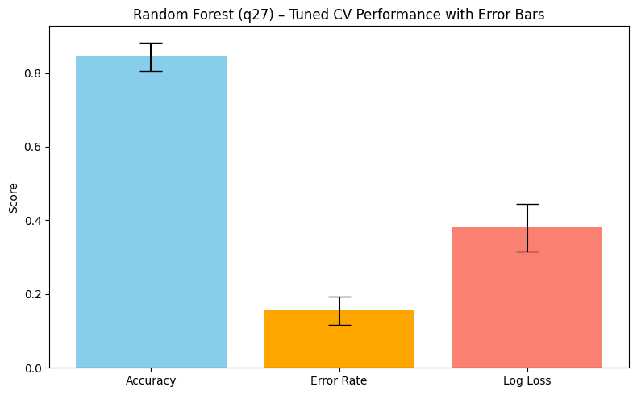


Q27: Considered Attempting Suicide
Random
Forest

Slide 19
Model Comparison – Q27: Considered Attempting Suicide
Random Forest | Sparse Logistic Regression
Sexual and gender identity BMI percentile Bullying at school Electronic vapor product use Electronic bullying Forced sexual intercourse Sex Saw physical violence in neighborhood Ever had sexual intercourse Ever smoked a cigarette | Negative | Positive
 | Sexual and gender identity 8. Unemployment Rate (Percent) | Electronic vapor product use Sex Bullying at school Forced sexual intercourse Saw physical violence in neighborhood BMI percentile Ever had sexual intercourse Electronic bullying
0.8447 ± 0.0384 | 0.8522 ± 0.0368
0.1553 ± 0.0384 | 0.1478 ± 0.0368
0.3804 ± 0.0647 | 0.3711 ± 0.0697
0.8444 | 0.8548
Accuracy | CV
Error Rate
Log Loss
Test Accuracy

Slide 20
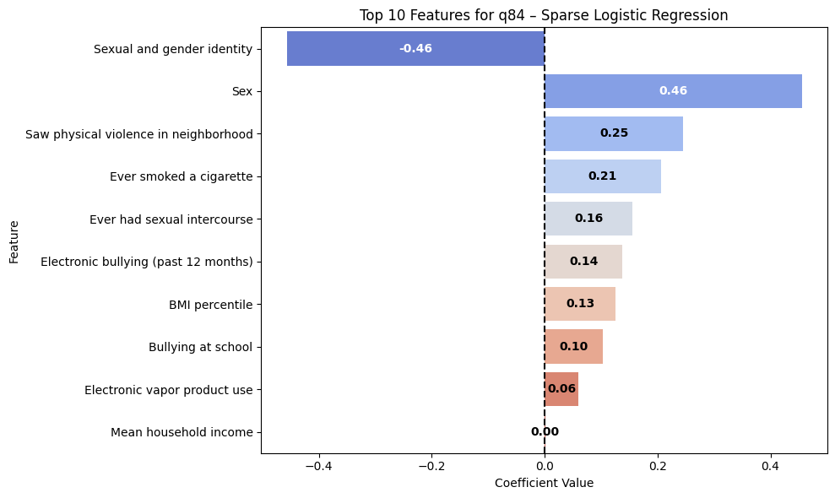
Q84: Frequency of Poor Mental Health Days
Sparse Logistic
Regression

Slide 21

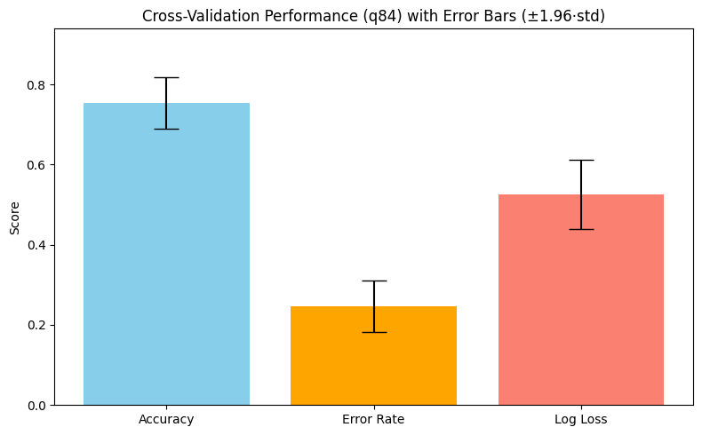

Q84: Frequency of Poor Mental Health Days
Sparse Logistic
Regression

Slide 22
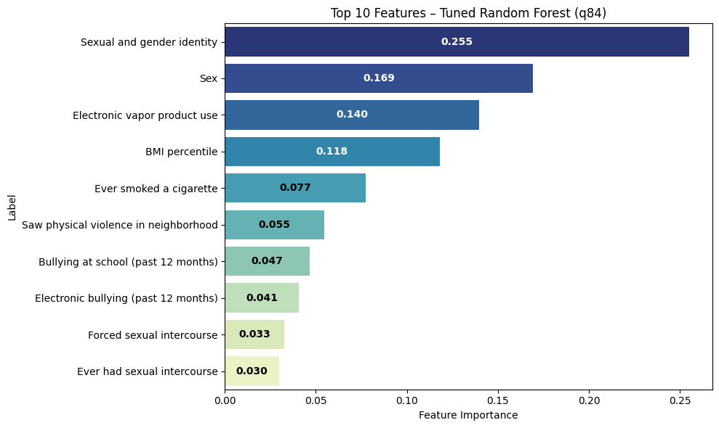
Q84: Frequency of Poor Mental Health Days
Random
Forest

Slide 23

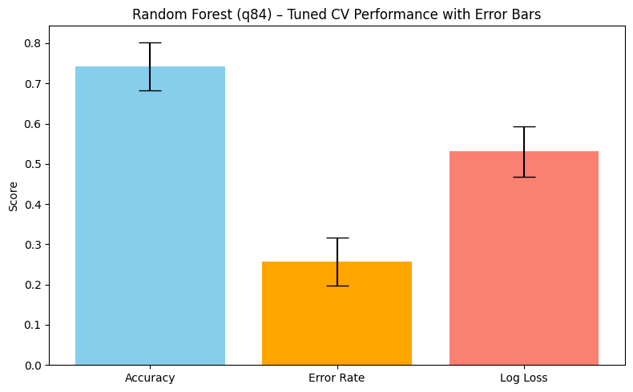


Q84: Frequency of Poor Mental Health Days
Random
Forest

Slide 24
Model Comparison – Q84: Frequency of Poor Mental Health Days
Random Forest | Sparse Logistic Regression
Sexual and gender identity Sex Electronic vapor product use BMI percentile Ever smoked a cigarette Saw physical violence in neighborhood Bullying at school Electronic bullying Forced sexual intercourse Ever had sexual intercourse | Negative | Positive
 | Sexual and gender identity | Sex Saw physical violence in neighborhood Ever smoked a cigarette Ever had sexual intercourse Electronic bullying BMI percentile Bullying at school Electronic vapor product use
0.7431 ± 0.0598 | 0.7531 ± 0.0647
0.2569 ± 0.0598 | 0.2469 ± 0.0647
0.5307 ± 0.0629 | 0.5257 ± 0.0859
0.7427 | 0.7220
Accuracy | CV
Error Rate
Log Loss
Test Accuracy

Slide 25
Insights & Interpretations
Both Sparse Logistic Regression (SLR) and Random Forest (RF) models achieved solid predictive accuracy across all mental health outcomes.
The highest test accuracy was for Q27 (Suicidal Thoughts): SLR: 85.5%, RF: 84.4%
Most consistent predictors across outcomes:
Sexual and gender identity ,
Bullying (in school and online),
Electronic vapor product use,
Exposure to physical violence.
Socioeconomic factors played a minor role:
Household income and unemployment had small effects.
GDP was not selected by any model.
Policy Implications
Prevention efforts should prioritize anti-bullying programs, LGBTQ+ support, and community violence reduction.

Slide 26

Thank You
We appreciate your time and feedback. We’re happy to answer any questions.

