Slide 1
Random Forests

Slide 2
Outline
Introduction
History of Random Forests
What is a Random Forest?
Why a Random Forest?
Case Study

Slide 3
Introduction
Random Forests can be regarded as ensemble learning with decision trees
Instead of building a single decision tree and use it to make predictions, build many slightly different trees
Combine their predictions using majority voting
The main two concepts behind random forests are:
The wisdom of the crowd — a large group of experts are collectively smarter than individual experts
Diversification — a set of uncorrelated tress
A supervised machine learning algorithm
Classification (predicts a discrete-valued output, i.e. a class)
Regression (predicts a continuous-valued output) tasks.

Slide 4
History of Random Forests
Introduction of the Random Subspace Method
“Random Decision Forests” [Ho, 1995] and “The Random Subspace Method for Constructing Decision Forests” [Ho, 1998]
Motivation:
Trees derived with traditional methods often cannot be grown to arbitrary complexity for possible loss of generalization accuracy on unseen data.
The essence of the methods are to build multiple trees in randomly selected subspaces of the feature space.
Trees in, different subspaces generalize their classification in complementary ways, and their combined classification can be monotonically improved.
[Ho, 1995] Tin Kam Ho, "Random decision forests," Proceedings of 3rd International Conference on Document Analysis and Recognition, Montreal, QC, Canada, 1995, pp. 278-282 vol.1, doi: 10.1109/ICDAR.1995.598994.
[Ho, 1998] Tin Kam Ho, "The random subspace method for constructing decision forests," in IEEE Transactions on Pattern Analysis and Machine Intelligence, vol. 20, no. 8, pp. 832-844, Aug. 1998, doi: 10.1109/34.709601.

Slide 5
What is a Random Forest?
Combined the Random Subspace Method with Bagging. Introduce the term Random Forest (a trademark of Leo Breiman and Adele Cutler, 2001)
“Random Forests” [1]
The generalization error of a forest of tree classifiers depends on the strength of the individual trees in the forest and the correlation between them.
[Breiman, 2001] Breiman, Leo. "Random forests." Machine learning 45 (2001): 5-32.

Slide 6
What is a Random Forest?
We have a single data set, so how do we obtain slightly different trees?
1. Bagging (Bootstrap Aggregating):
Take random subsets of data points from the training set to create N smaller data sets
Fit a decision tree on each subset
Results in low variance.
2. Random Subspace Method (also known as Feature Bagging):
Fit N different decision trees by constraining each one to operate on a random subset of features

Slide 7


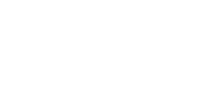




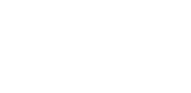

Bagging at training time
N subsets (with replacement)
Training set

Slide 8









Bagging at inference time
A test sample
75% confidence

Slide 9
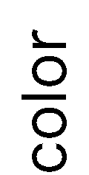













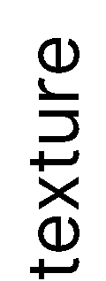
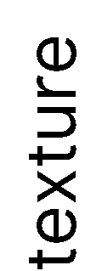















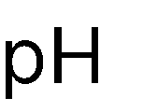





Random Subspace Method at training time
Training data

Slide 10






Random Subspace Method at inference time
A test sample
66% confidence

Slide 11

















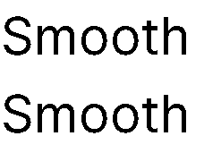








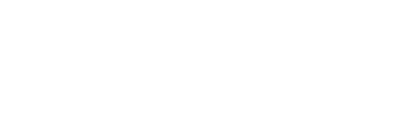

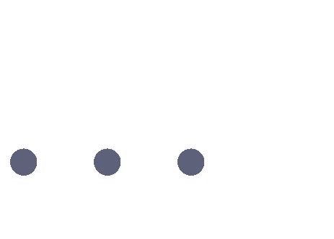






Random Forests
Tree 1
Tree 2
Random Forest
Tree N

Slide 12
Random Forests Algorithm
For b = 1 to B:
(a) Draw a bootstrap sample Z∗ of size N from the training data.
(b) Grow a random-forest tree to the bootstrapped data, by recursively repeating the following steps for each terminal node of the tree, until the minimum node size n_{min} is reached.
i. Select m variables at random from the p variables.
ii. Pick the best variable/split-point among the m.
iii. Split the node into two daughter nodes.
To make a prediction at a new point x we do:
For regression: average the results
For classification: majority vote
Output the ensemble of trees.

Slide 13
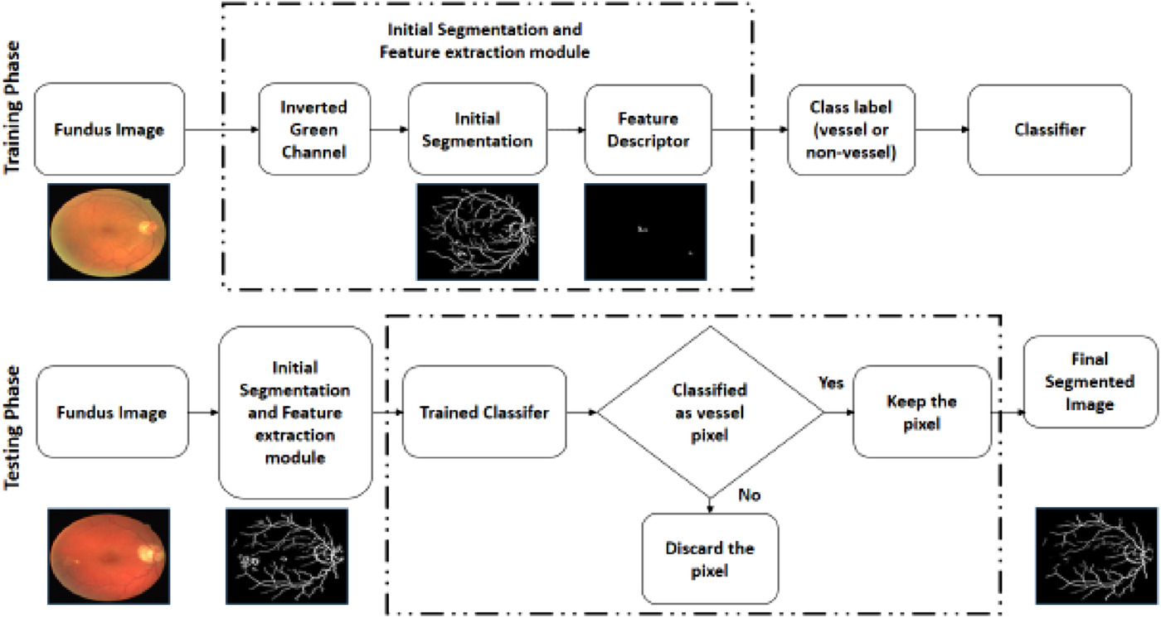
Case Study
An innovate approach for retinal blood vessel segmentation using mixture of supervised and unsupervised methods
IET Image Processing, Volume: 15, Issue: 1, Pages: 180-190, First published: 30 November 2020, DOI: (10.1049/ipr2.12018)

Slide 14
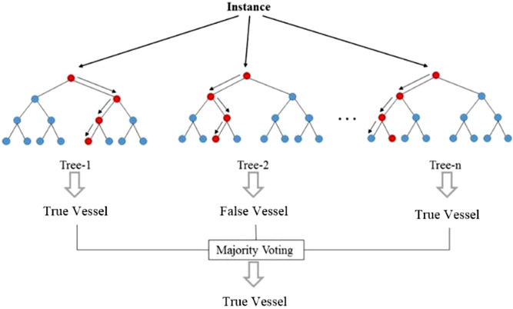
Case Study
An innovate approach for retinal blood vessel segmentation using mixture of supervised and unsupervised methods
IET Image Processing, Volume: 15, Issue: 1, Pages: 180-190, First published: 30 November 2020, DOI: (10.1049/ipr2.12018)

Slide 15
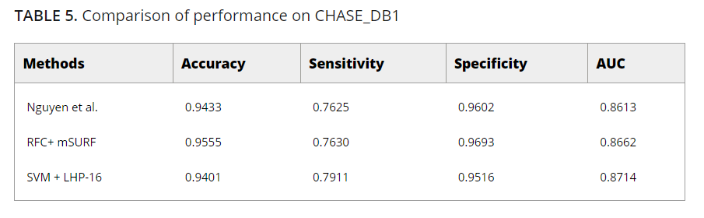
Case Study
An innovate approach for retinal blood vessel segmentation using mixture of supervised and unsupervised methods
IET Image Processing, Volume: 15, Issue: 1, Pages: 180-190, First published: 30 November 2020, DOI: (10.1049/ipr2.12018)

Slide 16
Why a Random Forest?
Accurate predictions
Standard decision trees often have high variance and low bias High chance of overfitting (with ‘deep trees’, many nodes)
With a Random Forest, the bias remains low and the variance is reduced thus we decrease the chances of overfitting
Flexible
Can be used with many features
Can be used for classification but also for regression
Disadvantages:
When the number of variables is large, but the fraction of relevant variables is small, random forests are likely to perform poorly when m is small

Slide 17
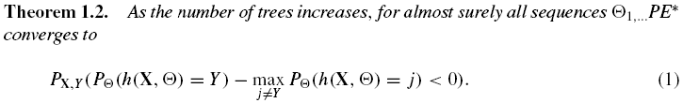
Characterizing the accuracy of RF
Margin function:
which measures the extent to which the average number of votes at X,Y for the right class exceeds the average vote for any other class. The larger the margin, the more confidence in the classification.
Generalization error:

Slide 18


Characterizing the accuracy of RF
Margin function for a random forest:
strength of the set of classifiers is
suppose is the mean value of correlation
the smaller,
the better

Slide 19
References
[1] Breiman, Leo. "Random forests." Machine learning 45 (2001): 5-32.
[2] Faculty of Mathematics and Computer Science, University of Bucharest. (n.d.). Practical Machine Learning [Decision Trees, Random Forests]. Practical Machine Learning. Retrieved May 1, 2023, from https://practical-ml-fmi.github.io/ML/
[3] Pramoditha, R. (2020, October 29). Random forests - an ensemble of decision trees. Medium. https://towardsdatascience.com/random-forests-an-ensemble-of-decision-trees-37a003084c6c

Slide 20
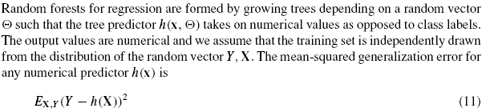

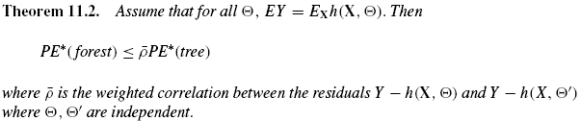
Random forests for regression

Slide 21
Thank you!

