Slide 1
INTEGRATIVE PROJECT OF THE 4TH SEMESTER OF LEI-ISEP Sprint C
29/05/2022
lei21_22_s4_2dg_04
Members:
João Beires nº 1190718
José Soares nº 1190782
José Maia nº 1191419
Lourenço Melo nº 1190811

Slide 2
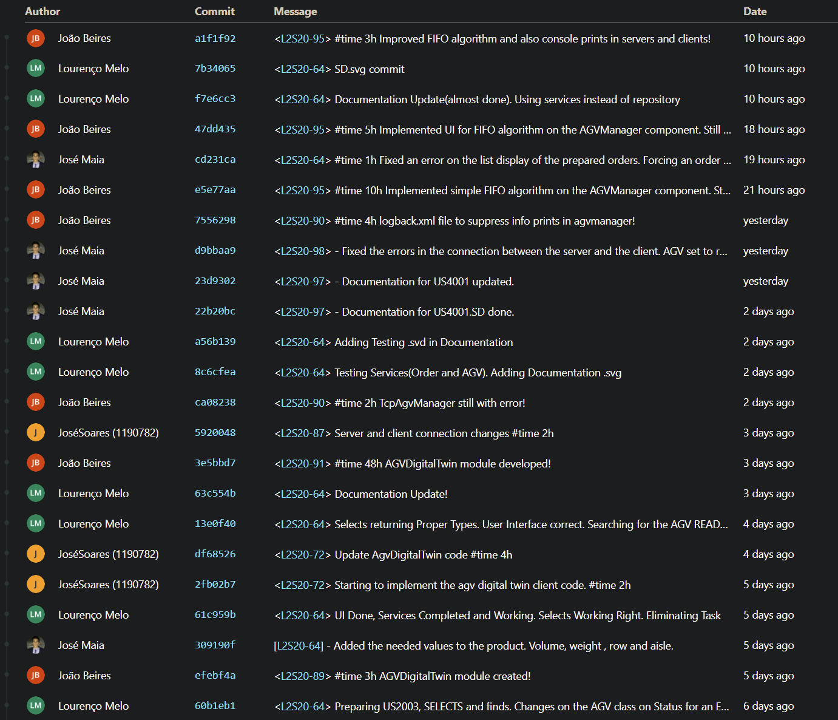
Commits
Commits were made with the issue tag in order to connect the commit with the jira issue.
We tried to make the descriptions brief and with all the important changes made.

Slide 3
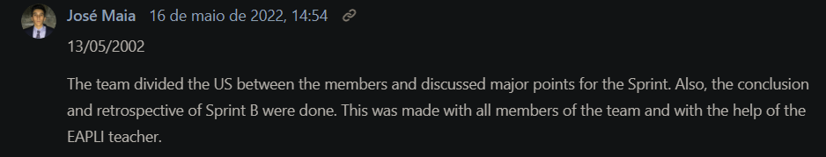
Documentation of the team, decisions and reunions
The log where this is documented can be found in this issue :
This was done by adding a comment in the issue with the date of the reunion and the made decisions :

Slide 4
Completed activities
ID | Atividade | Responsável | Baseline | Real | Estado
L2S20-64 | US2003 | Lourenço Melo | Início: 09-04-2020 Fim: 29-05-2020 | Início: 09-04-2020 Fim: 29-05-2020 | ✓
L2S20-65 | US2004 | José Soares | Início: 09-04-2020 Fim: 29-05-2020 | Início: 09-04-2020 Fim: 29-05-2020 | ✓
L2S20-66 | US2005 | Team | Início: 09-04-2020 Fim: 29-05-2020 | Início: 09-04-2020 Fim: 29-05-2020 | ✓
L2S20-69 | US4001 | José Maia | Início: 09-04-2020 Fim: 29-05-2020 | Início: 09-04-2020 Fim: 29-05-2020 | ✓
L2S20-70 | US4002 | João Beires | Início: 09-04-2020 Fim: 29-05-2020 | Início: 09-04-2020 Fim: 29-05-2020 | ✓
L2S20-71 | US5001 | Team | Início: 09-04-2020 Fim: 29-05-2020 | Início: 09-04-2020 Fim: 29-05-2020 | ✓
L2S20-72 | US5002 | Team | Início: 09-04-2020 Fim: 29-05-2020 | Início: 09-04-2020 Fim: 29-05-2020 | ✓

Slide 5
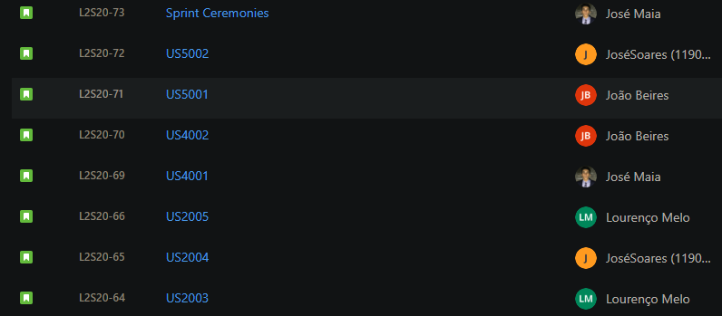
Division of tasks on jira
The tasks were divided has we saw in the previous slide, but jira didn´t allow to assign more than one member to a issue.

Slide 6
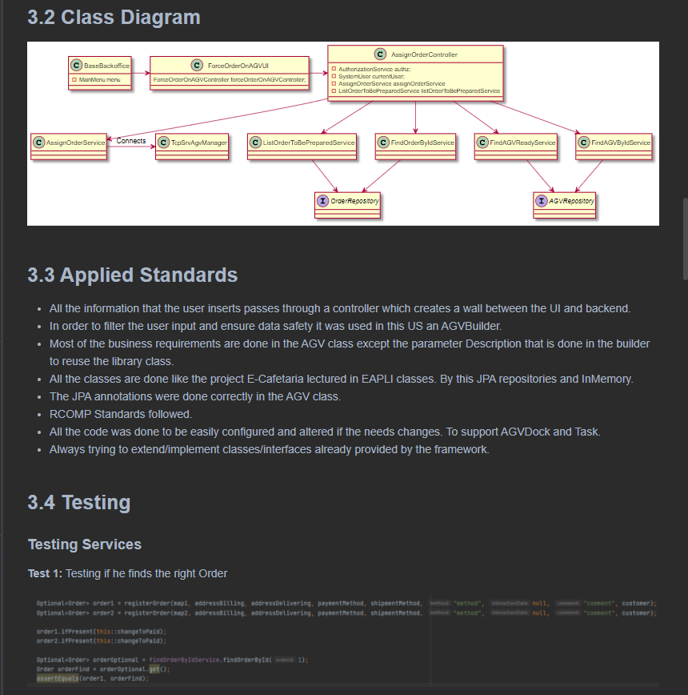
Documentation
The documentation of the US’s is stored on the “docs” directory.

Slide 7
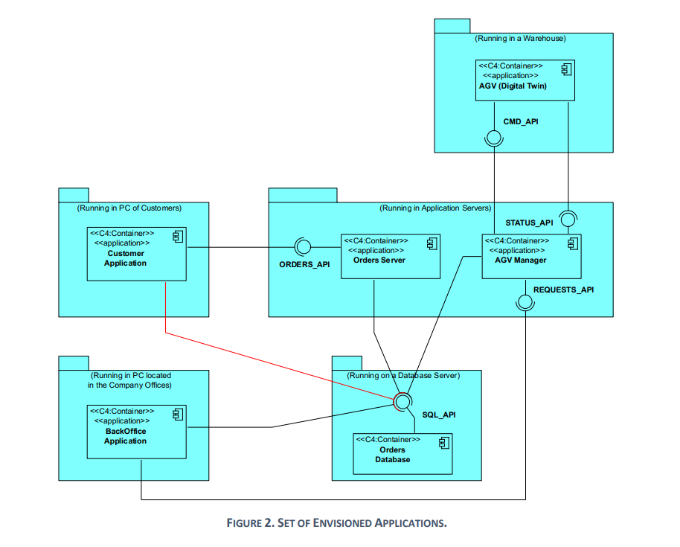
Application

Slide 8
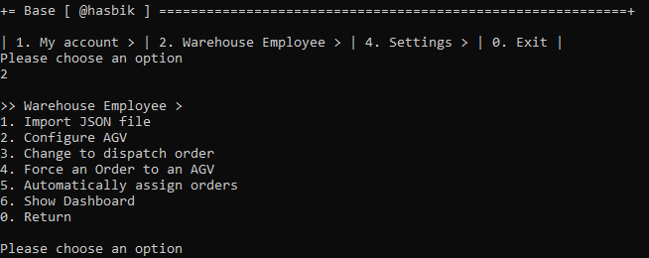
Warehouse Employee menu

Slide 9
INTEGRATIVE PROJECT OF THE 4TH SEMESTER Sprint C
29/05/2022

