Slide 1

Grupo 2DG_04
João Beires – 1190718
José Soares – 1190782
Lourenço Melo – 1190811
José Maia - 1191419

Slide 2
Methodology
Task management tools like Jira.
Smart commits to associate Jira issues with Bitbucket commits.
Used Jira to log time.
Merge tool allowing that multiple people could work simultaneously on the project.
Important meetings and decisions were logged in Jira.
The team had consistent meetings and everyone helped eachother.

Slide 3

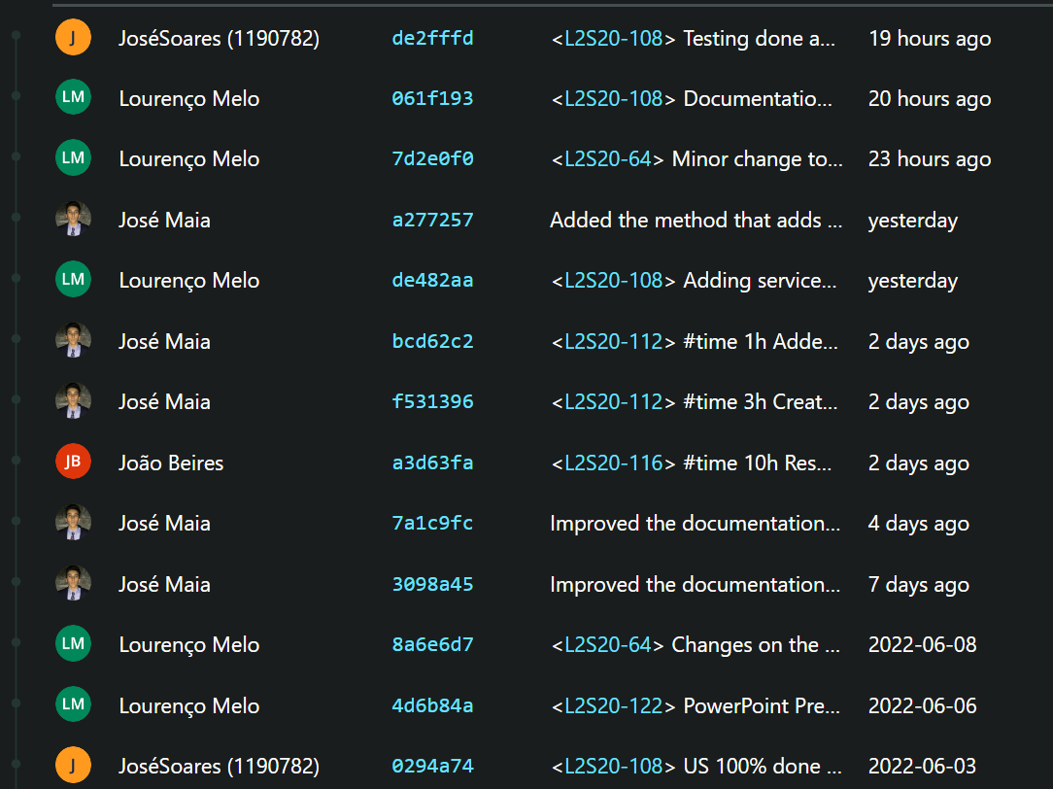

Commits

Slide 4

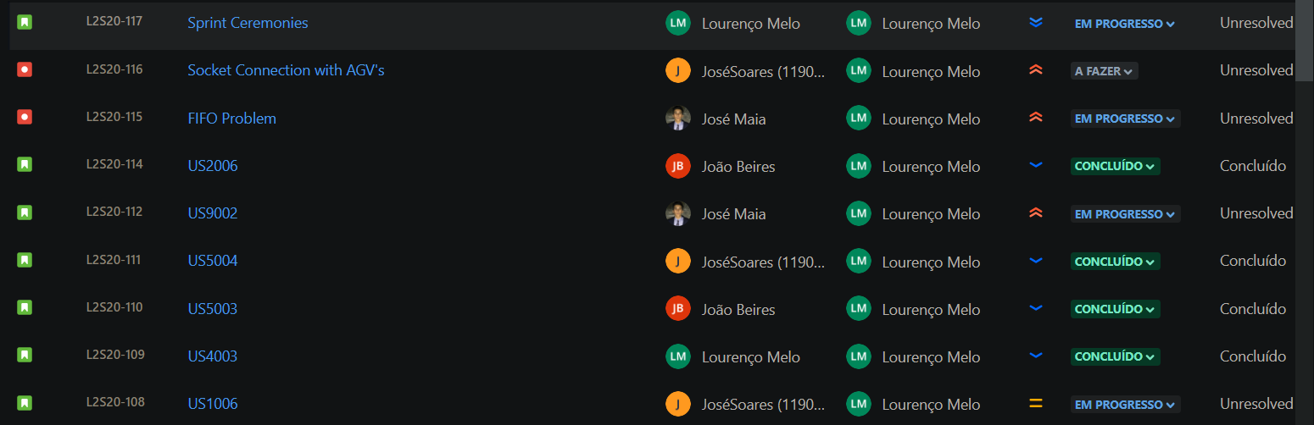
Tasks division

Slide 5
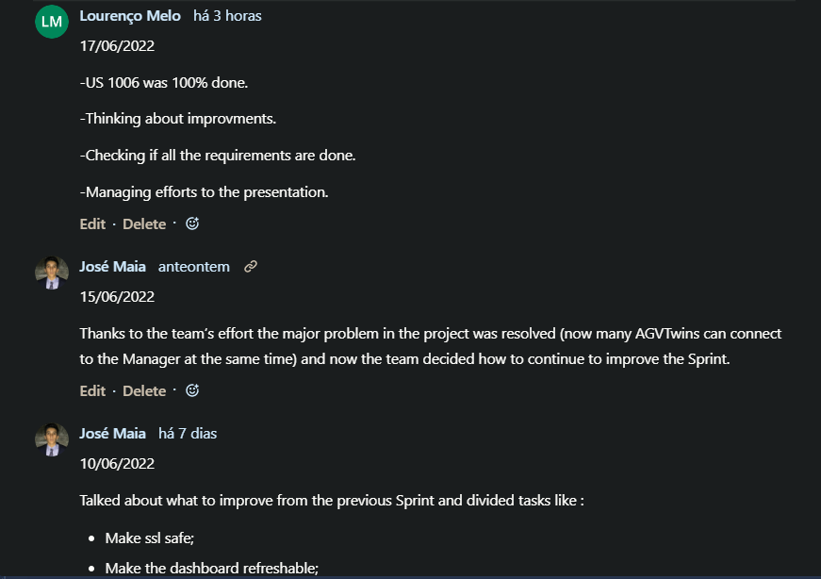
Sprint Ceremonies

Slide 6
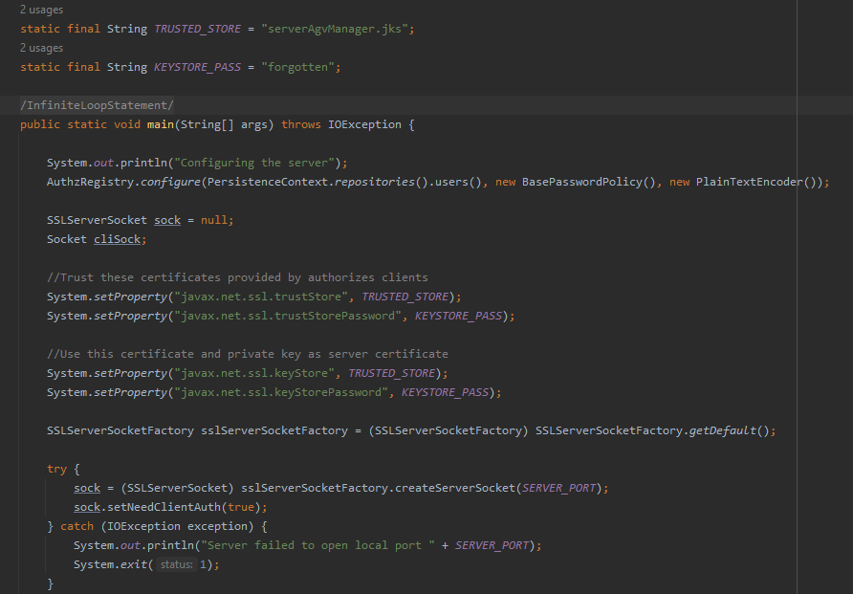
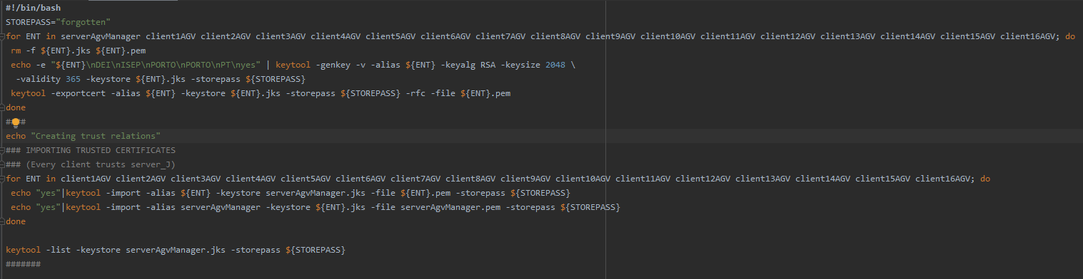
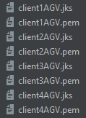

SSL Certificates

Slide 7

Thank You For Your Attention
lei21_22_s4_2dg_04

