Slide 1
EQUINOR – IFP collaboration: Machine Learning Miniprojects
Production Forecast using data driven techniques

Slide 2
Project: Production forecast using data-driven techniques
The relationship between petrophysical parameters, production conditions, and hydrocarbon volumes is nonlinear. Proposing a relationship among them using conventional mathematical approaches can be challenging. Data-driven approaches, such as machine learning, can capture the complex interplay between these parameters and make predictions about production volumes.
This mini-project focuses on developing predictions based on production data from a single well in the Volve field. The independent variables for this problem include downhole pressure, temperature, and fluid production volumes. Participants are encouraged to employ a variety of supervised machine learning techniques to forecast the hydrocarbon production of the well in the Volve field.
Case study:
  VOLVE Field. Production Data.
Method:
  Supervised Learning - Regression:
  Linear regression / Ridge regression / Random Forest / Neural networks (Deep Learning)
Notes:
The production data of a single well will be divided into train and testing sets.
02_production_data_forecast_using_data_driven_approaches

Slide 3
Proposed Workflow
Get the data.
Explore the data
  What is this data about?
  What are the distributions like?
  Are there any outliers? Missing values?
  Are the features correlated?
  …
Prepare the data
  What transformations are necessary? Standardize vs Normalize?
  What to do with the missing values? Impute? Delete?
  Are all the features useful?
  …
What models could tackle this project?
  Initial screening of performance.
  Be mindful of the input that each model needs. Standardization/ Normalization might be detrimental in some cases (e.g. Decision Trees) and necessary in others.
Tuning.
  At this time, you might have already shortlisted the models you want to develop. Which hyperparameters are best?
Present your results.
  Use visualizations to convey the most important parts of the project in a clear way.
Hint: explore scikit-learn pipelines!

Slide 4

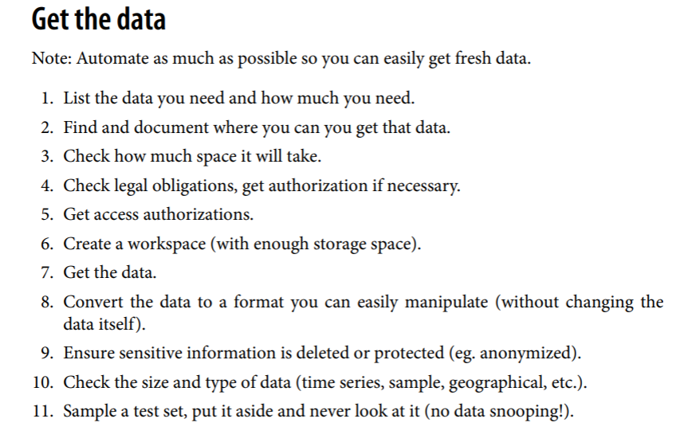
Where to start?
Hands_On_Machine_Learning_with_Scikit_Learn_and_TensorFlow-427-432.pdf (unicamp.br)

Slide 5

Github (not a requirement, but a life-saver tool!)
- The beginner's guide to Git & Github: The beginner’s guide to Git & GitHub (freecodecamp.org)
But…what is Git?
In simple words:
An easy way to keep your code up to date, while collaborating with your team.
Free, open-source version control software.
Some useful links:
Tip: you can integrate it with your vscode and make your life easier.
- Getting started with Git: Getting started with Git - GitHub Docs
- QuickStart with Github: Quickstart - GitHub Docs
- Git documentation: Git - Documentation (git-scm.com) (my favorite so far)

Slide 6
EQUINOR – IFP collaboration: Machine Learning Miniprojects
Maria Betania Cedeno Tepedino – Data scientist subsurface.

Slide 7

Anuttida Vesprasit.
Tamil Selvan Pandurangan
Project: Facies classification using Machine Learning
The dataset originates from a course at The University of Kansas. Its aim is to predict facies using well log data. The emphasis of this project is on supervised learning. Wireline log data, including gamma-ray (GR), induction logging deep resistivity (ILD), porosity (PHI), neutron porosity, and photoelectric effect (PE), have been integrated with core descriptions. Additionally, each data point encompasses two geological constraining variables: a nonmarine-marine indicator and the relative position. By combining these datasets, participants are invited to devise and implement one or more solutions to address this classification challenge. Well-log data from nine wells is available for analysis.
Case study:
  Gas fields in North America. The Hugoton and Panoma fields
Method:
  Supervised Learning - Classification:
  Support Vector Machines/ Random Forest / Multilayer Perceptron
Dataset: IFP_ML_Miniprojects/01_facies_classification/00_data/02_SEG_2016_ml_contest at main · vescequi/IFP_ML_Miniprojects (github.com)
Notes:
About comment:
Even though it is a gas field, some F1 scores obtained by different methods range from 0,38 (SVM) to 0,52 (Multilayer Perceptron) The F1 score from the initial publication was 0.47.
Should we set a test and train data?
9 wells + 1 pseudowell. 4149 observations in total

Slide 8

Project: 2021 SPWLA Well-log based reservoir property estimation with machine learning
Noa Luzinski.
Aliona Potilitsina.
Well log interpretation is a key component of reservoir modeling and reserve estimation. Typically, petrophysicists perform interpretations to estimate reservoir properties. However, if sufficient training data is available, data-driven methods can be employed. The goal of this contest is to create data-driven models that estimate reservoir properties such as shale volume, porosity, and fluid saturation from a standard set of well logs. The provided wireline logs to be used include gamma ray, bulk density, neutron porosity, resistivity, and sonic. This mini-project serves as an example of supervised learning, with a particular focus on regression.
Case study:
  VOLVE Field / SPWLA 2021 open-source data.
Method:
  Supervised learning – Regression:
  Non-parametric regression / Neural Networks / Random forest.
Dataset: IFP_ML_Miniprojects/03_well_log_based_reservoir_property_estimation/00_data at main · vescequi/IFP_ML_Miniprojects (github.com)

