Slide 1
Theory Of Computation

Slide 2
Meet Your Presenter
Name: Anshul Shukla
Roll-Number: IC-2K20-12 Course: MCA(5-Years) Semester: 8th Semester Institute: International Institute of Professional Studies, Devi Ahilya University
Type 0,1,2,3- Grammar:

Slide 3
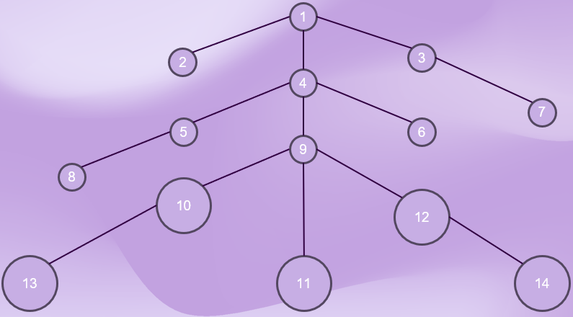
Write the labels of the nodes of the following derivation tree T which are not labelled. It is given that T is the derivation tree whose yield is in {a, b}*
Question 12:
1
2
3
4
7
5
6
9
8
10
12
13
11
14

Slide 4
Question 12:
Write the labels of the nodes of the following derivation tree T which are not labelled. It is given that T is the derivation tree whose yield is in {a, b}*
Let's denote the nodes of the derivation tree T with labels according to the symbols in the yield of the tree.
Given that the yield is in {a, b}*
A
b
A
A
A
b
a
a
A
A
b
A
ε
ε
A
1
b
A
2
3
4
A
a
7
6
A
b
5
9
A
8
10
a
12
A
A
13
11
ε
14
ε
b

Slide 5
A
b
A
A
A
b
a
a
A
A
b
A
ε
ε
A
1
b
A
2
3
A
a
4
7
A
b
5
6
A
a
9
A
A
8
10
12
ε
b
ε
13
11
14

