Slide 1
Tutorial on TensorFlow

Slide 2
Introduction

Slide 3
TensorFlow
Interface for expressing machine learning algorithms, and an implementation for executing large-scale algorithms
Dataflow framework that compiles to native CPU / GPU code
Auto-differentiation autodiff (no more taking derivatives by hand)
Drastic reduction in development time
Visualization (TensorBoard)
https://www.tensorflow.org/

Slide 4
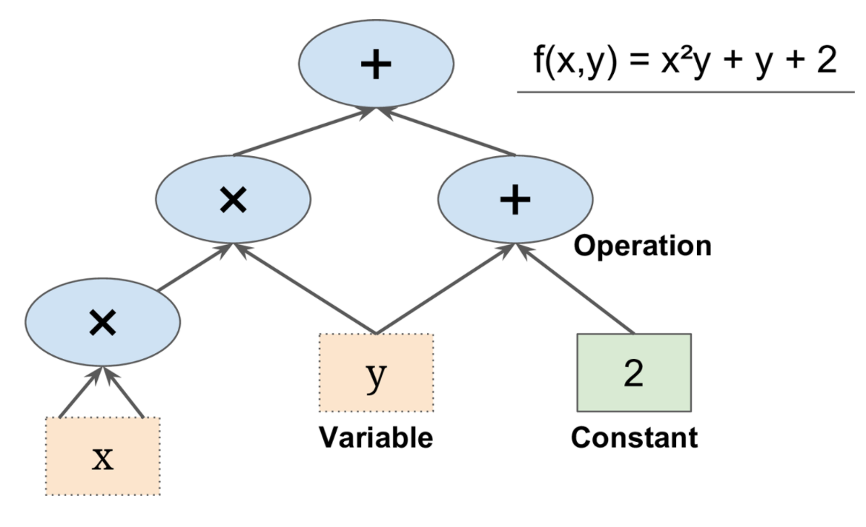
Programming Model
Express a numeric computation as a graph
Graph nodes are operations which have any number of inputs and outputs
Graph edges are tensors which flow between nodes

Slide 5
What’s a Tensor?
An n-dimensional array
0-d tensor: scalar (number)
1-d tensor: vector
2-d tensor: matrix
….

Slide 6
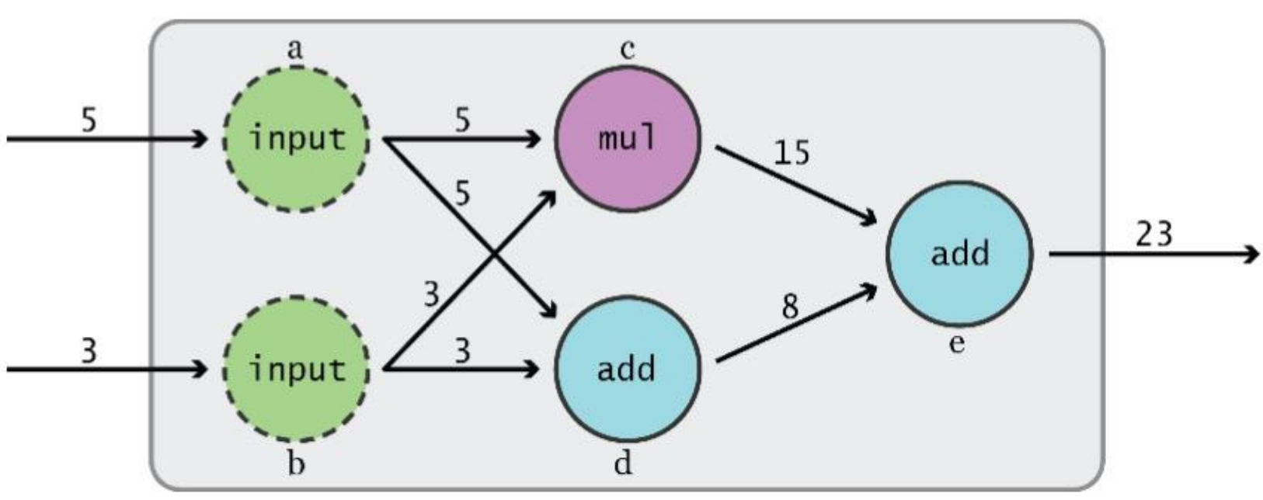
Data Flow Graphs
TensorFlow separates definition of computations from their execution:
Phase 1: assemble a graph
Phase 2: use a session to execute operations in the graph.

Slide 7
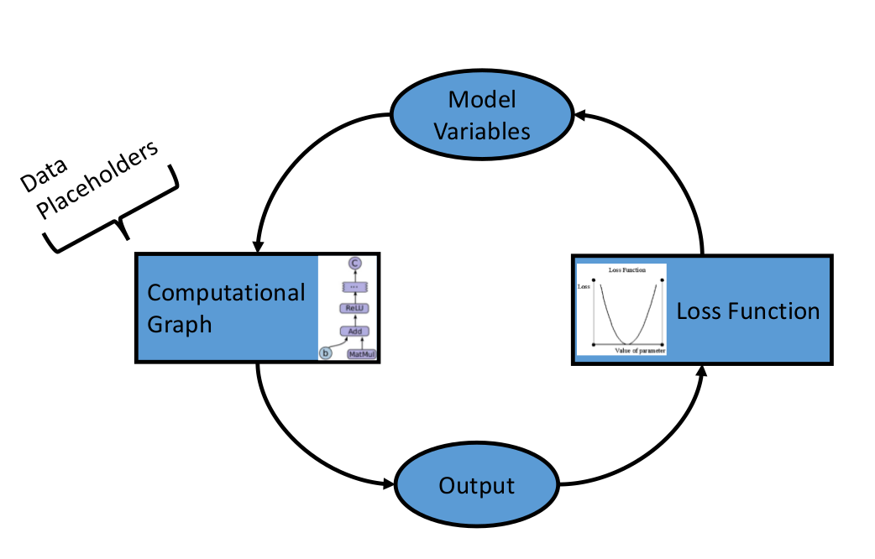
How does it work
Import data, generate data, or setup a data-pipeline through placeholders.
Feed data through computational graph.
Evaluate output on loss function.
Use backpropagation to modify the variables.
Repeat until stopping condition.

Slide 8
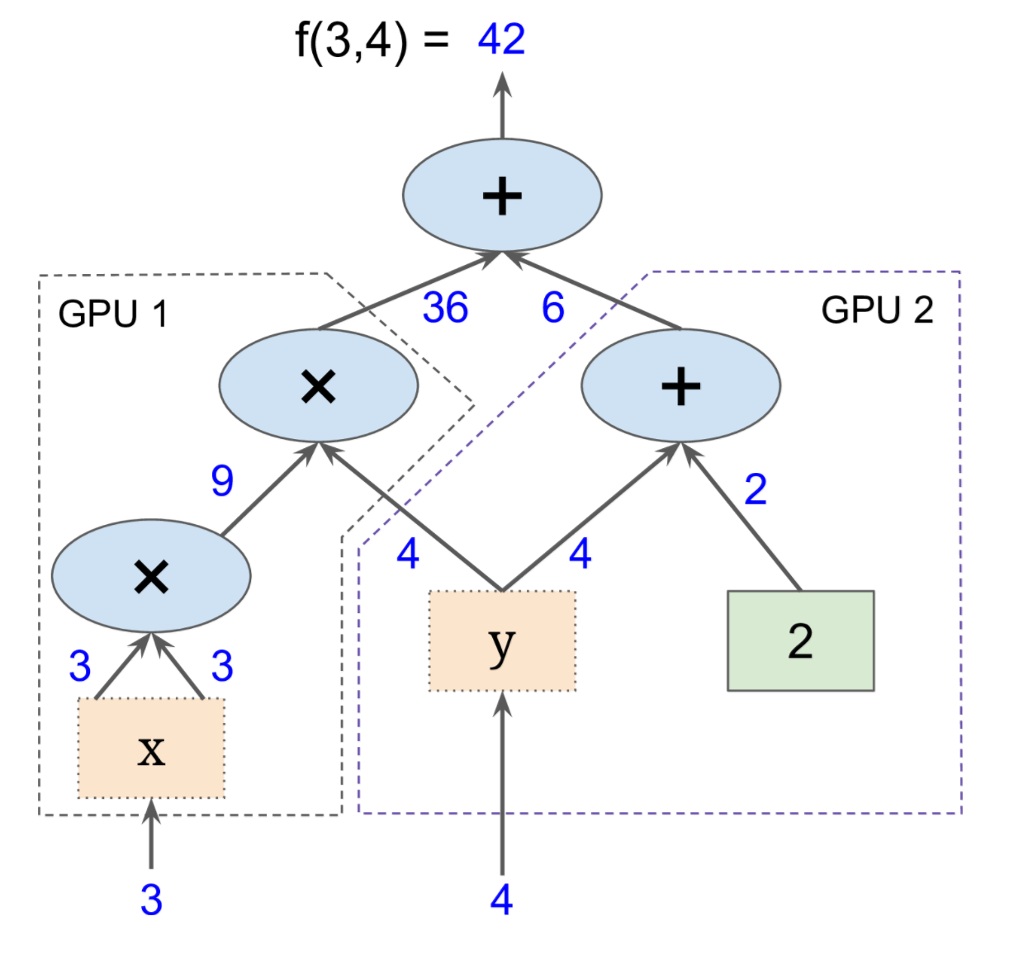
Big Data: Distributed Environment
Portability: deploy computation to one or more CPUs or GPUs in a desktop, server, or mobile device with a single API

Slide 9
Basic Usage

Slide 10
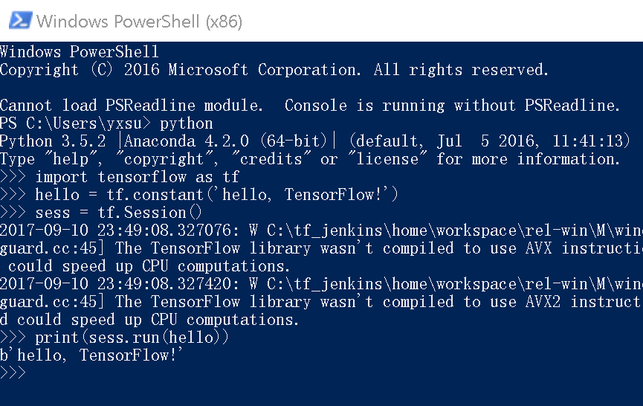
Installation
Windows:
Install python 3.5 from: https://repo.continuum.io/archive/Anaconda3-4.2.0-Windows-x86_64.exe
Open Windows PowerShell, then install tensorflow by typing:
$ pip install tensorflow
Notes: if you have GPU and CUDA installed, try tensorflow-gpu, it will be much faster.
Validate your installation:
Type the following contents in python:
>>> import tensorflow as tf >>> hello = tf.constant('Hello, TensorFlow!') >>> sess = tf.Session() >>> print(sess.run(hello))

Slide 11
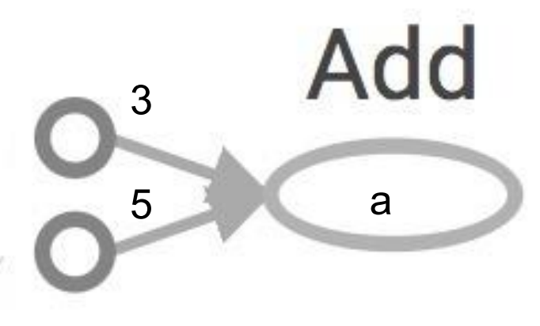
Operators and Variables
import tensorflow as tf
a = tf.add(3, 5)
Nodes:
Operators, variables and constants
Edges:
Tensors

Slide 12
Session: How to obtain the value of a
Create a session, assign it to variable
Within the session, evaluate the graph to fetch the value of a
import tensorflow as tf
a = tf.add(3, 5)
sess = tf.Session()
print sess.run(a)
Or:
import tensorflow as tf
a = tf.add(3, 5)
with tf.Session() as sess:
print sess.run(a)

Slide 13
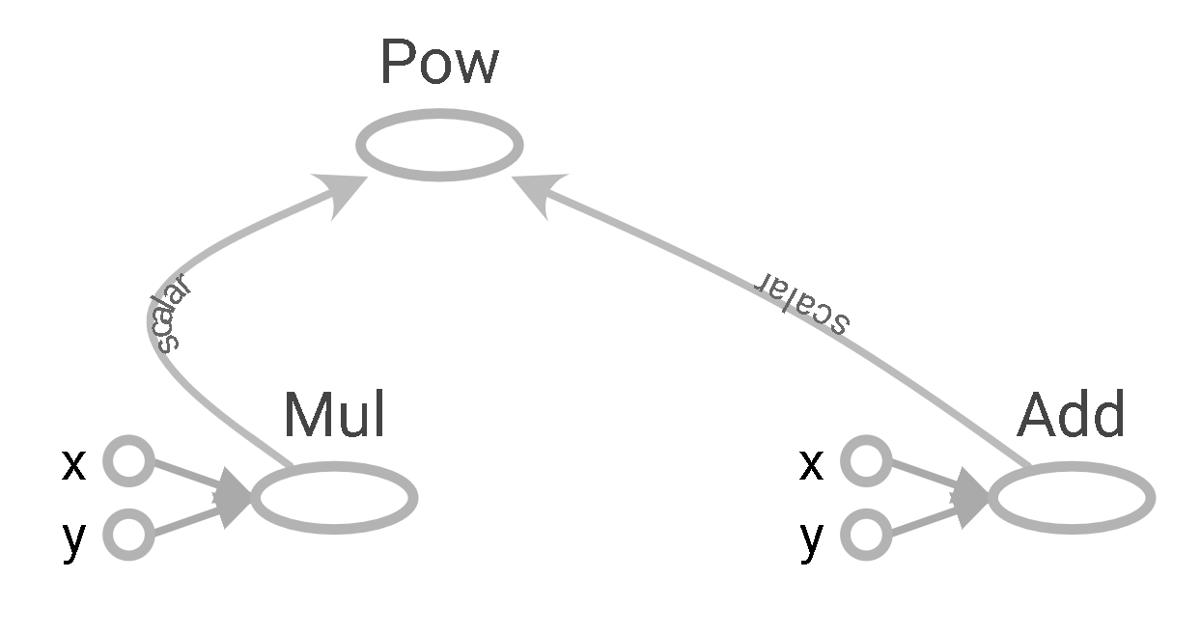
More Graphs
import tensorflow as tf
x = 2
y = 3
op1 = tf.add(x, y)
op2 = tf.multiply(x, y)
op3 = tf.pow(op2, op1)
with tf.Session() as sess:
op3 = sess.run(op3)

Slide 14
More Basic Operators
Arithmetic Operators
Subtraction | tf.subtract(x, y, name=None)
Multiplies a scalar times a Tensor | tf.scalar_mul(scalar, x)
Element-wise division | tf.div(x, y, name=None)
Python style division | tf.divide(x, y, name=None)
Element-wise remainder of division | tf.mod(x, y, name=None)
Transformation
Convert string to number | tf.string_to_number(string_tensor, out_type=None, name=None)
The size of a tensor | tf.size(input, name=None, out_type=tf.int32)
Split a tensor | tf.split(split_dim, num_split, value, name='split')
See all available operators: https://www.tensorflow.org/versions/r0.12/api_docs/python/

Slide 15
Matrix Operations
Matrix Operations | Code
Identity matrix | identity_matrix = tf.diag([1.0,1.0,1.0]) print(sess.run(identity_matrix))
2x3 random norm matrix | A = tf.truncated_normal([2,3]) print(sess.run(A))
2x3 constant matrix | B = tf.fill([2,3], 5.0) print(sess.run(B))
Create matrix from np array | D = tf.convert_to_tensor(np.array([[1., 2., 3.], [-3., -7., -1.], [0., 5., -2.]])) print(sess.run(D))
Matrix Multiplication | print(sess.run(tf.matmul(B, identity_matrix)))
Matrix Determinant | print(sess.run(tf.matrix_determinant(D)))
Matrix Inverse | print(sess.run(tf.matrix_inverse(D)))
Eigenvalues and Eigenvectors | print(sess.run(tf.self_adjoint_eig(D)))

Slide 16
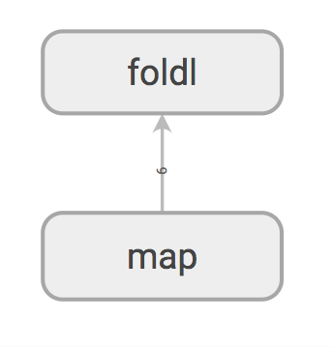
MapReduce Style Operators
Definitions
Map Operator | tf.map_fn(fn, elems, name=None)
Reduce from the first to the last | tf.foldl(fn, elems, name=None)
Reduce from the last to the first | tf.foldr(fn, elems, name=None)
import tensorflow as tf
import numpy as np
elements = tf.constant([1,2,3,4,5,6], name="input_data")
mapped_elems = tf.map_fn(lambda x: x * x, elements)
reduced_elem = tf.foldl(lambda a, x: a + x, mapped_elems)
sess = tf.Session()
sess.run(reduced_elem)
# will return 91 = 1*1 + 2*2 + 3*3 + 4*4 + 5*5 + 6*6

Slide 17
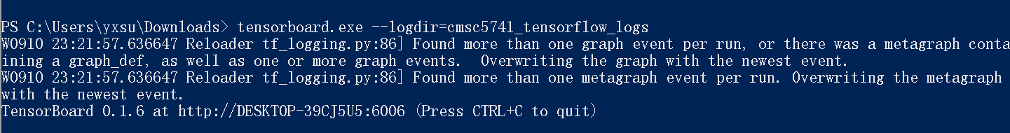
How to show the computation graph: TensorBoard
import tensorflow as tf
x = 2
y = 3
op1 = tf.add(x, y)
op2 = tf.multiply(x, y)
op3 = tf.pow(op2, op1)
sess = tf.Session()
op3 = sess.run(op3)
tf.summary.merge_all()
writer = tf.summary.FileWriter("cmsc5741_tensorflow_logs", sess.graph)
After executing the above code, type “tensorboard.exe –logdir=cmsc5741_tensorflow_logs
Use your browser to open the address displayed like the following example:

Slide 18
Applications

Slide 19
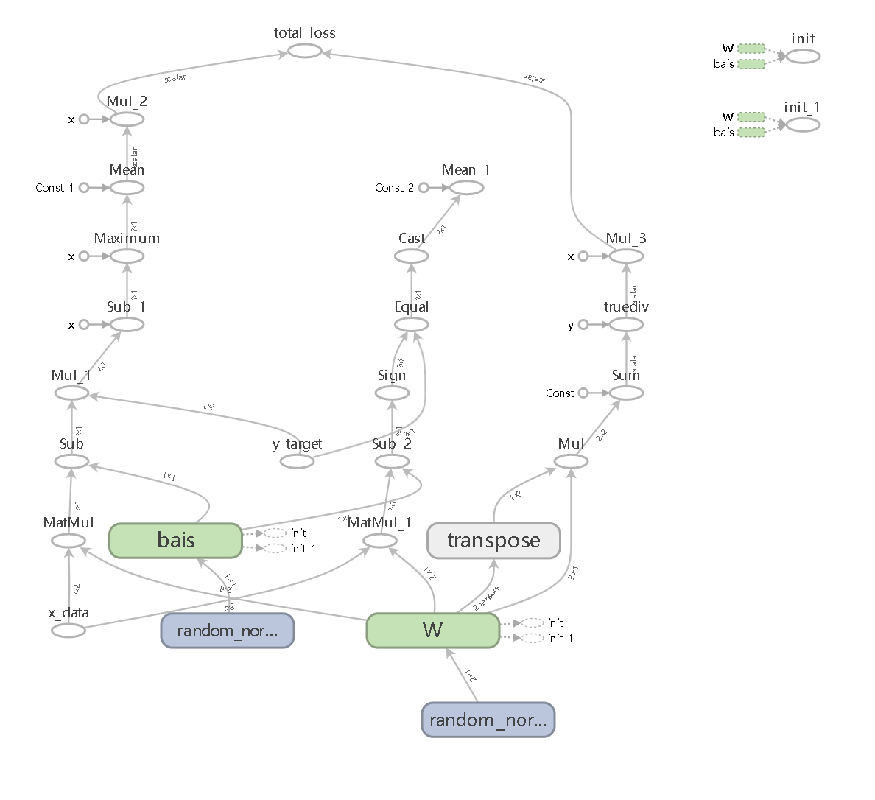
SVM Classification on TensorFlow
SVM will be introduced in Week 10
Define loss function
def loss_fn(W,b,x_data,y_target):
logits = tf.subtract(tf.matmul(x_data, W),b)
norm_term = tf.divide(tf.reduce_sum(tf.multiply(tf.transpose(W),W)),2)
classification_loss = tf.reduce_mean(tf.maximum(0., tf.subtract(delta, tf.multiply(logits, y_target))))
total_loss = tf.add(tf.multiply(C_param,classification_loss), tf.multiply(Reg_param,norm_term))
return total_loss

Slide 20
SVM Classification on TensorFlow
Define the training operator
x_data = tf.placeholder(shape=[None, X.shape[1]], dtype=tf.float32)
y_target = tf.placeholder(shape=[None, 1], dtype=tf.float32)
W = tf.Variable(tf.random_normal(shape=[X.shape[1],1]))
bias = tf.Variable(tf.random_normal(shape=[1,1])) # Calculation of loss and accuracy.
total_loss = loss_fn(W, bias, x_data, y_target) # Defining train_op
train_op = tf.train.GradientDescentOptimizer(initial_learning_rate).minimize(total_loss)

Slide 21
SVM Classification on TensorFlow
Run
for step_idx in range(num_steps): # Get the batch of data.
X_batch, y_batch = next_batch_fn(x_train, y_train, num_samples=batch_size) # Run the optimizer.
sess.run(train_op, feed_dict={x_data: X_batch, y_target: y_batch}) # Calculation of loss and accuracy.
loss_step = sess.run(total_loss, feed_dict={x_data: X_batch, y_target: y_batch})
train_acc_step = sess.run(accuracy, feed_dict={x_data: x_train, y_target: np.transpose([y_train])})
test_acc_step = sess.run(accuracy, feed_dict={x_data: x_test, y_target: np.transpose([y_test])})

Slide 22
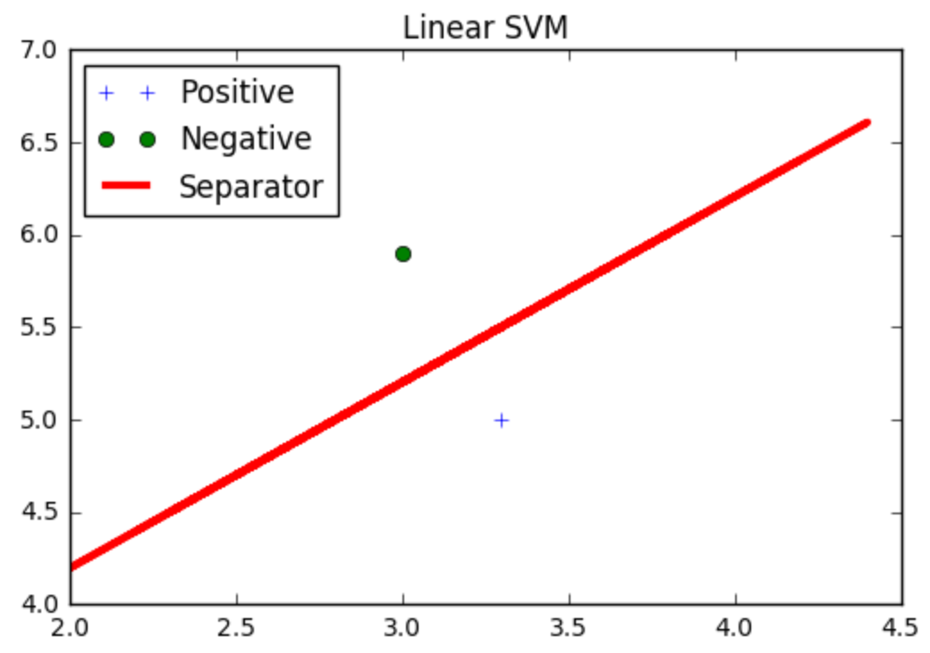
SVM Classification on TensorFlow
See the complete source code in note
Notes:
# coding: utf-8
# In[1]:
import matplotlib.pyplot as plt
import numpy as np
import tensorflow as tf
from sklearn import datasets
import random
import sys
# In[10]:
##########################
### Required Functions ###
##########################
delta = 1.0
Reg_param = 1.0
C_param = 0.1
batch_size = 32
num_steps = 3000
is_evaluation = True
initial_learning_rate=0.1
def loss_fn(W,b,x_data,y_target):
logits = tf.subtract(tf.matmul(x_data, W),b)
norm_term = tf.divide(tf.reduce_sum(tf.multiply(tf.transpose(W),W)),2)
classification_loss = tf.reduce_mean(tf.maximum(0., tf.subtract(delta, tf.multiply(logits, y_target))))
total_loss = tf.add(tf.multiply(C_param,classification_loss), tf.multiply(Reg_param,norm_term))
return total_loss
def inference_fn(W,b,x_data,y_target):
prediction = tf.sign(tf.subtract(tf.matmul(x_data, W), b))
accuracy = tf.reduce_mean(tf.cast(tf.equal(prediction, y_target), tf.float32))
return accuracy
def next_batch_fn(x_train,y_train,num_samples=batch_size):
index = np.random.choice(len(x_train), size=num_samples)
X_batch = x_train[index]
y_batch = np.transpose([y_train[index]])
return X_batch, y_batch
# In[11]:
##########################
### Dataset peparation ###
##########################
# Dataset loading and organizing.
iris = datasets.load_iris()
# Only the first two features are extracted and used.
X = iris.data[:, :2]
# The labels are transformed to -1 and 1.
y = np.array([1 if label==0 else -1 for label in iris.target])
# Get the indices for train and test sets.
my_randoms = np.random.choice(X.shape[0], X.shape[0], replace=False)
train_indices = my_randoms[0:int(0.5 * X.shape[0])]
test_indices = my_randoms[int(0.5 * X.shape[0]):]
# Splitting train and test sets.
x_train = X[train_indices]
y_train = y[train_indices]
x_test = X[test_indices]
y_test = y[test_indices]
# In[12]:
#############################
### Defining Placeholders ###
#############################
x_data = tf.placeholder(shape=[None, X.shape[1]], dtype=tf.float32)
y_target = tf.placeholder(shape=[None, 1], dtype=tf.float32)
W = tf.Variable(tf.random_normal(shape=[X.shape[1],1]))
bias = tf.Variable(tf.random_normal(shape=[1,1]))
# Calculation of loss and accuracy.
total_loss = loss_fn(W, bias, x_data, y_target)
accuracy = inference_fn(W, bias, x_data, y_target)
# Defining train_op
train_op = tf.train.GradientDescentOptimizer(initial_learning_rate).minimize(total_loss)
# In[13]:
###############
### Session ###
###############
sess = tf.Session()
# Initialization of the variables.
init = tf.initialize_all_variables()
sess.run(init)
# In[14]:
###############################
### Training the Linear SVM ###
###############################
for step_idx in range(num_steps):
# Get the batch of data.
X_batch, y_batch = next_batch_fn(x_train, y_train, num_samples=batch_size)
# Run the optimizer.
sess.run(train_op, feed_dict={x_data: X_batch, y_target: y_batch})
# Calculation of loss and accuracy.
loss_step = sess.run(total_loss, feed_dict={x_data: X_batch, y_target: y_batch})
train_acc_step = sess.run(accuracy, feed_dict={x_data: x_train, y_target: np.transpose([y_train])})
test_acc_step = sess.run(accuracy, feed_dict={x_data: x_test, y_target: np.transpose([y_test])})
# Displaying the desired values.
if (step_idx + 1) % 100 == 0:
print('Step #%d, training accuracy= %% %.2f, testing accuracy= %% %.2f ' % (step_idx + 1, float(100 * train_acc_step), float(100 * test_acc_step)))
# In[15]:
if is_evaluation:
[[w1], [w2]] = sess.run(W)
[[b]] = sess.run(bias)
x_line = [data[1] for data in X]
# Find the separator line.
line = []
line = [-w2/w1*i+b/w1 for i in x_line]
# coor_pos_list = [positive_X, positive_y]
# coor_neg_list = [negative_X, negative_y]
for index, data in enumerate(X):
if y[index] == 1:
positive_X = data[1]
positive_y = data[0]
elif y[index] == -1:
negative_X = data[1]
negative_y = data[0]
else:
sys.exit("Invalid label!")
# uncomment if plotting is desired!
# Plotting the SVM decision boundary.
plt.plot(positive_X, positive_y, '+', label='Positive')
plt.plot(negative_X, negative_y, 'o', label='Negative')
plt.plot(x_line, line, 'r-', label='Separator', linewidth=3)
plt.legend(loc='best')
plt.title('Linear SVM')
plt.show()

