Slide 1
DeepFake Audio Detection
GitHub Repository: https://github.com/LovatoTomas/DF_AudioDeepfakeDetection
Authors : Tomas Lovato, Alisea Bovo

Slide 2
Project Overview
2
This project focuses on detecting audio DeepFakes using the ASVspoof 2019 dataset, which includes 3 different datasets : Training Set, Development Set, and Evaluation Set with different distributions of spoofing techniques.
The goal is to evaluate preprocessing techniques and machine learning models to distinguish between bonafide (real) speech and spoofed audio.
Authors: Tomas Lovato, Alisea Bovo Digital Forensics 2024 / 2025 GitHub Repository: https://github.com/LovatoTomas/DF_AudioDeepfakeDetection

Slide 3
Dataset Details
3
Speaker Distribution:
Training: 20 speakers (8 male, 12 female)
Development: 20 speakers (8 male, 12 female)
Evaluation: 48 speakers (21 male, 27 female)
Samples:
Logical Access (LA): Training (25380), Dev (24844), Evaluation (80000)
Spoofing Techniques:
6 known attack types (TTS and VC) and 11 unknown attack types.
Authors: Tomas Lovato, Alisea Bovo Digital Forensics 2024 / 2025 GitHub Repository: https://github.com/LovatoTomas/DF_AudioDeepfakeDetection

Slide 4
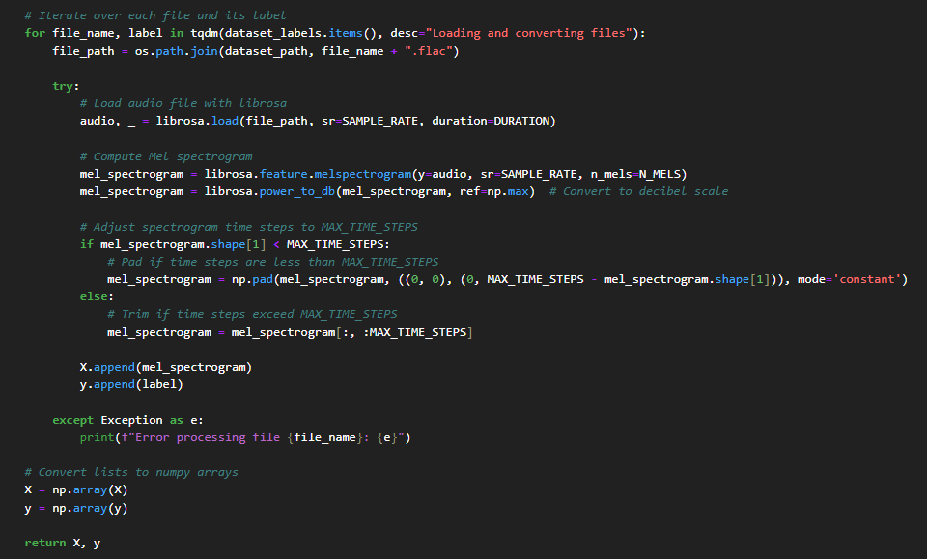

Audio Preprocessing Strategies #1
4
The real difference in the solutions lies in how it has been handle the input audio:
Mel Spectrogram (for CNN) :
Load audio with Librosa
Fixed sample rate: 16 kHz
Normalize audio in time
Pad or truncate to standard duration
Extract Mel spectrogram
Authors: Tomas Lovato, Alisea Bovo Digital Forensics 2024 / 2025 GitHub Repository: https://github.com/LovatoTomas/DF_AudioDeepfakeDetection

Slide 5
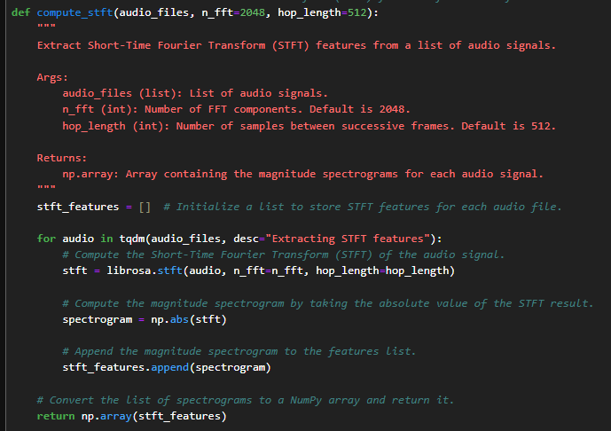
Audio Preprocessing Strategies #2
5
The real difference in the solutions lies in how it has been handle the input audio:
STFT Features (with dimensionality reduction):
Load audio with Librosa
Fixed sample rate: 16 kHz
Normalize audio in time
Scale values (normalization)
Extract STFT features
Reduce features
Authors: Tomas Lovato, Alisea Bovo Digital Forensics 2024 / 2025 GitHub Repository: https://github.com/LovatoTomas/DF_AudioDeepfakeDetection

Slide 6
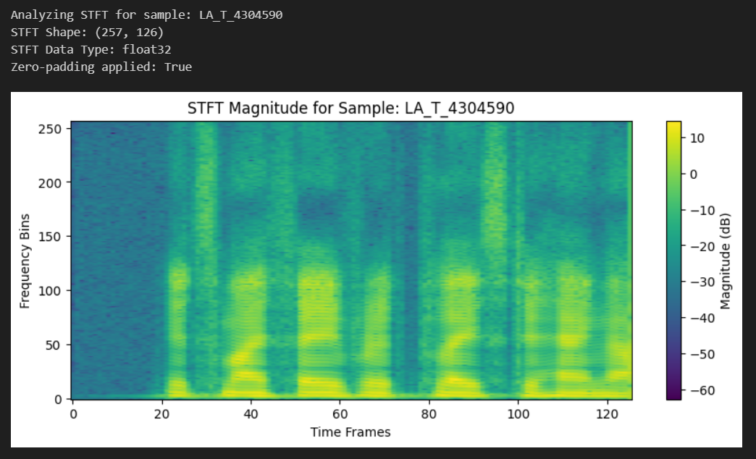
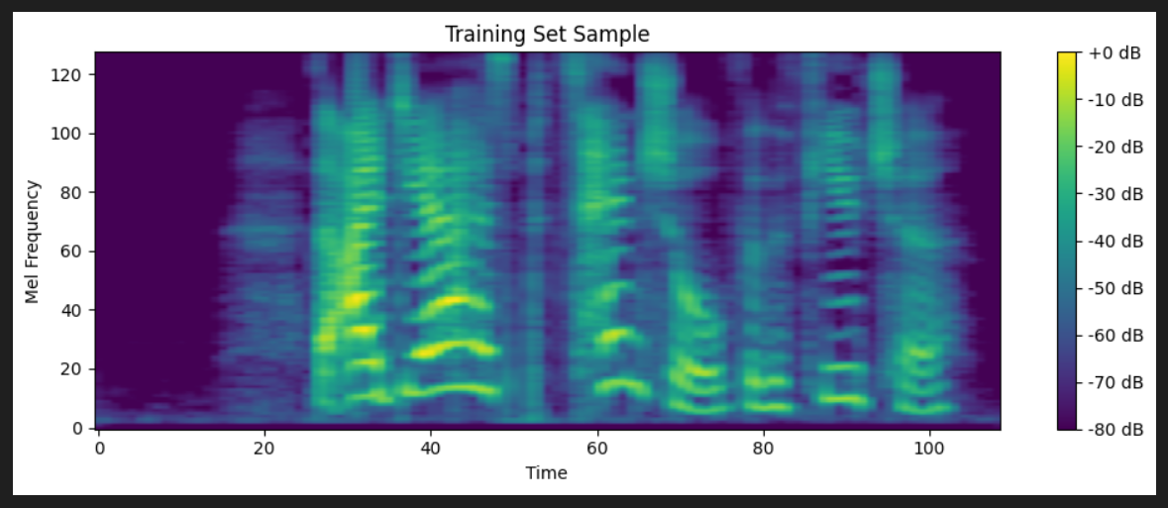
Some example:
6
MEL SPECTROGRAM
SFTF
Authors: Tomas Lovato, Alisea Bovo Digital Forensics 2024 / 2025 GitHub Repository: https://github.com/LovatoTomas/DF_AudioDeepfakeDetection

Slide 7
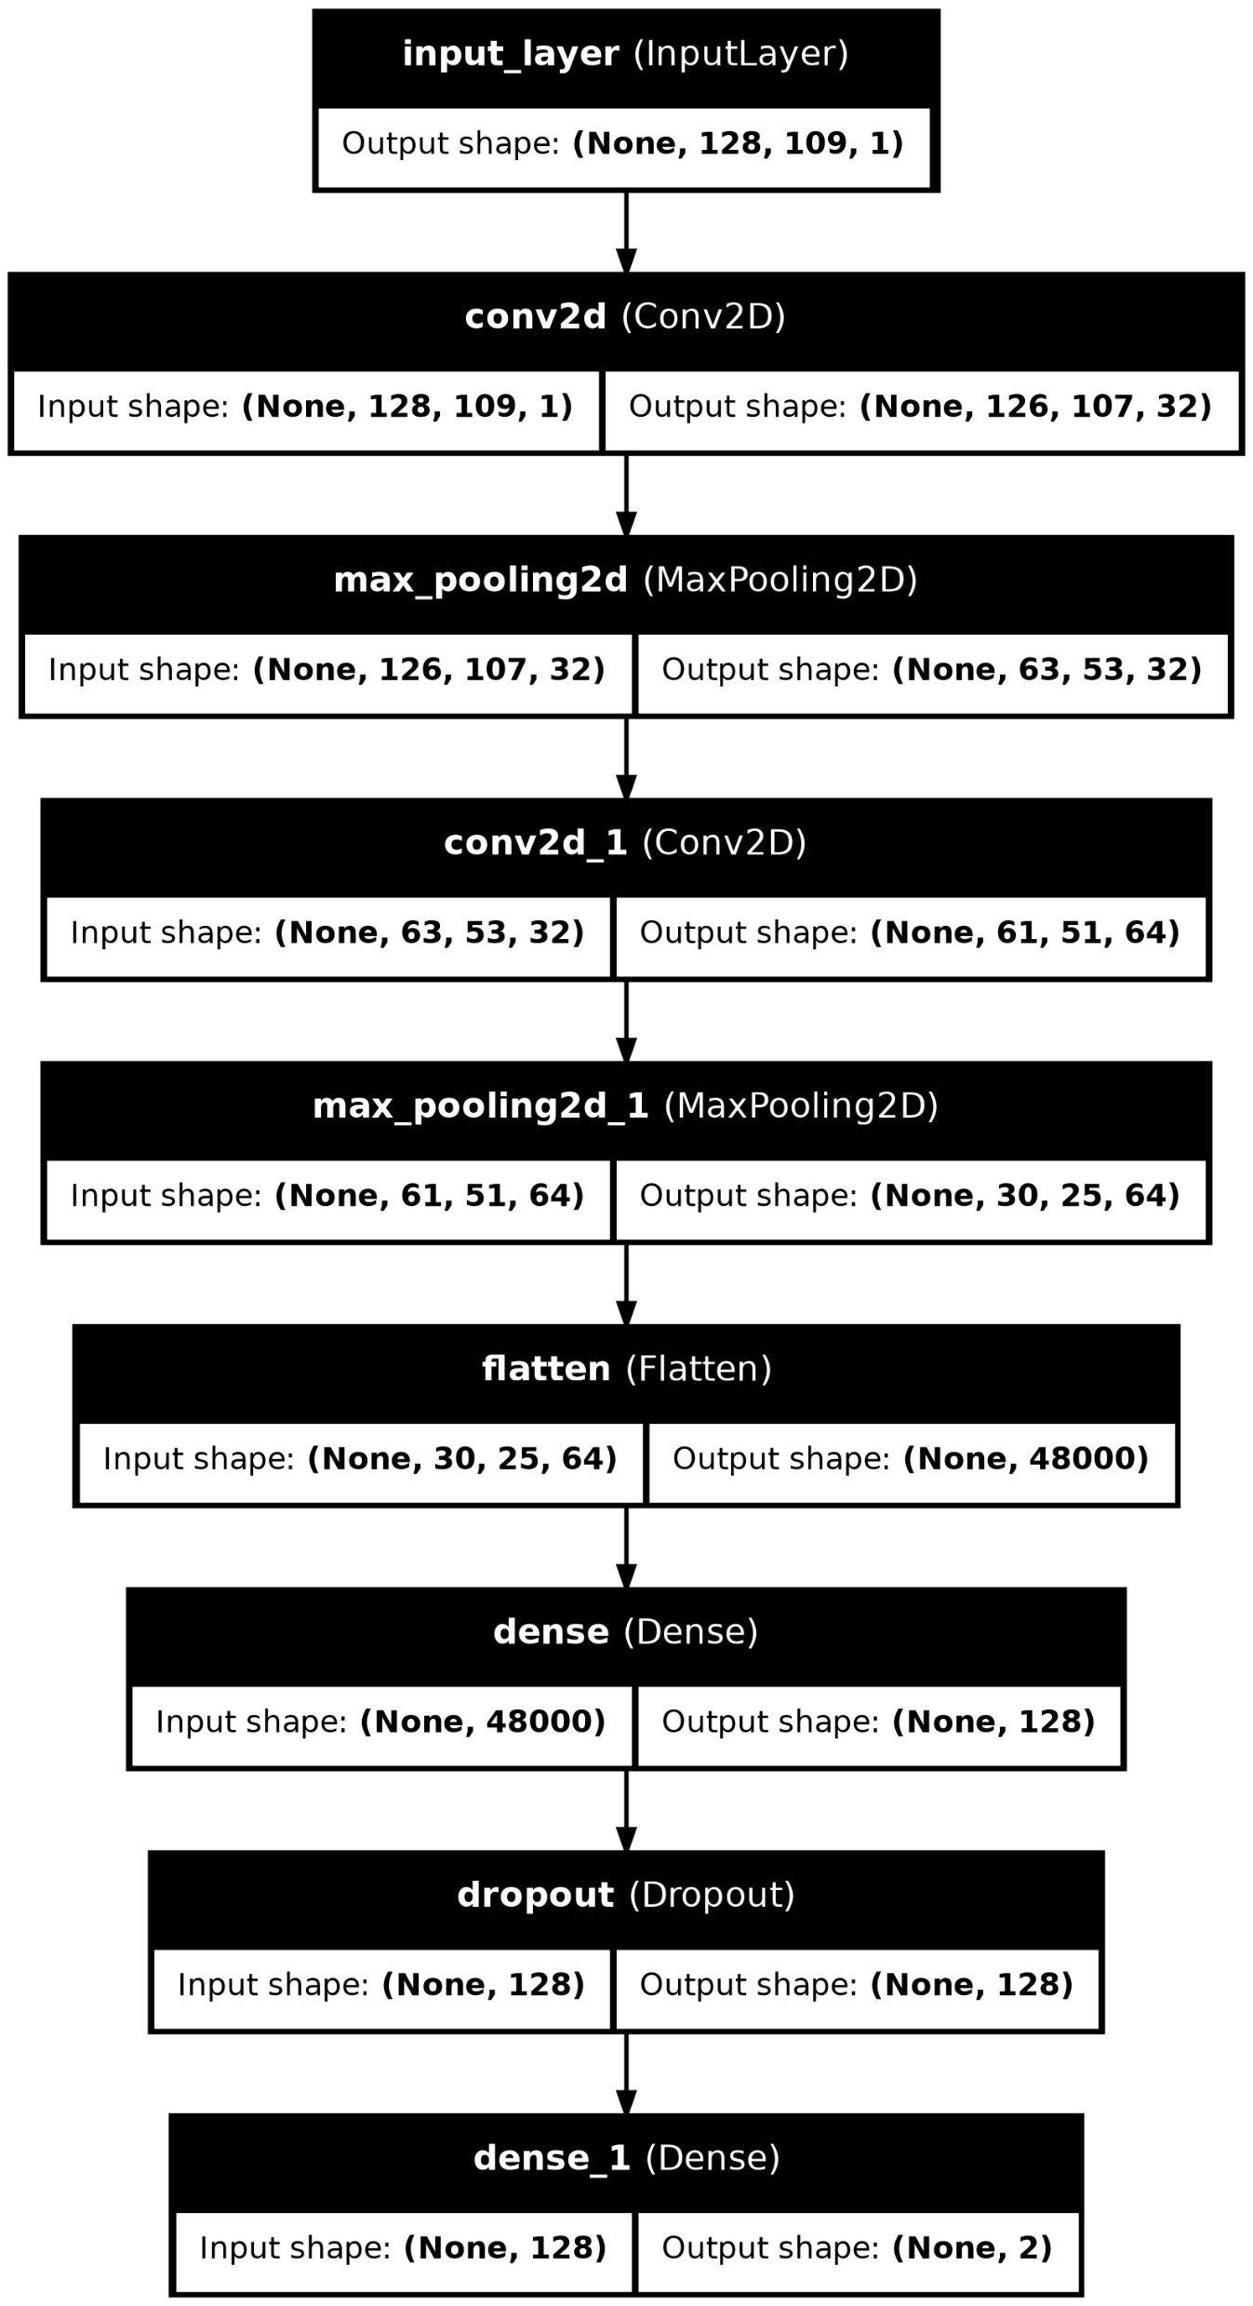
Experiments with Mel Spectrogram - Unbalanced Training
7
The results obtained are high accuracy, but biased predictions. The model tended to classify most test samples as spoofed.
On the Test Set, the unseen data performed worse.
Using a simple CNN model on an unbalanced training set.
Authors: Tomas Lovato, Alisea Bovo Digital Forensics 2024 / 2025 GitHub Repository: https://github.com/LovatoTomas/DF_AudioDeepfakeDetection

Slide 8
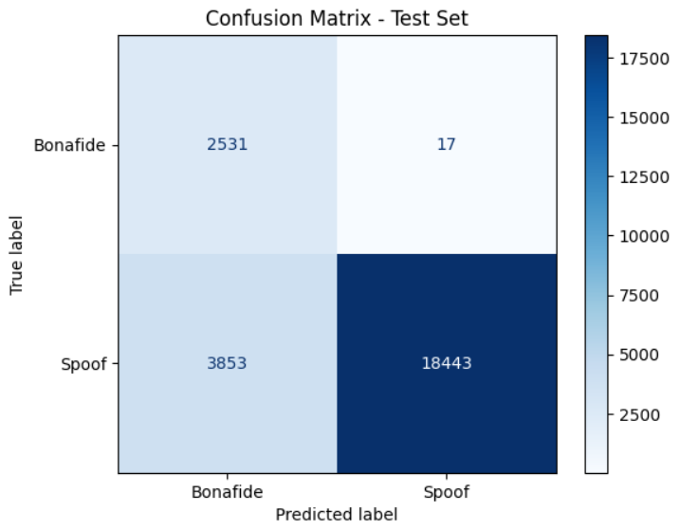
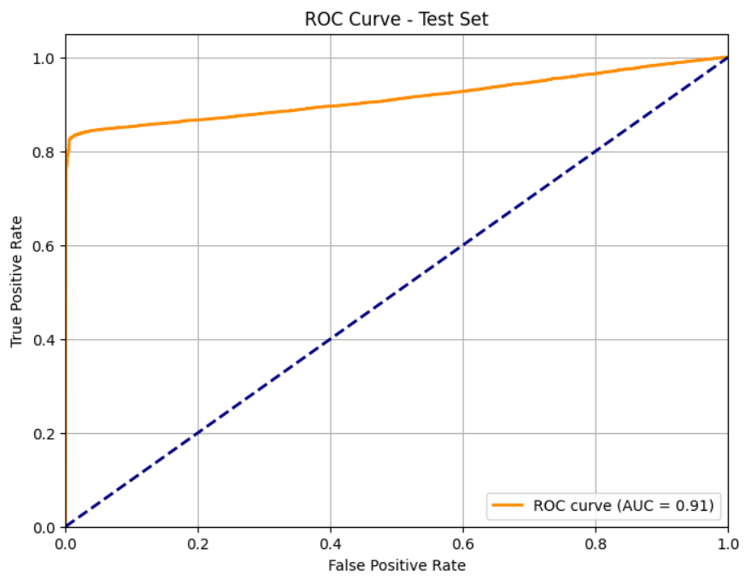
Experiments with Mel Spectrogram - Unbalanced Training
8
Authors: Tomas Lovato, Alisea Bovo Digital Forensics 2024 / 2025 GitHub Repository: https://github.com/LovatoTomas/DF_AudioDeepfakeDetection
Authors: Tomas Lovato, Alisea Bovo Digital Forensics 2024 / 2025 GitHub Repository: https://github.com/LovatoTomas/DF_AudioDeepfakeDetection

Slide 9
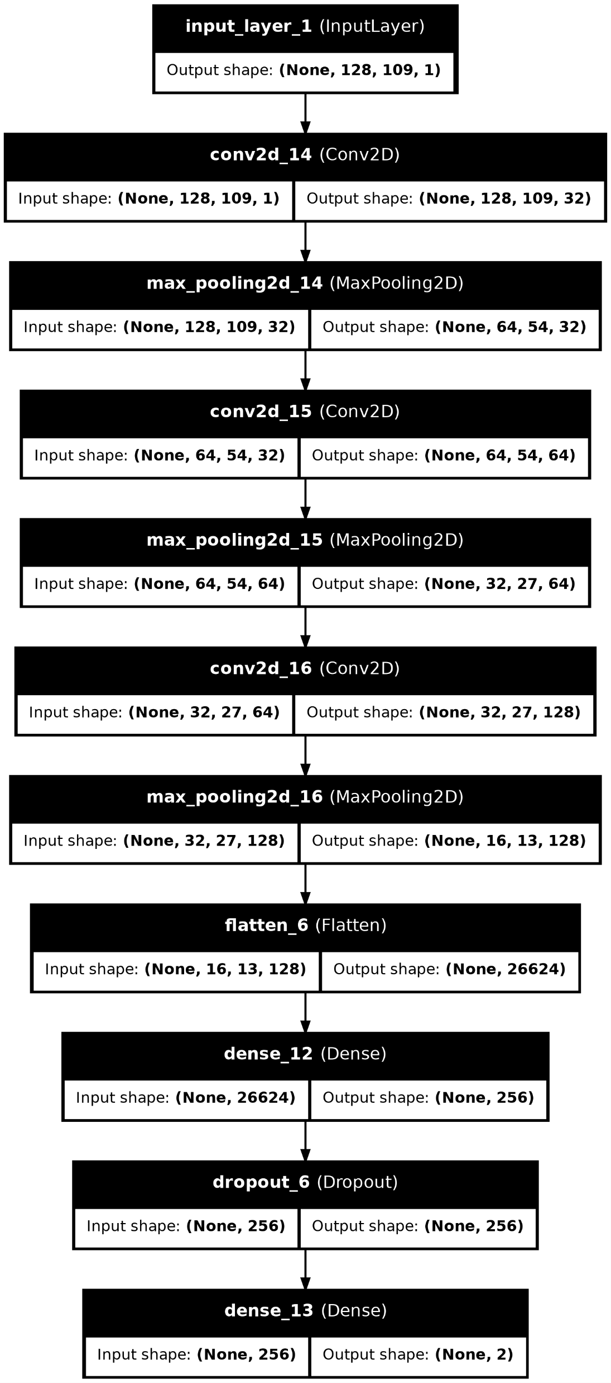
Balanced Training - Mel Spectrogram
9
Load the training set, filter the bonafide samples, shuffle the spoof samples, and balance the two classes by selecting an equal number of samples from each.
It led to significant improvements in the confusion matrix and ROC scores.
Both for seen and unseen datasets.
Authors: Tomas Lovato, Alisea Bovo Digital Forensics 2024 / 2025 GitHub Repository: https://github.com/LovatoTomas/DF_AudioDeepfakeDetection

Slide 10

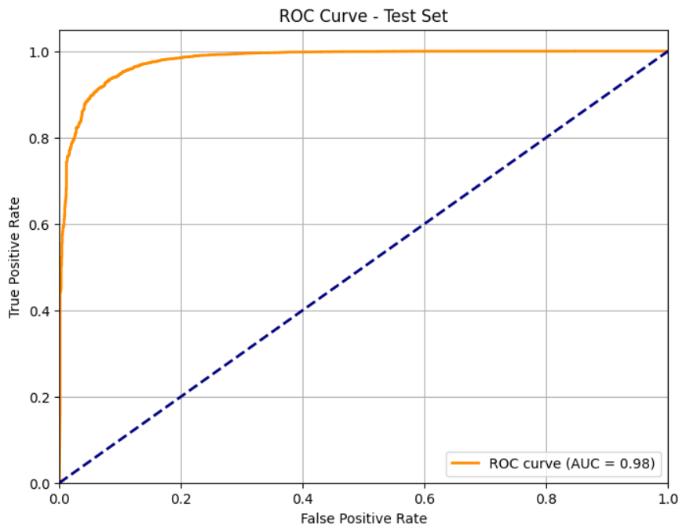
Balanced Training - Mel Spectrogram
10
Authors: Tomas Lovato, Alisea Bovo Digital Forensics 2024 / 2025 GitHub Repository: https://github.com/LovatoTomas/DF_AudioDeepfakeDetection

Slide 11

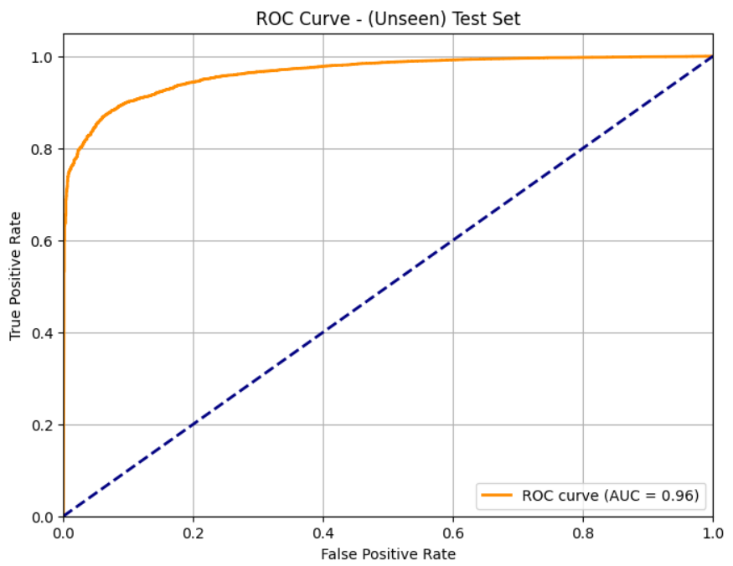
Balanced Training - Mel Spectrogram
11
Authors: Tomas Lovato, Alisea Bovo Digital Forensics 2024 / 2025 GitHub Repository: https://github.com/LovatoTomas/DF_AudioDeepfakeDetection

Slide 12
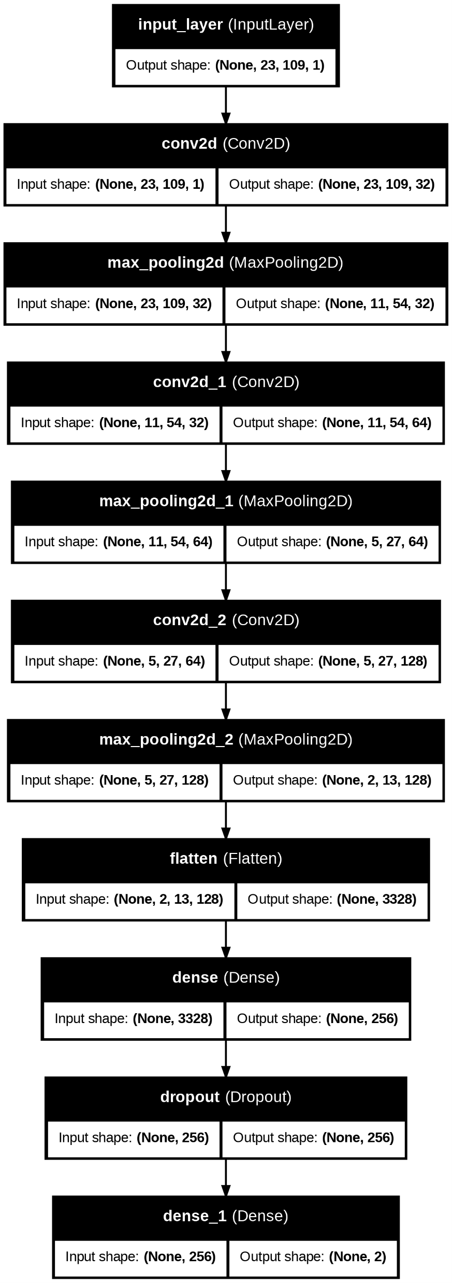
Advanced CNN Architecture
12
Larger kernels were used in the convolution process to better capture temporal dependencies.
As a result, the model achieved near-perfect metrics on both seen and unseen datasets.
Authors: Tomas Lovato, Alisea Bovo Digital Forensics 2024 / 2025 GitHub Repository: https://github.com/LovatoTomas/DF_AudioDeepfakeDetection

Slide 13
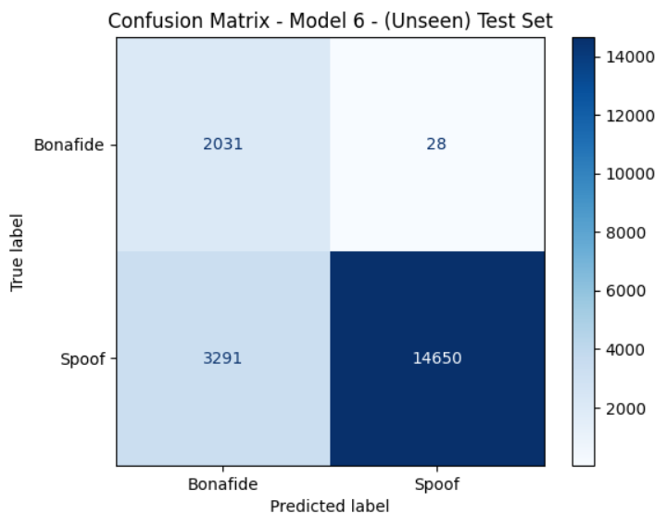
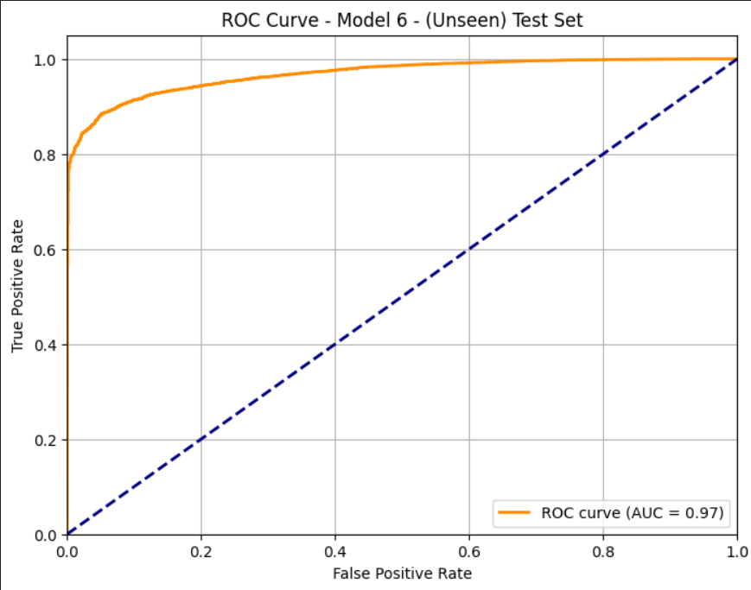
Advanced CNN Architecture
13
Authors: Tomas Lovato, Alisea Bovo Digital Forensics 2024 / 2025 GitHub Repository: https://github.com/LovatoTomas/DF_AudioDeepfakeDetection

Slide 14
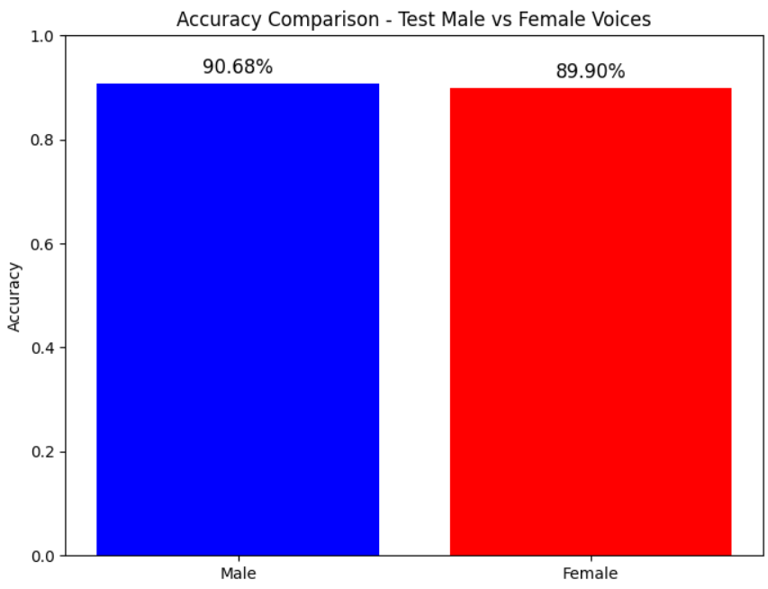
Fairness Analysis
14
Despite a higher number of male samples, the model did not exhibit gender bias.
Slightly better performance for female voices in some cases.
Authors: Tomas Lovato, Alisea Bovo Digital Forensics 2024 / 2025 GitHub Repository: https://github.com/LovatoTomas/DF_AudioDeepfakeDetection

Slide 15
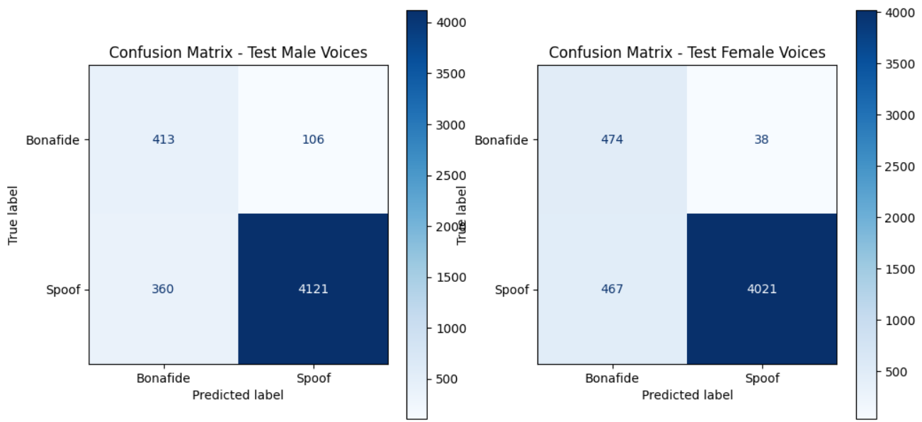
Fairness Analysis
15
Authors: Tomas Lovato, Alisea Bovo Digital Forensics 2024 / 2025 GitHub Repository: https://github.com/LovatoTomas/DF_AudioDeepfakeDetection

Slide 16
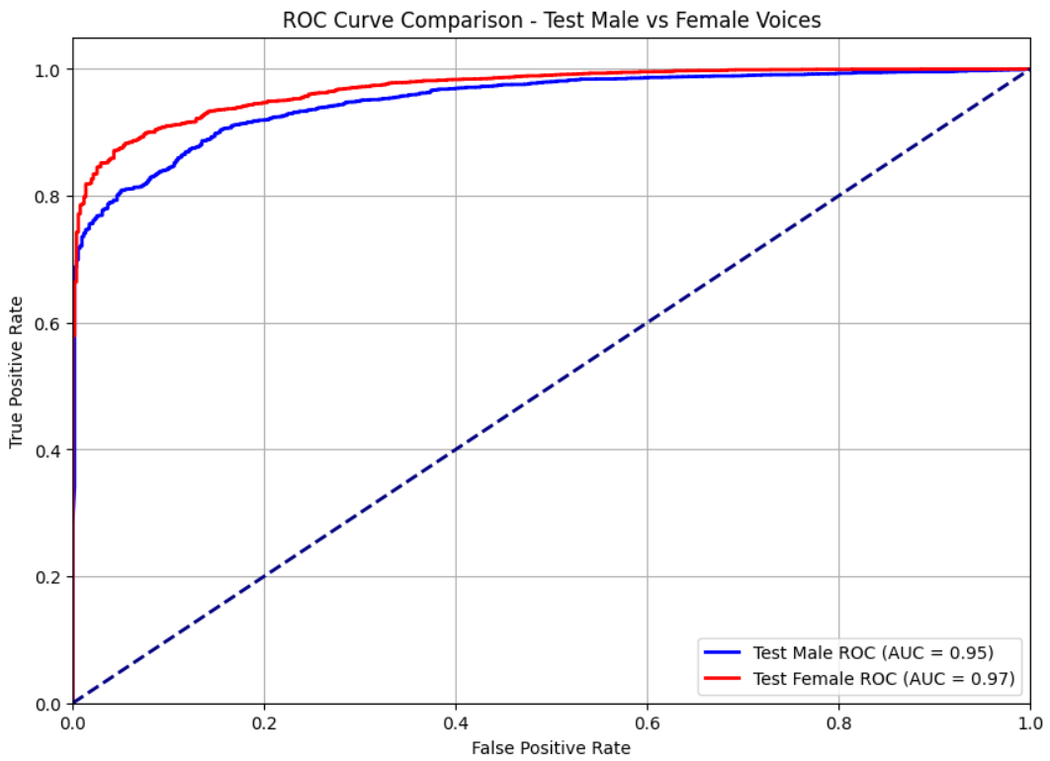
Fairness Analysis
16
Authors: Tomas Lovato, Alisea Bovo Digital Forensics 2024 / 2025 GitHub Repository: https://github.com/LovatoTomas/DF_AudioDeepfakeDetection

Slide 17
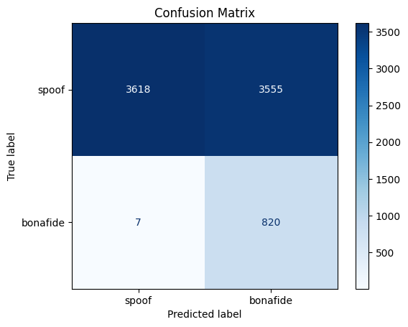
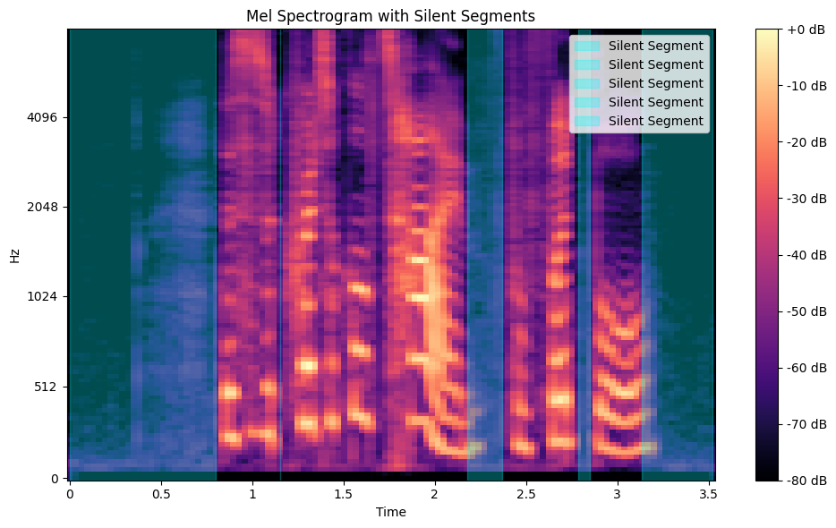
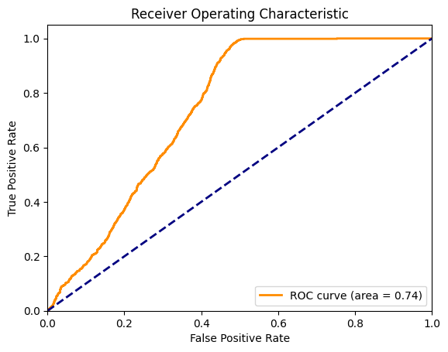
Silence Removal
17
Authors: Tomas Lovato, Alisea Bovo Digital Forensics 2024 / 2025 GitHub Repository: https://github.com/LovatoTomas/DF_AudioDeepfakeDetection

Slide 18
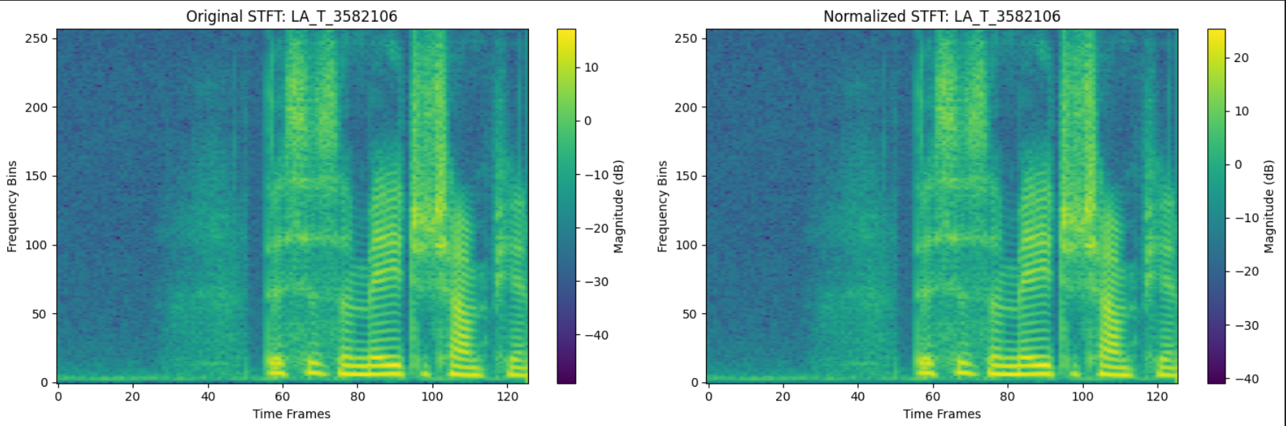
STFT Feature Extraction
18
STFT features required dimensionality reduction using Autoencoders. it did not perform well due to the similarity between bona fide and spoofed data and it is limited in its ability to manage inputs with more than one dimension.
Prior to each operation, the dataset undergoes initial normalization.
Authors: Tomas Lovato, Alisea Bovo Digital Forensics 2024 / 2025 GitHub Repository: https://github.com/LovatoTomas/DF_AudioDeepfakeDetection

Slide 19
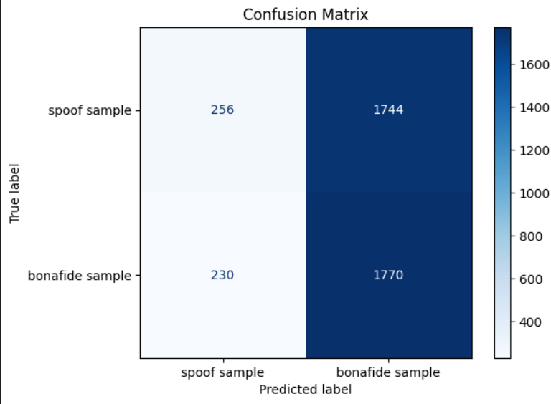
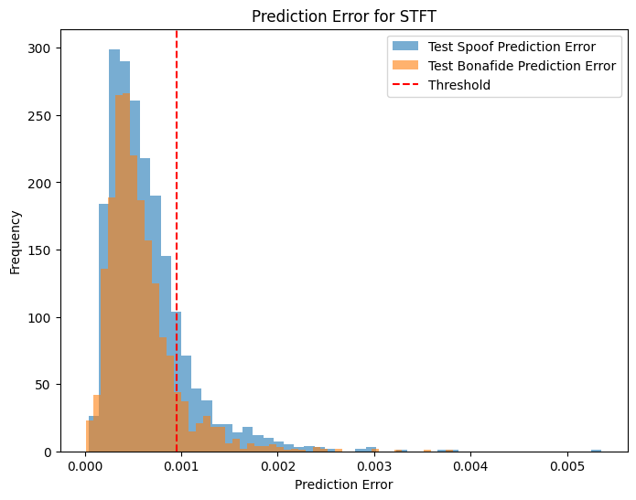
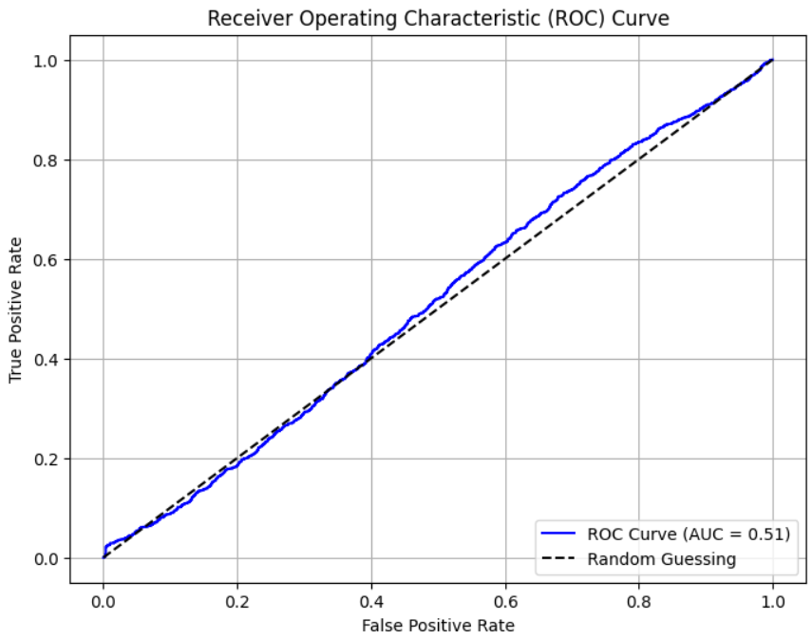
STFT Feature Extraction AE
19
Authors: Tomas Lovato, Alisea Bovo Digital Forensics 2024 / 2025 GitHub Repository: https://github.com/LovatoTomas/DF_AudioDeepfakeDetection

Slide 20
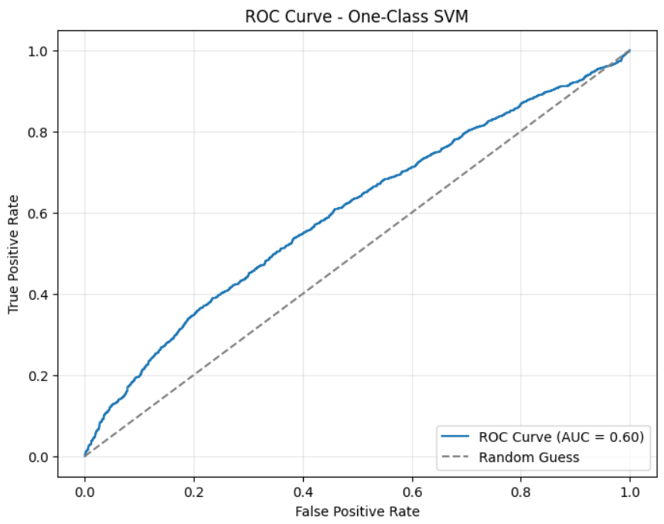
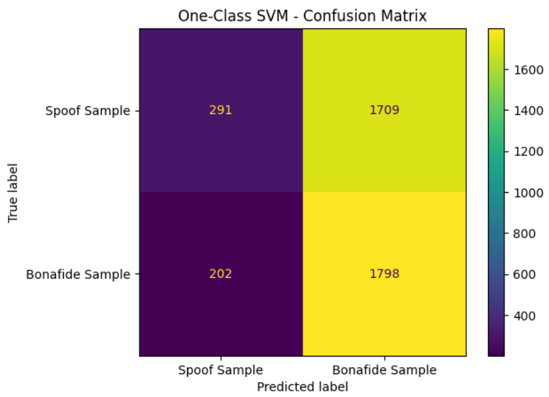
STFT Feature Extraction OCSVM
20
This One-class-SVM receives as input the reconstructed samples from the latent space of the autoencoder.
Authors: Tomas Lovato, Alisea Bovo Digital Forensics 2024 / 2025 GitHub Repository: https://github.com/LovatoTomas/DF_AudioDeepfakeDetection

Slide 21
Alternative work
21
MFCC Features and SVM:
The model achieved an ROC score of around 0.7, with moderate false positives and negatives, and future work will focus on parameter tuning through grid search to enhance performance.
Mel spectrogram and RNN:
The model reach the accuracy of the 50%
Mel spectrogram and decision tree:
The model didn’t perform well, infact it was obtained a negative R². This indicates that the model performs worse than a baseline model that predicts the most frequent class for all instances.
Authors: Tomas Lovato, Alisea Bovo Digital Forensics 2024 / 2025 GitHub Repository: https://github.com/LovatoTomas/DF_AudioDeepfakeDetection

Slide 22
Conclusions
22
Achievements: We successfully applied effective preprocessing of Mel Spectrograms with CNNs, leading to improved DeepFake detection performance. Additionally, using MFCC and STFT features with SVM provided valuable insights for better model accuracy.
Challenges: The model faces challenges in generalizing to unseen spoofing attacks, and the computational complexity of feature extraction remains a hurdle.
To improve: Future efforts will focus on improving model generalization, optimizing feature extraction, and enhancing computational efficiency for practical deployment.
Authors: Tomas Lovato, Alisea Bovo Digital Forensics 2024 / 2025 GitHub Repository: https://github.com/LovatoTomas/DF_AudioDeepfakeDetection

