Slide 1
程序设计原理
任课教师： 李雪威
2026.9

Slide 2
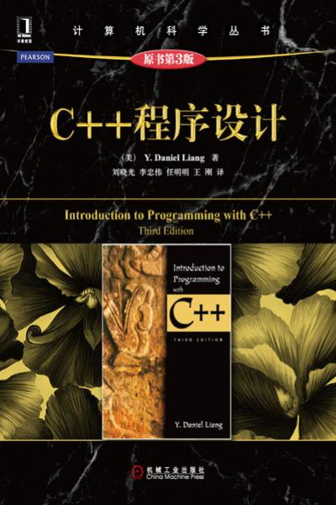
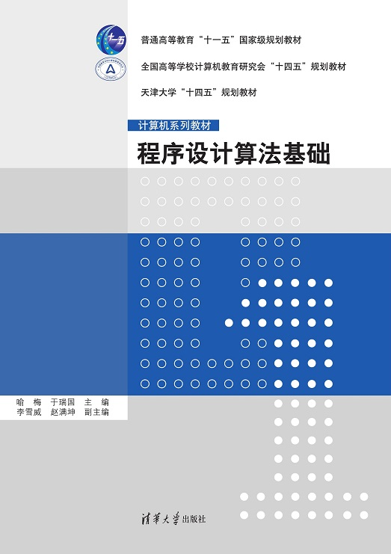
参考教材

Slide 3
第二章 基本变量类型与运算
变量的定义和要素
  标识符
  数据类型（原始类型）
    bool
    char
    short, int, long, float, double、表数范围、类型转换
    void
常量（const/define）
基本算术运算
  运算符
    简单算术运算符：+, -, *, /, and %
    运算+赋值运算符：+=，-=，*=，/=, %=
    自增自减：++，--
    关系运算符：>,<,>=,<=,==,!=
  数学函数
Notes:
数值类型数据，非数值类型数据
有符号、无符号

Slide 4
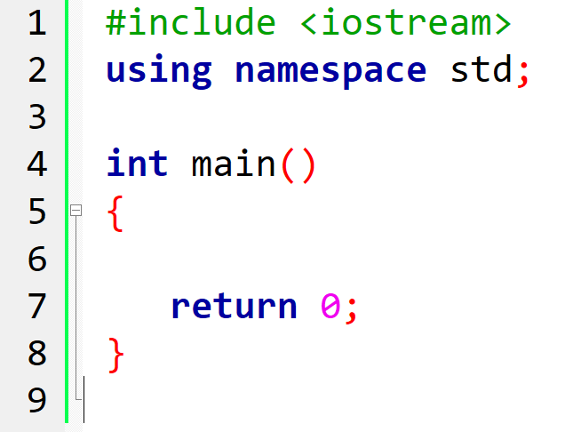
回顾：C/C++程序的基本框架
Notes:
头文件、名空间、主函数（入口）、自定义函数、输入输出，返回值、注释等。

Slide 5
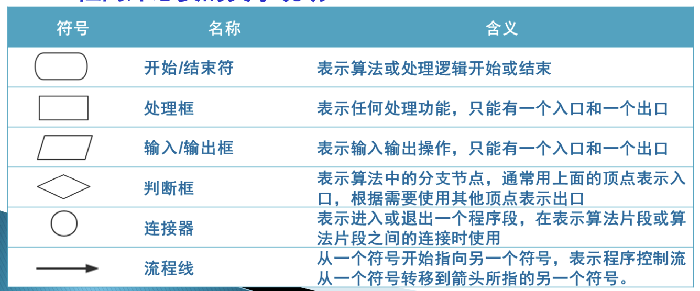
计算a+b
1. 输入两个数a和b
2. 计算a+b
3. 输出a+b的结果

Slide 6
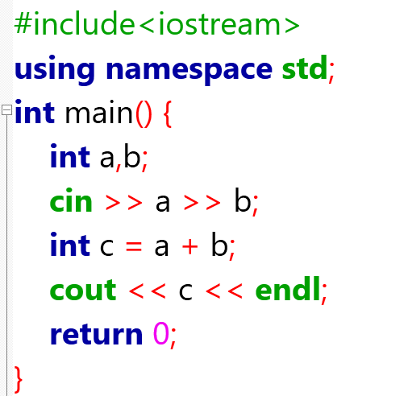
计算a+b
#include<iostream>
using namespace std;
int main() {
int a,b;
cin >> a >> b;
int c = a + b;
cout << c << endl;
return 0;
}
Notes:
溢出？

Slide 7
Programming Style and Documentation
Appropriate Comments and Comment Styles
Proper Indentation and Spacing
#include <iostream>
using namespace std;
/*This program preform mathematical computation and display the result on the console.*/
int main()
{
cout << "(10.5 + 2 * 3) / (45 - 3.5) = ";
cout << (10.5 + 2 * 3) / (45 - 3.5) << endl;
return 0;
}

Slide 8
Standard output and input
cout
cin
#include <iostream>
using namespace std;
int main()
{
double r = 2.0;
int s = 32767;
cin >> s >> r;
cout << s << endl;
cout << r * r << endl;
return 0;
}
#include <iostream>
using namespace std;
int main()
{
int a = 10;
double r = 2.0;
int s = 32767;
cout << s << endl;
cout << r * r << endl;
return 0;
}

Slide 9
Identifiers 标识符命名规则
An identifier is a sequence of characters that consists of letters, digits, and underscores (_).
An identifier must start with a letter or an underscore. It cannot start with a digit.
An identifier cannot be a reserved word.
An identifier can be of any length, but your C++ compiler may impose some restriction. Use identifiers of 31 characters or fewer to ensure portability.

Slide 10
Declaring Variables 变量声明
int x,y; // Declare x,y to be integer variables;
double radius; // Declare radius to be a double variable;
char a; // Declare a to be a character variable;
判断：
1stValue
first-name
@mail
my var
float

Slide 11
Assignment Statements 赋值语句
x = 1; // Assign 1 to x;
y = 2; // Assign 2 to y;
radius = 1.0; // Assign 1.0 to radius;
a = 'A'; // Assign 'A' to a;
x = y + 1;
//Assign the addition of y and 1 to x;
x = x +1;
int a = 1;
double d = 1.4;

Slide 12
Standard output and input
标准输入输出
cout
cin
#include <iostream>
using namespace std;
int main()
{
double r = 2.0;
int s = 32767;
cin >> s >> r;
cout << s << endl;
cout << r * r << endl;
return 0;
}
#include <iostream>
using namespace std;
int main()
{
int a = 10;
double r = 2.0;
int s = 32767;
cout << s << endl;
cout << r * r << endl;
return 0;
}

Slide 13
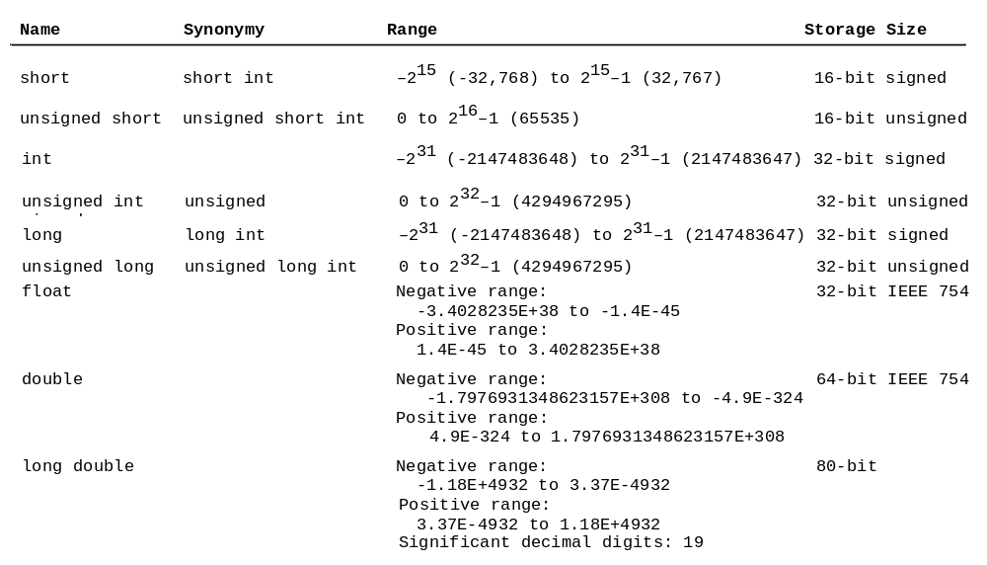
Numerical Data Types and Operations
overflow？

Slide 14

Numeric Operators
数值操作（算术运算）

Slide 15
课堂练习：矩形周长
Rectangle
Write a program which calculates the area and perimeter of a given rectangle.
Input
The length a and breadth b of the rectangle are given in a line separated by a single space.
Output
Print the area and perimeter of the rectangle in a line. The two integers should be separated by a single space.
Constraints
1 ≤ a, b ≤ 100
Sample Input 1
3 5
Sample Output 1
15 16
程序设计原理 天津大学
Notes:
本次课结束

Slide 16
Constants 常量
const datatype CONSTANTNAME = VALUE;
A constant must be declared and initialized in the same statement.
#include <iostream>
using namespace std;
int main()
{
const int LENGTH = 10;
const int WIDTH = 5;
const char NEWLINE = '\n';
int area;
area = LENGTH * WIDTH;
cout << area;
cout << NEWLINE;
return 0;
}

Slide 17
Constants
#define identifier value
#include <iostream>
using namespace std;
#define LENGTH 10
#define WIDTH 5
#define NEWLINE '\n'
int main()
{
int area;
area = LENGTH * WIDTH;
cout << area;
cout << NEWLINE;
return 0;
}
Notes:
不进行类型检查

Slide 18
表数范围
上溢出overflow
When a variable is assigned a value that is too large to be stored, it causes overflow. For example, executing the following statement causes overflow, because the largest value that can be stored in a variable of the short type is 32767. 32768 is too large.
short value = 32767 + 1;
课下实验：
重新计算a+b，并计算a-b,a*b,a/b。测试输入边界。

Slide 19
Underflow
下溢出
When a variable is assigned a value that is too small to be stored, it causes underflow. For example, executing the following statement causes underflow, because the smalles value that can be stored in a variable of the short type is -32768. -32769 is too small.
short value = -32769;

Slide 20
Integer Division
整数运算
整数相除
+, -, *, /, and %
5 / 2 yields an integer 2.
5.0 / 2 yields a double value 2.5
5 % 2 yields 1 (the remainder of the division)

Slide 21

Remainder Operator
取余操作
Remainder is very useful in programming. For example, an even number % 2 is always 0 and an odd number % 2 is always 1. So you can use this property to determine whether a number is even or odd. Suppose today is Saturday and you and your friends are going to meet in 10 days. What day is in 10 days? You can find that day is Tuesday using the following expression:

Slide 22
Formatting Console Output
格式化输出
double amount = 12618.98;
double interestRate = 0.0013;
double interest = amount * interestRate;
cout << "Interest is:"<<interest<<endl;
Interest is: 16.4047
cout << "Interest is:" <<fixed<<setprecision(2)<<interest<<endl;
Interest is: 16.40
Notes:
iomanip 头文件

Slide 23
Conversion Rules 类型转换规则
When performing a binary operation involving two operands of different types, C++ automatically converts the operand based on the following rules:
If one of the operands is long double, the other is converted into long double.
Otherwise, if one of the operands is double, the other is converted into double.
Otherwise, if one of the operands is float, the other is converted into float.
Otherwise, if one of the operands is unsigned long, the other is converted into unsigned long.
Otherwise, if one of the operands is long, the other is converted into long.
Otherwise, if one of the operands is unsigned int, the other is converted into unsigned int.
Otherwise, both operands are converted into int.
Notes:
一般的，向位宽大的对齐。
举例

Slide 24
Type Casting
类型转换
Implicit casting 隐式转换
double d = 3; (type widening)
Explicit casting 显式转换
int i = static_cast<int>(3.0); (type narrowing)
int i = (int)3.9; (Fraction part is truncated)
Casting does not change the variable being cast. For example, d is not changed after casting in the following code:
double d = 4.5;
int i = static_cast<int>(d); // d is not changed

Slide 25
课堂练习：计算a/b
A/B Problem
Write a program which reads two integers a and b, and calculates the following values:
a ÷ b: d (in integer)
remainder of a ÷ b: r (in integer)
a ÷ b: f (in real number)
Input
Two integers a and b are given in a line.
Output
Print d, r and f separated by a space in a line. For f, the output should keep 5 decimal places
Constraints
1 ≤ a, b ≤ 109
Sample Input 1
3 2
Sample Output 1
1 1 1.50000
测试：除以0，除以极小值，观察结果
Notes:
测试：除以0，除以极小值，最大值，最小值

Slide 26
Augmented Assignment Operators
增量赋值
Operator Example Equivalent
+= i += 8 i = i + 8
-= f -= 8.0 f = f - 8.0
*= i *= 8 i = i * 8
/= i /= 8 i = i / 8
%= i %= 8 i = i % 8

Slide 27
Increment and Decrement Operators
自增自减
Operator Name Description
++var preincrement The expression (++var) increments var by 1 and evaluates
to the new value in var after the increment.
var++ postincrement The expression (var++) evaluates to the original value
in var and increments var by 1.
--var predecrement The expression (--var) decrements var by 1 and evaluates
to the new value in var after the decrement.
var-- postdecrement The expression (var--) evaluates to the original value
in var and decrements var by 1.

Slide 28
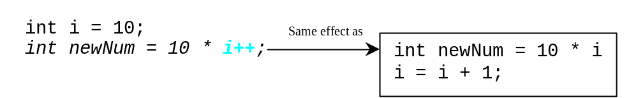
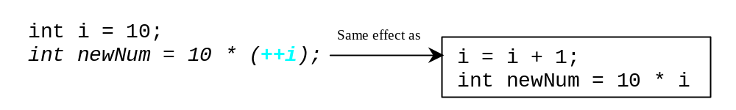
Increment and Decrement Operators, cont.

Slide 29
Increment and Decrement Operators, cont.
Using increment and decrement operators makes expressions short, but it also makes them complex and difficult to read. Avoid using these operators in expressions that modify multiple variables, or the same variable for multiple times such as this: int k = ++i + i.

Slide 30
课堂练习：钟表
Watch
Write a program which reads an integer S [second] and converts it to h:m:s where h,m,s denote hours, minutes (less than 60) and seconds (less than 60) respectively.
Input
An integer S is given in a line.
Output
Print h,m and s separated by ':'. You do not need to put '0' for a value, which consists of a digit.
Constraints
0≤S≤86400
Sample Input 1
46979
Sample Output 1
13:2:59
Notes:
本次课结束

Slide 31
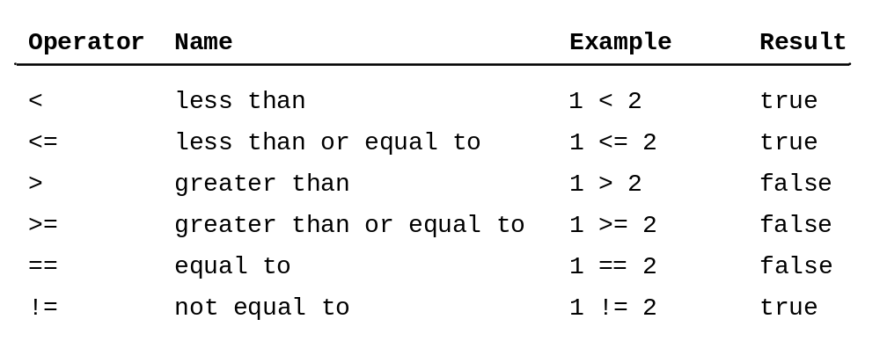
Relation Operators
关系运算
Notes:
比较运算符

Slide 32
The bool Data Type
布尔数据类型
Boolean value :true or false
A variable that holds Boolean value is known as a Boolean variable. The bool data type is used to declare Boolean variable.
For example:
bool lightOn = true; // 直接赋值
bool isPassed = (score >= 60); // 通过逻辑表达式赋值
Internally , C++ use 1 to represent true and 0 for false.
cout<< (4<5) <<endl; //比较运算符
零为flase，非零为true

Slide 33
The bool Data Type
bool类型常与比较运算符（如==、>、<）和逻辑运算符（如&&、||、!）结合使用：
bool result = (a > b) && (c < d);//组合多个条件
if(result) //条件判断
{
cout << "条件成立" << endl;
}
else
{
cout << "条件不成立" << endl;
}
bool类型广泛用于条件判断、循环控制、状态标记等场景。

Slide 34
The char Type 字符类型
char 是 C++ 中的基本数据类型，用于表示单个字符。
在内存中通常占用一个字节（8 位）。
在 ASCII 编码系统中，每个字符都对应一个唯一的整数值，char 类型可以存储这些值来表示相应的字符。
例如，char ch = 'A'; // 存储字符'A’
字符本质上是一个整数，可以与整数进行隐式转换：
int num = ch; // ‘A’ 的ASCII码值 65，所以num =65

Slide 35
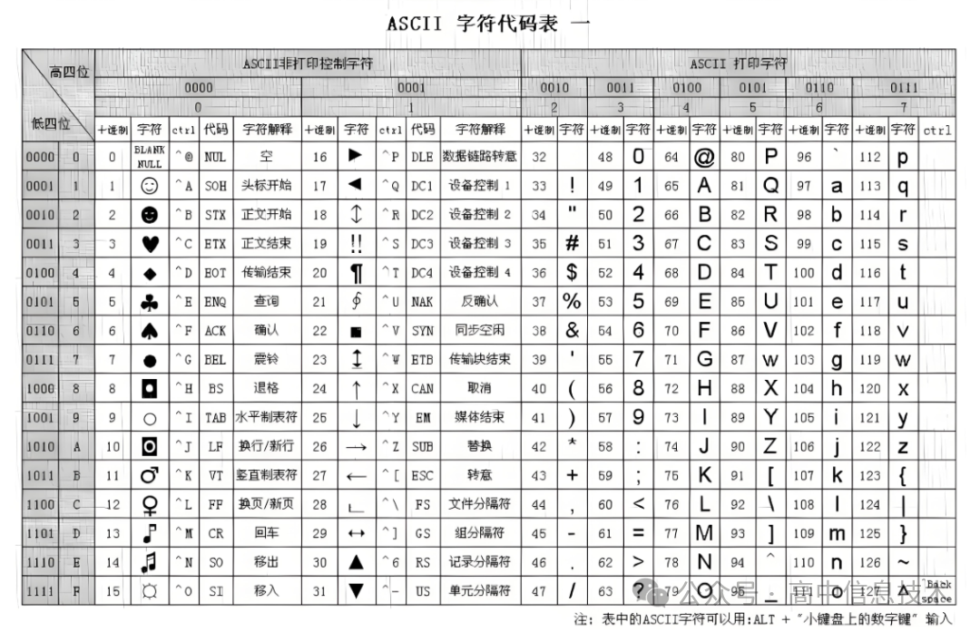
The char Type 字符类型
ASCII 码（American Standard Code for Information Interchange）
Notes:
图片来源于互联网

Slide 36
The char Type 字符类型
在 ASCII 中：
大写字母 A-Z 的编码为 65-90，
小写字母 a-z 的编码为 97-122。
两者之间的差值为 32，因此可以通过加减或位运算实现大小写转换：
#include <iostream>
using namespace std;
int main() {
char lower = 'a';
char upper = lower - 32; // 转换为大写
cout << "小写: " << lower << ", 大写: " << upper << endl;
char upper2 = 'Z';
char lower2 = upper2 + 32; // 转换为小写
cout << "大写: " << upper2 << ", 小写: " << lower2 << endl;
return 0;
}

Slide 37
举例：数字与字符的转换
数字 0-9 的 ASCII 编码为 48-57，可以通过加减操作实现数字与字符的互相转换：
#include <iostream>
using namespace std;
int main() {
int num = 5;
char numChar = num + '0'; // 数字转字符
cout << "数字转字符: " << numChar << endl;
char charNum = '7';
int digit = charNum - '0'; // 字符转数字
cout << "字符转数字: " << digit << endl;
return 0;
}

Slide 38
举例：数字与字符的转换
数字 0-9 的 ASCII 编码为 48-57，看程序写结果：
#include <iostream>
using namespace std;
int main() {
int num = 5;
char numChar = num + '0'; // 数字转字符
cout << "数字转字符: " << numChar << endl;
num = num+'0';
cout<<"num = "<<num<<endl;
char charNum = '7';
int digit = charNum - '0'; // 字符转数字
cout << "字符转数字: " << digit << endl;
charNum = '7'- '0'+59;
cout<<"charNum= "<< (charNum)<<endl;
return 0;
}

Slide 39
举例：转义字符
转义字符是以反斜杠（\）开头的特殊字符序列，用于表示字符串中无法直接输入或具有特殊意义的字符。
常用转义字符及其含义
\n : 换行
\r ：回车
\t ：水平制表符（Tab）
\\ ：反斜杠本身
\' ：单引号
\" ：双引号
\? ：问号
\0 ：空字符（NULL）
#include <iostream>
using namespace std;
int main() {
cout<<"Hello World! \n";
cout<<"It\’s a bag.";
cout<<"She said: \"Hi!\"";
cout<<"Backslash: \\";
cout << "First practice\t1st part";
return 0;
}

Slide 40
总结：变量声明与基本运算
变量的定义和要素
基本数据类型
  字符数据类型char
  数值数据类型（short, int, long/long long; float, double)
  类型转换（隐式、显式）
  bool类型
基本运算
  算术运算
  关系运算
  位运算（对整数的二进制形式运算）
    运算符： &, | , ^, ~, <<, >>
    优先级：高于逻辑运算符，但低于关系运算符和算术运算符。

Slide 41
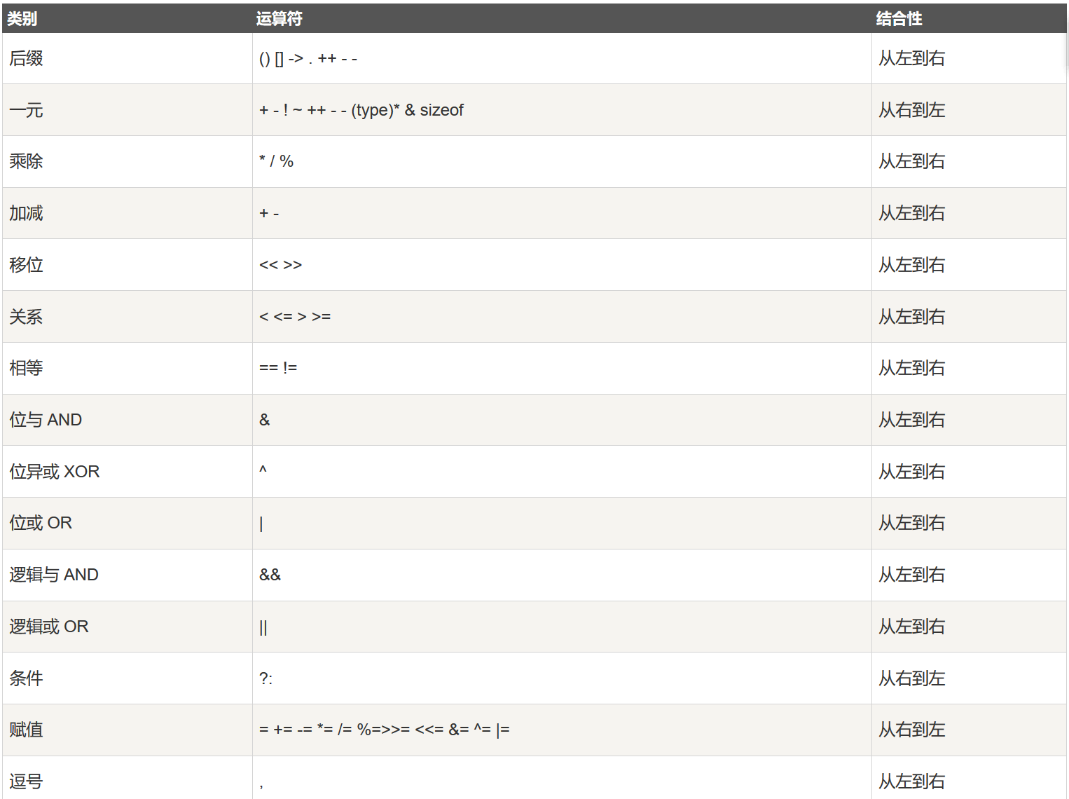
变量声明与基本运算
  运算符优先级（自学）

Slide 42
第一次实验参考
CodeBlocks /dev c++安装；
运行hello world 程序，理解C++程序结构
（#include、main、命名空间）及编译、链接过程；
调试：
用断点观察程序执行流；用监视窗口观察变量的内存值

