Slide 1
Parallelism
Week 9

Slide 2
What is parallelism?
Executing multiple things at the same time
In software:
  Multiple processes
  Multiple threads
In hardware:
  Instruction level parallelism

Slide 3
Multiple Processes
Run two or more independent program instances at the same time
Can be the same program or multiple programs
Examples:
  find ~ | grep myFile
  grep pattern1 myFile | grep partern2

Slide 4
Multithreading
Threads are software-level parallelism running inside a single process.
Since it’s one process, threads share memory (but not their stack and local variables)
Each thread has an associated priority level
Threads should “play-nice” by using yield and sleep functions.

Slide 5
Multithreading Example
Download at http://www.cs.ucla.edu/~cleak/cs35l
(demo9.tar.gz)

Slide 6
What can be achieved from multithreading?
Better throughput
  - Example: Multiple threads serving up webpages
Lower latencies
  Example: A dedicate thread polling input devices
Better designs (sometimes)
  Example: A chat server with one thread dedicated to each client.

Slide 7
What about without multicore and hyperthreading?
Designs can still be improved with threads
Systems can improve performance by switching threads when one is stalled
Logically, it still makes sense to partition many designs up into threads.

Slide 8
How much of a speed up can we get?
If you go from 1 thread on an 8 core machine to 8 threads on an 8 core machine, do we get 8x the throughput? Do we get 1/8 the latency?

Slide 9
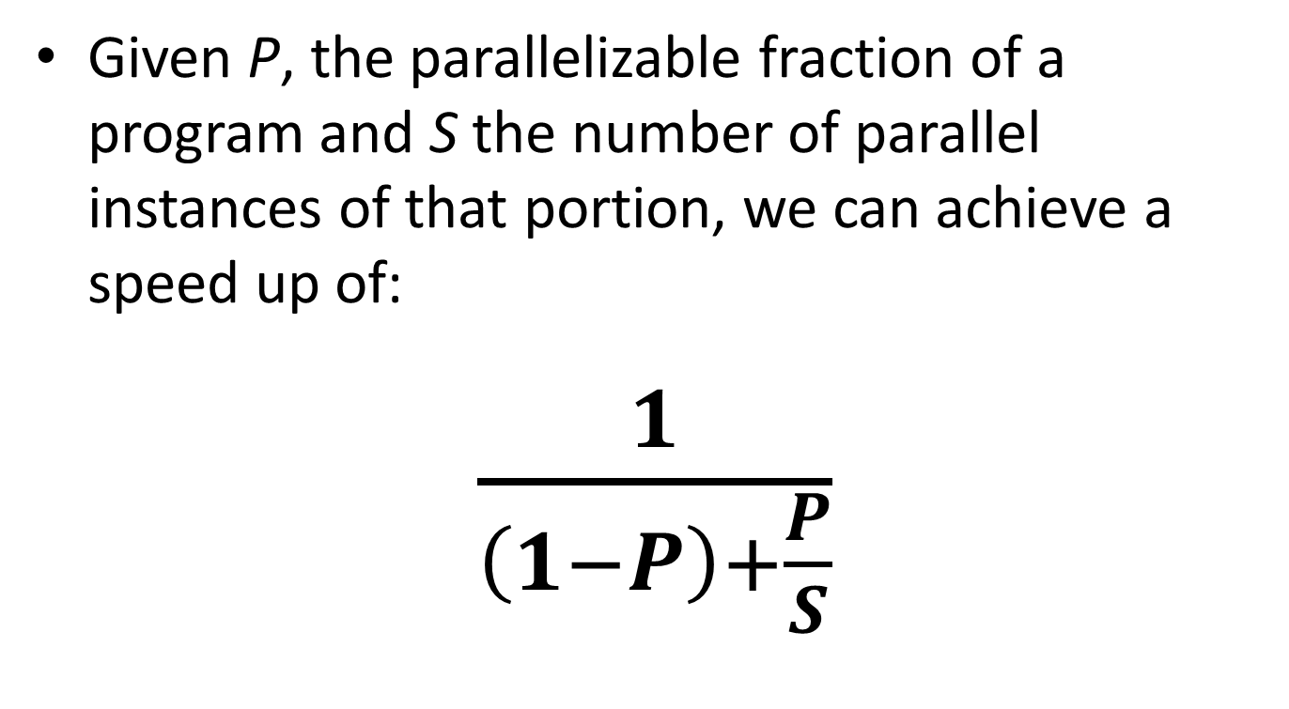
Amdahl’s Law

Slide 10
Refactoring (useful to read about)
List of refactorings can be found at:
  http://www.refactoring.com/catalog/index.html

Slide 11
The Lab
Some reminder about sed
On Wednesday we’ll cover refactoring

