Slide 1
Change Management: Part 2
Week 4

Slide 2
Version Control

Slide 3
What is a Versioning System?
The process of recording and being able to retrieve changes to a project
Benefits
  Any stored revision of a file can be retrieved, viewed, and changed.
  The differences between any two revisions can be displayed.
  Patches can be created automatically.
  Multiple developers can work simultaneously on the same project or file without overwriting one another's changes.
  The project can be branched to allow simultaneous development along varied tracks. These branches can be merged back into the main line of development.
  Distributed development is supported across large or small networks. (subversion offers a variety of authentication mechanisms.)

Slide 4
Terminology
'Repository' - Location on SVN server where versioned files are kept.
'Revision' - A certain version of all files in the project.
‘Trunk’ – The main project being developed (e.g. not a branch)
'Branch' - A 'fork' of the trunk.

Slide 5
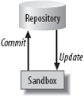
Repository
File-based database called the SVN repository
Contains all historic data about your project
Developers work from a sandbox which contains working copies of the files in your project
Changes from a sandbox are committed to the repository
Changes in the repository, but not in your sandbox, are updated from the repository
Each file is associated with a revision number

Slide 6
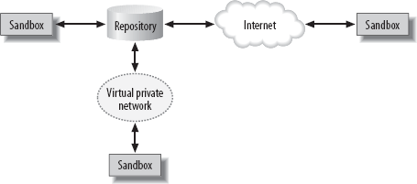
Repository with Multiple Users

Slide 7
Creating Your First Repository
Create a directory somewhere. This is where your repository will be and referred to as the repository_root_directory
Initialize the repoistory:
  svnadmin create repository_root_directory
  It creates a bunch of subdirectories in your repository
  Remember you should never edit the repository directly

Slide 8
Importing Projects
You have an existing projected called FooBar stored in a directory called FooBar-1.1
From within FooBar-1.1, you import the project with the command:
  svn import directory_to_import file://repository_path
It’ll open an editor and you can add notes to the SVN log regarding your changes/imports.
SVN import will complete after you quit and save the log
You can also import/access projects on other machines!

Slide 9
Checking Out Files
SVN stores projects and files in a central repository, but you work from a working copy, the sandbox.
SVN creates the sandbox as a subdirectory of your current working directory:
  svn checkout file://repository_path

Slide 10
Editing Files
Once you’ve checked out your files into a sandbox, you can edit them with your favorite editors.
Some SVN functions won’t work on binary files like MS Word files or JPEG images.

Slide 11
Committing Changes
Changes to your sandbox are not synchronized with the repository until you run the svn commit command
Its best run from the root directory of your sandbox and must be run within the sandbox
When you commit, SVN examines each directory and subdirectory under the current working directory. It searches for files that it is tracking that have changes and commits all changes to the repository.

Slide 12
Updating Sandboxes
svn update command checks your sandbox against the repository and downloads any changed files to the sandbox.
There can be “conflicts” if you’ve changed a file in your sandbox and someone else has changed the same file in the repository

Slide 13
Adding Files
To add a file to the a project in the repository
  Create the file in your sandbox
  svn add filename
  svn commit

Slide 14
Removing Files
To remove a file from the repository
  Remove the file from the sandbox
  svn remove filename
  svn commit

Slide 15
Comparing File Revisions
You can call svn diff with filenames, directories, or module names.
Usually, you call svn diff with at least one -r version specified. If you invoke it with a single -r N, svn compares the current copy in the working directory with the version in the repository
If you invoke svn diff with two versions in the –r option (e.g. svn diff –r N:M), svn compares the two revisions against each other and generates a patch to go from N to M.

Slide 16

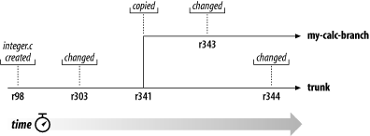
Branching
CVS
Subversion
Branch is a forked line of development in your project, with the line that has been forked off called the branch, and the main line the trunk.
SVN builds the branch and the trunk from the same source data, up until the point at which they diverge, which is called the base of the branch.
From that point, SVN stores the changes made to the branch separately from the changes in the trunk.

Slide 17
Uses for Branches
Variations on a Theme
Bugfix management
Experimental Work
Major changes like complete code rewrite
Release candidates for testing
Standards compliance

Slide 18
Making a Branch
Unlike CVS (svn’s predecessor) branches are simply files in svn
To make a branch, assuming your files are in the trunk directory, simply copy it: svn copy trunk myBranch

Slide 19
Add/Removing Files in a Branch
When svn add or svn remove are applied to files in a branch sandbox, the addition or removal applies only to the branch and does not affect the trunk.

Slide 20
Merging Branches
Merging a branch to the trunk applies the differences created during the life of the branch to the most recent revisions of the trunk code.
Merging from branch to trunk:
svn merge branch trunk
Merging from trunk to branch:
svn merge trunk branch
Merging from branch to branch
  svn merge branch1 branch2

Slide 21
When svn Goes Bad
Merge conflicts (e.g., two users editing the same line in the same file)
Deleting files in the repository can be dangerous: next svn update a different user does could delete uncommitted changes

Slide 22
svn in History
svn is slowly replacing its predecessor CVS
svn is greatly simplified compared to CVS (be happy you’re doing this lab now and not 10 years ago)
svn is intended to be a complete replacement to CVS, so it uses almost exactly the same commands

Slide 23
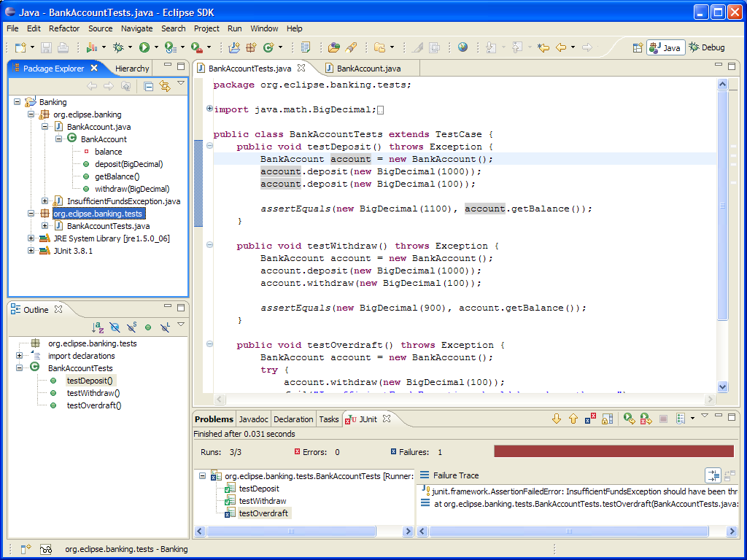
Subversion with Eclipse

Slide 24
To Get Started
Create an svn repository in your home directory
  mkdir home/knoppix/svnrepository
  svnadmin create /home/knoppix/svnrepository
Let’s say you want to add coreutils to your svn repository
  Go inside the coreutils directory
  svn import . file:///home/knoppix/svnrepository

