Slide 1
Genomic Data Preprocessing:
Understanding file formats
Love Odunlami
PhD Researcher at Earlham Institute

Slide 2
Outline
Genomic File Formats
FASTA, FASTQ
Importance of read quality in bioinformatics analysis
Bash Basics

Slide 3
Genomic File Formats
FASTA, FASTQ

Slide 4
Why are there different file formats
Historical developments
  New bioinformatic tools
  Advances in sequencing technology
Type of analysis
Related
Notes:
Type of analysis: Get the function of gene by blasting -

Slide 5
FASTA file
Basic representation of a genetic sequence
>gene01_ hypothetical gene
ATGCGTACGTAGCTAGCTAGCTAGCTAGCTAGCTAGCTAGCGTACGAGCTAGCTAGCTAGCTAGCTAGCT
A fasta file can hold DNA, RNA or protein sequences
  The extension tell you what information is contained in the file.

Slide 6
FASTA file cont’d
DNA/RNA: Uracil for RNA and Thymine for DNA – A G C is common
Protein: 20 Amino acids
Extension
  DNA/RNA: .fasta, .fa, .fna
  Protein: .faa

Slide 7
FASTQ file
It is an extension of FASTA file that adds a layer of information.
It includes the quality score. This helps to evaluate the confidence of each base call.
@Sequence_ID (sequence information)
ATGCGTACGTAGCTAGCTAGCTA (sequence)
+ (can be blank or have same information as first row)
IHIFHIGIHGIIHI (quality score)

Slide 8
FASTQ file cont’d
It holds Nucleotide sequences from DNA/RNA unlike FASTA files
It is used to store raw, high-throughput sequencing data from Illumina, Oxford Nanopore Technology
The file extensions: .fastq or .fq and
If compressed: fastq.gz or fq.gz

Slide 9
Other important file formats
GFF/GTF: Describe location of features like genes, exon etc.
VCF: Stores information like SNP, insertions, deletions etc.
SAM/BAM: Stores aligned sequence data
BED: Stores genomic coordinates of features like genes, exons, introns etc.
Notes:
GFF: General feature format
GTF: General transfer format
VCF: Variant calling format
SAM: sequence alignment map
BAM: Binary alignment map
BED: Browser extensible data

Slide 10
Importance of read quality in bioinformatics analysis

Slide 11
Importance of read quality
Read quality determines:
  the accuracy and
  reliability of the data
  If the data is useable for downstream analysis
Our analysis is guided by our goal and not the tool we are using.
A common tool used to assess read quality is FastQC
Notes:
After running the quality check a summary text will be generated. This text is a good way to know if the sequence passed quality check.

Slide 12
Bash Basics

Slide 13
Bash Basics
BASH (Bourne Again SHell) – is a command line interpreter (shell) and a scripting language.
Why use the command line
It allows easy access to files: genomic data are usually large
Automate repetitive task
Speed and efficiency e.g., moving/copying large files
Remote server connection

Slide 14
Thank you for your time
Practical session…

Slide 15
Useful links
https://tinyurl.com/22s653hs: Genomic Files 101
https://tinyurl.com/456str2s: Journey through bioinformatics file formats
https://datacarpentry.github.io/wrangling-genomics/instructor/aio.html: Data carpentry course on genomic data wrangling

Slide 16
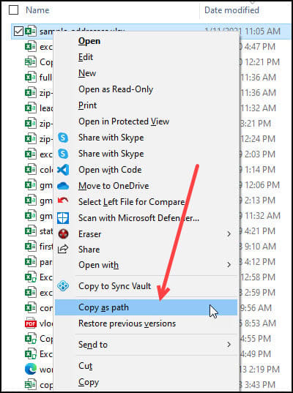
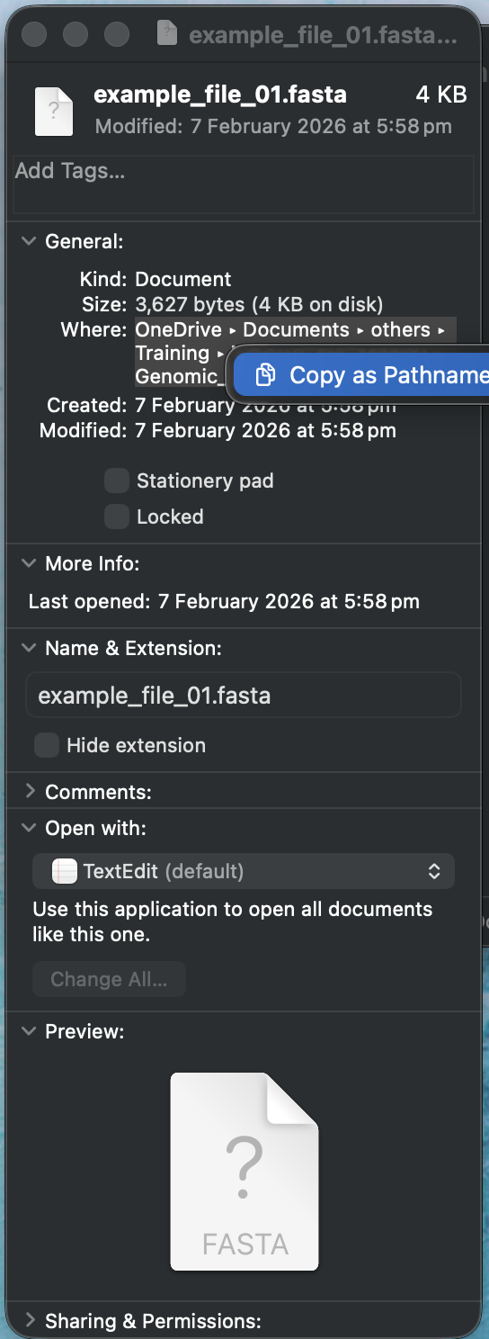
Mac vs Windows (MobaXterm)
Action | Mac | Windows (MobaXterm)
Copy text | Cmd + C | Ctrl + C ‼️
Paste text | Cmd + V | Ctrl + V or right-click
Interrupt a running command | Ctrl + C | Ctrl + C
‼️ Critical warning for Windows users: Ctrl + C interrupts a running command
Windows: C:\Users\Name\Downloads
Mac: /Users/username/Downloads/
You must change them to a forward slash (/)
Copying a file path
Pinterest
Notes:
The path copied on a windows uses backslashes to separate folders.

Slide 17
Types of file paths
Full (absolute) path:
/Users/username/Downloads/Genomic_files/example_file.fasta # Mac absolute path
/home/mobaxterm/Downloads/Genomic_files/example_file.fasta # MobaXterm absolute path
~ represents the home directory
~/Downloads/Genomic_files/ # Using ~ shortcut
Relative path:
Genomic_files/example_file.fasta # if you are already in ~/Downloads
example_file.fasta # if you are already in ~/Downloads/Genomic_files
Notes:
The file path tells the computer exactly where to find something.
Chart the course to the closest beach from where I am standing – relative path
Chart the course to the same beach from your home – this ensure that you’ll always get to the beach and anyone can use the path from your house to get to the beach. – absolute path.
When writing scripts always use the full path because its safer and more reproducible.

Slide 18
Acknowledgments
Chinemerem Akamihe

