Slide 1











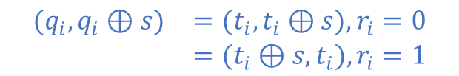






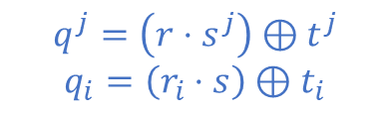
















1-out-of-2 OTE Protocol [IKNP03]
Sender
Receiver
Input :
$$\left(x_{i}^{0},x_{i}^{1}\right),i∈\left[1,n\right],s∈_{R}\{0,1\}^{n}$$
Input :
$r∈\{0,1\}^{n}$, $t^{j}∈_{R}\{0,1\}^{n}$, $j∈\left[1,k\right]$
$$t^{1}$$
$$⊕$$
$$r$$
$$∙$$
$$s^{1}$$
$$t^{2}$$
$$⊕$$
$$r$$
$$∙$$
$$s^{2}$$
$$t^{3}$$
$$⊕$$
$$r$$
$$∙$$
$$s^{3}$$
$$t^{k}$$
$$⊕$$
$$r$$
$$∙$$
$$s^{k}$$
$$t^{j}$$
$$($$
$$($$
$$($$
$$($$
$$t^{1}$$
$$⊕$$
$$r$$
$$t^{2}$$
$$⊕$$
$$r$$
$$t^{3}$$
$$⊕$$
$$r$$
$$t^{k}$$
$$⊕$$
$$r$$
$$…$$
$$r$$
$$⊕$$
$$t^{1}$$
$$t^{2}$$
$$t^{3}$$
$$…$$
$$t^{k}$$
$$…$$
$$t^{j}⊕r$$
$$)$$
$$)$$
$$)$$
$$)$$
Matrix Q
Matrix T
Columns:
Rows:
$$q^{j}=\left(r⋅s^{j}\right)⊕t^{j}$$
$$q_{i}=\left(r_{i}⋅s\right)⊕t_{i}$$
$$\begin{matrix}(q_{i},q_{i}⊕s) & =(t_{i},t_{i}⊕s),r_{i}=0 \\ & =(t_{i}⊕s,t_{i}),r_{i}=1\end{matrix}$$
$$m_{0}= H(q_{i})⊕x_{i}^{0}$$
$$m_{r_{i}}⊕H\left(t_{i}\right)=x_{i}^{r_{i}}$$
$m_{1}=H\left(q_{i}⊕s\right)$ $⊕x_{i}^{1}$
Output :
$$x_{i}^{r_{i}}$$

Slide 2

1-out-of-2 OTE Protocol [IKNP03]
Sender
Receiver
Input :
$$\left(x_{i}^{0},x_{i}^{1}\right),i∈\left[1,n\right],s∈_{R}\{0,1\}^{k}$$
Input :
$r∈\{0,1\}^{n}$, $t^{j}∈_{R}\{0,1\}^{n}$, $j∈\left[1,k\right]$
$$t^{1}$$
$$⊕$$
$$r$$
$$∙$$
$$s^{1}$$
$$t^{2}$$
$$⊕$$
$$r$$
$$∙$$
$$s^{2}$$
$$t^{3}$$
$$⊕$$
$$r$$
$$∙$$
$$s^{3}$$
$$t^{k}$$
$$⊕$$
$$r$$
$$∙$$
$$s^{k}$$
$$t^{j}$$
$$($$
$$($$
$$($$
$$($$
$$t^{1}$$
$$⊕$$
$$r$$
$$t^{2}$$
$$⊕$$
$$r$$
$$t^{3}$$
$$⊕$$
$$r$$
$$t^{k}$$
$$⊕$$
$$r$$
$$…$$
$$r$$
$$⊕$$
$$t^{1}$$
$$t^{2}$$
$$t^{3}$$
$$…$$
$$t^{k}$$
$$…$$
$$t^{j}⊕r$$
$$)$$
$$)$$
$$)$$
$$)$$
Matrix Q
Matrix T
Columns:
Rows:
$$q^{j}=\left(r⋅s^{j}\right)⊕t^{j}$$
$$q_{i}=\left(r_{i}⋅s\right)⊕t_{i}$$
$$\begin{matrix}(q_{i},q_{i}⊕s) & =(t_{i},t_{i}⊕s),r_{i}=0 \\ & =(t_{i}⊕s,t_{i}),r_{i}=1\end{matrix}$$
$$m_{0}= H(q_{i})⊕x_{i}^{0}$$
$$m_{r_{i}}⊕H\left(t_{i}\right)=x_{i}^{r_{i}}$$
$m_{1}=H\left(q_{i}⊕s\right)$ $⊕x_{i}^{1}$
Output :
$$x_{i}^{r_{i}}$$

Slide 3































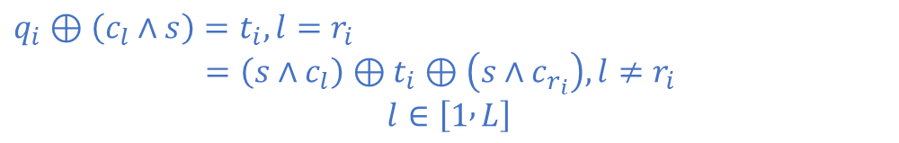























1-out-of-L OTE Protocol [KK13]
Sender
Receiver
Input :
$$\left(x_{i}^{0},x_{i}^{1},…,x_{i}^{L}\right),i∈\left[1,n\right],s∈_{R}\{0,1\}^{k}$$
Input :
$r∈\{1,2,…,L\}^{n}$, $t^{j}∈_{R}\{0,1\}^{n}$, $j∈\left[1,k\right]$
$$\left(c_{1},c_{2},…,c_{L}\right)$$
$$\left(c_{1},c_{2},…,c_{L}\right)$$
$$($$
$$($$
$$($$
$$($$
$$t_{1}⊕(c_{r_{1}}∧s)$$
$$t_{1}$$
$t_{1}$ $⊕c_{r_{1}}$
$$t^{1}$$
$${!s}^{1}$$
$$t^{2}$$
$${!s}^{2}$$
$$t^{3}$$
$${!s}^{3}$$
$$t^{k}$$
$${!s}^{k}$$
$$t_{2}⊕(c_{r_{2}}∧s)$$
$$t^{j}$$
$$t_{2}$$
$t_{2}$ $⊕c_{r_{2}}$
$$)$$
$$)$$
$$)$$
$$…$$
$$)$$
$$t_{3}⊕(c_{r_{3}}∧s)$$
columns
$$t_{3}$$
$t_{3}$ $⊕c_{r_{3}}$
$$⊕$$
$$⊕$$
$$⊕$$
$$⊕$$
$$($$
$$($$
$$($$
$$($$
$$…$$
$$…$$
$$…$$
$${tc}^{1}$$
$$s^{1}$$
$${tc}^{2}$$
$$s^{2}$$
$${tc}^{3}$$
$$s^{3}$$
$${tc}^{k}$$
$$s^{k}$$
$${tc}^{j}$$
$$t_{n}⊕(c_{r_{n}}∧s)$$
$$t_{n}$$
$t_{n}$ $⊕c_{r_{n}}$
$$)$$
$$)$$
$$)$$
$$)$$
Matrix Q
Matrix T
Matrix Tc
$$q^{j}=\left(t^{j}⋅{!s}^{j}\right)⊕\left({tc}^{j}⋅s^{j}\right)$$
$$q_{i}=\left(c_{r_{i}}∧s\right)⊕t_{i}$$
Columns:
Rows:
$q_{i}⊕\left(c_{l}∧s\right)$ $=t_{i},l=r_{i}$
$=\left(s∧c_{l}\right)⊕t_{i}⊕\left(s∧c_{r_{i}}\right),l≠r_{i}$
$$l∈\left[1 , L\right]$$
$${\{m}_{i,l}= H\left(q_{i}⊕\left(c_{l}∧s\right)\right)⊕x_{i}^{l}\}$$
$$m_{i,r_{i}}⊕H\left(t_{i}\right)=x_{i}^{r_{i}}$$
Output :
$$x_{i}^{r_{i}}$$

Slide 4


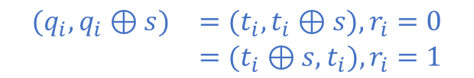




1-out-of-2 Random OTE Protocol
Sender
Receiver
Input :
$$s∈_{R}\{0,1\}^{k}$$
Input :
$r∈\{0,1\}^{n}$, $t^{j}∈_{R}\{0,1\}^{n}$, $j∈\left[1,k\right]$
$$t^{1}$$
$$⊕$$
$$r$$
$$∙$$
$$s^{1}$$
$$t^{2}$$
$$⊕$$
$$r$$
$$∙$$
$$s^{2}$$
$$t^{3}$$
$$⊕$$
$$r$$
$$∙$$
$$s^{3}$$
$$t^{k}$$
$$⊕$$
$$r$$
$$∙$$
$$s^{k}$$
$$t^{j}$$
$$($$
$$($$
$$($$
$$($$
$$t^{1}$$
$$⊕$$
$$r$$
$$t^{2}$$
$$⊕$$
$$r$$
$$t^{3}$$
$$⊕$$
$$r$$
$$t^{k}$$
$$⊕$$
$$r$$
$$…$$
$$r$$
$$⊕$$
$$t^{1}$$
$$t^{2}$$
$$t^{3}$$
$$…$$
$$t^{k}$$
$$…$$
$$t^{j}⊕r$$
$$)$$
$$)$$
$$)$$
$$)$$
Matrix Q
Matrix T
Columns:
Rows:
$$q^{j}=\left(r⋅s^{j}\right)⊕t^{j}$$
$$q_{i}=\left(r_{i}⋅s\right)⊕t_{i}$$
$$\begin{matrix}(q_{i},q_{i}⊕s) & =(t_{i},t_{i}⊕s),r_{i}=0 \\ & =(t_{i}⊕s,t_{i}),r_{i}=1\end{matrix}$$
$$m_{r_{i}}=H\left(t_{i}\right)$$
Output :
$$x_{i}^{0} = H(q_{i})$$
$$x_{i}^{1} =H\left(q_{i}⊕s\right)$$
Output :
$$x_{i}^{r_{i}}$$

Slide 5

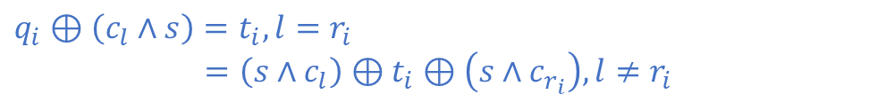


1-out-of-L Random OTE Protocol
Sender
Receiver
Input :
$$i∈\left[1,n\right],s∈_{R}\{0,1\}^{k}$$
Input :
$r∈\{1,2,…,L\}^{n}$, $t^{j}∈_{R}\{0,1\}^{n}$, $j∈\left[1,k\right]$
$$\left(c_{1},c_{2},…,c_{L}\right)$$
$$\left(c_{1},c_{2},…,c_{L}\right)$$
$$($$
$$($$
$$($$
$$($$
$$t_{1}⊕(c_{r_{1}}∧s)$$
$$t_{1}$$
$t_{1}$ $⊕c_{r_{1}}$
$$t^{1}$$
$${!s}^{1}$$
$$t^{2}$$
$${!s}^{2}$$
$$t^{3}$$
$${!s}^{3}$$
$$t^{k}$$
$${!s}^{k}$$
$$t_{2}⊕(c_{r_{2}}∧s)$$
$$t^{j}$$
$$t_{2}$$
$t_{2}$ $⊕c_{r_{2}}$
$$)$$
$$)$$
$$)$$
$$…$$
$$)$$
$$t_{3}⊕(c_{r_{3}}∧s)$$
columns
$$t_{3}$$
$t_{3}$ $⊕c_{r_{3}}$
$$⊕$$
$$⊕$$
$$⊕$$
$$⊕$$
$$($$
$$($$
$$($$
$$($$
$$…$$
$$…$$
$$…$$
$${tc}^{1}$$
$$s^{1}$$
$${tc}^{2}$$
$$s^{2}$$
$${tc}^{3}$$
$$s^{3}$$
$${tc}^{k}$$
$$s^{k}$$
$${tc}^{j}$$
$$t_{n}⊕(c_{r_{n}}∧s)$$
$$t_{n}$$
$t_{n}$ $⊕c_{r_{n}}$
$$)$$
$$)$$
$$)$$
$$)$$
Matrix Q
Matrix T
Matrix Tc
$$q^{j}=\left(t^{j}⋅{!s}^{j}\right)⊕\left({tc}^{j}⋅s^{j}\right)$$
$$q_{i}=\left(c_{r_{i}}∧s\right)⊕t_{i}$$
Columns:
Rows:
$q_{i}⊕\left(c_{l}∧s\right)$ $=t_{i},l=r_{i}$
$=\left(s∧c_{l}\right)⊕t_{i}⊕\left(s∧c_{r_{i}}\right),l≠r_{i}$
$$H\left(t_{i}\right)=x_{i}^{r_{i}}$$
$${\{m}_{i,l}= H\left(q_{i}⊕\left(c_{l}∧s\right)\right)\}$$
Output :
$$x_{i}^{r_{i}}$$

Slide 6
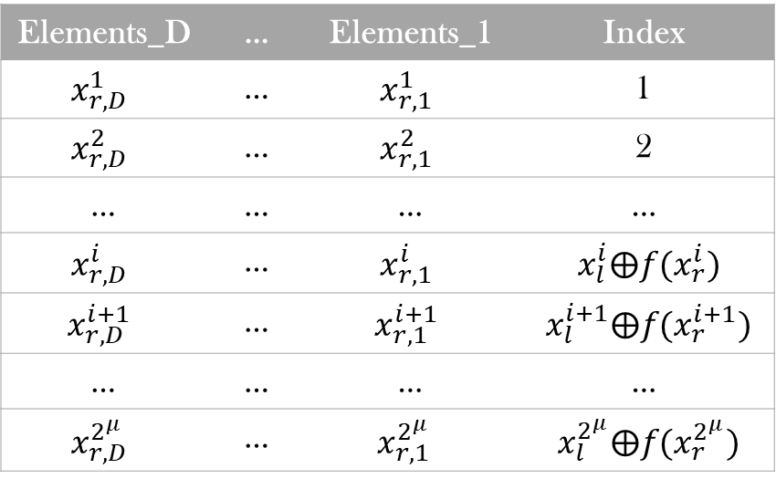
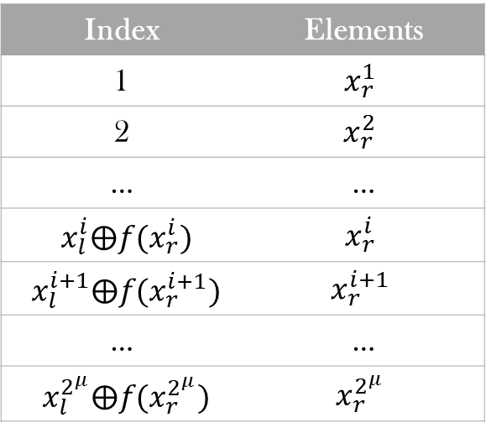
Sender’s View: Normal Hash
Receiver’s View: Cuckoo Hash
Elements_D | … | Elements_1 | Index
$$x_{r,D}^{1}$$ | … | $$x_{r,1}^{1}$$ | 1
$$x_{r,D}^{2}$$ | … | $$x_{r,1}^{2}$$ | 2
… | … | … | …
$$x_{r,D}^{i}$$ | … | $$x_{r,1}^{i}$$ | $x_{l}^{i}⨁f(x_{r}^{i})$
$$x_{r,D}^{i+1}$$ | … | $$x_{r,1}^{i+1}$$ | $x_{l}^{i+1}⨁f(x_{r}^{i+1})$
… | … | … | …
$$x_{r,D}^{2^{μ}}$$ | … | $$x_{r,1 }^{2^{μ}}$$ | $x_{l}^{2^{μ}}⨁f(x_{r}^{2^{μ}})$
Index | Elements
1 | $$x_{r}^{1}$$
2 | $$x_{r}^{2}$$
… | …
$x_{l}^{i}⨁f(x_{r}^{i})$ | $$x_{r}^{i}$$
$x_{l}^{i+1}⨁f(x_{r}^{i+1})$ | $$x_{r}^{i+1}$$
… | …
$x_{l}^{2^{μ}}⨁f(x_{r}^{2^{μ}})$ | $$x_{r}^{2^{μ}}$$

Slide 7
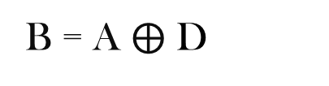
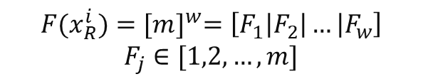







Multi-Point OPRF Matrix(Receiver)
1 | 0 | 0 | 1 | … | … | … | 0
0 | 1 | 0 | 1 | … | … | … | 1
1 | 1 | 1 | 0 | … | … | … | 0
0 | 1 | 0 | 0 | … | … | … | 0
0 | 1 | 1 | 1 | … | … | … | 1
0 | 1 | 0 | 1 | … | … | … | 0
… | … | … | … | … | … | … | …
… | … | … | … | … | … | … | …
1 | 1 | 0 | 0 | … | … | … | 0
Set $X_{R}=\{x_{R}^{1},x_{R}^{2},x_{R}^{3},…,x_{R}^{2^{μ}}\}$
$${F(x}_{R}^{i})={[m]}^{w}=\left[F_{1}\left|F_{2}\right|… | F_{w}\right]$$
$$F_{j}∈[1,2,…,m]$$
Init
Every element
Matrix A
1 | 1 | 1 | 1 | … | … | … | 1
1 | 1 | 1 | 1 | … | … | … | 1
1 | 1 | 1 | 1 | … | … | … | 1
1 | 1 | 1 | 1 | … | … | … | 1
1 | 1 | 1 | 1 | … | … | … | 1
1 | 1 | 1 | 1 | … | … | … | 1
… | … | … | … | … | … | … | …
… | … | … | … | … | … | … | …
1 | 1 | 1 | 1 | … | … | … | 1
1 | 1 | 1 | 1 | … | … | … | 1
1 | 0 | 1 | 1 | … | … | … | 1
1 | 1 | 1 | 1 | … | … | … | 1
0 | 1 | 1 | 1 | … | … | … | 1
1 | 1 | 0 | 0 | … | … | … | 1
1 | 1 | 1 | 1 | … | … | … | 1
… | … | … | … | … | … | … | …
… | … | … | … | … | … | … | …
1 | 1 | 1 | 1 | … | … | … | 0
$${Row:F}_{2}$$
$$A^{j}$$
$${Row:F}_{1}$$
B = A $⨁$ D
Sender
m rows
$${Row:F}_{3,4}$$
columns
1 | 0 | 1 | 1 | … | … | … | 0
1 | 1 | 0 | 0 | … | … | … | 0
0 | 0 | 1 | 0 | … | … | … | 1
1 | 0 | 1 | 1 | … | … | … | 1
1 | 1 | 1 | 1 | … | … | … | 0
1 | 0 | 1 | 0 | … | … | … | 1
… | … | … | … | … | … | … | …
… | … | … | … | … | … | … | …
0 | 0 | 1 | 1 | … | … | … | 0
$$B^{j}$$
$${Row:F}_{w}$$
w columns
Matrix B
Matrix D

