Slide 1
Supervised classification

Slide 2
Introduction to Support Vector Machines
Support Vector Machines (SVMs) are powerful supervised learning algorithms used for classification, regression, and outlier detection.
Developed by Vladimir Vapnik and colleagues at AT&T Bell Laboratories in the 1990s.
Based on statistical learning theory and structural risk minimization principles.
Core idea: Find an optimal hyperplane that maximally separates different classes.
SVMs excel at handling high-dimensional data and complex decision boundaries.
Particularly effective when the number of dimensions exceeds the number of samples.

Slide 3
The Intuition Behind SVMs
Goal: Find the decision boundary with maximum margin between classes.
Margin: Distance between the decision boundary and the closest data points.
Support Vectors: The critical data points closest to the decision boundary.
Key insight: Only these support vectors influence the position and orientation of the hyperplane.
Larger margins lead to better generalization to unseen data.
SVM optimization problem focuses on maximizing this margin.
This approach makes SVMs naturally resistant to overfitting.

Slide 4
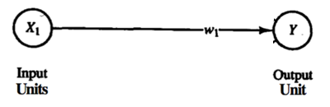
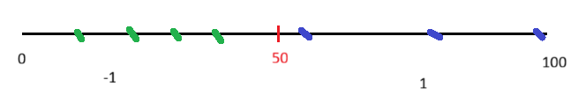



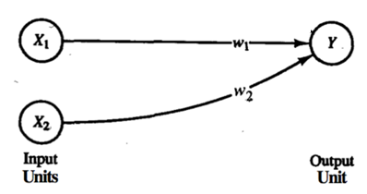
Linear Separators (Perceptron)
Binary classification can be viewed as the task of separating classes in feature space:
A point (one feature)
A line (2 features
A Plane (3 features)
…
x1 (sugar level) | x2 (systolic blood pressure) | y (label)
6.2 | 88 | -1
5 | 80 | 1
9.5 | 150 | -1
1
-1

Slide 5




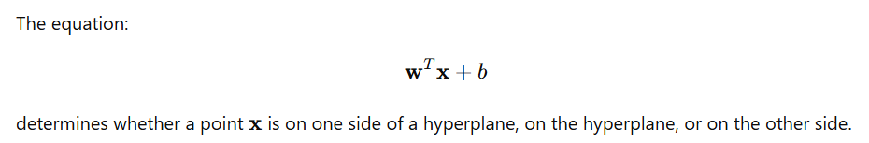
Linear Separators
Binary classification can be viewed as the task of separating classes in feature space:
Where:
x is
w is the normal vector to the hyperplane,
b is the bias term that determines the y intercept
Learning means finding the best w
OR
w^{T}x + b = 0
w^{T}x + b > 0
w^{T}x + b < 0
f(x) = sign(w^{T}x + b)

Slide 6
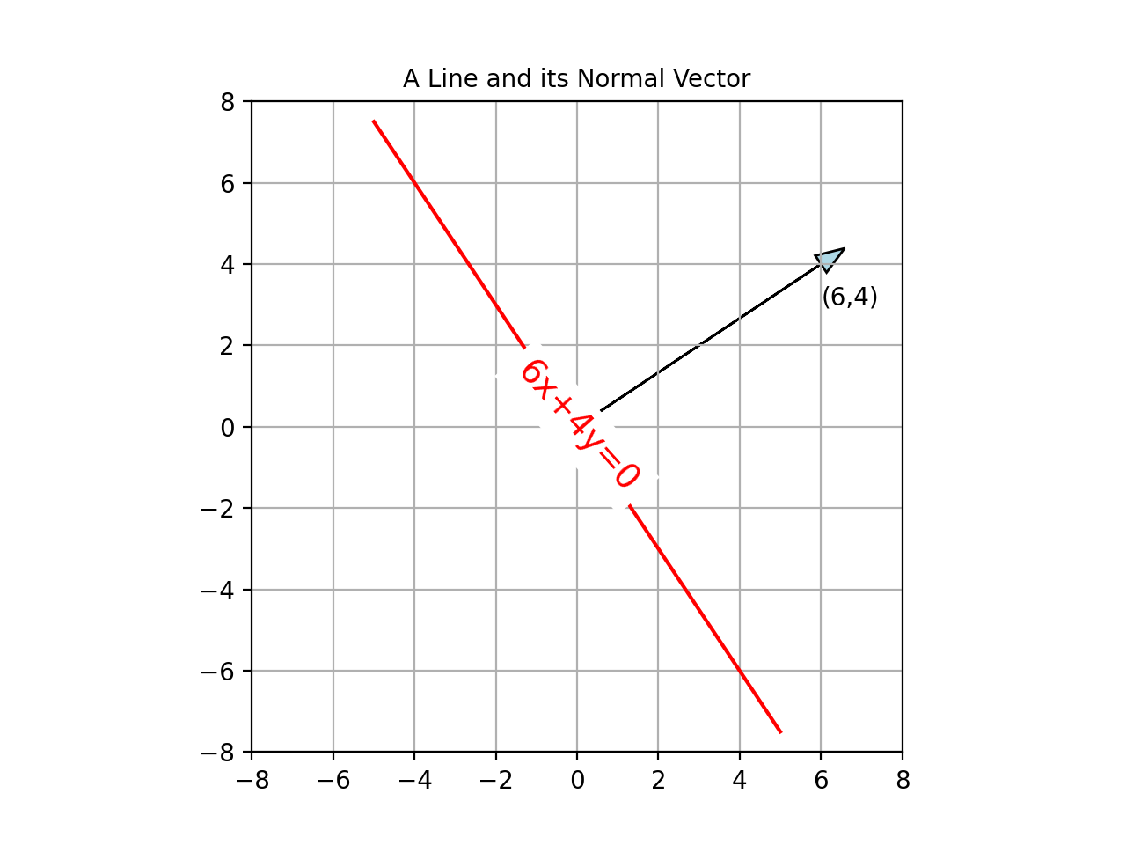
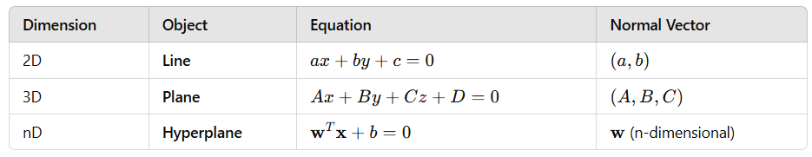
Linear Separators
The normal vector w points in the direction perpendicular to the hyperplane.
Learning means finding the best w

Slide 7
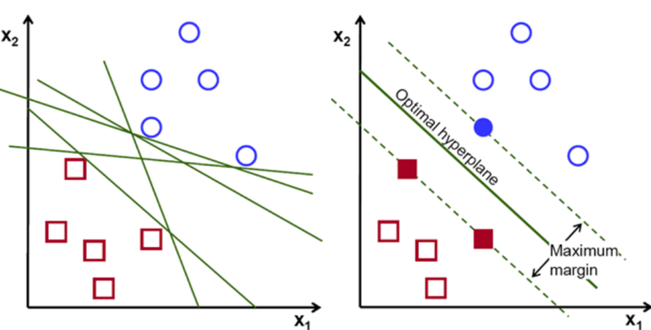
Linear Separators
Which of the linear separators is optimal?

Slide 8
Maximum Margin Classification
Maximizing the margin is good according to intuition.
Examples closest to the hyperplane are support vectors.
Margin ρ of the separator is the distance between support vectors.
Implies that only support vectors matter; other training examples are ignorable.
https://www.youtube.com/watch?v=efR1C6CvhmE&t=492s

Slide 9
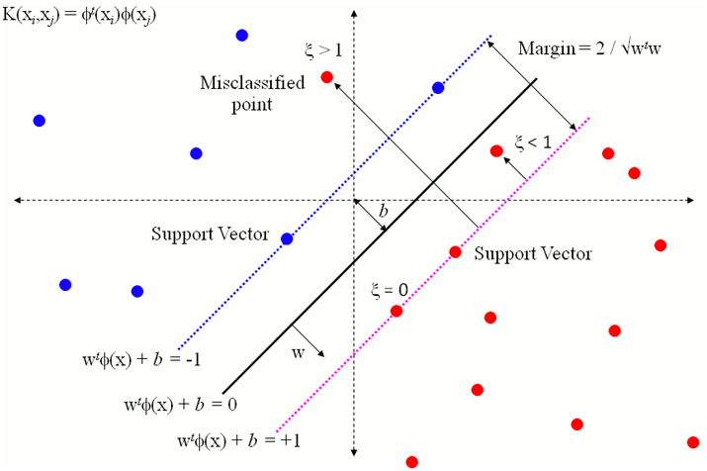
Soft Margin Classification
What if the training set is not linearly separable?
Slack variables ξ_{i} can be added to allow misclassification of difficult or noisy examples, resulting margin called soft.
Here we try to reach a balance between a wider margin that misclassifies more datapoints and less misclassifications that result in a narrower margin.

Slide 10
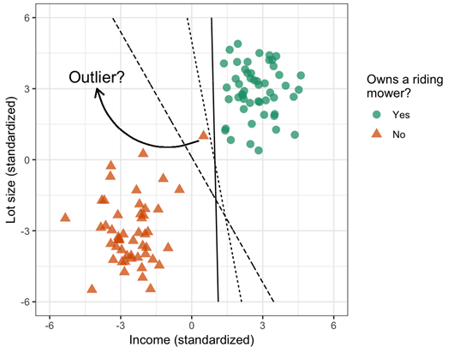
Allowing for misclassifications
Sometimes allowing for misclassifications is important for getting a good classification overall
Another application of soft margines

Slide 11
Non-linear SVMs
Datasets that are linearly separable with some noise work out great:
But what are we going to do if the dataset is just too hard?
How about… mapping data to a higher-dimensional space:
0
x
0
x
x²
0
x

Slide 12
Non-linear SVMs: Feature spaces
General idea: the original feature space can always be mapped to some higher-dimensional feature space where the training set is separable:
Φ: x → φ(x)

Slide 13
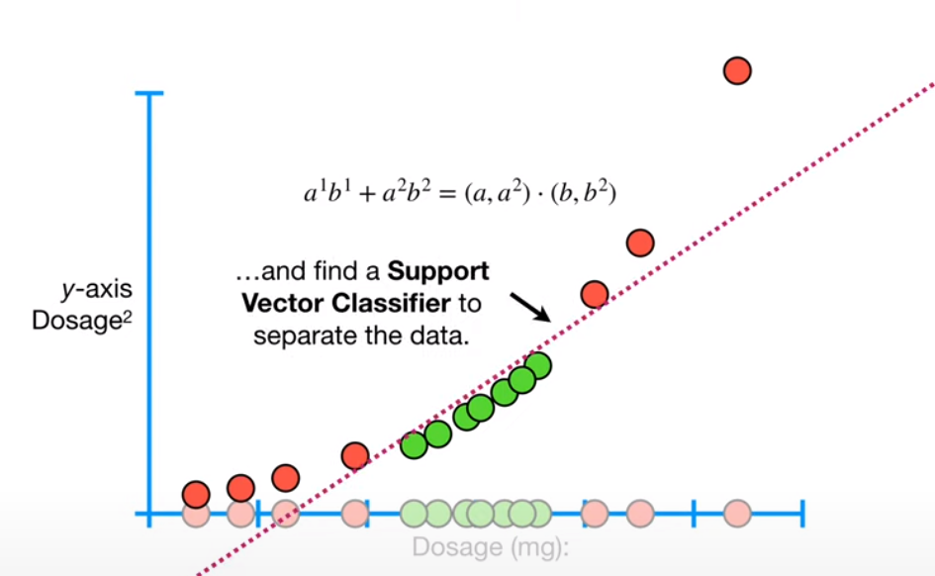
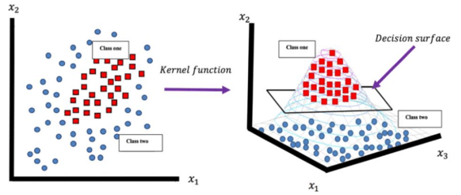
For non-linearly separable data, SVM can use the kernel trick to map inputs into high-dimensional feature spaces where a linear separation is possible.
E.g., Medication is only effective if the does is not too little or too high

Slide 14
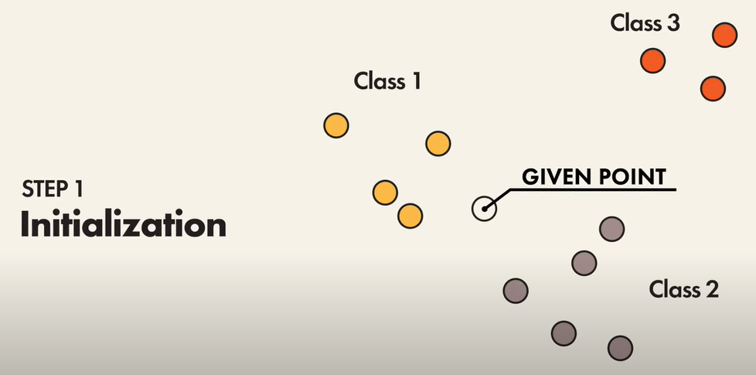
Classification Algorithms: K-Nearest Neighbors
KNN works by finding the most similar instances (neighbors) in the training data to a given input and predicting the output based on these neighbors.

Slide 15
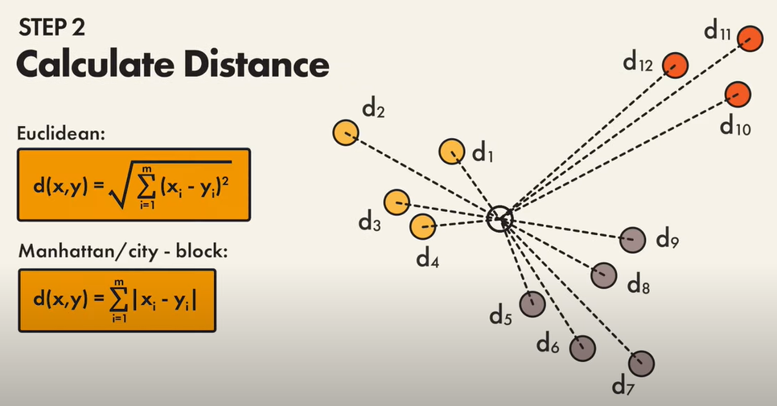
Classification Algorithms: K-Nearest Neighbours
KNN calculates the distance between the input sample and each training data point to identify the nearest neighbors.
Common distance measures include Euclidean, Manhattan, and Minkowski distances..

Slide 16
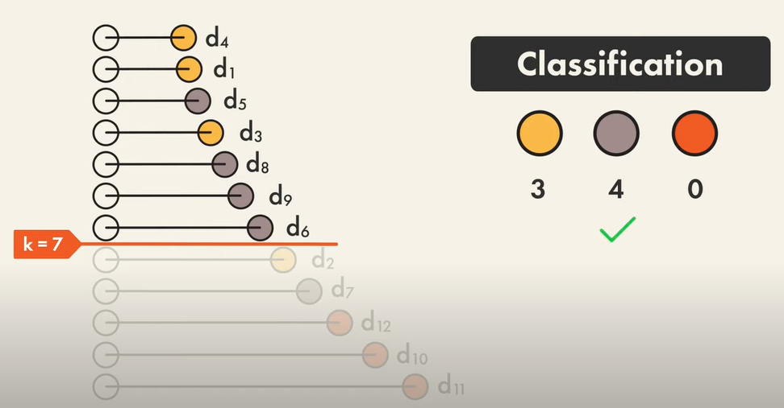
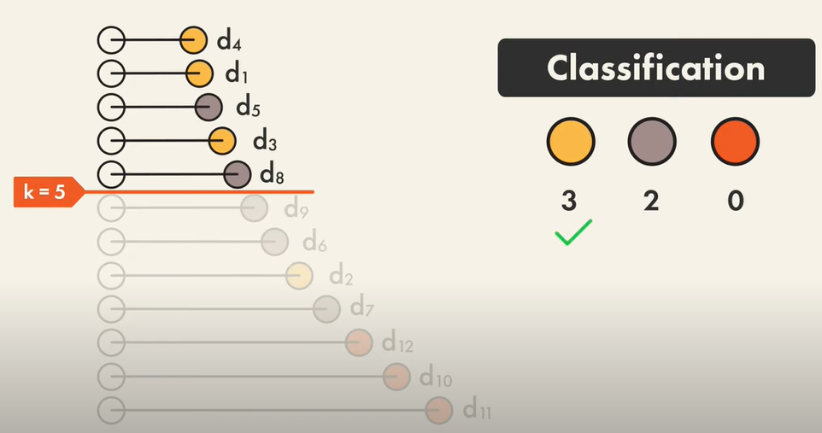
Classification Algorithms: K-Nearest Neighbours
The distances to the nodes are then sorted in increasing order
The first K distances are considered and the class making the majority of the nodes is selected

Slide 17
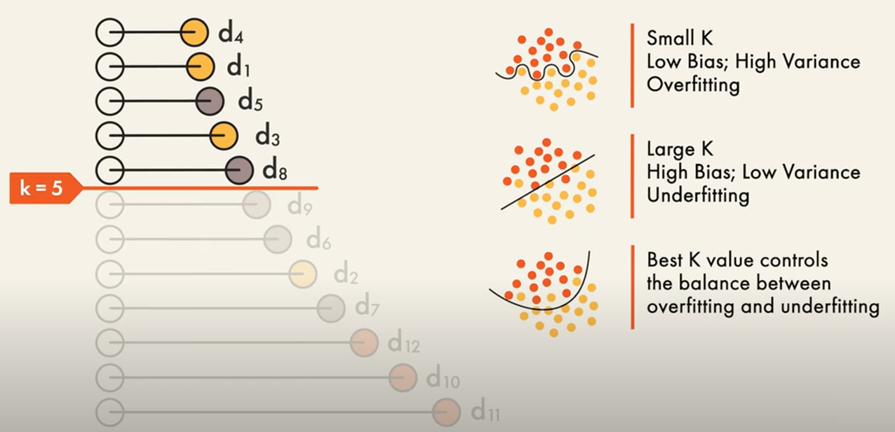
Classification Algorithms: K-Nearest Neighbors
The selected value of K can affect the classification
Too small K will result in Over-Fitting
Too large K will result in Under-Fitting

