Slide 1
Solving Problems by Searching
Today's Topic: Problem-Solving Through Search
Learning Objectives:
Understand problem-solving agents
Formulate problems formally
Learn uninformed search strategies
Explore informed (heuristic) search
Understand heuristic functions
"When the correct action to take is not immediately obvious, an agent may need to plan ahead: to consider a sequence of actions that form a path to a goal state."

Slide 2
Recap - Where We Are
Week 1: What is AI? Foundations and history
Week 2: Intelligent agents and their architectures
Today: How agents find sequences of actions to achieve goals
Example Scenario:
  You're in Arad, Romania
  Need to get to Bucharest tomorrow
  Three roads out: Sibiu, Timisoara, Zerind
  Which road do you take?
This is a search problem!

Slide 3
Problem-Solving Agents
Four-Phase Process:
  Goal Formulation
    Adopt goal: "Reach Bucharest"
    Goals organize behavior by limiting objectives
  Problem Formulation
    Abstract model of relevant world aspects
    States: cities
    Actions: drive between adjacent cities
  Search
    Simulate action sequences
    Find sequence that reaches goal
  Execution
    Execute the solution actions

Slide 4
Assumptions for This Chapter
We assume environments that are:
  Single-agent: No other agents to consider
  Fully observable: Complete state information
  Deterministic: Actions have predictable outcomes
  Static: World doesn't change during planning
  Discrete: Finite, distinct states
  Known: We know the rules
Key Insight: In such environments, solution = fixed sequence of actions
An open-loop system is one that does not use perceptual feedback to adjust its actions during execution.
  So once it starts acting:
    It does not look at new sensor data (percepts)
    It simply follows a pre-planned sequence of actions

Slide 5
Search Problem - Formal Definition
A search problem consists of:
  State Space: Set of all possible states
  Initial State: Where agent starts (e.g., Arad)
  Goal State(s): One or more target states (e.g., Bucharest)
  Actions: ACTIONS(s) returns applicable actions in state s
  Transition Model: RESULT(s, a) returns resulting state
  Action Cost Function: ACTION-COST(s, a, s') gives numeric cost
Solution: Path from initial state to goal state
Optimal Solution: Solution with lowest path cost

Slide 6
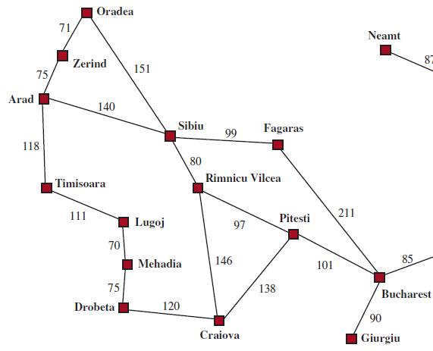
Example - Romania Road Map
Problem:
  States: Cities (Arad, Sibiu, Bucharest, etc.)
  Initial State: Arad
  Goal: Bucharest
  Actions: Drive to adjacent city
    ACTIONS(Arad) = {ToSibiu, ToTimisoara, ToZerind}
  Transition Model:
    RESULT(Arad, ToZerind) = Zerind
  Action Costs: Road distances in miles
State Space Graph: 20 cities, roads as edges

Slide 7
Problem Formulation - Abstraction
Real World vs. Abstract Model:
Real world state includes:
  Traveling companions
  Radio program
  Scenery
  Police proximity
  Road conditions
  Weather, traffic, etc.
Abstract state:
  Just: "In Arad" or "In Sibiu"
Abstraction: Removing detail from representation
  Must be valid: Abstract solution → detailed solution
  Must be useful: Abstract actions easier than original problem

Slide 8
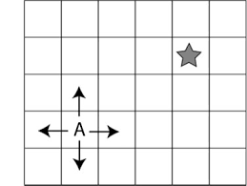
Example Problems - Grid World
Grid World:
  2D rectangular array of square cells
  Agent moves between adjacent cells (horizontally/vertically)
  May contain obstacles, objects
Vacuum World as Grid:
  States: Agent location + dirt locations
  2 cells: 2 × 2² = 8 states
  n cells: n × 2ⁿ states
  Actions: Left, Right, Pickup Dirt
  Goal: Every cell clean
  Cost: Each action costs 1

Slide 9
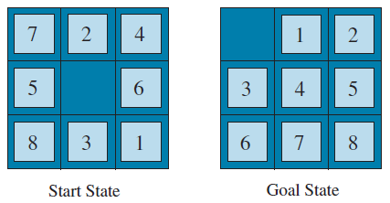
Example Problems - Sliding Tile Puzzles
8-Puzzle:
  3×3 grid with 8 numbered tiles + 1 blank
  States: Location of each tile
  Actions: Slide blank Left, Right, Up, Down
  Goal: Tiles in order
  State Space: 9!/2 = 181,440 reachable states
15-Puzzle:
  4×4 grid: 16!/2 > 10 trillion states!
Note: Action is conceptually moving the blank, not the tiles

Slide 10
Example Problems - Real World
Route Finding:
  Navigation systems, network routing, military planning
Touring Problems:
  Visit multiple locations
  Traveling Salesperson Problem (TSP): visit every city
VLSI Layout:
  Position millions of components on chip
Robot Navigation:
  Move in continuous space with obstacles
Assembly Sequencing:
  Order to assemble complex objects (e.g., electric motors)

Slide 11
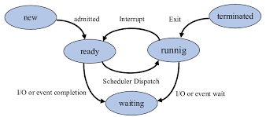
Search Trees and Graphs
State Space Graph:
  Vertices = states
  Edges = actions
  Describes the world
Search Tree:
  Root = initial state
  Nodes = states reached via different paths
  Describes paths explored
  May have multiple nodes for same state!
Key Distinction: Search tree has unique path to root; state space graph may have cycles
New
└── Ready
└── Running
├── Terminated
├── Ready
│ └── Running
│ ├── Terminated
│ ├── Ready
│ │ └── Running
│ │ └── ...
│ └── Waiting
│ └── Ready
│ └── Running
│ └── ...
└── Waiting
└── Ready
└── Running
├── Terminated
├── Ready
│ └── Running
│ └── ...
└── Waiting
└── Ready
└── Running
└── ...

Slide 12
Search Tree Concepts
Node: Data structure in search tree
  node.STATE: The state it represents
  node.PARENT: The node that generated it
  node.ACTION: Action from parent to this node
  node.PATH-COST: Total cost from initial state (g(n))
Expanding a node: Generate its successors
Frontier: Set of nodes available for expansion (also called "open list")
Reached: States we've already generated nodes for

Slide 13
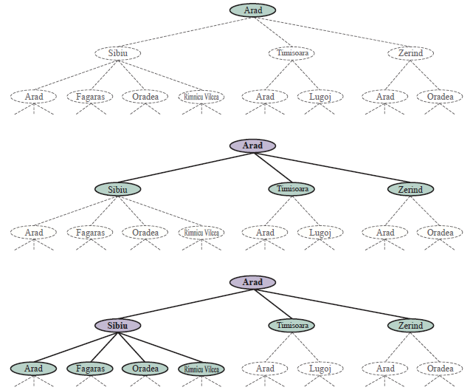
Visual - Search Tree Growth
Frontier separates:
  Interior: Expanded states
  Frontier: Reached but not expanded
  Exterior: Not yet reached

Slide 14
Redundant Paths and Cycles
Problem: Same state reachable via multiple paths
Example:
  Arad → Sibiu (140 miles)
  Arad → Zerind → Oradea → Sibiu (297 miles)
Cycle: Arad → Sibiu → Arad → Sibiu → ...
  Without checking:
  10×10 grid: 100 states, ~100 million paths of length 9!
  With checking: ~100 paths
Solution: Keep track of reached states
Graph search: Check for redundant paths
Tree-like search: Don't check (uses less memory, visits states multiple times)

Slide 15
Measuring Search Performance
Four Criteria:
  Completeness: Guaranteed to find solution when one exists?
  Cost Optimality: Finds lowest-cost solution?
  Time Complexity: How long to find solution?
    Measured in number of nodes generated
  Space Complexity: Maximum memory needed?
    Measured in maximum number of nodes stored
  Complexity Parameters:
    b: Branching factor (number of successors)
    d: Depth of shallowest solution
    m: Maximum depth of search tree

Slide 16
Uninformed vs. Informed Search
Uninformed Search:
  No information about how close a state is to goal
  Only knows: This is/isn't a goal
  Examples: Breadth-first, Depth-first, Uniform-cost
Informed Search:
  Has hints about distance to goal
  Uses heuristic function h(n)
  Examples: Greedy best-first, A*
Analogy: Searching in the dark vs. having a compass

Slide 17
UNINFORMED SEARCH STRATEGIES :
Breadth-First Search (BFS)
Strategy: Expand shallowest node first
  Root first, then all depth-1 nodes, then depth-2, etc.
Implementation:
  FIFO queue (First-In-First-Out)
  New nodes go to back of queue
Properties:
  Complete: Yes (if b is finite)
  Optimal: Yes (if all actions same cost)
  Time: O(b^d) - exponential
  Space: O(b^d) - keeps all nodes in memory
Problem: Memory is the bottleneck

Slide 18
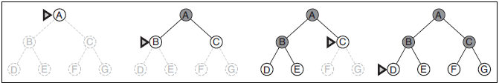
BFS - Example on Tree
Key: Explores in waves of increasing depth

Slide 19
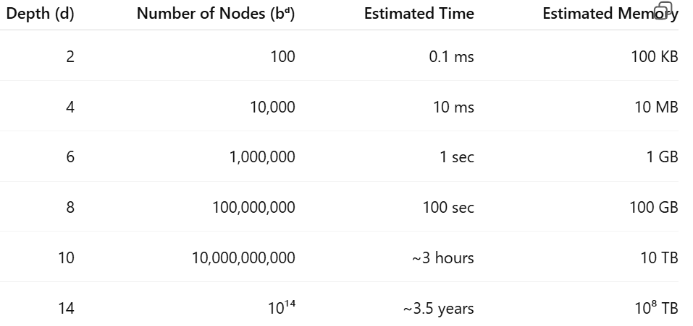
BFS - Memory Problem
b = Branching Factor, d = Depth of Solution
Key Insight: Exponential growth is brutal
  Memory fills up before time runs out
  d=14 impossible even with infinite memory

Slide 20
BFS - Example on Graph
https://www.youtube.com/watch?v=oDqjPvD54Ss

Slide 21
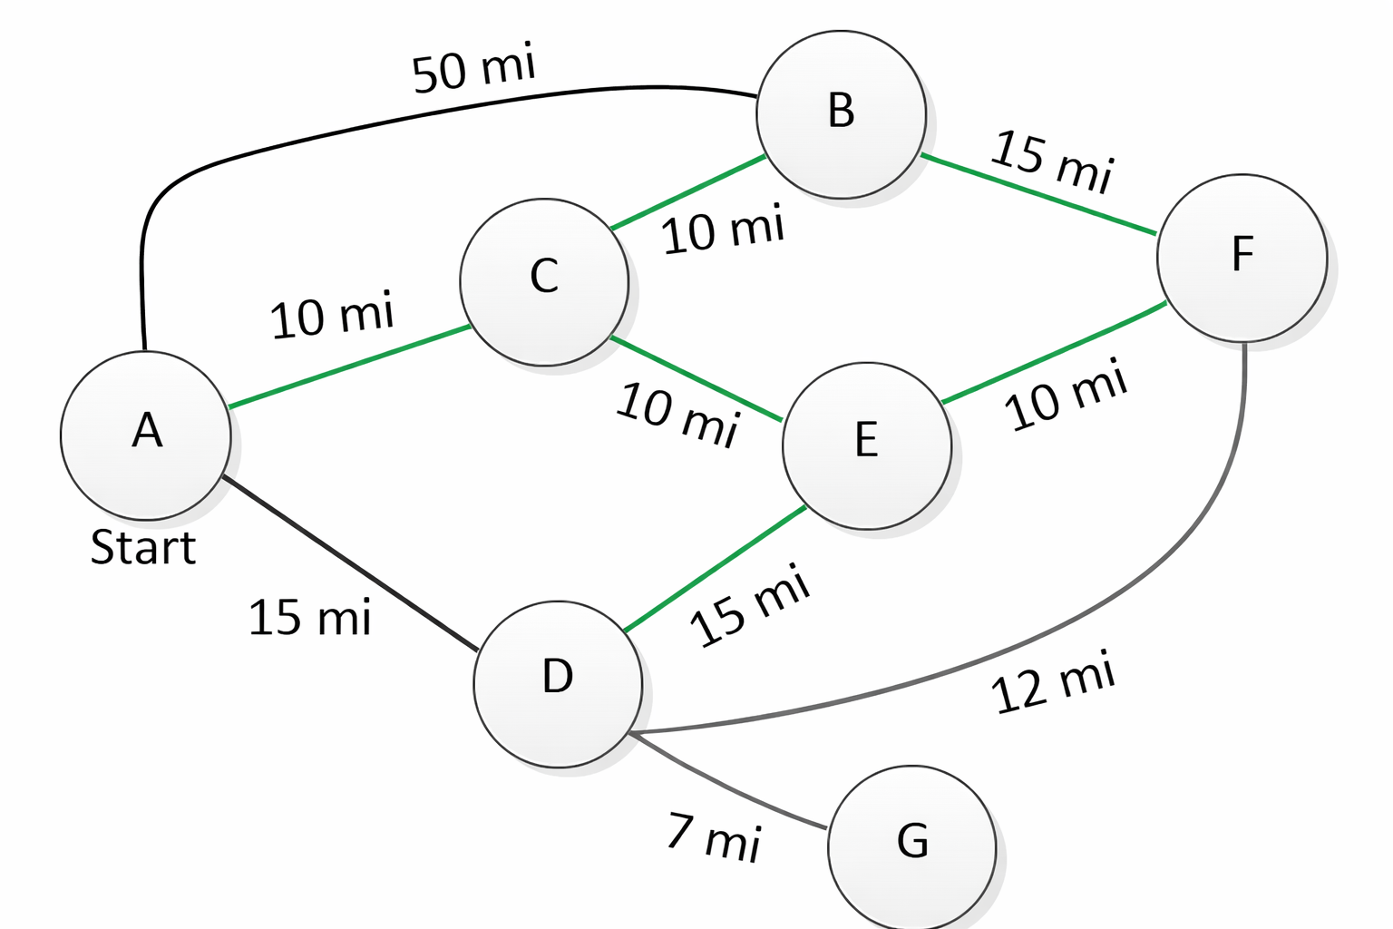
BFS - Example on Graph
What is the best way from A to F? Use BFS.

Slide 22
Uniform-Cost Search (UCS)
Strategy: Expand node with lowest path cost g(n)
Also called: Dijkstra's algorithm
  Uniform-Cost Search is Dijkstra’s algorithm when you stop as soon as the goal is popped from the priority queue.
Implementation:
  Priority queue (the frontier) ordered by path cost
  Always expands cheapest node
    the node with the lowest cumulative path cost so far
Example - Romania:
  Sibiu (80), Fagaras (99) → expand Sibiu first
  Even if Fagaras reaches Bucharest, might not be optimal
  Keep searching until optimal path found
Key: Tests goal when expanding, not when generating
  When the node is being taken off the priority queue
https://www.youtube.com/watch?v=CerlT7tTZfY
https://www.youtube.com/watch?v=bZkzH5x0SKU

Slide 23
UCS - Properties
Properties:
  Complete: Yes (if all costs ≥ ε > 0)
  Optimal: Yes
  Time: O(b^(1+⌊C*/ε⌋))
  Space: O(b^(1+⌊C*/ε⌋))
Where:
  C* = cost of optimal solution
  ε = minimum action cost
When all costs equal: UCS ≈ BFS
Advantage: Optimal even with varying action costs
Disadvantage: Can explore large trees of low-cost actions

Slide 24
UCS - Properties
Properties:
  Complete: Yes (if all costs ≥ ε > 0)
    If a path to the goal exists, the algorithm is guaranteed to find it
  Optimal: Yes
  When all costs equal: UCS ≈ BFS
Advantage: Optimal even with varying action costs
Disadvantage: Can explore large trees of low-cost actions

Slide 25
UCS - Example on Graph
What is the best way from A to F? Use UCS.

Slide 26
Depth-First Search (DFS)
Strategy: Expand deepest node first
  Go as deep as possible, then backtrack
Implementation:
  LIFO queue (stack)
  New nodes go to front
Typically: Tree-like search (doesn't track reached states)
Properties:
  Complete: No (can get stuck in infinite paths)
  Optimal: No (returns first solution found)
  Time: O(b^m)
  Space: O(bm)

Slide 27
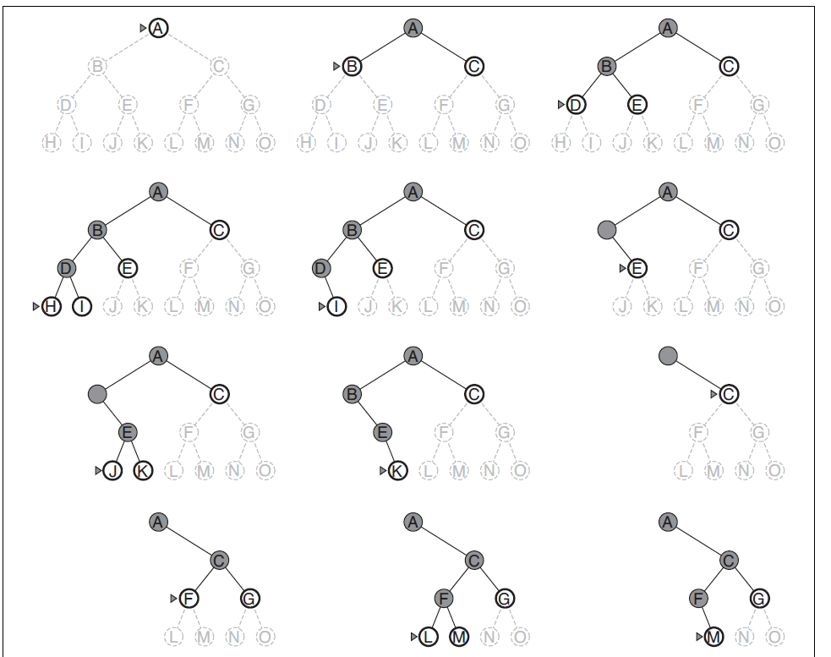
DFS - Example on Tree

Slide 28
DFS - Why Use It?
Major Advantage: Memory Efficiency
  BFS: Stores O(b^d) nodes
  DFS: Stores O(bm) nodes
Example: b=10, m=10
  BFS: 10 billion nodes
  DFS: 100 nodes
Use Cases:
  Finite, tree-shaped state spaces
  Constraint satisfaction (Chapter 5)
  Logic programming (Chapter 9)
  When memory is extremely limited
Depth First Search Algorithm | Graph Theory

Slide 29
Depth-Limited Search
Problem: DFS can go infinitely deep (if state space has cycles)
  Solution: Impose depth limit ℓ
  Treat nodes at depth ℓ as having no successors
Properties:
  Complete: No (unless ℓ ≥ d)
  Optimal: No
  Time: O(b^ℓ)
  Space: O(bℓ)
Challenge: Choosing good ℓ
  Too small: Miss solution
  Too large: Inefficient

Slide 30
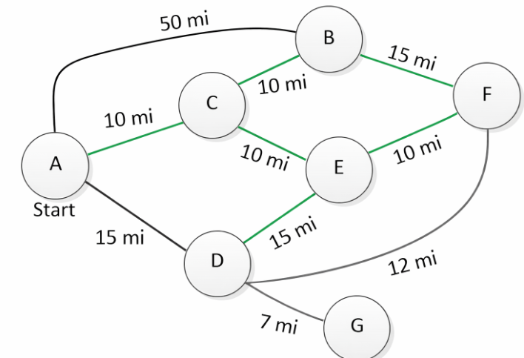
DFS - Example on Graph
What is the best way from A to F? Use DFS.

Slide 31
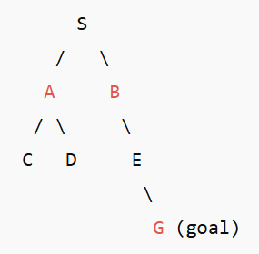
Iterative Deepening Search (IDS)
IDS repeatedly runs Depth-Limited Search (DLS) with increasing depth limits until a goal is found.
  Strategy: Try all depth limits: 0, 1, 2, 3, ...
  It is a depth-first algorithm that behaves like breadth-first in terms of results.
Properties:
  Complete: Yes (finite branching)
  Optimal: Yes (if all costs equal)
  Time: O(b^d)
  Space: O(bd)
Best of both worlds: BFS completeness + DFS memory efficiency

Slide 32
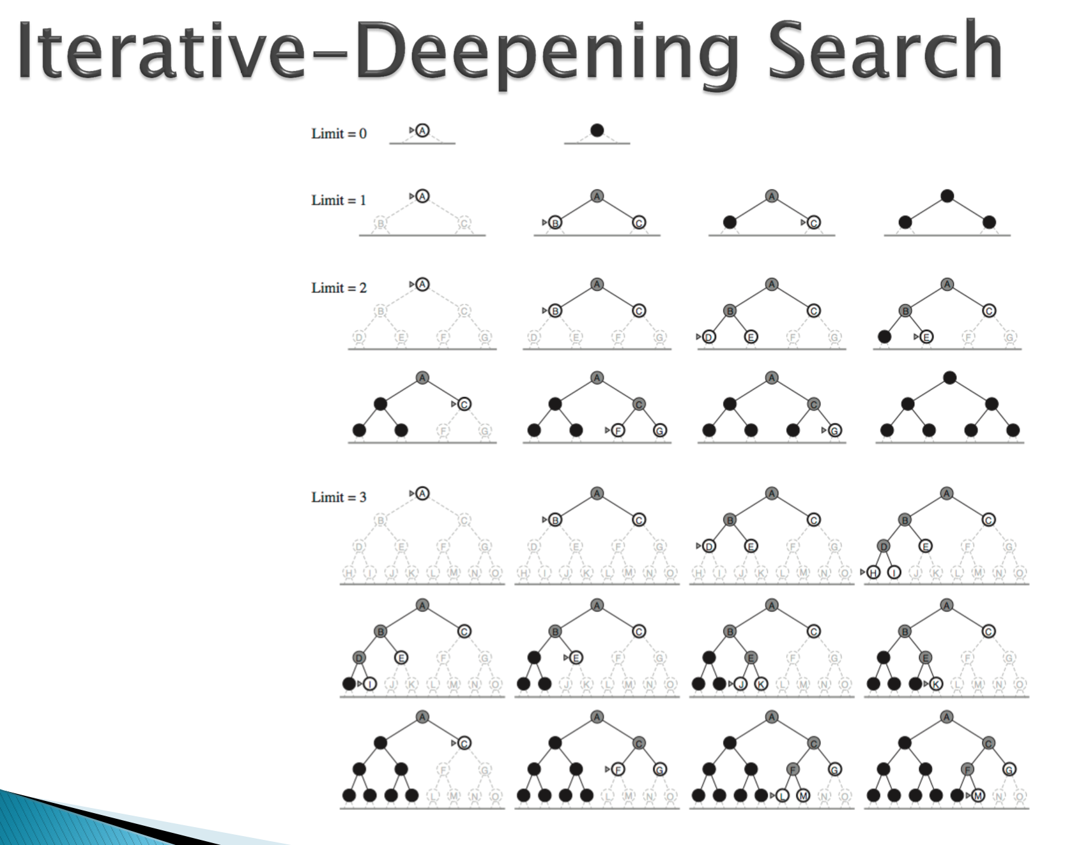

Slide 33
Iterative Deepening Search (IDS)
Why redoing work is NOT wasteful
  At first it looks inefficient because nodes are revisited, but:
    Most nodes are at the deepest level
    Upper levels are small compared to bottom levels
  So total work is still:
    O(b^d)
  Same as BFS, where:
    bbb = branching factor
    ddd = depth of shallowest solution
  The repeated visits add only a small constant factor.
IDS has:
  Optimality of BFS
  Memory efficiency of DFS
That’s why it’s often called:
  The best uninformed search strategy in practice

Slide 34
IDS - Example on Graph
What is the best way from A to F? Use IDS.

Slide 35
Bidirectional Search
Strategy: Search forward from start AND backward from goal
Motivation: 2 × b^(d/2) << b^d
Example: b=10, d=10
Unidirectional: 10^10 = 10 billion
Bidirectional: 2 × 10^5 = 200,000
50,000× faster
Challenge: Need to search backwards
Requires inverse actions
Must check if two frontiers have met

Slide 36
Bidirectional Search
Bidirectional Search runs two searches (BFS) at the same time:
  one forward from the start state
  one backward from the goal state
  and stops when the two searches meet in the middle.
Instead of searching: Start → → → → → → Goal
you search: Start → → → ← ← ← Goal
  and meet somewhere in between.
Motivation: 2 × b^(d/2) << b^d
Example: b=10, d=10
  Unidirectional: 10^10 = 10 billion
  Bidirectional: 2 × 10^5 = 200,000
  50,000× faster

Slide 37
Bidirectional Search - How It Works
How It Works (Step by Step)
  Put start in forward frontier
  Put goal in backward frontier
  Expand one level from the start side
  Expand one level from the goal side
  After each expansion, check:
    Has any state been generated by both searches?
  If yes → path found by joining the two partial paths

Slide 38
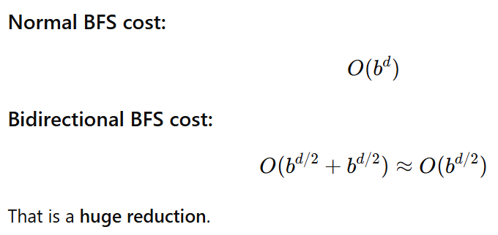
Bidirectional Search - How It Works
Why It’s Faster
  If:
    Branching factor = b
    Solution depth = d

Slide 39
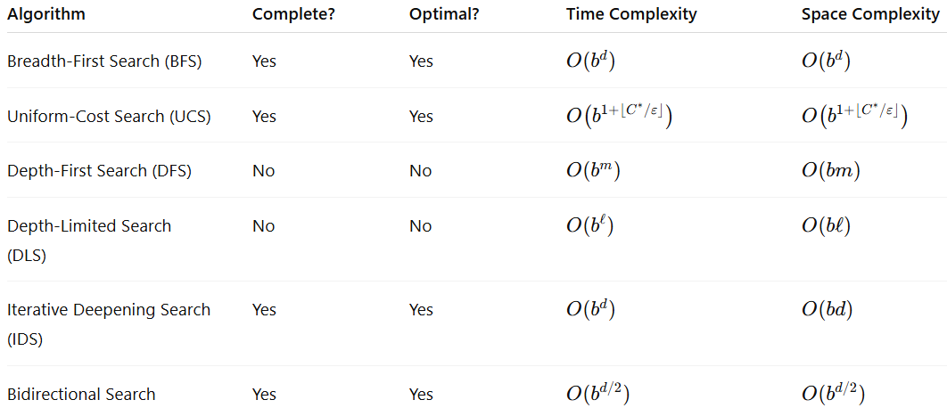
Comparing Uninformed Searches

Slide 40
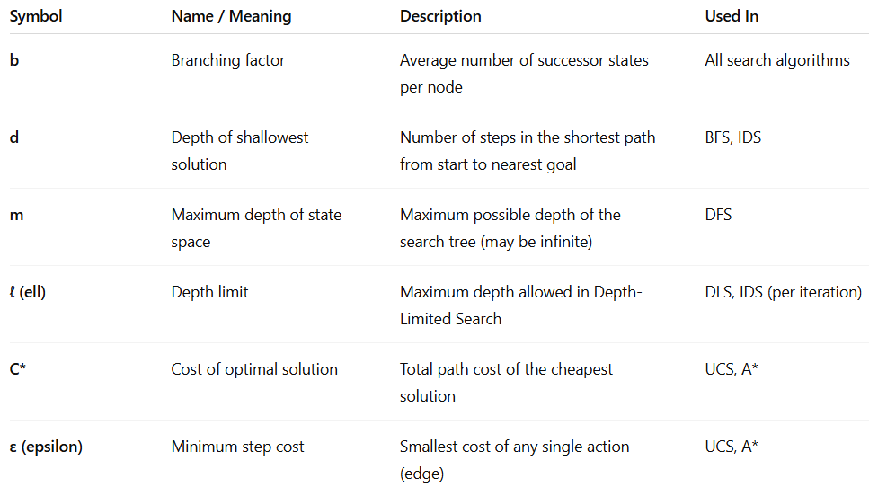
Comparing Uninformed Searches

Slide 41
Uninformed Search - When to Use What?
Breadth-First:
  Small state space
  All actions same cost
  Need optimal solution
Uniform-Cost:
  Different action costs
  Need optimal solution
  Have enough memory
Depth-First/IDS:
  Large/infinite state space
  Limited memory
  IDS preferred for completeness
Bidirectional:
  Can compute predecessors
  Single goal (or few goals)
  Want big speedup

