Slide 1
COSC2396
UNIX and C Systems Programming
Fall 2025
Subhendu Bhadra

Slide 2
Topics – Section 3
Section 3 (Unix Systems Programming):
1. Process creation
2. Signals
3. Inter-process communications
4. Sockets
5. Multi-Threading
6. Pipes

Slide 3
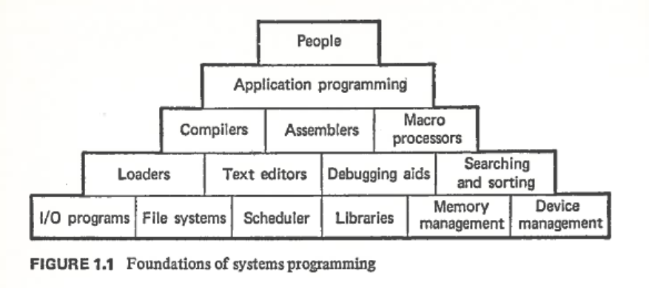
Unix Systems Programming
System Software

Slide 4
Unix Systems Programming
Introduction
UNIX commands are programs that are written in C that interact with the UNIX environment using functions called Systems Calls. UNIX provides a well-defined, limited number of entry points directly into the kernel called system calls. It is the list of services or functions that UNIX provides. System Calls are API (Application Programming Interface) of Operating System.
The list of system calls is defined in the file /usr/include/sys/syscall.h
#define SYS_syscall 0
#define SYS_exit 1
#define SYS_fork 2
#define SYS_read 3
#define SYS_write 4
#define SYS_open 5
#define SYS_close 6
#define SYS_link 9
#define SYS_unlink 10
#define SYS_chdir 12
#define SYS_chmod 15
#define SYS_getrusage 19
#define SYS_getpid 20
#define SYS_stat 38
#define SYS_getppid 39
#define SYS_sigaction 46

Slide 5
Unix Systems Programming
Introduction
In System programming, we learn various Systems Calls and how to use them in a program.
System Calls run in special CPU mode called Kernel (Protected) Mode that uses an extended set of instructions & can access all the registers.
Application programs run in User (Real) Mode where a restricted set of instructions can be run and only a portion of the registers is accessible.
When an application program runs and invokes a system call like open() in user mode it generates a “software interrupt” to cross the user/kernel mode boundary.
Then the System Call corresponding to open() system call (usually, sys_open() kernel function) starts running in Kernel Mode where it checks the arguments and validates that the arguments are correct and that the owner of the process can open the file. Then, it performs the operation and returns the file handler of the open file.
If there is an error in any of the arguments, the system call will return –1 and a global variable errno is set.

Slide 6
Unix Systems Programming
Introduction
The global variable int errno is defined in the standard C library and stores the status of the last system call executed. It is either 0 on success or an error number defined in /usr/include/sys/errno.h file. A human readable error message can be generated using perror()
#define EPERM 1 /* Operation not permitted */
#define ENOENT 2 /* No such file or directory */
#define ESRCH 3 /* No such process */
#define EINTR 4 /* Interrupted system call */
#define EIO 5 /* Input/output error */
#define EBADF 9 /* Bad file descriptor */
#define ECHILD 10 /* No child processes */
#define EDEADLK 11 /* Resource deadlock avoided */
#define ENOMEM 12 /* Cannot allocate memory */
#define EACCES 13 /* Permission denied */
#define EFAULT 14 /* Bad address */
#define EBUSY 16 /* Device busy */
#define EEXIST 17 /* File exists */
#define EINVAL 22 /* Invalid argument */
#define ENFILE 23 /* Too many open files in system */
#define EPIPE 32 /* Broken pipe */
#define EAGAIN 35 /* Resource temporarily unavailable */
#define EOPNOTSUPP 45 /* Operation not supported */

Slide 7
Unix Systems Programming
Introduction
Man command https://man.openbsd.org/OpenBSD-5.9/man.1
UNIX man command can be used to view manpages for system calls (usually section 2) and library functions (section 3) as well.
Example:
  man –s 2 write
  man –s 3 time
man –k <name>or apropos <name> can be used to search all system calls with name

Slide 8
Unix Systems Programming
Introduction
UNIX Programmer’s Manual [by K. Thompson and D. M. Ritchie in 1973] defines the system calls (in Section 2) and the general-purpose library functions available to programmers (in Section 3)
Some useful UNIX system calls:
  chdir − change working directory
  chmod − change mode of file
  chown − change owner
  close − close a file
  creat − create a new file
  dup − duplicate an open file descriptor
  exit − terminate process
  fstat − get status of open file
  getuid − get user identification
  kill − send signal to a process
  mknod − make a directory or a special file
  nice − set program priority
  open − open for reading or writing
  read − read from file
  sleep − stop execution for interval
  time − get date/time measured in seconds since epoch (January 1, 1970 00:00:00 GMT).
  times − get process times
  write − write on a file

Slide 9
Unix Systems Programming
Introduction
Library function is a function in a standard C library. Few library functions are provided below:
  String functions – strlen, strcpy, strcat, strcmp, strncpy, strncat, strncmp, strdup, strstr, strchr, strtok
  String conversion – atof, atoi, atol
  Math functions: abs, fabs, ceil, floor, round, trunc, exp, log, rand, pow, sqrt, cos, sin, tan, acos, asin, atan
  Memory functions – memcpy, memset, memmove, memcmp, memset
  Input/Output – fopen, fclose, feof, fgetc, fputc, fprintf, fscanf, fgets, fputs, fread, fwrite, fseek, ftell, rewind
  Time manipulation – ctime
  crypt − password encoding
  getpw − get name from UID
  mesg − write message on typewriter

Slide 10
Unix Systems Programming
Introduction
When a process is created, there are three file pointers are opened by default. They are defined in stdio.h header.
  stdin (0) – default Standard Input
  stdout (1) – default Standard Output
  stderr (2) – default Standard Error
Redirect standard output to a file and then restore to console [error handling omitted for space]
  stdout_save = dup(STDOUT_FILENO )
  out_fd = open("output.log", O_RDWR | O_CREAT | O_TRUNC, 0600)
  dup2(out_fd, STDOUT_FILENO)
  close(out_fd)
  // Any printf or puts will now write to "output.log"
  puts(“puts : this line is redirected to output.log");
  fprintf(stdout, “fprintf : this line is redirected to output.log\n");
  // Ensure all buffered output is written before redirection change
  fflush(stdout);
  // restoration
  dup2(stdout_save, STDOUT_FILENO)
  close(stdout_save)
  // This line will print to the console (the original stdout)
  puts("This line is back to the console.");

Slide 11
Unix Systems Programming
Introduction
The Unix getrusage() system call provides information about important system resources used by a process or its terminated child processes. It is declared in <sys/resource.h> and returns data in a struct rusage shown below.
  struct rusage {
  struct timeval ru_utime; /* user time used */
  struct timeval ru_stime; /* system time used */
  long ru_maxrss; /* max resident set size */
  long ru_ixrss; /* integral shared text memory size */
  long ru_idrss; /* integral unshared data " */
  long ru_isrss; /* integral unshared stack " */
  long ru_minflt; /* page reclaims */
  long ru_majflt; /* page faults */
  long ru_nswap; /* swaps */
  long ru_inblock; /* block input operations */
  long ru_oublock; /* block output operations */
  long ru_msgsnd; /* messages sent */
  long ru_msgrcv; /* messages received */
  long ru_nsignals; /* signals received */
  long ru_nvcsw; /* voluntary context switches */
  long ru_nivcsw; /* involuntary " */
  };

Slide 12
Unix Systems Programming
Introduction
System resource limits are also defined in <sys/resource.h>
  struct rlimit {
    rlim_t rlim_cur; /* current (soft) limit */
    rlim_t rlim_max; /* maximum value for rlim_cur */
  };
  #define RLIMIT_CPU 0 /* cpu time in milliseconds */
  #define RLIMIT_FSIZE 1 /* maximum file size */
  #define RLIMIT_DATA 2 /* data size */
  #define RLIMIT_STACK 3 /* stack size */
  #define RLIMIT_CORE 4 /* core file size */
  #define RLIMIT_RSS 5 /* resident set size */
  #define RLIMIT_MEMLOCK 6 /* locked-in-memory address space */
  #define RLIMIT_NPROC 7 /* number of processes */
  #define RLIMIT_NOFILE 8 /* number of open files */
Use system calls getrlimit() & setrlimit() in C and ulimit command to get/set the resource limits.
struct rlimit rl; result = getrlimit(RLIMIT_STACK, &rl);
struct rlimit rl; rl.rlim_cur = 64L * 1024L * 1024L; result = setrlimit(RLIMIT_STACK, &rl);
  ulimit –a
  ulimit –s
  ulimit –s 512
  ulimit –f unlimited

