Slide 1

William Stallings Computer Organization and Architecture 10th Edition
Notes:
Lecture slides prepared for “Computer Organization and Architecture”, 10/e, by William Stallings, Chapter 6 “Internal Memory”.

Slide 2
Chapter 6
Internal Memory
Notes:
We begin this chapter with a survey of semiconductor main memory subsystems,
including ROM, DRAM, and SRAM memories. Then we look at error control
techniques used to enhance memory reliability. Following this, we look at more
advanced DRAM architectures.

Slide 3
6.2 Error Correction

Slide 4
Errors in Semiconductor Memory
Semiconductor memory system is subject to errors
Two types of failures:
Hard failures
Soft Error
What can go wrong in a hard failure?
What can go wrong in a soft failure?

Slide 5
Error Correction
Hard Failure
Permanent physical defect
Memory cell or cells affected cannot reliably store data but become stuck at 0 or 1 or switch erratically between 0 and 1
Can be caused by:
Harsh environmental abuse
Manufacturing defects
Wear
Soft Error
Random, non-destructive event that alters the contents of one or more memory cells
No permanent damage to memory
Can be caused by:
Power supply problems
Alpha particles – radio active decay because radioactive nuclei are found in small quantities in nearly all materials
Notes:
A semiconductor memory system is subject to errors. These can be categorized as
hard failures and soft errors. A hard failure is a permanent physical defect so that
the memory cell or cells affected cannot reliably store data but become stuck at
0 or 1 or switch erratically between 0 and 1. Hard errors can be caused by harsh
environmental abuse, manufacturing defects, and wear. A soft error is a random,
nondestructive event that alters the contents of one or more memory cells without
damaging the memory. Soft errors can be caused by power supply problems
or alpha particles. These particles result from radioactive decay and are distressingly
common because radioactive nuclei are found in small quantities in nearly all
materials. Both hard and soft errors are clearly undesirable, and most modern main
memory systems include logic for both detecting and correcting errors.

Slide 6
Error Correct Logic
Notes:
Figure 5.7 illustrates in general terms how the process is carried out. When
data are to be written into memory, a calculation, depicted as a function f, is performed
on the data to produce a code. Both the code and the data are stored. Thus,
if an M-bit word of data is to be stored and the code is of length K bits, then the
actual size of the stored word is M + K bits.
When the previously stored word is read out, the code is used to detect and possibly
correct errors. A new set of K code bits is generated from the M data bits and
compared with the fetched code bits. The comparison yields one of three results:
• No errors are detected. The fetched data bits are sent out.
• An error is detected, and it is possible to correct the error. The data bits plus
error correction bits are fed into a corrector, which produces a corrected set of
M bits to be sent out.
• An error is detected, but it is not possible to correct it. This condition is reported.
Codes that operate in this fashion are referred to as error-correcting codes. A
code is characterized by the number of bit errors in a word that it can correct and detect.

Slide 7
Error Correction Logic
When data are to be written into memory, a calculation, depicted as a function f, is performed on the data to produce a code.
Both the code and the data are stored. Thus, if an M bit word of data is to be stored and the code is of length K bits, then the actual size of the stored word is M + K bits.
When the previously stored word is read out, the code is used to detect and possibly correct errors.
A new set of K code bits is generated from the M data bits and compared with the fetched code
Codes that operate in this fashion are called error-correcting codes

Slide 8
Parity Bit (Not in Book)
To detect errors in data communication and processing, an additional bit is sometimes added to a binary code word to define its parity.
A parity bit is the extra bit included to make the total number of 1’s in the resulting code word either even or odd.

Slide 9
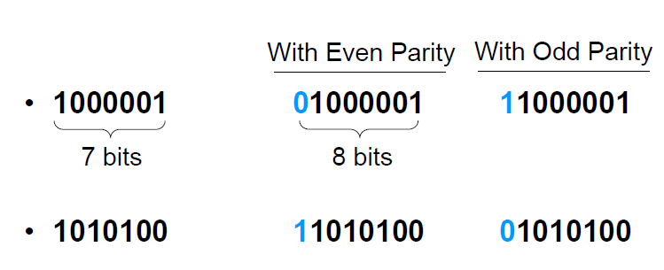
Parity Bit Example

Slide 10
Characteristics of Parity
Even parity is more common
Parity may be used with binary numbers
The parity bit may be placed in any fixed position in the code

Slide 11
Parity Bit Generation and Checking
An even parity bit is generated at the sending end for all 7-bit ASCII characters
The 8-bit characters including the parity bits are transmitted to their destination
The parity of each character is then checked at the receiving end
If the parity of the received character is not even (assuming even parity is used), at least one bit has changed its value during the transmission

Slide 12
Pros and Cons of Parity
If the number of bits changed is even, the error will not be detected.
It can only detect one, three, or any odd number of errors in each character.
Parity does not indicate which bit contained the error, even when it can detect it.
The data must be discarded entirely and re- transmitted from scratch.
It uses only a single bit, resulting in the least overhead.

Slide 13
Hamming Code
The most common types of error-correcting codes used in RAM are based on the codes devised by R.W. Hamming.
K parity bits are added to an n-bit data word, forming a new word of n + k bits.
The bit positions are numbered in sequence from 1 to n + k.
Those positions numbered with powers of two are reserved for the parity bits.
The code can be used with words of any length

Slide 14
Hamming Code Example
Suppose we want to send 8 bits
D1, D2, D3,… D7 D8
Determine how many Parity Bits needed?
Use the equation: 2^{k} – 1 >= D + K
For example D=8:
K=3: 2³ – 1 < 8 + 3
K=4: 2⁴ – 1 > 8 + 3
We need 4 Parity bits or Check bits

Slide 15
Hamming Code Example
How many parity bits de we need for 7 bit data?
7 Data Bits
4 Check Bits

Slide 16
Hamming Code Example
Let say we want to transmit the following 8 bits of data 00111001
Create the transmitted data with parity bits
Parity/Check bit is added at every power of 2
Locations 1, 2, 4, 8 and so on
So total bits to transfer?

Slide 17
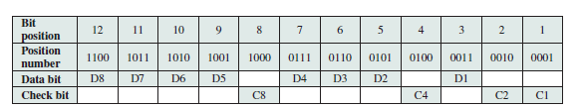
Hamming Code Example: 8-bits

Slide 18
Hamming Code Example: 8-bits
For C1 check position numbers with Least Significant Bit is 1
That would be 3, 5, 7, 9,11
So we can say D1, D2, D4, D5, D7

Slide 19
Hamming Code Example: 8-bits
For C2 check bit position number 2 with a 1
That would be 3, 6, 7, 10 and 11
So we can say D1, D3, D4, D6, D7
For C4, bit position 3 and For C8, bit position 4

Slide 20
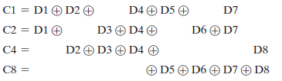
Hamming Code Example: 8-bits

Slide 21
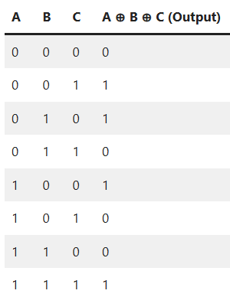
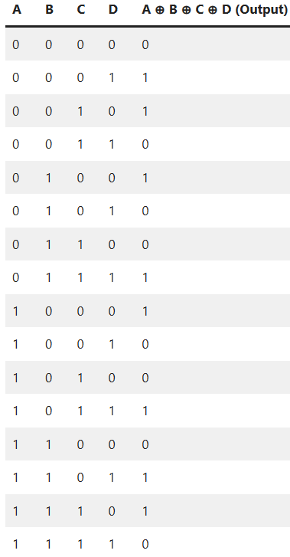
Xor – Exclusive Or

Slide 22
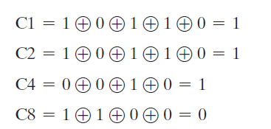
Hamming Code Example: 8-bits
Data 00111001

Slide 23
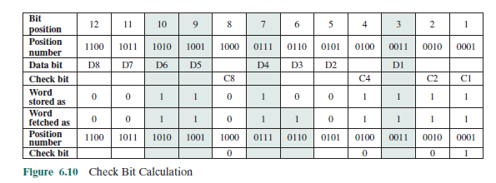
Hamming Code
Data 00111001
Assume, Bit position 3 gets inverted

Slide 24
Hamming Code Example: 8-bits

Slide 25
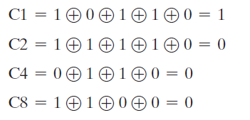
Hamming Code Example: 8-bits

Slide 26
Hamming Code
Data 00111001

Slide 27
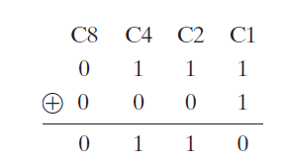
Hamming Code

Slide 28
Table 5.2
Increase in Word Length with Error Correction
Notes:
The first three columns of Table 5.2
lists the number of check bits required for various data word lengths.
For convenience, we would like to generate a 4-bit syndrome for an 8-bit data
word with the following characteristics:
• If the syndrome contains all 0s, no error has been detected.
• If the syndrome contains one and only one bit set to 1, then an error has
occurred in one of the 4 check bits. No correction is needed.
• If the syndrome contains more than one bit set to 1, then the numerical value
of the syndrome indicates the position of the data bit in error. This data bit is
inverted for correction.

Slide 29
6.3 DDR DRAM

Slide 30
Advanced DRAM Organization
SDRAM
DDR-DRAM
Dynamic Random-Access Memory
One of the most critical system bottlenecks when using high-performance processors is the interface to main internal memory
The traditional DRAM chip is constrained both by its internal architecture and by its interface to the processor’s memory bus
A number of enhancements to the basic DRAM architecture have been explored
The schemes that currently dominate the market are SDRAM and DDR-DRAM
RDRAM
Notes:
As discussed in Chapter 1, one of the most critical system bottlenecks when using
high-performance processors is the interface to main internal memory. This interface
is the most important pathway in the entire computer system. The basic building
block of main memory remains the DRAM chip, as it has for decades; until
recently, there had been no significant changes in DRAM architecture since the
early 1970s. The traditional DRAM chip is constrained both by its internal architecture
and by its interface to the processor’s memory bus.
We have seen that one attack on the performance problem of DRAM
main memory has been to insert one or more levels of high-speed SRAM cache
between the DRAM main memory and the processor. But SRAM is much costlier
than DRAM, and expanding cache size beyond a certain point yields diminishing
returns.
In recent years, a number of enhancements to the basic DRAM architecture
have been explored. The schemes that currently dominate the market are SDRAM
and DDR-DRAM. We examine each of these in turn.

Slide 31
Synchronous DRAM (SDRAM)
One of the most widely used forms of DRAM
Exchanges data with the processor synchronized to an external clock signal and running at the full speed of the processor/memory bus without imposing wait states
With synchronous access the DRAM moves data in and out under control of the system clock
The processor or other master issues the instruction and address information which is latched by the DRAM
The DRAM then responds after a set number of clock cycles
Meanwhile the master can safely do other tasks while the SDRAM is processing
Notes:
One of the most widely used forms of DRAM is the synchronous DRAM
(SDRAM) [VOGL94]. Unlike the traditional DRAM, which is asynchronous, the
SDRAM exchanges data with the processor synchronized to an external clock signal
and running at the full speed of the processor/memory bus without imposing
wait states.
In a typical DRAM, the processor presents addresses and control levels to
the memory, indicating that a set of data at a particular location in memory should
be either read from or written into the DRAM. After a delay, the access time, the
DRAM either writes or reads the data. During the access-time delay, the DRAM
performs various internal functions, such as activating the high capacitance of the
row and column lines, sensing the data, and routing the data out through the output
buffers. The processor must simply wait through this delay, slowing system
performance.
With synchronous access, the DRAM moves data in and out under control of
the system clock. The processor or other master issues the instruction and address
information, which is latched by the DRAM. The DRAM then responds after a set
number of clock cycles. Meanwhile, the master can safely do other tasks while the
SDRAM is processing the request.

Slide 32
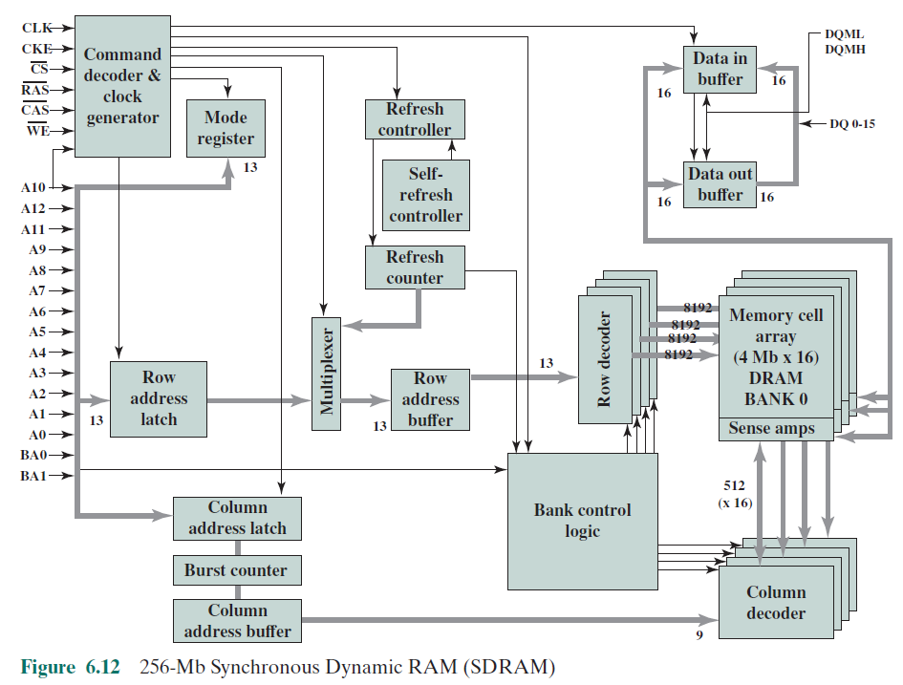
Notes:
Figure 6.12 shows the internal logic of a typical 256-Mb SDRAM typical
of SDRAM organization.

Slide 33
Internal Logic of SDRAM 256-MB
SDRAM employs a burst mode to eliminate the address setup time and row and column line precharge time after the first access.
In burst mode, a series of data bits can be clocked out rapidly after the first bit has been accessed.
This mode is useful when all the bits to be accessed are in sequence and in the same row of the array as the initial access.
In addition, the SDRAM has a multiple-bank internal architecture that improves opportunities for on-chip parallelism.
Performs best when it is transferring large blocks of data sequentially

Slide 34
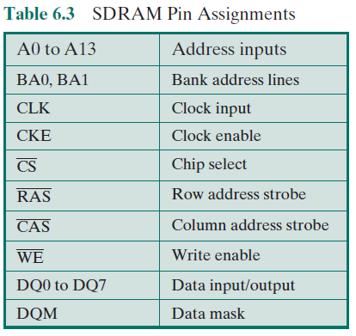
Table 6.3
SDRAM
Pin
Assignments
Notes:
Table 6.3 defines the various pin assignments.
The SDRAM employs a burst mode to eliminate the address setup time and
row and column line pre-charge time after the first access. In burst mode, a series of
data bits can be clocked out rapidly after the first bit has been accessed. This mode
is useful when all the bits to be accessed are in sequence and in the same row of the
array as the initial access. In addition, the SDRAM has a multiple-bank internal
architecture that improves opportunities for on-chip parallelism.
The mode register and associated control logic is another key feature differentiating
SDRAMs from conventional DRAMs. It provides a mechanism to
customize the SDRAM to suit specific system needs. The mode register specifies
the burst length, which is the number of separate units of data synchronously fed
onto the bus. The register also allows the programmer to adjust the latency between
receipt of a read request and the beginning of data transfer.
The SDRAM performs best when it is transferring large blocks of data serially,
such as for applications like word processing, spreadsheets, and multimedia.

Slide 35
Double Data Rate SDRAM (DDR SDRAM)
Developed by the JEDEC Solid State Technology Association (Electronic Industries Alliance’s semiconductor-engineering-standardization body)
Numerous companies make DDR chips, which are widely used in desktop computers and servers
DDR achieves higher data rates in three ways:
First, the data transfer is synchronized to both the rising and falling edge of the clock, rather than just the rising edge
Second, DDR uses higher clock rate on the bus to increase the transfer rate
Third, a buffering scheme is used
Notes:
Although SDRAM is a significant improvement on asynchronous RAM, it still
has shortcomings that unnecessarily limit that I/O data rate that can be achieve. To
address these shortcomings a newer version of SDRAM, referred to as double-data-
rate DRAM (DDR RAM) provides several features that dramatically increase
the data rate. DDR DRAM was developed by the JEDEC Solid State Technology
Association, the Electronic Industries Alliance’s semiconductor-engineering-standardization
body. Numerous companies make DDR chips, which are widely used in
desktop computers and servers.
DDR achieves higher data rates in three ways. First, the data transfer is synchronized
to both the rising and falling edge of the clock, rather than just the rising
edge. This doubles the data rate; hence the term double data rate . Second, DDR
uses higher clock rate on the bus to increase the transfer rate. Third, a buffering
scheme is used, as explained subsequently.

Slide 36
2-Bit Prefetch Buffer
The initial DDR version makes use of a 2-bit prefetch buffer.
The prefetch buffer is a memory cache located on the SDRAM chip.
It enables the SDRAM chip to preposition bits to be placed on the data bus as rapidly as possible.
The DDR I/O bus uses the same clock rate as the memory chip, but because it can handle two bits per cycle, it achieves a data rate that is double the clock rate.
The 2-bit prefetch buffer enables the SDRAM chip to keep up with the I/O bus.

Slide 37
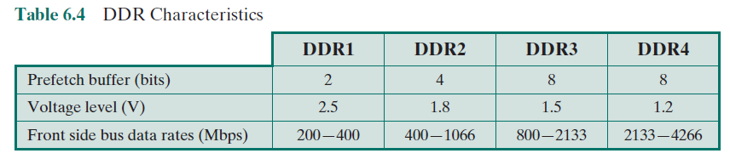
Table 6.4
DDR Characteristics
Notes:
JDEC has thus far defined four generations of the DDR technology (Table 5.4).
The initial DDR version makes use of a 2-bit prefetch buffer. The prefetch buffer is
a memory cache located on the SDRAM chip. It enables the SDRAM chip to preposition
bits to be placed on the data bus as rapidly as possible. The DDR I/O bus
uses the same clock rate as the memory chip, but because it can handle two bits per
cycle, it achieves a data rate that is double the clock rate. The 2-bit prefetch buffer
enables the SDRAM chip to keep up with the I/O bus.

Slide 38
6.4 EDRAM

Slide 39
EDRAM
Embedded DRAM (eDRAM). eDRAM is a DRAM integrated on the same chip or MCM of an application-specific integrated circuit (ASIC) or microprocessor.
eDRAM is intermediate between on-chip SRAM and off-chip DRAM:
For the same surface area, eDRAM provides a larger size memory than SRAM but smaller than off-chip DRAM.
eDRAM’s cost-per-bit is higher than stand alone DRAM chips used as external memory, but it has a lower cost-per-bit than SRAM.
Access time to eDRAM is greater than SRAM but, because of its proximity and the ability to use wider busses, eDRAM provides faster access than DRAM.

Slide 40
6.5 Flash Memory

Slide 41
Flash Memory
Used both for internal memory and external memory applications
First introduced in the mid-1980’s
Is intermediate between EPROM and EEPROM in both cost and functionality
Uses an electrical erasing technology like EEPROM
It is possible to erase just blocks of memory rather than an entire chip
Gets its name because the microchip is organized so that a section of memory cells are erased in a single action
Does not provide byte-level erasure
Uses only one transistor per bit so it achieves the high density of EPROM
Notes:
Another form of semiconductor memory is flash memory. Flash memory is used
both for internal memory and external memory applications. Here, we provide a
technical overview and look at its use for internal memory.
First introduced in the mid-1980s, flash memory is intermediate between
EPROM and EEPROM in both cost and functionality. Like EEPROM, flash memory
uses an electrical erasing technology. An entire flash memory can be erased in
one or a few seconds, which is much faster than EPROM. In addition, it is possible
to erase just blocks of memory rather than an entire chip. Flash memory gets its
name because the microchip is organized so that a section of memory cells are
erased in a single action or "flash." However, flash memory does not provide bytelevel
erasure. Like EPROM, flash memory uses only one transistor per bit, and so
achieves the high density (compared with EEPROM) of EPROM.

Slide 42
Summary
Internal
Memory
Chapter 6
Semiconductor main memory
Organization
DRAM and SRAM
Types of ROM
Chip logic
Chip packaging
Module organization
Interleaved memory
Error correction
DDR DRAM
Synchronous DRAM
DDR SDRAM
EDRAM
Flash memory
Operation
Notes:
Chapter 5 summary.

Slide 43
Important
Quiz Next Week
Short Question and Answers, in-class on paper Chapter 5 and 6
Assignment 1
Questions from chapter 1-6
Solution to be submitted online

