Slide 1

William Stallings Computer Organization and Architecture 10th Edition
Notes:
Lecture slides prepared for “Computer Organization and Architecture”, 10/e, by William Stallings, Chapter 6 “Internal Memory”.

Slide 2
Chapter 6
Internal Memory
Notes:
We begin this chapter with a survey of semiconductor main memory subsystems,
including ROM, DRAM, and SRAM memories. Then we look at error control
techniques used to enhance memory reliability. Following this, we look at more
advanced DRAM architectures.

Slide 3
6.1 Semiconductor Main Memory

Slide 4
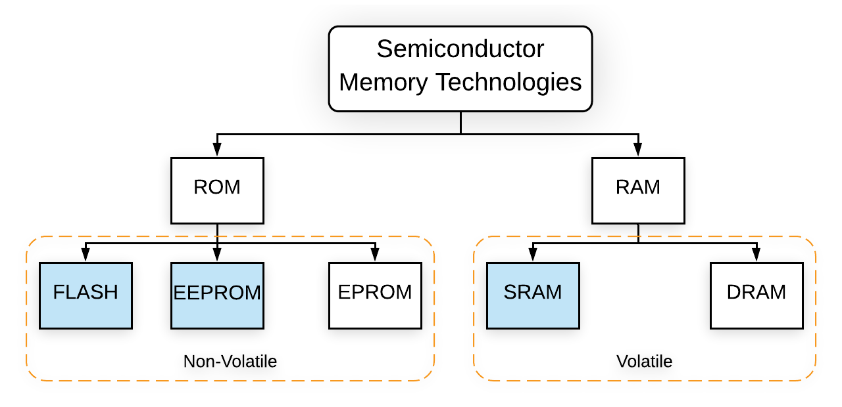
Semiconductor Main Memory
Semiconductor chips are used for main memory

Slide 5
Semiconductor Main Memory
All semiconductor memory cells share certain properties:
They exhibit two stable (or semistable) states, which can be used to represent binary 1 and 0.
They are capable of being written into (at least once), to set the state.
They are capable of being read to sense the state.

Slide 6
Fig 6.1 Memory Cell Operation
3 Terminals:
The select terminal selects a memory cell for a read or write operation.
The control terminal indicates read or write.
For writing, the other terminal provides an electrical signal that sets the state of the cell to 1 or 0. For reading, that terminal is used for output of the cell’s state
Notes:
In earlier computers, the most common form of random-access storage for computer
main memory employed an array of doughnut-shaped ferromagnetic loops
referred to as cores. Hence, main memory was often referred to as core, a term that
persists to this day. The advent of, and advantages of, microelectronics has long
since vanquished the magnetic core memory. Today, the use of semiconductor chips
for main memory is almost universal. Key aspects of this technology are explored
in this section.
The basic element of a semiconductor memory is the memory cell. Although a variety
of electronic technologies are used, all semiconductor memory cells share certain
properties:
• They exhibit two stable (or semistable) states, which can be used to represent
binary 1 and 0.
• They are capable of being written into (at least once), to set the state.
• They are capable of being read to sense the state.
Figure 5.1 depicts the operation of a memory cell. Most commonly, the cell
has three functional terminals capable of carrying an electrical signal. The select
terminal, as the name suggests, selects a memory cell for a read or write operation.
The control terminal indicates read or write. For writing, the other terminal
provides an electrical signal that sets the state of the cell to 1 or 0. For reading, that
terminal is used for output of the cell’s state. The details of the internal organization,
functioning, and timing of the memory cell depend on the specific integrated
circuit technology used and are beyond the scope of this book, except for a brief
summary. For our purposes, we will take it as given that individual cells can be
selected for reading and writing operations.

Slide 7
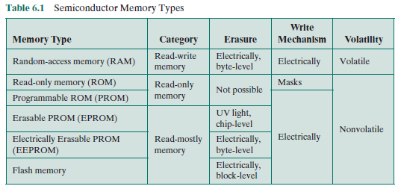
DRAM and SRAM
All the memory types that we will explore in this chapter are random access

Slide 8
Dynamic RAM (DRAM)
RAM technology is divided into two technologies:
Dynamic RAM (DRAM)
Static RAM (SRAM)
DRAM
Made with cells that store data as charge on capacitors
Presence or absence of charge in a capacitor is interpreted as a binary 1 or 0
Requires periodic charge refreshing to maintain data storage
The term dynamic refers to tendency of the stored charge to leak away, even with power continuously applied
Notes:
RAM technology is divided into two technologies: dynamic and
static. A dynamic RAM (DRAM) is made with cells that store data as charge on
capacitors. The presence or absence of charge in a capacitor is interpreted as a
binary 1 or 0. Because capacitors have a natural tendency to discharge, dynamic
RAMs require periodic charge refreshing to maintain data storage. The term
dynamic refers to this tendency of the stored charge to leak away, even with power
continuously applied.

Slide 9
Static RAM (SRAM)
SRAM
Digital device that uses the same logic elements used in the processor
Binary values are stored using traditional flip-flop logic gate configurations
Will hold its data as long as power is supplied to it
Notes:
RAM technology is divided into two technologies: dynamic and
static. A dynamic RAM (DRAM) is made with cells that store data as charge on
capacitors. The presence or absence of charge in a capacitor is interpreted as a
binary 1 or 0. Because capacitors have a natural tendency to discharge, dynamic
RAMs require periodic charge refreshing to maintain data storage. The term
dynamic refers to this tendency of the stored charge to leak away, even with power
continuously applied.

Slide 10
Fig 6.2 Typical Memory Cell Structures
Notes:
Figure 5.2a is a typical DRAM structure for an individual cell that stores 1 bit.
The address line is activated when the bit value from this cell is to be read or written.
The transistor acts as a switch that is closed (allowing current to flow) if a voltage is
applied to the address line and open (no current flows) if no voltage is present on
the address line.
For the write operation, a voltage signal is applied to the bit line; a high voltage
represents 1, and a low voltage represents 0. A signal is then applied to the
address line, allowing a charge to be transferred to the capacitor.
For the read operation, when the address line is selected, the transistor turns
on and the charge stored on the capacitor is fed out onto a bit line and to a sense
amplifier. The sense amplifier compares the capacitor voltage to a reference value
and determines if the cell contains a logic 1 or a logic 0. The readout from the cell
discharges the capacitor, which must be restored to complete the operation.
Although the DRAM cell is used to store a single bit (0 or 1), it is essentially
an analog device. The capacitor can store any charge value within a range; a threshold
value determines whether the charge is interpreted as 1 or 0.
Figure 5.2b is a typical SRAM structure for an individual cell. Four transistors
(T₁, T₂, T₃, T₄) are cross connected in an arrangement that produces a stable logic
state. In logic state 1, point C₁ is high and point C₂ is low; in this state, T₁ and T₄ are off
and T₂ and T₃ are on. In logic state 0, point C₁ is low and point C₂ is high; in this state,
T₁ and T₄ are on and T₂ and T₃ are off. Both states are stable as long as the direct
current (dc) voltage is applied. Unlike the DRAM, no refresh is needed to retain data.
As in the DRAM, the SRAM address line is used to open or close a switch.
The address line controls two transistors (T₅ and T₆). When a signal is applied to
this line, the two transistors are switched on, allowing a read or write operation. For
a write operation, the desired bit value is applied to line B, while its complement
is applied to line B. This forces the four transistors (T₁, T₂, T₃, T₄) into the proper
state. For a read operation, the bit value is read from line B.

Slide 11
SRAM versus DRAM
SRAM
Both volatile
Power must be continuously supplied to the memory to preserve the bit values
Dynamic cell
Simpler to build, smaller
More dense (smaller cells = more cells per unit area)
Less expensive
Requires the supporting refresh circuitry
Tend to be favored for large memory requirements
Used for main memory
Static
Faster
Used for cache memory (both on and off chip)
DRAM
Notes:
Both static and dynamic RAMs are volatile; that is,
power must be continuously supplied to the memory to preserve the bit values.
A dynamic memory cell is simpler and smaller than a static memory cell. Thus, a
DRAM is more dense (smaller cells = more cells per unit area) and less expensive
than a corresponding SRAM. On the other hand, a DRAM requires the supporting
refresh circuitry. For larger memories, the fixed cost of the refresh circuitry is more
than compensated for by the smaller variable cost of DRAM cells. Thus, DRAMs
tend to be favored for large memory requirements. A final point is that SRAMs are
somewhat faster than DRAMs. Because of these relative characteristics, SRAM is
used for cache memory (both on and off chip), and DRAM is used for main memory.

Slide 12
Read Only Memory (ROM)
Contains a permanent pattern of data/program that cannot be changed
No power source is required to maintain the bit values in memory – nonvolatile
Data or program is permanently in main memory and never needs to be loaded from a secondary storage device
Data/program is actually wired into the chip as part of the fabrication process
Disadvantages of this:
No room for error, if one bit is wrong the whole batch of ROMs must be thrown out
Data insertion step includes a relatively large fixed cost
Notes:
As the name suggests, a read-only memory (ROM) contains a permanent pattern
of data that cannot be changed. A ROM is nonvolatile; that is, no power source is
required to maintain the bit values in memory. While it is possible to read a ROM,
it is not possible to write new data into it. An important application of ROMs is
microprogramming, discussed in Part Four. Other potential applications include
• Library subroutines for frequently wanted functions
• System programs
• Function tables
For a modest-sized requirement, the advantage of ROM is that the data or program
is permanently in main memory and need never be loaded from a secondary storage
device.
A ROM is created like any other integrated circuit chip, with the data actually
wired into the chip as part of the fabrication process. This presents two problems:
• The data insertion step includes a relatively large fixed cost, whether one or
thousands of copies of a particular ROM are fabricated.
• There is no room for error. If one bit is wrong, the whole batch of ROMs must
be thrown out.

Slide 13
Programmable ROM (PROM)
Less expensive alternative
Nonvolatile and may be written into only once
Writing process is performed electrically and may be performed by supplier or customer at a time later than the original chip fabrication
Special equipment is required for the writing process
Provides flexibility and convenience
Attractive for high volume production runs
Notes:
When only a small number of ROMs with a particular memory content is
needed, a less expensive alternative is the programmable ROM (PROM). Like the
ROM, the PROM is nonvolatile and may be written into only once. For the PROM,
the writing process is performed electrically and may be performed by a supplier
or customer at a time later than the original chip fabrication. Special equipment is
required for the writing or “programming” process. PROMs provide flexibility and
convenience. The ROM remains attractive for high-volume production runs.

Slide 14
Read-Mostly Memory
EPROM
Erasable programmable read-only memory – erase all cells before re-writing
More expensive than PROM but it has the advantage of the multiple update capability
EEPROM
Electrically erasable programmable read-only memory
Can be written into at any time without erasing prior contents
Combines the advantage of non-volatility with the flexibility of being updatable in place, only addressed bytes are updated
More expensive than EPROM
Flash Memory
Intermediate between EPROM and EEPROM in both cost and functionality
Uses an electrical erasing technology, does not provide byte-level erasure
Microchip is organized so that a section of memory cells are erased in a single action or “flash”
Erasure process can be performed repeatedly using ultraviolet radiation
Notes:
Another variation on read-only memory is the read-mostly memory, which is
useful for applications in which read operations are far more frequent than write
operations but for which nonvolatile storage is required. There are three common
forms of read-mostly memory: EPROM, EEPROM, and flash memory.
The optically erasable programmable read-only memory (EPROM) is read
and written electrically, as with PROM. However, before a write operation, all the
storage cells must be erased to the same initial state by exposure of the packaged
chip to ultraviolet radiation. Erasure is performed by shining an intense ultraviolet
light through a window that is designed into the memory chip. This erasure process
can be performed repeatedly; each erasure can take as much as 20 minutes to
perform. Thus, the EPROM can be altered multiple times and, like the ROM and
PROM, holds its data virtually indefinitely. For comparable amounts of storage, the
EPROM is more expensive than PROM, but it has the advantage of the multiple
update capability.
A more attractive form of read-mostly memory is electrically erasable programmable
read-only memory (EEPROM). This is a read-mostly memory that can
be written into at any time without erasing prior contents; only the byte or bytes
addressed are updated. The write operation takes considerably longer than the read
operation, on the order of several hundred microseconds per byte. The EEPROM
combines the advantage of non-volatility with the flexibility of being updatable in
place, using ordinary bus control, address, and data lines. EEPROM is more expensive
than EPROM and also is less dense, supporting fewer bits per chip.
Another form of semiconductor memory is flash memory (so named because
of the speed with which it can be reprogrammed). First introduced in the mid-1980s,
flash memory is intermediate between EPROM and EEPROM in both cost and
functionality. Like EEPROM, flash memory uses an electrical erasing technology.
An entire flash memory can be erased in one or a few seconds, which is much faster
than EPROM. In addition, it is possible to erase just blocks of memory rather than
an entire chip. Flash memory gets its name because the microchip is organized so
that a section of memory cells are erased in a single action or “flash.” However,
flash memory does not provide byte-level erasure. Like EPROM, flash memory
uses only one transistor per bit, and so achieves the high density (compared with
EEPROM) of EPROM.

Slide 15
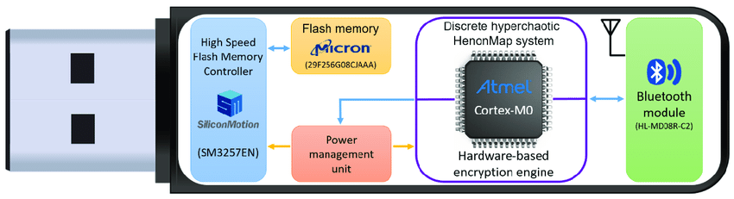
USB
USB drives, also known as USB flash drives or thumb drives, are based on flash memory technology.
Flash memory is a type of non-volatile storage that retains data even when the power is disconnected.
USB drives use NAND flash memory, which is a specific type of flash memory technology, to store data.
This makes them a convenient and portable storage solution for transferring and carrying data.
Flash memory is also commonly used in other storage devices like SSDs (Solid State Drives), memory cards, and some types of portable media players.

Slide 16
Chip Logic
Semiconductor memory comes in packaged chips
Tradeoffs exist among speed, density, and cost
For semiconductor memories, one key design issue is the number of bits that may be read/written at a time

Slide 17
Notes:
Figure 6.3 shows a typical organization of a 16-Mbit DRAM. In this case, 4 bits
are read or written at a time. Logically, the memory array is organized as four square
arrays of 2048 by 2048 elements. Various physical arrangements are possible. In any
case, the elements of the array are connected by both horizontal (row) and vertical
(column) lines. Each horizontal line connects to the Select terminal of each cell in its
row; each vertical line connects to the Data-In/Sense terminal of each cell in its column.
Address lines supply the address of the word to be selected. A total of log₂ W
lines are needed. In our example, 11 address lines are needed to select one of 2048
rows. These 11 lines are fed into a row decoder, which has 11 lines of input and 2048
lines for output. The logic of the decoder activates a single one of the 2048 outputs
depending on the bit pattern on the 11 input lines (2¹¹ = 2048).
An additional 11 address lines select one of 2048 columns of 4 bits per column.
Four data lines are used for the input and output of 4 bits to and from a data buffer.
On input (write), the bit driver of each bit line is activated for a 1 or 0 according to
the value of the corresponding data line. On output (read), the value of each bit line
is passed through a sense amplifier and presented to the data lines. The row line
selects which row of cells is used for reading or writing.
Because only 4 bits are read/written to this DRAM, there must be multiple
DRAMs connected to the memory controller to read/write a word of data to the bus.
Note that there are only 11 address lines (A0–A10), half the number you
would expect for a 2048 * 2048 array. This is done to save on the number of pins.
The 22 required address lines are passed through select logic external to the chip
and multiplexed onto the 11 address lines. First, 11 address signals are passed to the
chip to define the row address of the array, and then the other 11 address signals are
presented for the column address.
As an aside, multiplexed addressing plus the use of square arrays result in a
quadrupling of memory size with each new generation of memory chips. One more
pin devoted to addressing doubles the number of rows and columns, and so the size
of the chip memory grows by a factor of 4.
Figure 5.3 also indicates the inclusion of refresh circuitry. All DRAMs require
a refresh operation. A simple technique for refreshing is, in effect, to disable the
DRAM chip while all data cells are refreshed. The refresh counter steps through all
of the row values. For each row, the output lines from the refresh counter are supplied
to the row decoder and the RAS line is activated. The data are read out and
written back into the same location. This causes each cell in the row to be refreshed.

Slide 18
Chip Logic
Addressing 2¹¹ = 2048 to Save number of pins
Multiplexed: First 11 address signals are passed to define row RAS, and next 11 to define column CAS
WE is write enable to write,
OE is output enable to read
Increase 1 bit for addressing.
Doubles the rows and cols
So effective increase is 4 times
Notes:
Figure 6.3 shows a typical organization of a 16-Mbit DRAM. In this case, 4 bits
are read or written at a time. Logically, the memory array is organized as four square
arrays of 2048 by 2048 elements. Various physical arrangements are possible. In any
case, the elements of the array are connected by both horizontal (row) and vertical
(column) lines. Each horizontal line connects to the Select terminal of each cell in its
row; each vertical line connects to the Data-In/Sense terminal of each cell in its column.
Address lines supply the address of the word to be selected. A total of log₂ W
lines are needed. In our example, 11 address lines are needed to select one of 2048
rows. These 11 lines are fed into a row decoder, which has 11 lines of input and 2048
lines for output. The logic of the decoder activates a single one of the 2048 outputs
depending on the bit pattern on the 11 input lines (2¹¹ = 2048).
An additional 11 address lines select one of 2048 columns of 4 bits per column.
Four data lines are used for the input and output of 4 bits to and from a data buffer.
On input (write), the bit driver of each bit line is activated for a 1 or 0 according to
the value of the corresponding data line. On output (read), the value of each bit line
is passed through a sense amplifier and presented to the data lines. The row line
selects which row of cells is used for reading or writing.
Because only 4 bits are read/written to this DRAM, there must be multiple
DRAMs connected to the memory controller to read/write a word of data to the bus.
Note that there are only 11 address lines (A0–A10), half the number you
would expect for a 2048 * 2048 array. This is done to save on the number of pins.
The 22 required address lines are passed through select logic external to the chip
and multiplexed onto the 11 address lines. First, 11 address signals are passed to the
chip to define the row address of the array, and then the other 11 address signals are
presented for the column address.
As an aside, multiplexed addressing plus the use of square arrays result in a
quadrupling of memory size with each new generation of memory chips. One more
pin devoted to addressing doubles the number of rows and columns, and so the size
of the chip memory grows by a factor of 4.
Figure 5.3 also indicates the inclusion of refresh circuitry. All DRAMs require
a refresh operation. A simple technique for refreshing is, in effect, to disable the
DRAM chip while all data cells are refreshed. The refresh counter steps through all
of the row values. For each row, the output lines from the refresh counter are supplied
to the row decoder and the RAS line is activated. The data are read out and
written back into the same location. This causes each cell in the row to be refreshed.

Slide 19
Notes:
As was mentioned in Chapter 2, an integrated circuit is mounted on a package that
contains pins for connection to the outside world.
Figure 5.4a shows an example EPROM package, which is an 8-Mbit chip
organized as 1M * 8. In this case, the organization is treated as a one-word-per-chip
package. The package includes 32 pins, which is one of the standard chip package
sizes. The pins support the following signal lines:
• The address of the word being accessed. For 1M words, a total of 20 (2²⁰ = 1M)
pins are needed (A0–A19).
• The data to be read out, consisting of 8 lines (D0–D7).
• The power supply to the chip (V_{cc}).
• A ground pin (V_{ss}).
• A chip enable (CE) pin. Because there may be more than one memory chip,
each of which is connected to the same address bus, the CE pin is used to indicate
whether or not the address is valid for this chip. The CE pin is activated
by logic connected to the higher-order bits of the address bus (i.e., address bits
above A19). The use of this signal is illustrated presently.
• A program voltage (V_{pp}) that is supplied during programming (write operations).
A typical DRAM pin configuration is shown in Figure 5.4b, for a 16-Mbit chip
organized as 4M * 4. There are several differences from a ROM chip. Because
a RAM can be updated, the data pins are input/output. The write enable (WE)
and output enable (OE) pins indicate whether this is a write or read operation.
Because the DRAM is accessed by row and column, and the address is multiplexed,
only 11 address pins are needed to specify the 4M row/column combinations
(2¹¹ * 2¹¹ = 2²² = 4M). The functions of the row address select (RAS) and column
address select (CAS) pins were discussed previously. Finally, the no connect (NC)
pin is provided so that there are an even number of pins.

Slide 20
Module Organization
If a RAM chip contains only 1 bit per word, then clearly we will need at least a number of chips equal to the number of bits per word.
As an example, Figure 6.5 shows how a memory module consisting of 256K 8-bit words could be organized.
For 256K words, an 18-bit address is needed and is supplied to the module from some external source (e.g., the address lines of a bus to which the module is attached).
The address is presented to 8 256K * 1-bit chips, each of which provides the input/output of 1 bit.

Slide 21
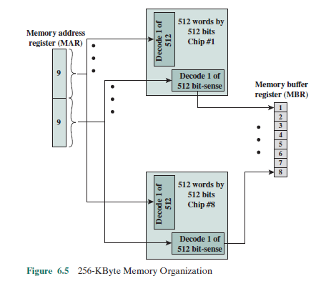
Notes:
If a RAM chip contains only 1 bit per word, then clearly we will need at least a
number of chips equal to the number of bits per word. As an example, Figure 5.5
shows how a memory module consisting of 256K 8-bit words could be organized. For
256K words, an 18-bit address is needed and is supplied to the module from some
external source (e.g., the address lines of a bus to which the module is attached).
The address is presented to 8 256K * 1-bit chips, each of which provides the input/
output of 1 bit.

Slide 22
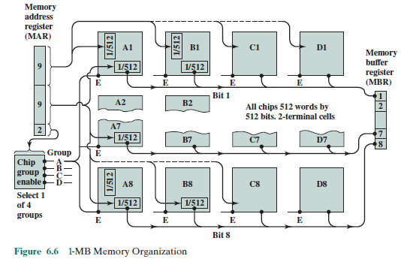
Notes:
If a RAM chip contains only 1 bit per word, then clearly we will need at least a
number of chips equal to the number of bits per word. As an example, Figure 5.5
shows how a memory module consisting of 256K 8-bit words could be organized. For
256K words, an 18-bit address is needed and is supplied to the module from some
external source (e.g., the address lines of a bus to which the module is attached).
The address is presented to 8 256K * 1-bit chips, each of which provides the input/
output of 1 bit.

Slide 23
Interleaved Memory
Main memory is composed of a collection of DRAM memory chips.
A number of chips can be grouped together to form a memory bank. It is possible to organize the memory banks in a way known as interleaved memory.
Each bank is independently able to service a memory read or write request, so that a system with K banks can service K requests simultaneously, increasing memory read or write rates by a factor of K.
If consecutive words of memory are stored in different banks, then the transfer of a block of memory is speeded up.
Notes:
Main memory is composed of a collection of DRAM memory chips. A number of
chips can be grouped together to form a memory bank. It is possible to organize
the memory banks in a way known as interleaved memory. Each bank is independently
able to service a memory read or write request, so that a system with
K banks can service K requests simultaneously, increasing memory read or write
rates by a factor of K. If consecutive words of memory are stored in different
banks, then the transfer of a block of memory is speeded up. Appendix G explores
the topic of interleaved memory.

Slide 24
Today’s Class
6.1

