Slide 1
System Sequence Diagram (SSD)
… using Visual Paradigm

Slide 2
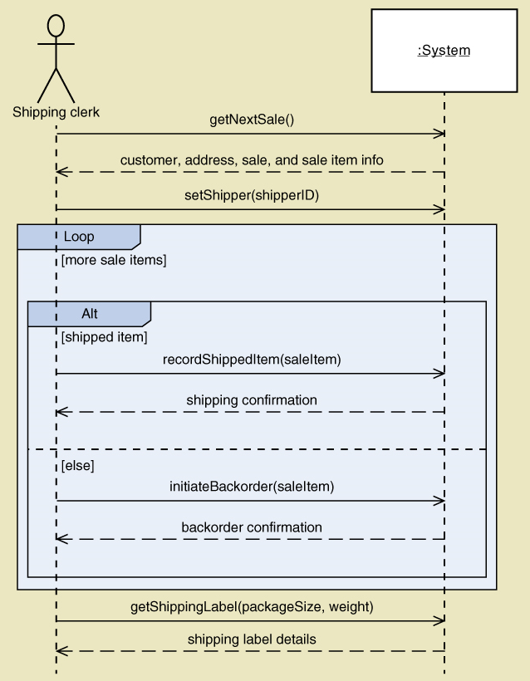
SSD for Ship items

Slide 3
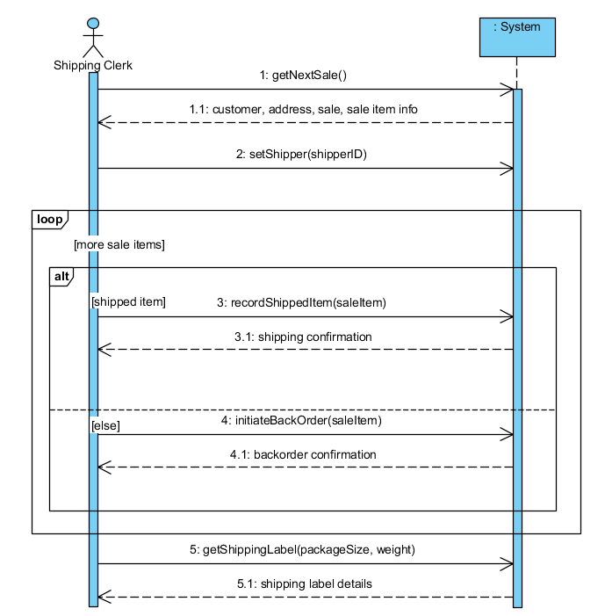
Individual Lab Instructions
Follow the VP tutorial / lab while the instructor is doing an in-class demo
Optional: Review the steps using the pre-recorded video
When naming a modeling element, add your initials
E.g., MT Shipping Clerk, …
You can skip this rule for naming System and Operations
Save your individual work to A4_Lab_<student name>.vpp and make a copy to General\A4 folder on your MS Teams

Slide 4
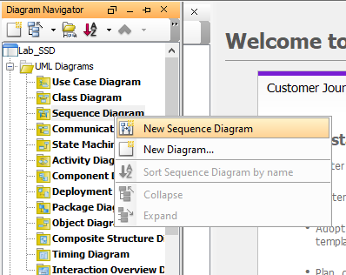
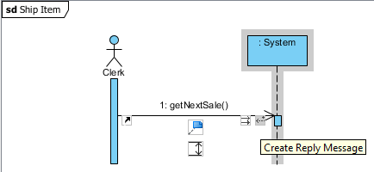
SSD using Visual Paradigm
Create a new Sequence Diagram
Add Actor (Shipping Clerk)
Add Lifeline (:System)
Add Message
Create Reply message
Add Combined Fragment
E.g., Loop, Alt
Interaction Operands
Guard condition

Slide 5
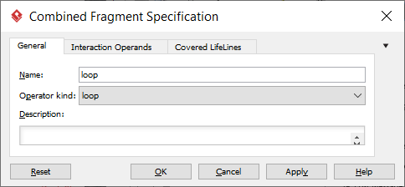
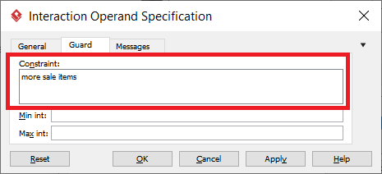
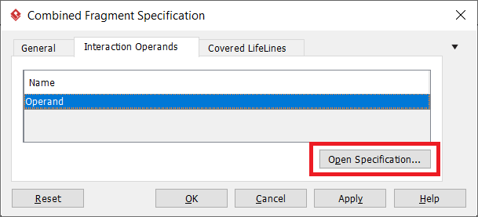
SSD: Add guard to operand (Option 1)
Fragment: Loop
Interaction Operands tab
Open Specification…
Guard tab
Edit Constraint

Slide 6
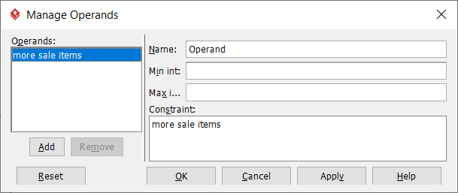
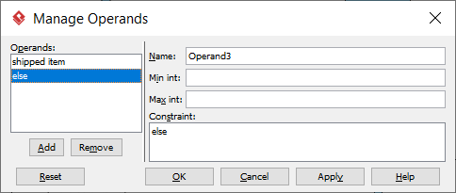
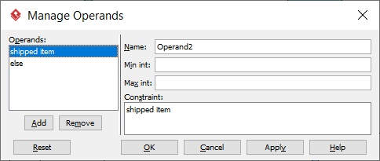
SSD: Add guard to operand (Option 2)
Operand
Manage Operands…
Short-cut to access:
Interaction Operands
Operand 1, 2, 3
Constraints

Slide 7
Putting it together… (06_VP_SSD.mp4)

