Slide 1
Approaches to System Development

Slide 2
Contents
The System Development Life Cycle
Assumptions and uses in predictive and adaptive SDLC
Methodologies:
SDLC, Models, Tools, and Techniques
Key features of:
Agile Development
The Unified Process (UP)
Extreme Programming (XP)
Scrum

Slide 3
Two General Approaches to the SDLC
Predictive Approach to the SDLC
Waterfall model
Assumes the project can be planned in advance and that the information system can be developed according to the plan
Requirements are well understood and/or low technical risk
Adaptive Approach to the SDLC
Iterative model
Assumes the project must be more flexible and adapt to changing needs as the project progresses
Requirements and needs are uncertain and/or high technical risk

Slide 4
Two General Approaches to the SDLC
Most projects fall on a continuum between Predictive and Adaptive

Slide 5
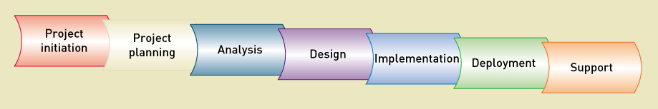
Traditional Predictive SDLC
Earlier approach, based on engineering
Phases are completed in sequence:
Planning, Analysis, Design, Implementation, and Deployment
Waterfall model
When a phase is completed, it's cast in stone:
You fall over the waterfall to the next phase
→ no overlap, no going back

Slide 6
Waterfall Predictive SDLC

Slide 7
Modified Waterfall →with Overlapping Phases
More flexibility
The next phase can start before the prior phase is completed
…but still assumes predictive planning and sequential phases

Slide 8
Newer: Adaptive SDLC
Response to increasingly complex requirements and uncertain technological environments
Incremental development: "growing a system"
Portions of the system are completed in small increments
…and integrated together as the project progresses
"Walking Skeleton"
The complete system structure is built with bare-bones functionality
Details & design are fleshed out in later iterations

Slide 9
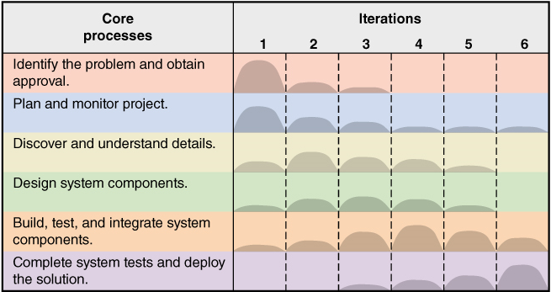
The Generic Adaptive Approach: - Six Core Processes used in each iteration - Multiple Iterations as required

Slide 10
Methodologies, Models, Tools & Techniques
Methodologies (Systems Development Processes)
System development guidelines: what to do when, why & how
Models
An abstraction of an important part of the real world (i.e., representation of knowledge)
Tools
Software to USE during the SDLC
Techniques
Things to DO to complete an activity

Slide 11
Methodologies aka: System Development Process
Provides guidelines for every facet of system development:
What to do when, why and how
Specifies an SDLC
With activities and tasks
Specifies models and reporting for:
Project planning and project management
Specifies analysis and design models
Use Cases, Prototypes, ERD, Sequence/State/Activity diagrams
Specifies implementation and testing techniques
TDD, Refactoring, Unit/Integration/Acceptance/Stress/Production Testing
Specifies deployment and support techniques

Slide 12
Models
Abstractions of important aspects of the real world
Activity/Use Case/Entity-Relationship/Sequence/State Diagrams
Help to understand a complex concept
By focusing only on the relevant part
Several models can be used to show different aspects of the same concept
Crucial for communicating project information
Some models are for components that will be built
Some models are used to manage the development process

Slide 13
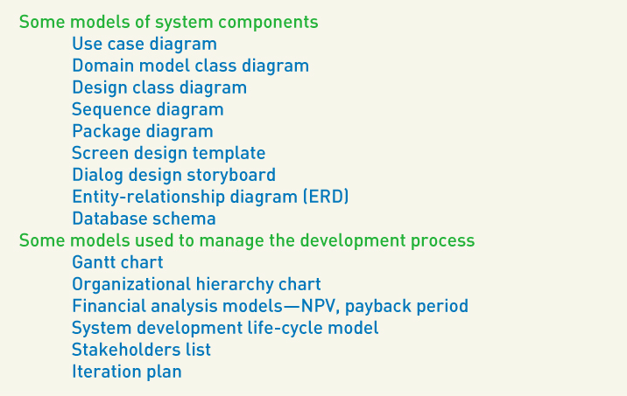
Model Examples

Slide 14
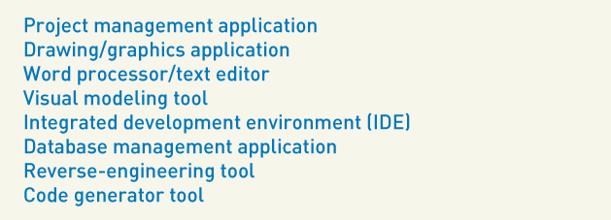
Typical Tools
Microsoft Project
Visio
MS Word
Visual Paradigm
Visual Studio, Eclipse
SQL Server, MySQL

Slide 15
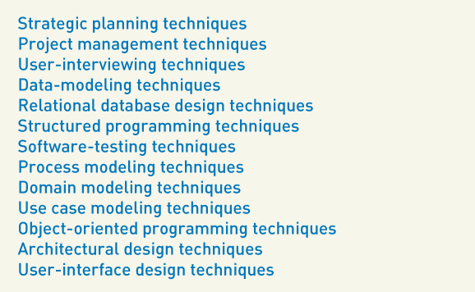
Techniques - learning techniques is the key to developing expertise in a field

Slide 16
Agile Development
A philosophy & guidelines for developing information systems in an unknown, rapidly changing environment

Slide 17
Agile Values
Agile Values are in the “Manifesto for Agile Software Development”
The 4 core values are expressed as "X over Y":
Value 1 - Individuals and interactions over processes and tools
Smaller team of skilled developers, located in the same room
Value 2 - Working software over comprehensive documentation
A working solution is better than a 50-page description of it
Value 3 - Customer collaboration over contract negotiation
Teams invest effort to discover what the stakeholders need
…and can educate stakeholders on the implications of decisions
Value 4 - Responding to change over following a plan
Stakeholders' understanding of the problem and the solution changes
→ as they start to understand its potential ←

Slide 18
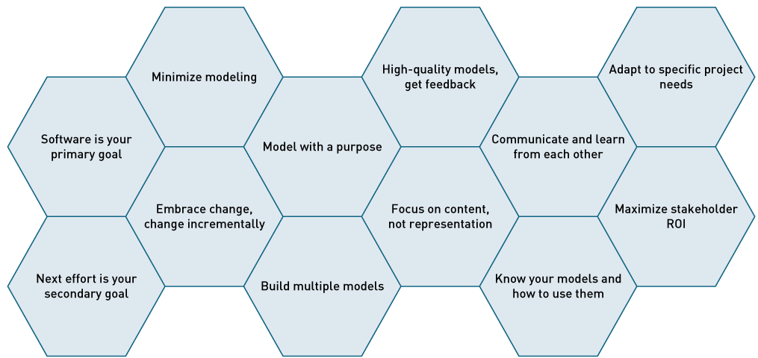
Agile Principles

Slide 19
Agile Principles
Develop working software as the primary goal
Don’t get tied down & distracted by documentation or models
Enable the next effort as your secondary goal
Be aware of next step versions or revisions
Minimize your modeling activity
Only build what helps move the project forward
Embrace change, and change incrementally
Take small steps that keep you on track and that can be reversed if necessary
Model with a purpose:
Model to understand
Model to communicate

Slide 20
Agile Principles
Build multiple models
Look at problems from different perspectives
Build high-quality models and get feedback
Focus on content rather than representation
Informal hand-drawn models are often okay
Always focus on stakeholder needs
Learn from each other with open communication
Know your models and how to use them
Adapt to specific project needs
Maximize stakeholder return on investment (ROI)

Slide 21
Scrum - Definitions
Product Backlog
Prioritized list of user requirements
Product owner
The client stakeholder who controls the Product Backlog
Scrum master
Owns the Scrum process (make sure Scrum is being applied correctly)
Servant leader
Listening actively to team needs.
Removing obstacles that slow down progress
Protecting the team from outside pressure or scope creep.
Encouraging collaboration, trust, and continuous learning.

Slide 22
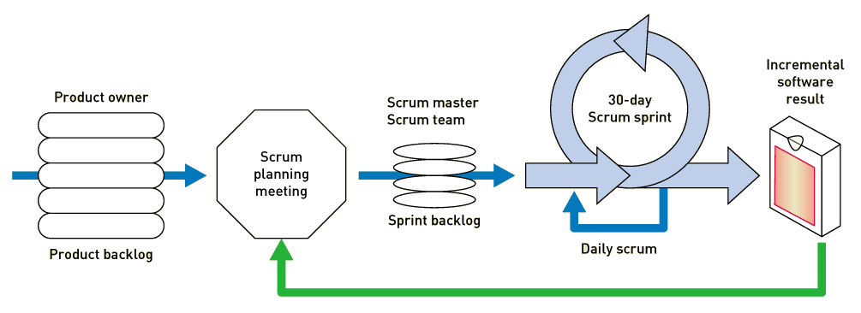
Scrum Sprint (Agile's Iteration)
A time-controlled mini-project to implement part of the system

Slide 23
Sprint
A period, at most 4 weeks (a month), where the Scrum Team work to meet the customer’s needs
includes all of the Scrum events (see next slide)
This is a development iteration
With a fixed timespan; the same for every Sprint in the project
At the end of each Sprint, the team must deliver a tested functioning solution (increment)

Slide 24
Scrum Events
Sprint Planning: meeting at the beginning of the Sprint where the team plan the Product Backlog items they can complete in the next Sprint.
Daily Scrum: daily meeting for the team with two goals: (1) get ready to collaborate for the day, (2) check if the team is still on track to complete their forecast by the end of the Sprint.
Sprint Review: meeting at the end of the Sprint where the Scrum Team review the work completed in the past Sprint with stakeholders. The Product Backlog is updated as an outcome of this event.
Sprint Retrospective: meeting at the end of the Sprint where the team reflect on the way they worked with the goal of improving in the next Sprint.

Slide 25
Event: Sprint Planning
The team selects the Use Stories / Use Cases that they can accomplish in one Sprint, or iteration
Drawn from the product backlog in priority sequence
Team estimates of the level of effort required
Complex Use Cases may be divided into smaller tasks or subroutines
Scope of each sprint is frozen (but can be reduced if necessary)
Time period is kept constant

Slide 26
Event: Daily Scrum Meeting
All team members are required to be present
Stakeholders are invited, but do not provide input
Each team member answers 3 questions:
What did you accomplish yesterday?
What do you plan to do today?
Do you have any impediments?
No discussion during the meeting
It's the Scrum Master's responsibility to resolve obstacles after the meeting
Team members expected to offer help … offline, not during the meeting
Stakeholders can offer clarification … again, offline

Slide 27
Event: Daily Scrum Meeting
All team members are required to be present
Stakeholders are invited, but do not provide input
Each team member answers 3 questions:
What did you accomplish yesterday?
What do you plan to do today?
Do you have any impediments?
No discussion during the meeting
It's the Scrum Master's responsibility to resolve obstacles after the meeting
Team members expected to offer help … offline, not during the meeting
Stakeholders can offer clarification … again, offline

Slide 28
Event: Sprint Review
At the end of a Sprint, the team is expected to produce a tested working solution
Stakeholders are invited to the Sprint Review
They can examine the results of the sprint, provide comments & recommendations for the product
Recommendations, new product ideas and fixes become tasks in the product backlog list
The Product Owner reprioritizes the backlog list
The Scrum team starts planning the next sprint

Slide 29
Scrum Artifacts
Product Backlog: ordered list of all work items the Product Owner would like to see in the product: feature, bug fix, enhancement, documentation requirement.
These items are called Product Backlog Items (PBI)
User Stories are just one kind of PBI
Sprint Backlog: list of PBI that the team has committed to for the next Sprint.
The work is often broken down into tasks
Increment: the product that the team built in the Sprint.
The quality at the end of Sprint must meet the Team’s current Definition of Done and they should be proud to ship it.

Slide 30
Artifact: Product Backlog (1)
Occasionally the result of Sprint 0, the analysis phase
Collection of Use Cases & Domain Class Diagram
The result of the requirements gathering process
These are skeletons
Use Cases
Name & 1-sentence description, usually
Domain Classes
First-cut data structures
No major commitment to details yet

Slide 31
Artifact: Product Backlog (2)
Prioritized by the Product Owner
Usually a manager or higher, from the user area
Someone that knows the business and the company
Is part of the team, usually located with, or near to, them
The Product Owner is the first point of contact
If the team needs detailed information or a business decision
If the Product Owner cannot solve the problem, they would find the stakeholder that can

Slide 32
Artifact: Sprint Backlog
Subset of Product Backlog
Collection of Use Cases selected for the next Sprint
If, during a Sprint, the team is unable to accomplish all selected use cases
Excess use cases are returned to the Product Backlog
The Sprint duration is never increased

Slide 33
Summary (1)
Predictive SDLC (waterfall method)
Used when it is possible to plan the project completely in advance
Adaptive SDLC (using iterations)
Used when the requirements are less certain and the project will need to react to changes

Slide 34
Summary (2)
All System development projects:
Use a methodology (or development process)
A methodology includes an SDLC and tools, techniques, and models
Agile development
Is the current trend in system development
Unified Process
A formal iterative approach which uses UML models, Agile philosophy, and UP disciplines
Extreme Programming (XP)
An iterative approach which takes good practices to the extreme
Scrum
An iterative approach using a Scrum Sprint

