Slide 1
Requirements Gathering

Slide 2
Chapter 2 Outline
The RMO Consolidated Sales and Marketing System Project
Systems Analysis Activities
What Are Requirements?
Stakeholders
Information-Gathering Techniques
Models and Modeling
Documenting Workflows with Activity Diagrams

Slide 3
Learning Objectives
Describe the activities of systems analysis
Explain the difference between functional and nonfunctional requirements
Identify and understand different kinds of stakeholders and their contributions to requirements definition
Describe information-gathering techniques and determine when each is best applied
Describe the role of models in systems analysis
Develop UML activity diagrams to model workflows

Slide 4
Systems Analysis Activities
Need to discover and understand extensive and complex business processes and business rules
SDLC starting processes:
Identify the problem
Obtain approval
Plan the project (as seen in Chapter 1)
Project planning and project management are covered in detail later in the text

Slide 5
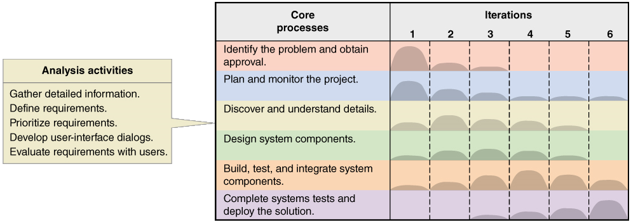
Systems Analysis Activities Involve discovery and understanding

Slide 6
Systems Analysis Activities
Gather Detailed Information … using:
Interviews, questionnaires, documents, business process observation, vendor research, comments and suggestions
Define Requirements
Model the functional and non-functional requirements
Prioritize Requirements
Essential/important vs. nice to have
Develop User-System Dialogs
Flow of interaction between user and system
Evaluate Requirements with Users
User involvement, feedback, adapt to changes

Slide 7
What Are Requirements?
System Requirements =
Functional requirements + Non-functional requirements
Functional Requirements – the behaviors, tasks, or functions the system must perform.
Also called use cases
Non-Functional Requirements – other system characteristics
Constraints, performance goals, security, …etc.

Slide 8
FURPS+ Requirements Acronym
Functional requirements
Usability requirements
Reliability requirements
Performance requirements
Security requirements
+ even more categories…

Slide 9
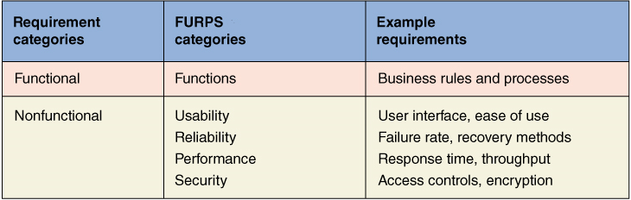
FURPS+ Requirements Acronym

Slide 10
Additional Requirements Categories
Design constraints –
Specific restrictions for hardware and software
Implementation requirements
Specific languages, tools, protocols, etc.
Interface requirements
Interface links to other systems
Physical requirements
Physical facilities and equipment constraints
Supportability requirements
Automatic updates and enhancement methods
Systems Analysis and Design in a Changing World, 7th Edition - Chapter 2

Slide 11
Stakeholders Who do you involve and talk to?
Stakeholders
People who have an interest in the successful implementation of the system
Internal Stakeholders
People within the organization
External stakeholders
People outside the organization (vendors, customers, regulatory authorities)
Operational stakeholders (may be internal or external)
People who regularly interact with the system
Executive stakeholders (may be internal or external)
People who don’t directly interact, but use the information or have a financial interest

Slide 12
Stakeholders of a comprehensive accounting system for a public company

Slide 13
Information Gathering Techniques
Interviewing users and other stakeholders
Distributing and collecting questionnaires
Reviewing inputs, outputs, and documentation
Observing and documenting business procedures
Collecting active user comments and suggestions

Slide 14
Interviewing Users and Other Stakeholders
Prepare detailed questions
Meet with individuals or groups of users
Multiple levels: front-line (clerical) staff, managers, executives
Obtain and discuss answers to the questions
Document the answers
Follow up as needed in future meetings or interviews
Modeling raises more questions about procedures & products

Slide 15
Themes for Information Gathering Questions

Slide 16
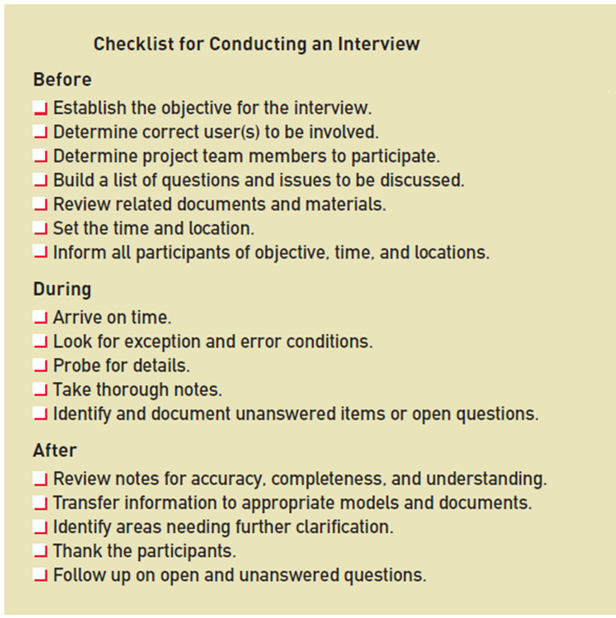
Preparing for the Interview

Slide 17
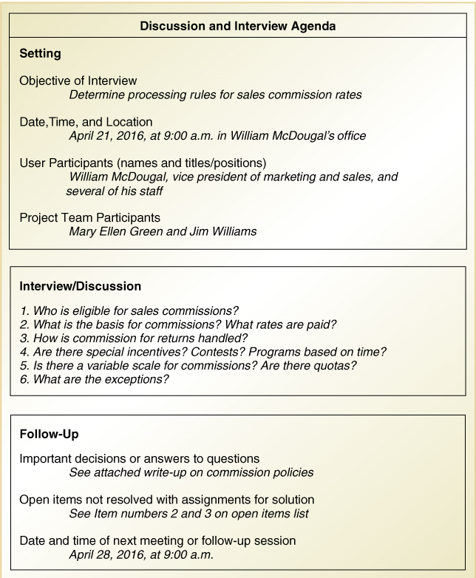
Interview Session Agenda

Slide 18
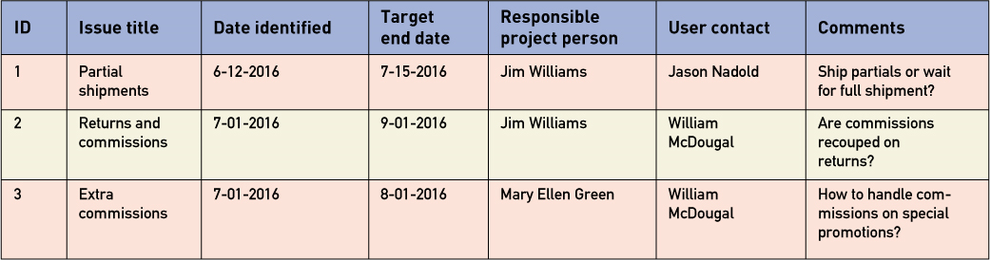
Keep an Open-Items List - add to it as you discover more questions

Slide 19
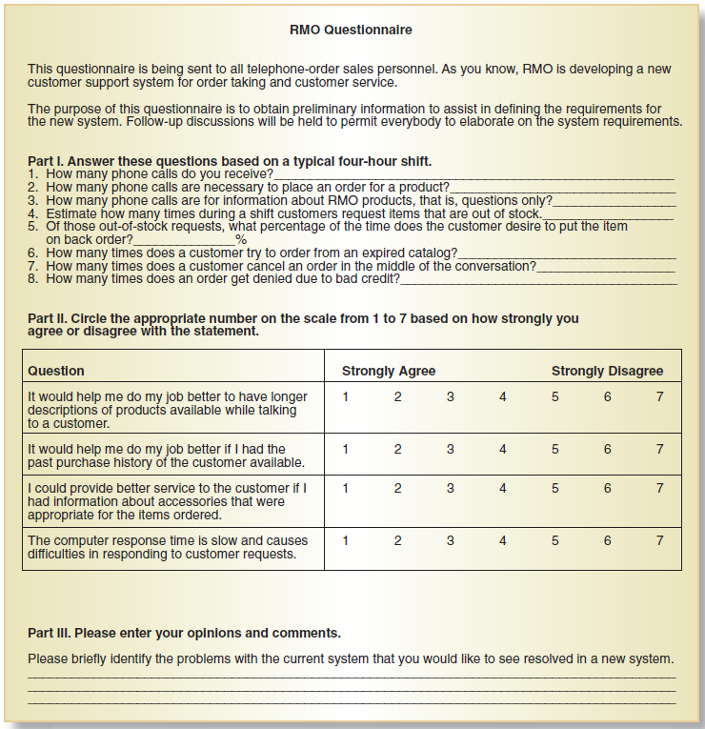
Distribute and Collect Questionnaires
If you use a survey service (like surveyMonkey.com)
Email staff with the link so they know it comes from you
Professionally, they should refuse to answer questions about the business from external Internet domains.
Don't make it too long or they won't respond

Slide 20
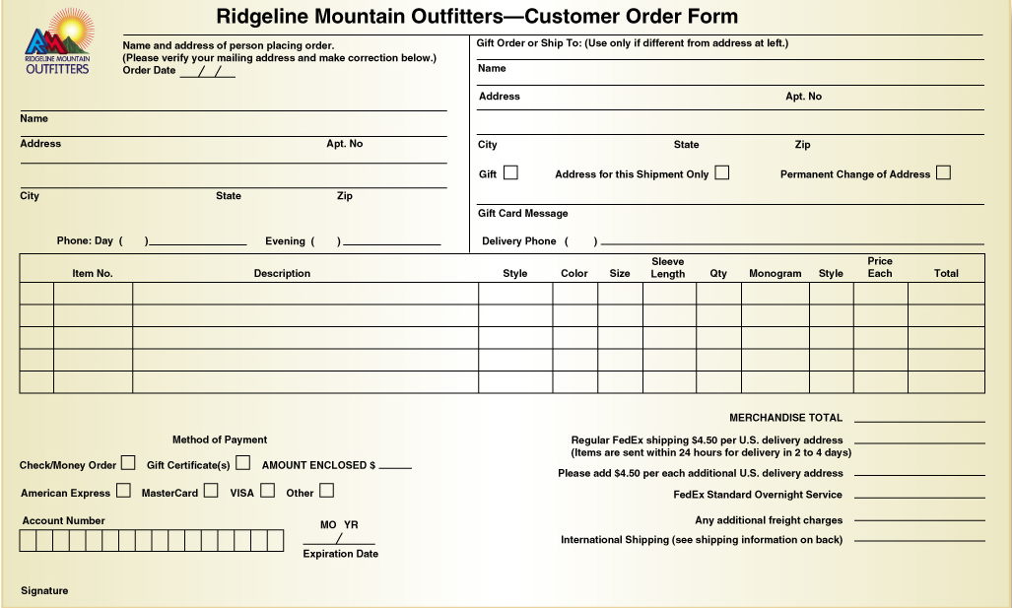
Review Inputs, Outputs, and Procedures

Slide 21
Additional Techniques
Observe and Document Business Processes
Watch and learn
Document with an Activity diagram (next section)
Research Vendor Solutions
See what others have done for similar situations
White papers, vendor literature, competitors
Collect Active User Comments and Suggestions
Feedback on models and tests
Users know it when they see it

Slide 22
Models and Modeling
How do we define requirements?
After collecting information, create models
Model
A representation of some aspect of the system being built
Types of Models
Textual model – something written down, described
Graphical models – diagram, schematic
Mathematical models – formulas, statistics, algorithms
Unified Modeling Language (UML)
Standard graphical modeling symbols/terminology used for information systems

Slide 23
Reasons for Modeling
Learn by doing the modeling exercise
Reduce complexity by abstraction
Remember all the details
Communicate with other development team members
Communicate with a variety of users and stakeholders
Document what was done for future maintenance/enhancement
Create Order

Slide 24
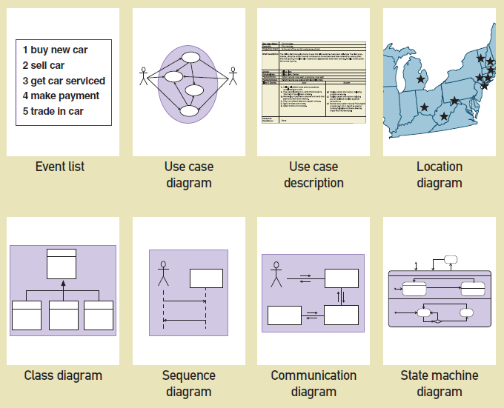
Some Analysis and Design Models

Slide 25
Documenting Workflows with Activity Diagrams
Workflow – sequence of processing steps that completely handles one business transaction or customer request
Activity Diagram– describes user (or system) activities, the person who does each activity, and the sequential flow of these activities
Useful for showing a graphical model of a workflow
A UML diagram

Slide 26
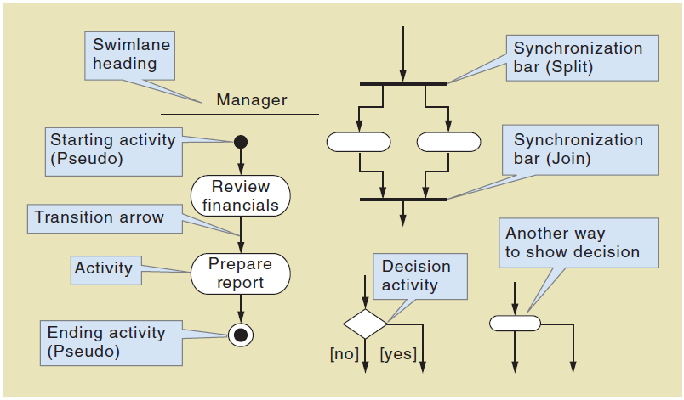
Activity Diagrams Symbols

Slide 27
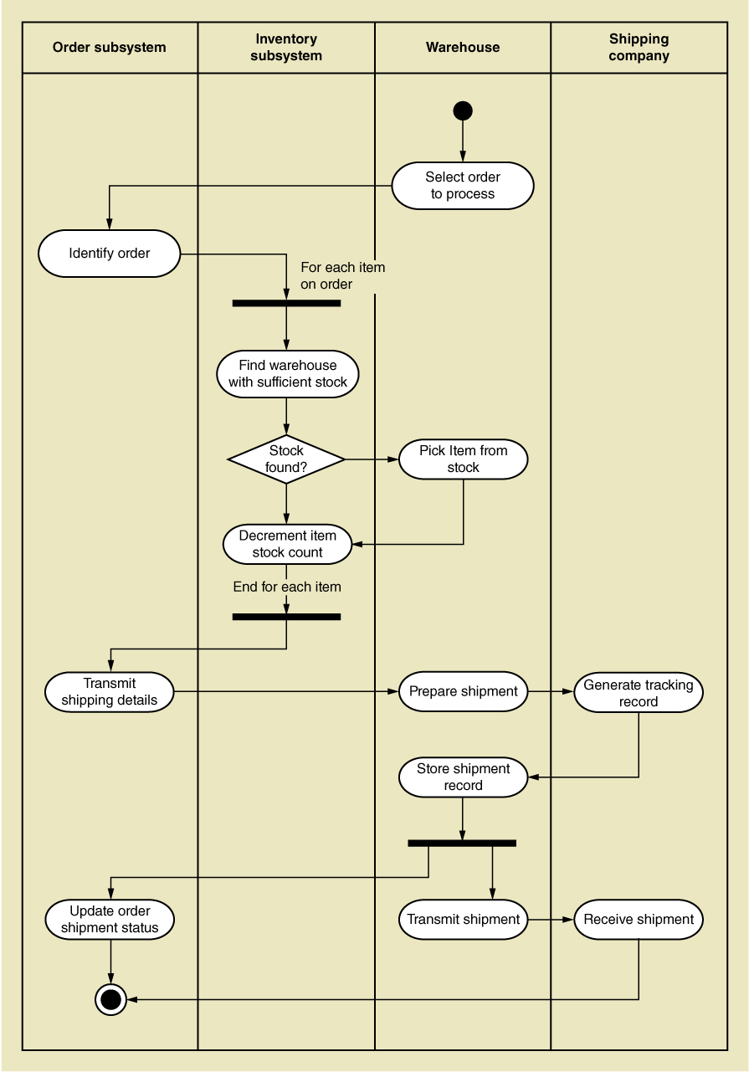
Activity Diagram for RMO Order Fulfillment

Slide 28
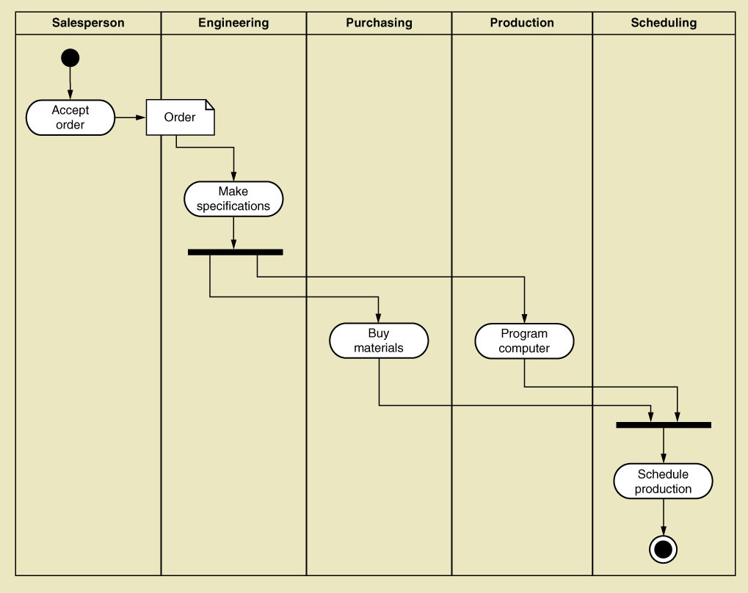
Activity Diagram with Concurrent Paths
We can't schedule production until the materials have been purchased and the machinery has been programmed,

Slide 29
Summary
Systems analysis activates correspond to the core SDLC process Discover and understand details
System projects originate from the information system strategic plan, which contains an technology architecture plan and an application architecture plan
The RMO CSMS Project will be used throughout the text as an example of analysis and design

Slide 30
Summary
Systems analysis involves defining system requirements– functional and non-functional
Analysis activities include
Gather detailed information
Define requirements
Prioritize requirements
Develop user-interface dialogs
Evaluate requirements with users
FURPS+ is the acronym for functional, usability, reliability, performance, and security requirements

Slide 31
Summary
Stakeholders are the people who have an interest in the success of the project
There are internal vs. external stakeholders and operational vs. executive stakeholders

Slide 32
Summary
Information gathering techniques are used to collect information about the project
Interviews, questionnaires, reviewing documents, observing business processes, researching vendors, comments and suggestions
The UML Activity Diagram is used to document (model) workflows after collecting information
Models and modeling are used to explore and document requirements
Unified Modeling Language (UML) is the standard set of notations and terminology for information systems models

