Slide 1
User Stories & Use Cases

Slide 2
Overview
Chapter 2 provided an overview of:
systems analysis activities,
functional and non-functional requirements,
modelling,
information gathering techniques
This chapter focuses on Use Cases, a key aspect of functional requirements
Earlier chapters identified some use cases:
Look up supplier,
Enter/update product information,
Enter/Update contact information
This chapter’s opening case, Waiters on Call, has use cases:
Record an order, Record delivery, Update an order,
Sign in driver, Reconcile driver receipts,
Produce end of day deposit slip, Produce weekly sales reports

Slide 3
User Stories
A User Story is a one-sentence description:
...of a work-related task
…done by a user
…to achieve some goal or result
Acceptance Criteria:
Identify features that must be present at the completion of the task
The template for a user story description is:
As a <role> I want to <goal> so that <benefit>
As a barber I want to have new shop system .
As a coustmer I want to track my order delivery so I know when it gonna happen.

Slide 4
Sample User Story
User Story:
As a customer, I want to track my order status in real time so that I know when to expect delivery.
What is user story for a guy who want to send email .or a guy who want to update his address ( exam question )
User Acceptance Criteria:
Customers must be able to view current order status (Processing, Shipped, Delivered, etc.).
The tracking information must automatically update when the carrier updates their system.
Delivered orders must show the delivery date and time.
Tracking page must display estimated delivery date if available.
Customers must receive a notification when the order status changes.

Slide 5
Sample User Story
User Story:
As a system administrator, I want to set user access levels so that sensitive data is protected.
User Acceptance Criteria:
Administrators must be able to assign roles (Admin, Editor, Viewer) from a dashboard.
Role changes must take effect immediately.
Users with restricted roles must be blocked from accessing unauthorized pages.
An error message must appear when access is denied.
New users must default to the lowest access level until explicitly changed.

Slide 6
Describing Use Cases as feature…..
Use case— an activity that the system performs or feature of system …
…usually in response to an event: a request from a user
Use cases define functional requirements
Analysis decomposes the system into a set of use cases
(functional decomposition)
So analysis going to come with list of feature or requirement or use cases or things the system can perfome and how the technique .
There are two techniques for Identifying use cases:
User goal technique
Event decomposition technique
Use Cases are named using Verb-Noun notation

Slide 7
User Goal Technique
Simple and effective:
Identify all potential categories of users of the system
Ask them to describe the tasks the computer can help them with
Probe further to refine the tasks into specific user goals:
I need to Ship items, Track a shipment, and Create a return.

Slide 8
User Goal Technique: Some RMO CSMS Users and Goals

Slide 9
User Goal Technique: Specific Steps
Identify all potential users of the new system
Classify them in terms of their functional role
…shipping, marketing, sales, customer
Further classify potential users by organizational level
…operational, management, executive
Interview each type of user:
List specific goals they will have when using the new system
Current goals, plus innovative functions to add value

Slide 10
User Goal Technique: Specific Steps cont'd
Class notes :
First approach go & ask the goal and feture ..
As a analysist have to look at all those system user rewiremnt sn dhtne see what things sre needed and what not
Last word always be user they are the one who use the system and who paid the system and see .
Lets example buld a house or artirech and you know everything and see
We always go back fo the user said to refuse the user side
List preliminary Use Cases by type of user
Look for duplicate or similar use case names
Resolve inconsistencies
Identify where different users have the same use cases
Review the completed list with each type of user
…and with stakeholders

Slide 11
Event Decomposition Technique
Class notes:
Start grabbing all the info we have and loook at each even and then you find the use case in each . ( System need to solve)
Identify the use case all we have .
We care about the even thar have to do something for the system
look at image on next slide :
A more Comprehensive and Complete Technique:
Identify the events that occur, to which the system must respond.
For each event, name a use case (verb + noun)
…describing what the system does when the event occurs
Event
Something that occurs at a specific time and place,
Can be described,
Should be remembered by the system.

Slide 12
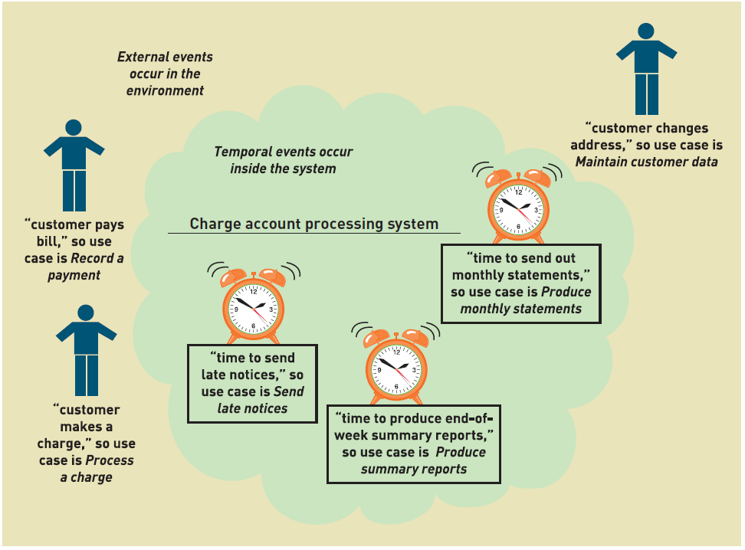
Events and Use Cases

Slide 13
Event Decomposition Technique Types of Events
Class notes :
What is state event ?
An event causes the system to move from one state to another.
External Event
An event that occurs outside the system
Usually initiated by an external agent (actor)
Temporal Event
An event that occurs as a result of reaching a point in time
It's the first of the month … time to generate end-of-month report
State Event
An event or state change inside the system triggering a process
An order reduces an item to its reorder point
All event types must have an actor
The user initiating the event or requiring the result of the event

Slide 14
Event Decomposition Technique External Event Checklist
External actor wants something, resulting in a transaction
Customer buys a product
External agent or actor requests information
Customer wants to know product details
External information changes, needs to be updated
Customer has new address and phone
Management wants some information
Sales manager needs update on production plans

Slide 15
Event Decomposition Technique Temporal Event Checklist
Internal outputs are needed at points in time
Management reports (summary or exception)
Operational reports (detailed transactions)
Internal statements and documents (including payroll)
External outputs needed at points of time
Statements, status reports, bills, reminders
Can be combined with state events:
IF end-of-month AND product at reorder point → Place Order

Slide 16
Event Decomposition Technique Finding the event that affects the system

Slide 17
Event Decomposition Technique Tracing a sequence of transactions - resulting in several events

Slide 18
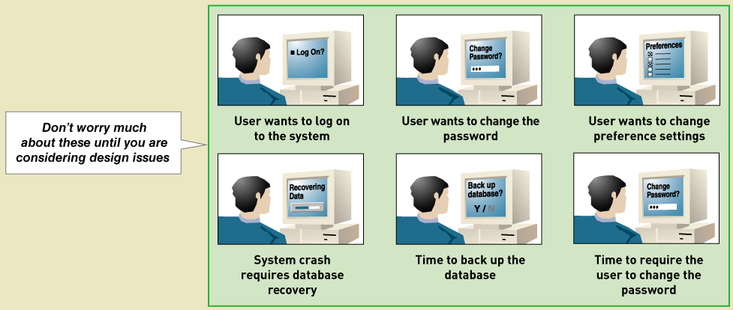
Analytical Assumption: Perfect Technology
Analysis assumes no limits in technology or people
The Design process will address these later

Slide 19
Event Decomposition Technique: Specific Steps (continued)
List external events that will require a response from the system
Identify and name the use case that the system requires
Describe the event in a sentence
List temporal events that require a response from the system
Identify and name the use case that the system requires
Establish the point of time that will trigger the use case

Slide 20
Event Decomposition Technique: Specific Steps (continued)
List state events that the system might respond to
Particularly if it is a real-time system, where devices or internal state changes trigger use cases.
Name the use case that the system requires
Define the state change
When events and use cases are defined:
Confirm they are required, assuming perfect technology
Do not include events for non-functional requirements:
Login, logout, change password, backup and restore the database
These are added later.

Slide 21
Event Decomposition Technique: Benefits
Events are broader than the user goal technique:
…includes temporal and state events
Decomposes to the right analytical level:
The Elementary Business Process (EBP)
…a fundamental business process performed
by one person,
in one place,
in response to a business event
Assumes perfect technology
Ensuring all functions that support the users' work are identified
…and not additional functions for security and system controls

Slide 22
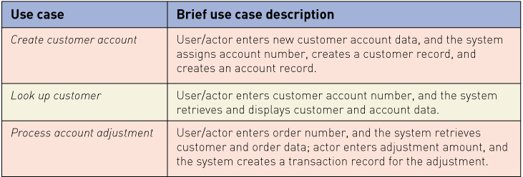





Brief Use Case Descriptions
Last slide by 27 January
A one-sentence description describing the main steps in a use case
If you need more, you perhaps have a compound use case
Ends with the system in a stable state
no unsaved data, no immediate follow-on action required

Slide 23
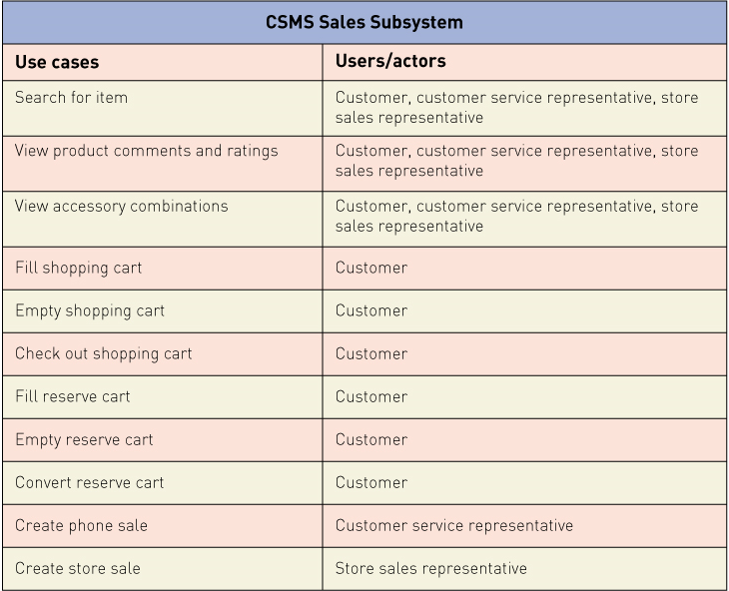
RMO CSMS Project's Use Cases

Slide 24
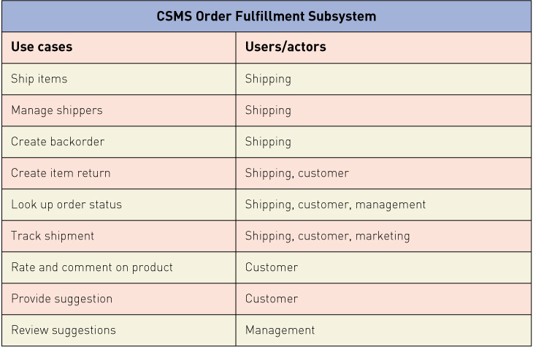
RMO CSMS Project's Use Cases cont'd

Slide 25
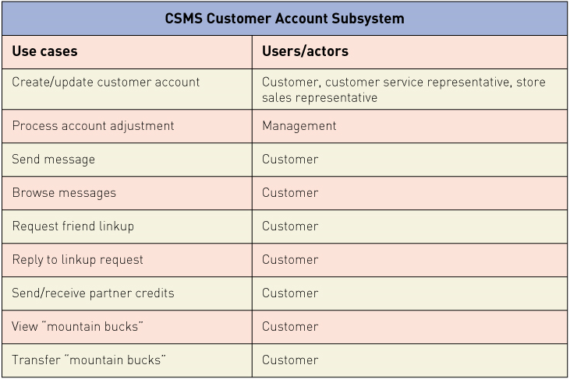
RMO CSMS Project's Use Cases cont'd

Slide 26
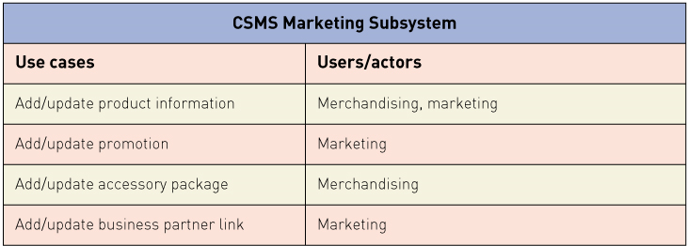
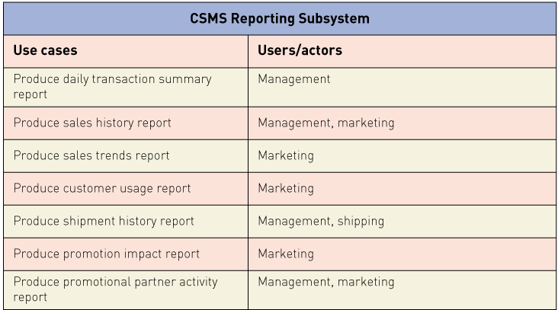
RMO CSMS Project's Use Cases cont'd

Slide 27
Events and Use Cases
Event Table – a catalog of use cases listed by event. Contains detailed information
Trigger – a signal that indicates an event has occurred (optional: implied from event)
Source – an external agent that initiates event and supplies data for the event
Response – an output produced by the system
Destination – an external agent that receives the response

Slide 28
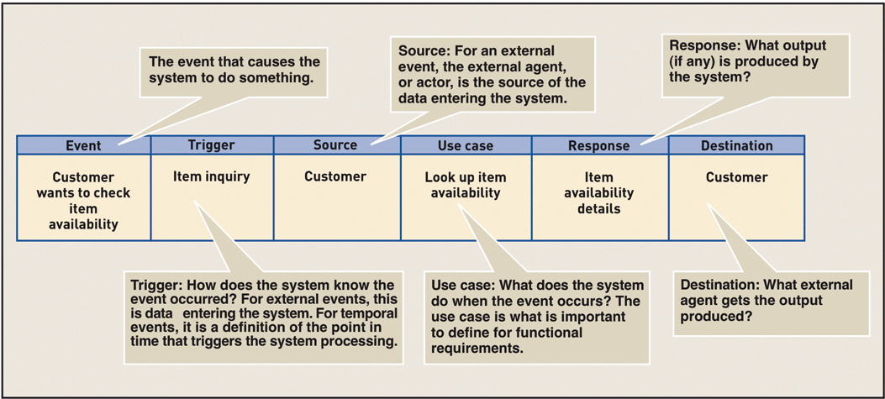
Information about Each Event in an Event Table
Figure 5-11

Slide 29
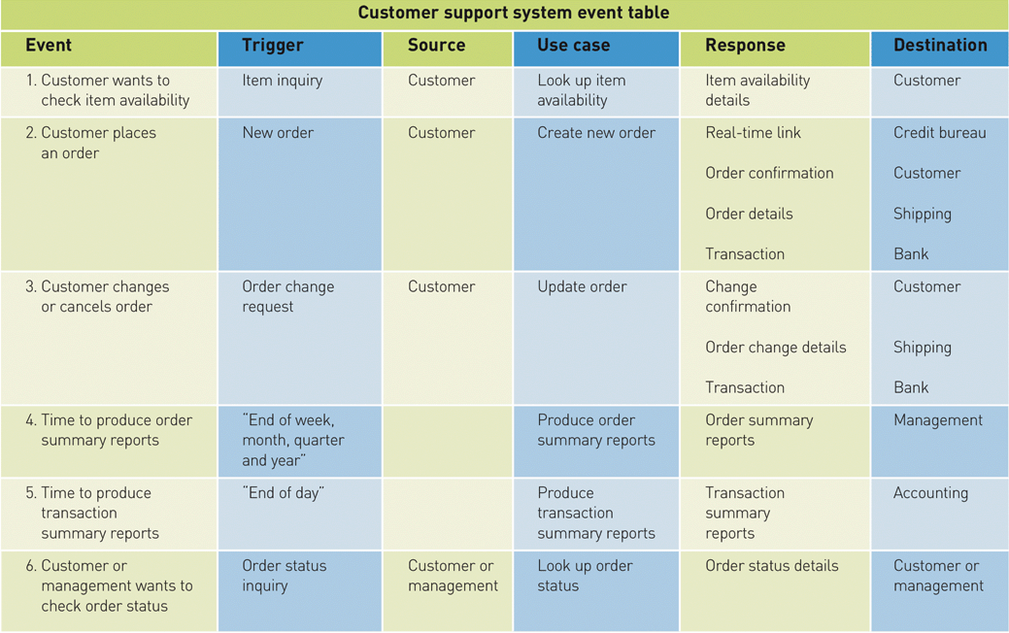
Sample Event Table‏
Figure 5-12

Slide 30
Use Case Diagrams
A graphical UML model used to show Use Cases
…and their relationships to actors
UML is the Unified Modelling Language
The standard for diagrams and terminology when developing information systems
Actor
The UML name for an end user
Or a separate system initiating events
Automation boundary: the boundary between
The computerized portion of the application
And the users who operate the application

Slide 31
Use Case Diagrams Symbols

Slide 32
Use Case Diagrams - Can be drawn for a whole subsystem

Slide 33
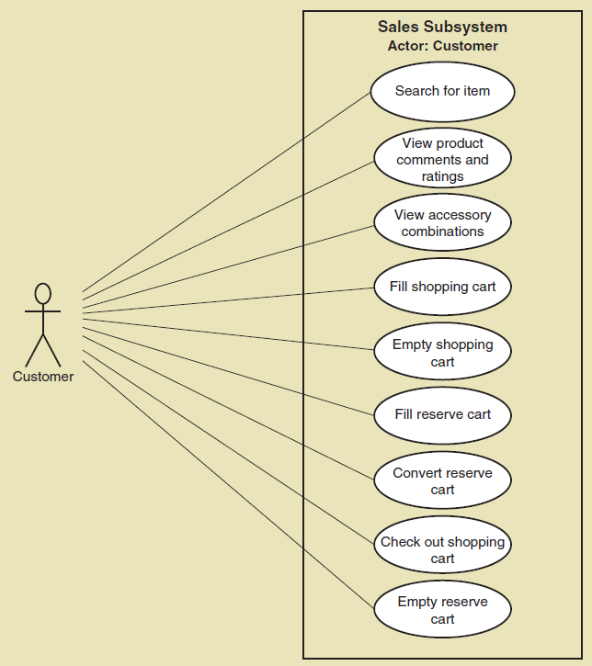
Use Case Diagrams - Can be drawn for a single actor, such as customer

Slide 34
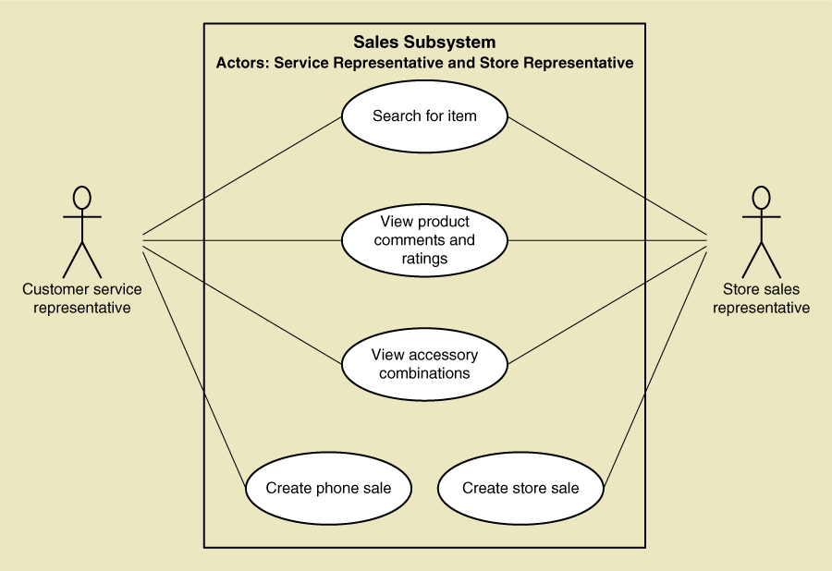
Use Case Diagrams - Can be drawn for a related subset of actors, such as RMO staff

Slide 35
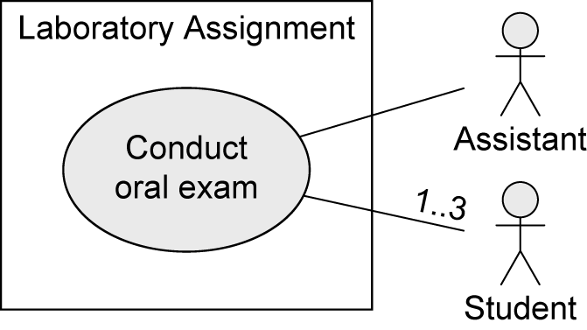
Relationships between Use Cases and Actors
Actors are connected with use cases via solid lines (associations).
Every actor must communicate with at least one use case.
An association is always binary.
Multiplicities may be specified.
Slide source: Slides accompanying UML@Classroom
By: Martina Seidl

Slide 36
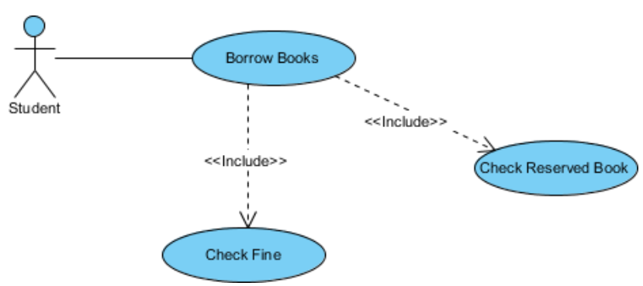
Use Case Diagrams: <<Include>> relationships
<<includes>> is a relationship between use cases:
One use case requires a function already provided by another use case
The included use case is always executed as part of the base use case.
The arrow points toward the subroutine
Implying the use case includes, uses, or depends on the subroutine

Slide 37
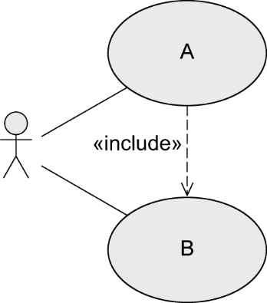
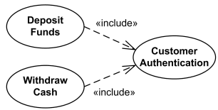
«include» - Relationship
The behavior of one use case (included use case) is integrated in the behavior of another use case (base use case)
Example:
Base use case
requires the behavior of the included use
case to be able to offer its functionality
Included use case
may be executed on its own
Slide source: Slides accompanying UML@Classroom
By: Martina Seidl

Slide 38
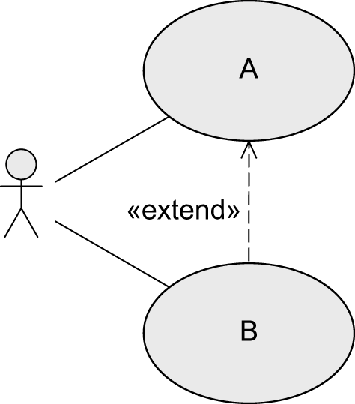
«extend» - Relationship
The behavior of one use case (extending use case) may be integrated in the behavior of another use case (base use case) but does not have to.
Both use cases may also be executed independently of each other.
A decides if B is executed.
Extension points define at which point in A the behavior is integrated.
Conditions define under which circumstances the behavior is integrated.
Base use case
Extending use case
Slide source: Slides accompanying UML@Classroom
By: Martina Seidl

Slide 39
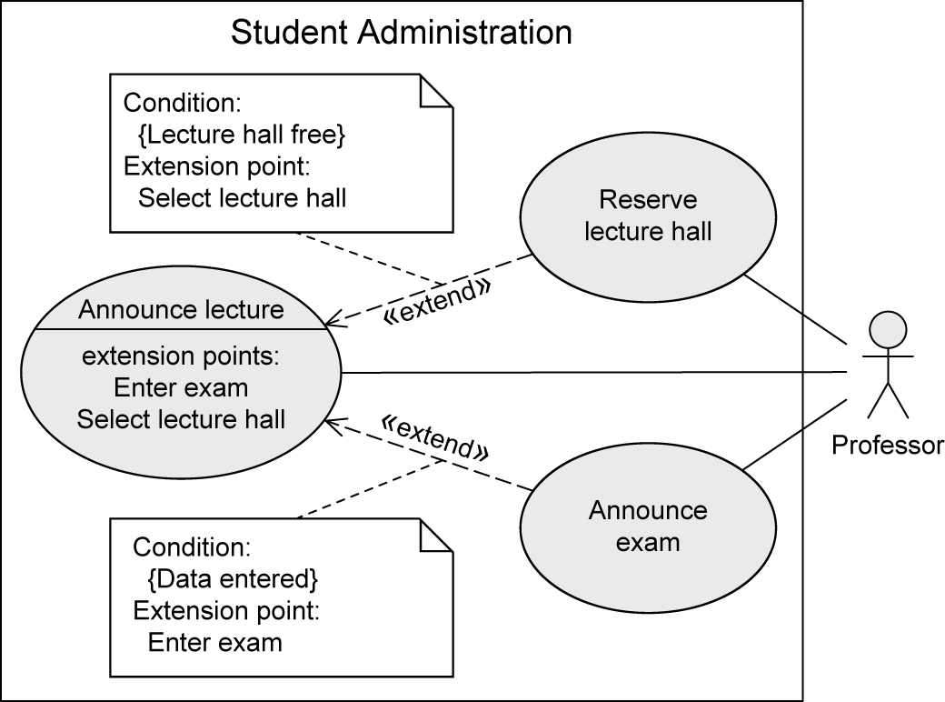
«extend» - Relationship: Extension Points
Extension points are written directly within the use case.
Specification of multiple extension points is possible.
Example:
Slide source: Slides accompanying UML@Classroom
By: Martina Seidl

Slide 40
Use Case Diagrams: Steps to presenting a Use Case Diagram
Identify stakeholders & users who would benefit by seeing a use case diagram
Determine what they need to review:
For which subsystem, which types of user and which use cases
For each potential communication need:
Select the use cases and actors to be shown
Draw the use case diagram
Name each use case diagram
Note how and when it should be used to review use cases

Slide 41
Summary
This is the first of three chapters focused on modelling functional requirements as a part of systems analysis
Use Cases
Identify activities the system carries out in response to a user request
Two techniques for identifying use cases are:
The user goal technique
The event decomposition technique
The user goal technique begins by:
Identifying end users (actors)
Asking what specific goals they have when interacting with the system
The event decomposition technique begins by:
Identifying events that occur that require the system to respond.

Slide 42
Summary
There are three types of events:
external, temporal, and state events
Brief Use Case Descriptions are written for use cases
A Use Case Diagram is a standardised UML model
It shows the actors, the automation boundary & the uses cases that involve each actor
It can contain <<includes>> for use cases used like subroutines
A variety of use case diagrams can be drawn
…depending on the presentation needs of the analysis

