Slide 1
Domain Modeling: Use Case Descriptions
…System Sequence Diagrams (SSD)
…Activity Diagrams

Slide 2
Overview (1)
We're going to continue our analysis, re-iterating & expanding on the details of the Use Cases and Domain Class Models
This chapter focuses on detail modelling for use cases to document the internal steps within a use case
Fully developed use case descriptions provide information about each use case, including actors, stakeholders, preconditions, post conditions, the flow of activities and exceptions conditions
Activity diagrams can diagrammatically show the flow of activities for a use case

Slide 3
Overview (2)
System sequence diagrams (SSDs) show the inputs and outputs for each use case as messages
CRUD analysis, which correlates problem domain classes and use cases, is an effective technique to double check that all required use cases have been identified
Not all use cases are modelled at this level of detail. Only model when there is complexity and a need to communicate details

Slide 4
Use Case Descriptions
All Use Cases (simplex or complex) should have a brief description
Summary of intent

Slide 5
Use Case Descriptions
These are required for more complex use cases
Typical use case description templates include:
Use case name
Scenario (if needed)
Triggering event
Brief description
Actors
Related use cases (<<includes>>)
Stakeholders
Preconditions
Postconditions
Flow of activities
Exception conditions

Slide 6
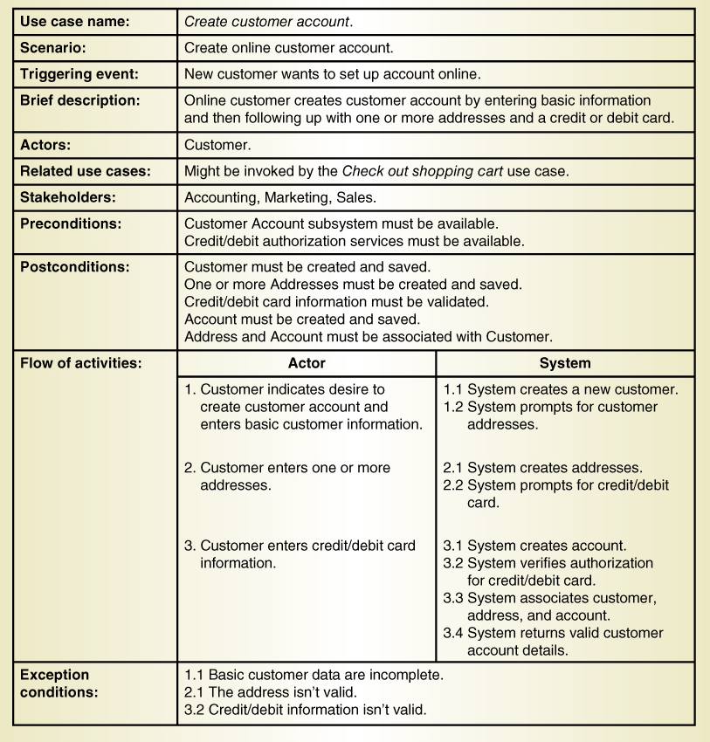
Fully Developed Use Case Description Create Customer Account

Slide 7
Fully Developed Use Case Description Create customer account (part 1 )

Slide 8
Fully Developed Use Case Description Create customer account (part 2 )

Slide 9
Use Case Description Details
Use case name
Verb-noun
Scenario (if needed)
A use case can have more than one scenario (special case or more specific path)
Triggering event
Based on event decomposition technique
Brief description
Written previously when use case was identified
Primary Actor(s)
Usually there is only one primary actor

Slide 10
Use Case Description Details
Related use cases <<includes>>
If one use case invokes or includes another
Stakeholders
Anyone with an interest in the use case
Preconditions
What must be true (specially the data) before the use case begins
Post conditions
What must be true (specially the data) when the use case is completed
Use for planning test case expected results
Flow of activities
The activities that go on between actor and the system
Exception conditions
Where and what can go wrong

Slide 11
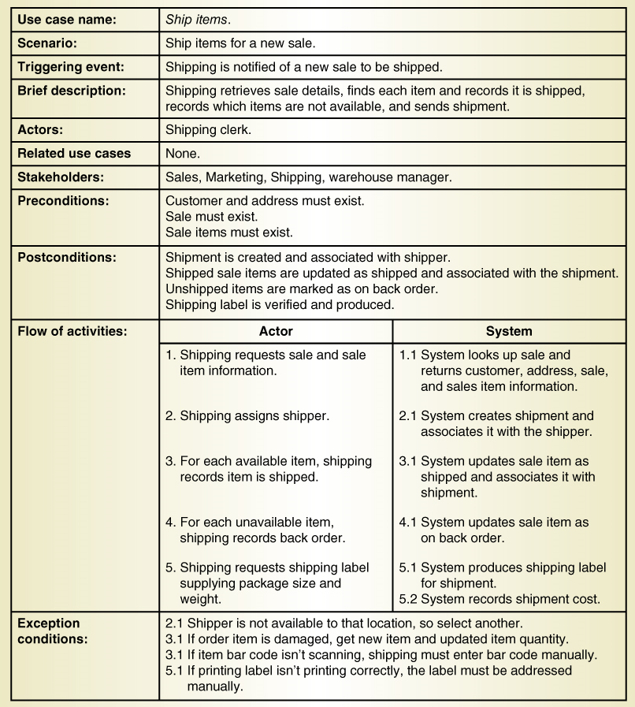
Fully Developed Use Case Description: Ship items

Slide 12
Fully Developed Use Case Description Ship items (part 1 )

Slide 13
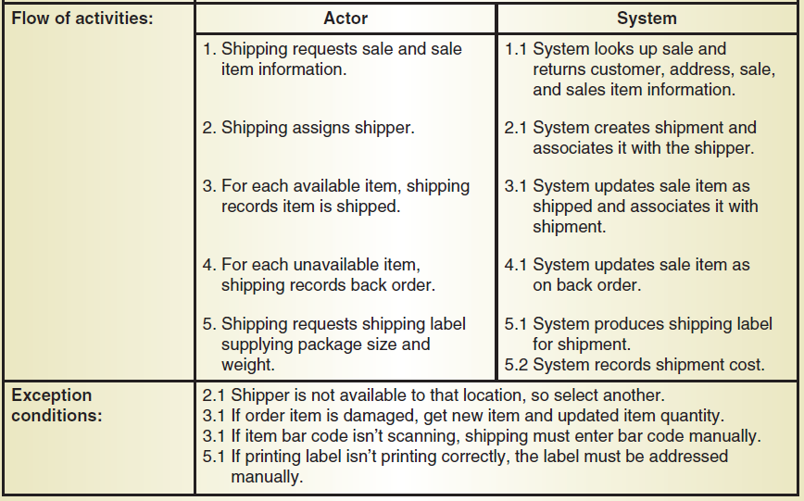
Fully Developed Use Case Description Ship items (part 2 )

Slide 14
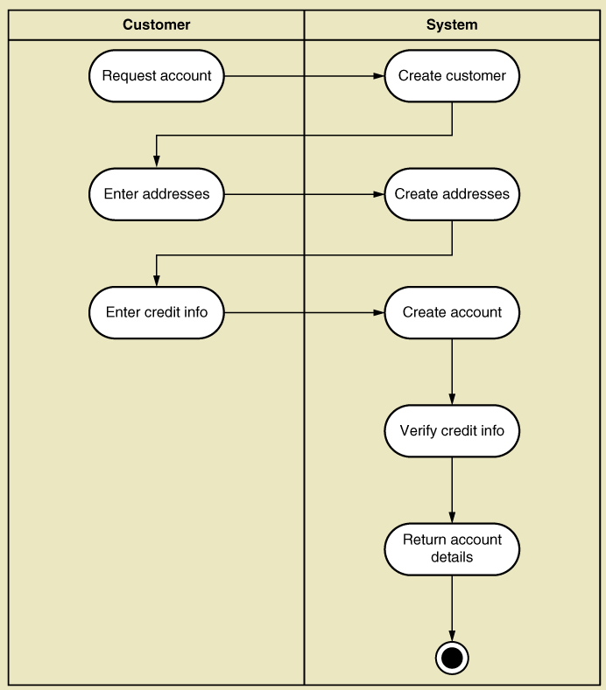
Activity Diagram: Create customer account

Slide 15
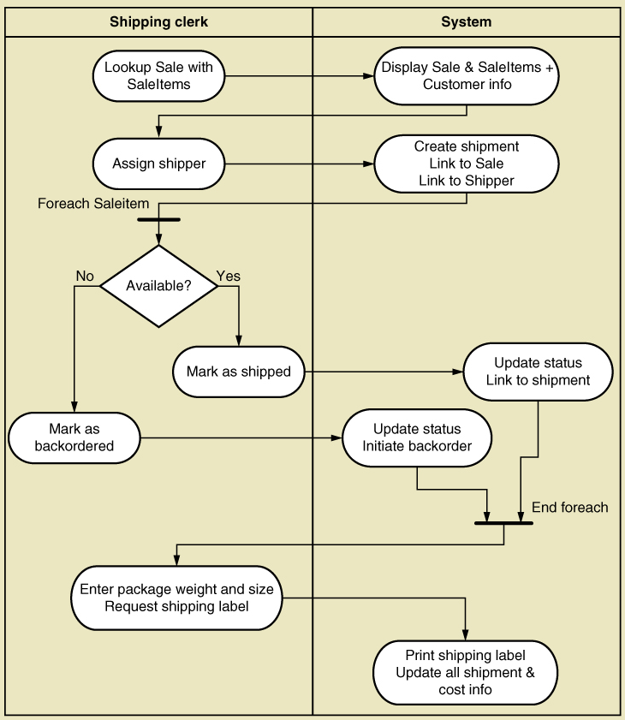
Activity Diagram: Ship Items
Synchronization bars for loop
Decision diamond

Slide 16
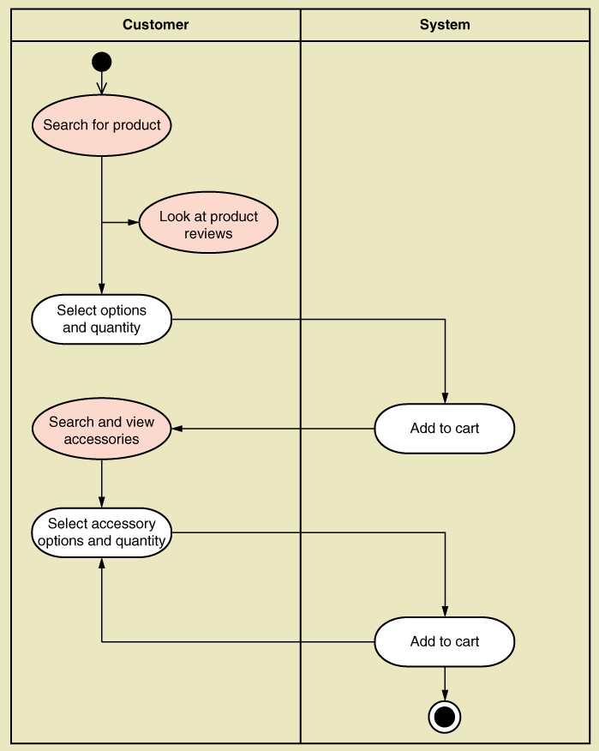
Activity Diagram: Fill shopping cart
This diagram shows use case with <<includes>> relationships
Note shown: decision activity

Slide 17
System Sequence Diagram (SSD)
Special case for a UML sequence diagram
Only shows actor and one object
The one object represents the complete system
Shows input & output messaging requirements for a use case
Actor, :System, object lifeline
Messages
In Systems Design, the Multi-layer Design Sequence Diagram will include a breakdown of :System
Boundary (screens), controllers, entities, data access layer

Slide 18
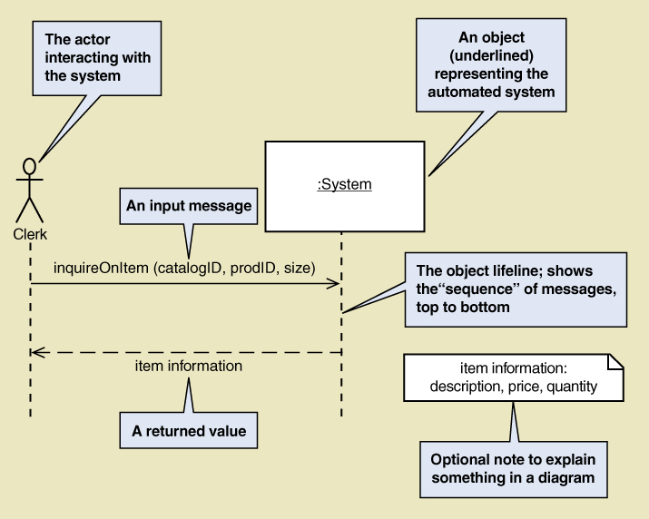
System Sequence Diagram (SSD) Notation

Slide 19
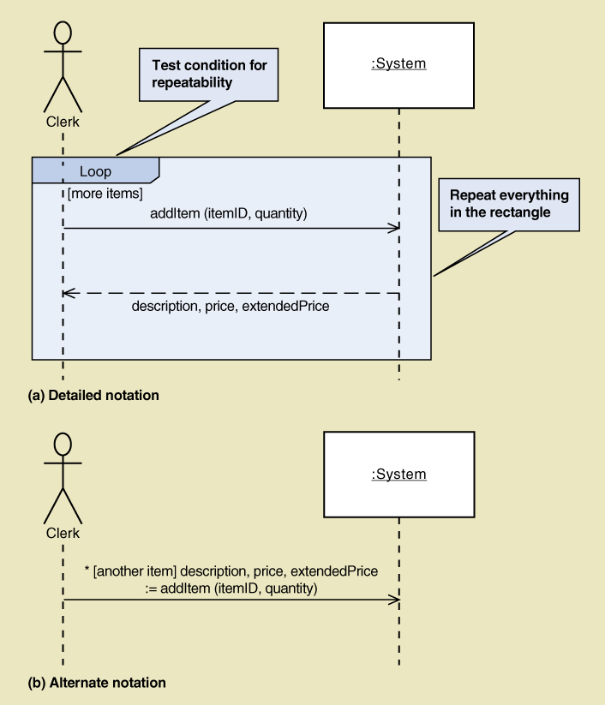
SSD Loop Examples
Loop frame
Better for multiple message/return interactions
OK for single messages too.
Single-line loop
Single message and return
* (repeated for each item)

Slide 20
Message Notation for SSD
* [true/false condition] return-value := message-name (parameter-list)
An asterisk (*) indicates a repeating or looping message
Brackets [ ] indicate a true/false condition.
If true, the message is sent. Otherwise, it isn't.
Message-name is the description of the requested service
written as a verb-noun (like a method call)
Parameter-list shows the data passed with the message.
The initiating message is in round brackets, the return-value isn't.
Return-value can be in the same line as the message, before the :=
A one-line notation with containing both expected response-and-message

Slide 21
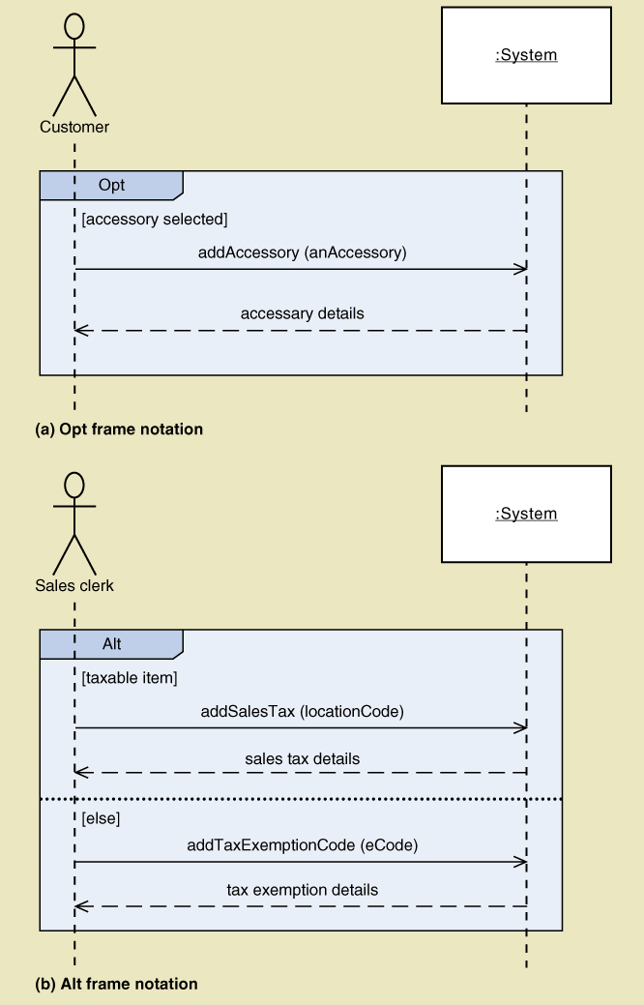
SSD Message Examples
"Opt" Frame (optional message)
Whole frame executed if condition is true
Usually for one condition → multiple messages
When there's just the one message:
Just attach the condition to the message
"Alt" Frame
For an if-else process

Slide 22
Steps for Developing SSD
Identify the input message
See use case flow of activities or activity diagram
Describe the message from the external actor to the system using the message notation
Name it verb-noun: what the system is asked to do
Consider parameters the system will need
Identify any special conditions on input messages
Iteration/loop frame
Opt or Alt frame
Identify and add output return values
On message itself: aValue:= getValue(valueID)
As explicit return on separate dashed line

Slide 23
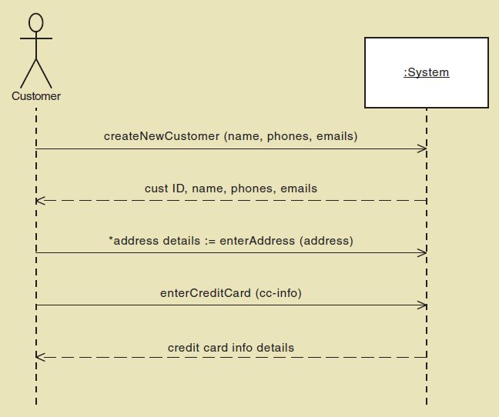
SSD for Create customer account

Slide 24
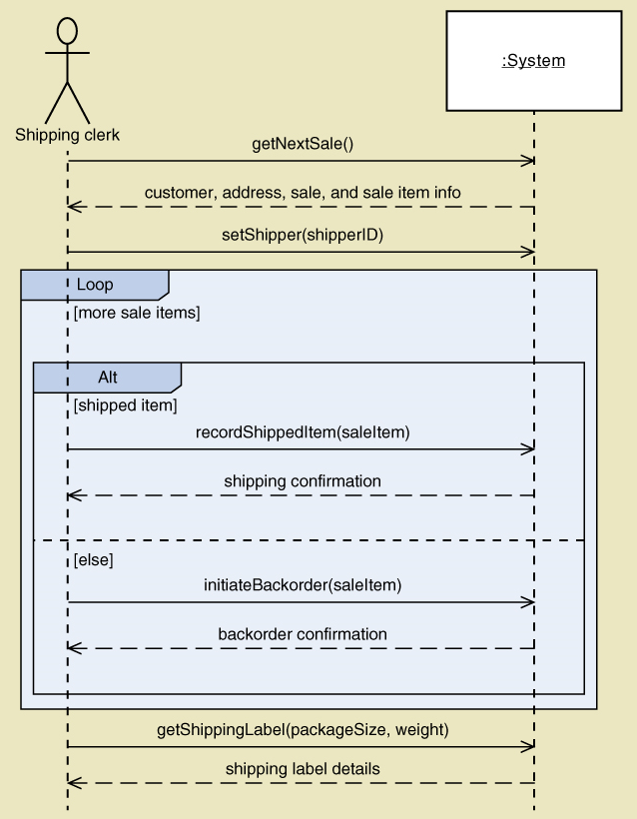
SSD for Ship items

Slide 25
Use Cases and CRUD
CRUD technique –
Create
Retrieve
Update
Delete
A good cross-check against the existing set of use cases, in the context of the database
Ensure that all classes have a complete set of use cases
Not for primary identification of use cases

Slide 26
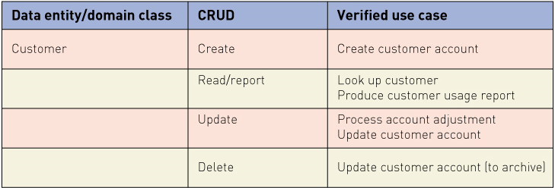
Verifying use cases for Customer

Slide 27
CRUD Analysis: Steps
Identify all domain classes
For each class verify that use cases exist to
Create a new instance
Update existing instances
Retrieve (read or report) information in the class
Delete or archive inactive instances
Add new use cases as required.
Identify responsible stakeholders
Identify which application (use case) has responsibility for each action:
which to create (C), which to update (U), which to use (R), …

Slide 28
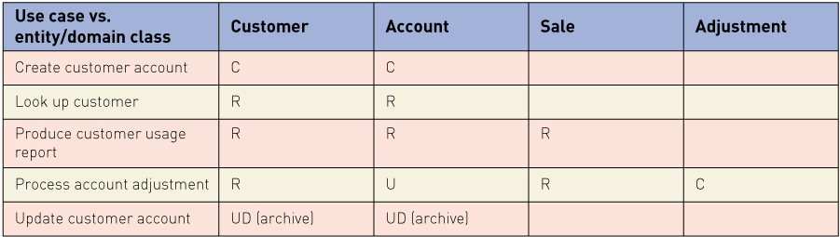
Sample CRUD Matrix

Slide 29
Interrelated Proofing of Requirements Models
Use cases
Use case diagram
Use case description
Activity diagram
System sequence diagram (SSD)
Domain Classes
Domain model class diagram
State machine diagram

Slide 30
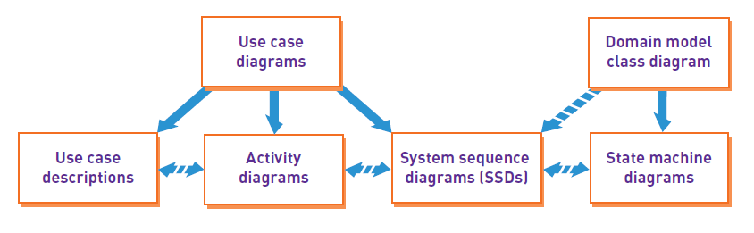
Integrating Requirements Models

Slide 31
Summary (1)
Prior chapters modelled two primary aspects of functional requirements: use cases and domain classes
This chapter provided models with details of use cases
Fully developed use case descriptions provide information about each use case:
actors, stakeholders, preconditions, post conditions, the flow of activities and exceptions conditions
Activity diagrams can also show the flow of activities for a use case

Slide 32
Summary (2)
System sequence diagrams (SSDs) show the inputs and outputs for each use case as messages
With conditions, parameters required and expected results
CRUD analysis verifies classes are fully supported by the system:
Use cases fully process all required actions.
Not all use cases and domain classes are modelled at a detailed level.
Model only when there is complexity and there is a need to communicate details
All of the models must be consistent and integrate together to provide a complete picture of the requirements and specification.

