Slide 1
7.1 Introduction
In this chapter, we discuss one of C’s most powerful features—the pointer.
Pointers enable programs to
  accomplish pass-by-reference,
  pass functions between functions,
  manipulate strings and arrays, and
  create and manipulate dynamic data structures that grow and shrink at execution time, such as linked lists, queues, stacks and trees.

Slide 2
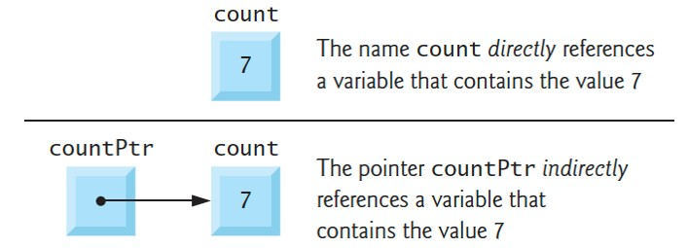
7.2 Pointer Variable Definitions and Initialization (1 of 3)
A pointer contains the address of another variable that contains a specific value
The pointer points to that variable
A variable name directly references a value
A pointer indirectly references a value
Referencing a value through a pointer is called indirection
Notes:
Part 1: A box contains a value 7 and is labeled count. The name count directly references a variable that contains the value 7. Part 2: A box labeled count P t r is to the left of the box labeled count that contains a value 7. An arrow from the left box points to the right box. The pointer count P t r indirectly references a variable that contains the value 7.

Slide 3
7.2 Pointer Variable Definitions and Initialization (2 of 3)
Declaring Pointers
Define countPtr as an int *—a pointer to an integer:
  int *countPtr;
Read right-to-left, “countPtr is a pointer to int” or “countPtr points to an object of type int.”
* indicates that the variable is a pointer.
Pointer Variable Naming
Our convention – end each pointer variable name with Ptr
Other common naming conventions include starting the variable name with p (e.g., pCount) or p_ (e.g., p_count)

Slide 4
7.2 Pointer Variable Definitions and Initialization (3 of 3)
Define Variables in Separate Statements
The * does not distribute to each variable:
  int *countPtr, count;
  countPtr is a pointer to int, but count is just an int
Always write the preceding declaration as two statements to prevent ambiguity:
  int *countPtr;
  int count;
Initializing and Assigning Values to Pointers
Initialize pointers when they’re defined, or assign them a value
A pointer may be initialized to NULL, 0 or an address:
  NULL points to nothing.
  0 is equivalent to NULL. NULL is preferred.
  Assigning a variable’s address to a pointer is discussed in Section 7.3

Slide 5
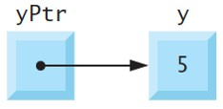
7.3 Pointer Operators (1 of 6)
Unary address operator (&) returns the address of its operand
int y = 5;
int *yPtr = &y;
  initializes pointer variable yPtr with variable y’s address
  yPtr is then said to “point to” y

Slide 6
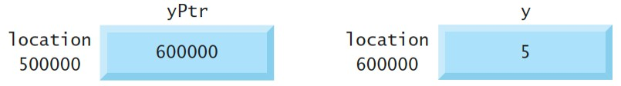
7.3 Pointer Operators (2 of 6)
The following diagram shows the preceding pointer’s representation in memory, assuming that integer variable y is stored at location 600000 and the pointer variable yPtr is stored at location 500000
Notes:
A pointer variable labeled y P t r is stored at memory location 500000 with a value 600000 in the memory block. An integer variable labeled y is stored at memory location 600000 with the value 5 in the memory block.

Slide 7
7.3 Pointer Operators (3 of 6)
Unary indirection operator (*), also called the dereferencing operator
Apply to a pointer operand to get the value of the object to which the pointer points—known as dereferencing a pointer
yPtr points to y, which is 5, so the following statement prints 5
  printf("%d", *yPtr);
Dereferencing a pointer that has not been initialized with or assigned the address of another variable in memory is an error
  Can cause a fatal execution-time error, accidentally modify data, produce incorrect results, or lead to a security breach

Slide 8
7.3 Pointer Operators (4 of 6)
Figure 7.1 demonstrates the pointer operators & and *
Conversion specification %p outputs a memory location as a hexadecimal integer on most platforms
The & and * operators are complements of one another
The addresses in the output will vary across systems that use different processor architectures, different compilers and even different compiler settings

Slide 9
7.3 Pointer Operators (5 of 6)
// fig07_01.c
// Using the & and * pointer operators.
#include <stdio.h>
int main(void) {
int a = 7;
int *aPtr = &a; // set aPtr to the address of a
printf("Address of a is %p\nValue of aPtr is %p\n\n", &a, aPtr);
printf("Value of a is %d\nValue of *aPtr is %d\n\n", a, *aPtr);
printf("Showing that * and & are complements of each other\n");
printf("&*aPtr = %p\n*&aPtr = %p\n", &*aPtr, *&aPtr);
}

Slide 10
7.3 Pointer Operators (6 of 6)
Address of a is 0x7fffe69386cc
Value of aPtr is 0x7fffe69386cc
Value of a is 7
Value of *aPtr is 7
Showing that * and & are complements of each other
&*aPtr = 0x7fffe69386cc
*&aPtr = 0x7fffe69386cc

Slide 11
7.4 Passing Arguments to Functions by Reference (1 of 18)
By default, arguments (other than arrays) are passed by value
Functions often need to modify variables in the caller or to receive a pointer to a large object to avoid the overhead of copying it (as in pass-by-value)
A return statement can return at most one value from a called function to its caller—pass-by-reference can enable a function to “return” multiple values by modifying the caller’s variables
Pointers and the indirection operator enable pass-by-reference
When calling a function with arguments that should be modified in the caller, you use & to pass each variable’s address
A function that receives the address of a variable in the caller can use the indirection operator (*) to modify the value at that location in the caller’s memory, thus effecting pass-by-reference

Slide 12
7.4 Passing Arguments to Functions by Reference (2 of 18)
Pass-By-Value
Line 11 of Figure 7.2 passes the variable number by value to function cubeByValue (lines 16–18), which cubes its argument and returns the new value
Line 11 assigns the new value to number in main, replacing number’s value

Slide 13
7.4 Passing Arguments to Functions by Reference (3 of 18)
// fig07_02.c
// Cube a variable using pass-by-value.
#include <stdio.h>
int cubeByValue(int n); // prototype
int main(void) {
int number = 5; // initialize number
printf("The original value of number is %d", number);
number = cubeByValue(number); // pass number by value to cubeByValue
printf("\nThe new value of number is %d\n", number);
}
// calculate and return cube of integer argument
int cubeByValue(int n) {
return n * n * n; // cube local variable n and return result
}

Slide 14
7.4 Passing Arguments to Functions by Reference (4 of 18)
The original value of number is 5
The new value of number is 125

Slide 15
7.4 Passing Arguments to Functions by Reference (5 of 18)
Line 12 of Figure 7.3 passes the variable number’s address to function cubeByReference (lines 17–19)
Passing the address enables pass-by-reference
The function’s parameter is a pointer to an int called nPtr (line 17).
The expression *nPtr dereferences the pointer
The function assigns the calculation result to *nPtr—which is really the variable number in main—thus changing number’s value in main
Use pass-by-value unless the caller explicitly requires the called function to modify the argument variable’s value in the caller
  Prevents accidental modification of the caller’s arguments and is another example of the principle of least privilege

Slide 16
7.4 Passing Arguments to Functions by Reference (6 of 18)
// fig07_03.c
// Cube a variable using pass-by-reference with a pointer argument.
#include <stdio.h>
void cubeByReference(int *nPtr); // function prototype
int main(void) {
int number = 5; // initialize number
printf("The original value of number is %d", number);
cubeByReference(&number); // pass address of number to cubeByReference
printf("\nThe new value of number is %d\n", number);
}

Slide 17
7.4 Passing Arguments to Functions by Reference (7 of 18)
// calculate cube of *nPtr; actually modifies number in main
void cubeByReference(int *nPtr) {
*nPtr = *nPtr * *nPtr * *nPtr; // cube *nPtr
}

Slide 18
7.4 Passing Arguments to Functions by Reference (8 of 18)
The original value of number is 5
The new value of number is 125

Slide 19
7.4 Passing Arguments to Functions by Reference (9 of 18)
Use a Pointer Parameter to Receive an Address
A function receiving an address must use a pointer parameter
  void cubeByReference(int *nPtr) {
Pointer Parameters in Function Prototypes
The function prototype for cubeByReference (Figure 7.3, line 6) specifies an int * parameter
It’s not necessary to include pointer names in function prototype
  They’re ignored by the compiler
  But it’s good practice to include them for documentation purposes

Slide 20
7.4 Passing Arguments to Functions by Reference (10 of 18)
Functions That Receive One-Dimensional Arrays
The compiler does not differentiate between a function that receives a pointer and one that receives a one-dimensional array
The function must “know” when it’s receiving an array versus. a single variable passed by reference
A parameter of the form int b[] is converted to int *b
The two forms are interchangeable

Slide 21
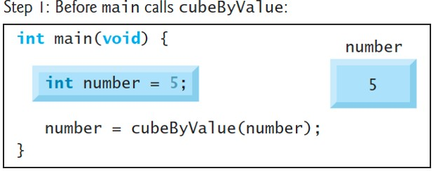
7.4 Passing Arguments to Functions by Reference (11 of 18)
Pass-By-Value Step-By-Step
Notes:
Before main calls cube By Value: The figure contains 4 lines of C code that reads as follows: Line 1 at indentation level 0, int main open parenthesis void close parenthesis open curly bracket. Line 2 at indentation level 1, int number equals 5 semicolon. Line 3 at indentation level 1, number equals cube By Value open parenthesis number close parenthesis semicolon. Line 4 at indentation level 0, close curly bracket. The integer number 5 passed as the value is depicted on the right side in a memory block.

Slide 22
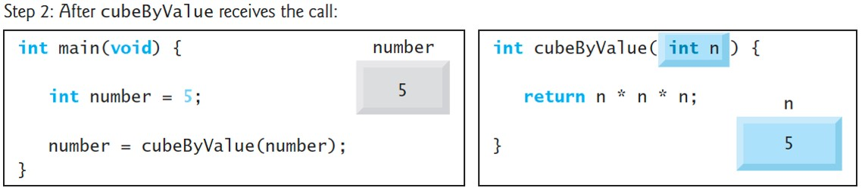
7.4 Passing Arguments to Functions by Reference (12 of 18)
Pass-By-Value Step-By-Step
Notes:
After cube By Value receives the call: Part 1 contains 4 lines of C code that reads as follows: Line 1 at indentation level 0, int main open parenthesis void close parenthesis open curly bracket. Line 2 at indentation level 1, int number equals 5 semicolon. Line 3 at indentation level 1, number equals cube By Value open parenthesis number close parenthesis semicolon. Line 4 at indentation level 0, close curly bracket. The integer number 5 passed as the value is depicted on the right side in a memory block. Part 2 contains 3 lines of C code that reads as follows: Line 1 at indentation level 0, int cube By Value open parenthesis int n close parenthesis open curly bracket. Line 2 at indentation level 1, return n asterisk n asterisk n semicolon. Line 3 at indentation level 0, close curly bracket. The integer number 5 received as n is depicted on the lower right side in a memory block.

Slide 23
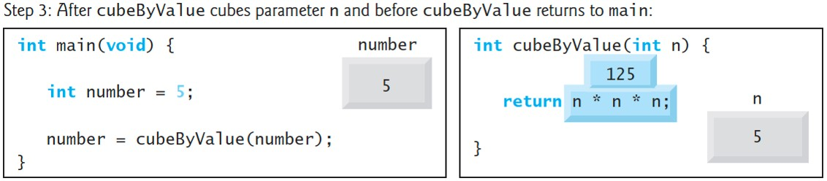
7.4 Passing Arguments to Functions by Reference (13 of 18)
Pass-By-Value Step-By-Step
Notes:
After cube By Value cubes parameter n and before cube By Value returns to main: Part 1 contains 4 lines of C code that reads as follows: Line 1 at indentation level 0, int main open parenthesis void close parenthesis open curly bracket. Line 2 at indentation level 1, int number equals 5 semicolon. Line 3 at indentation level 1, number equals cube By Value open parenthesis number close parenthesis semicolon. Line 4 at indentation level 0, close curly bracket. The integer number 5 passed as the value is depicted on the right side in a memory block. Part 2 contains 3 lines of C code that reads as follows: Line 1 at indentation level 0, int cube By Value open parenthesis int n close parenthesis open curly bracket. Line 2 at indentation level 1, return n asterisk n asterisk n semicolon. Line 3 at indentation level 0, close curly bracket. The integer number 5 received as n is depicted at the lower right in a memory block. The value of n asterisk n asterisk n is shown above Line 2 as 125.

Slide 24
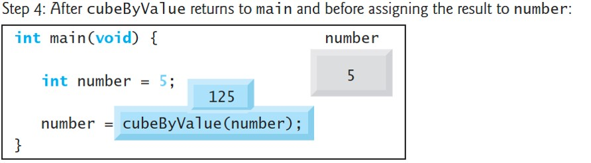
7.4 Passing Arguments to Functions by Reference (14 of 18)
Pass-By-Value Step-By-Step
Notes:
After cube By Value returns to main and before assigning the result to number: The figure contains 4 lines of C code that reads as follows: Line 1 at indentation level 0, int main open parenthesis void close parenthesis open curly bracket. Line 2 at indentation level 1, int number equals 5 semicolon. Line 3 at indentation level 1, number equals cube By Value open parenthesis number close parenthesis semicolon. Line 4 at indentation level 0, close curly bracket. The integer number 5 passed as the value is depicted on the right side in a memory block. The value 125 is shown above the function cube By Value.

Slide 25
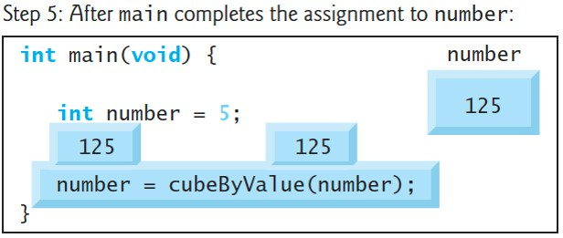
7.4 Passing Arguments to Functions by Reference (15 of 18)
Pass-By-Value Step-By-Step
Notes:
After main completes the assignment to number: The figure contains 4 lines of C code that reads as follows: Line 1 at indentation level 0, int main open parenthesis void close parenthesis open curly bracket. Line 2 at indentation level 1, int number equals 5 semicolon. Line 3 at indentation level 1, number equals cube By Value open parenthesis number close parenthesis semicolon. Line 4 at indentation level 0, close curly bracket. The new assigned value of 125 to the integer number is depicted on the right side in a memory block. The value 125 is shown above the function cube By Value and the number in line 3.

Slide 26
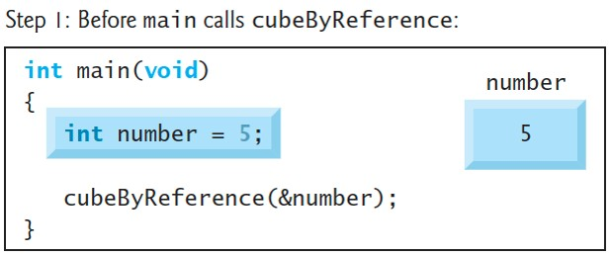
7.4 Passing Arguments to Functions by Reference (16 of 18)
Pass-By-Reference Step-By-Step
Notes:
Before main calls cube By Reference: The figure contains 4 lines of C code that reads as follows: Line 1 at indentation level 0, int main open parenthesis void close parenthesis open curly bracket. Line 2 at indentation level 1, int number equals 5 semicolon. Line 3 at indentation level 1, cube By Reference open parenthesis ampersand number close parenthesis semicolon. Line 4 at indentation level 0, close curly bracket. The integer number 5 passed as the reference is depicted on the right side in a memory block.

Slide 27
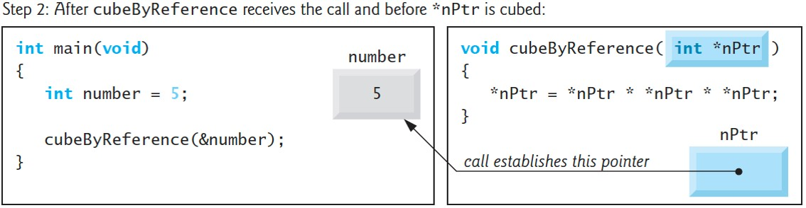
7.4 Passing Arguments to Functions by Reference (17 of 18)
Pass-By-Reference Step-By-Step
Notes:
After cube By Reference receives the call and before asterisk n P t r is cubed: Part 1 contains 4 lines of C code that reads as follows: Line 1 at indentation level 0, int main open parenthesis void close parenthesis open curly bracket. Line 2 at indentation level 1, int number equals 5 semicolon. Line 3 at indentation level 1, cube By Reference open parenthesis ampersand number close parenthesis semicolon. Line 4 at indentation level 0, close curly bracket. The integer number 5 passed as the reference is depicted on the right side in a memory block. Part 2 contains 4 lines of C code that reads as follows: Line 1 at indentation level 0, void cube By Reference open parenthesis int asterisk n P t r close parenthesis. Line 2 at indentation level 0, open curly bracket. Line 3 at indentation level 1, asterisk n P t r equals asterisk n P t r asterisk asterisk n P t r asterisk asterisk n P t r. Line 4 at indentation level 0, close curly bracket. A memory block labeled n P t r on the lower right side points to the memory block in part 1. The pointer arrow is labeled call establishes this pointer.

Slide 28
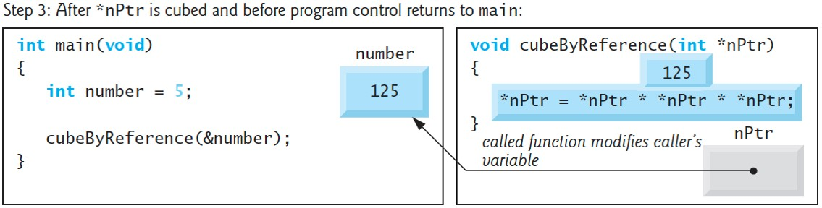
7.4 Passing Arguments to Functions by Reference (18 of 18)
Pass-By-Reference Step-By-Step
Notes:
After asterisk n P t r is cubed and before program control returns to main: Part 1 contains 4 lines of C code that reads as follows: Line 1 at indentation level 0, int main open parenthesis void close parenthesis open curly bracket. Line 2 at indentation level 1, int number equals 5 semicolon. Line 3 at indentation level 1, cube By Reference open parenthesis ampersand number close parenthesis semicolon. Line 4 at indentation level 0, close curly bracket. The integer number 125 returned to the main is depicted to the right side in a memory block. Part 2 contains 4 lines of C code that reads as follows: Line 1 at indentation level 0, Void cube By Reference open parenthesis int asterisk n P t r close parenthesis. Line 2 at indentation level 0, open curly bracket. Line 3 at indentation level 1, asterisk n P t r equals asterisk n P t r asterisk asterisk n P t r asterisk asterisk n P t r. Line 4 at indentation level 0, close curly bracket. A memory block labeled n P t r on the lower right side points to the memory block in part 1. The pointer arrow is labeled called function modifies caller’s variable. The value 125 is shown above line 3.

Slide 29
7.7 sizeof Operator (1 of 8)
Operator sizeof determines an object’s or type’s size in bytes
Applied at compilation time unless its operand is a variable-length array (V L A; Section 6.12)
When applied to an array’s name as in Figure 7.12 (line 12), sizeof returns as a size_t value the array’s total number of bytes
sizeof is a compile-time operator, so it does not incur any execution-time overhead (except for V L A s).

Slide 30
7.8 Pointer Expressions and Pointer Arithmetic
Pointers are valid operands in arithmetic expressions, assignment expressions and comparison expressions
Not all arithmetic operators are valid with pointer variables
This section describes the operators that can have pointers as operands, and how these operators are used

Slide 31
7.8.1 Pointer Arithmetic Operators
The following arithmetic operations are allowed for pointers:
  incrementing (++) or decrementing
  adding an integer to a pointer (+ or +=),
  subtracting an integer from a pointer
  and
  subtracting one pointer from another—meaningful only when both pointers point into the same array.
Pointer arithmetic on pointers that do not refer to array elements is a logic error.

Slide 32
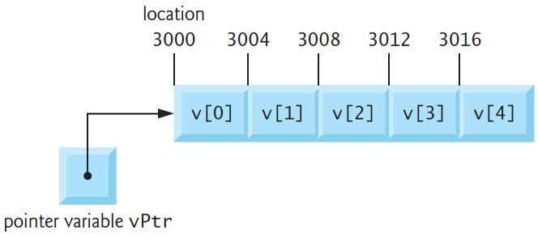
7.8.2 Aiming a Pointer at an Array
Assume int v[5] is defined, and its first element is at location 3000
Assume vPtr points to v[0]
The following diagram illustrates this scenario for a machine with four-byte integers
vPtr can be initialized to point to v with either of the statements
  vPtr = v;
  vPtr = &v[0];
Notes:
The array shown as boxes has a length of 5. The elements in each box of the array from left to right are v open square bracket 0 close square bracket to v open square bracket 4 close square bracket. The locations of the boxes from left to right are 3000, 3004, 3008, 3012, and 3016, respectively. An arrow from a box labeled pointer variable v P t r points to location 3000.

Slide 33
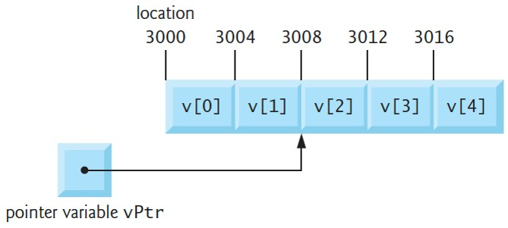
7.8.3 Adding an Integer to a Pointer
In arithmetic, 3000 + 2 yields the value 3002
  Normally not the case with pointer arithmetic
Adding an integer to or subtracting one from a pointer increments or decrements by that integer times the size of the object to which the pointer refers
The diagram shows result of vPtr += 2; for 4-byte objects
Notes:
The array shown as boxes has a length of 5. The elements in each box of the array from left to right are v open square bracket 0 close square bracket to v open square bracket 4 close square bracket. The locations of the boxes from left to right are 3000, 3004, 3008, 3012, and 3016, respectively. An arrow from a box labeled pointer variable v P t r points to location 3008.

Slide 34
7.8.4 Subtracting an Integer From a Pointer
If vPtr contains 3016 (v[4]), the following statement would set vPtr back to 3000 (v[0])—the beginning of the array.
  vPtr −= 4;
Using pointer arithmetic to adjust pointers to point outside an array’s bounds is a logic error that could lead to security problems.

Slide 35
7.8.5 Incrementing and Decrementing a Pointer
To increment or decrement a pointer by one, use the
increment (++) and decrement
operators
  ++vPtr;
  vPtr++;
  −−vPtr;
  vPtr−−;

Slide 36
7.8.6 Subtracting One Pointer From Another
If vPtr contains the location 3000 and v2Ptr contains the address 3008, the following statement assigns to x the number of array elements between vPtr and v2Ptr, in this case, 2 (not 8).
  x = v2Ptr - vPtr;
Pointer arithmetic is undefined unless performed on elements of the same array
We cannot assume that two variables of the same type are stored side-by-side in memory unless they’re adjacent elements of an array

Slide 37
7.8.7 Assigning Pointers to One Another
Pointers of the same type may be assigned to one another
This rule’s exception is a pointer to void (i.e., void *)—a generic pointer that can represent any pointer type
All pointer types can be assigned to a void *, and a void * can be assigned a pointer of any type (including another void *)
A cast operation is not required

Slide 38
7.8.8 Pointer to void
A pointer to void cannot be dereferenced
A void * contains a memory location for an unknown type
  Number of bytes to which the pointer refers is not known
The compiler must know the type to determine the number of bytes that represent the referenced value
Dereferencing a void * pointer is a syntax error

Slide 39
7.8.9 Comparing Pointers
You can compare pointers using equality and relational operators
Meaningful only if the pointers point to elements of the same array
Otherwise, such comparisons are logic errors
A common use of pointer comparison is determining whether a pointer is NULL

Slide 40
7.9 Relationship Between Pointers and Arrays
Arrays and pointers often may be used interchangeably
Think of an array name as a constant pointer to the first element
Pointers can be used to do any operation involving array subscripting
int b[5];
int *bPtr;
  The array name b is a pointer to the array’s first element
  Can set bPtr to the address of the array b’s first element with the statement:
    bPtr = b;
  Equivalent to taking the address of array b’s first element:
    bPtr = &b[0];

Slide 41
7.9.1 Pointer/Offset Notation
b[3] can alternatively be referenced with the pointer expression
  *(bPtr + 3)
The 3 in the expression is the offset to the pointer
When bPtr points to the array’s first element, the offset indicates which array element to reference
  Offset’s value is identical to the array subscript
Referred to as pointer/offset notation
Parentheses are required because the precedence of * is higher than that of +

Slide 42
7.9.2 Pointer/Subscript Notation
Pointers can be subscripted like arrays
If bPtr has the value b, the following expression refers to the array element b[1]
  bPtr[1]
Referred to as pointer/subscript notation.

Slide 43
7.10 Arrays of Pointers (1 of 2)
Arrays may contain pointers
  Commonly for array of strings, referred to simply as a string array
Each element in a C string is essentially a pointer to its first character
const char *suit[4] = {"Hearts", "Diamonds", "Clubs", "Spades"};
  The char * indicates that each suit element is of type “pointer to char.”
  const indicates that the string each element points to cannot be modified
  "Hearts", "Diamonds", "Clubs" and "Spades" are placed into the array
  Each is stored in memory as a null-terminated character string that’s one character longer than the number of characters in the quotes

Slide 44
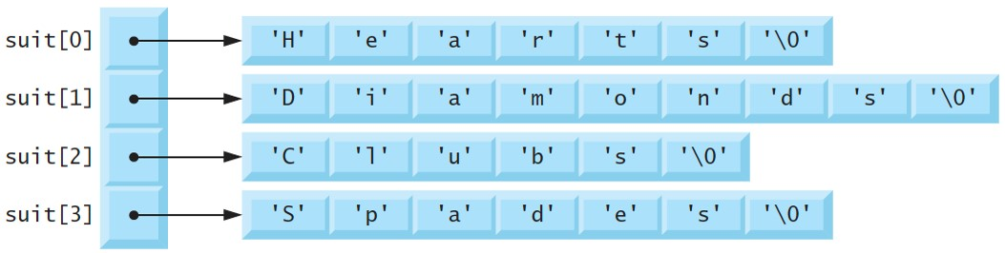
7.10 Arrays of Pointers (2 of 2)
Only pointers are actually stored in the array, as shown in the following diagram
Notes:
The array has four elements labeled suit open square bracket 0 close square bracket to suit open square bracket 3 close square bracket and is shown as a column to the left. Each of the elements points to the first element of an array each on the right. The elements in these arrays are each within open single quote and close single quote to depict that they are characters. Suit open square bracket 0 close square bracket points to an array of length 7 with values labeled 'H' 'e' 'a' 'r' 't' 's' 'backslash 0'. Suit open square bracket 1 close square bracket points to an array of length 9 with values labeled 'D' 'i' 'a' 'm' 'o' 'n' 'd' 's' 'backslash 0'. Suit open square bracket 2 close square bracket points to an array of length 6 with values labeled 'C' 'l' 'u' 'b' 's' 'backslash 0'. Suit open square bracket 3 close square bracket points to an array of length 7 with values labeled 'S' 'p' 'a' 'd' 'e' 's' 'backslash 0'.

Slide 45
7.12 Function Pointers
A function’s name is really the starting address in memory of the code that performs the function’s task
A pointer to a function contains the address of the function in memory
Pointers to functions can be passed to functions, returned from functions, stored in arrays, assigned to other function pointers of the same type and compared with one another for equality or inequality

