Slide 1
DATA EXTRACTION AND NLP TEST ASSIGNMENT
COMPREHENSIVE ANALYSIS OF FINANCIAL TEXTS
By : Deependra Singh Parihar

Slide 2

PROJECT OVERVIEW
Objective:The primary goal of this project was to extract and analyze text data from a set of URLs related to ﬁnancial news articles. The analysis aimed to compute various readability and sentiment-based metrics to assess the complexity and emotional tone of the texts.

Slide 3

Key Components
Data Extraction: Extracting and cleaning text data from URLs.
Analysis: Performing readability and sentiment analysis.
Output Generation: Compiling results into a structured CSV ﬁle.

Slide 4



DATA EXTRACTION
Input File: Input.xlsx
Purpose: Lists URLs for text extraction.
Process Overview:
Scraping: Used BeautifulSoup to extract article titles and bodies.
Filtering: Removed irrelevant content like ads and headers.
Saving: Stored cleaned text in .txt ﬁles named by URL_ID.

Slide 5
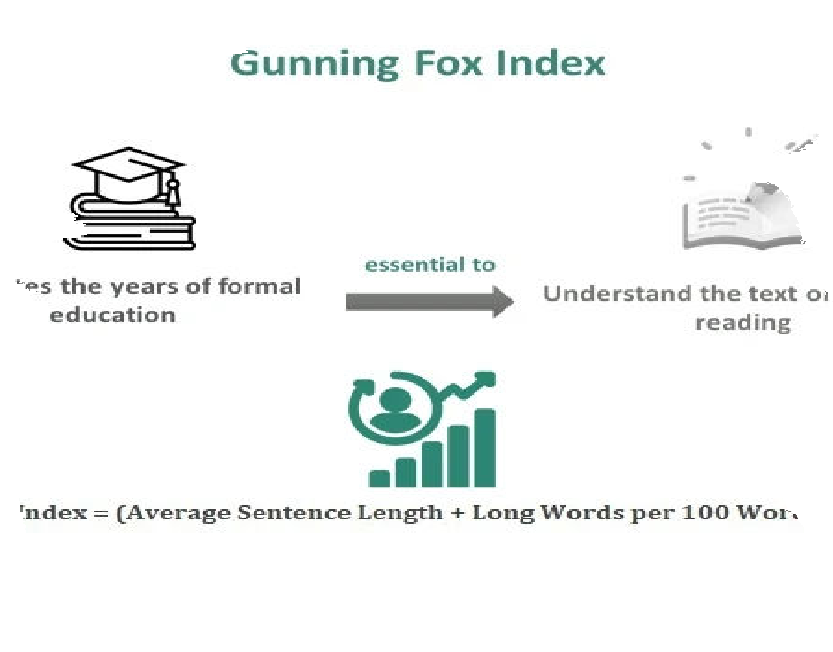
READABILITY METRICS
L. Average Sentence Length: Total words divided by sentences.
2. Percentage of Complex Words: Ratio of words with more than two syllables.
Gunning Fox Index: Measures text complexity. Fog Index=0.4×(Average Sentence Length+Perc entage of Complex Words

Slide 6

SENTIMENT ANALYSIS
Clean Text: Removed stop words. Dictionary: Classiﬁed words as positive or negative.
Calculate Scores:
Positive and Negative Scores: Count of matching words.
Polarity Score :
(Positive Score−Negative Score) (Positive Score+Negative Score)+0.000001)
Subjectivity Score :
(Positive Score + Negative Score) Total words + 0.000001)

Slide 7
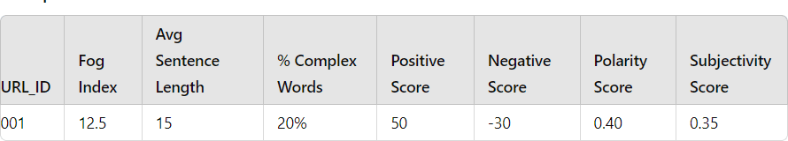
OUTPUT DATA STRUCTURE
Output File: output.csv
Contents: Includes readability and sentiment metrics for each URL.

Slide 8


SUMMARY
Extracted and analyzed ﬁnancial texts.
Calculated readability and sentiment metrics.
Compiled results in output.csv

