Slide 1

Kubernetes
Vanshika Agrawal

Slide 2



Agenda
What is Kubernetes
Components of K8s
Architecture of K8s
Master Node Components
Worker Node Components
Generic Commands
Scaling
Rolling Updates

Slide 3

What is kubernetes
Kubernetes is an opensource container management tool which automates deploying, scaling, and managing containerized applications.
Kubernetes cluster consists of 2 types of resources:
Control Plane: manages the cluster. It coordinates all the activities in a cluster such as scheduling applications, managing application’s desired state, scaling applications and rolling out new updates.
Node: A node is a VM or physical computer that serves as a worker machine in Kubernetes cluster
Components of Kubernetes:
Pods: In K8s we do not interact with containers directly. They are wrapped into functional units called pods(may have one or more containers). Each pod associates to an IP address so that they can interact with each other.
Nodes: Physical or VM where pods are wrapped. It can have single or multiple pods.
Cluster: Nodes are wrapped in a physical unit called cluster(single or multiple nodes).

Slide 4
Cluster
Node 1
Node 2
pod1
IP 1
Pod 1
IP 2
Pod 2
Control Plane
Container 1
Con. 2
pod2

Slide 5
4. Replica Sets: When any of the pods crash, k8s bring pods from replica sets to avoid down time.
5. Service: Pods(one or more) can associate to service where service will provide a static IP and DNS name. So even if a pod dies and a new pod comes in, it won’t affect as DNS name will be same. Types: Cluster IP(for applications that don’t need to be exposed), Node Port(Like LB, also enable port for particular node), Load Balancer(allows external traffic to k8s cluster).
6. Deployments: These are k8s objects used to manage pods. We can scale the application by increasing the number of running pods or update application using k8s deployment.
Command: kubectl create deployment first-deployment-image=<docker-image-name> --port=8080 –replicas=4

Slide 6
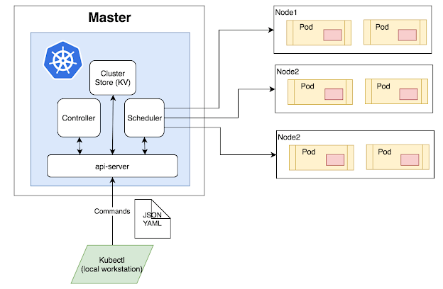
Kubernetes Architechture
Cluster will have a master node and a number of worker nodes(having pods).
Master Node will check all worker nodes and whether pods running smoothly or not. If any pods are down inside node, he will assign a new pod with new IP. If any Nodes are down he will tag all the pods from that node to a new node.

Slide 7
Components of Master Node
Master Node is the first and most vital component which is responsible of k8s cluster. It is the entry point of all administrative tasks.
API Server: acts as a cluster gateway(entry point). Each request coming to the cluster is first served by api server. Basically it exposes few IP’s to access all operations going in cluster. We can this using command kubectl or K8s UI.
Scheduler: It schedules the tasks to the slave nodes. It stores the resourse usage information of every slave node and distribute the work accordingly.
Controller Manager: In Kubernetes, a controller is a control loop that watches the shared state of the cluster through the apiserver and makes changes attempting to move the current state towards the desired state
ETCD: Key-Value database store which stores configuration of k8s cluster. It also stores all secret and configmap data.

Slide 8
Components of Worker Node
Worker nodes are another essential component which contains all the required services to manage the networking between containers , communicate with master node, which allows us to assign resources to scheduled containers.
Kubelet: A process responsible for communication between the k8s control plane and the Node. It manages pods and containers running on a machine
Container runtime: responsible for pulling container image from a registry, unpacking the container running the application.

Slide 9
Commands
minikube version and kubectl version(to check minikube and kubectl are in place)
minikube start(to start the cluster)
kubectl cluster-info
kubectl get nodes(shows all nodes that can be used to host our applications. In this case one node is available)
kubectl create deployment spring-boot-k8s –image= gcr.io/google-samples/kubernetes-bootcamp:v1 --port=8080 (to run docker image in a pod)
kubectl get deployments(we can see 1 deployment running a single instance of our app. The instance is running inside a docker container on our node)
kubectl get services: We have a service called Kubernetes by default when minikube starts. TO create a new service and expose it to external traffic we will use the expose command.

Slide 10
Commands
8. kubectl expose deployment spring-boot-k8s –type=NodePort(To expose application outside cluster using service)
minikube service spring-boot-k8s --url(to get service url using which we can access our application)
Check if the service is exposed using to outside world using curl
Kubectl delete service -l app= spring-boot-k8s
Using dashboard UI we can see Deployments, Service, Nodes, Pods etc in UI.
Note: To get started with Kubernetes development, you can use Minikube. Minikube is a lightweight Kubernetes implementation that creates a VM on our local machine and deploys a simple cluster containing only one node
Kubectl is a command line interface to interact with Kubernetes.

Slide 11
Scaling a deployment
Commands:
Kubectl get rs(to see the replica set created by the deployment)
Kubectl scale deployments/spring-boot-k8s –replicas=4
Check: kubectl get deployments and kubectl get pods –o wide(there are 4 pods now with different IP addresses.)
minikube service spring-boot-k8s --url.(curl this url and seeit will load balance among all 4 pods.)

Slide 12
Rolling Updates
Commands:
Kubectl describe pods(To view the current version of the app)
Kubectl set image deployments/spring-boot-k8s container_name= gcr.io/google-samples/kubernetes-bootcamp:v2(to update the image to version 2)
The command notified the deployment to use a different image for your app and initiated a rolling update. Check the status of the new pods, and view the old ones getting terminated with the
Kubectl get pods command.
3. Kubectl rollout status deployments/spring-boot-k8s(to confirm the update)

Slide 13
RollBack Updates
Commands:
Kubectl set image deployments/spring-boot-k8s container_name=gcr.io/google-samples/kubernetes-bootcamp:v10(to update the image to version 10)
Kubectl get deployments : will not list desired number of available pods.
Kubectl get pods: Some if the pods have status ImagePullBackOff
Kubectl describe pods: in the events section notice v10 is not available.
2. Kubectl rollout undo deployments/spring-boot-k8s(it will revert the deployment to the previous known state. Updates are versioned and we can rollback to any previous state)

Slide 14


Thank You

