Slide 1
Chapter 4: Threads线程

Slide 2
Chapter 4: Threads
Overview综述
Multithreading Models多线程模型
Threading Issues若干多线程问题
Pthreads POSIX线程
Windows XP Threads
Linux Threads
Java Threads

Slide 3
Benefits
Responsiveness响应能力
Resource Sharing资源共享
Economy经济性：进程创建所需的内存和资源的分配时代价高，线程要快
Utilization of MP Architectures充分利用多处理器体系结构

Slide 4

Single and Multithreaded Processes

Slide 5
User Threads用户线程
Thread management done by user-level threads library不依赖于OS核心（内核不了解用户线程的存在），应用进程利用线程库提供创建、同步、调度和管理线程的函数来控制用户线程。调度由应用软件内部进行，通常采用非抢先式和更简单的规则，也无需用户态/核心态切换，所以速度特别快。一个线程发起系统调用而阻塞，则整个进程在等待。
Three primary thread libraries:
  POSIX Pthreads
  Win32 threads
  Java threads
用户线程的维护由应用进程完成；
内核不了解用户线程的存在；
用户线程切换不需要内核特权；
用户线程调度算法可针对应用优化；
线程状态是与进程状态独立的
  当进程占用CPU时，运行态的线程占用CPU运行

Slide 6

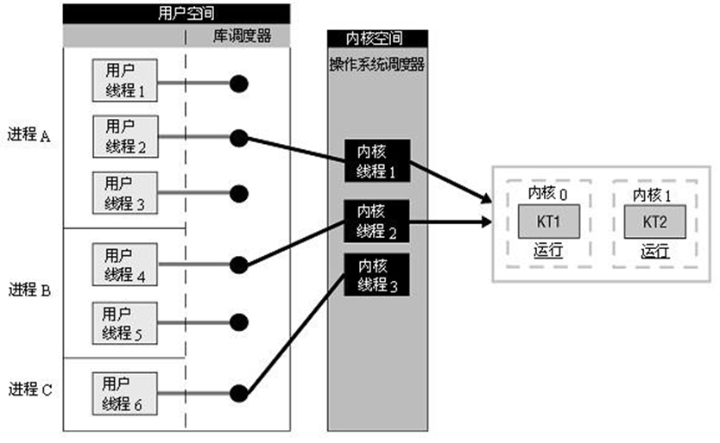
User Threads用户线程（图）

Slide 7
Kernel Threads内核线程
Supported by the Kernel
依赖于OS核心，由内核的内部需求进行创建和撤销，用来执行一个指定的函数。一个线程发起系统调用而阻塞，不会影响其他线程。时间片分配给线程，所以多线程的进程获得更多CPU时间。
Examples
  Windows XP/2000
  Solaris
  Linux
  Tru64 UNIX
  Mac OS X
内核维护进程和线程的上下文信息；
线程切换由内核完成；
一个线程发起系统调用而阻塞，不会影响其他线程的运行。
时间片分配给线程，所以多线程的进程获得更多CPU时间。

Slide 8
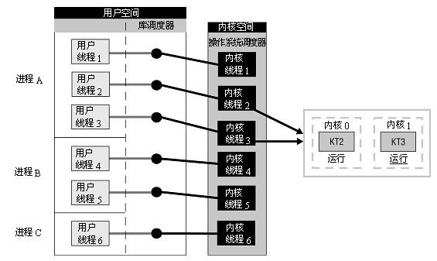
Kernel Threads内核线程（图）

Slide 9
Multithreading Models
多线程的3种实现方式
Many-to-One
One-to-One
Many-to-Many

Slide 10

Many-to-One
Many user-level threads mapped to single kernel thread
Examples:
  Solaris Green Threads
  GNU Portable Threads

Slide 11
Many-to-One Model

Slide 12

One-to-One
Each user-level thread maps to kernel thread
Examples
  Windows NT/XP/2000
  Linux
  Solaris 9 and later

Slide 13
One-to-one Model

Slide 14
Many-to-Many Model
Allows many user level threads to be mapped to many kernel threads
Allows the operating system to create a sufficient number of kernel threads
Solaris prior to version 9
Windows NT/2000 with the ThreadFiber package

Slide 15

Many-to-Many Model

Slide 16
Two-level Model
Similar to M:M, except that it allows a user thread to be bound to kernel thread
Examples
  IRIX
  HP-UX
  Tru64 UNIX
  Solaris 8 and earlier

Slide 17

Two-level Model

Slide 18
Threading Issues有关线程的问题
问题：现在进程中有多个线程！
Semantics of fork() and exec() system calls fork和 exec 系统调用的语义：进程中的线程如何处理？一些 UNIX 系统选择了两种fork , 一个复制所有的线程，另外一个仅仅复制调用fork系统调用的线程
Thread cancellation
Signal handling信号处理问题：现在进程中有多个线程，那么那些线程响应信号呢？或者说，信号是给那些线程的呢？发送到信号所应用的线程;发送到进程的所有线程;发送到进程的某些线程;规定一个特定线程来接收进程的所有信号
Thread pools问题：创建和撤销线程开销大(当然比进程要小的多)，而被撤销的线程可能由于用户请求又需要再创建。解决办法：使用线程池
Thread specific data
Scheduler activations调度器激活：一种解决用户线程库与内核间通信的方法

Slide 19
Semantics of fork() and exec()
Does fork() duplicate only the calling thread or all threads?

Slide 20
Thread Cancellation
Terminating a thread before it has finished
Two general approaches:
  Asynchronous cancellation terminates the target thread immediately
  Deferred cancellation allows the target thread to periodically check if it should be cancelled

Slide 21
Signal Handling
Signals are used in UNIX systems to notify a process that a particular event has occurred
A signal handler is used to process signals
  Signal is generated by particular event
  Signal is delivered to a process
  Signal is handled
Options:
  Deliver the signal to the thread to which the signal applies
  Deliver the signal to every thread in the process
  Deliver the signal to certain threads in the process
  Assign a specific threa to receive all signals for the process

Slide 22
Thread Pools
Create a number of threads in a pool where they await work
Advantages:
  Usually slightly faster to service a request with an existing thread than create a new thread
  Allows the number of threads in the application(s) to be bound to the size of the pool

Slide 23
Thread Specific Data
Allows each thread to have its own copy of data
Useful when you do not have control over the thread creation process (i.e., when using a thread pool)

Slide 24
Scheduler Activations
Both M:M and Two-level models require communication to maintain the appropriate number of kernel threads allocated to the application
Scheduler activations provide upcalls - a communication mechanism from the kernel to the thread library
This communication allows an application to maintain the correct number kernel threads

Slide 25
Pthreads
A POSIX standard (IEEE 1003.1c) API for thread creation and synchronization
API specifies behavior of the thread library, implementation is up to development of the library
Common in UNIX operating systems (Solaris, Linux, Mac OS X)

Slide 26
Windows XP Threads
Implements the one-to-one mapping
Each thread contains
  A thread id
  Register set
  Separate user and kernel stacks
  Private data storage area
The register set, stacks, and private storage area are known as the context of the threads
The primary data structures of a thread include:
  ETHREAD (executive thread block)
  KTHREAD (kernel thread block)
  TEB (thread environment block)

Slide 27
Linux Threads
Linux refers to them as tasks rather than threads
Thread creation is done through clone() system call
clone() allows a child task to share the address space of the parent task (process)

Slide 28
Java Threads
Java threads are managed by the JVM
Java threads may be created by:
  Extending Thread class
  Implementing the Runnable interface

Slide 29
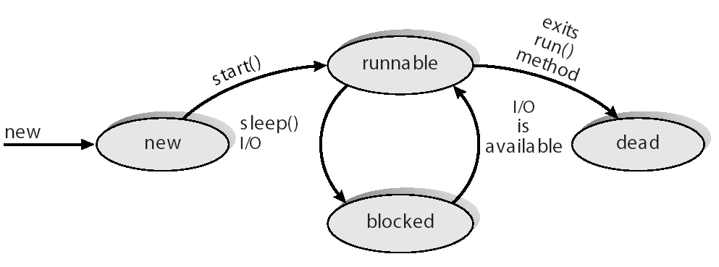
Java Thread States

Slide 30
End of Chapter 4

