Slide 1
CS173 · DATA MINING · FINAL PROJECT
CausalStock
Event-Structured Temporal Causal Modeling for News-Driven Stock Prediction
Data-driven
Structured
Honest
3 EDA findings → 3 new event attributes
20-class events, not one sentiment score
stratified + chronological dual reporting
Team 2 · CS173 Final Project · May 2026

Slide 2
AGENDA
Roadmap
01
Problem & Baseline
Prior-method limits, the CausalStock baseline, our innovations
02
Data Analysis (EDA)
A four-part exploratory analysis that drives the event schema
03
Method — the Three Phases in Depth
Phase 1 extraction · Phase 2 causal discovery · Phase 3 prediction — each covered in detail
04
Experiments
Stratified vs chronological results, and an ablation
05
Comparison & Conclusion
A multi-axis comparison with the baseline, and future work
CausalStock · CS173 Data Mining · Team 2
2

Slide 3
01 · PROBLEM
What Prior Methods Get Wrong
Most news-driven models compress each article into one sentiment score. Three things break:
1. Information Loss
"Apple launches iPhone, outlook +20%" → sentiment +0.8
A single sentiment score discards the event's type, magnitude, and affected entity.
2. Lack of Causality
Cannot tell a rate hike acting directly vs. via earnings.
Models capture surface correlation, not the logic between events, and cannot explain a prediction.
3. Ignoring Temporal Dynamics
A policy change may surface in prices only days later.
A news impact is treated as instantaneous — missing lag, diffusion, and gradual effects.
CausalStock · CS173 Data Mining · Team 2
3

Slide 4
01 · BASELINE
Baseline — CausalStock (NeurIPS 2024)
What the baseline does
Denoised news encoder
Stock-level causal graph
An LLM compresses each article into one dense embedding vector.
Lag-dependent causality is learned between individual stocks.
Two blind spots — and our response
Baseline blind spot | CausalStock (ours) response
One vector per article hides event type, magnitude, entity | A structured event: (S,A,O,M) + impact profile
A stock-level graph cannot say what kind of event drove a link | A causal graph over 20 event types, transferable across firms
Takeaway: the baseline is strong but structure-blind — we restore event structure and move causality to the event-type level.
CausalStock · CS173 Data Mining · Team 2
4

Slide 5
01 · INNOVATION
What We Change — Three Innovations
Each prior-method problem maps to one design change:
Prior-method problem | CausalStock innovation
Information loss (sentiment scalar) | Structured event: (S, A, O, magnitude) + impact profile
Lack of causality | Lag-aware causal discovery over 20 event types
Ignoring temporal dynamics | A learned lag matrix T_lag and lag-gated attention
Two principles cut across all three:
Data-driven — the event schema is earned from a measured EDA, not assumed. Honest — every result is reported under both a stratified and a chronological split.
CausalStock · CS173 Data Mining · Team 2
5

Slide 6
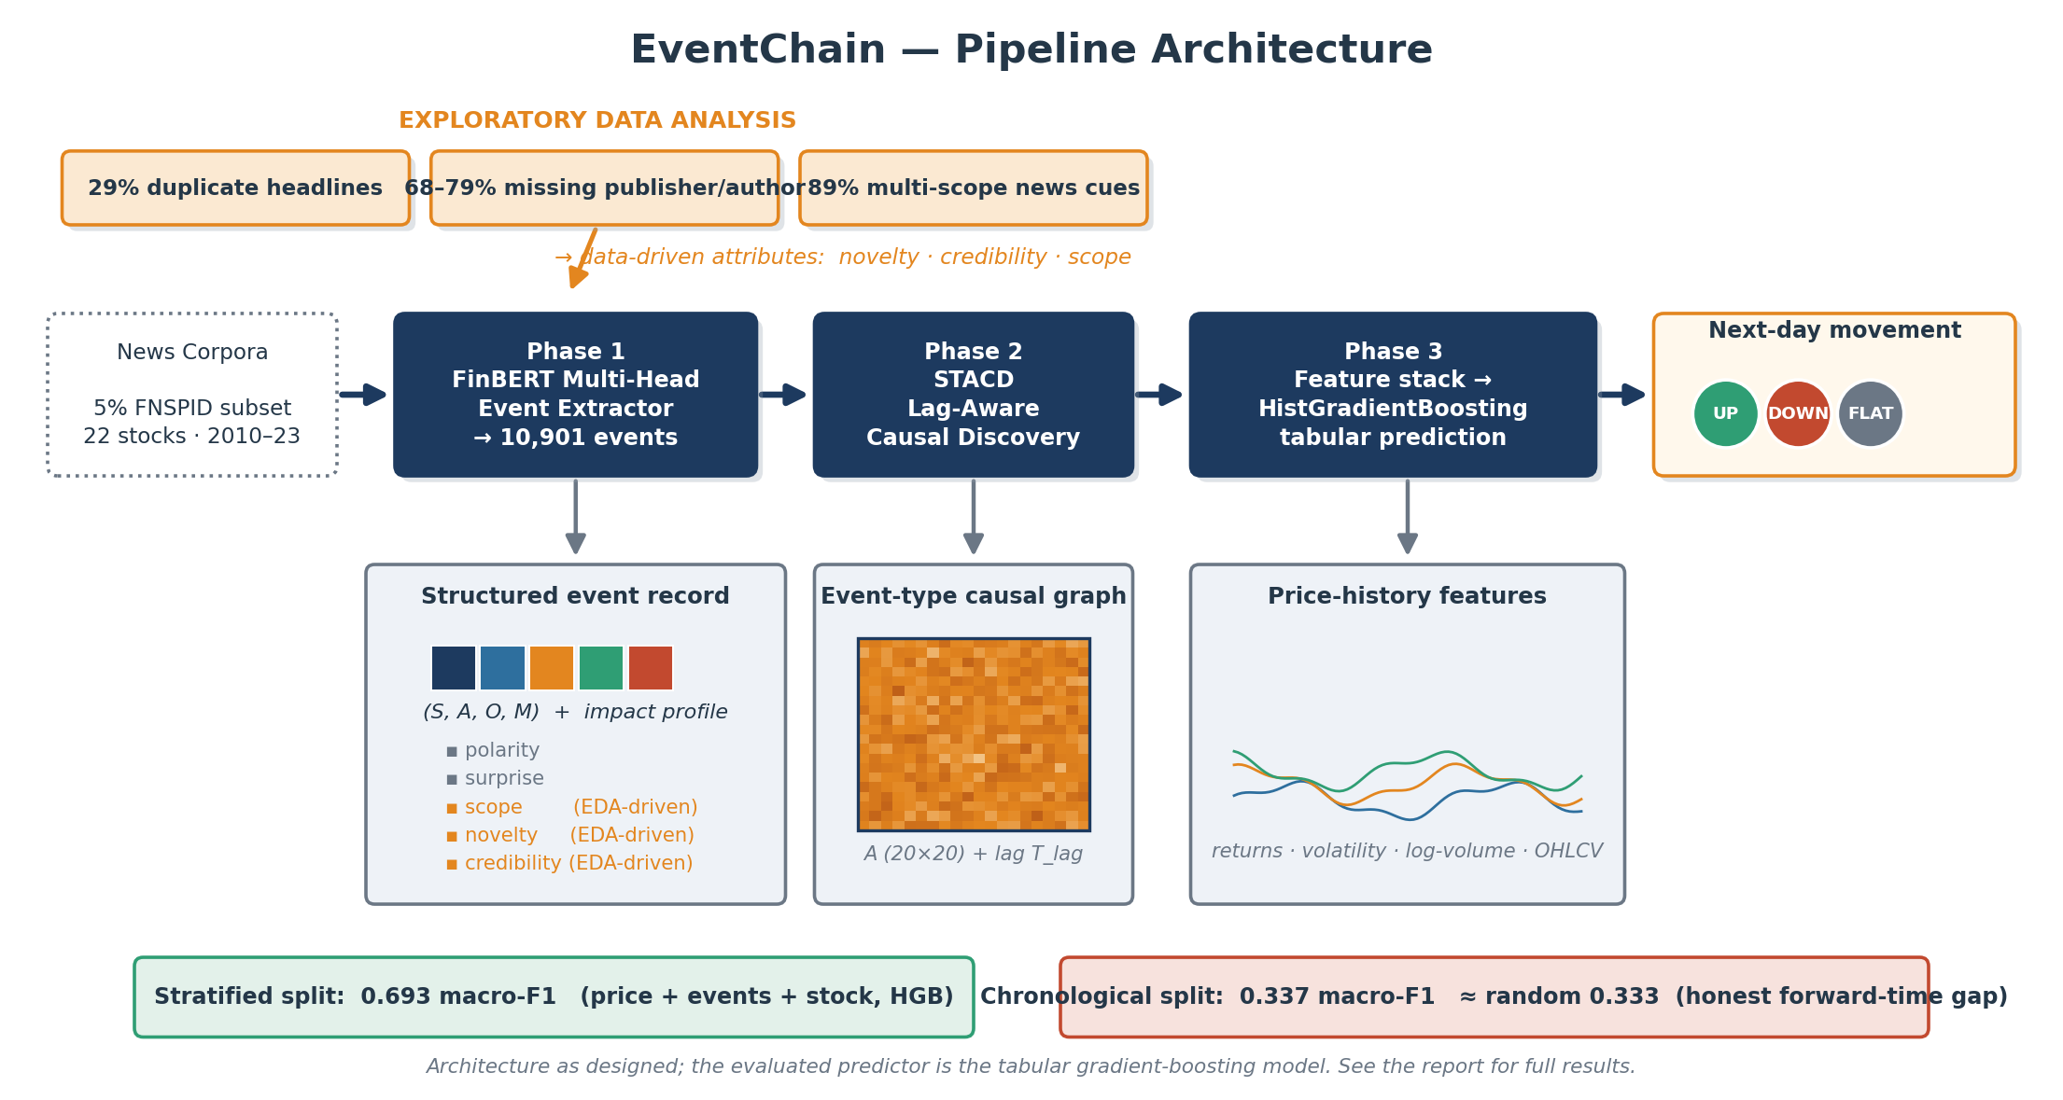
01 · FRAMEWORK
End-to-End Pipeline
Three stages: extract structured events, learn lag-aware event-type structure, predict with a transparent tabular model.
CausalStock · CS173 Data Mining · Team 2
6

Slide 7
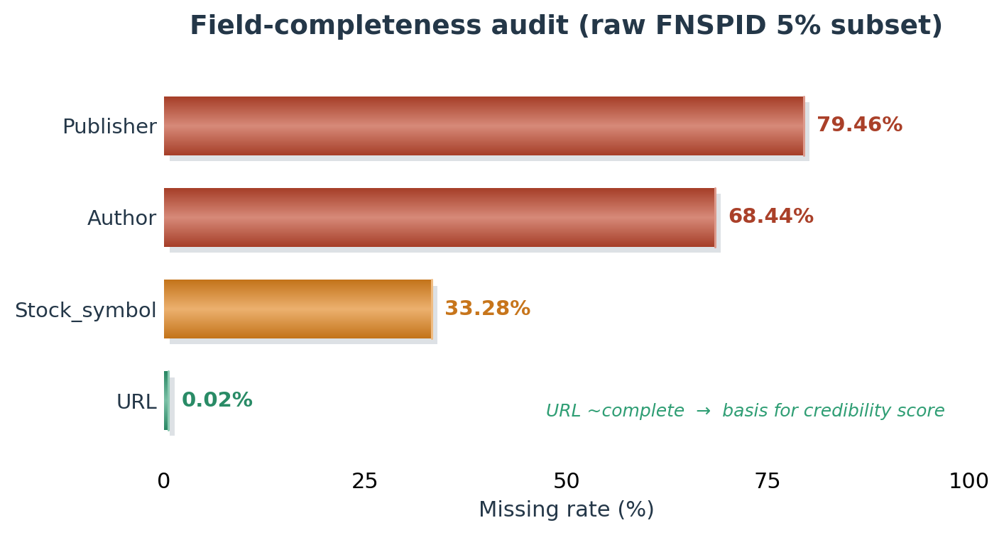
02 · DATA ANALYSIS (1/4)
Dataset Snapshot & Field Completeness
10,901
9,566
22
2010–23
OBSERVATIONS
structured events
ticker-aligned examples
stocks
time span
▪ URL present 99.98%, Stock_symbol 67%, Author 32%, Publisher 21%.
→ publisher / author too sparse to supervise on; credibility instead comes from the URL domain.
▪ Duplicate-headline rows: 36,248 (~29%).
→ the same event reported many times; motivates a novelty attribute.
▪ Article length: median 3,724 / p90 6,949 / p99 29,925 chars.
CausalStock · CS173 Data Mining · Team 2
7

Slide 8
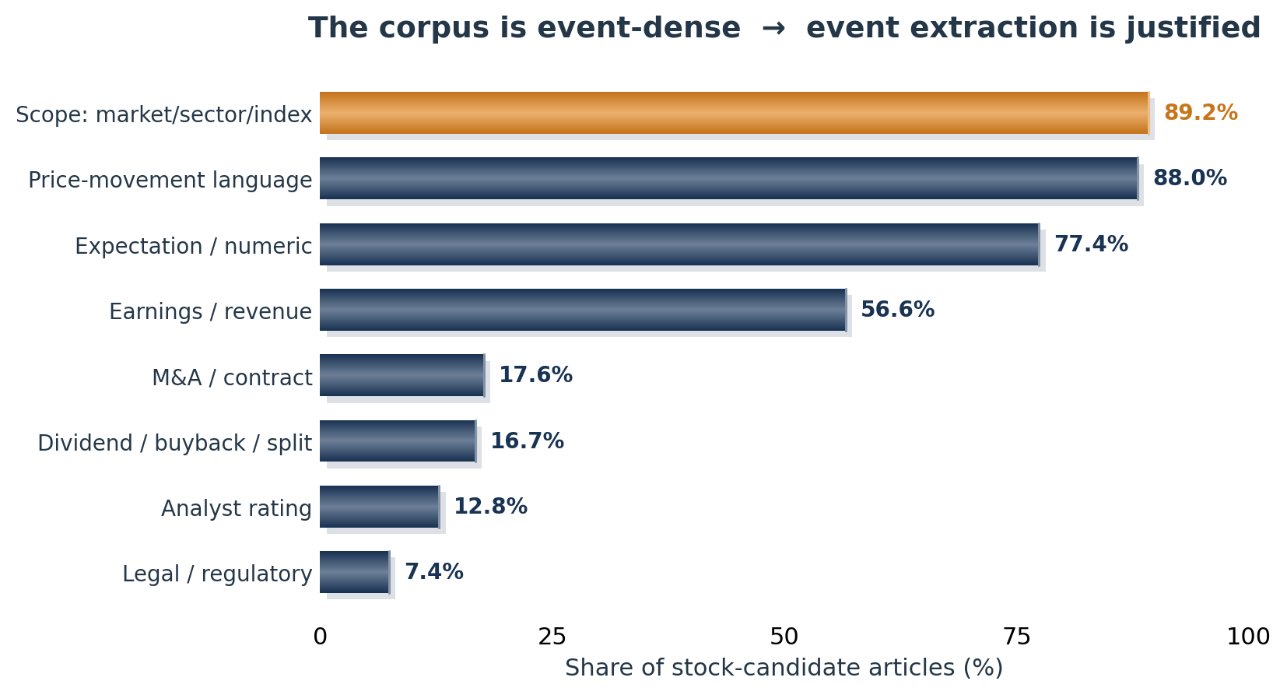
02 · DATA ANALYSIS (2/4)
Event-Clue Density — Why Event Extraction
88% of articles carry explicit price-movement language and 77% a numeric comparison — the corpus is not diffuse opinion but a stream of discrete, typable events. This is the empirical justification for structured event extraction over sentiment scoring.
CausalStock · CS173 Data Mining · Team 2
8

Slide 9
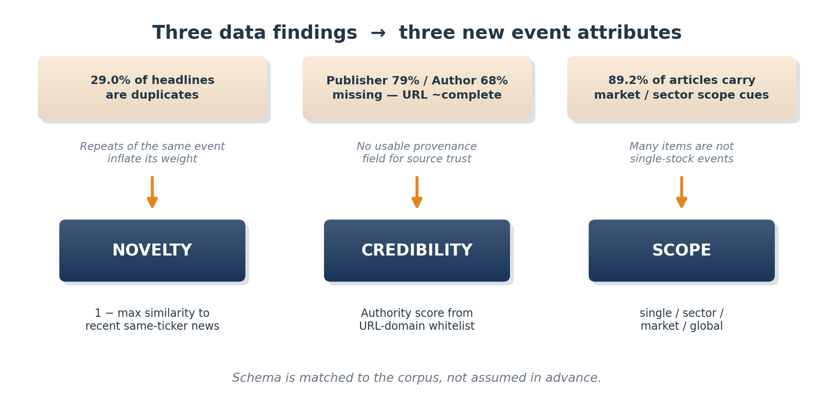
02 · DATA ANALYSIS (3/4)
Data Findings Drive the Schema
Three measured properties — 29% duplicates, 68–79% missing provenance, 89% multi-scope — each motivate one event attribute.
CausalStock · CS173 Data Mining · Team 2
9

Slide 10
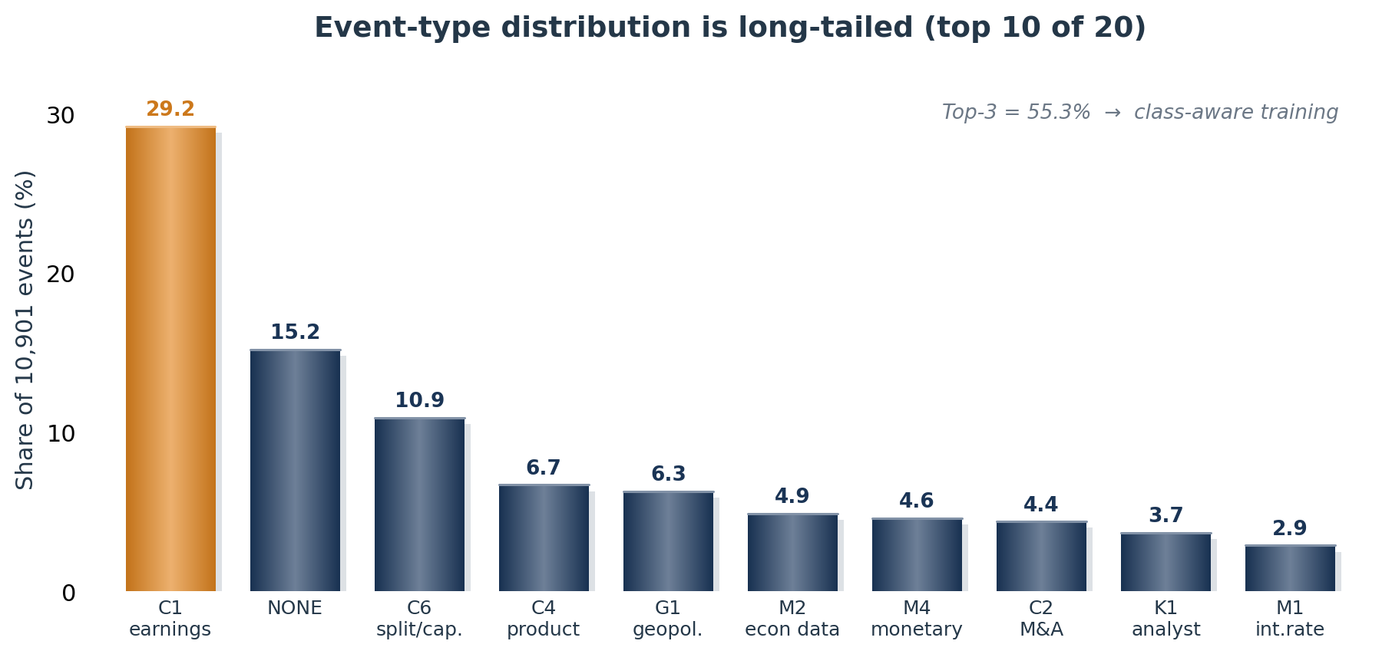
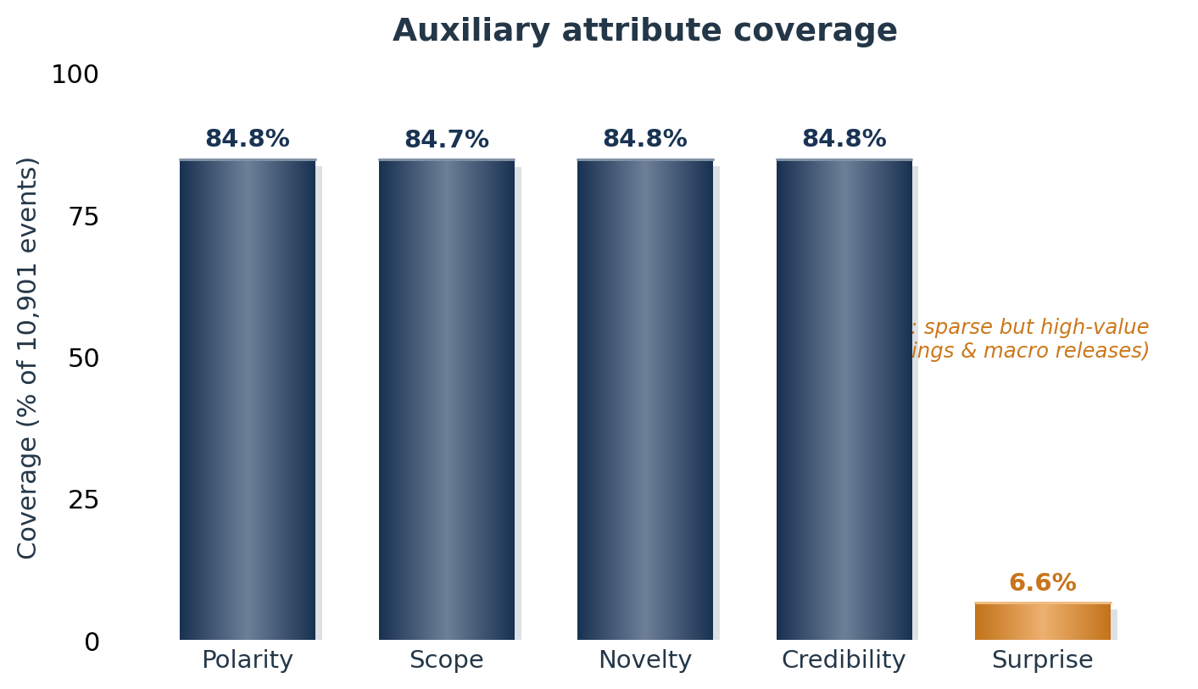
02 · DATA ANALYSIS (4/4)
Event Stream — Distribution & Attribute Coverage
Event types are long-tailed — the top three are 55% of all events, so training must be class-aware. Polarity / scope / novelty / credibility reach ~85% coverage and are used as standard attributes; surprise is sparse (6.6%), treated as a high-value indicator. A 50-sample audit: 84% type, 78% action, 91% polarity agreement.
CausalStock · CS173 Data Mining · Team 2
10

Slide 11
03 · METHOD — PHASE 1 (1/2)
Phase 1 — The Structured Event Schema
Phase 1 turns each free-text article into ONE structured event record — a core quadruple plus a five-attribute impact profile.
EVENT CORE — (type, S, A, O, M)
20-CLASS ONTOLOGY — FOUR FAMILIES
▪ type — one of a 20-class event ontology
▪ subject (S) — the entity that acts
▪ action (A) — the relation or verb
▪ object (O) — the entity affected
▪ magnitude (M) — signed numeric size of the move
▪ Macro — rate decisions, inflation, GDP, jobs
▪ Corporate — earnings, M&A, guidance, products
▪ Knowledge — analyst ratings, research, forecasts
▪ Geopolitics — regulation, sanctions, conflict
IMPACT PROFILE — 5 ATTRIBUTES ATTACHED TO EVERY EVENT
polarity
surprise
scope
novelty
credibility
directional sign
vs. expectation
breadth of entities
first report vs repeat
source reliability
Where used: scope · novelty · credibility are EDA-driven; the profile becomes Phase-3 event features and weights events in the Phase-2 causal aggregation.
CausalStock · CS173 Data Mining · Team 2
11

Slide 12
03 · METHOD — PHASE 1 (2/2)
Phase 1 — Extraction Model & Weak Supervision
A FinBERT encoder with a multi-head decoder, trained on labels built by a four-step weak-supervision pipeline.
MODEL — FinBERT + MULTI-HEAD DECODER
WEAK-SUPERVISION PIPELINE
▪ Encoder — ProsusAI/finbert, pretrained on financial text
▪ Head 1 — event-type classification (20-way softmax)
▪ Head 2 — argument spans (subject / object token spans)
▪ Head 3 — magnitude regression (signed scalar)
▪ Heads share the encoder and are trained jointly
1 — LLM silver label (no gold labels at scale)
2 — rule correction (finance keyword / regex)
3 — market grounding (check M vs realized return)
4 — hallucination filter → accept event
10,901
20
84.8%
84 / 78 / 91%
structured events
event types
avg attribute coverage
audit: type / action / polarity
CausalStock · CS173 Data Mining · Team 2
12

Slide 13
03 · METHOD — PHASE 2 (1/2)
Phase 2 — Lag-Aware Causal Discovery (STACD)
Phase 2 learns the temporal causal structure between the 20 event types — what drives what, and after how long.
GOAL — TWO LEARNED MATRICES
MECHANISM — STACD COMPONENTS
A ∈ (0,1)²⁰ˣ²⁰
▪ Sparse temporal attention
attention over the event sequence, sparsified to keep real links
directed causal strength — A[i,j] = how strongly type i drives type j
▪ Time-direction mask
only the past attends to the future — no leakage backward
T_lag ∈ ℝ²⁰ˣ²⁰
▪ Lag-aware Gaussian gate
expected lag in days between cause and effect
peaks when the observed gap matches the learned T_lag
▪ Causal-strength gate
modulates each attention weight by the learned strength A
Both matrices are learned end-to-end from the event stream.
▪ NOTEARS-style regularizer
an acyclicity penalty that keeps the graph a valid DAG
CausalStock · CS173 Data Mining · Team 2
13

Slide 14
03 · METHOD — PHASE 2 (2/2)
Phase 2 — Attention Modulation & Interpretability
The three gates enter the attention score additively in log-space; the loss adds sparsity and an acyclicity penalty.
ATTENTION MODULATION
TERMS
g_ij = exp( -(|t_i-t_j| - T_lag[k_j,k_i])^2 / 2σ^2 )
▪ s_ij — raw attention score
▪ m_ij — time-direction mask
▪ g_ij — lag-aware Gaussian gate
▪ A — causal-strength matrix
▪ h(A) — DAG acyclicity penalty
s_ij' = s_ij + log m_ij + log g_ij + log A[k_j,k_i]
α_ij = softmax_j ( s_ij' )
L = L_pred + λ1·||A||1 + λ_DAG·h(A)^2
k_j = event type of token j
Why nodes are event types, not stocks
A 20-node event-type graph stays the same across companies and markets, so it is designed to support interpretable, transferable event-chain analysis — a stock-level graph is bound to a fixed company universe.
CausalStock · CS173 Data Mining · Team 2
14

Slide 15
03 · METHOD — PHASE 3 (1/3)
Phase 3 — Problem Setup & Dataset
INPUTS → OUTPUT
THREE-CLASS DISTRIBUTION
▪ 32 recent news events
▪ 30-day OHLCV price window
▪ Target stock identity
▪ Output: next-day direction, threshold ±0.5%
39.4%
43.3%
17.3%
UP
DOWN
FLAT
FLAT is the minority class — macro-F1 is emphasized.
9,566
22
2010–2023
ticker-aligned examples
stocks
time span
CausalStock · CS173 Data Mining · Team 2
15

Slide 16
03 · METHOD — PHASE 3 (2/3)
Phase 3 — Feature Engineering (132-d)
x = [ price ‖ event ‖ stock-ID ] = 132-dimensional feature vector
PRICE · 28-d
EVENT · 82-d
STOCK-ID · 22-d
▪ Multi-horizon returns — 1 / 5 / 10 / 20-day
▪ Realized volatility & ranges
▪ Log-volume & volume trend
▪ OHLC ratios & gaps
▪ Short-term momentum
▪ Per-type event counts (20-d)
▪ Signed magnitude sums per family
▪ Absolute magnitude sums
▪ Impact-profile means — polarity, surprise, scope, novelty, credibility
▪ Last-event type one-hot
▪ One-hot ticker identity
▪ 22 stocks in the universe
▪ Lets the model learn ticker-specific volatility and reaction patterns
Every feature is an aggregate over the 32-event / 30-day window — strictly past information, no look-ahead.
CausalStock · CS173 Data Mining · Team 2
16

Slide 17
03 · METHOD — PHASE 3 (3/3)
Phase 3 — Model: HistGradientBoosting
The classifier over the 132-d vector is HistGradientBoosting (HGB) — a histogram-based gradient-boosted tree ensemble.
WHY HGB OVER A NEURAL NET
CONFIGURATION & TRAINING
▪ Heterogeneous features — counts, ratios, one-hots handled natively
▪ Scale-invariant tree splits — minimal feature engineering
▪ Strong, interpretable baseline — reads each source's contribution
▪ Robust on a 9,566-example dataset — no large-data requirement
▪ max_iter 150 · learning_rate 0.04 · L2 0.05
▪ Early stopping on a held-out validation loss
▪ 3-class softmax output — UP / DOWN / FLAT
▪ macro-F1 as the headline metric (FLAT is the minority class)
▪ Evaluated under both stratified and chronological splits
CausalStock · CS173 Data Mining · Team 2
17

Slide 18
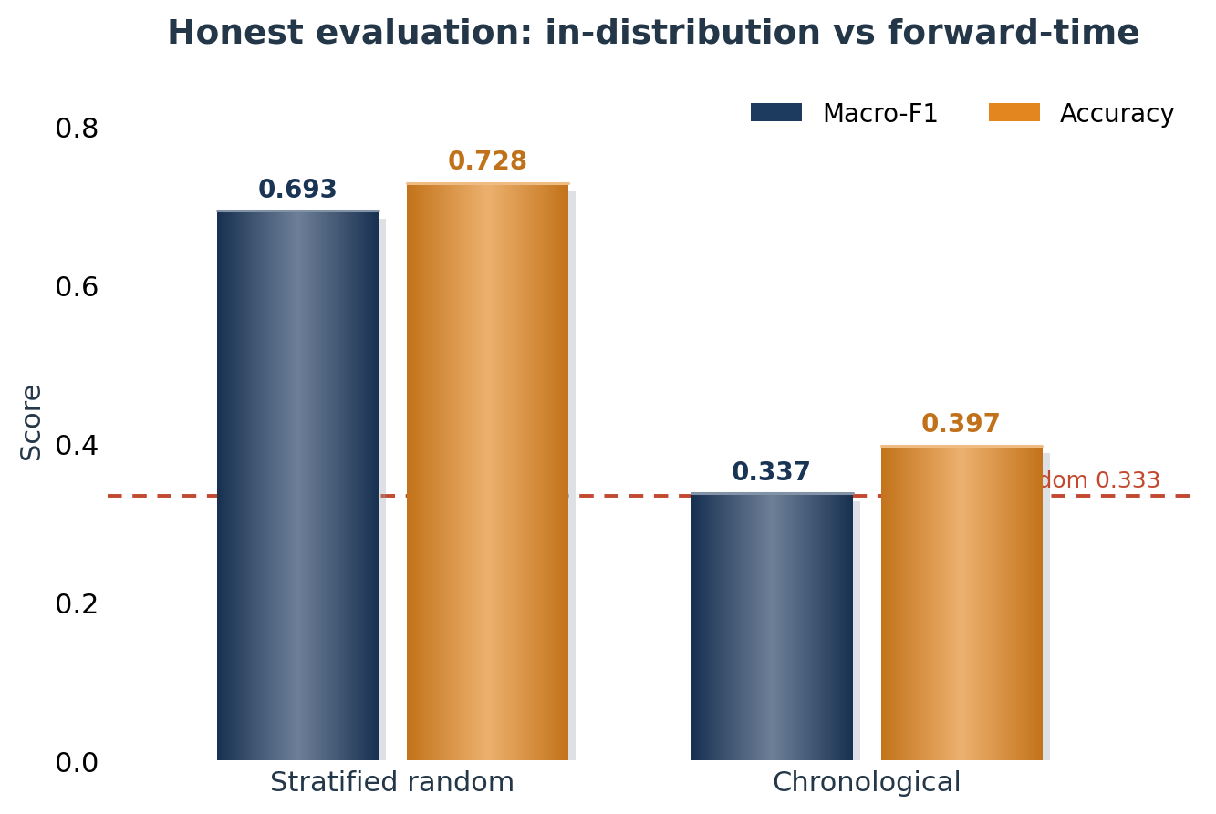
04 · EXPERIMENTS
Key Result — Stratified vs Chronological
TWO HONEST READINGS
▪ Stratified random — macro-F1 0.693, accuracy 0.728. Well above the 0.43 majority and 0.33 random baselines: the features carry signal.
▪ Chronological — macro-F1 0.337. Near random, consistent with semi-strong market efficiency: forward-time prediction is hard.
We report both — reporting only the stratified number would overstate real predictive power.
CausalStock · CS173 Data Mining · Team 2
18

Slide 19
04 · EXPERIMENTS
Ablation — Feature-Group Contribution
Stratified-random macro-F1 for the combined-feature models:
Feature set | Dim. | Macro-F1
Price + events | 110 | 0.684
Full: price + events + stock ID | 132 | 0.693
Reading
▪ Adding stock identity lifts macro-F1 from 0.684 to 0.693 — ticker-specific volatility and reaction patterns remain useful.
▪ The combined representation is learnable under a stratified split — it is the configuration we report.
CausalStock · CS173 Data Mining · Team 2
19

Slide 20
05 · COMPARISON
Comparison with the Baseline — Multi-Axis
Axis | CausalStock (NeurIPS 2024) | Ours
Causality level | Stock-level graph | Event-type graph (20×20)
News representation | Dense denoised embedding | Structured event + impact profile
Prediction task | Binary up / down | 3-class with a ±0.5% FLAT zone
Evaluation protocol | Mostly random split | Stratified + chronological
Data scale | Larger, multi-dataset | 5% FNSPID subset, 22 stocks
Complementary, not competing — event-type causality transfers across companies and markets; stock-level causality is bound to a fixed company universe.
CausalStock · CS173 Data Mining · Team 2
20

Slide 21
05 · COMPARISON
Comparison — An Interpretable Reading of the Gap
Our setup is harder and stricter than the baseline's — the gap is explainable along four axes:
We predict 3 classes with a ±0.5% FLAT dead zone; the baseline predicts binary up/down. FLAT is the hard minority class.
Task
A 5% FNSPID subset over 22 stocks — far smaller; cross-stock relational signal is limited at this scale.
Data
Our directly comparable number is the chronological one; a random split mixes market regimes and inflates apparent performance.
Protocol
The baseline couples news with a price-derived causal backbone end-to-end; our evaluated layer is a transparent tabular model over aggregated event statistics — interpretable but lossier.
Method
We do not claim to beat the baseline — we contribute a transferable event-type formulation and a stricter, honest evaluation.
CausalStock · CS173 Data Mining · Team 2
21

Slide 22
05 · CONCLUSION
Conclusion & Future Work
WHAT WE CONTRIBUTE
FUTURE WORK
▪ A clearer event-structured problem formulation.
▪ An EDA-driven event schema — attributes earned from measured data.
▪ A mathematically specified lag-aware event-causal model.
▪ An honest analysis separating information content from forward-time predictability.
▪ Integrate A and T_lag directly as Phase-3 features.
▪ Model cross-stock event propagation.
▪ Regime-aware temporal encoding against distribution shift.
▪ Rolling walk-forward validation as the default protocol.
We do not claim solved stock prediction — we claim a clean formulation and an honest study of where structured news helps.
CausalStock · CS173 Data Mining · Team 2
22

Slide 23
THANK YOU
Q & A
Q & A — Thank you for listening
CausalStock · CS173 Data Mining Final · Team 2
CausalStock · CS173 Data Mining · Team 2
23

