Slide 1
CS173 · DATA MINING · FINAL PROJECT
CausalStock
Event-Structured Temporal Causal Modeling for News-Driven Stock Prediction
Data-driven
Structured
Honest
3 EDA findings → 3 new event attributes
20-class events instead of one sentiment score
stratified + chronological dual reporting
Team 2 · CS173 Final Project · May 2026

Slide 2
AGENDA
Roadmap
01
Problem & Innovation
What prior methods get wrong, and the three things we change
02
Framework & Data
The three-stage pipeline; exploratory data analysis that drives the schema
03
Method
Phase 1 event extraction · Phase 2 causal discovery · Phase 3 prediction
04
Experiments & Conclusion
Results, ablation, comparison, and an honest read
CausalStock · CS173 Data Mining · Team 2
2

Slide 3
01 · PROBLEM
What Prior Methods Get Wrong
Most news-driven models compress each article into one sentiment score. Three things break:
1. Information Loss
"Apple launches a new iPhone, outlook +20%" → sentiment +0.8
A single sentiment score discards the event's type, magnitude, and affected entity.
2. Lack of Causality
Cannot tell a rate hike acting directly vs. via lowered earnings.
Models capture surface correlation, not the logic between events, and cannot explain a prediction.
3. Ignoring Temporal Dynamics
A policy change may surface in prices only days or weeks later.
A news impact is treated as instantaneous — missing lag, diffusion, and gradual effects.
CausalStock · CS173 Data Mining · Team 2
3

Slide 4
01 · INNOVATION
What We Change — Three Innovations
Each prior-method problem maps to one design change in CausalStock:
Prior-method problem | CausalStock innovation
Information loss (sentiment scalar) | Structured event: (subject, action, object, magnitude) + impact profile
Lack of causality | Lag-aware causal discovery over 20 event types — a transferable graph
Ignoring temporal dynamics | A learned lag matrix T_lag and lag-gated attention
Two principles cut across all three:
Data-driven — the event schema is earned from a measured EDA of the corpus, not assumed. Honest — every result is reported under both a stratified and a chronological split.
CausalStock · CS173 Data Mining · Team 2
4

Slide 5
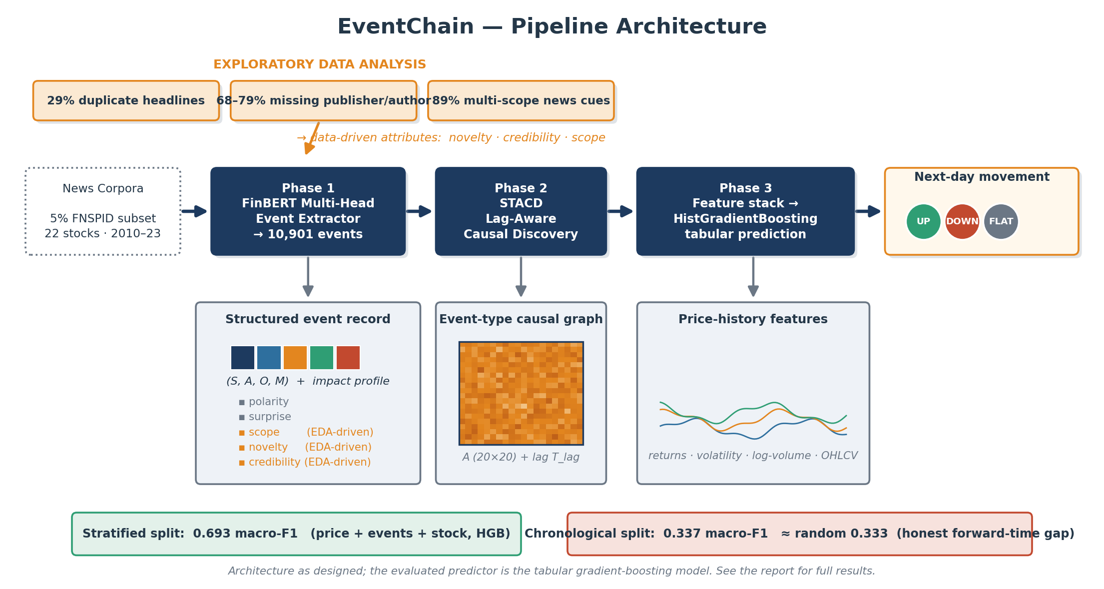
01 · FRAMEWORK
End-to-End Pipeline
Three stages: extract structured events, learn lag-aware event-type structure, predict with a transparent tabular model.
CausalStock · CS173 Data Mining · Team 2
5

Slide 6
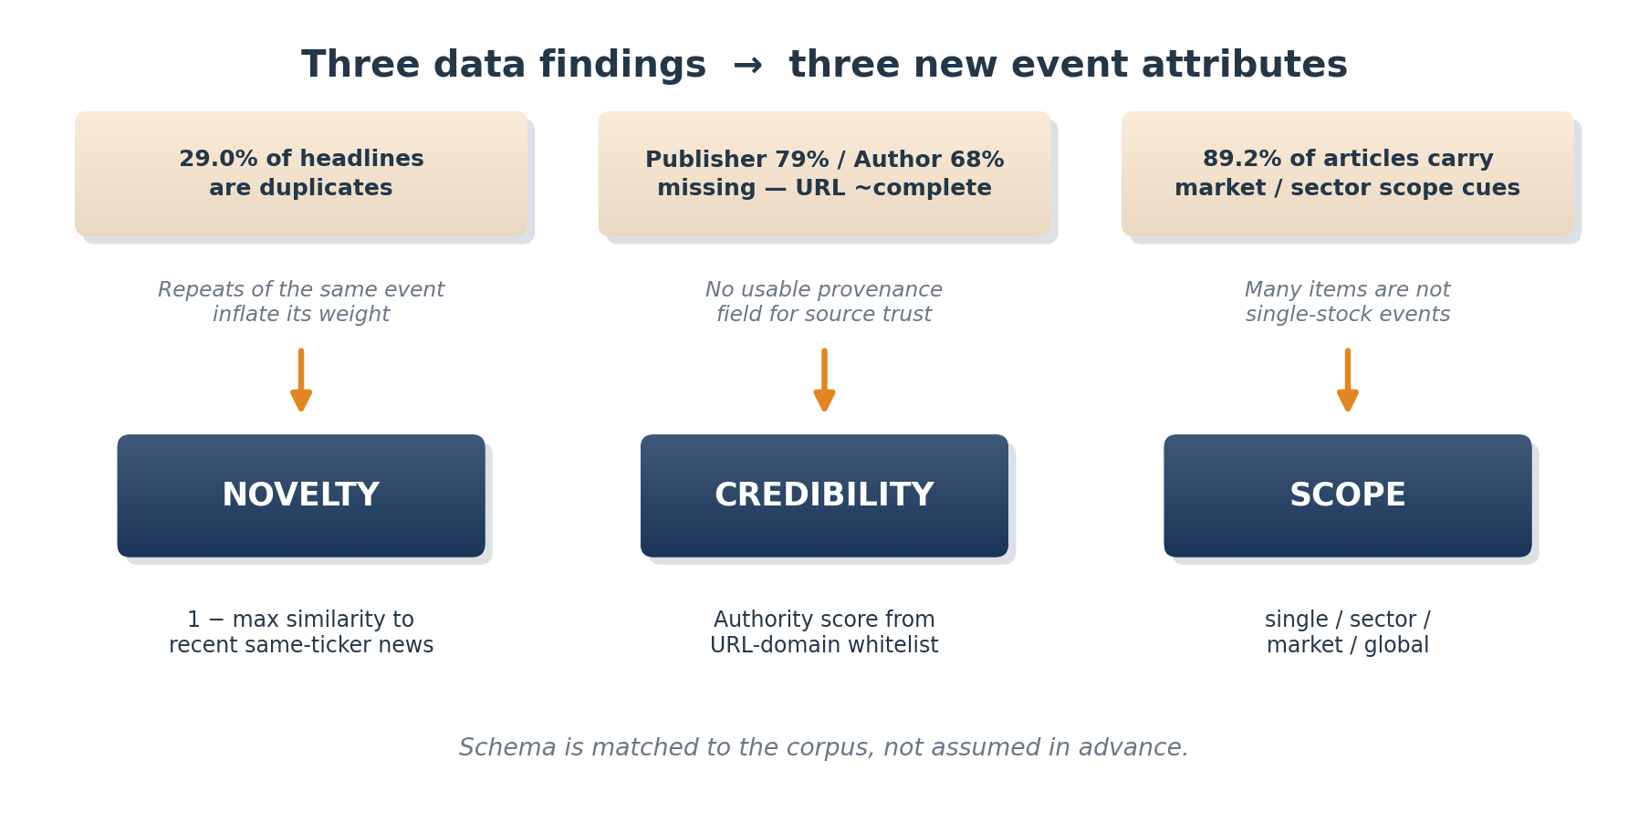
02 · DATA
Exploratory Data Analysis — The Data Drives the Schema
We profiled the raw FNSPID 5% subset before fixing the schema:
88% of articles carry price-movement language and 77% a numeric comparison — the corpus is event-dense, so structured event extraction is justified over sentiment scoring. Three further findings each motivate one attribute:
CausalStock · CS173 Data Mining · Team 2
6

Slide 7
03 · METHOD — PHASE 1
Phase 1 — Structured Event Extraction
STRUCTURED EVENT
FinBERT + MULTI-HEAD DECODER
▪ e = (type, subject, object, magnitude)
▪ 20-class event ontology (Macro / Corporate / Knowledge / Geopolitical)
▪ + impact profile: polarity, surprise, scope, novelty, credibility
▪ Encoder: ProsusAI/finbert for financial text
▪ Three heads: event-type, argument spans, magnitude
▪ Weak supervision: LLM silver labels + rule/market corrections
10,901
20
84.8%
ProsusAI
structured events
event types
avg attribute coverage
finbert encoder
CausalStock · CS173 Data Mining · Team 2
7

Slide 8
03 · METHOD — PHASE 2
Phase 2 — Lag-Aware Causal Discovery (STACD)
GOAL — TWO MATRICES
ATTENTION MODULATION
▪ A ∈ (0,1)²⁰ˣ²⁰ — directed event-type strength
▪ T_lag — expected lag, in days
g_ij = exp( −(|t_i−t_j| − T_lag[k_j,k_i])² / 2σ² )
s̃_ij = s_ij + log m_ij + log g_ij + log A[k_j,k_i]
MECHANISM — STACD
▪ Sparse temporal attention
▪ Time-direction mask — only past attends to future
▪ Lag-aware Gaussian gate + causal-strength gate
▪ NOTEARS-style acyclicity (DAG) regularizer
α_ij = softmax_j ( s̃_ij )
L = L_pred + λ₁‖A‖₁ + λ_DAG · h(A)²
Nodes are event types, not stocks — the resulting graph is designed to support interpretable, transferable event-chain analysis.
CausalStock · CS173 Data Mining · Team 2
8

Slide 9
03 · METHOD — PHASE 3
Phase 3 — Problem Setup & Dataset
INPUTS → OUTPUT
THREE-CLASS DISTRIBUTION
▪ 32 recent news events
▪ 30-day OHLCV price window
▪ Target stock identity
▪ Output: next-day direction, threshold ±0.5%
39.4%
43.3%
17.3%
UP
DOWN
FLAT
FLAT is the minority class — macro-F1 is emphasized.
9,566
22
2010–2023
ticker-aligned examples
stocks
time span
CausalStock · CS173 Data Mining · Team 2
9

Slide 10
03 · METHOD — PHASE 3
Phase 3 — Feature Engineering & Model
x = [ price ‖ event ‖ stock-ID ] — a 132-dimensional vector
Price 28-d
Event 82-d
Stock 22-d
returns, volatility, log-volume, OHLC
type counts, signed/abs magnitude, last type
one-hot ticker identity
Why HistGradientBoosting (HGB) over a neural net?
▪ Heterogeneous features — handles counts, ratios, and one-hots natively.
▪ Strong, interpretable baseline — quantifies each source's contribution.
▪ Scale-invariant tree splits — minimal feature engineering.
▪ Configuration: max_iter 150 · learning_rate 0.04 · l2 0.05.
CausalStock · CS173 Data Mining · Team 2
10

Slide 11
03 · METHOD — PHASE 3
Phase 3 — Feature Detail
PRICE FEATURES (28-d)
EVENT FEATURES (82-d)
▪ Daily returns — 10
▪ Return statistics (mean, std, 5-day) — 4
▪ Log-volume statistics — 2
▪ Relative OHLC summaries — 12
▪ Per-type event counts — 20
▪ Signed magnitude sums — 20
▪ Absolute magnitude sums — 20
▪ Last-event one-hot — 20
▪ Global magnitude statistics — 2
CausalStock · CS173 Data Mining · Team 2
11

Slide 12
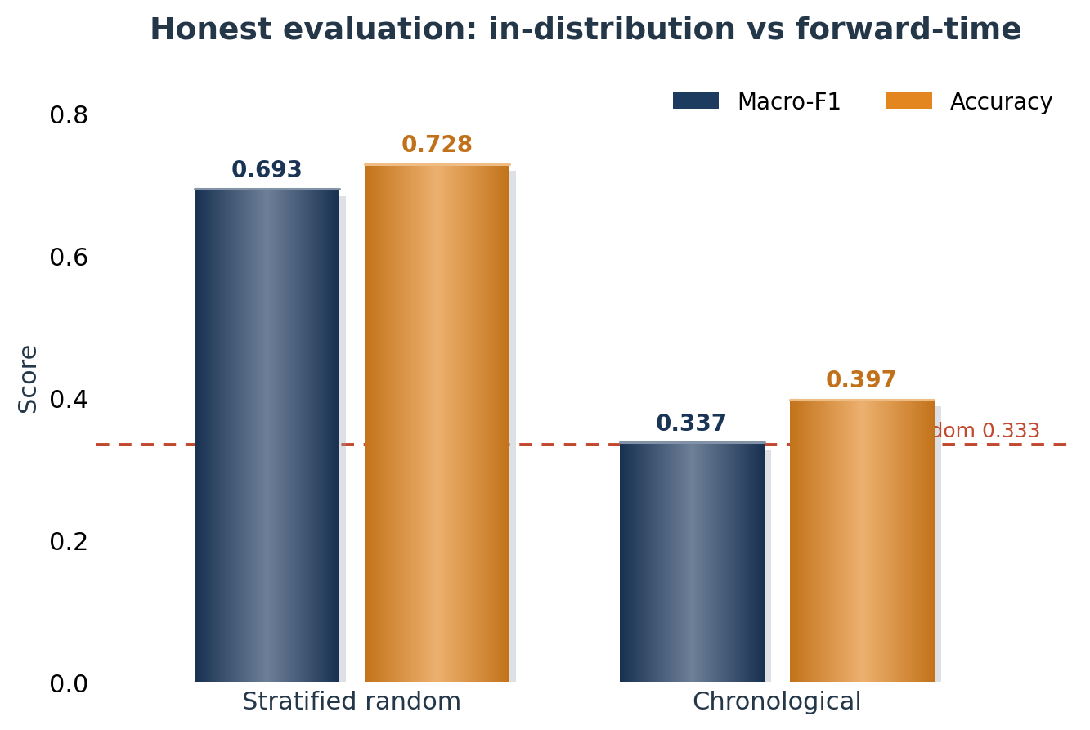
04 · EXPERIMENTS
Key Result — Stratified vs Chronological
TWO HONEST READINGS
▪ Stratified random — macro-F1 0.693, accuracy 0.728. Well above the 0.43 majority and 0.33 random baselines: the features carry usable signal.
▪ Chronological — macro-F1 0.337. Near random, consistent with semi-strong market efficiency: forward-time prediction is genuinely hard.
We report both splits — reporting only the stratified number would overstate real-world predictive power.
CausalStock · CS173 Data Mining · Team 2
12

Slide 13
04 · EXPERIMENTS
Ablation — Feature-Group Contribution
Stratified-random macro-F1 for the combined-feature models:
Feature set | Dim. | Macro-F1
Price + events | 110 | 0.684
Full model: price + events + stock ID | 132 | 0.693
Reading
▪ Adding stock identity lifts macro-F1 from 0.684 to 0.693 — ticker-specific volatility and reaction patterns remain useful.
▪ The combined price-event-stock representation is learnable under a stratified split; it is the configuration we report.
CausalStock · CS173 Data Mining · Team 2
13

Slide 14
04 · EXPERIMENTS
Comparison with the NeurIPS 2024 CausalStock
Axis | CausalStock (NeurIPS 2024) | Ours
Causality level | Stock-level graph | Event-type graph (20×20)
News representation | Dense denoised embedding | Structured event + impact profile
Prediction task | Binary up / down | 3-class with a ±0.5% FLAT zone
Evaluation | Mostly random split | Stratified + chronological
Complementary, not competing
Event-type causality transfers across companies and markets; stock-level causality is bound to a fixed company universe. We evaluate on a stricter, dual-split protocol.
CausalStock · CS173 Data Mining · Team 2
14

Slide 15
04 · CONCLUSION
Conclusion & Future Work
WHAT WE CONTRIBUTE
FUTURE WORK
▪ A clearer event-structured problem formulation.
▪ An EDA-driven event schema — three attributes earned from measured data.
▪ A mathematically specified lag-aware event-causal model.
▪ An honest analysis separating in-distribution information content from forward-time predictability.
▪ Integrate A and T_lag directly as Phase-3 features.
▪ Model cross-stock event propagation.
▪ Regime-aware temporal encoding against distribution shift.
▪ Rolling walk-forward validation as the default protocol.
We do not claim solved stock prediction — we claim a clean formulation and an honest study of where structured news helps.
CausalStock · CS173 Data Mining · Team 2
15

Slide 16
THANK YOU
Q & A
Q & A — Thank you for listening
CausalStock · CS173 Data Mining Final · Team 2
CausalStock · CS173 Data Mining · Team 2
16

