Slide 1
CS173 · DATA MINING · FINAL PROJECT
EventChain
Structured Event-Chain Modeling for News-Driven Stock Prediction
数据驱动的结构化事件链建模
Data-driven
Interpretable
Honest
3 EDA findings → 3 new event attributes
structured events + transparent tabular model
stratified + chronological dual reporting
Team 2 · CS173 Final Project · May 2026

Slide 2
AGENDA
Roadmap
01
Data & Problem
FNSPID task; the CausalStock (NeurIPS'24) baseline and its gap
02
EDA
Missingness, headline duplication, event-clue density
03
Method
Structured events + lag-aware event-type causal discovery
04
Experiments
Attribute coverage, ablation, stratified vs chronological
05
Discussion
Limits, what we learned, future work
EventChain · CS173 Data Mining · Team 2
2

Slide 3
01 · PROBLEM
Task: News-Driven Stock Movement Prediction
SETUP
CLASS DISTRIBUTION (3-class, imbalanced)
▪ Input: 32 recent events + 30-day OHLCV + ticker ID
▪ Output: next-day direction — UP / DOWN / FLAT
▪ Decision threshold δ = 0.5%
▪ Dataset: 5% FNSPID subset · 22 stocks · 2010–2023
39.4%
43.3%
17.3%
UP
DOWN
FLAT
FLAT is the hard minority class — central to the honest evaluation.
Why it is hard
A news item is not a standalone signal: a rate hike triggers a chain — credit tightening → tech-sector revaluation → supply-chain cooling — over hours to weeks. Sentiment scores collapse this structure.
EventChain · CS173 Data Mining · Team 2
3

Slide 4
01 · BASELINE
Baseline — CausalStock (NeurIPS 2024)
What it does
Denoised news encoder
An LLM compresses each article into one dense embedding vector.
Stock-level causal graph
Lag-dependent causality is learned between stocks (s₁ ↔ s₂).
Two blind spots — and our response
Baseline blind spot | EventChain response
One vector per article hides event type, magnitude, affected entity | Structured event: (S, A, O, M) + impact profile
Stock-level graph cannot say what kind of event drove a link | Causal graph over 20 event types, transferable across firms
Takeaway: the baseline is strong but structure-blind — EventChain restores event structure and moves causality to the transferable event-type level.
EventChain · CS173 Data Mining · Team 2
4

Slide 5
01 · POSITIONING
EventChain vs CausalStock — Every Choice Is Data-Justified
Dimension | CausalStock (baseline) | EventChain (ours) | Data evidence
News representation | Denoised dense embedding | (S,A,O,M) + impact profile | 88% price / 77% numeric cues
Causal graph nodes | Stock-level (22×22) | Event-type level (20×20) | long-tailed event distribution
Source trust | — | URL-domain credibility | Publisher 79% / Author 68% missing
Repetition | — | Novelty attribute | 29% duplicate headlines
Multi-stock news | implicit | explicit Scope attribute | 89.2% multi-scope cues
Evaluation | mostly random split | stratified + chronological | 0.69 → 0.34 temporal drift
Core claim: every method choice in EventChain is justified by a specific, measured finding in the FNSPID data.
EventChain · CS173 Data Mining · Team 2
5

Slide 6
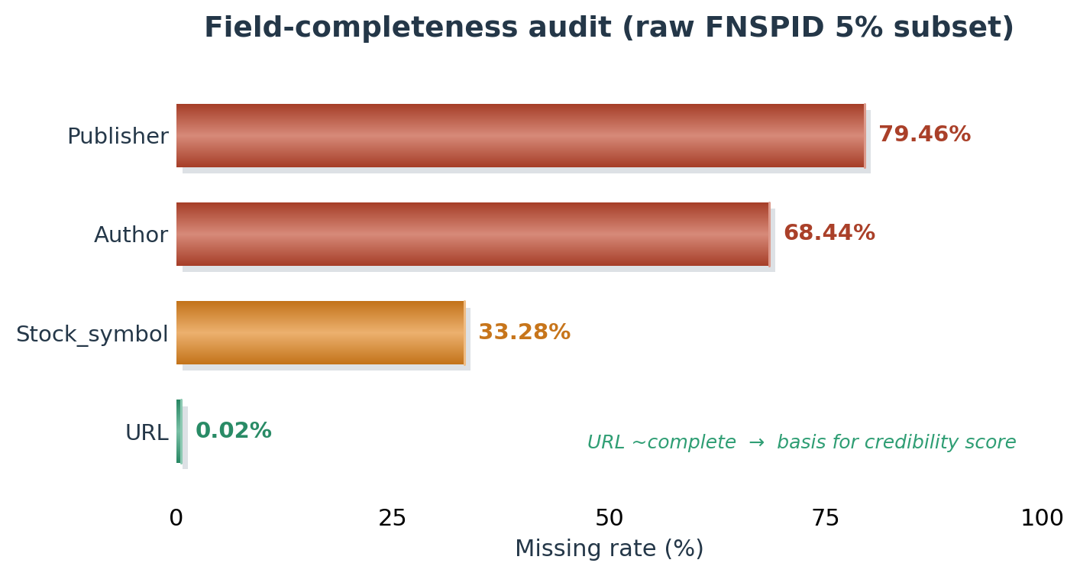
02 · EDA (1/2)
Dataset Snapshot & Missingness Audit
10,901
9,566
22
2010–23
OBSERVATIONS
structured events
ticker-aligned examples
stocks
time span
▪ Publisher 79% / Author 68% missing — cannot be used as supervision.
▪ URL missing only 0.02% — a clean, near-complete signal.
→ derive a credibility score from the URL domain
▪ Duplicate headlines 29.0% — the same event reported many times.
→ first report carries peak impact; repeats decay → novelty
EventChain · CS173 Data Mining · Team 2
6

Slide 7
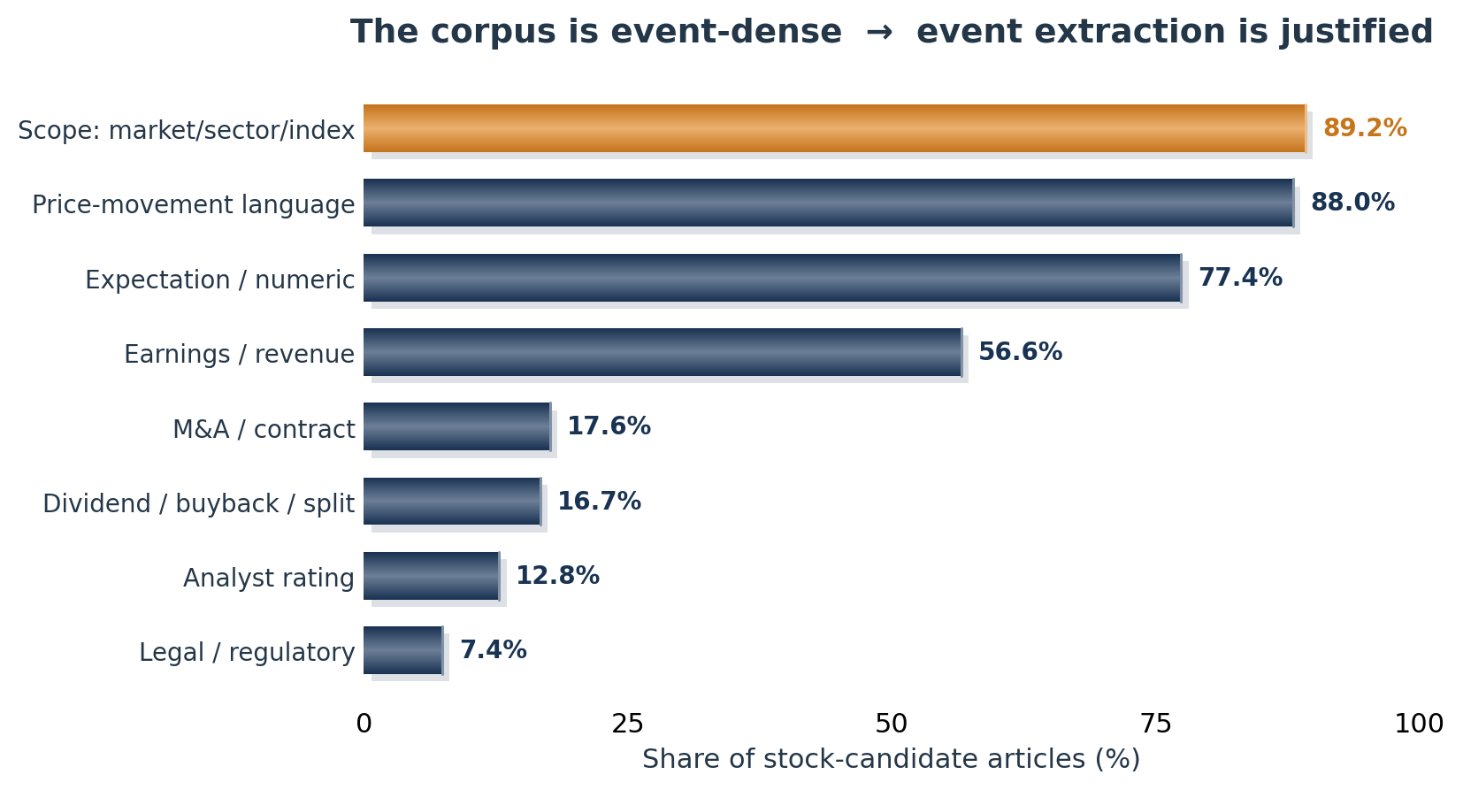
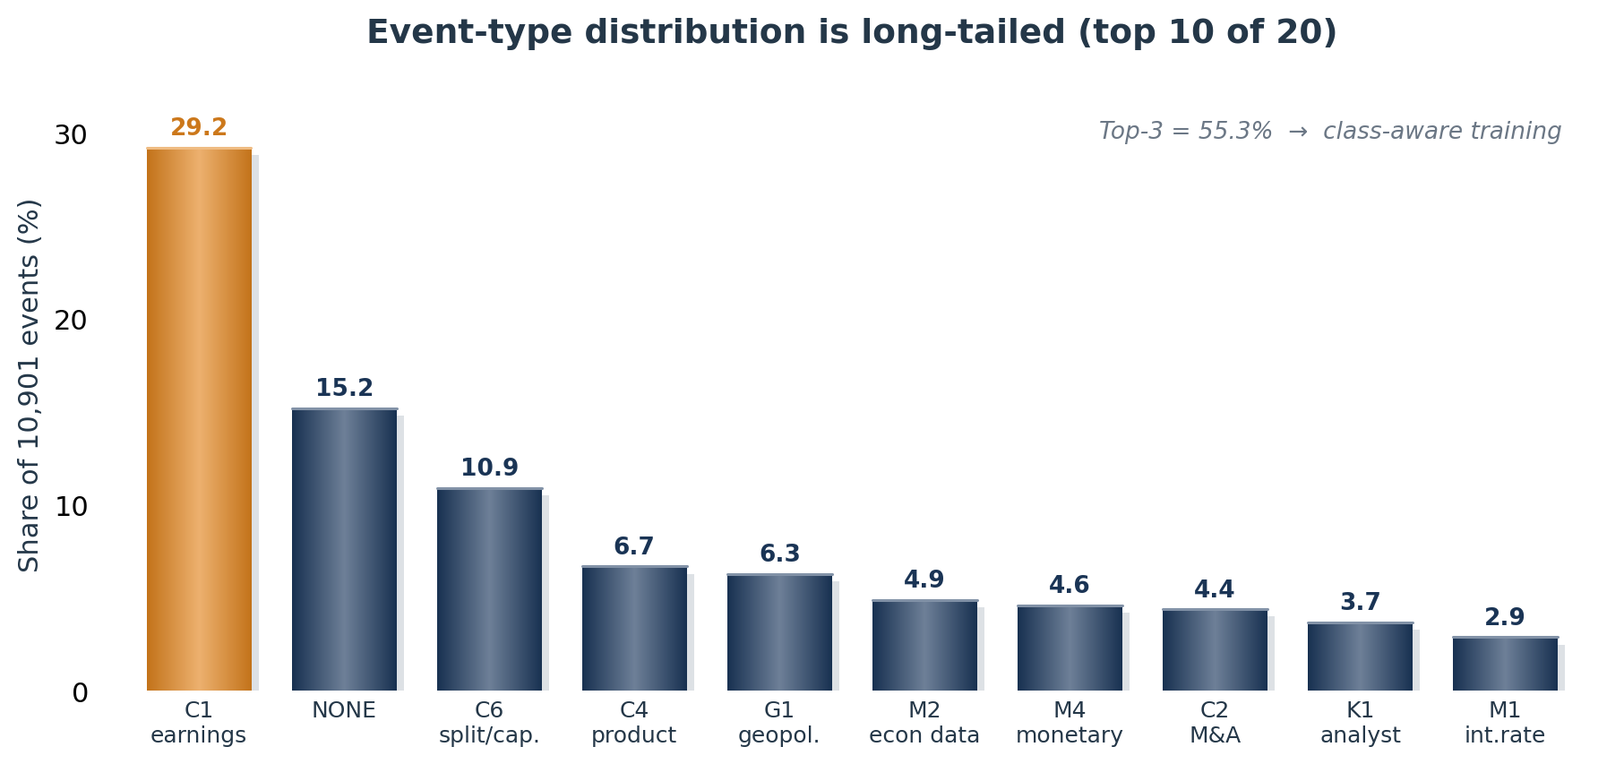
02 · EDA (2/2)
Event Density & Long-Tailed Distribution
Two design drivers:
(1) the corpus is event-dense (88% price, 77% numeric cues) → a structured event representation is justified over sentiment; (2) event types are long-tailed (top-3 = 55%) → class-aware training.
EventChain · CS173 Data Mining · Team 2
7

Slide 8
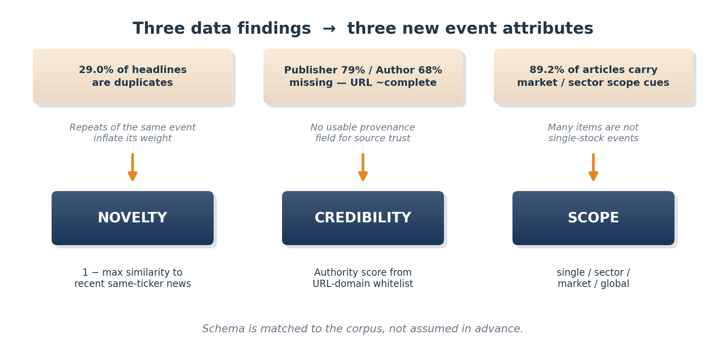
02 · FROM DATA TO DESIGN
The Innovation — Three Findings, Three Attributes
Not bolted on: novelty, credibility and scope are each earned from a measured property of the FNSPID corpus.
EventChain · CS173 Data Mining · Team 2
8

Slide 9
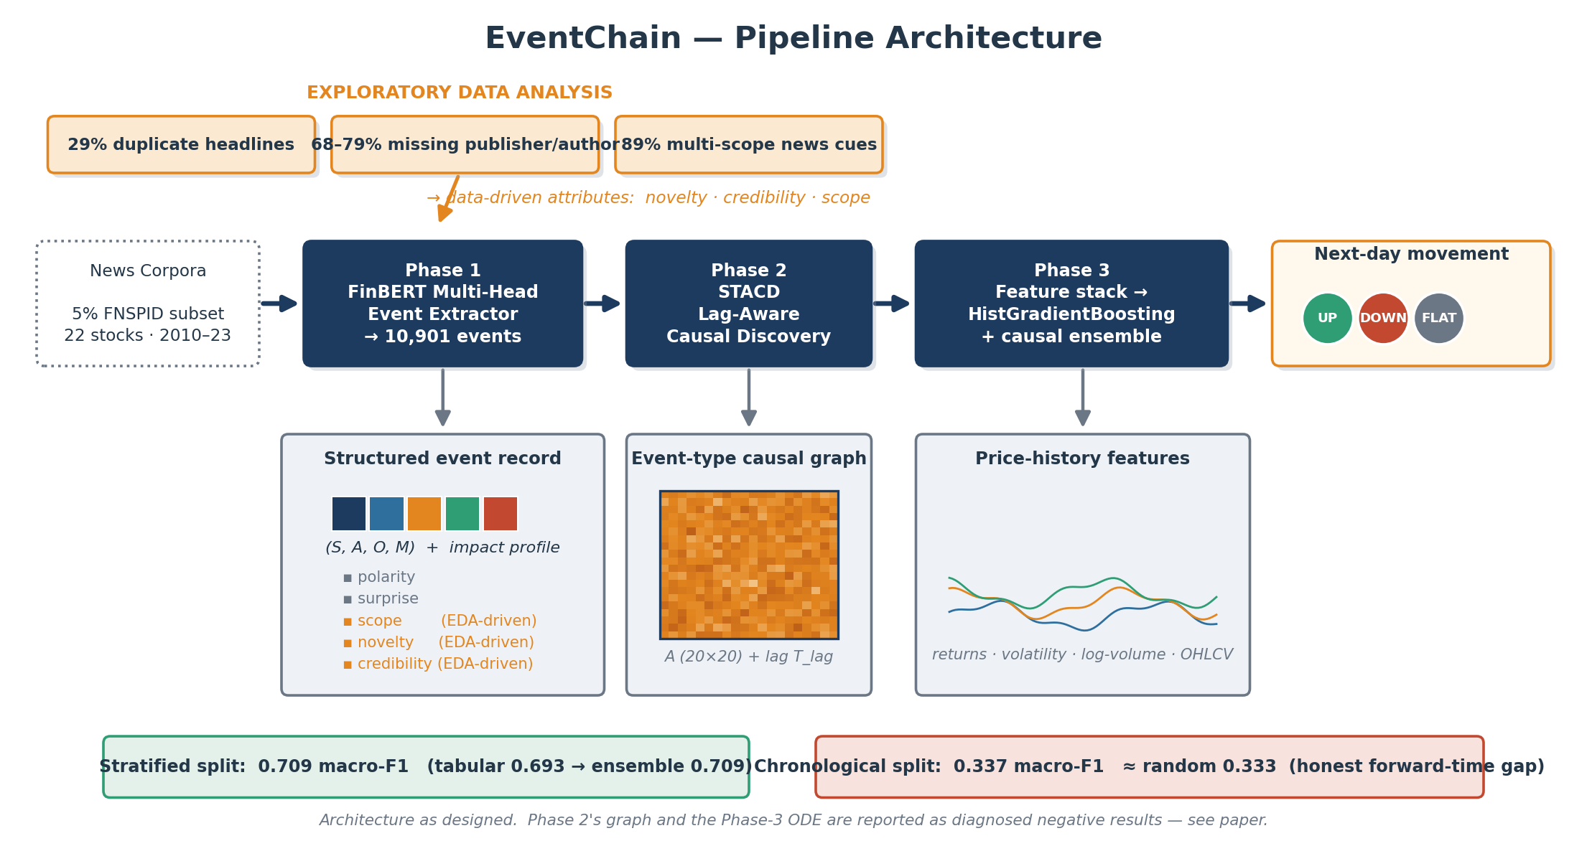
03 · METHOD
End-to-End Framework
EventChain · CS173 Data Mining · Team 2
9

Slide 10
03 · METHOD — PHASE 1
Structured Event Extraction
EXTRACTOR — FinBERT + multi-head decoder
WEAK SUPERVISION + HYBRID CORRECTION
▪ Type head — 20-way event-type softmax
▪ Span heads — subject / object boundaries
▪ Magnitude head — scalar event intensity
▪ Aux heads — scope / novelty / credibility
▪ Silver labels from GPT-4 / DeepSeek
▪ Rule correction for surprise: (actual − expected) / |expected|
▪ Novelty from sentence-embedding similarity
▪ Credibility from a URL-domain whitelist
Event = (Subject, Action, Object, Magnitude) + impact profile { polarity, surprise, scope, novelty, credibility }
10,901
20
4
84.8%
events extracted
event types
decoder heads
avg attr. coverage
EventChain · CS173 Data Mining · Team 2
10

Slide 11
03 · METHOD — PHASE 1
The Three Data-Driven Attributes
Novelty
Decays the weight of repeated reporting; novel = 1.
novelty = 1 − max sim(textᵢ, recent same-ticker news)
Credibility
3-tier domain whitelist; robust to missing Publisher / Author.
credibility = score( domain(URLᵢ) )
Scope
Down-weights ticker assignment when news is not single-stock.
scope ∈ { single, sector, market, global }
EventChain · CS173 Data Mining · Team 2
11

Slide 12
03 · METHOD — PHASE 2
Lag-Aware Event-Type Causal Discovery (STACD)
OBJECTIVE
MECHANISM — sparse temporal attention
▪ A ∈ (0,1)²⁰ˣ²⁰ — directed event-type strength
▪ T_lag ∈ ℝ₊²⁰ˣ²⁰ — expected delay (days)
gᵢⱼ = exp( −(|tᵢ−tⱼ| − T_lag[kⱼ,kᵢ])² / 2σ² )
s̃ᵢⱼ = sᵢⱼ + log mᵢⱼ + log gᵢⱼ + log A[kⱼ,kᵢ]
DESIGN CHOICES
▪ Time-direction mask — only past attends to future
▪ Gaussian lag gate — attention peaks at the learned lag
▪ Causal-strength gate — type-pair prior in log-space
▪ DAG regularization — NOTEARS acyclicity
αᵢⱼ = softmaxⱼ ( s̃ᵢⱼ )
L = L_pred + λ₁‖A‖₁ + λ_DAG · h(A)²
h(A) = tr( e^{A⊙A} ) − K (NOTEARS)
Nodes are event types, not stocks — the graph transfers across companies.
EventChain · CS173 Data Mining · Team 2
12

Slide 13
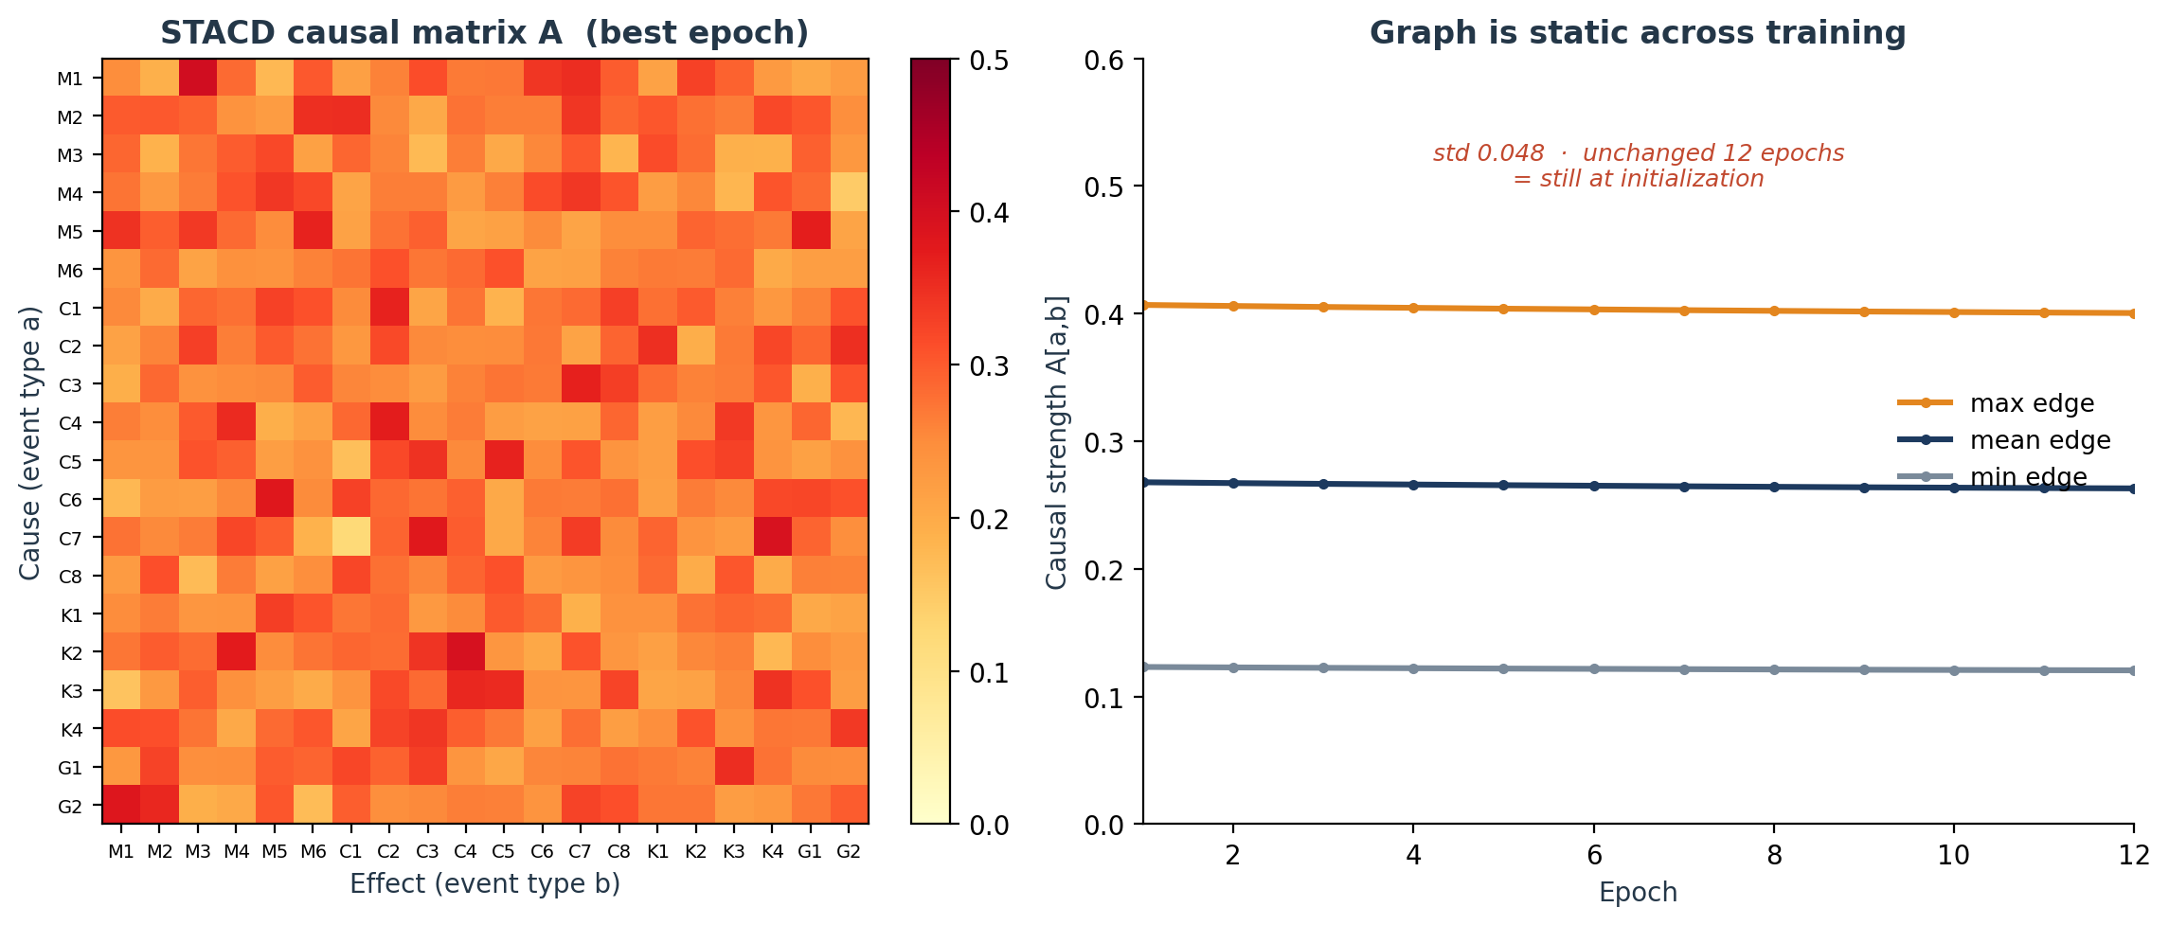
03 · METHOD — PHASE 2
Phase 2 Result — The Causal Graph Did Not Learn
STACD trained 12 epochs on 9,527 real event sequences — a clear, honestly-reported negative result:
DIAGNOSED NEGATIVE RESULT
▪ Trained A: mean 0.267, std 0.048 — identical to its initialization (0.269 / 0.048).
▪ Across 12 epochs A barely moves (mean change 0.005 per entry).
▪ STACD prediction head ≈ 0.5 (random) — almost no gradient reaches the graph.
→ same weak forward signal as the chronological collapse
Honest takeaway: end-to-end causal discovery is not identifiable on a low-signal target — next step: estimate the graph from observed lagged co-occurrence.
EventChain · CS173 Data Mining · Team 2
13

Slide 14
03 · METHOD — PHASE 3
Prediction Layer
FEATURE STACK — 132-dimensional vector
Price 28-d
Event 82-d
Stock 22-d
returns, volatility, log-volume, OHLC
type counts, signed/abs magnitude, last type
one-hot ticker identity
WHY HISTGRADIENTBOOSTING
CAUSAL ENSEMBLE
▪ Handles heterogeneous features (counts, ratios, one-hots)
▪ Strong yet transparent — readable vs heavy neural nets
▪ Scale-invariant tree splits — no feature scaling
▪ max_iter 150 · lr 0.04 · L2 0.05
▪ Tabular features + learned causal-temporal
event representations from Phase 2 / 3
▪ Meta-ensemble over several gradient-boosted heads
→ this is the configuration that reaches 0.709
EventChain · CS173 Data Mining · Team 2
14

Slide 15
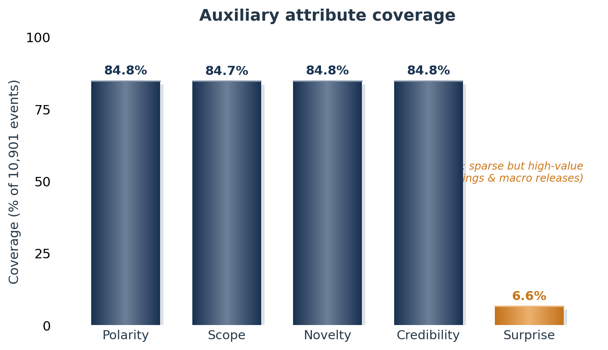
04 · EXPERIMENTS
Experiment 1 — Auxiliary Attribute Coverage
TAKEAWAYS
▪ Polarity, scope, novelty, credibility — ~85% coverage: dense, usable signals.
▪ Surprise — only 6.6%: sparse but high-value, concentrated in earnings & macro.
→ treat the four as standard features; treat surprise as a sparse high-information indicator
EventChain · CS173 Data Mining · Team 2
15

Slide 16
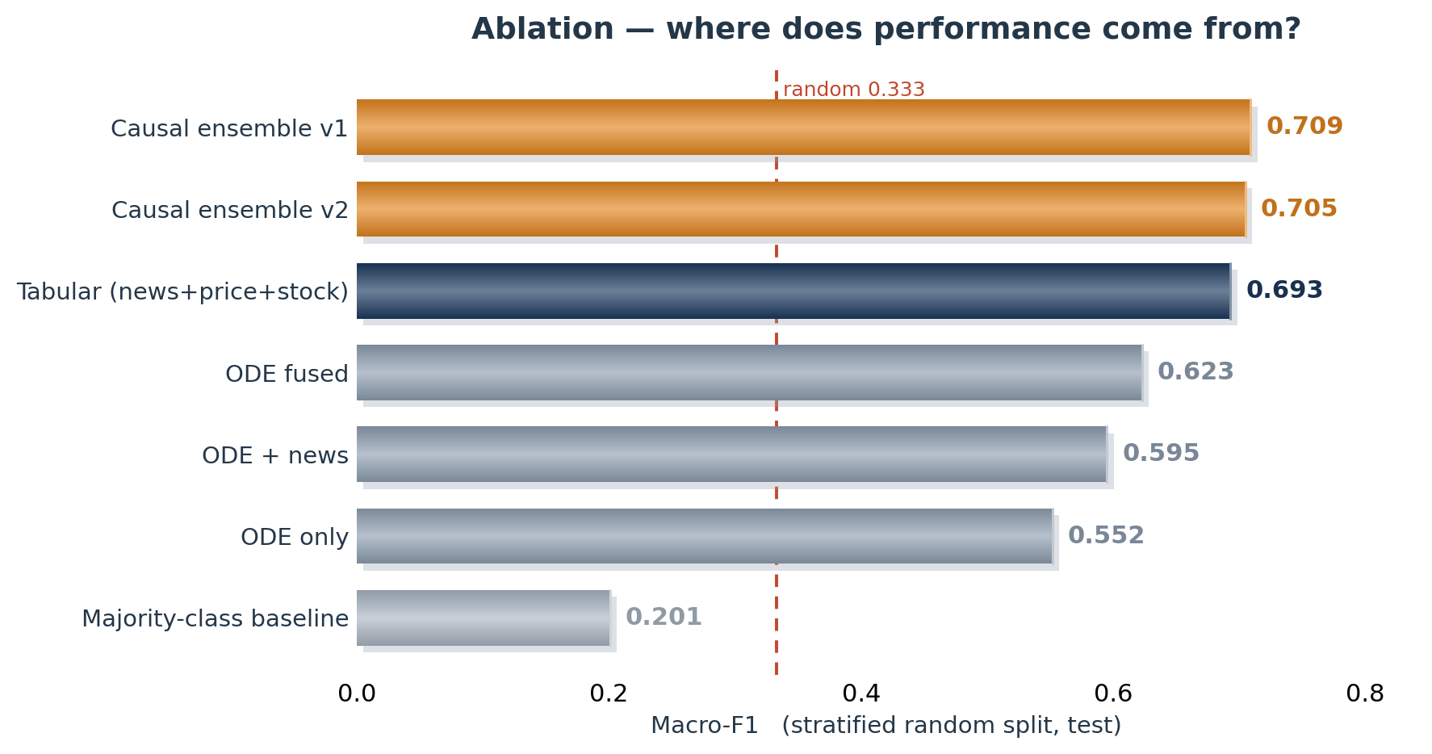
04 · EXPERIMENTS
Experiment 2 — Main Results & Ablation
READING
▪ Tabular news+price+stock — 0.693 macro-F1.
▪ Causal ensemble — 0.709: a consistent +1.6-point gain.
▪ ODE-only variants stay below the tabular baseline — not featured.
single seed — read as a preliminary point estimate
EventChain · CS173 Data Mining · Team 2
16

Slide 17
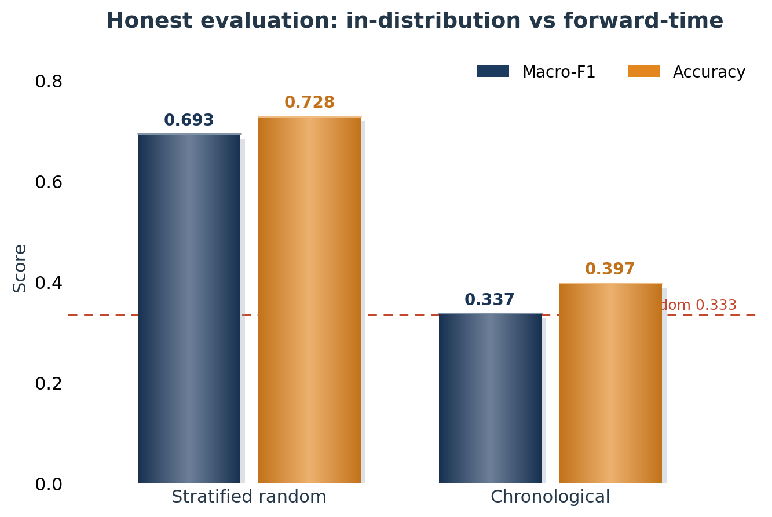
04 · EXPERIMENTS
Experiment 3 — Honest Evaluation
THREE HONEST READINGS
▪ Stratified 0.693 — features carry usable signal in-distribution.
▪ Chronological 0.337 ≈ random 0.333 — forward-time direction at ±0.5% is near-impossible (consistent with semi-strong market efficiency).
▪ FLAT collapses under the time split — the model degenerates to the majority classes.
Stratified-only reporting would overstate real predictive power.
EventChain · CS173 Data Mining · Team 2
17

Slide 18
05 · DISCUSSION
Limits, What We Learned, Future Work
WHAT WE LEARNED
LIMITS
FUTURE WORK
▪ EDA-driven attribute design is the strongest, most defensible contribution.
▪ Three negative results share one cause — the weak forward-time signal.
▪ Stratified-only reporting overstates real-world power.
▪ End-to-end causal discovery did not learn — graph stays at initialization.
▪ Neural-ODE propagation overfits — low-SNR daily data, high-capacity continuous-time models fit noise.
▪ Single seed; 5% subset; 22 tickers limit regime coverage.
▪ Event-type graph from lagged co-occurrence (no end-to-end gradient).
▪ Multi-seed confidence intervals; rolling walk-forward validation.
▪ LLM-assisted surprise extraction to lift its 6.6% coverage.
EventChain · CS173 Data Mining · Team 2
18

Slide 19
REFERENCES & Q&A
Key References · Thank You
Baseline
Li et al. CausalStock: Deep End-to-end Causal Discovery for News-driven Stock Movement Prediction. NeurIPS 2024.
Data
Dong et al. FNSPID: A Comprehensive Financial News Dataset in Time Series. KDD ADS 2024.
NLP
Araci. FinBERT: Financial Sentiment Analysis with Pre-trained Language Models. arXiv 2019.
Causal
Zheng et al. DAGs with NO TEARS. NeurIPS 2018.
Causal
Tank et al. Neural Granger Causality. TPAMI 2022.
Caveat
Reisach et al. Beware of the Simulated DAG! NeurIPS 2021.
Q & A — Thank you for listening
EventChain · CS173 Data Mining Final · Team 2
EventChain · CS173 Data Mining · Team 2
19

