Slide 1
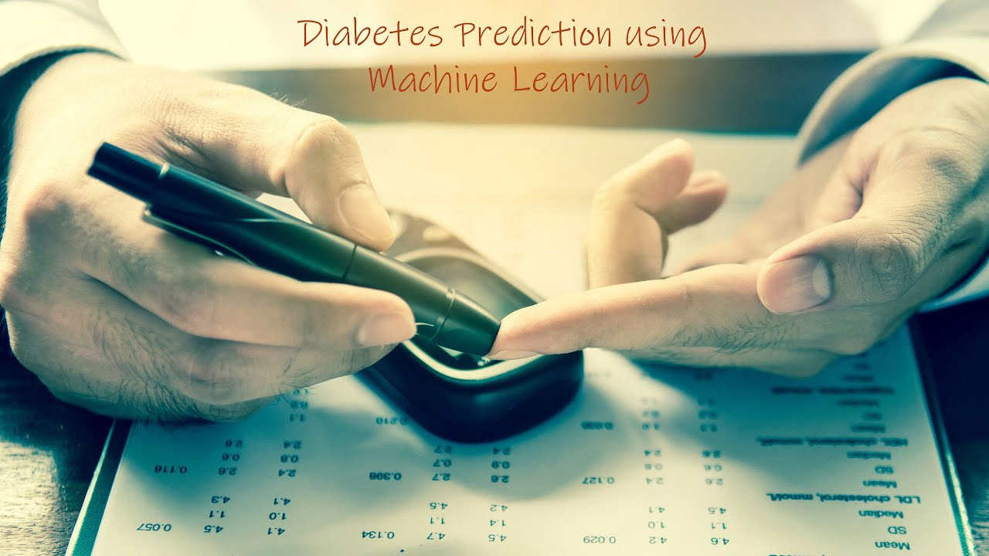
EXPOSyS DATA LABs INTERNSHIP PROJECT
Presented by
K.Lovely Srenika

Slide 2
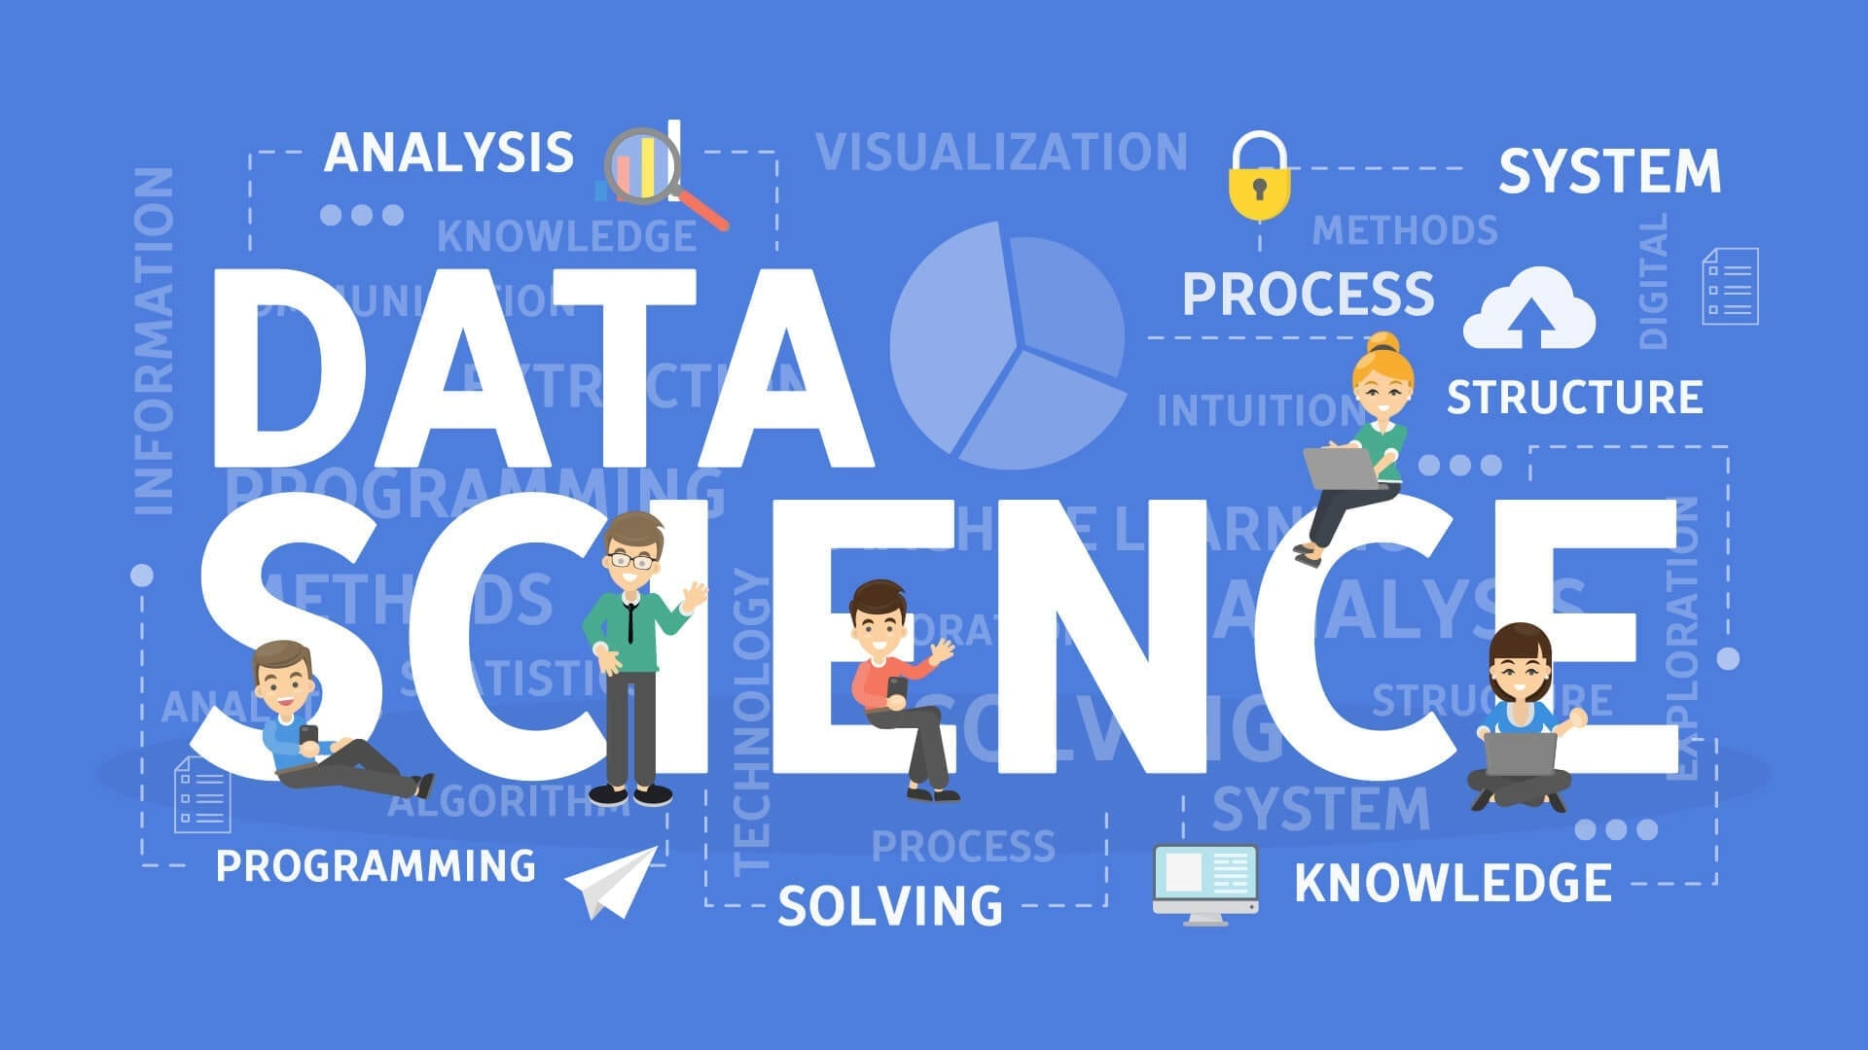

Slide 3
INTRODUCTION
Diabetes has become one of the major causes of national disease and death in most countries.
According to the International Diabetes Federation report, the figure is expected to rise to more than 642 million in 2040, so early screening and diagnosis of diabetes patients have great significance in detecting and treating diabetes on time.
Diabetes is a multifactorial metabolic disease, its diagnostic criteria is difficult to cover all the ethology, damage degree, pathogenesis and other factors, so there is a situation for uncertainty and imprecision under various aspects of medical diagnosis process.
With the development of Data mining, researchers find that machine learning is playing an increasingly important role in diabetes research.
Machine learning techniques can find the risky factors of diabetes and reasonable threshold of physiological parameters to unearth hidden knowledge from a huge amount of diabetes-related data, which has a very important significance for diagnosis and treatment of diabetes. So this project provides a survey of machine learning techniques that has been applied to diabetes data screening and diagnosis of the disease.
In this project, conventional machine learning techniques are described in early screening and diagnosis of diabetes.
More over deep learning techniques which have a significance of biomedical effect are also described.

Slide 4
TYPES OF DIABETES & SYMPTOMS
Diabetes can be segmented into three types:
1. Type 1 diabetes
2. Type 2 diabetes and
3. Gestational diabetes.
SYMPTOMS :
Excessive thrist and hunger
Frequent urination
Drowsiness or fatigue
Dry, itchy skin
Blurry vision
Slow-healing wounds

Slide 5
CONVENTIONAL MACHINE LEARNING TECHNIQUES
The applications of conventional machine learning techniques in the early screening and diagnosis of diabetes mellitus will be introduced from two aspects:
1.Supervised learning and
2.Unsupervised learning.
Supervised Machine Learning :
Supervised learning is the types of machine learning in which machines are trained using well "labelled" training data, and on basis of that data, machines predict the output. The labelled data means some input data is already tagged with the correct output.
Unsupervised Machine Learning :
Unsupervised learning is a type of machine learning in which models are trained using unlabeled dataset and are allowed to act on that data without any supervision.

Slide 6
PROPOSED SYSTEM
Goal of the project is to investigate for model to predict diabetes with better accuracy, different classification algorithms to predict diabetes.
They are :
1. K Nearset Neighbor
2. Simple Vector Machine
3. Naive Bias
4. Random Forest Classifier

Slide 7
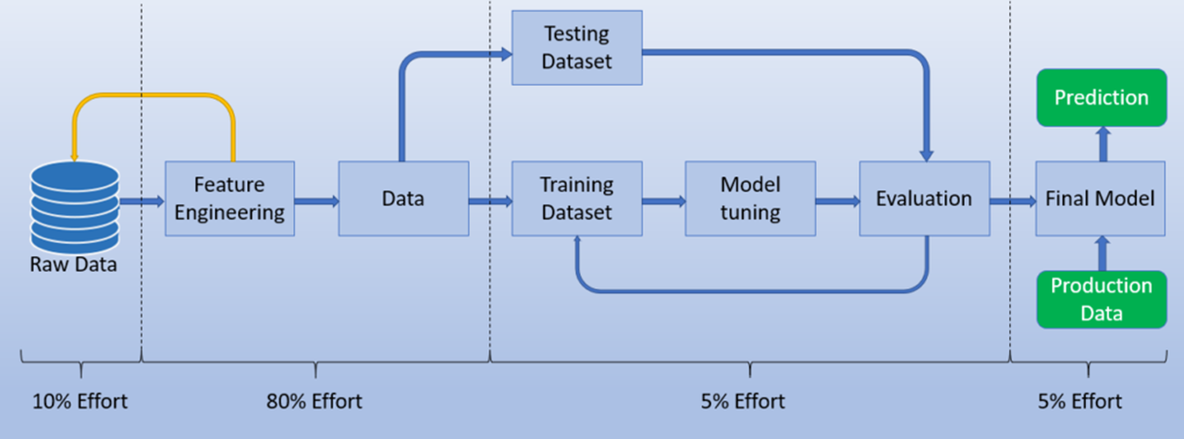
Steps fOR implementing the model

Slide 8
ReQUIRED Softwares and libraries
SOFTWARES :
1. Colab Notebook
2. Kaggle notebook for dataset-PIMA Indian diabetes dataset
LIBRARIES :
1. Pandas
2.Numpy
3.ScikitLearn.
4.Seaborn

Slide 9
CONCLUSION
We have described a machine learning approach to predicting diabetes as in early stage. Diabetes is very dangerous disease that causes premature death.study shows that its possible for some people to reverse it.
Though Diet changes and weight loss you may be able to reach and hold normal blood sugar levels without medication. Hence it becomes almost mandatory to use machine learning to predict diabetes disease.
In this we predicted diabetes by using machine learning algorithms and find out the initial symptoms of diabetes.The result of our method shows better performance in terms of efficiency and accuracy. We have applied many ML algorithms on Diabetes dataset and the performance of those algorithms have been analysed.

Slide 10
THANK YOU

