Slide 1

CYBER CRIME ANALYSIS
By Lovepreet Kaur
Course:Btech AIML
JULY 2026

Slide 2

Introduction
Digital transformation and rising cyber attacks.
Growth in online attacks and industries.
Impact on privacy,data and finances.
Need for cyber crime analysis.

Slide 3

CORE PROBLEM
Cyber Crimes are increasing day by day.
Difficult to analyze .
Needs for data driven insights to improve decision making.

Slide 4

OBJECTIVES
Identify major cyber crime categories(phishing,ransomware..)
Identify yearly trends(2018-2024)
Visualize attack frequency and impact.
Suggest preventive measures.

Slide 5

Methodology
.Dataset:Cyber Crime record(2018-2024)
.Tools:Python,Pandas, Matplotlib,Seaborn,Streamlit
Approach:
Data cleaning->Analysis->Visualization->Dashboard

Slide 6
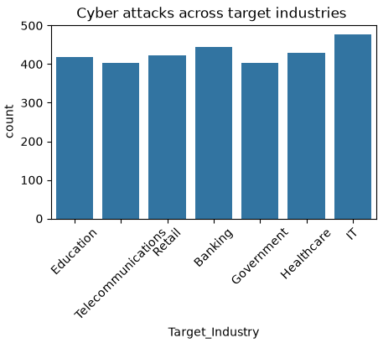
KEY FINDINGS AND VISUALS
.IT industry recorded the highest number of cyber attacks.
.Cyber attacks distributed across all industries, indicating that no sector is completely safe.

Slide 7


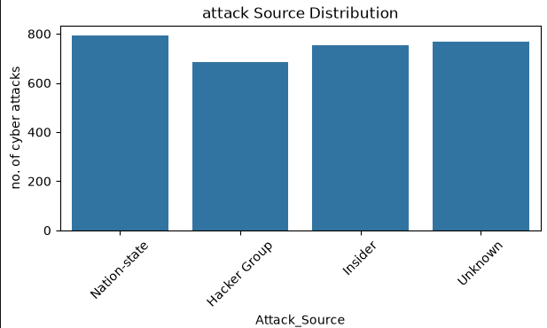
Attack source Analysis
.Nation state attacks are most frequent.
.Unknown and Insider attacks are also most common.
.Organizations need protection against wider range of cyber threats.

Slide 8

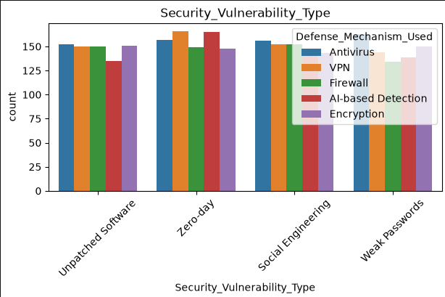
Security vulnerability Distribution
.zero day vulnerability are among the most common.
.No single defense mechanism completely prevent all type of vulnerabilities.

Slide 9

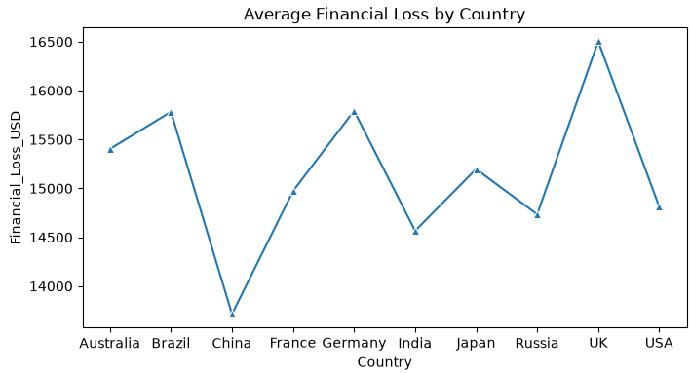
Financial Loss by attack id
.
.

Slide 10
Conclusion
The analysis highlighted the most common attack sources,target industries,financial losses and security vulnerabilities.
The findings can help organizations understand cyber threats and improve their security strategies.
.Overall,project achieved its objective of transforming raw data into meaningful insights for better decision making.

Slide 11
Future Scope
Apply Machine Learning models to predict future cyber attacks.
Perform advanced analytics using larger datsets.

Slide 12

Thank You

