Slide 1


Presentation on L1 Module4

Slide 2

CONTENTS
Task2: Missionary-Cannibal Problem
5
What Technical Debt Is And How It's Measured ?
1
How to Automate Business Processes ?
2
Graph Basics
3
Task1: Water-Jug Problem
4
L1:Module4

Slide 3
What Technical Debt Is And How It's Measured ?
How It's Measured ?
Technical debt ratio (TDR) is the ratio of the cost to fix the codebase compared to building it. Organizations can measure the price in either time or monetary value.
How to identify technical debt
Code Reviews
Static Code Analysis Tools
Issue Trackers
Developer Feedback
Technical debt refers to the cost of additional rework caused by choosing an easy, quick solution over a better approach that would take longer. Like financial debt, technical debt accumulates interest over time, meaning the longer it remains unaddressed, the more time and resources it will require to resolve.
When a technical team implements a sub-optimal solution to a problem, they are making a trade-off between paying the cost now to implement the optimal solution versus paying it later.
L1:Module4

Slide 4
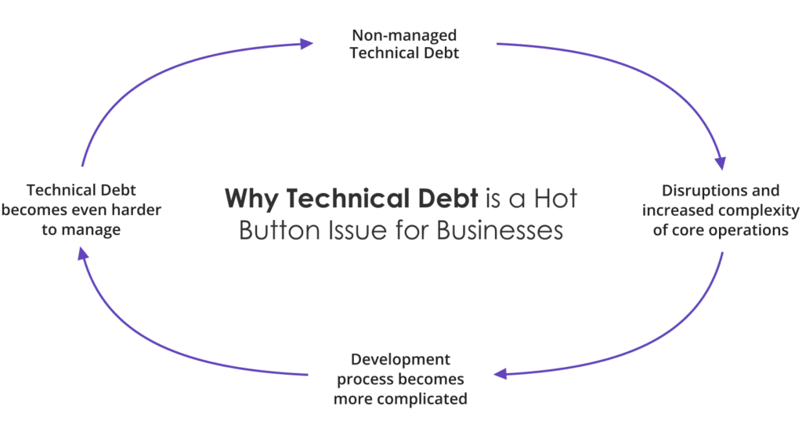
Technical Debt
Band of Acceptance
High
Technical Debt
$
Business Value
Low
No. of violations
High
L1:Module4

Slide 5
What is Automate Business Processes ?
How to Automate Business Processes ?
Process analysis: Ensure that you thoroughly understand the current process so that you can replicate and improve it through automation.
Process design: Outline the exact steps the automated technology will handle.
Prototyping, testing and development: Ensure automated process can be performed successfully and repeatedly before replacing the existing business process.
Training: Train users on the new system and on the new procedures.
Deployment: This is when the thoroughly tested technological solution goes live, along with new procedures for the people working with the technology.
Monitoring, maintenance and improvement: Monitor the automated technology to make sure it’s doing its job properly.
Impact assessment
Business process automation (BPA) refers to the use of technology to streamline and automate repetitive manual tasks within an organization.
The goals of BPA include improving operational efficiency, reducing errors, standardizing processes and freeing up staff to focus on more strategic value-added activities.
Why BPA?-Cost savings -Time savings - Process standardization - Consistency over time - Fewer errors - Improved data tracking -Improved transparency, accountability and security
L1:Module4

Slide 6
Automate Business Processes
START
Manual Review
Approval
Monitoring
Decision Point
Input Data
Validation
Automated Process
Execution
END
This is the Logical Sequence of a how a buisness Process executes:
Start: The process begins with input-->InputData: Data is received and passed for the validation--> Validation: Ensure the input data meets the necessary criteria --> Decision Point: Determines whether to automate the process or require manual review-->Approval and Execution: Once validated the process executes accordingly--> Monitoring: The system tracks progress and logs issues--> End: The process concludes successfully
L1:Module4

Slide 7
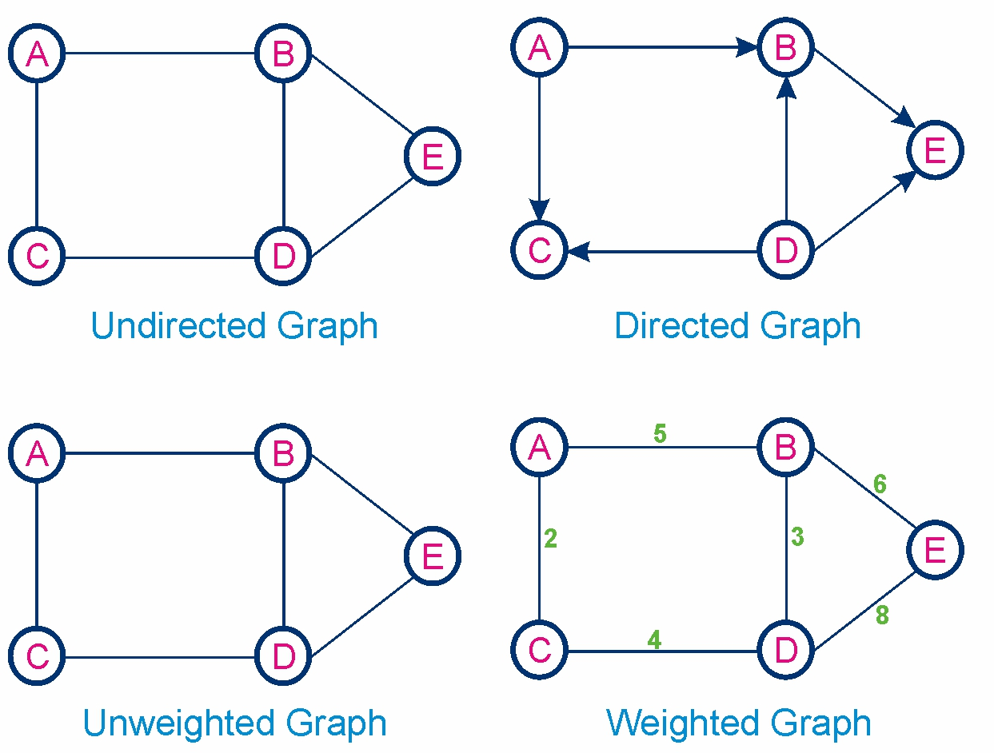
Graphs BasicS Graph Data Structure is a non-linear data structure consisting of vertices and edges. It is useful in fields such as social network analysis, recommendation systems, and computer networks.
Undirected Graphs:Undirected graphs where edges are bi-directional and have no arrows.
Directed Graphs:Directed graphs where the edges have arrows that show path direction.
Unweighted Graphs:A graph where no weights are assigned to each edge.
Weighted Graphs:A graph where weights are assigned to each edge.
L1:Module4

Slide 8
Graph Traversal -BFS and DFS To traverse a Graph means to start in one vertex, and go along the edges to visit other vertices until all vertices, or as many as possible, have been visited.
BFS explores the graph level by level, starting from a chosen root node (vertex 0 in this case).
Mark the start node as visited and place it in a queue.
Remove a node from the queue, visit it, and perform necessary actions.
Add all unvisited neighboring nodes of the current node to the queue and mark them as visited.
Repeat steps 2 and 3 until the queue is empty, indicating that all reachable nodes have been processed.
L1:Module4

Slide 9
GrapH Traversal -DFS
The DFS algorithm explores graphs by diving deep into each branch. The DFS algorithm starts at a node and travels along a path until it can't go further. Then, the DFS algorithm backtracks to explore other paths. The DFS algorithm uses a stack to keep track of nodes.
Start at the initial node.
Mark the current node as visited.
For each unvisited neighbour, call the DFS function recursively.
Continue until all nodes connected to the starting node are visited.
Push the elements in the stack and then visit any neighbour branch completely while backtracking pop the elements from stack and then finally when all the branches are visited the starting node is popped out.
L1:Module4

Slide 10
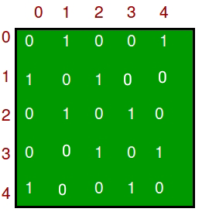
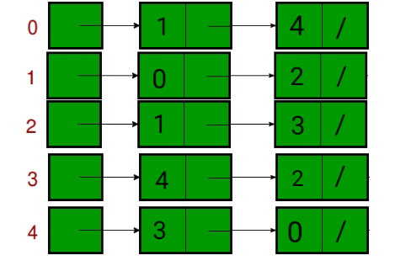
Comparison between Adjacency List and Adjacency Matrix representation of Graph
Adjacency Matrix: In the adjacency matrix representation, a graph is represented in the form of a two-dimensional array. The size of the array is V x V, where V is the set of vertices.
This representation makes use of VxV matrix, so space required in worst case is O(|V|2).
Adjacency List: In the adjacency list representation, a graph is represented as an array of linked list. The index of the array represents a vertex and each element in its linked list represents the vertices that form an edge with the vertex.
In the worst case, if a graph is connected O(V) is required for a vertex and O(E) is required for storing neighbours corresponding to every vertex .Thus, overall space complexity is O(|V|+|E|).
L1:Module4

Slide 11
Shortest Paths from Source to all Vertices using Dijkstra’s Algorithm
Dijkstra's algorithm finds the shortest path from a given source node to every other nodes.
For example, if the nodes of the graph represent cities, and the costs of edges represent the average distances between pairs of cities connected by a direct road, then Dijkstra's algorithm can be used to find the shortest route between one city and all other cities.
L1:Module4

Slide 12
Task Links
Task1(Water-Jug Problem) Link:Link1
Task2(Missionaries Cannibal Problem) Link:Link2
L1:Module4

Slide 13
Water-Jug Problem graph
Level0
0,0
Level1
In this I have used BFS over DFS because BFS will give me the shortest path and faster then the DFS.
Here I will traverse Level wise such as Level0 elements then all the elements in Level1 and so on.
If the element which is already visited before we will store it in a list and we will not revisist it again to avoid repeatation.
In this we will use a Queue to store the valid state and then to pop out element which is visited first and then storing its child /neighbour nodes. We will store the poped elements in a list to retrieve them.
REPRESENTS The element is already visited:
Here we have initial state as (0,0) and the goal to achieve 4 in any of the jug.
0,3
5,0
5,3
5,3
Level2
3,0
0,0
0,0
2,3
Level3
2,0
0,3
5,0
Level4
2,3
0,0
0,2
Level5
5,2
A,B
Level6
4,3
0,2
5,0
L1:Module4

Slide 14
Missionary Cannibal Problem Graph
Level0
3,3,1
Level1
In this I have used BFS over DFS because BFS will give me the shortest path and faster then the DFS.
Here we have Initial state as (3,3,1)->(M,C,B) and the goal state is to reach (0,0,0) on the left side.
Define the valid moves for the movement on the boat as only 2 candidates are allowed at time.
Define a Queue Push the staring point and then visit for its neighbours after poping the first node. When there solution or goal state is achieved push that path to a list and display the path.
In this way we be able to find the shortest path among all possible solutions.
3,2,1
2,2,0
3,1,0
Level2
3,3,1
3,3,1
3,2,1
3,0,0
3,1,1
2,2,0
1,1,0
2,2,1
0,2,0
0,3,1
0,1,0
1,1,1
Level11
0,0,0
L1:Module4

Slide 15
Thank you
Lovepreet Singh
XS0905
L1:Module4

