Slide 1
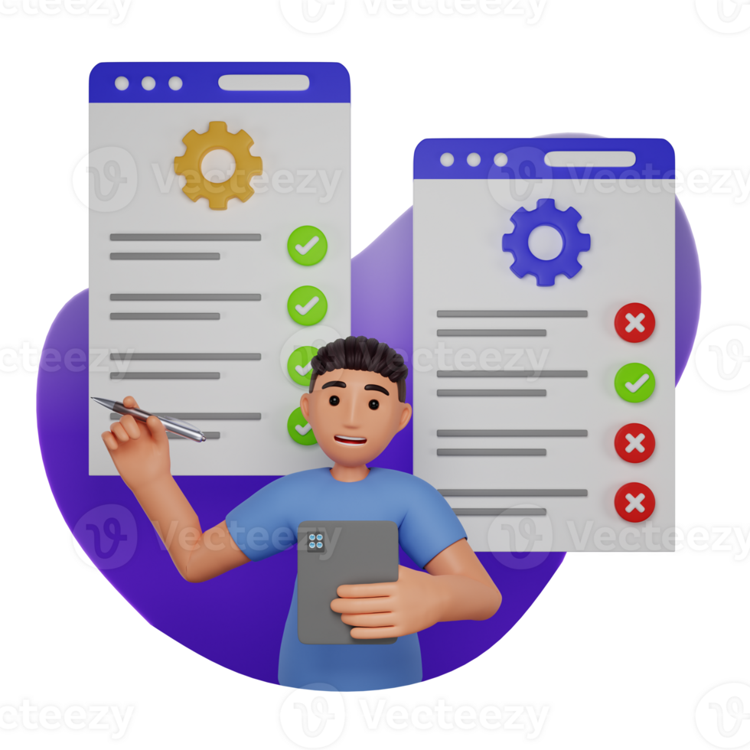
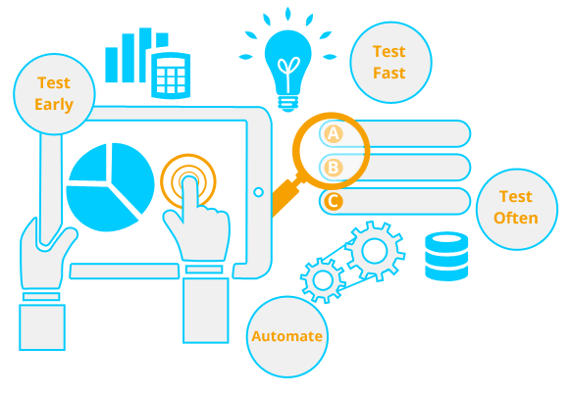
Testing Engineering Task

Slide 2
Contents
Testing Fundamentals
What is Software Testing and Manual / Automation testing ?
SDLC and STLC life cycle, Validation and Verification.
What is TestOps
What is QAOps
Domain Driven Testing , Keyword Driven Testing and TDD/BDD
Types of Testing (Functional and Non- functional), Alpha and Beta Testing
CX testing , Smoke Testing , Microservices Testing, API Testing, Mobile Testing
Performance Testing and their types, White BOX and Black Box Testing
Agile, Waterfall Model, V-model
Defect Management: Tracking, Life Cycle, Severity, and Priority
Test Plan
Practical Task:
Design 9-10 Test Case
Prepare a bug report if found any.
Write automation script for the test cases.

Slide 3
What is Software Testing
Manual / Automation testing
Manual testing is a type of testing in which we do not use any tools (automation) to perform the testing. In this testing, testers make test cases for the codes test the software, and give the final report about that software.
Automation testing is a type of testing in which we take the help of tools (automation) to perform the testing. It is faster than manual testing because it is done with some automation tools. There is no chance of any human errors.
Software testing is the process of evaluating software to make sure it works as expected. It helps to find issues early in the development process, which can reduce risks later on.
Benefits of software testing:
Prevent bugs
Improve performance
Improve accuracy
Improve usability

Slide 4
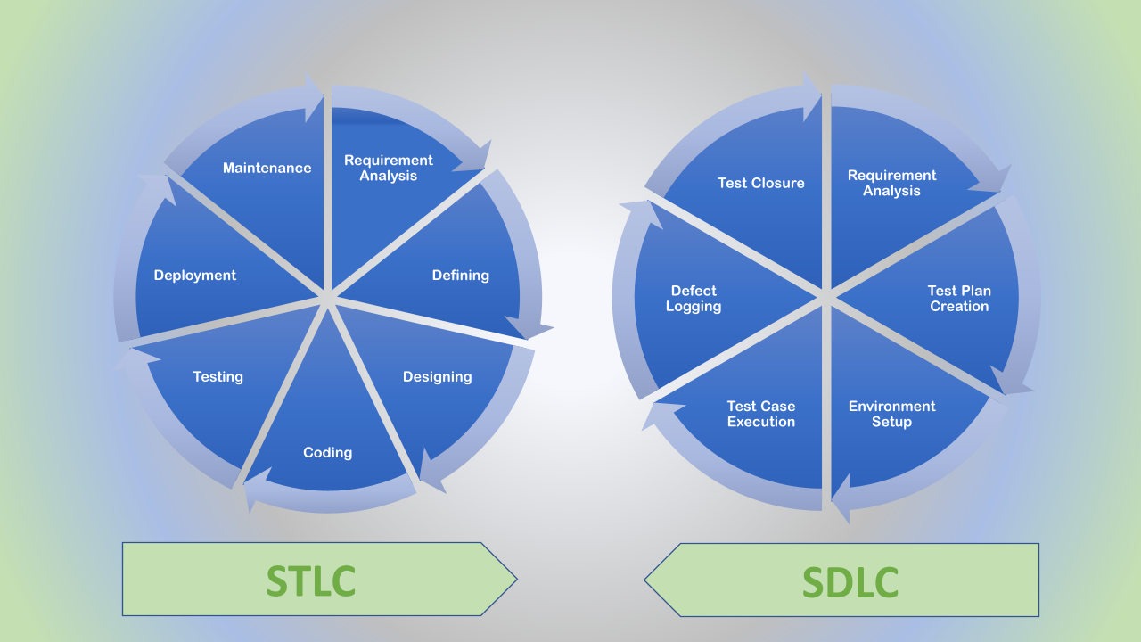
SDLC and STLC life cycle
Verification:
Focus: Checks if the software meets design specifications and technical requirements.
Activities: Includes reviews, inspections, and walkthroughs of requirements, design, and code.
Validation:
Focus: Checks if the software meets user needs and expectations.
Activities: Includes testing (black box, white box, etc.) to assess functionality, usability, and performance.
Software Development Life Cycle (SDLC) is a structured process used by software development teams to design, develop, test, and deliver high-quality software.
The STLC (Software Testing Life Cycle) is cyclical and an iterative procedure that has the purpose of preventing loopholes/ errors in the software. Usually, the STLC counts analysis, planning, designing, setup, implementation, and test-ending activities. I

Slide 5

Software Testing Trends
AI-Driven Testing: AI and machine learning will play a significant role in automating testing processes, predicting test outcomes, and identifying vulnerabilities early on.
Codeless Automation: The rise of codeless automation tools will enable testers to automate testing without writing code, making testing more accessible and efficient.
Integration with DevOps and CI/CD Pipelines: Testing will be increasingly integrated into DevOps and CI/D pipelines, ensuring that every code change is thoroughly tested before deployment.
Cloud-Based Automation Testing: Cloud-based testing platforms will become more prevalent, allowing for scalable and flexible testing environments.
Performance Engineering: Testing for performance will become increasingly important, as applications and systems become more complex and demanding.
Cybersecurity Testing: Security testing will be crucial, as organizations face increasing cyber threats.
IoT Testing: Testing for Internet of Things (IoT) devices and applications will become more common.
TestOps is a discipline that manages testing operations to scale test coverage and improve efficiency, while future trends in testing include AI-driven testing, codeless automation, and increased integration with DevOps and CI/CD pipelines. Test automation plays a crucial role in TestOps, enabling faster, more reliable, and scalable testing.
Benefits:
Faster and more efficient testing.
Improved software quality.
Reduced testing costs.
Increased test coverage.

Slide 6
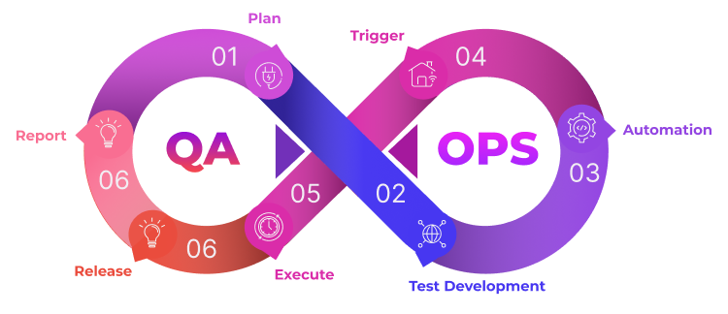
Quality Assurance (QA):
QA is a process of ensuring that a product or service meets specified quality standards.
It involves testing and evaluating the product to identify defects and ensure it functions as intended.
Quality Engineering (QE):
QE takes a proactive approach to quality, aiming to prevent defects from occurring in the first place.
It involves embedding quality practices throughout the entire software development lifecycle.
Performance Engineering:
Performance Engineering is a discipline within Quality Assurance (QA) that focuses on ensuring a system's performance and reliability.
Performance engineering fosters collaboration among various teams, tools, and processes by establishing continuous feedback loops.
QAOps combines Quality Assurance (QA) and software operations (Ops)
QAOps is an emerging practice that integrates QA into the software delivery pipeline.
QAOps is a new-age testing practice that is changing the way quality assurance works. With the emergence of big data, cloud and AI, a new testing method that works with complex technologies emerged

Slide 7
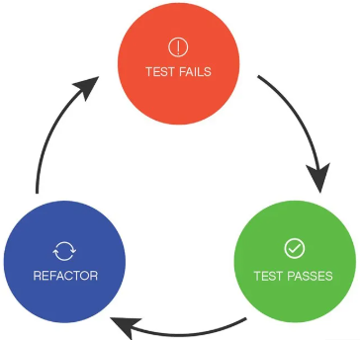
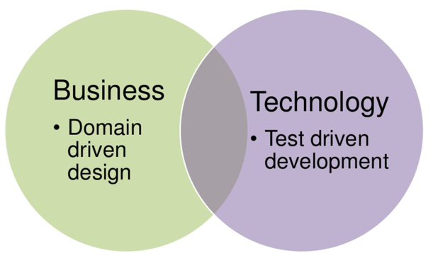
TDD/BDD
TDD
BDD
The test-driven development process involves writing automated tests before writing the code. The results from these automated tests provide insights for the developer to improve their code.
TDD is a continuous and iterative process of improving your code through tests. The goal after each test is to make the code incrementally better.
Create Tests >>Execute 1 Specific Test>>Implement The Code>>Run All Tests And Refactor The Code
Simply put, BDD is an Agile testing methodology that uses system behaviour to guide the development activities. Instead of starting with a test like in TDD, BDD starts with analyzing the desired behaviour that developers want to create. After that, they’ll express the desired behaviour using the Gherkin syntax, which consists of Given - When - Then statements.
Scenarios written in a natural language format, easily understood by both technical and non-technical team members.

Slide 8
Domain-driven testing/ keyword-driven testing
Domain-driven testing
keyword-driven testing
Focus: Validates the application's behavior based on the domain's business rules and user interactions.
Approach: Testers develop a domain-specific language to write test cases, focusing on actions and scenarios relevant to the domain.
Example: In an e-commerce application, a domain-driven test might focus on verifying the order processing flow, including actions like adding items to the cart, applying discounts, and completing the purchase.
Focus: Uses predefined keywords to represent actions and data, making test automation easier and more maintainable.
Approach: Testers define keywords (e.g., "login", "click", "enter text") and associate them with specific actions in the application.
Example: In an e-commerce application, a keyword-driven test might use keywords like "login", "search for product", "add to cart", and "checkout" to automate the purchase process.

Slide 9
Types of Testing (Functional and Non- functional), Alpha and Beta Testing
Functional and Non-functional Testing
Alpha and Beta Testing
Functional testing is a type of software testing in which the system is tested against the functional requirements and specifications. Functional testing ensures that the requirements or specifications are properly satisfied by the application. This type of testing is particularly concerned with the result of processing.
Non-functional testing is a type of software testing that is performed to verify the non-functional requirements of the application. It verifies whether the behaviour of the system is as per the requirement or not. It tests all the aspects which are not tested in functional testing. Non-functional testing is defined as a type of software testing to check non-functional aspects of a software application.
Alpha Testing is a type of software testing performed to identify bugs before releasing the product to real users or to the public. Alpha Testing is one of the user acceptance tests. It is the first stage of software testing, during which the internal development team tests the program before making it available to clients or people outside the company.
Beta Testing is performed by real users of the software application in a real environment. Beta testing is one type of User Acceptance Testing. A pre-release version of the product is made available for testing to a chosen set of external users or customers during the second phase of software testing.

Slide 10
CX testing , Smoke Testing , Microservices Testing, API Testing, Mobile Testing
Smoke Testing:
It is a quick, preliminary test to verify that the most critical functionalities of a software application are working as expected before more in-depth testing.
Focus: Verifying that the application is in a "stable" state and can be further tested.
Methods: Manual or automated testing of key features.
API Testing:
focuses on verifying the functionality and performance of Application Programming Interfaces (APIs).
Focus: Ensuring that APIs are working as expected, returning the correct data, and handling different scenarios.
Methods: Functional testing, performance testing, security testing, and integration testing.
Mobile Testing:
IT ensures that mobile applications function correctly and provide a positive user experience on various devices and operating systems.
Focus: Device compatibility, performance, usability, and security.
Methods: Functional testing, performance testing, usability testing, and security testing.
Microservices Testing:
involves testing individual microservices and their interactions to ensure that the overall application functions correctly.
Focus: Ensuring the reliability, performance, and scalability of the microservices architecture.
Types:
Unit Testing: Testing individual components or functions in isolation.
Integration Testing: Testing how different microservices interact with each other.
CX Testing (Customer Experience Testing):
evaluates the overall user experience by simulating real-world scenarios to identify potential issues and ensure a positive user journey.
Focus: User satisfaction, ease of use, and overall experience with the product or service.
Methods: Usability testing, A/B testing, surveys, and feedback collection tools.

Slide 11
Performance Testing and their types
Performance Testing is a type of software testing that ensures software applications perform properly under their expected workload. It is a testing technique carried out to determine system performance in terms of sensitivity, reactivity, and stability under a particular workload.
Types:
Load Testing
Stress Testing
Scalability Testing
Volume Testing
It simulates a real-world load on the system to see how it performs under stress. It helps identify bottlenecks and determine the maximum number of users or transactions the system can handle.
It is a type of load testing that tests the system’s ability to handle a high load above normal usage levels. It helps identify the breaking point of the system and any potential issues that may occur under heavy load conditions.
In this, the software application’s effectiveness is determined by scaling up to support an increase in user load. It helps in planning capacity additions to your software system.
A large number of data is saved in a database and the overall software system’s behaviour is observed. The objective is to check the product’s performance under varying database volumes.

Slide 12
White BOX and Black Box Testing
White Box Testing
Black Box Testing
White box testing techniques analyse the internal structures the used data structures, internal design, code structure, and the working of the software rather than just the functionality as in black box testing.
White box testing is mainly focused on ensuring that the internal code of the software is correct and efficient.
Example: Functional, Non-Functional Testing
Black-box testing is a type of testing in which it only focuses on the outer structure of the implementation that needs to be tested.
Black box testing is mainly focused on testing the functionality of the software, ensuring that it meets the requirements and specifications.
Example: Unit Testing, Integration Testing

Slide 13
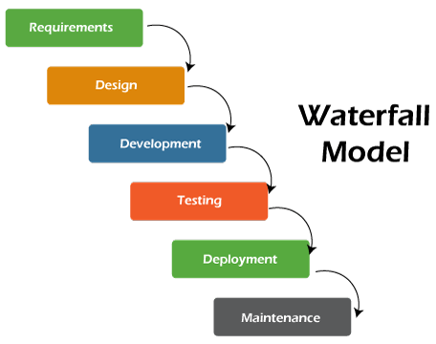
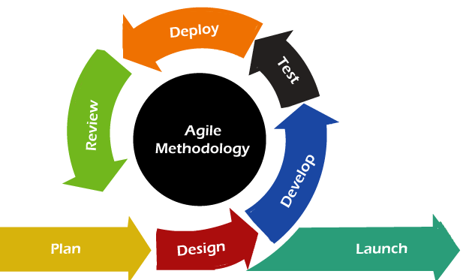
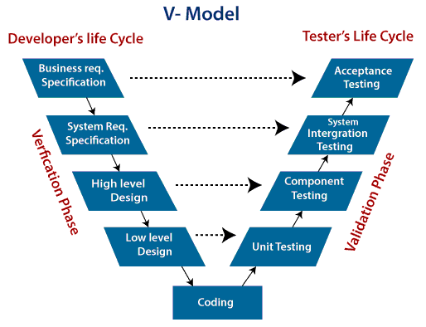
Agile Methodology, Waterfall Model and V-model
Waterfall Model
Agile Methodology
V- Model
Agile focuses on customer feedback, collaboration, small and rapid releases.
Its purpose is to manage complex projects.
When the requirement is well defined and not ambiguous.
The V-shaped model should be used for small to medium-sized projects where requirements are clearly defined and fixed.
Waterfall model is not an ideal model to develop a large scale project size.
The requirements in the waterfall model should be clear at the beginning time.

Slide 14
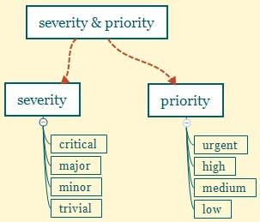
Defect Management: Tracking, Life Cycle, Severity, and Priority
Defect management involves tracking, classifying, and resolving software issues, focusing on severity (impact) and priority (urgency) to ensure efficient resource allocation and timely resolution.
Defect Tracking:
Purpose: To log, monitor, and manage defects throughout their lifecycle.
Tools: Utilize bug tracking systems (e.g., Jira, Bugzilla) to record, assign, and track defect details.
Information: Defect descriptions, severity levels, priority levels, assigned developers, status updates, and resolution details.
Defect Life Cycle:
IT CONSISTS OF VARIOUS STAGES AS:
New
Assigned
Open
Resolved
Retest
Verified
Reopened
Closed
Duplicate
Rejected
Severity and Priority
Severity measures the impact of a defect on the software's functionality, while priority measures how urgently the defect should be fixed

Slide 15
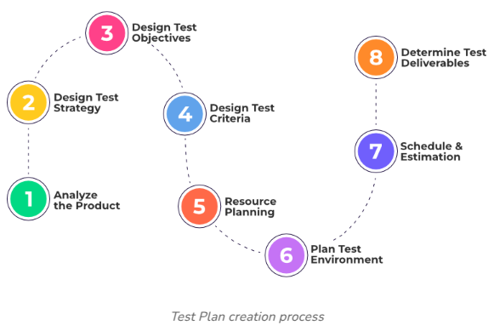
Test Plan
A test plan is a document that consists of all future testing-related activities. It is prepared at the project level and in general, it defines work products to be tested, how they will be tested, and test type distribution among the testers.
Why is a Test Plan Important?
Provides a roadmap for testing
Reduces the risk of defects
Improves communication
Facilitates efficient resource allocation
Enables better tracking and reporting

Slide 16
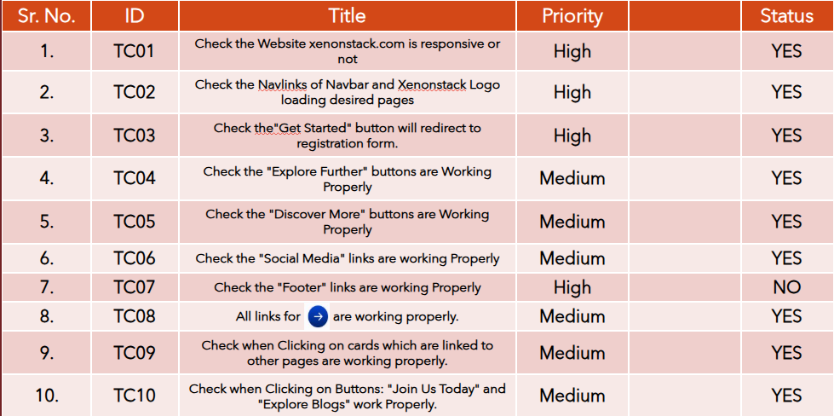
Practical Task
Testing report

Slide 17
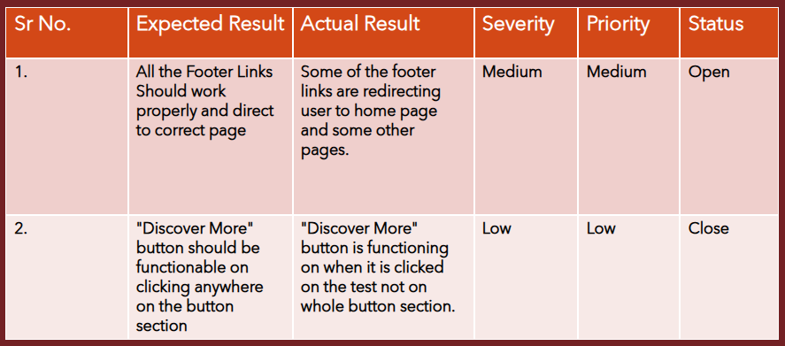
BUG REPORT

Slide 18
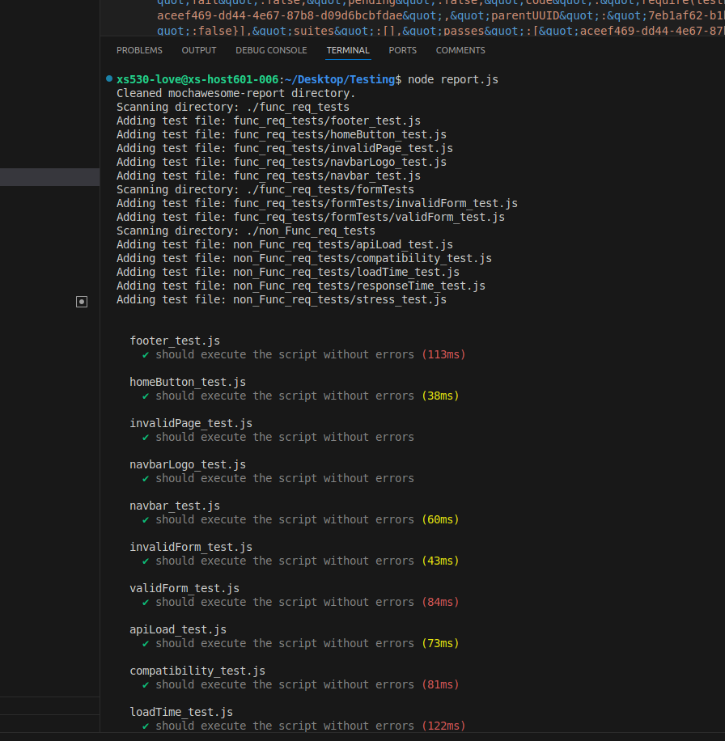
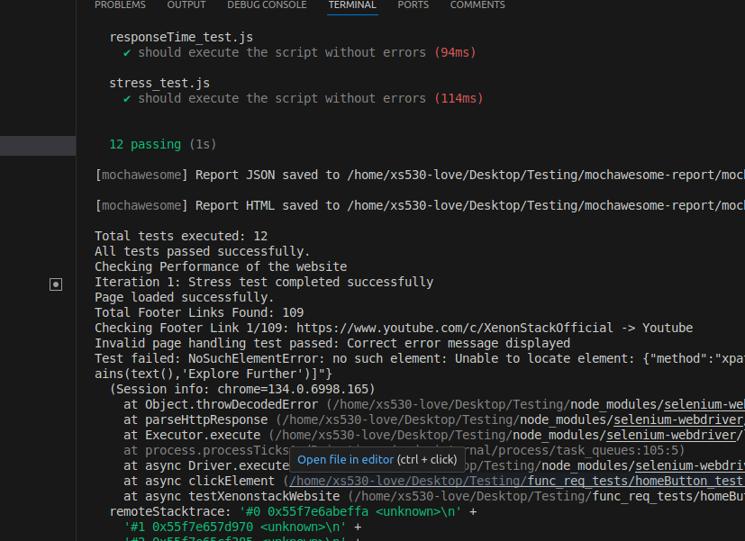
ScreenShots
Github Link: Link​
Or visit https://github.com/Lovepreet5555/Test

Slide 19
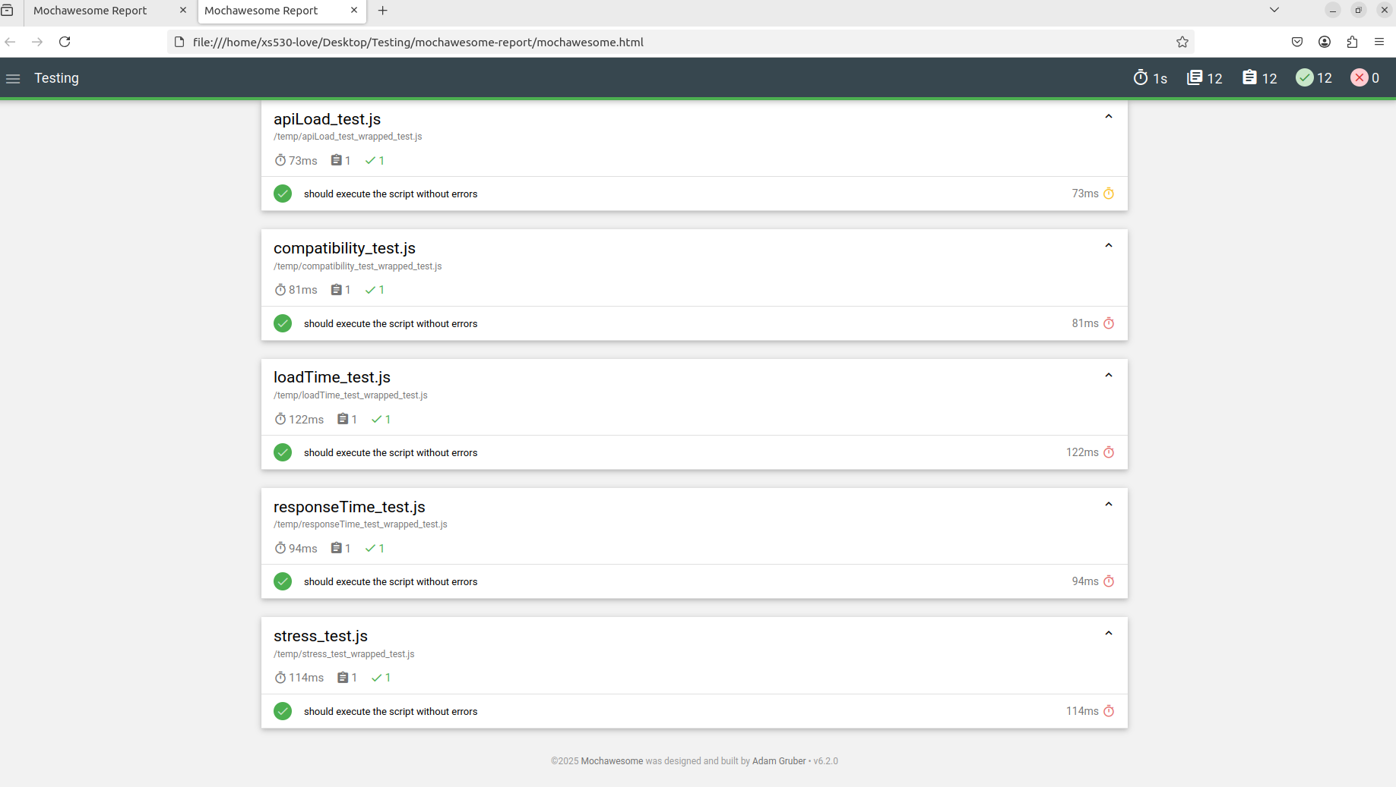
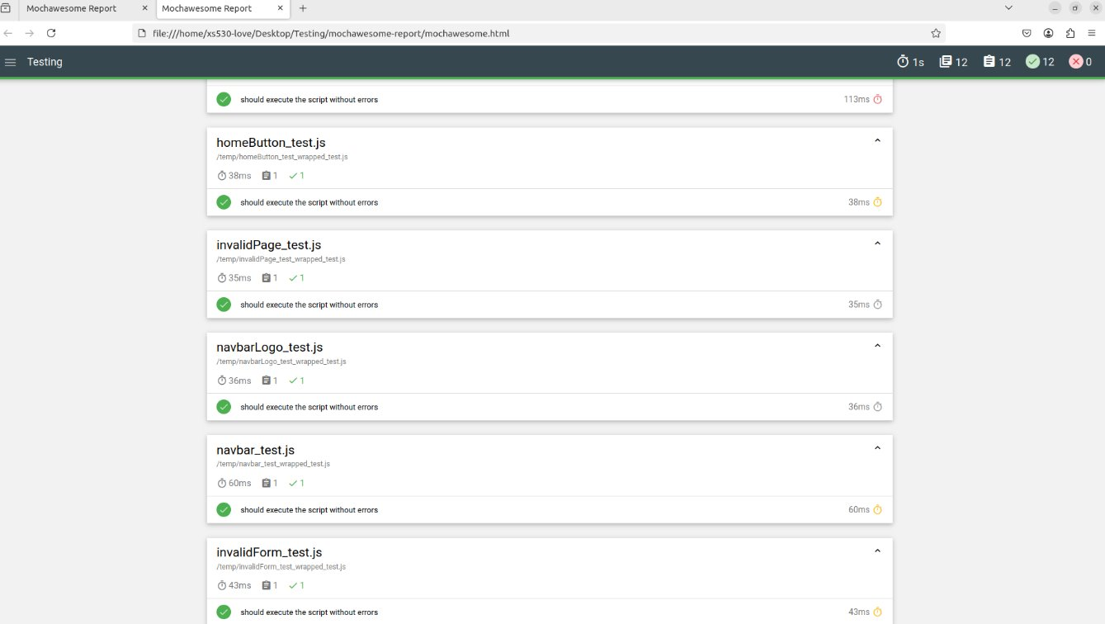

Slide 20
Thank you
Lovepreet Singh
XS0905

