Slide 1
Week 5 - Tutorial

Slide 2
Convolutional Neural Network Architecture
Materials:
https://e2eml.school/how_convolutional_neural_networks_work.html
Notes:
https://blog.csdn.net/v_JULY_v/article/details/79434745

Slide 3
Convolutional Neural Network Architecture
The input to the neural network consists of an 84 × 84 × 4 image.
The first hidden layer convolves 16 8 × 8 filters with stride 4 with the input image and applies a rectifier nonlinearity. The second hidden layer convolves 32 4 × 4 filters with stride 2, again followed by a rectifier nonlinearity. The final hidden layer is fully-connected and consists of 256 rectifier units. The output layer is a fully-connected linear layer with a single output for each valid action. The number of valid actions varied between 4 and 18 on the games we considered."

Slide 4
Convolutional Neural Network Architecture
For each layer in this network, compute the number of
weights per filter in this layer (including bias)
width and height of layer (convolutional layers)
neurons in this layer
connections into the neurons in this layer
independent parameters in this layer
You should assume the input images are gray-scale, there is no padding, and there are 18 valid actions (outputs).

Slide 5
Convolutional Neural Network – First Layer
The input to the neural network consists of an 84 × 84 × 4 image.
The first hidden layer convolves 16 8 × 8 filters with stride 4 with the input image and applies a rectifier nonlinearity. The second hidden layer convolves 32 4 × 4 filters with stride 2, again followed by a rectifier nonlinearity. The final hidden layer is fully-connected and consists of 256 rectifier units. The output layer is a fully-connected linear layer with a single output for each valid action. The number of valid actions varied between 4 and 18 on the games we considered."
First Convolutional Layer:
a.
Weights per filter: 1 + M × N × L = 1 + 8 × 8 × 4 = 257.
This formula calculates the number of weights per filter.
M and N represent the width and height of the filter (8x8), while L is the depth of the input (which is 4 in this case, as the input is a stack of 4 frames of images). We add one for a bias term, resulting in 257 weights per filter.
Notes:
每个滤波器的权重：1 + M × N × L = 1 + 8 × 8 × 4 = 257。这个公式计算的是每个滤波器的权重数量。M和N是滤波器的宽度和高度（8x8），L是输入的深度（这里为4，因为输入是4帧图像堆叠的结果）。加上一个偏置项，所以每个滤波器有257个权重。
这一层的宽度和高度：1 + (J – M) / s = 1 + (84 – 8) / 4 = 20。这个公式计算的是卷积后输出的宽度和高度。J和K是输入的宽度和高度（84x84），M和N是滤波器的宽度和高度（8x8），s是步长（4）。没有填充（P=0），所以输出的宽度和高度都是20。
这一层的神经元数量：20 × 20 × 16 = 6400。每个特征图（由一个滤波器产生）上的每个元素都可以看作是一个神经元，所以神经元的数量就是特征图的宽度 x 高度 x 深度（滤波器数量）。
这一层的连接数量：20 × 20 × 16 × 257 = 1644800。每个神经元都与前一层的257个单位（包括一个偏置）有连接，所以连接的总数就是神经元数量乘以每个神经元的连接数。
这一层的独立参数数量：16 × 257 = 4112。每个滤波器有257个独立参数（包括偏置），所以总的参数数量就是滤波器数量乘以每个滤波器的参数数量。

Slide 6
Convolutional Neural Network – First Layer
The input to the neural network consists of an 84 × 84 × 4 image.
The first hidden layer convolves 16 8 × 8 filters with stride 4 with the input image and applies a rectifier nonlinearity. The second hidden layer convolves 32 4 × 4 filters with stride 2, again followed by a rectifier nonlinearity. The final hidden layer is fully-connected and consists of 256 rectifier units. The output layer is a fully-connected linear layer with a single output for each valid action. The number of valid actions varied between 4 and 18 on the games we considered."
b. Width and height of layer (convolutional layers)
1 + (J – M) / s = 1 + (84 – 8) / 4 = 20.
This formula calculates the width and height of the output after convolution.
J and K represent the width and height of the input (84x84), M and N represent the width and height of the filter (8x8), and s is the stride (4). There is no padding (P=0), so the width and height of the output are both 20.
Notes:
每个滤波器的权重：1 + M × N × L = 1 + 8 × 8 × 4 = 257。这个公式计算的是每个滤波器的权重数量。M和N是滤波器的宽度和高度（8x8），L是输入的深度（这里为4，因为输入是4帧图像堆叠的结果）。加上一个偏置项，所以每个滤波器有257个权重。
这一层的宽度和高度：1 + (J – M) / s = 1 + (84 – 8) / 4 = 20。这个公式计算的是卷积后输出的宽度和高度。J和K是输入的宽度和高度（84x84），M和N是滤波器的宽度和高度（8x8），s是步长（4）。没有填充（P=0），所以输出的宽度和高度都是20。
这一层的神经元数量：20 × 20 × 16 = 6400。每个特征图（由一个滤波器产生）上的每个元素都可以看作是一个神经元，所以神经元的数量就是特征图的宽度 x 高度 x 深度（滤波器数量）。
这一层的连接数量：20 × 20 × 16 × 257 = 1644800。每个神经元都与前一层的257个单位（包括一个偏置）有连接，所以连接的总数就是神经元数量乘以每个神经元的连接数。
这一层的独立参数数量：16 × 257 = 4112。每个滤波器有257个独立参数（包括偏置），所以总的参数数量就是滤波器数量乘以每个滤波器的参数数量。

Slide 7
Convolutional Neural Network – First Layer
The input to the neural network consists of an 84 × 84 × 4 image.
The first hidden layer convolves 16 8 × 8 filters with stride 4 with the input image and applies a rectifier nonlinearity. The second hidden layer convolves 32 4 × 4 filters with stride 2, again followed by a rectifier nonlinearity. The final hidden layer is fully-connected and consists of 256 rectifier units. The output layer is a fully-connected linear layer with a single output for each valid action. The number of valid actions varied between 4 and 18 on the games we considered."
c. Number of neurons in the layer: 20 × 20 × 16 = 6400.
Each element on each feature map (generated by a filter) can be considered as a neuron, so the number of neurons is the width x height x depth (number of filters) of the feature map.
Notes:
每个滤波器的权重：1 + M × N × L = 1 + 8 × 8 × 4 = 257。这个公式计算的是每个滤波器的权重数量。M和N是滤波器的宽度和高度（8x8），L是输入的深度（这里为4，因为输入是4帧图像堆叠的结果）。加上一个偏置项，所以每个滤波器有257个权重。
这一层的宽度和高度：1 + (J – M) / s = 1 + (84 – 8) / 4 = 20。这个公式计算的是卷积后输出的宽度和高度。J和K是输入的宽度和高度（84x84），M和N是滤波器的宽度和高度（8x8），s是步长（4）。没有填充（P=0），所以输出的宽度和高度都是20。
这一层的神经元数量：20 × 20 × 16 = 6400。每个特征图（由一个滤波器产生）上的每个元素都可以看作是一个神经元，所以神经元的数量就是特征图的宽度 x 高度 x 深度（滤波器数量）。
这一层的连接数量：20 × 20 × 16 × 257 = 1644800。每个神经元都与前一层的257个单位（包括一个偏置）有连接，所以连接的总数就是神经元数量乘以每个神经元的连接数。
这一层的独立参数数量：16 × 257 = 4112。每个滤波器有257个独立参数（包括偏置），所以总的参数数量就是滤波器数量乘以每个滤波器的参数数量。

Slide 8
Convolutional Neural Network – First Layer
The input to the neural network consists of an 84 × 84 × 4 image.
The first hidden layer convolves 16 8 × 8 filters with stride 4 with the input image and applies a rectifier nonlinearity. The second hidden layer convolves 32 4 × 4 filters with stride 2, again followed by a rectifier nonlinearity. The final hidden layer is fully-connected and consists of 256 rectifier units. The output layer is a fully-connected linear layer with a single output for each valid action. The number of valid actions varied between 4 and 18 on the games we considered."
d. Number of connections in the layer: 20 × 20 × 16 × 257 = 1,644,800.
Each neuron is connected to 257 units (including one bias) in the previous layer, so the total number of connections is the number of neurons times the number of connections per neuron.
Notes:
每个滤波器的权重：1 + M × N × L = 1 + 8 × 8 × 4 = 257。这个公式计算的是每个滤波器的权重数量。M和N是滤波器的宽度和高度（8x8），L是输入的深度（这里为4，因为输入是4帧图像堆叠的结果）。加上一个偏置项，所以每个滤波器有257个权重。
这一层的宽度和高度：1 + (J – M) / s = 1 + (84 – 8) / 4 = 20。这个公式计算的是卷积后输出的宽度和高度。J和K是输入的宽度和高度（84x84），M和N是滤波器的宽度和高度（8x8），s是步长（4）。没有填充（P=0），所以输出的宽度和高度都是20。
这一层的神经元数量：20 × 20 × 16 = 6400。每个特征图（由一个滤波器产生）上的每个元素都可以看作是一个神经元，所以神经元的数量就是特征图的宽度 x 高度 x 深度（滤波器数量）。
这一层的连接数量：20 × 20 × 16 × 257 = 1644800。每个神经元都与前一层的257个单位（包括一个偏置）有连接，所以连接的总数就是神经元数量乘以每个神经元的连接数。
这一层的独立参数数量：16 × 257 = 4112。每个滤波器有257个独立参数（包括偏置），所以总的参数数量就是滤波器数量乘以每个滤波器的参数数量。

Slide 9
Convolutional Neural Network – First Layer
The input to the neural network consists of an 84 × 84 × 4 image.
The first hidden layer convolves 16 8 × 8 filters with stride 4 with the input image and applies a rectifier nonlinearity. The second hidden layer convolves 32 4 × 4 filters with stride 2, again followed by a rectifier nonlinearity. The final hidden layer is fully-connected and consists of 256 rectifier units. The output layer is a fully-connected linear layer with a single output for each valid action. The number of valid actions varied between 4 and 18 on the games we considered."
d. Number of independent parameters in the layer: 16 × 257 = 4112.
Each filter has 257 independent parameters (including bias), so the total number of parameters is the number of filters times the number of parameters per filter.
Notes:
每个滤波器的权重：1 + M × N × L = 1 + 8 × 8 × 4 = 257。这个公式计算的是每个滤波器的权重数量。M和N是滤波器的宽度和高度（8x8），L是输入的深度（这里为4，因为输入是4帧图像堆叠的结果）。加上一个偏置项，所以每个滤波器有257个权重。
这一层的宽度和高度：1 + (J – M) / s = 1 + (84 – 8) / 4 = 20。这个公式计算的是卷积后输出的宽度和高度。J和K是输入的宽度和高度（84x84），M和N是滤波器的宽度和高度（8x8），s是步长（4）。没有填充（P=0），所以输出的宽度和高度都是20。
这一层的神经元数量：20 × 20 × 16 = 6400。每个特征图（由一个滤波器产生）上的每个元素都可以看作是一个神经元，所以神经元的数量就是特征图的宽度 x 高度 x 深度（滤波器数量）。
这一层的连接数量：20 × 20 × 16 × 257 = 1644800。每个神经元都与前一层的257个单位（包括一个偏置）有连接，所以连接的总数就是神经元数量乘以每个神经元的连接数。
这一层的独立参数数量：16 × 257 = 4112。每个滤波器有257个独立参数（包括偏置），所以总的参数数量就是滤波器数量乘以每个滤波器的参数数量。

Slide 10
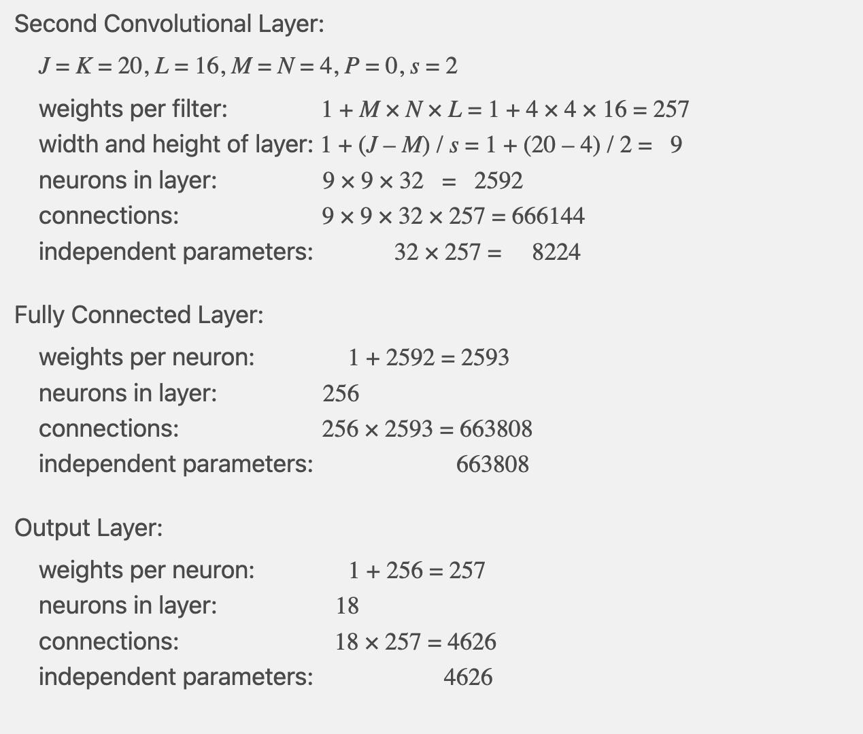
Convolutional Neural Network – Second Convolutional Layer:

Slide 11
Q2. Weight Initialization
Briefly describe the problem of vanishing or exploding gradients, and how Weight Initialization can be used to prevent it.

Slide 12
A2. Weight Initialization
"Weight Initialization" refers to the process of setting initial values for the weights of neurons before training a neural network. This process is vital for the efficiency of the training and the final outcome of the network.
The problems of "Vanishing and Exploding Gradients" refer to the possibility that gradients might become extremely small or large during the training process of deep neural networks, which could make training very challenging.

Slide 13
A2. Vanishing and Exploding Gradients
1. Vanishing Gradients: If gradients become too small (close to 0), during the backpropagation process, the error gets multiplied by a value close to 0 at each layer. Thus, in a deep network, this error practically 'vanishes,' leading to extremely minimal updates to the weights, known as the "Vanishing Gradient" problem. 2. Exploding Gradients: If gradients become too large, the error becomes increasingly larger during backpropagation, leading to an excessive update of weights, known as the "Exploding Gradient" problem.
Notes:
"消失和爆炸梯度"问题是指在深度神经网络的训练过程中，梯度可能变得非常大或非常小，以至于使训练变得非常困难。
具体来说，如果梯度太小（接近0），在反向传播过程中，错误会在每层被乘以一个接近0的数，因此在多层网络中，这个错误几乎会"消失"，从而使权重更新变得极其微小，这就是所谓的"梯度消失"问题。
相反，如果梯度太大，错误会在反向传播过程中变得越来越大，导致权重更新过大，这就是所谓的"梯度爆炸"问题。

Slide 14
A2. Weight Initialization
To prevent these problems, we can ensure that during the initial stage of training, neither the forward-propagated signals nor the backward-propagated signals will vanish or explode by properly initializing the weights.
Common methods for weight initialization include Xavier/Glorot initialization, which adjust the variance of the initial values of the weights based on the number of input and output neurons to maintain a reasonable size of the signals.

Slide 15
A2. Xavier Initialization
The main idea of Xavier initialization is to have the variance of the outputs be equal to the variance of the inputs, and to ensure the gradients have the same variance before and after flowing through a layer in the backpropagation pass.
Propose the weights of a layer should be initialized from a random distribution with zero mean and a specific variance, specifically:
Var(W) = 1/n
where n is the number of inputs to a neuron.
This ensures that the weights are not too small (which can lead to vanishing gradients) and not too large (which can lead to exploding gradients), making it easier to train deep neural networks.
Notes:
Xavier 初始化的主要思想是使输出的方差等于输入的方差，并确保在反向传播过程中，通过一层前后，梯度具有相同的方差。
为了实现这一点，他们提出，一个层的权重应该从一个零均值和特定方差的随机分布中初始化，具体为：
Var(W) = 1/n
其中 n 是一个神经元的输入数量。
这确保了权重不会太小（可能导致梯度消失）也不会太大（可能导致梯度爆炸），使得更容易训练深度神经网络。

Slide 16
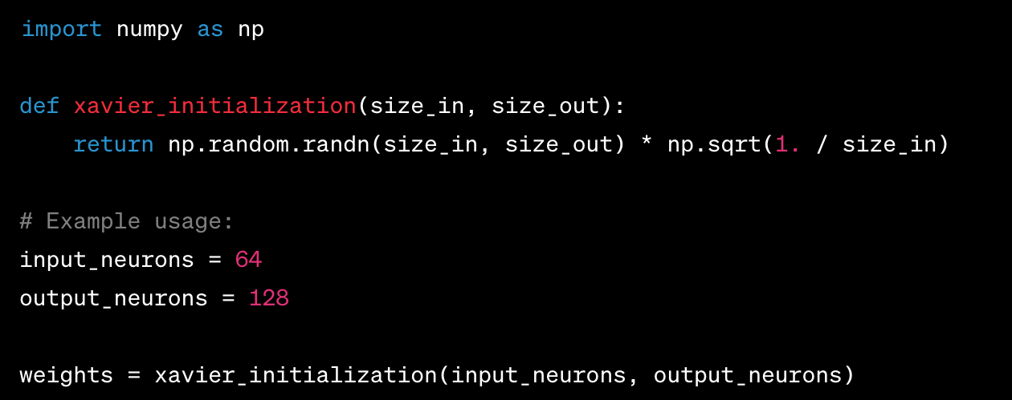
A2. Xavier Initialization - Numpy

Slide 17
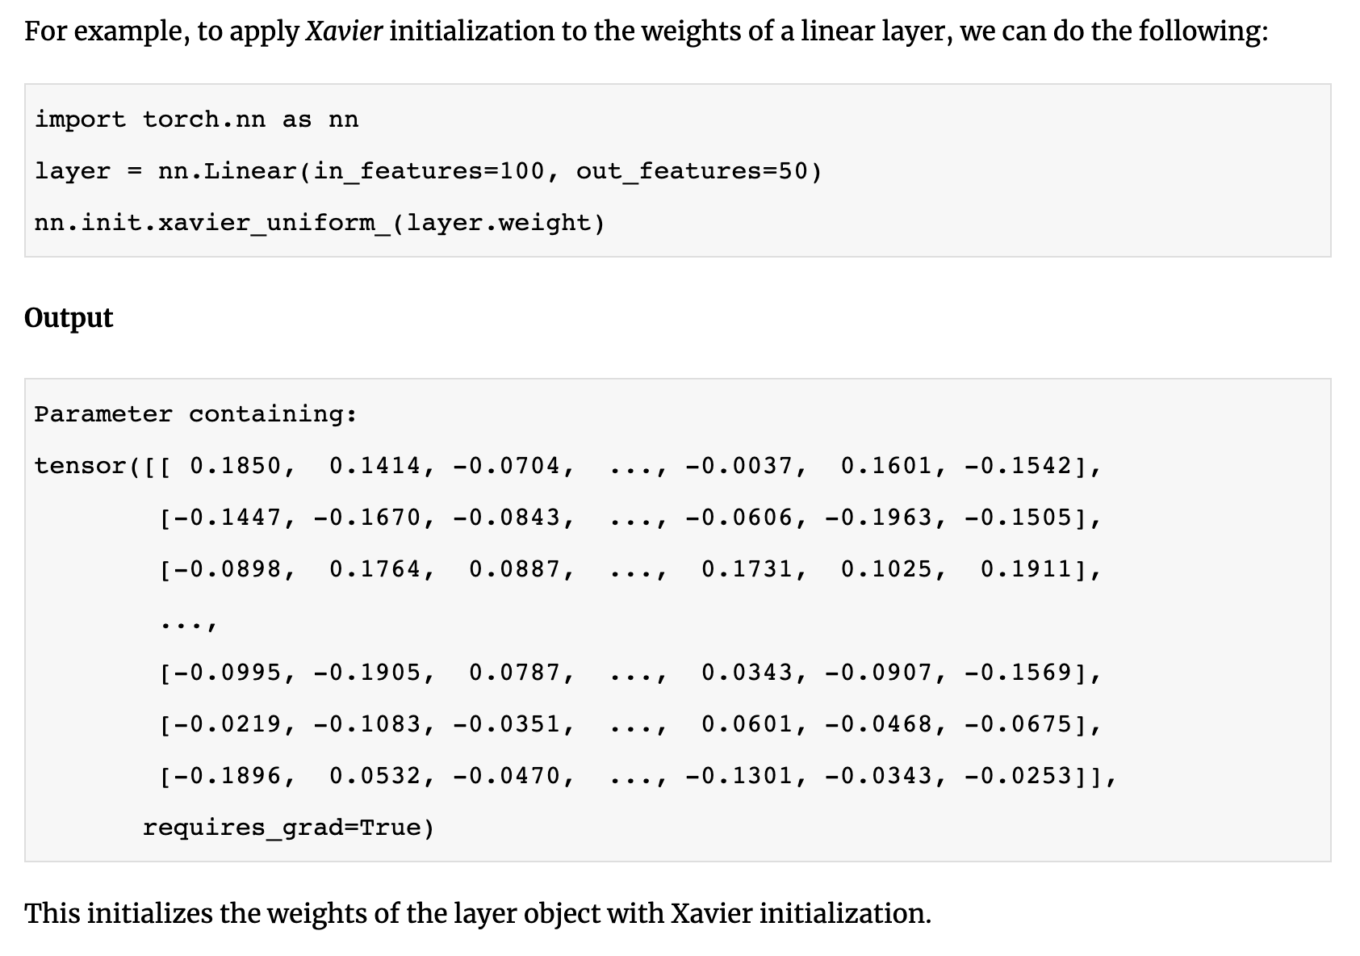
A2. Xavier Initialization - Pytorch

Slide 18
A2. Weights Initialization
https://medium.com/geekculture/how-to-deal-with-vanishing-and-exploding-gradients-in-neural-networks-24eb00c80e84
https://deeplizard.com/learn/video/8krd5qKVw-Q
https://www.binarystudy.com/2023/03/weight-initialization-in-pytorch.html

Slide 19
Q3. Residual and Dense Networks
Explain the difference between a Residual Network and a Dense Network. https://medium.com/@romybuch22/in-between-resnets-and-densenets-b12e4ad0025a
Notes:
https://medium.com/@romybuch22/in-between-resnets-and-densenets-b12e4ad0025a

Slide 20
Q3. Residual and Dense Networks
Explain the difference between a Residual Network and a Dense Network.
Notes:
残差网络 (ResNet) 是一种深度学习架构，其使用残差块。这些块包含快捷连接（也称为跳过连接），允许将一层的输入添加到其输出。这个过程允许梯度直接通过快捷连接流动，这有效地缓解了在非常深的网络中消失梯度的问题。
密集网络 (DenseNet) 是另一种深度学习架构，它将每一层与前馈方式中的每一层连接。这意味着一层接收所有前面层的特征图作为输入。已经证明，密集网络在保持相似或更优性能的同时，需要的参数比传统的卷积网络要少得多，因为它们能够更有效地重用特征。

Slide 21
Q3. Residual Networks
In traditional neural networks, the output of each layer is the result of a linear transformation of the output of the previous layer through some weights, followed by a nonlinear activation function. In this setting, each layer needs to learn a complete mapping from input to output. This can be difficult in deeper networks because the model needs to remember many complex mappings.
The main idea of Residual Networks (ResNet) is not to let each layer learn a complete mapping, but to let each layer learn the difference, or the "residual", between the input and the output. In this way, each layer only needs to adjust the input, rather than learning from scratch. This greatly simplifies the learning task.
Notes:
残差网络 (ResNet) 是一种深度学习架构，其使用残差块。这些块包含快捷连接（也称为跳过连接），允许将一层的输入添加到其输出。这个过程允许梯度直接通过快捷连接流动，这有效地缓解了在非常深的网络中消失梯度的问题。
密集网络 (DenseNet) 是另一种深度学习架构，它将每一层与前馈方式中的每一层连接。这意味着一层接收所有前面层的特征图作为输入。已经证明，密集网络在保持相似或更优性能的同时，需要的参数比传统的卷积网络要少得多，因为它们能够更有效地重用特征。

Slide 22
Q3. Residual Networks
For example, suppose we have a layer with input x and we want the output to be y.
In traditional neural networks, this layer needs to directly learn a function F such that F(x) = y.
In a residual network, this layer only needs to learn a function F such that
F(x) = y - x, i.e., it learns the difference between the input and output.
Then, we can simply add this difference to the input to get the desired output, i.e.,
F(x) + x = y. This is why we say that a building block is defined as y = F{x, {Wᵢ}} + x.
Residual connections, also known as skip connections, are tools to implement this idea. For each layer, we have an extra connection that adds the input directly to the output. This is why we say that this connection connects the output of the t layer and the hypothesis of the t+2 layer.
Notes:
在传统的神经网络中，每一层的输出是上一层的输出通过一些权重进行线性变换，然后通过一个非线性激活函数得到的。在这种设置下，每一层都需要学习一个从输入到输出的完整映射。这在较深的网络中可能会很难，因为模型需要记住许多复杂的映射。 残差网络（ResNet）的主要思想是，不让每一层都学习一个完整的映射，而是让每一层学习输入和输出之间的差值，也就是"残差"。这样，每一层只需要调整输入就足够了，而不是从头开始学习。这大大简化了学习的任务。 例如，假设我们有一个层，它的输入是x，我们希望得到的输出是y。在传统的神经网络中，这个层需要直接学习一个函数F，使得F(x) = y。但在残差网络中，这个层只需要学习一个函数F，使得F(x) = y - x，即学习输入和输出之间的差值。然后，我们可以简单地通过将这个差值加到输入上，得到我们想要的输出，即F(x) + x = y。这就是为什么我们会说，一个构建块被定义为 y = F{x, {Wᵢ}} + x。 残差连接，也称为跳跃连接，就是实现这个想法的工具。对于每一层，我们都有一个额外的连接，将输入直接添加到输出上。这就是为什么我们会说，这个连接是连接第 t 层的输出和第 t+2 层的假设的。 F{x, {Wᵢ}}: 这部分代表由权重{Wᵢ}定义的一种函数或变换，它被应用于输入x。在神经网络中，这通常指的是由多个权重和一个激活函数组成的一层或多层网络。
y = F{x, {Wᵢ}} + x: 这个等式的意思是，我们预测的输出y是由两部分组成的。一部分是原始输入x通过函数F{x, {Wᵢ}}变换后的值，另一部分是原始输入x自己。在残差网络中，这种结构使得网络可以学习输入和期望输出之间的"残差"，即他们之间的差值。

Slide 23
Q3. Dense Networks
In traditional Convolutional Neural Networks (CNNs), the output of each layer indeed serves as the input to the next layer.
In DenseNets, the output of each layer is forwarded not just to the next layer, but to all subsequent layers. This key feature of DenseNets allows information to flow directly from any layer of the network to all subsequent layers.
So, a defining characteristic of DenseNets is their "dense" connectivity, meaning each neuron is able to receive the outputs from all neurons of preceding layers. This comprehensive manner of connection can enhance model performance as each layer has access to information from all previous layers, not just the immediate previous layer. This network architecture helps reduce vanishing gradient problems, enhances feature reuse, and increases the stability of training.

Slide 24
Q3. Dense Networks
In DenseNets (Densely Connected Networks), every layer is directly connected to every other layer that is in front of it. This means that each neuron receives the outputs of all previous neurons in the network as inputs. This is a sharp contrast to traditional Convolutional Neural Networks, where each layer is connected only to the previous one.
An important consequence of this type of connection is that in a DenseNet with L layers, there will be [L(L+1)]/2 direct connections.
The first layer has 1 output, the second layer has 2 outputs (as it receives outputs from the first and second layers), the third layer has 3 outputs (as it receives outputs from the first, second, and third layers), and so forth, up to the Lth layer. If you add up all these outputs, you will get [L(L+1)]/2 connections.

Slide 25
Q3. Dense Networks
More specifically, the ith layer in the network, denoted as Xi, receives feature maps from all preceding layers as input: Xi=Hi([X₀, X₁,..., Xᵢ₋₁]).
Here, Hi is a composite function that performs three operations: Batch Normalization, ReLU activation, and a 3x3 Convolution. Batch Normalization is a technique used for training deep neural networks that standardizes the inputs for each mini-batch, thereby improving the performance and stability of neural networks.
The ReLU (Rectified Linear Unit) activation function is a popular nonlinear function that outputs all negative numbers as zero and all positive numbers as their own value. The 3x3 Convolution is a convolution operation performed on the input feature maps to extract features.

Slide 26
Email: JINGYING.GAO@UNSW.EUD.AU
Assignment Question Email: cs3411@cse.unsw.edu.au

