Slide 1
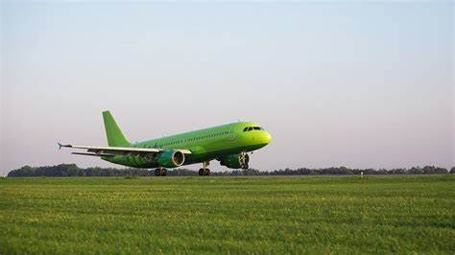
SAFETY TRENDS AND ECONOMIC BENEFITS OF AIR TRAVEL
DSC 640 DATA PRESENTATION AND VISUALIZATION

Slide 2
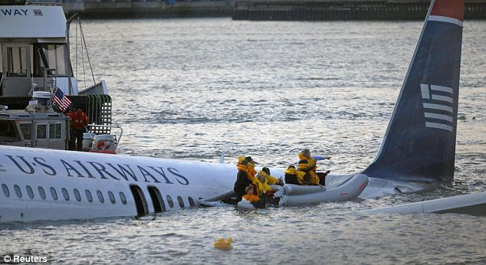

Introduction
This analysis focuses on providing an overview of safety trends in Air travel.
Analysis focuses on providing a comprehensive overview of safety trends in both air travel and motor vehicle travel. By examining historical data on accidents and fatalities, we aim to illustrate the significant improvements in air travel safety over the years and compare these trends with motor vehicle safety
The insights derived from this analysis will guide our strategic decisions. It helps in identifying areas where we can further enhance safety measures and improve operational efficiencies. Shareholders need to be confident that the company is proactively managing risks and capitalizing on opportunities for growth.
Objectives
Analyze and visualize safety trends in air travel vs. motor vehicle travel
Demonstrate the economic benefits of commercial aviation
Provide data-driven insights for strategic business decisions

Slide 3
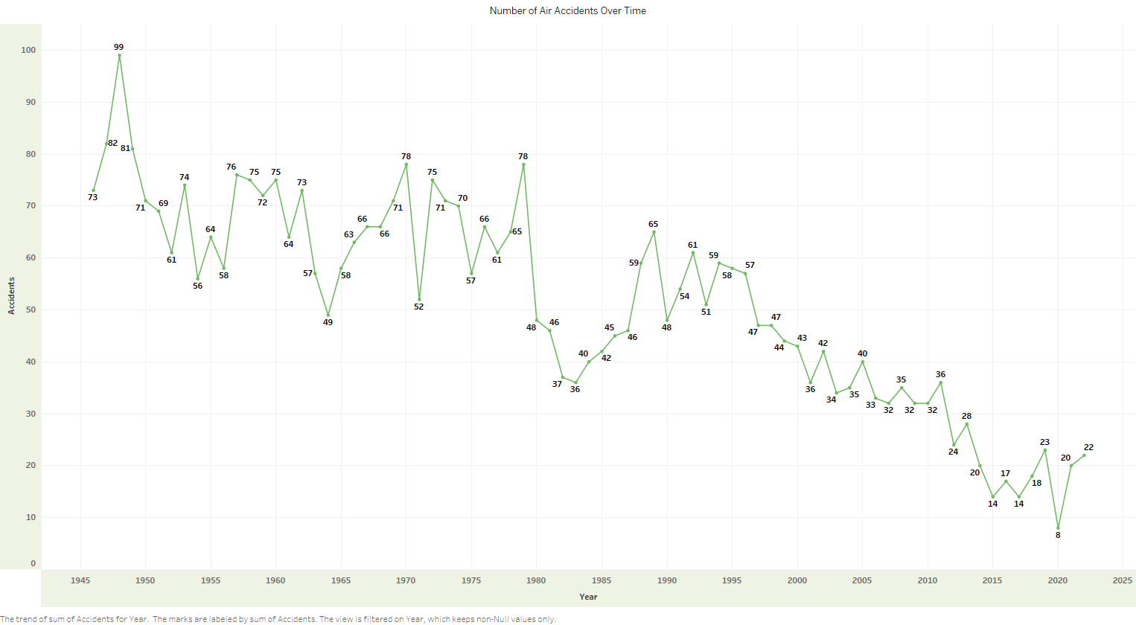
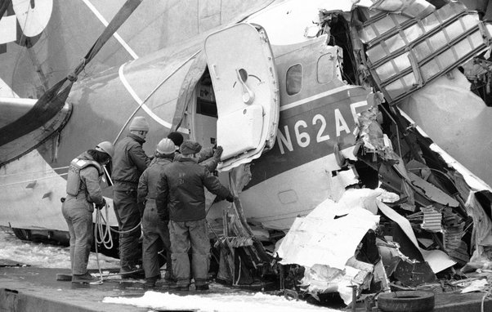
Historical Air Accidents & Trend 1940s-1950s: High volatility with peaks and troughs in the number of accidents.
1960s-1970s: Continued fluctuations but with a general downward trend starting in the mid-1970s.
1980s Onwards: A clear and steady decline in the number of accidents, highlighting the industry's progress in improving safety measures.
2000s and Beyond: The accident rate remains low, with some minor fluctuations, reflecting ongoing improvements and effective safety practices.

Slide 4
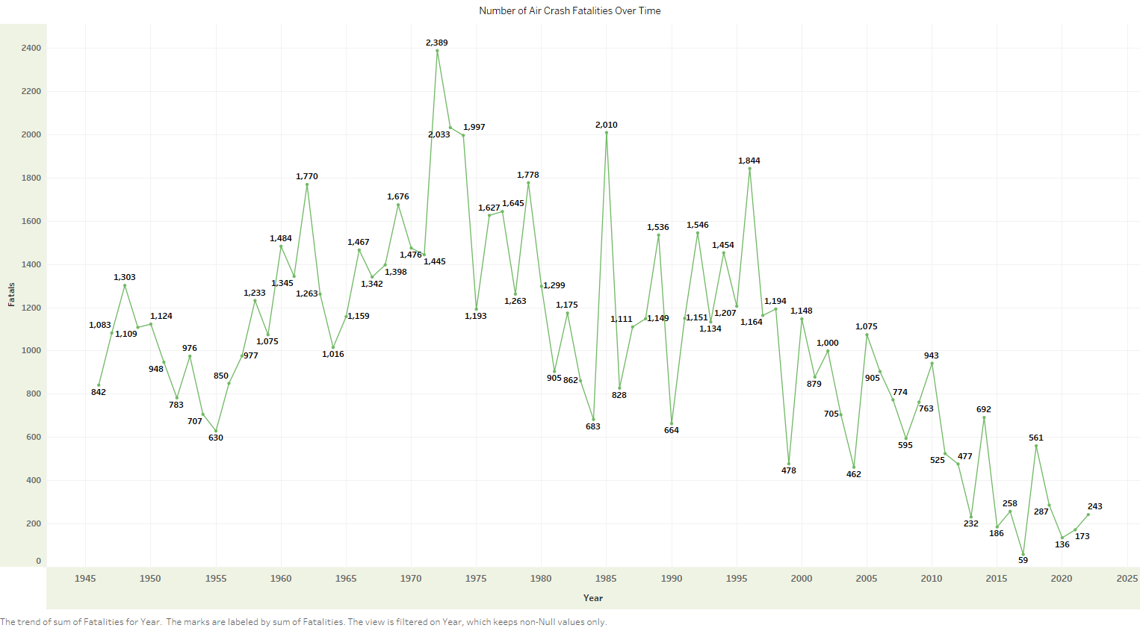
Fatalities from air travel accidents 1940s-1970s: Significant peaks in fatalities, with a peak of 2,389 fatalities in 1972.
1980s-Present: A general downward trend in fatalities, showing the impact of improved safety measures.
Recent Years: The fatalities have significantly decreased, with notable lows in 2017 (59 fatalities) and 2013 (136 fatalities).

Slide 5
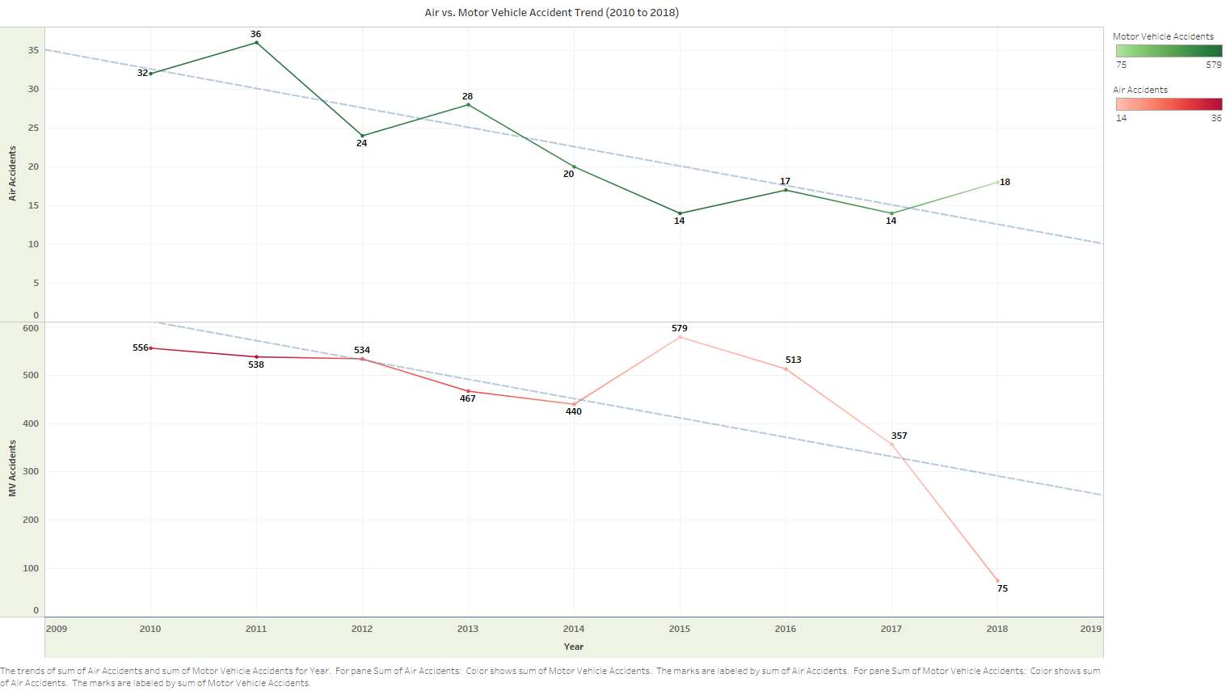
Air vs. Motor Vehicle Accident Trend (2010 to 2018) Air Accidents Trend:
2010: 32 accidents, 2011: Increased to 36 accidents, 2014: Slight peak at 28 accidents, 2015-2018: Decrease from 28 to 18 accidents.
Motor Vehicle Accidents Trend:
2010: 556 accidents, 2015: Peak at 579 accidents, 2018: Significant reduction to 75 accidents. Air travel maintains a relatively lower number of accidents compared to motor vehicles, reinforcing its superior safety record.

Slide 6
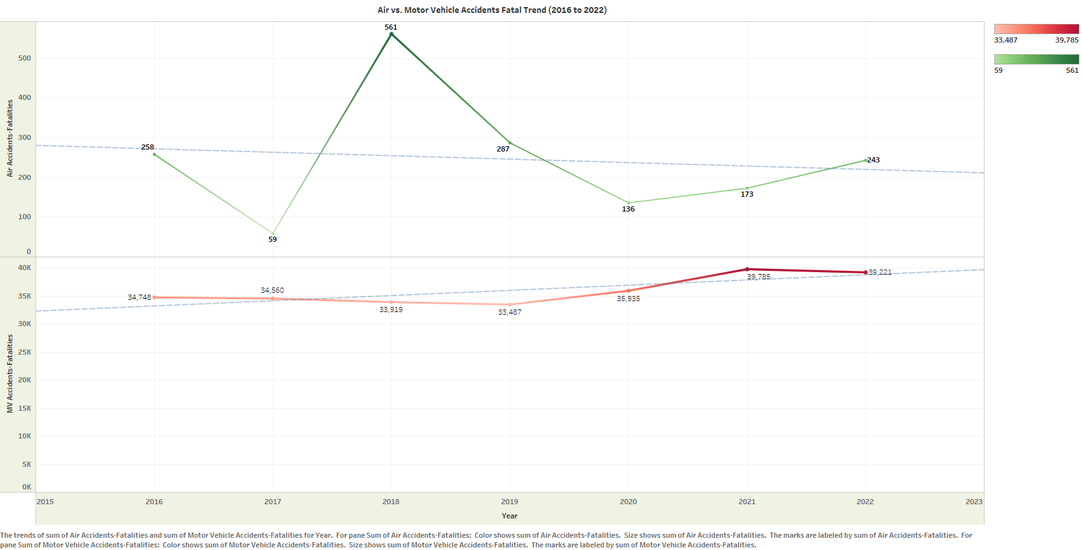
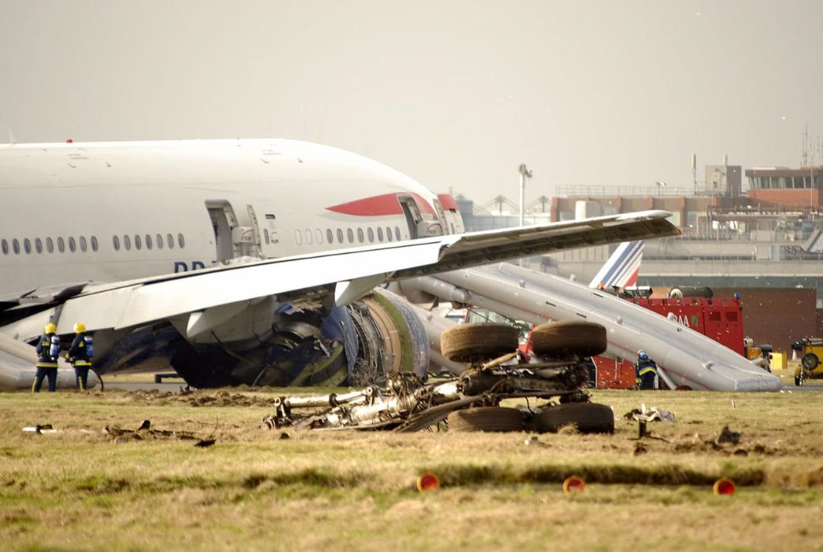

Air vs. Motor Vehicle Accidents Fatal Trend (2016 to 2022) Air Accident Fatalities Trend:
2016: 258 fatalities, 2017: Sharp decline to 59 fatalities, 2019: Peak at 561 fatalities, 2022: Increase to 243 fatalities.
Motor Vehicle Fatalities Trend:
2016: 34,748 fatalities, 2019: Slight decline to 33,487 fatalities, 2021: Peak at 39,785 fatalities, 2022: Slight decline to 39,221 fatalities. Air Travel Safety -The peak in 2019 followed by a decline suggests responsiveness to safety improvements after incidents. Motor Vehicle Safety - The slight increases and decreases suggest marginal improvements, but overall high fatality rates remain a concern.

Slide 7
Economic Impact of Commercial Aviation
Commercial Aviation as a Critical Economic Engine:
Commercial aviation is not just about transporting passengers and cargo; it is a vital part of the global economy. In the United States, it serves as a significant economic engine, driving growth, creating jobs, and facilitating trade and tourism.
Contribution to U.S. GDP:
In 2023, commercial aviation contributed 5% to the U.S. GDP, amounting to $1.37 trillion. This substantial economic contribution underscores the importance of the aviation industry to the national economy.
The industry's impact on GDP is multifaceted, including direct contributions from airlines, airports, and aircraft manufacturing, as well as indirect contributions from related industries such as tourism and logistics.
Job Creation and Employment:
Commercial aviation supports more than 10 million American jobs. This includes not only jobs directly within the aviation industry but also in sectors that rely on aviation, such as travel, tourism, and international trade.
The industry provides employment opportunities across a wide range of roles, from pilots and flight attendants to ground crew, engineers, and administrative staff.
Operational Scale and Global Reach:
Every day, U.S. airlines operate over 26,000+ flights, highlighting the scale of operations required to meet the travel demands of millions of passengers.
These flights carry approximately 2.6 million passengers to and from nearly 80 countries, demonstrating the global connectivity facilitated by commercial aviation.
In addition to passenger travel, U.S. airlines transport 61,000 tons of cargo daily to over 220 countries, playing a crucial role in global trade and supply chains.

Slide 8
Stakeholder & Media Communication
Long-standing Reliability: Air travel has been a cornerstone of transportation since 1945, recognized for its unparalleled speed and reliability compared to other modes of travel such as water and road.
Commitment to Safety and Service: Throughout our history, we have consistently prioritized the safety and service needs of our passengers, overcoming challenges to maintain our commitment to excellence.
Addressing Current Challenges: The challenges we face today are temporary, akin to previous obstacles we've successfully navigated. We are confident in our ability to maintain and enhance our brand's quality amidst current circumstances.
Industry Collaboration: We are actively collaborating with other leading air travel companies to review and implement comprehensive safety measures. This collaborative effort aims to ensure that air travel remains safe and reliable for public use.
Continuous Improvement: We remain dedicated to ongoing safety enhancements, rigorously adhering to and exceeding federal aviation guidelines to uphold the highest standards of safety and service excellence.
Discount Program - Stakeholders review
Frequent Flyer and First-Time Flier Discounts: Introduce enticing discount programs for frequent flyers and first-time fliers to encourage them to experience air travel with us. This initiative aims to foster customer loyalty and attract new travelers eager for their inaugural flight experience.
Promoting Honest Reviews: Encourage customers to share their genuine experiences on social media platforms. By doing so, we aim to build trust and reliability in air travel among a wider audience.
Television Campaign: Long Travel-Live: Launch a compelling television campaign titled "Long Travel-Live," showcasing our luxurious facilities and highlighting the reliability and comfort of air travel with us. This initiative seeks to captivate potential customers and reinforce our commitment to quality service.

Slide 9
Conclusion
Significant Improvements Over Time :
Our analysis has demonstrated a significant improvement in air travel safety over the past several decades. The data clearly shows a steady decline in both the number of accidents and fatalities, reflecting the industry's ongoing commitment to enhancing safety measures, adopting advanced technologies, and implementing rigorous regulatory standards.
Economic Impact- Vital Role of Commercial Aviation:
The economic contributions of the aviation industry underscore its importance as a vital economic engine, providing significant benefits to the national and global economy.
Strategic Importance for Our Company:
The insights derived from this analysis will guide our strategic decisions. By identifying trends and patterns in safety data, we can pinpoint areas where further enhancements in safety measures are necessary.
Shareholders need to be confident that the company is proactively managing risks. This involves a continuous assessment of safety protocols, adopting advanced technologies, and adhering to stringent regulatory standards. Proactive risk management helps in mitigating potential threats and ensures the long-term sustainability of the company.
In addition to managing risks, the analysis highlights opportunities for growth. By showcasing our commitment to safety and operational excellence, we can strengthen our market position, attract more customers, and foster partnerships. These opportunities contribute to the company's growth and profitability, providing tangible benefits to our shareholders.

Slide 10
Questions..? - email: amahalingam@my365.bellevue.edu
Reference
Federal Aviation Administration, https://www.faa.gov/
Primary dataset utilized for the project, air travel accidents and fatalist per year.
Supplemental data utilized for the project, CRSS Crash Stats & Reports, and FARS - Fatality Analysis Reporting System (FARS), NHTSA
Airlines of America, airlines economic impact www.airlines.org

